Slide 1
Update on mechanics

Slide 2
Motivations
Carbon envelop is useful in the case of the beam tests (easy to install, remove,…) but maybe not necessary for LUXE :
We need to leave a precise gap of 100um between sensors and need to align the sensors
The sensors will be install for all the time life of LUXE
The sensors are 500um instead of 320um
The price is 30k$
proposition
Production of a precise frame glued on the tungsten plane.
Dimensions : ~size of the tungsten plane, 900u thickness
For sensor transportation and test : plastic box

Slide 3
Place for the sensor
Don’t look at it
100um wall
900um thickness
Only one object to align respect to the tungsten

Slide 4
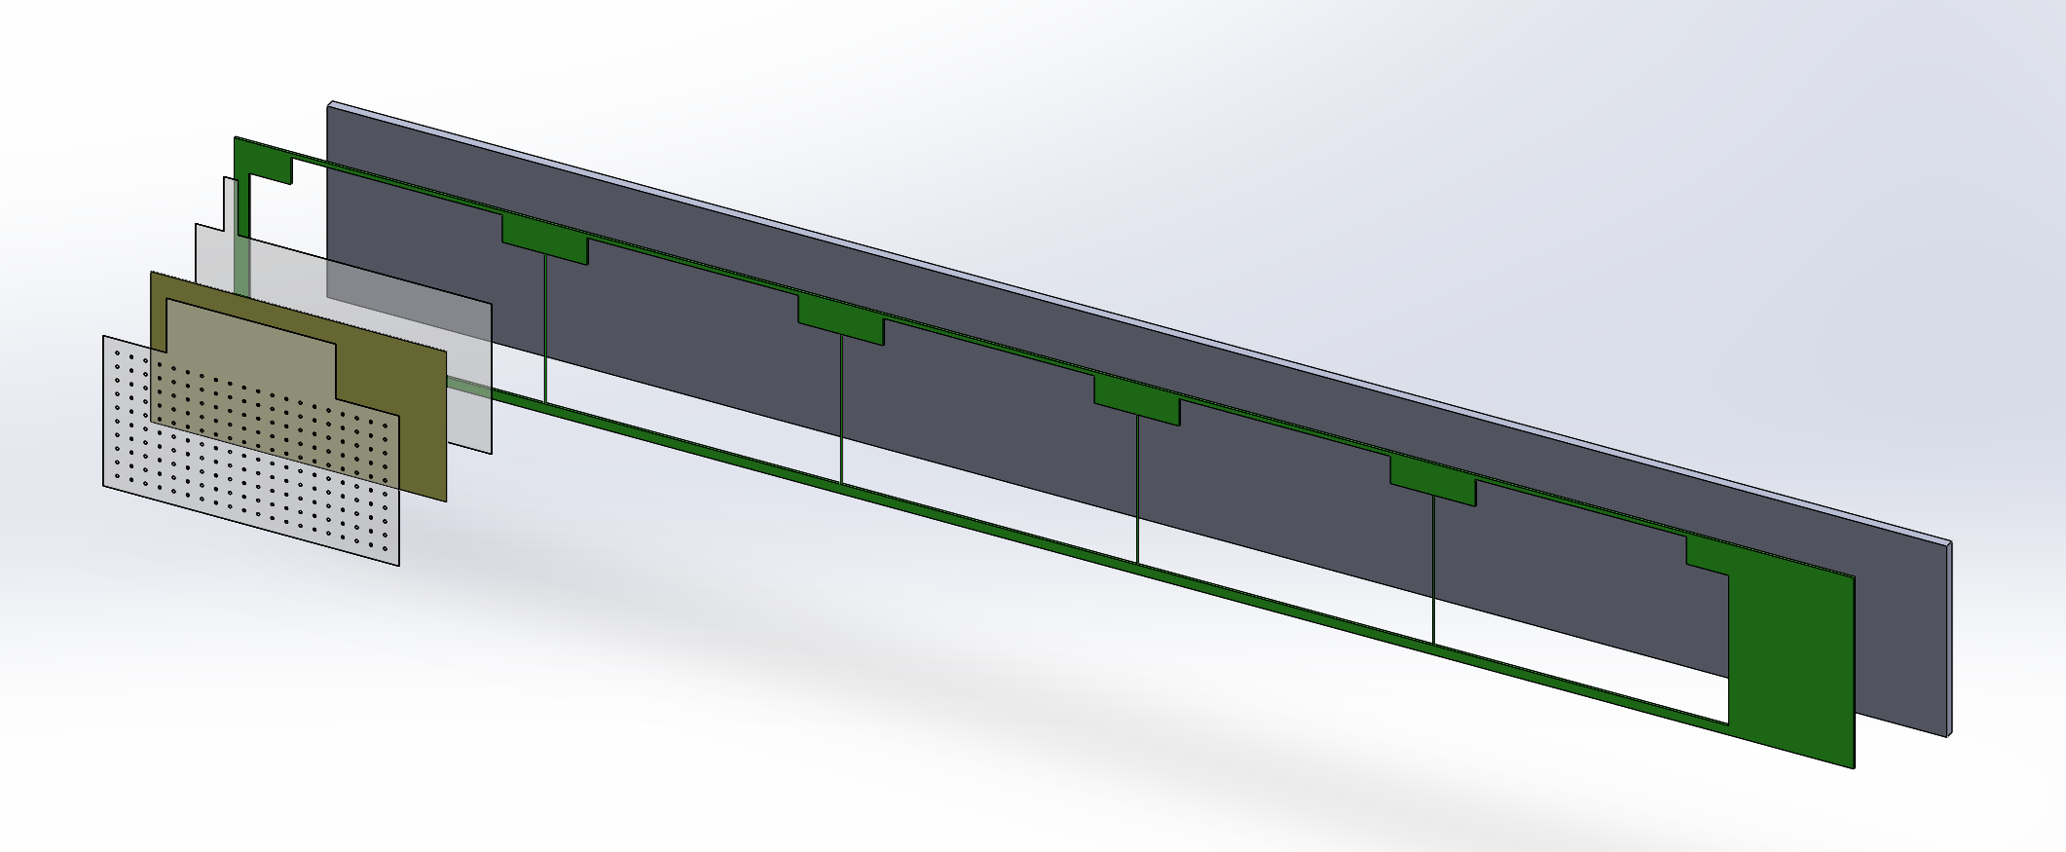

Slide 5
future
Try to avoid to glue the sensor on the tungsten : “floating sensor”
Thin layer of plastic above all the sensors once in the frame
…

