Slide 1
How to study charge carriers lifetime by optical methods?
Ideas are welcome!
Why optical? Allows to check wafers without metallization,
electrical contacts etc.
Roentgen pumping – visible light reflection
Optical-Pump/THz-Probe Spectroscopy
Double photon absorption – UV (~200 nm) light?
Something else?

Slide 2


Electrical methods?
HV
Sapphire
sample
Electrode with holes

Slide 3
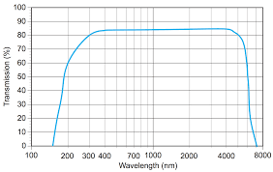
The optical bandgap is the threshold for photons to be absorbed, while the transport gap is the threshold for creating an electron–hole pair that is not bound together.
Sapphire optical transmission
9.9 eV – 125 nm
For sapphire band gap is 9.9 eV, transport and optical bandgaps are similar.
Visible light
Conduction band
Bandgap
Valence band
100 nm – 12.4 eV soft Röntgen
Röntgen photon
Intensive Röntgen
Amount of reflected visible light ~ Röntgen intensity x Lifetime of charge carriers
Charge collection efficiency (if low) ~ Lifetime of charge carriers

Slide 4





Röntgen source
Visible light
Reflected visible light
Sapphire wafer

Slide 5
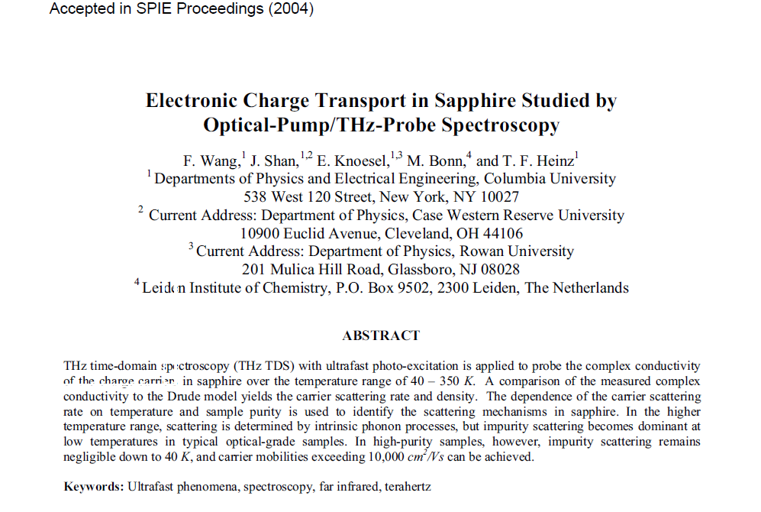

Slide 6
Experimental Setup
Ti:S Regen
1 KHz, 1 mJ
150 fs, 810 nm
Emitter
Sample
Detector
Tripling
UV: 270 nm
40 μJ
-
Lock-in
amplifier

Slide 7
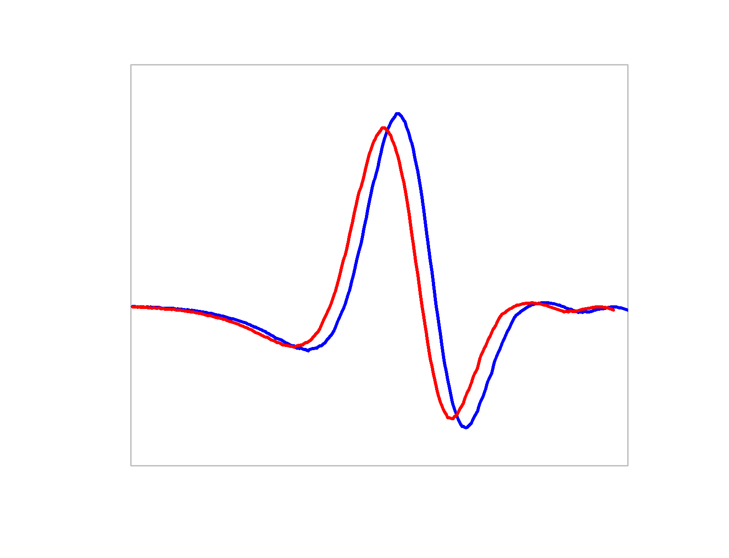
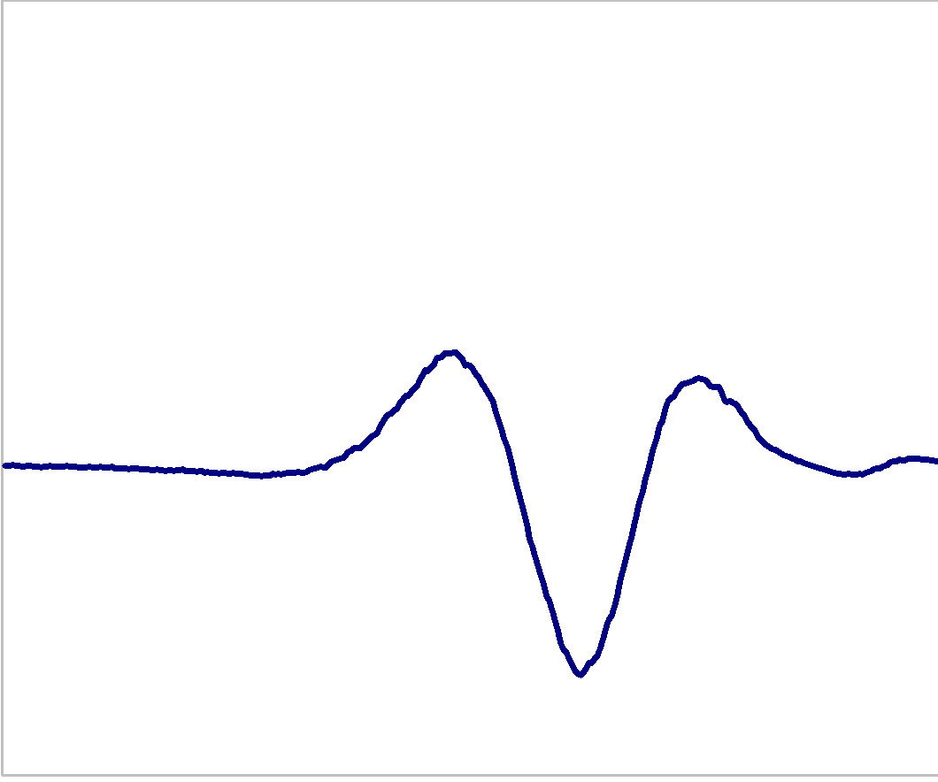
Probing Transient Conductivity by THz Time-Domain Spectroscopy
Optical pump
Sample
E(t)
τ
Detector
·
⊕
·
⊕
·
⊕
THz Probe
Current (j=σE) radiates
ΔE(t)X100
Conductivity

Slide 8
Electrical methods?
HV
Sapphire
sample
Electrode with holes

