Slide 1
news

Slide 2
LCWS
Interesting talks (on the top of the Alina’s one)
  Anisotropic Conductive Films : https://indico.cern.ch/event/995633/contributions/4259332/attachments/2209872/3740107/LCWS_MVicente_ACF.pdf
  Possibility to have really thin (~10 um) conductive glue layer between our different layers. I am in touch with the group (CERN). Can be already used in LUXE
  Ultra thin PCB ~1.2 mm including chip : https://indico.cern.ch/event/995633/contributions/4261854/attachments/2208995/3738133/ecal_v1.pdf. this could be important for LC not really for LUXE

Slide 3
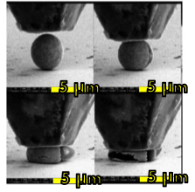
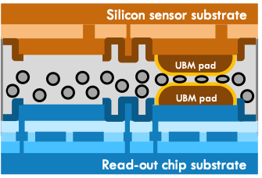
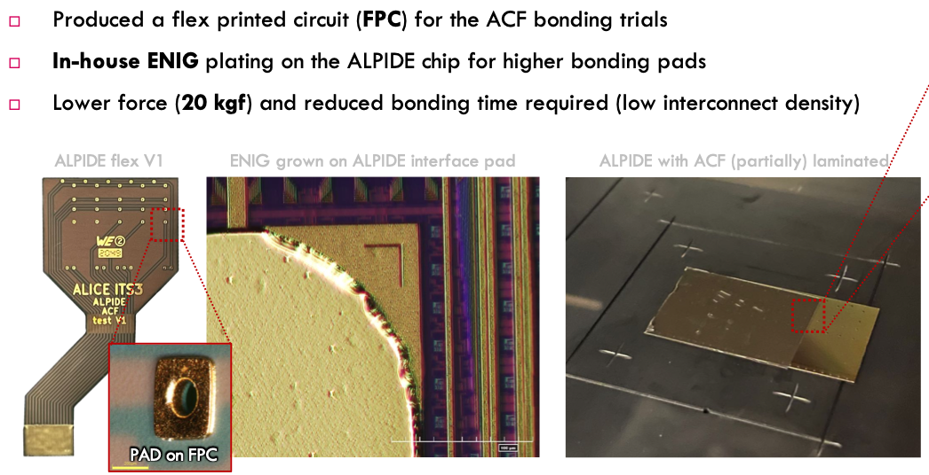
Anisotropic conductive film or paste
Film needs pressure, paste needs heat only
Start to be intensively used in industry for screen mainly for gluing the electronic close to the screen (phone, TV,…)
Can reduce the conductive layer between the fanout and sensor to few micron.

Slide 4
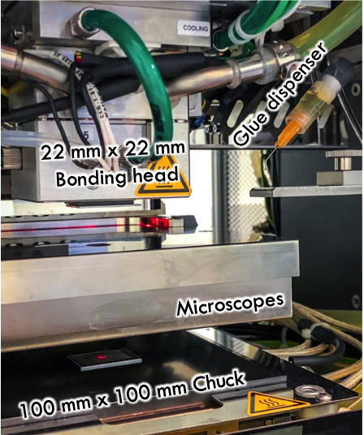
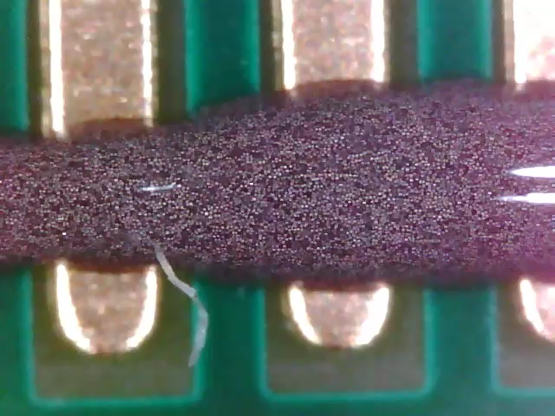
Anisotropic conductive film or paste
CERN has a machine (installed at Geneva university)
I am in contact with the CERN group (EP R&D) and they look interested to work with us. Meeting yesterday
Test : on one of the CALICE sensor , we glue the PCB using a ACF (or ACP)

Slide 5
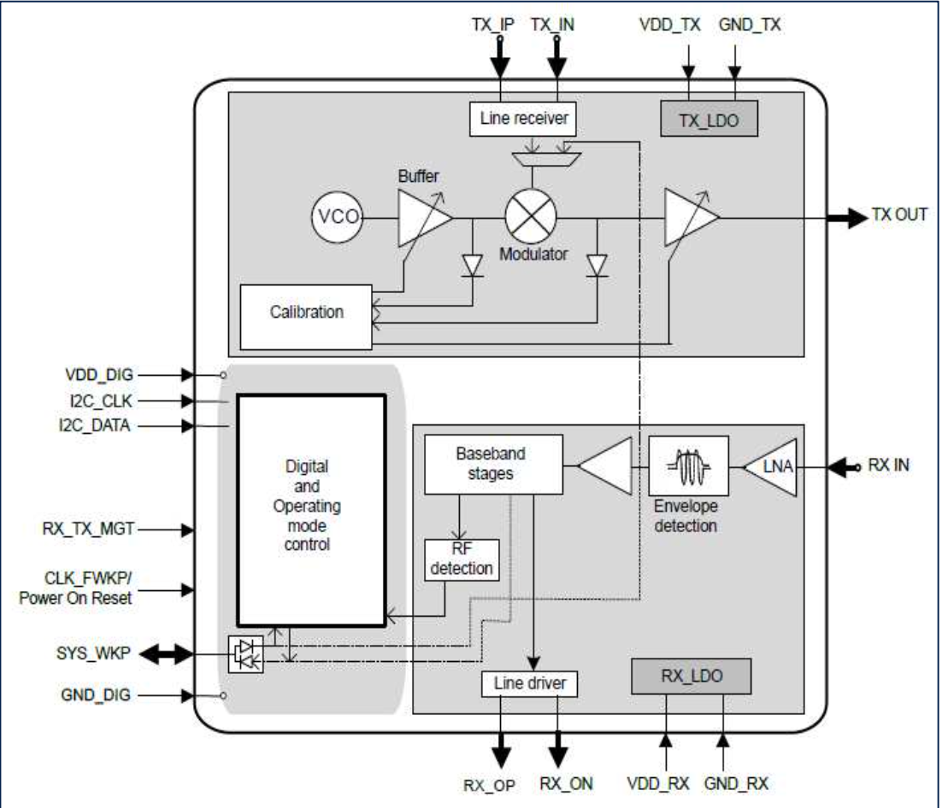
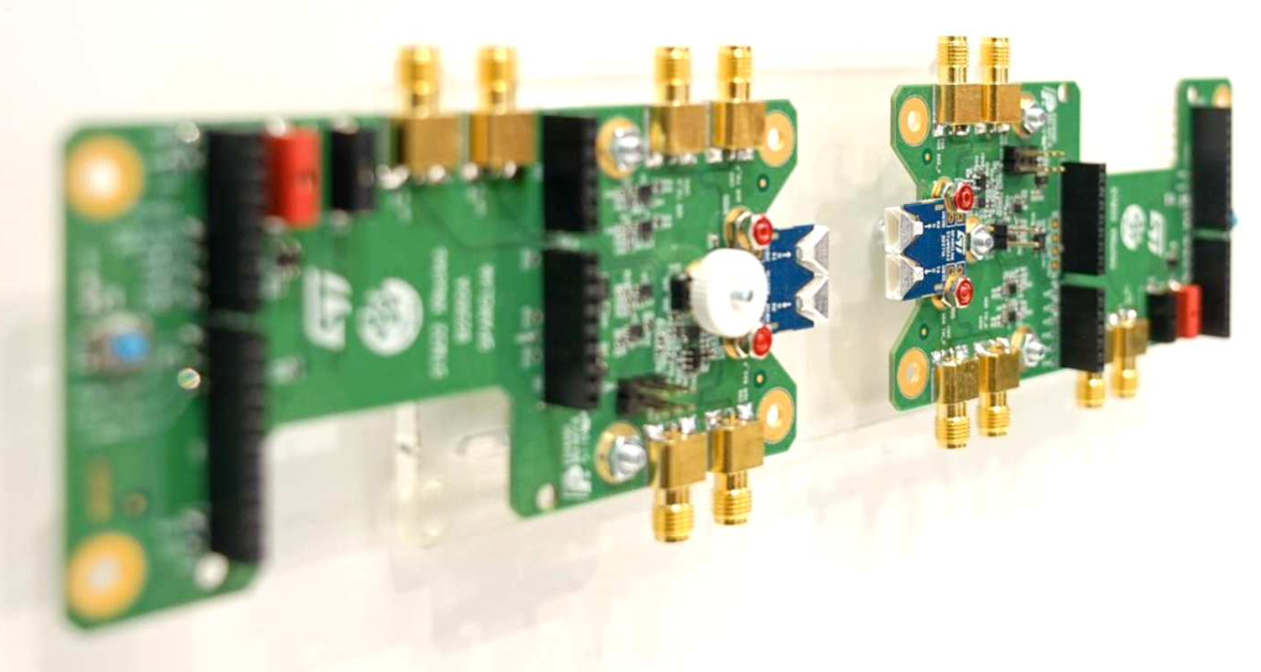
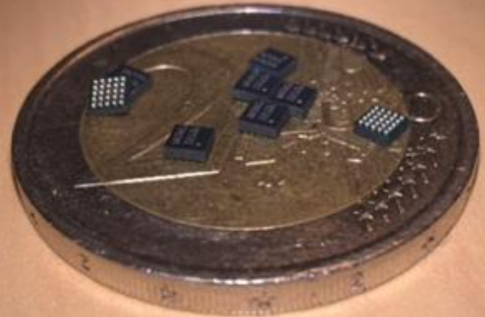
Wireless meeting
On the 17/3 we (Marek,Jakub and me) met with E. Locci (head of WADAPT) and C.Dehos.
A chip exists and can be purchased via a company (I am in touch with the company).
The first test will be to send data at 5Gbps wireless over a distance of few cm

Slide 6
Wireless R&D
I contacted the company which produce the chip and the test board
The company changed its policy and sell only big quantities
CEA people are in discussion with the company to deliver us two boards

Slide 7
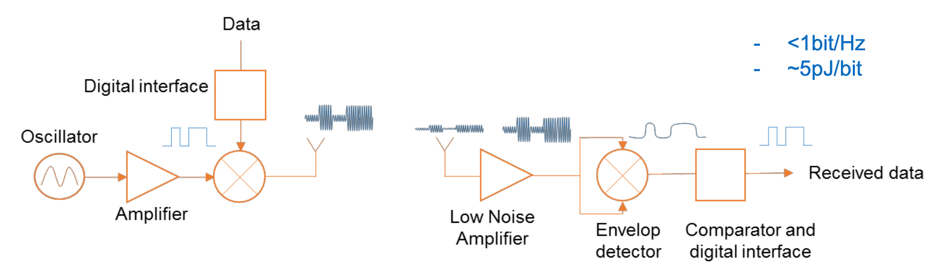
What we want to test
DAQ PC
SENSOR
FEB
Up to 6Gbps
Data processing (FPGA,…)
Ethernet/optic fiber
Thanks to the WADAPT CERN group

Slide 8
First draft GaAs fanout needs modifications. On going.

Slide 9
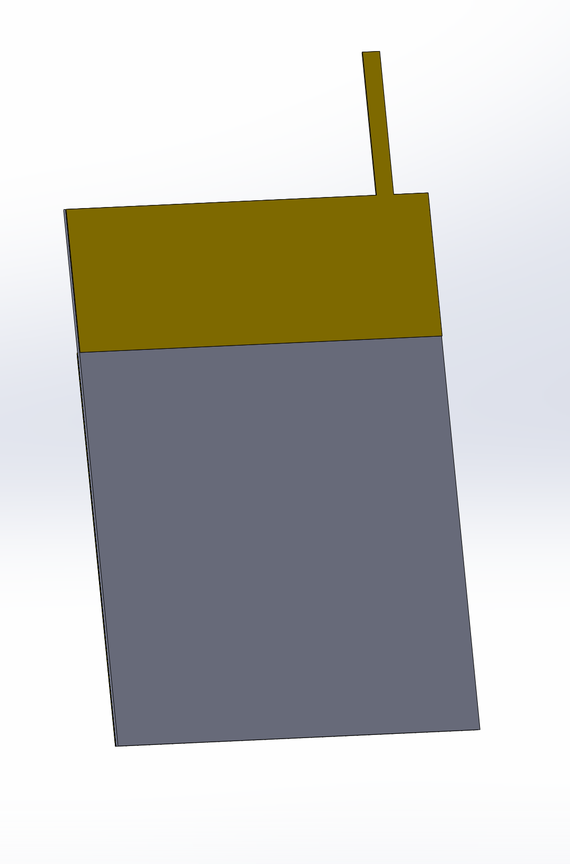
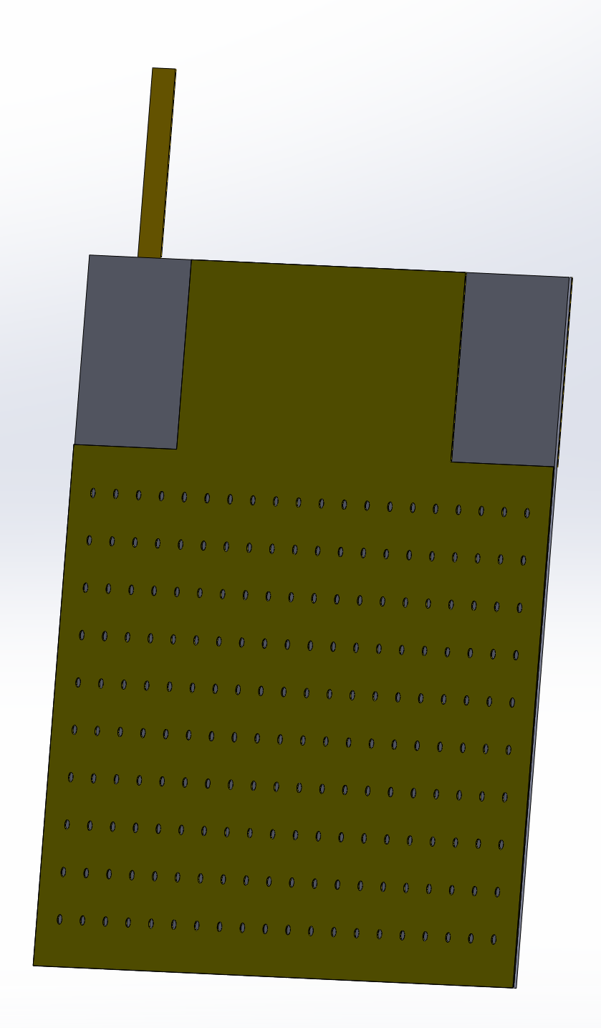
HV Kapton : new idea to decrease the thickness
We don’t need to cover all the sensor surface to polarize it
We don’t have space limitation on the top of the detector
In between the W plane : fanout, glue, sensor : <650 um
Readout side
HV side
Not in between the W plane
In between the W plane

