Slide 1

Geant4 simulations for the LUXE gamma profiler
M. Bruschi, A. Sbrizzi

Slide 2
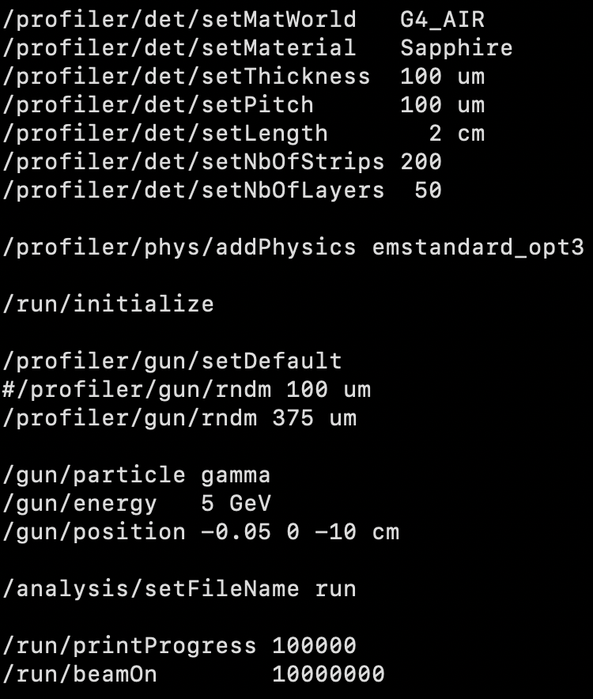
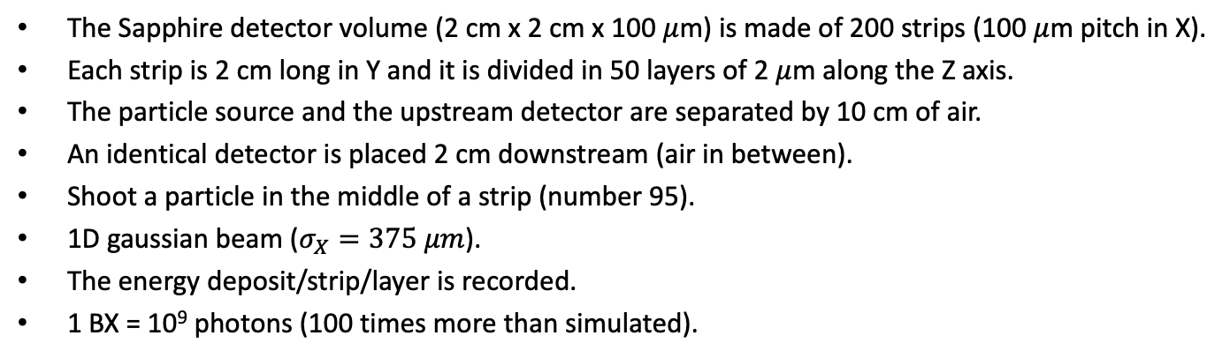

Geometry
The Sapphire detector volume (2 cm x 2 cm x 100 $μ$m) is made of 200 strips (100 $μ$m pitch in X).
Each strip is 2 cm long in Y and it is divided in 50 layers of 2 $μ$m along the Z axis.
The particle source and the upstream detector are separated by 10 cm of air.
An identical detector is placed 2 cm downstream (air in between).
Shoot a particle in the middle of a strip (number 95).
1D gaussian beam ($σ_{X}=375 μm$).
The energy deposit/strip/layer is recorded.
1 BX = 10⁹ photons (100 times more than simulated).
2 cm
10⁷ $γ$ (E$γ$= 5 GeV)
Y
Z
X
2

Slide 3
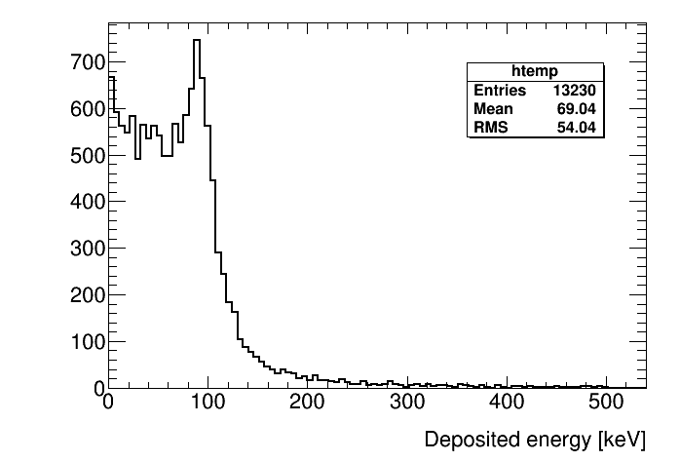
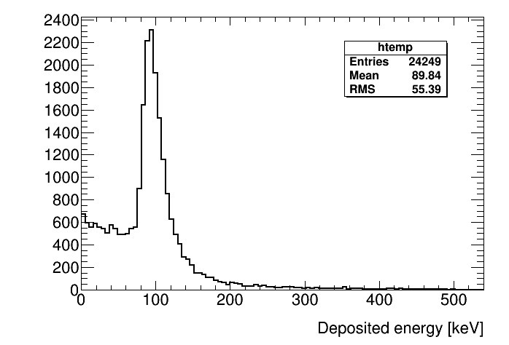
Total energy deposited per gamma interaction
Upstream
detector
Downstream detector
The energy deposited in sapphire due to gamma conversions in 10 cm of air peaks at ~90 keV.
The peak sits on the top of the flat spectrum of gamma conversions in sapphire.
The average energy deposited in the downstream detector is about 30% larger.
3

Slide 4
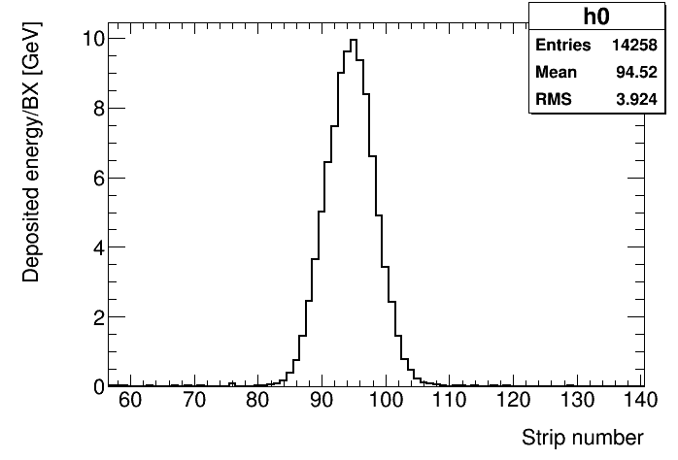
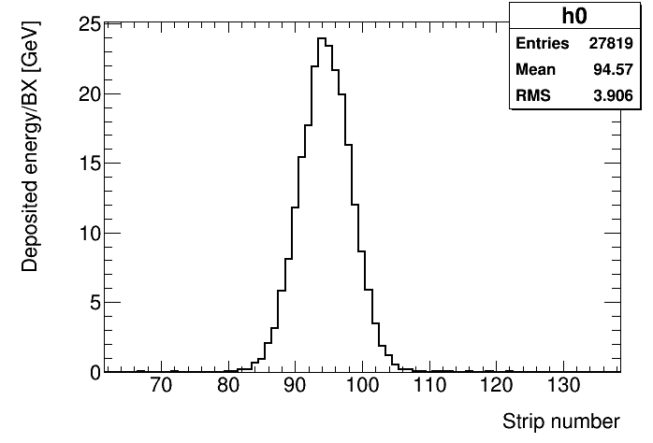
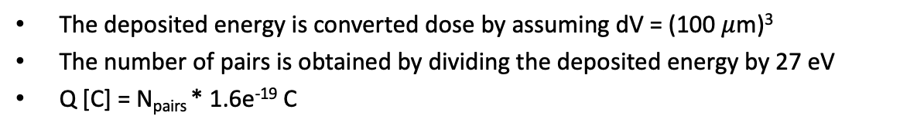
Total energy deposited per strip
Upstream
detector
Downstream detector
The deposited energy is converted dose by assuming dV = (100 $μ$m)³
The number of pairs is obtained by dividing the deposited energy by 27 eV
Q [C] = N_{pairs} * 1.6e⁻¹⁹ C
Detector | E_{dep}/BX [GeV] | Dose/BX [Gy] | Q [pC]
Upstream | 10 | 1 | 60
Downstream | 25 | 2.5 | 140
4

Slide 5
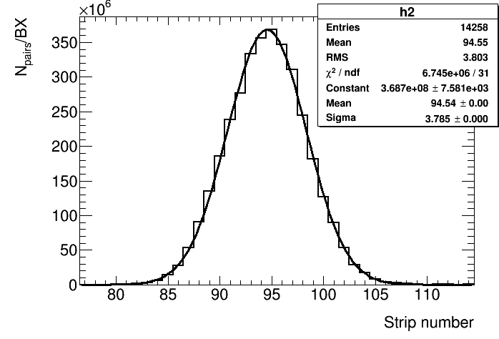
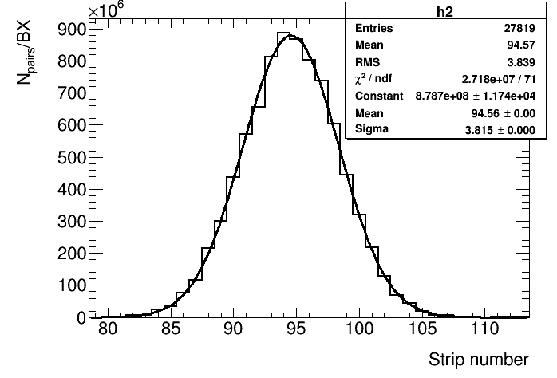
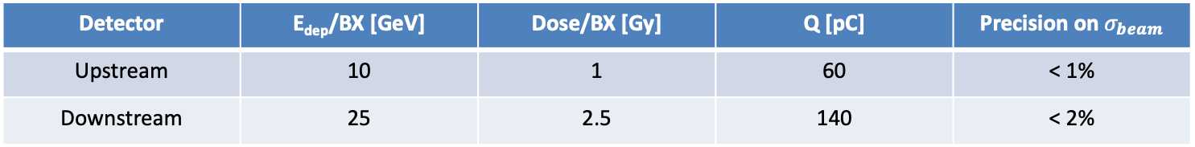
Total energy deposited per strip
Upstream
detector
Downstream detector
The precision on beam width reconstruction is extracted from a gaussian fit of the number of pairs.
A Poissonian error is assigned to the number of pairs (very small error).
Detector | E_{dep}/BX [GeV] | Dose/BX [Gy] | Q [pC] | Precision on $σ_{beam}$
Upstream | 10 | 1 | 60 | < 1%
Downstream | 25 | 2.5 | 140 | < 2%
5

