Slide 1
The LUXE Beam Profiler
M. Bruschi, N. Cavanagh, U. Dosselli, K. Fleck, M. Morandin, G. Sarri, A. Sbrizzi, S. Schuwalow, A. Tyazhev, M. Zanetti
and A. Zarubin

Slide 2
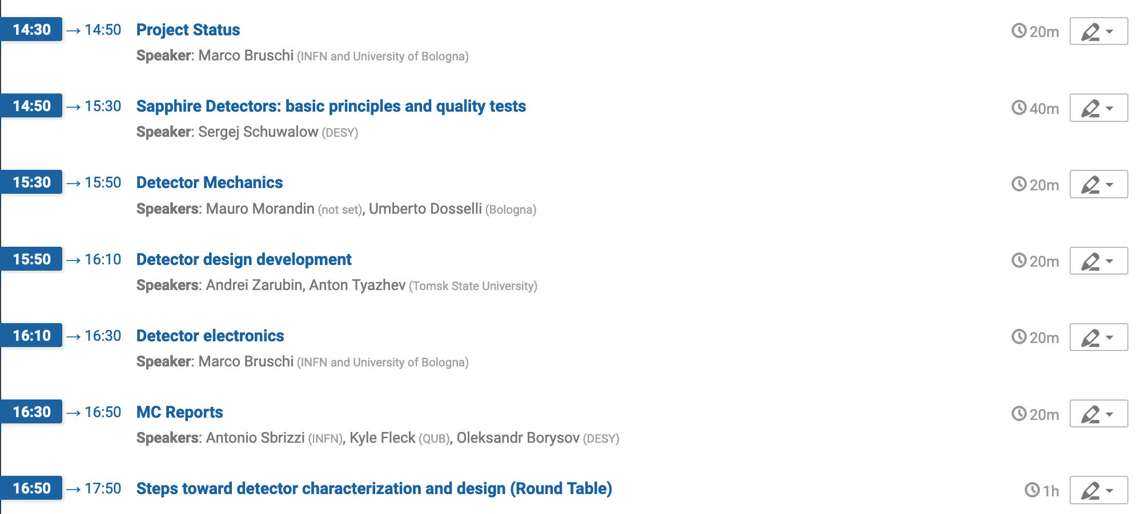
Gamma profiler “long” meeting
April 12th from 14:30 until 18:00
Review of detector technology and next steps
  Project status (Marco)
  Sapphire Detectors including quality tests (Sergej)
  Readout Electronics (Marco, ?)
  Detector Mechanics (PD?, Sergej)
  MC simulation status (TBA)
  Detector design development (Anton, Andrei?)
  Steps toward detector characterization and design (round table)

Slide 3
Backup

Slide 4
GBP collaboration tasks
Detector
  Procurement (DESY, U. TOMSK, INFN PD)
  Production (TOMSK)
  Design and Integration (DESY, BELFAST, PD, BO, TOMSK)
  Tests
    Characterization in the lab (DESY, PD, BELFAST –laser tests at RAL-)
    CCE uniformity (DESY, PD, TOMSK)
    Test Beam (DESY, BO, PD, TOMSK, BELFAST)
Mechanics (PD)
  Design (DESY, PD System Eng.)
  Production
  Tests, Commissioning
Electronics (BO)
  Design
  Production
  Tests, Commissioning
* Data Acquisition (ask Louis for milestones)
Slow control
  HV,LV
  Table movements (PD)
  Calibrations (BO)
Data Quality (DESY, PhD)
MC
  Detector performances (PD –PhD-, BELFAST)
    Stand Alone
    LUXE
Data Analysis (DESY, PhD, BELFAST)

Slide 5
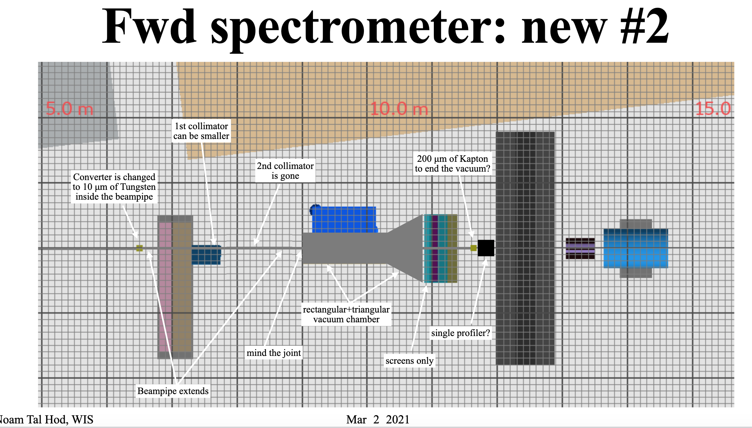

Slide 6
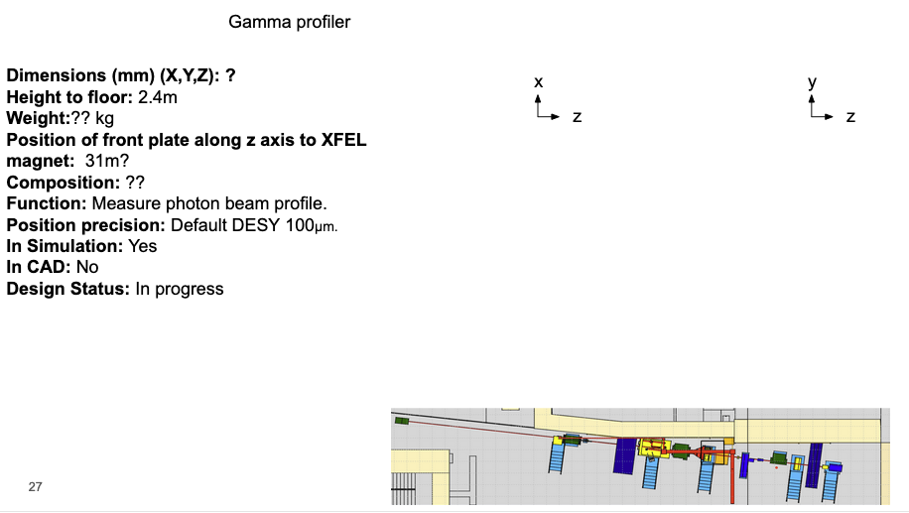
Inputs for the TC
CAD type?

Slide 7
Discussions items
Detector
  procurements / on going purchases (Wuppertal, delivery 12/04 100 um, PD Un. Wafers, 100-150 um, TOMSK negotiating with Monocrystal)
  Test strategy
MC simulation: Now we know the definitive deployment
  Recalculate fundamental quantities of the CDR
    DOSE
    Beam profile reconstruction precision
    Charge Signal strength
    Coulomb scattering effects
    Charge sharing effects
    Profile reconstruction performances
Next Meeting: When?
    April 6th at 15:00
    April 9th at 14:30
    Other?

Slide 8
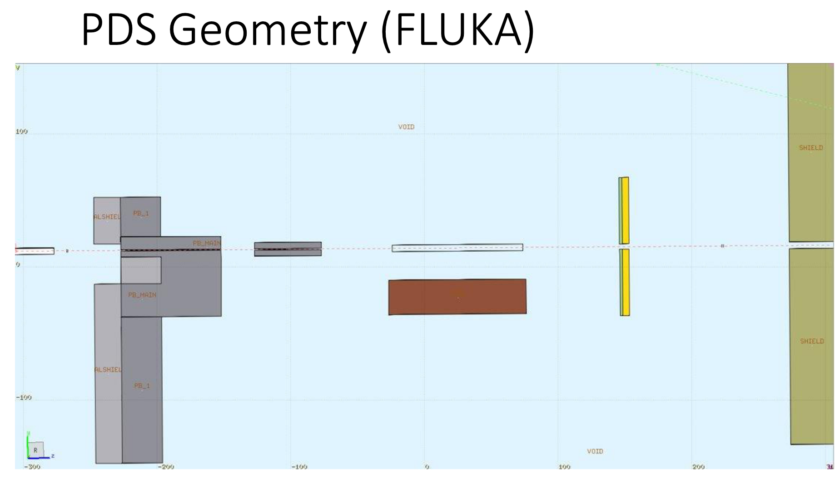
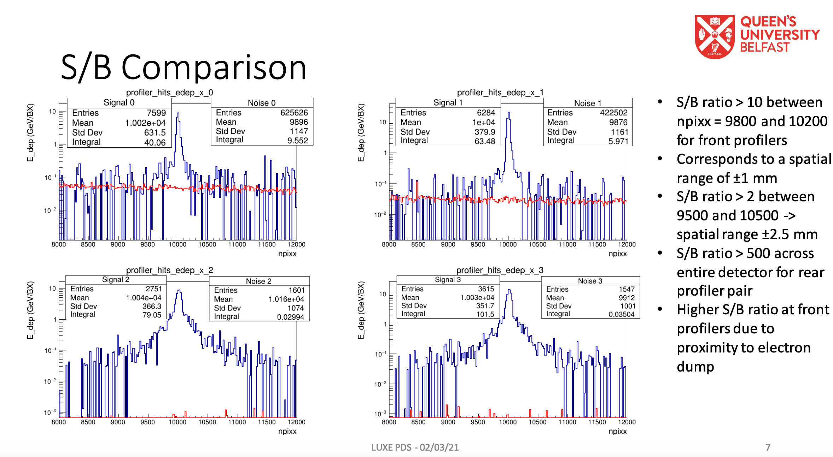
Motivation
To place movable tables in vacuum would be in principle possible
  Technical challenging
  More expensive
Beam line new #2 is the preferred solution for the GBP
  X-Y stations placed just outside the beam pipe
  200 um of Kapton, or similar will not spoil significantly the performances
  12m distance from the IP will guarantee maximum beam opening
    Easier and better profile reconstruction
    Less damage from irradiation
  FLUKA simulation has shown that in the rear station impact of the beam background is minimal

Slide 9
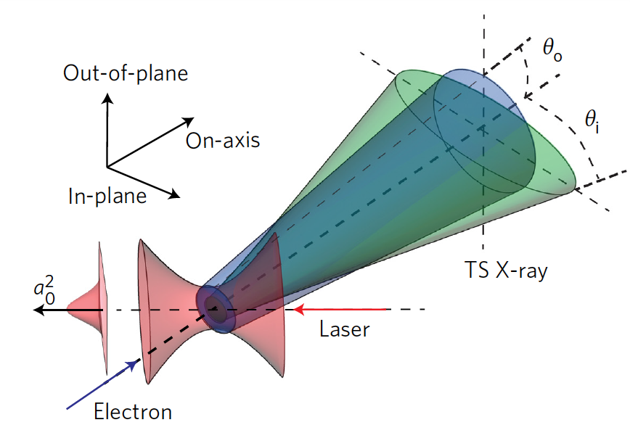
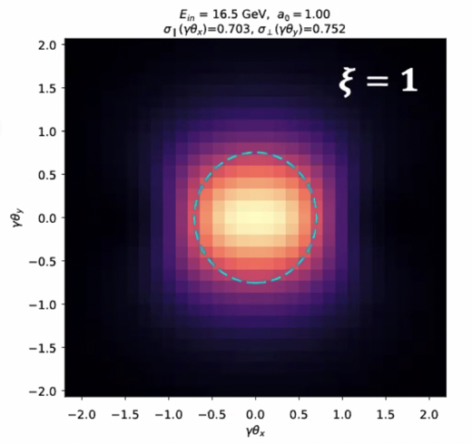
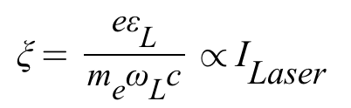
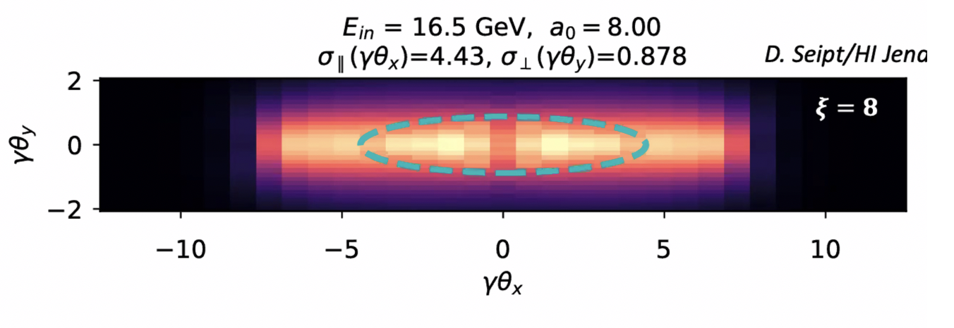
Photon beam properties
An electron oscillating in an intense laser field (dimensionless intensity ξ > 1) undergoes non-linear Thomson scattering
In a linearly polarized laser pulse, the cone angle of photon emission is θ∥~ξ/γ_{e} and θ⊥~1/γ_{e} in the directions parallel and perpendicular to the laser polarization axis, respectively.
This leads to an elliptic transverse distribution of the gamma-ray beam, with the ellipticity being equal to the laser intensity experienced by the electron at the moment of emission.
G. Sarri et al., Phys. Rev. Lett. (2014)
O. Har-Shemesh, and A. Di Piazza, A. Opt. Lett. (2012).
W. Yan et al., Nat. Phot. (2017)

Slide 10
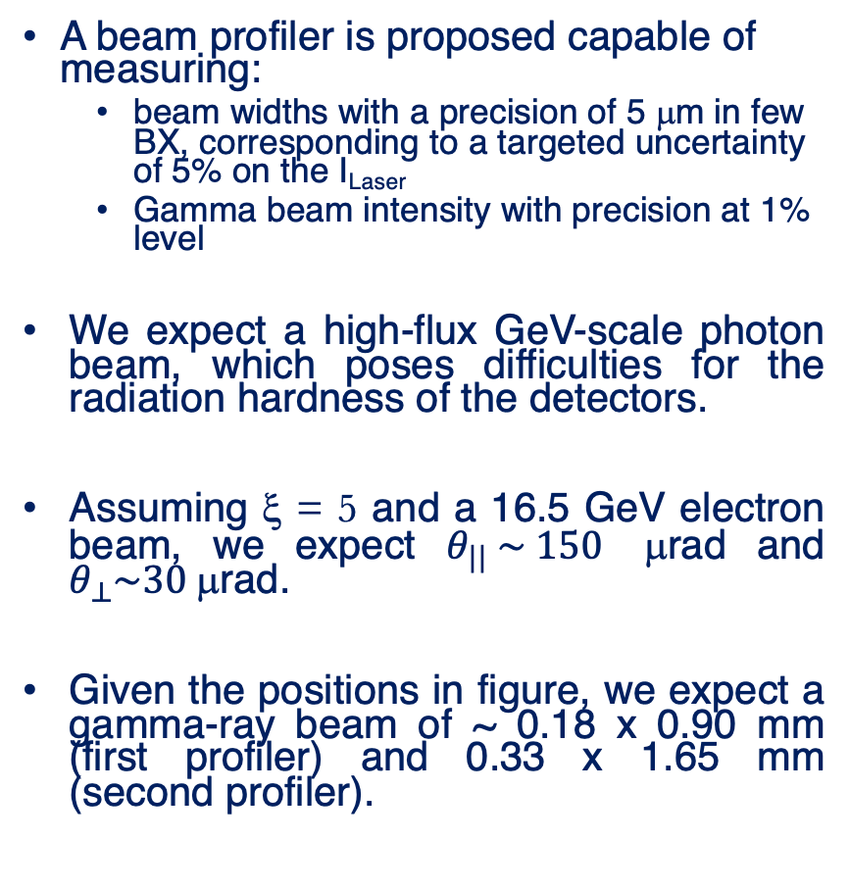
Beam profiler measured quantities
A beam profiler is proposed capable of measuring:
  beam widths with a precision of 5 μm in few BX, corresponding to a targeted uncertainty of 5% on the I_{Laser}
  Gamma beam intensity with precision at 1% level
We expect a high-flux GeV-scale photon beam, which poses difficulties for the radiation hardness of the detectors.
Assuming ξ = 5 and a 16.5 GeV electron beam, we expect $θ_{||} \sim 150$ μrad and $θ_{⊥}\sim 30$μrad.
Given the positions in figure, we expect a gamma-ray beam of ~ 0.18 x 0.90 mm (first profiler) and 0.33 x 1.65 mm (second profiler).

Slide 11
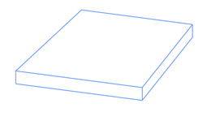
Proposed detector
0.01 cm
Beam profile contained in a 2x2 cm² detector
Extremely high dose suggests to use two detectors with strips placed orthogonally each other
High particle density can be dealt only with analog readout of the strips and center of gravity algorithm to reconstruct the beam profile shape
Strips with 100 μm pitch seems to be a reasonable compromise to reach the target precision (5 μm) using a reasonable number of readout channels (400)
Since the absorbed dose depends on the detector thickness and there is no problem with signal strength, the detector should be as thin as possible: dz=100 μm for sapphire
2 cm
Photon beam
2 cm
0.01 cm
200+200 readout channels
Chosen Material: Sapphire

Slide 12
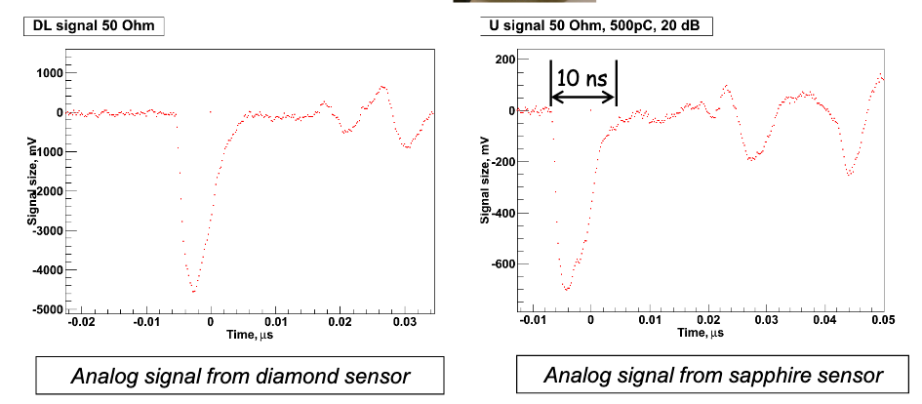
Why Sapphire?
Sapphire is Al₂O₃
S. Schuwalow et al.: Investigation of a direction sensitive sapphire detector stack at the 5 GeV electron beam at DESY-II / JINST 10 P08008
Specific characteristics of sapphire:
  ☺ High radiation resistance: ~ 10 MGy
  ☺ Leakage current does not increase with dose
  ☹ High eh creation energy
  ☹ Low collection efficiency (~10%)
  ☺ Fast response (low electron mobility compensated by reduced distance travelled by electrons)
  ☺ Low Cost: 1euro/cm² (compared to diamond 3000 euro/cm²)

Slide 13

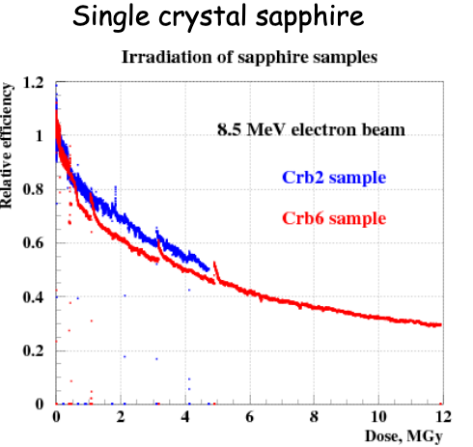
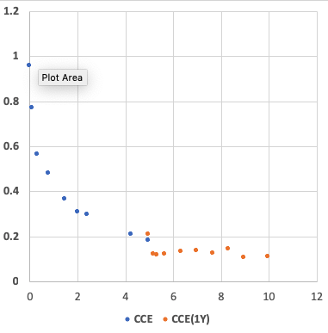
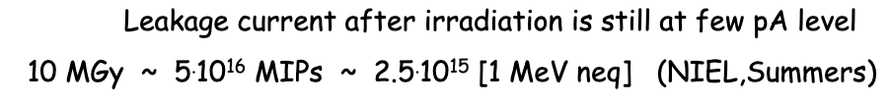
Sapphire Radiation Hardness
Relative Efficiency
Dose, MGy

Slide 14
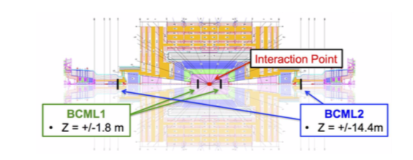
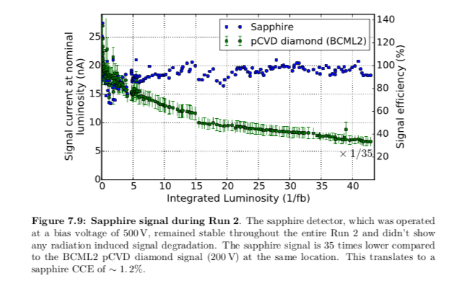
Tests on sapphire detectors
Intensive beam tests for FLASH and XFEL (electron beams)
Sapphire detectors have been intensively tested as beam halo and beam loss monitors at the Large Hadron Collider (CMS)
A sapphire version of BCM has been intensively tested during RUN2 (BCML2 sapphire) and the performances can be compared with BCML2 pCVD diamond version
Improved version (increased signal strength) of sapphire detector under consideration also for HL-LHC
CERN-THESIS-2017-071

Slide 15
Adding sub-millimetric movement to the detector
100 μm
radiation damage of Sapphire leads only to the lost of charge collection efficiency
the leakage current stays negligible (~pA)
Displace detector along strips, for instance, by ~0.1 mm every 10 days
Piezo motors (micrometric steps) are widely used
Factor 100 in lifetime achieved!
Method does not work with Silicon (too high leakage current when high dose is absorbed)
Regular position scans will also be useful for calibration purposes (two independent movements for each detector)

Slide 16
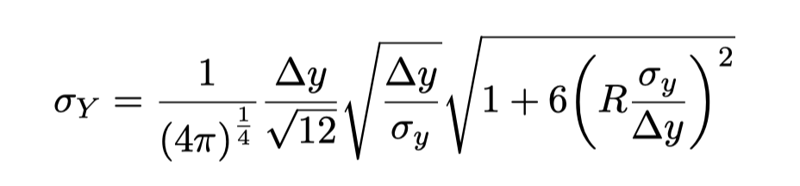
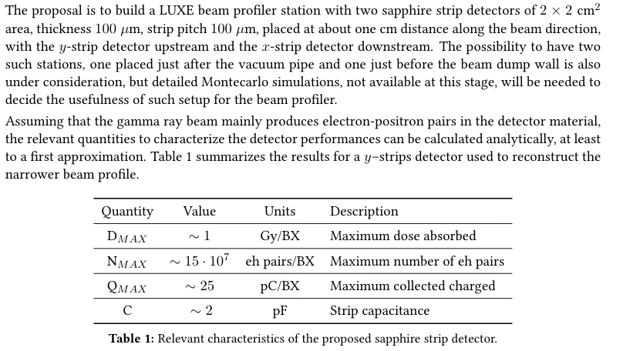
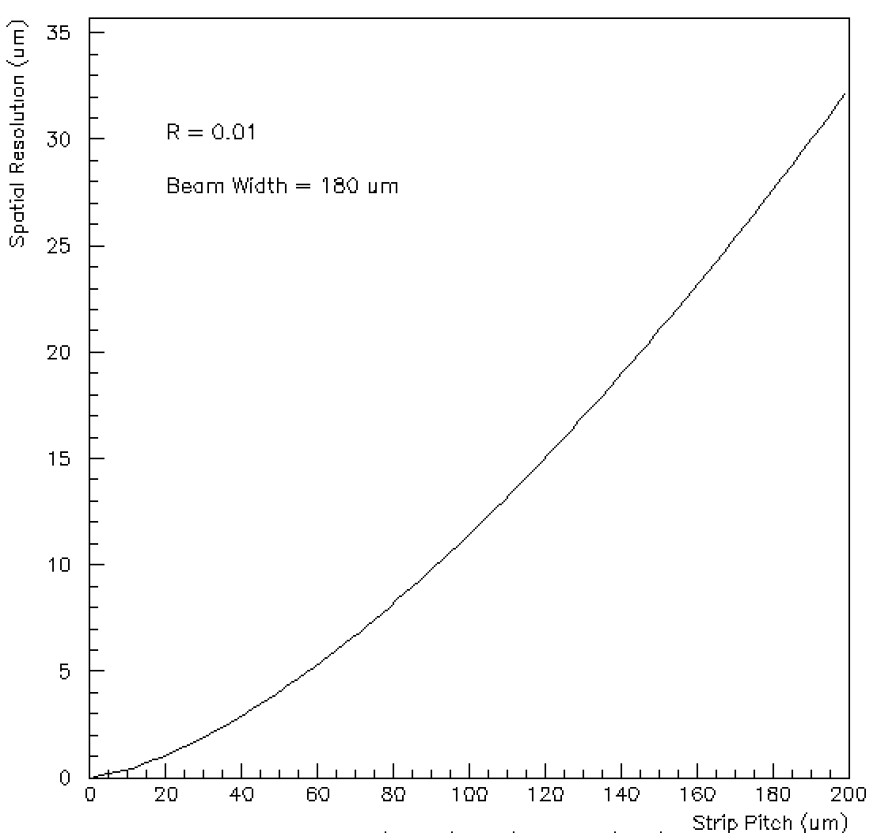

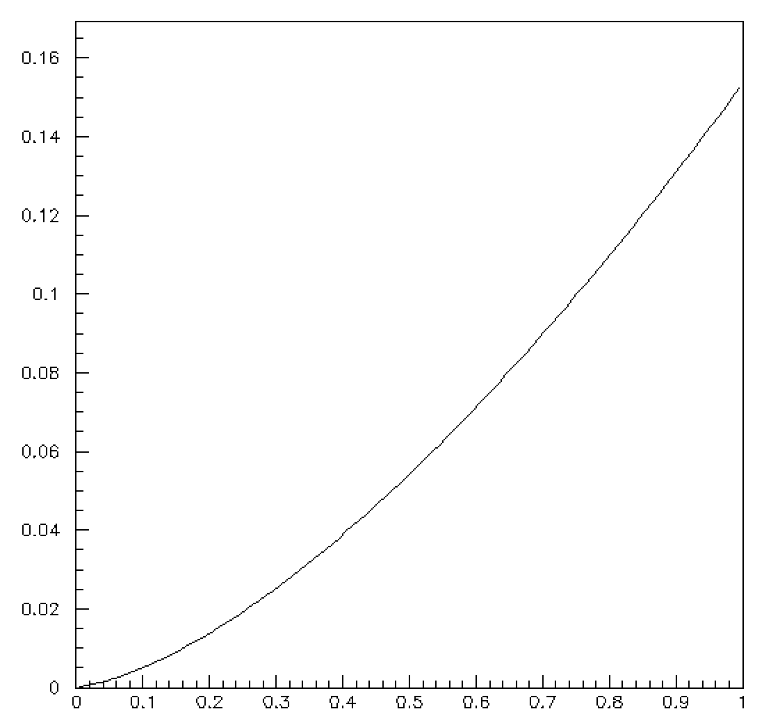


Detector Performances
σ_{y}: Beam width
Δy: Strip pitch
R: energy resolution
COG Algorithm
Assuming 10 MGy , lifetime ~ 120 days
COG Algorithm
  11 μm on the single BX
  5 μm on 4 BX
  Readout energy resolution R ~ 1% needed
Point of attention
Detector Thickness: 0.14% Xo
1m of air : 0.33% Xo

Slide 17
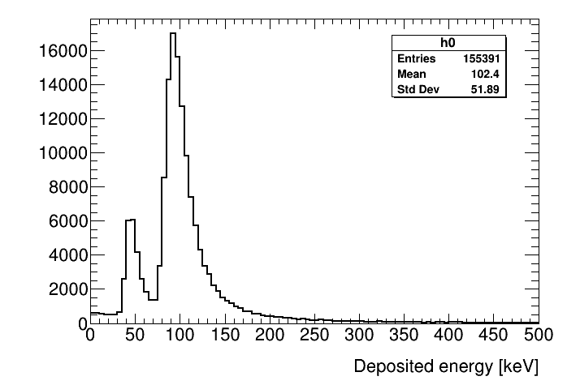
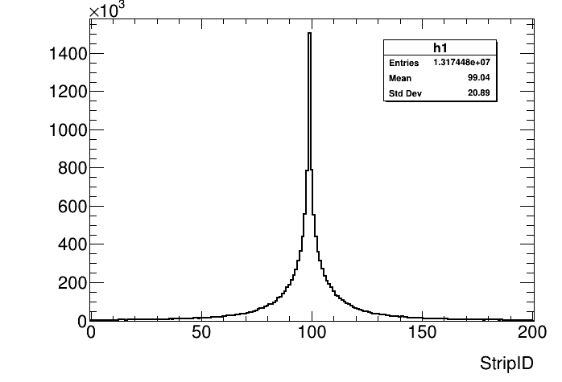
MC Standalone
5 GeV gamma
Y
Z
X
A standalone Geant4 MC simulation of the detector is being developed to study systematic effects
First tests performed with a pencil beam of 5 GeV and 6m of air show a non negligible beam width spread

Slide 18
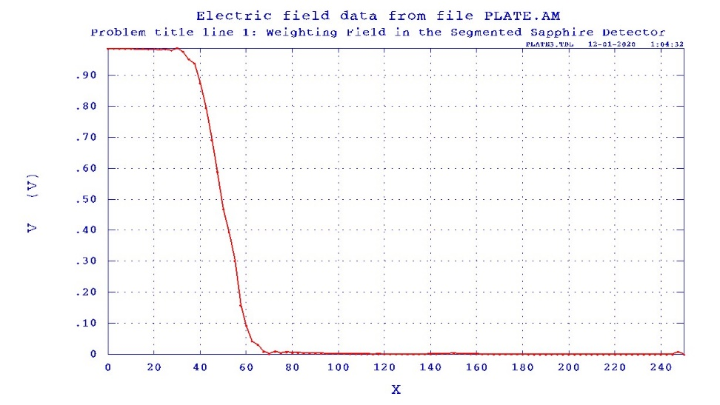
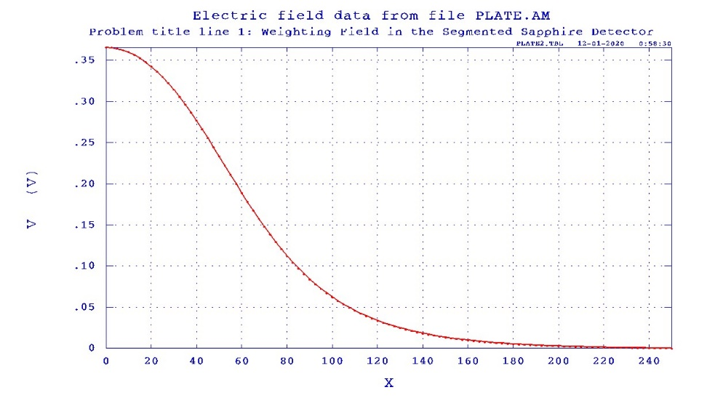
MC standalone - Digitization
Charge sharing among neighbouring strips will be an important source of systematic uncertainty in the beam profile reconstruction
It can be studied using Ramo-Shockley theorem
First geometry implemented and weighting fields will be the basis for signal digitization in MC
CCE will change with irradiation (common problem for all the solid state detectors material)
  To be studied with MC and TB
Gap 20 µm
99% CCE
50% CCE
Neighbour strips
Signal strip
Neighbour strips
Signal strip

Slide 19
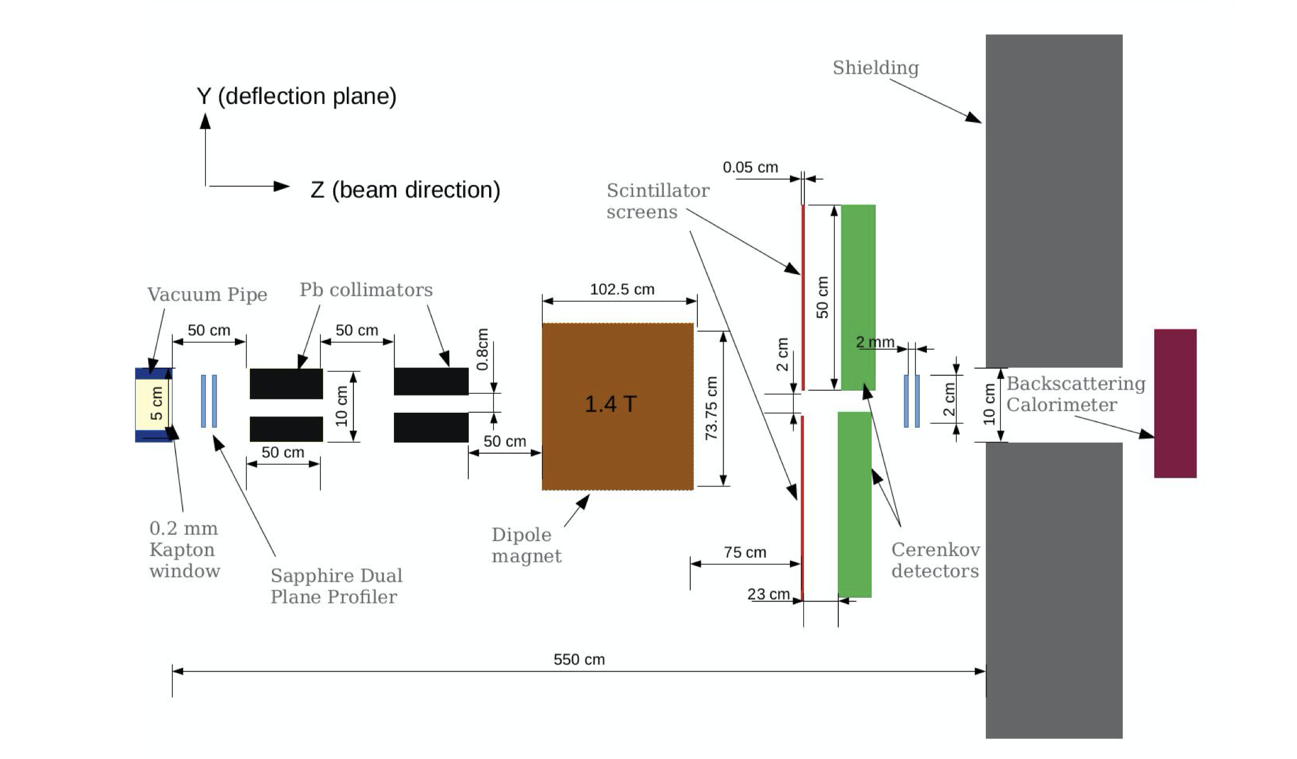
Beam Profiler in Full Simulation (FLUKA and GEANT4)
The detector geometry is being implemented also in the FLUKA and GEANT4 full simulation
Important to understand backgrounds and to provide inputs for systematic uncertainties studies to the standalone version

Slide 20
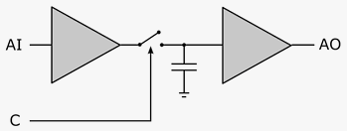
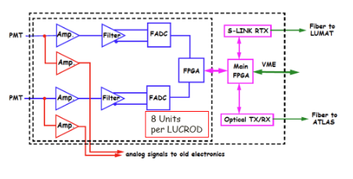
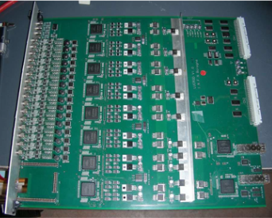
Readout Electronics
Can be a rather straightforward design
  Plenty of signal: ~25 pC/BX (peak)
  Low rate: 1 Hz
Signals transmitted via cat 5 cables
Plugged into a FE card (LUBPRO, to be designed):
  Array of Sample-and-Hold capacitors
  Control logic for switching and multiplexing the outputs to a readout card
  10 RJ45 inputs 1 analog output
Read-out card. One possible option
  ATLAS LUCID LUCROD (existing)
  Array of 16 FADC 12 bit dynamic range
10 LUBPRO and 1 LUCROD will be necessary to readout the entire beam profiler
  One could also think to develop a unique readout card for the run and use LUCROD for test
Sample/Hold
LUCROD CARD

Slide 21
Next Steps
Procure detector prototypes and start testing them in the lab
  Strip Detectors could be available in 6 months
Test beam at ELBE/FRASCATI/XFEL for validation
  Will start in one year from now
  No LUBPRO FE needed for the tests, only one LUCROD (16 channels, available)
After validation, start
  LUBPRO design, production (estimate one year)
  Movable support mechanics design, production (estimate one year)

Slide 22
Test Beam plans (2022 and beyond)
Scan of metallized sapphire sensors for response uniformity study: all sensors before final installation. Beam requirements: ~ 2 mm beam spot, e⁻ ~ 10 MeV, intensity ≥ 10⁵ /bunch. Measured variables: signals from strips, current in the HV circuit. At several positions measure dependence of signal size on HV.
Radiation hardness study (1-2 sensors). Beam requirements are similar to the previous case. Measure the sensor response vs time for the stable beam conditions until several MGy accumulated local dose. Control HV current (beam on/off). For several doses perform HV scan. Displace sensor wrt the beam and repeat measurements.
Study of profiler performance in the narrow electron beam. Required beam spot size ≤ 0.1 mm. Sensor inclination wrt the beam allows to simulate elliptic spot shape. Make the detailed scan in the direction perpendicular to the strips and find reconstructed beam parameters.
Repeat performance study at the photon beam (spontaneous emission U1/U2 beamlines XFEL). Energetic photons (i.e. Bremsstrahlung) would be useful, and this option is being investigated

Slide 23
Costs, resources
Costs (educated guess): ~ 150 k€ per Station
  Detector ~ 5 k€
  LUCROD ~ 15 k€
  LUBPRO ~ 50 k€
  Cables ~ 4 k€
  Infrastructures (movable plane plus piezo motors and control, high voltage and crate for the readout) ~ 70 k€
The following group are interested
  University of Belfast
  DESY
  INFN Bologna, Padova, Trieste
  University of Tomsk
  + .....
} Could be also fully redesigned (higher costs)

Slide 24
Conclusions
A proposal for the LUXE beam profile has been developed and discussed in the LUXE CDR
The detector technology based on sapphire is ideal for the experimental conditions in which the LUXE experiment will operate
  Large dose (High Radiation resistance)
  Large photon flux (plenty of signal, no CCE problems)
All the main technologies both in the detector side and readout side are either available or easily achievable
A prototype to be tested in lab can be available in a time scale of 6 months
Costs are contained
MC work needed to study sources of systematic uncertainties and detector geometry optimization to reach the required spatial resolution has been started (both standalone and full simulation)

Slide 25
Backup Slides

Slide 26
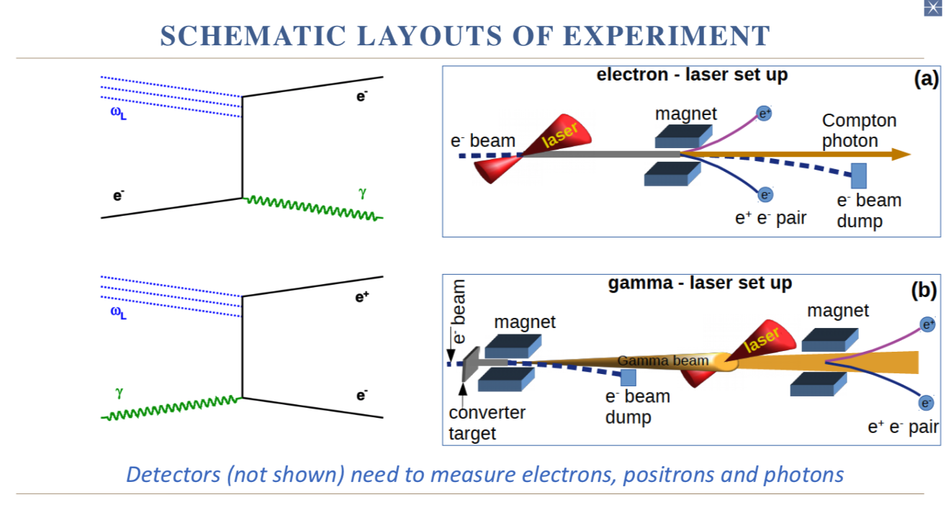
LUXE experimental setup
QED theory prediction deviation of vacuum behavior in presence of a strong external field
Using the XFEL electron beam and the state-of-art laser technology (O(TW)), intensity of the order of Schwinger limit (~1.3E18 V/m) are reached (electron-positron pair creation in vacuum)

Slide 27
Dynamic Range
The LUCROD board installed for LUCID has noise at level of 1 ADC count ~ 0.350 mV, and 12 bit dynamic range
Leakage current (O(pA)) << I(signal) ~ 13 mA
An effective dynamic range of 10-11 bits should be possible
A MC simulation is necessary to check if this is enough for reconstructing the beam profile
If not, one could think to different gain factors (LUCROD allows up to x 16 )

Slide 28
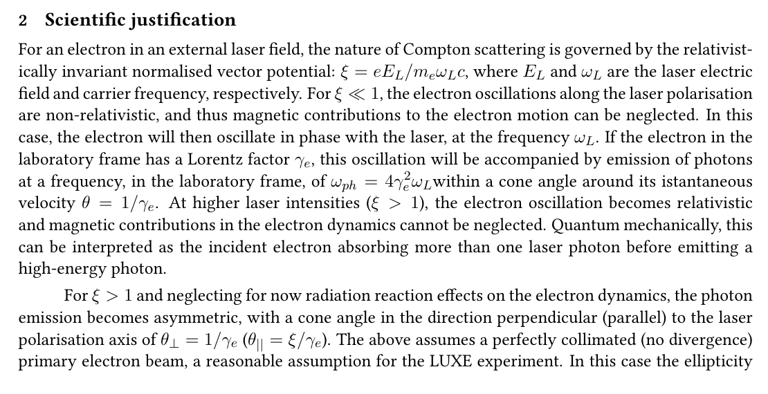
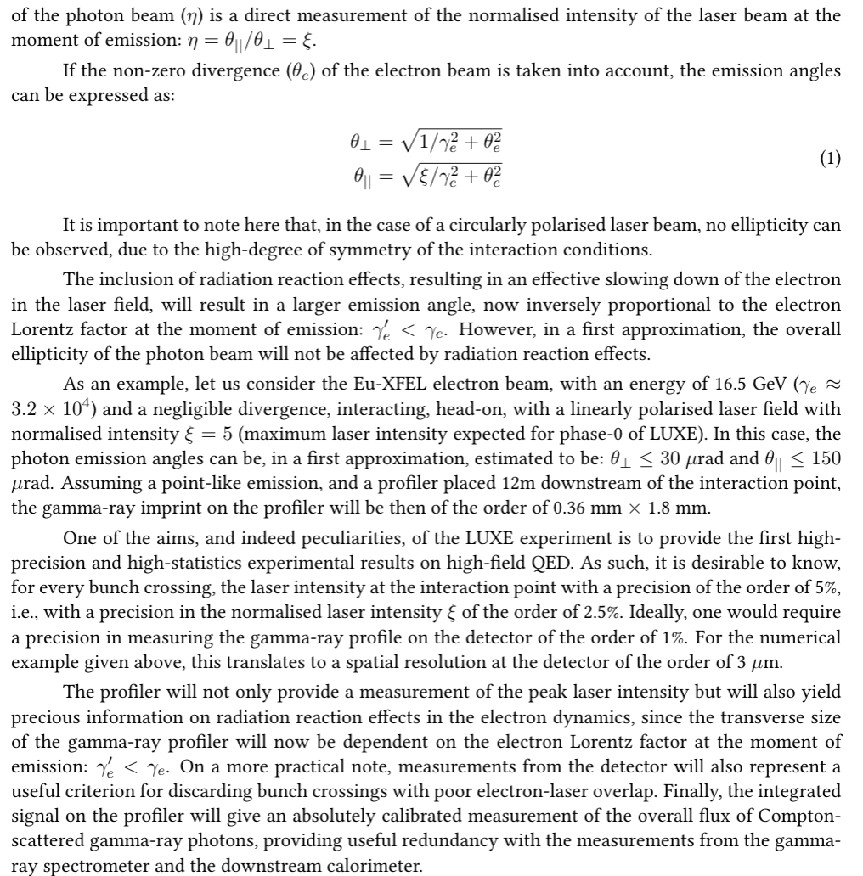

Slide 29
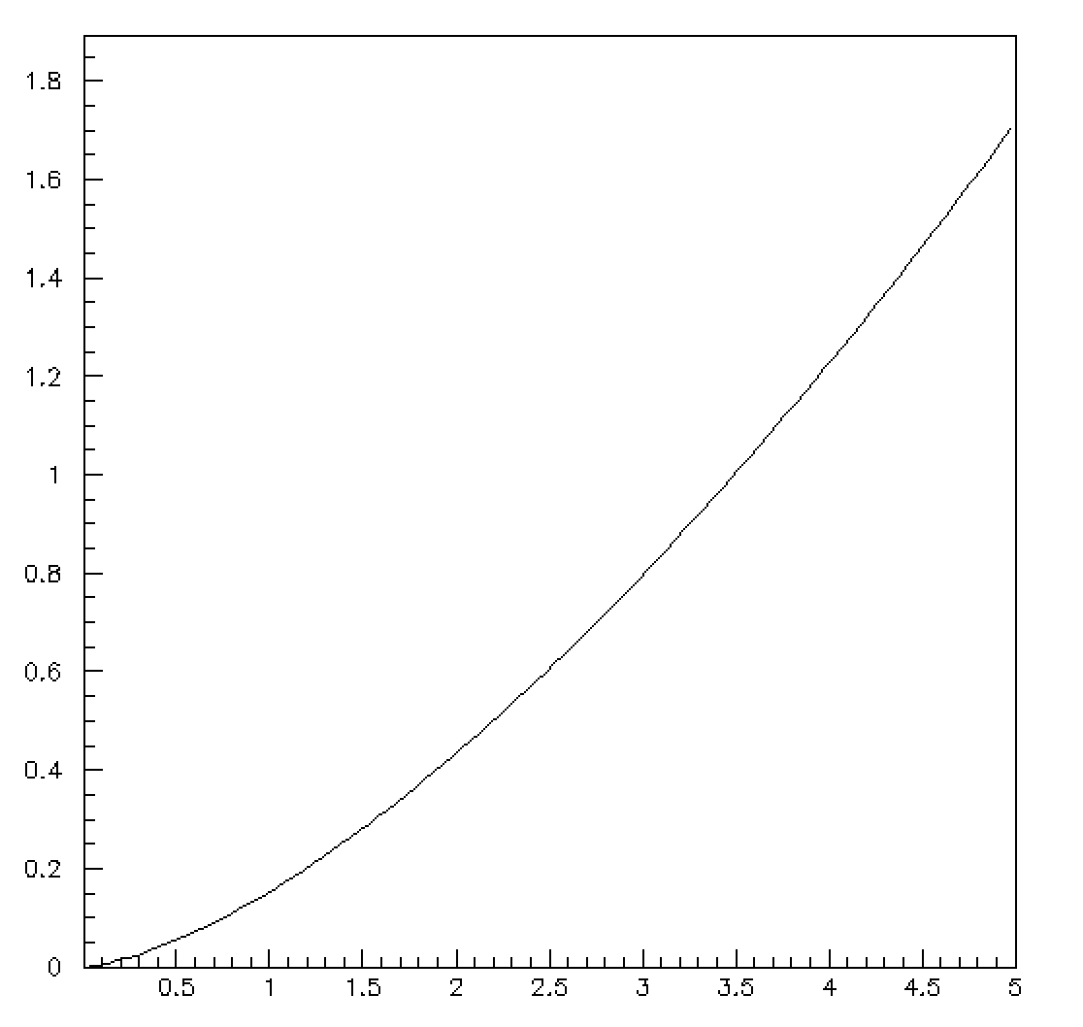
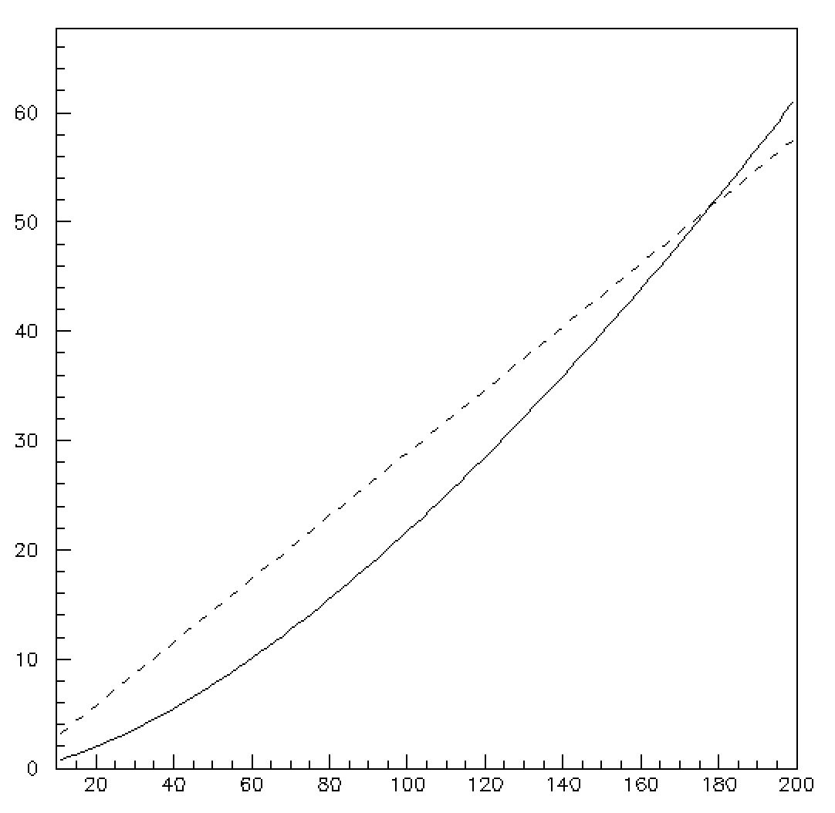
Spatial Resolution (CoG)
σY(um)
σ_{Y}/σ_{y}
R=0.01
σy=50 um
R=0.01
Δy/sqrt(12)
Δy/σ_{y}
Δy(um)

Slide 30
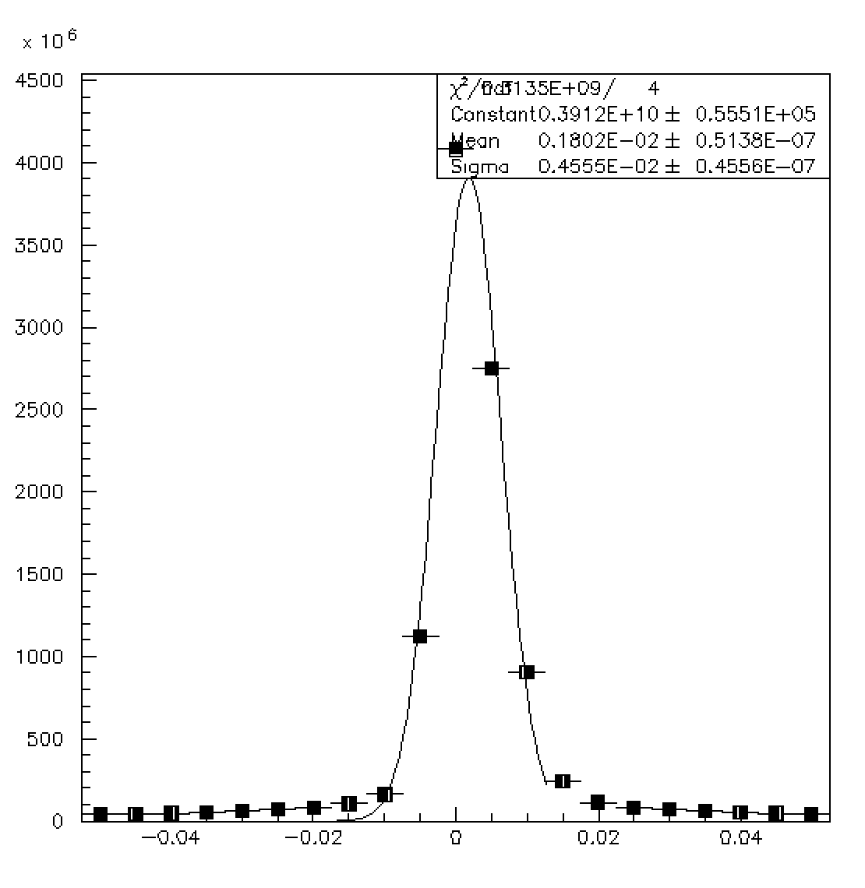
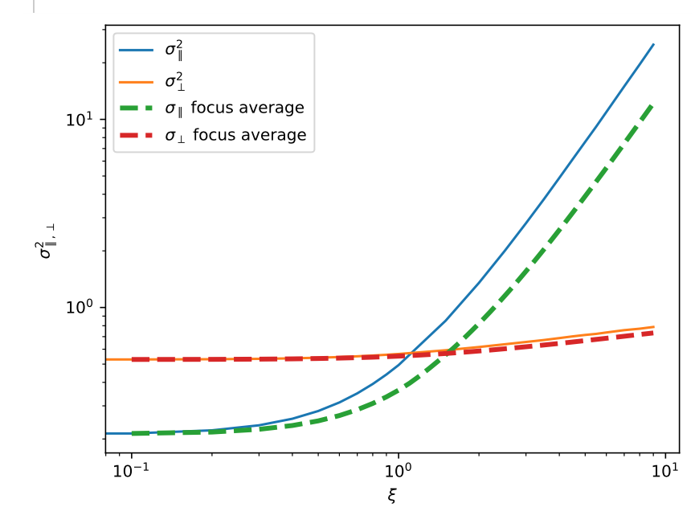
Ellipticity
X(cm)

Slide 31
A proposal for the LUXE beam profile has been developed and discussed in the LUXE CDR
Despite the harsh radiation environment in which the detector will operate and the very good stability needed to achieve the target spatial resolution in the beam profile reconstruction, there is confidence that the proposed version will perform according to the specs
Advantages of the proposed detector
  Very high radiation resistance
  All the main technologies both in the detector side and readout side are either available or easily achievable
  A prototype to be tested in lab can be available in a time scale of 6 months
  Costs are contained
MC work needed to study sources of systematic uncertainties and detector geometry optimization has been started

