Slide 1
Bunch Patterns and Beam Distribution
Patterns, Kickers, Multi-Beamline Operation

Slide 2
Beam Distribution Scheme
TLD Kicker
Magnetic, pulsed
Fast (4.5 MHz)
Horizontal kick (left)
Lambertson Septum
Vertical deflection (up)
Beam Distribution Kicker
Magnetic, pulsed
Slow (tens of µs)
Vertical kick (up)
Lambertson Septum
Horizontal deflection (left)
SASE2
T5D
SASE1
T4D
TLD
SASE3

Slide 3
Fresh Bunch Mode: Implementation
Lasing in SA1 induces energy spread => less or no lasing in SA3
Lasing can be suppressed
on individual bunches
by exciting a trajectory oscillation with a fast kicker (soft kick).

Slide 4
Fresh Bunch Mode: Implementation
Lasing in SA1 induces energy spread => less or no lasing in SA3
Lasing can be suppressed
on individual bunches
by exciting a trajectory oscillation with a fast kicker.

Slide 5
Fresh Bunch Mode: Implementation
Lasing in SA1 induces energy spread => less or no lasing in SA3
Lasing can be suppressed
on individual bunches
by exciting a trajectory oscillation with a fast kicker.
Horizontal kick
Static horizontal correction

Slide 6
Fresh Bunch Mode: Implementation
Lasing in SA1 induces energy spread => less or no lasing in SA3
Lasing can be suppressed
on individual bunches
by exciting a trajectory oscillation with a fast kicker.
Static horizontal correction

Slide 7
Fresh Bunch Mode: Additional Kick in T4
There is a new “TLD-type” kicker in the T4 section, in front of SA3.
It is fired for SA1 bunches to increase the oscillation amplitude in SA3.
Horizontal T4 kick
Static horizontal correction

Slide 8
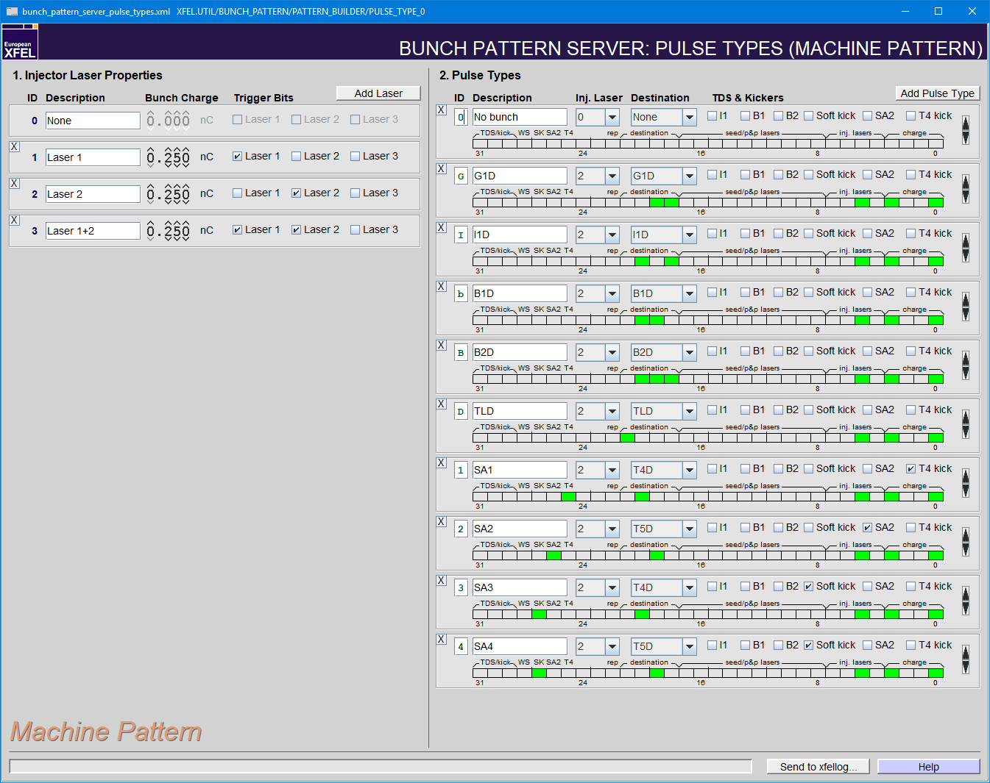
Beam Distributon: Get Your Kicks (All Four of Them)
Four types of kicks can be triggered by the timing system:
Kick to TLD (fast) Destination: TLD
Kick to south branch/SASE2 (slow) Destination: T5D or Bit: “SA2”
Soft kick (fast, one of the TLD kickers) Bit: “SK” (Soft Kick)
T4 kick in front of SASE3 (fast) Bit: “T4”

Slide 9
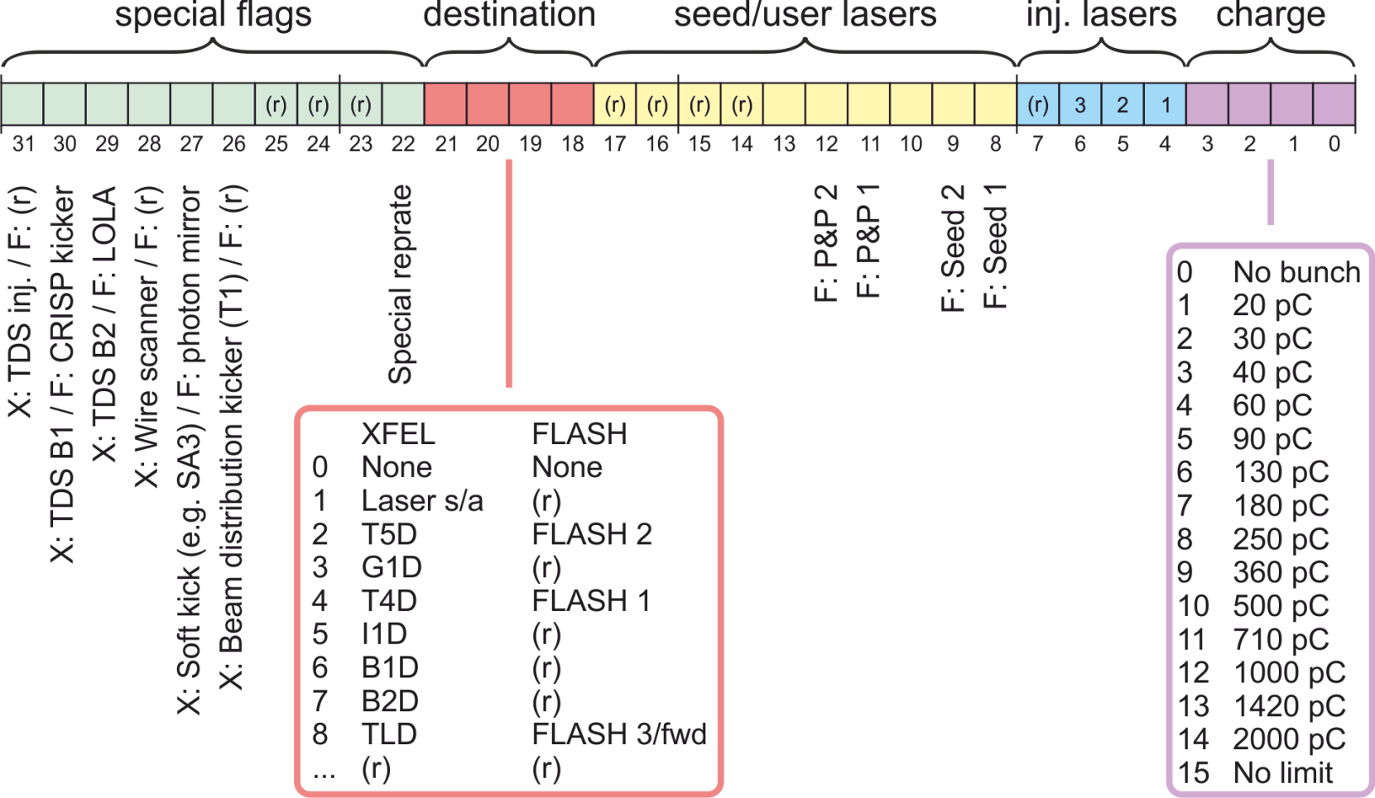
The Timing Pattern in Detail
The timing pattern is an information block that is distributed by the timing system before each macropulse.
Based on it, timing boards generate triggers.
Based on it, hard- and software can classify bunches/pulses.
Table with 7200 entries
9 MHz raster (111 ns step)
Covers a time span of 800 µs (RF flat-top of FLASH)
Each entry is described by a 32-bit number (integer/word).

Slide 10
Live from the Virtual XFEL

Slide 11
Subtrains – Reflecting the Pattern in the Control System
A subtrain is the set of all bunches in a macropulse that share some common feature. Five of them are defined at the XFEL.
They appear mainly in property names:
X.SA2.TRAIN.MEAN_PKPK the mean value and peak-to-peak variation over all bunches of subtrain SA2
ALL contains all bunches.
SA1 contains all bunches with destination T4D that are not affected by a soft kick in TL.
SA2 contains all bunches with destination T5D.
SA3 contains all bunches with destination T4D that are affected by a soft kick in TL.
DUD contains all bunches that are not going through a SASE undulator, i.e. those with destination G1D, I1D, B1D, B2D, or TLD.
SASE2
T5D
SASE1
T4D
B1D
B2D
TLD
SASE3
G1D
I1D

