Slide 1
Error Tolerances and Girder Errors from a beam dynamics point of view
The message of this presentation is, for an HMBA-like upgrade project:
Girder-Girder == Magnet-Magnet
IF ANY, USE MEASURED SURVEY DATA INSTEAD OF GIRDER-GIRDER ERRORS
S.M.Liuzzo, ESRF, Grenoble, 11th May 2021

Slide 2
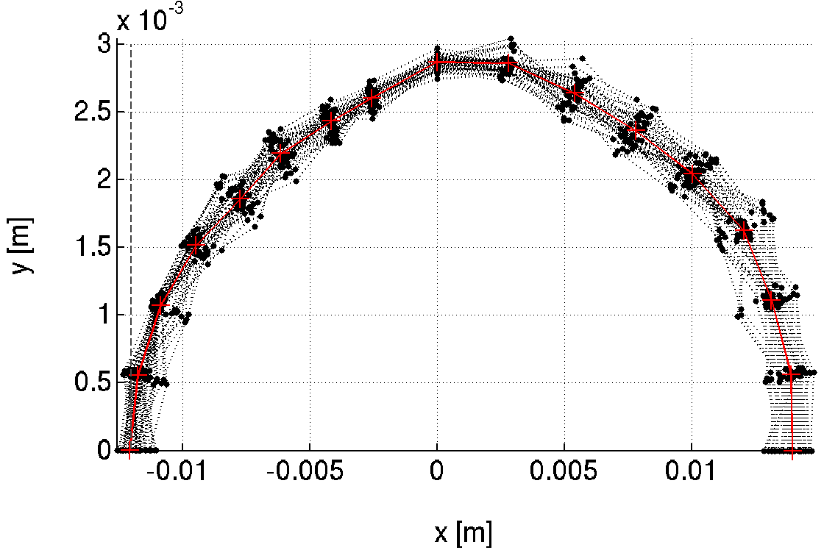
Tolerance estimates objective
Septum
2 main parameters to achieve,
Absolute values depend on facility layout.
TARGET
Injected
beam
-10mm (-8.1mm @INJECTION)
~100% Injection Efficiency
>10h
Touschek Lifetime
@ 200mA uniform, 5pm
Also :
Emittance variation < 2pm
Feasible correction strengths
Orbit < 100um rms
etc…

Slide 3
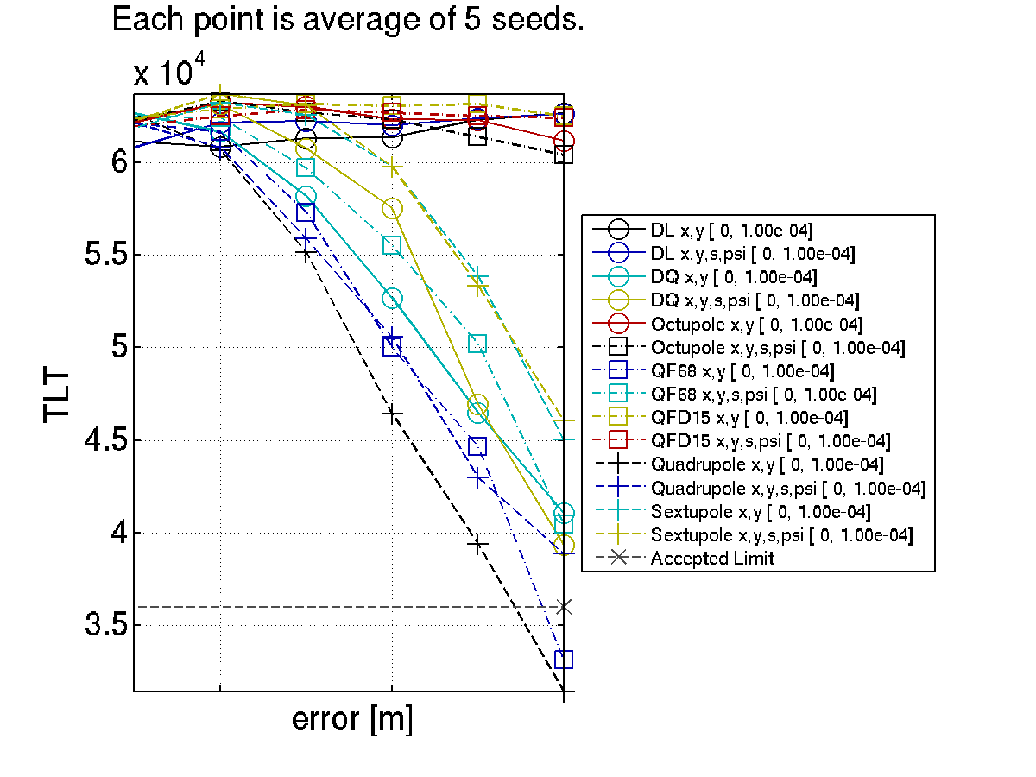
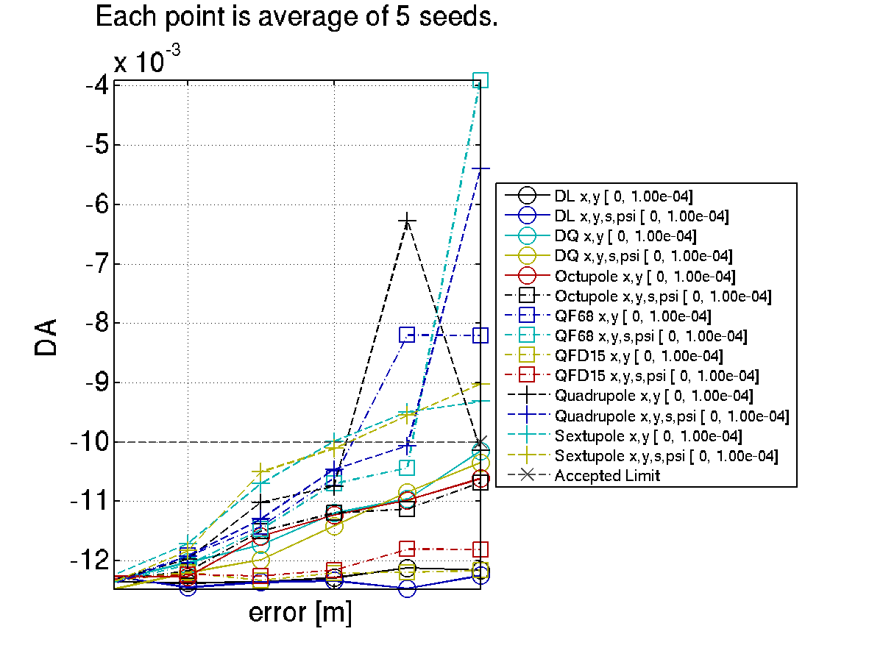
Liftime and dynamic apertures vs error sources
How tolerances were defined
A CLUSTER is crucial for this analysis. Each error set to analyze requires 1CPUx4h
17h
The line where I should have placed it.
DA=-10mm
Lifetime = 10h
10h
The line where I should have placed it.
Sext. Alignment do more on DA than on TLT ;
Moderate gradient are irrelevant compared to high gradient ;
Etc. etc.
How to determine the ”tolerance” ? ➔ DRAW A LINE (relative impact of each error), RESCALE globally.
CAoPAC Workshop l GSI, Darmstadt 10-13 March 2015 l S.M.Liuzzo

Slide 4
Comparable tolerance table
How tolerances were defined
In RED
The worst crossing of the “line” for each performance parameter
DQ (combined function dipoles) behave as quadrupoles concerning errors. Evident the impact on vertical dispersion compared to the other quadrupoles (defocussing quadrupoles).
Quadrupoles have large impact on orbit and horizontal dispersion, also in this case, lifetime and DA are strongly affected. QF6 and QF8 are dominant.
Sextupoles have the largest impact on DA, they are also the strongest source of beta-beating and emittance as expected.
Octupoles influence is limited compared to quadrupole and sextupoles, nevertheless they do have an impact on DA. Their effect on lifetime is very small.
Rotations up to 100urad have impact on the various parameters but limited.

Slide 5
Tolerable random errors
How tolerances were defined
Each error, on each magnet family, is studied individually looking at the dependence of DA, lifetime, emittances and all relevant parameters vs error amplitude.
Required: | DX | DY | DS | DPSI | DK
 | μm | μm | μm | μrad | 10^-4
DL | >100 | >100 | 1000 | 500 | 10
DQ, QF[68] | 70 | 50 | 500 | 200 | 5
Q[DF][1-5] | 100 | 85 | 500 | 500 | 5
SFD | 70 | 50 | 500 | 1000 | 35
OF | 100 | 100 | 500 | 1000
Sextupoles and high gradient quadrupoles are the most relevant limitations, nevertheless, this alignment specifications are currently achievable.
(DX=DY=60μm, 84 μm between two magnets).

Slide 6
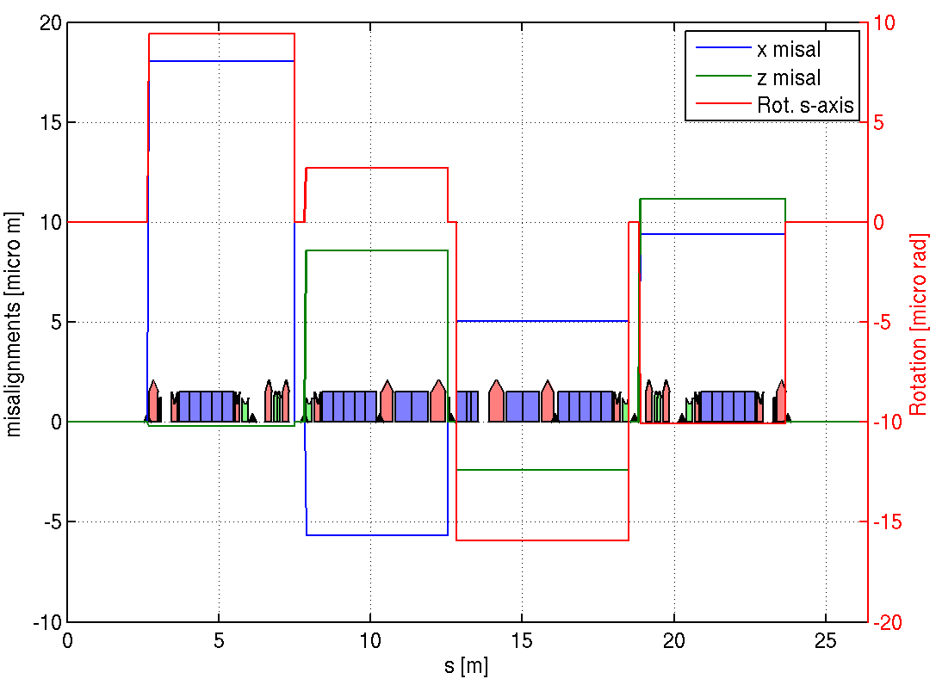
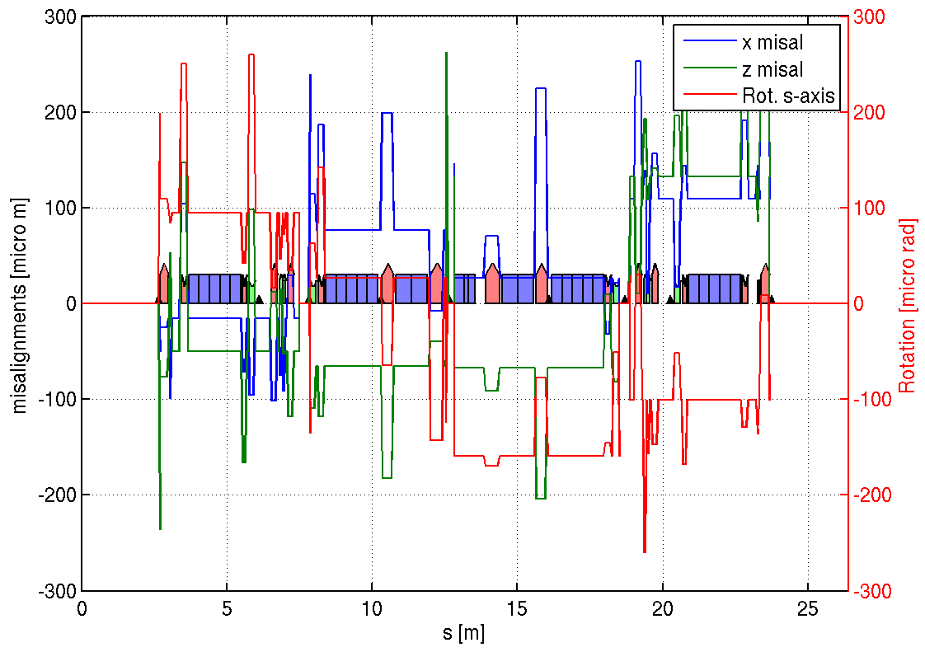
Girder Errors
How
GIRDER
tolerances were defined
Girder displacements and rotations
Girder displacements and rotations
+ random errors Quad. and Sext.
4 girders, BPMs are moved with the girder.
l 30-31 May 2014 l S.M.Liuzzo

Slide 7
Dynamic aperture @S3 septum vs errors for s28A + RDT correction
How
GIRDER
tolerances were defined
-20%
All is NOT the sum of each error
26/07/2013
l WP1 ESRF upgrade l May 2014 l S.M.Liuzzo

Slide 8
error values for a reduction of 20% of Hor. Dynamic Aperture @S3
How
GIRDER
tolerances were defined
RDT correction
Strong impact off quadrupole errors
No influence on emittances

Slide 9
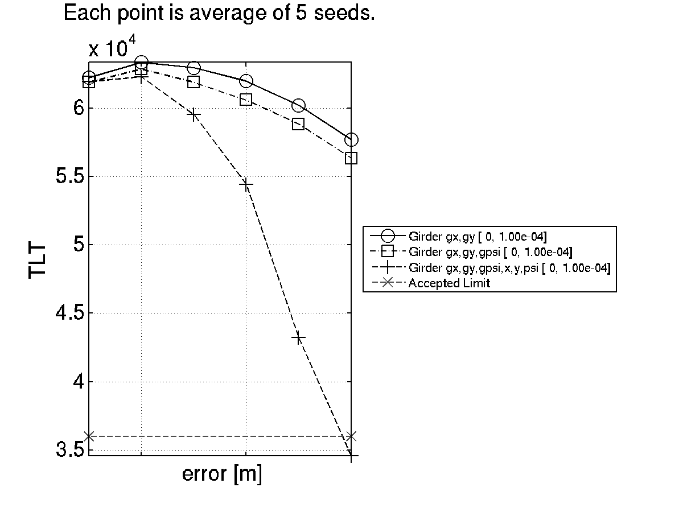
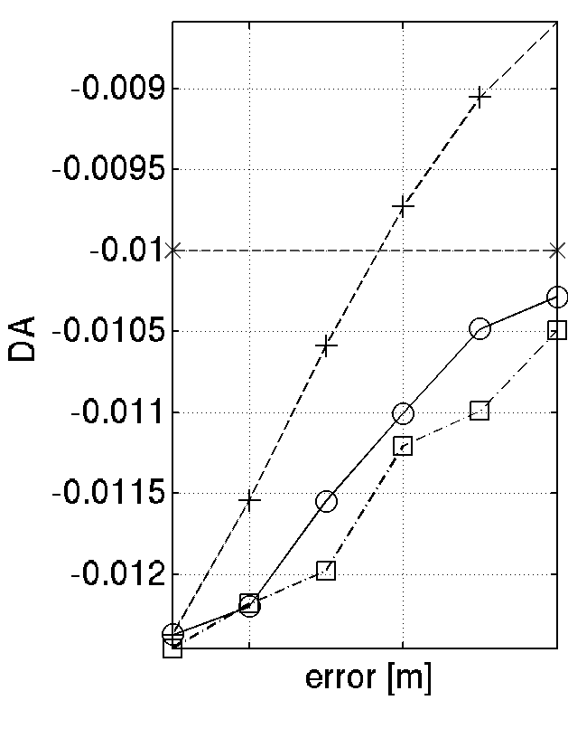
Girder Errors
How
GIRDER
tolerances were defined
Hor. DA @ QFI, X0.81 to scale at S3,
8mm required at S3, 10mm accepted at QFI
Girders+Magnets
17h
girders
BAD
Girders+Magnets
In terms of DA girders and magnet alignment approx. sum up. In terms of lifetime, magnets+girder have a stronger impact.
Girders only
(g) Stands for girder errors,
no (g), are quadrupole and sextupole individual misalignments
10h
GOOD

Slide 10
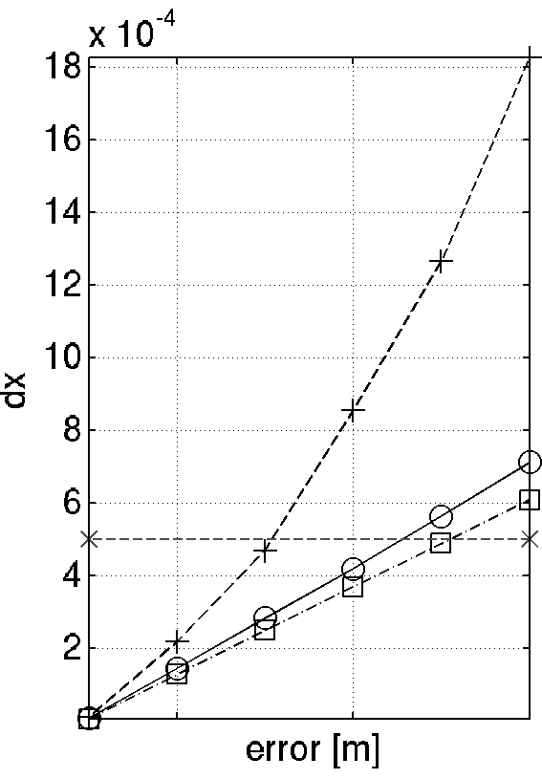
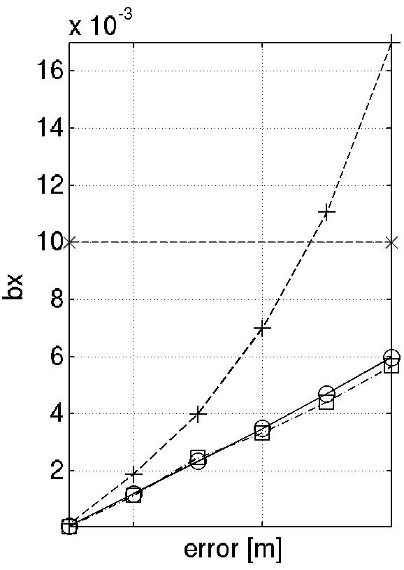
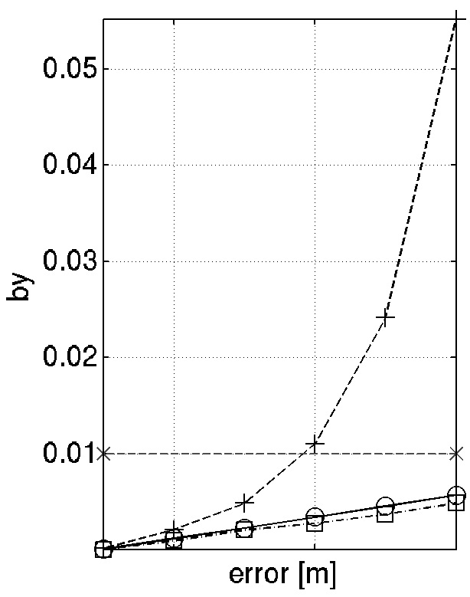
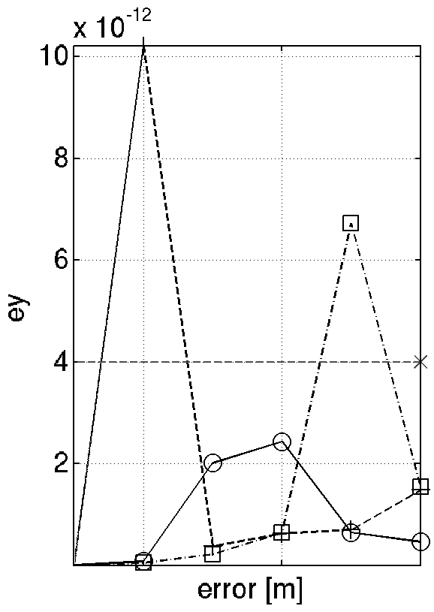
Summary Table of Girder Errors
Commissioning-like correction sequence to get these data
Cluster, Average over several (10) error seeds.
Computing cluster
(g) Stands for girder errors, no g, are quadrupole and sextupole individual misalignments
How
GIRDER
tolerances were defined

Slide 11
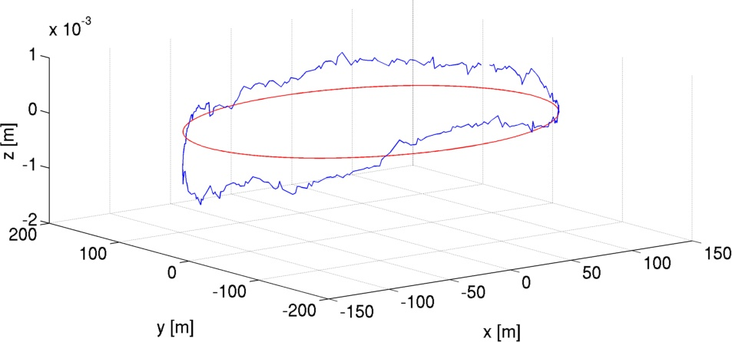
The measured position of the lattice
How
GIRDER
tolerances were excluded
This is where the machine is. Let’s use this information!
nominal
current
ESRF 1994-2018
EBS 2019-?? We placed EBS where the old SR used to be. Everyone is happy.

Slide 12
Survey errors PLUS random errors
How
GIRDER
tolerances were excluded
The blue curve represents the current ESRF storage ring position.
The x symbols are the interpolated positions on this curve for the S28A lattice.
BPM are positioned on the same curve.
DX and DZ and girder rotations are applied.
Errors are ramped in steps of 20% up to the nominal value.
Added random errors to account for unknown magnetic center position
Random Gaussian DX DY in quadrupoles and sextupoles on top of the survey errors.
l ESRF Upgrade l June 2014 l S.M.Liuzzo

Slide 13
Long range errors
How
GIRDER
tolerances were excluded
Error “waves” applied to the lattice: DX, DY, Rotations for quad and sext.
Correction performed for each frequency and amplitude set as:
Open trajectory correction
Orbit correction
RDT correction
storage ring survey data
simulated 1st harmonic,
Simulations performed on the OAR asd cluster, 8h-600cpu
26/07/2013

Slide 14
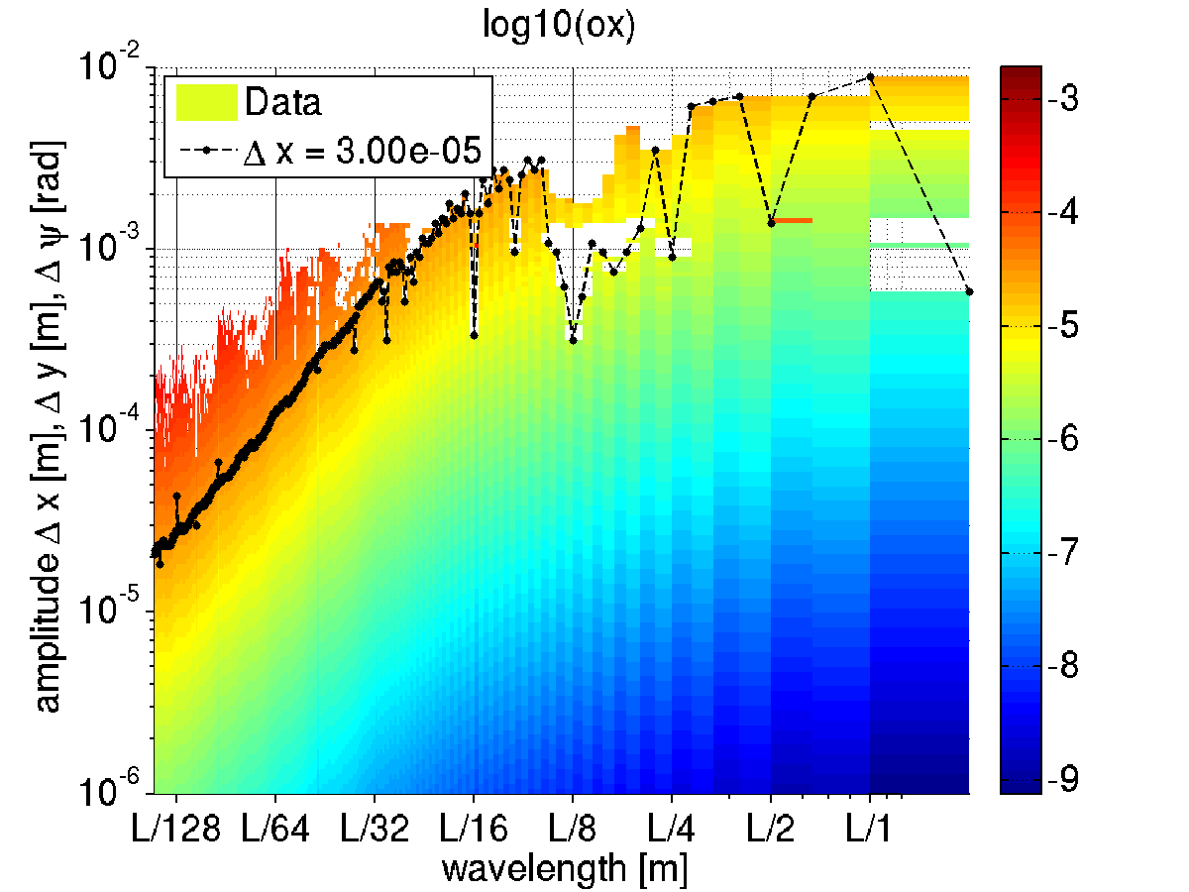
Long range errors: error envelope function
How
GIRDER
tolerances were excluded
Impact of error “waves” on horizontal orbit
At a wavelength of L/128~6m
30um errors amplitude give
30 um residual orbit distortion.
At a wavelength of L/2~422m
7mm errors amplitude give
30 um residual orbit distortion.
SLOW, LARGE VARIATIONS HAVE LIMITED IMPACT ON THE OPTICS
26/07/2013

Slide 15
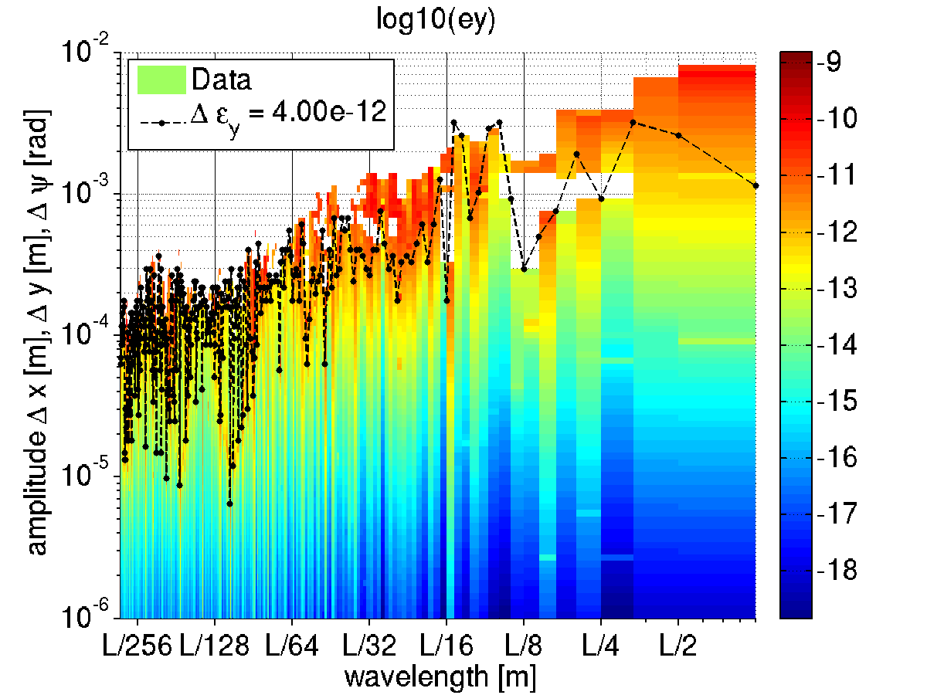
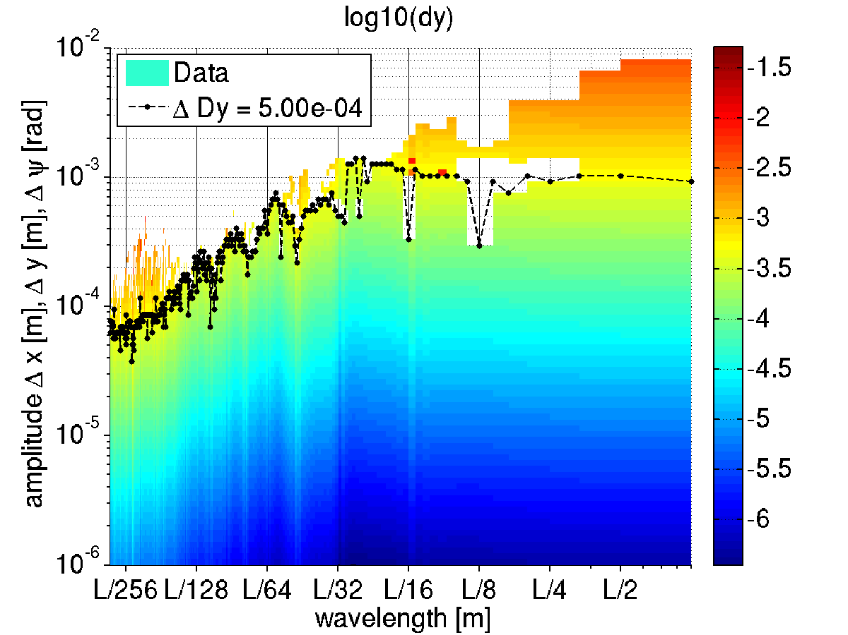
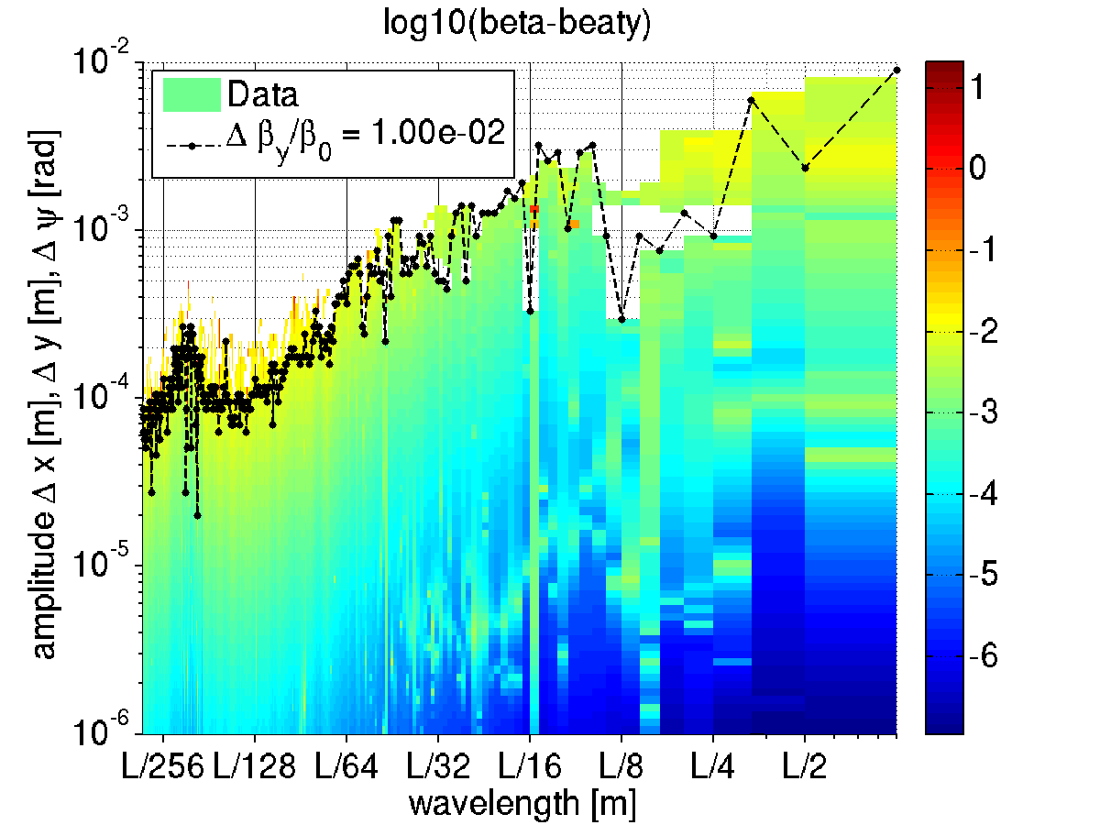
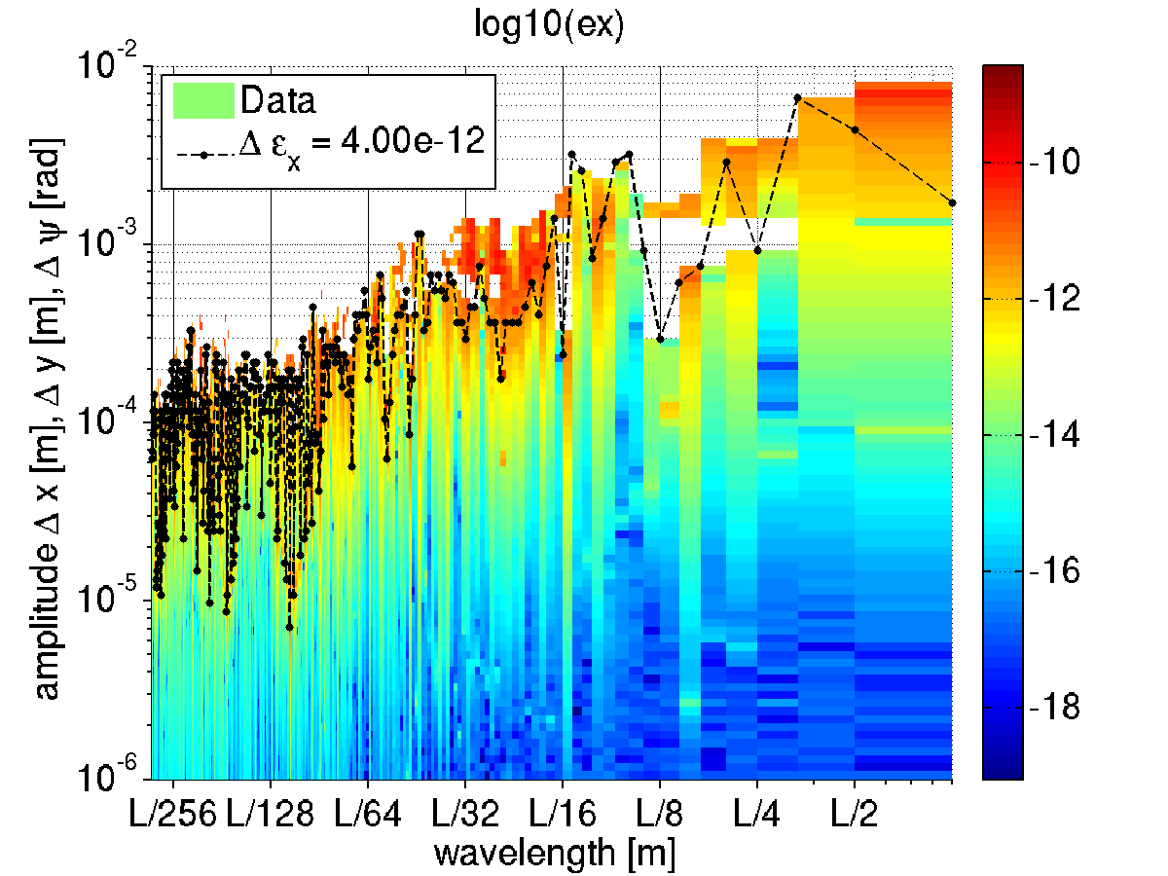
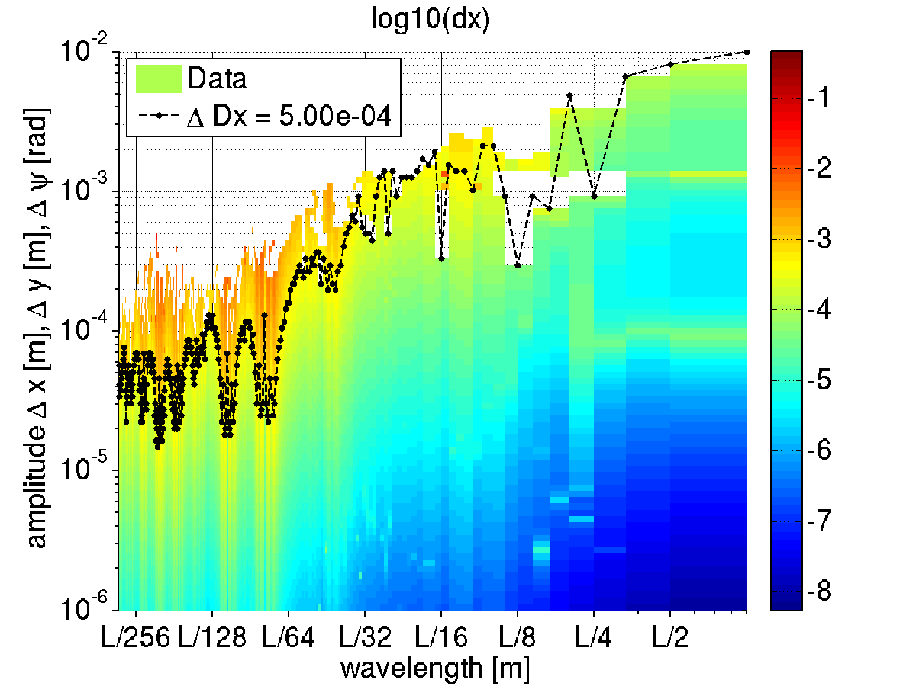
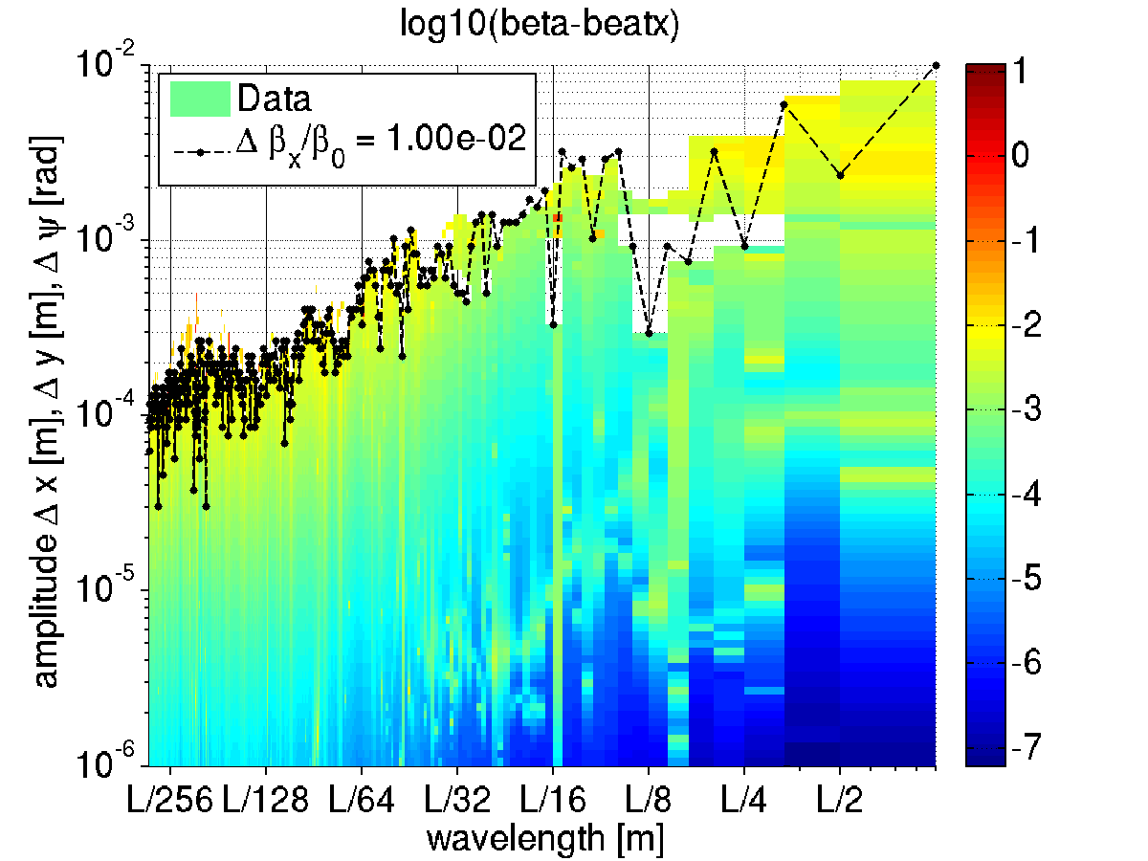
Emittance, dispersion and beta-beating vs wavelength
How
GIRDER
tolerances were excluded

Slide 16
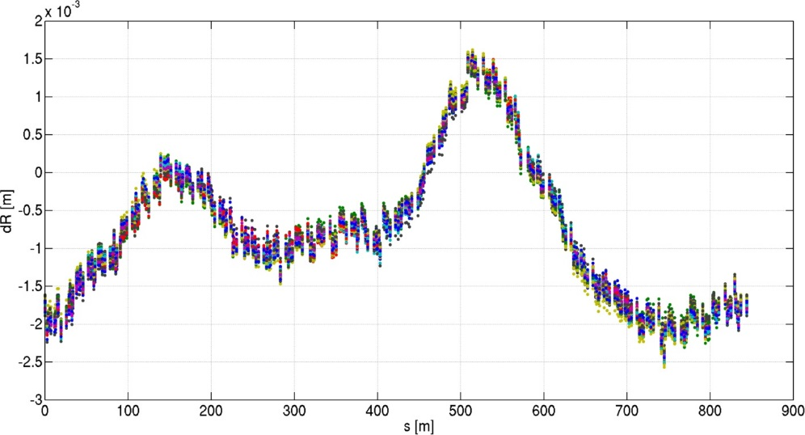
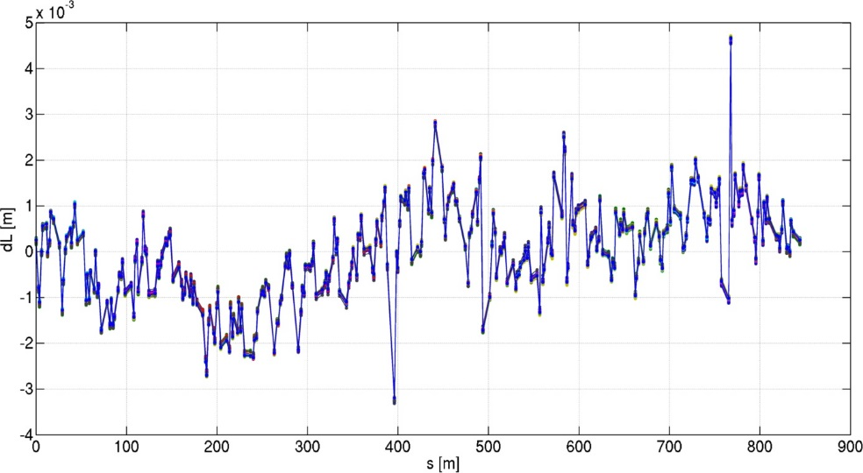
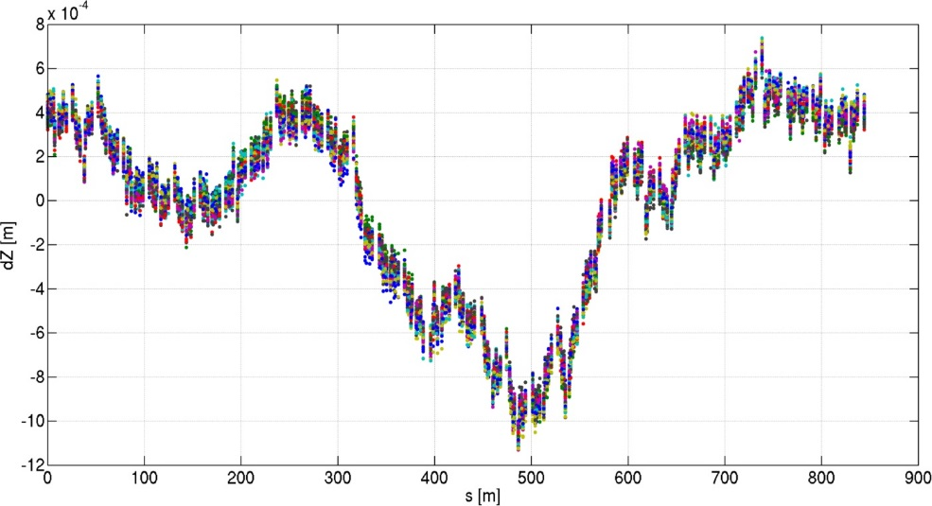
Simulated survey errors current positions (from ALGE group)
How
GIRDER
tolerances were excluded
WHERE WILL THE SR BE
if we remove it and reinstall it?
horizontal
Longitudinal (electrons path)
50 cases
DATA from ALIGNMENT GROUP
Simulated survey errors about the current position of the lattice.
Rotations are random, but for a 21urad systematic outward tilt.
Data provided in 320 points for the current lattice.
vertical
26/07/2013

Slide 17
Dynamic aperture and lifetime
How
GIRDER
tolerances were excluded
The above curves are interpolated to set the errors in the S28A lattice.
On the blue curve
nominal
current
Lifetime: 16.6h
range:[16.4 17.1]
MEASURED SURVEY + simulated alignment errors
SET IN THE LATTICE
AND TESTED FOR DA/LIFETIME AFTER CORRECTION
TARGET
-10mm (-8.1mm @S3)
26/07/2013

Slide 18
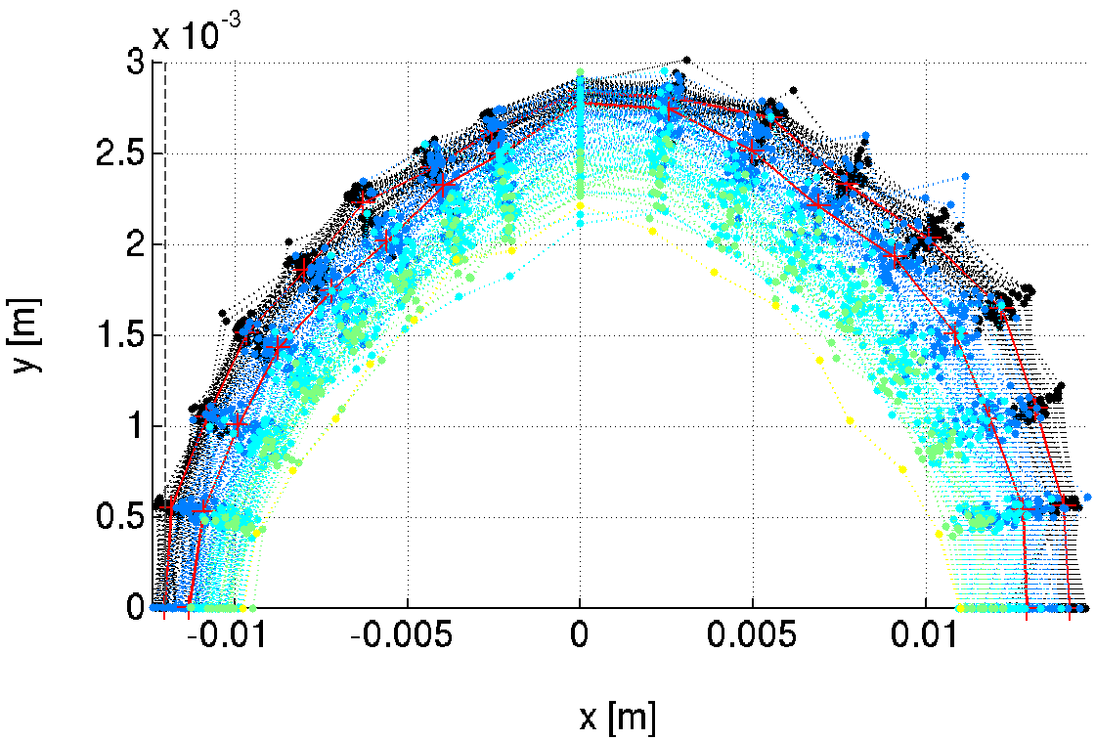
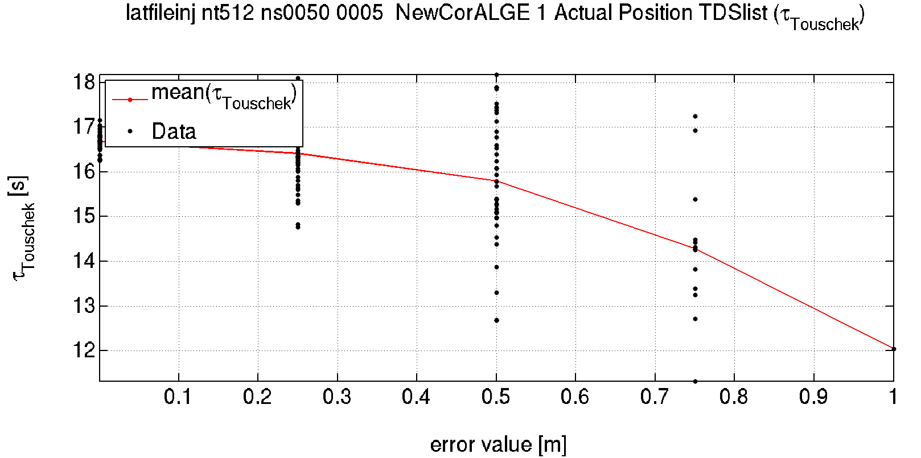
Additional Random errors
How
GIRDER
tolerances were excluded
Additional random errors are still required to describe the error on the position of the magnetic centers of the magnets.
Increasing random errors
Lifetime goes from 16.6h to about 12h with many lost seeds and increasing range.
TARGET
-10mm (-8.1mm @S3)
As above + RANDOM ERRORS SET IN THE LATTICE
AND TESTED FOR DA/LIFETIME AFTER CORRECTION

Slide 19
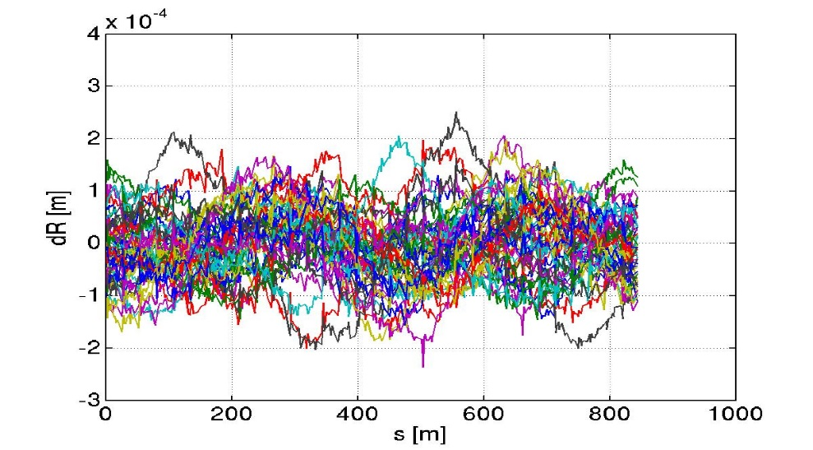
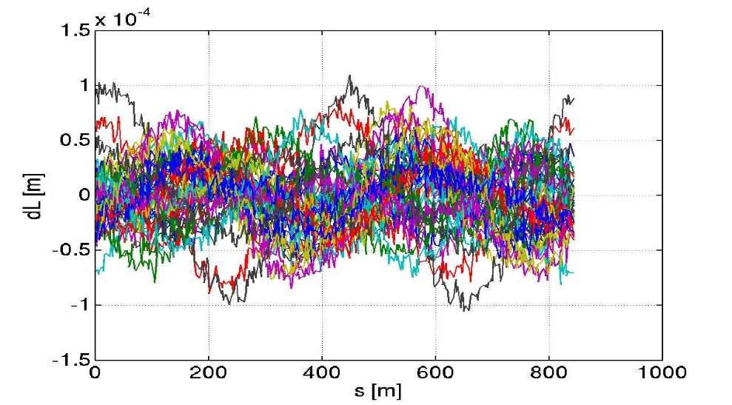
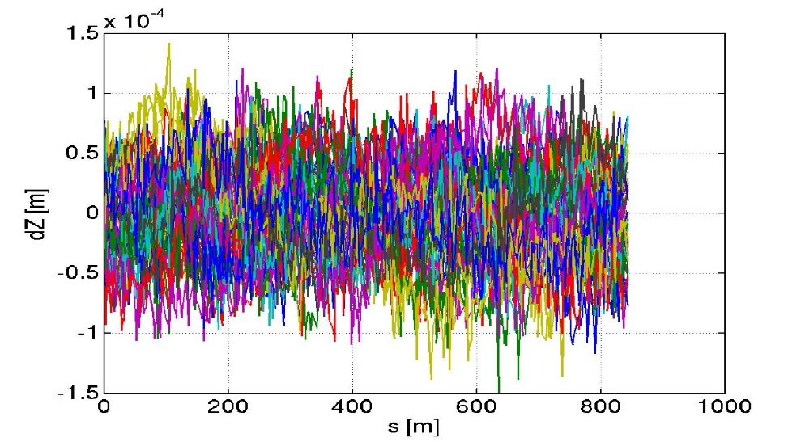
Simulated survey errors nominal positions (from ALGE group)
How
GIRDER
tolerances were excluded
horizontal
Longitudinal (electrons path)
Simulated survey errors about the nominal position of the lattice.
Rotations are random, but for a 21urad systematic outward tilt.
Data provided in 320 points for the current lattice.
vertical
PREVIOUS

Slide 20
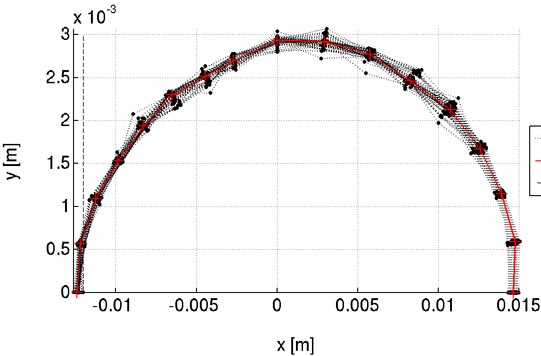
Dynamic aperture and lifetime
How
GIRDER
tolerances were excluded
The above curves are interpolated to set the errors in the S28A lattice.
On the red curve
nominal
current
Lifetime: 16.7h
range:[16.6 17]
IDEAL SURVEY SET IN THE LATTICE
AND TESTED FOR DA/LIFETIME AFTER CORRECTION
TARGET
-10mm (-8.1mm @S3)

Slide 21
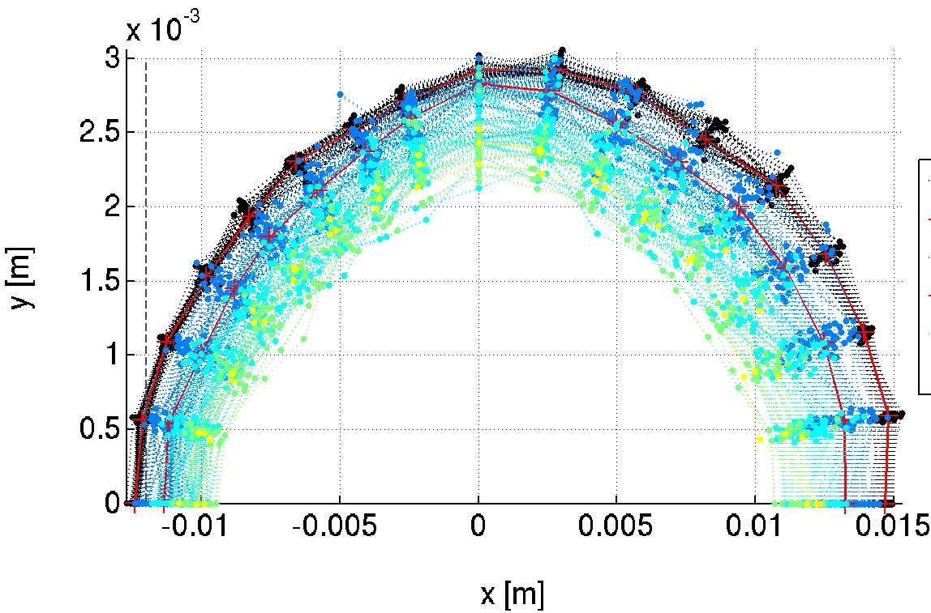
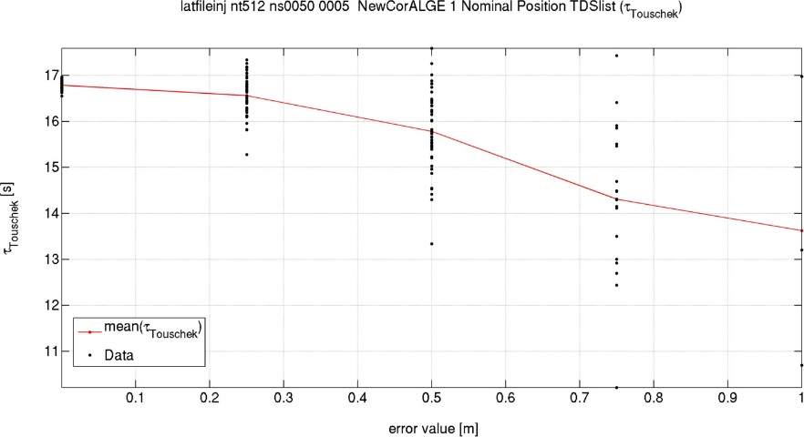
Additional Random errors
How
GIRDER
tolerances were excluded
Additional random errors are still required to describe the error on the position of the magnetic centers of the magnets.
Increasing errors
Lifetime goes from 16.7h to about 13h with many lost seeds and increasing range.
TARGET
-10mm (-8.1mm @S3)
IDEAL SURVEY + RANDOM ERRORS SET IN THE LATTICE
AND TESTED FOR DA/LIFETIME AFTER CORRECTION

Slide 22
In practice
Conclusion
We have no specific beam dynamics interest in the girder-girder tolerance themselves.
Those are not precisely defined among different groups and may lead to lack of understanding.
From beam dynamics, we can say that: large, slow, smooth, variations of position are not detrimental.
From a beam dynamics point of view, as long as magnet-magnet tolerances (actually, single magnets rms position errors) are achieved at every location in the machine, including between magnets standing on neighboring girders, we will get the foreseen Dynamic Aperture and LIFETIME.
We let the alignment group decide how to achieve this requirement.
For ESRF-EBS It worked extremely well, largely exceeding expectations/simulations.
From steerers/orbit data
Achieved magnet-to-magnet
25-40 μm
Expected magnet-to-magnet
60-70 μm
rms DX DY
alignment
In order to model the lattice at the location where it will be installed, we included in all “predictive” (DA, LT, IE,etc) simulations the Simulated Survey Position provided by the alignment group.
This may be usefull also for maximum correctors strength evaluation, and/or definition of Beamlines alignment strategies.

Slide 23
Tolerable random errors
Conclusion
Each error, on each magnet family, is studied individually looking at the dependence of DA, lifetime, emittances and all relevant parameters vs error amplitude.
Required: | DX | DY | DS | DPSI | DK
 | μm | μm | μm | μrad | 10^-4
DL | >100 | >100 | 1000 | 500 | 10
DQ, QF[68] | 70 | 50 | 500 | 200 | 5
Q[DF][1-5] | 100 | 85 | 500 | 500 | 5
SFD | 70 | 50 | 500 | 1000 | 35
OF | 100 | 100 | 500 | 1000
To answer the question:
What girder-girder tolerances did you use?
60
Many simulations for 1 number needed
GIRDERS
Survey simulations or SAME AS worst case MAGNET-MAGNET
Sextupoles and high gradient quadrupoles are the most relevant limitations, nevertheless, this alignment specifications are currently achievable.
(DX=DY=60μm, 84 μm between two magnets).

Slide 24
conclusions
The definition of alignment tolerance can be done in a quasi deterministic way, to give relative impact on final parameters of each source of errors. Finally this is NOT directly usefull for alignment. Unless some specification is really demanding, everything will be alignment to the minimum value found: one single number.
Running Girder-to-girder simulations is also not really useful. For compact machines girder-to-girder is the same as magnet-to-magnet. Using simulated Survey data is more realistic, simpler and efficient.
Large, slow, SR position variations are not an issue for beam dynamics. Magnet to magnet is what really counts.
For upgrade project using the measured positions of the SR and hypothetical positions after dismantling and reinstallation, shares well the contribution of alignment and magnet center fiducialization error sources. Simulations of the measured survey may be included in the model simply, sparing a lot of time and effort, and simplifying the communication among colleagues.

Slide 25
BACKUP

Slide 26
Comparable tolerance table
How tolerances were defined
This table provides a deterministic way to compare error impact on lattices.
It is used also to asses the performances of correction schemes and correction algorithms
Further reduction of this data is needed to provide a tolerance table.

Slide 27
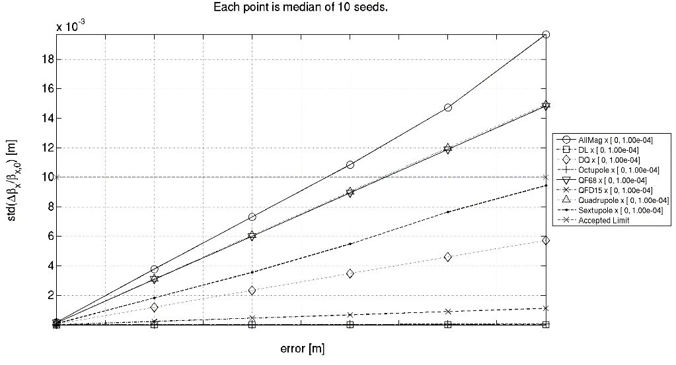
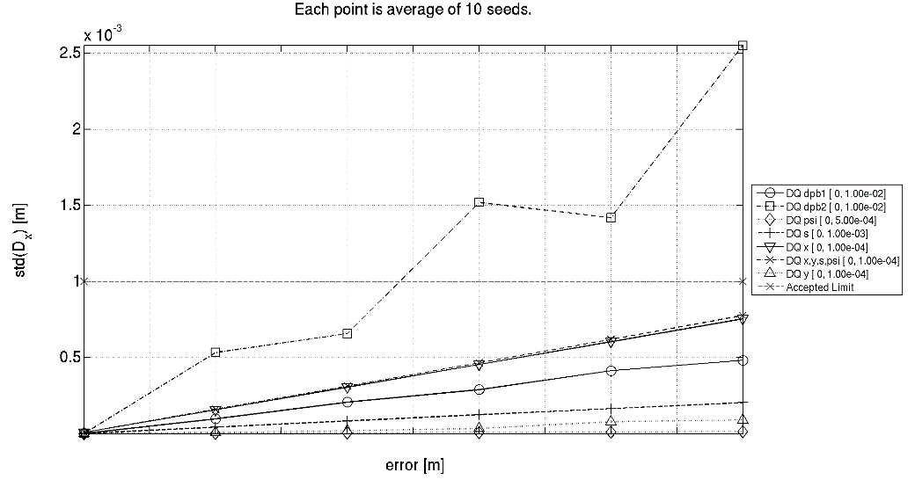
definition of a List of tolerable errors
How tolerances were defined
Compare magnet groups for the same error
Compare error sources for the same magnet group
beta beating = 1%
Hor. Disp. = 1mm
Tolerated errors

Slide 28
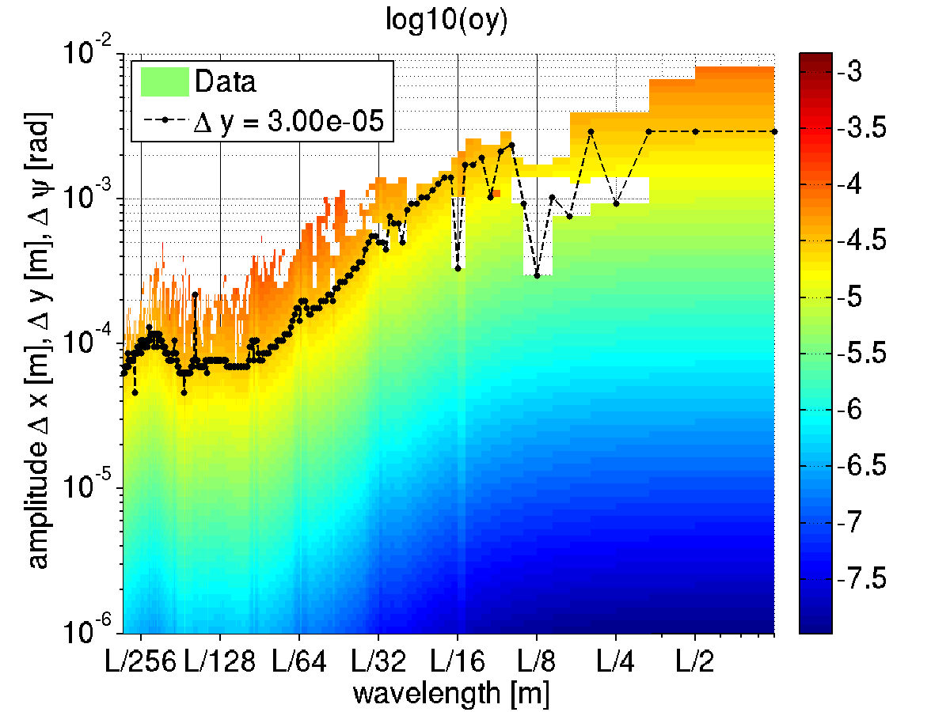
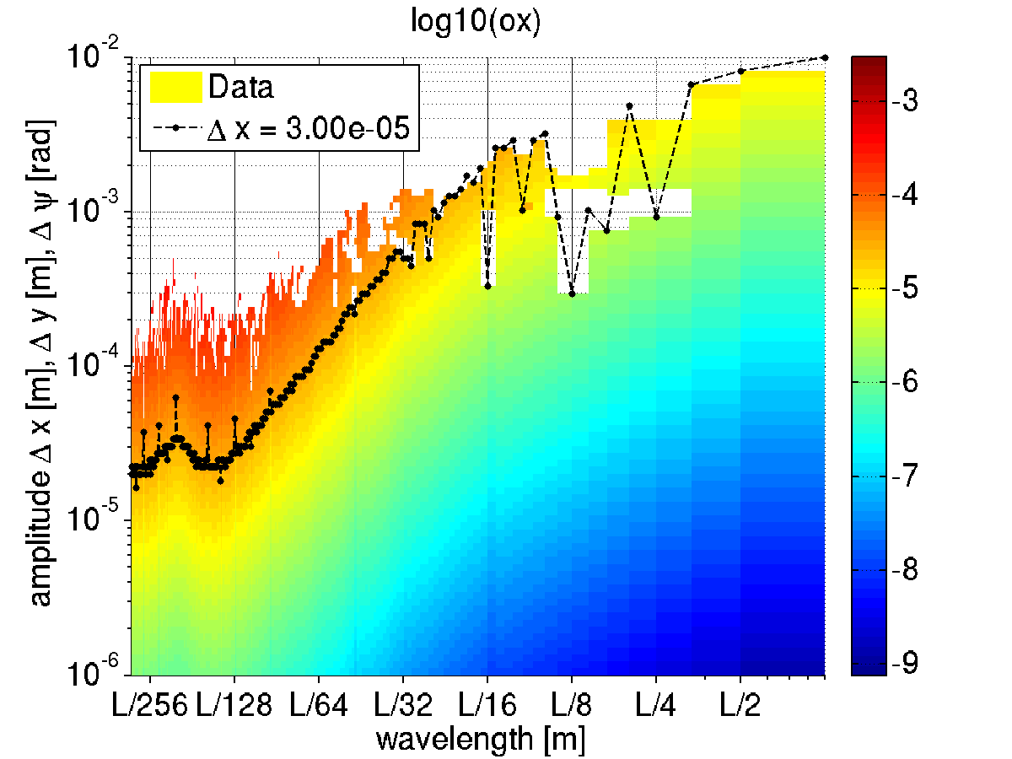
error amplitude giving 30um orbit after correction vs wavelength
Amplitude is X, Y and rotation about s (rad) simultaneously

Slide 29
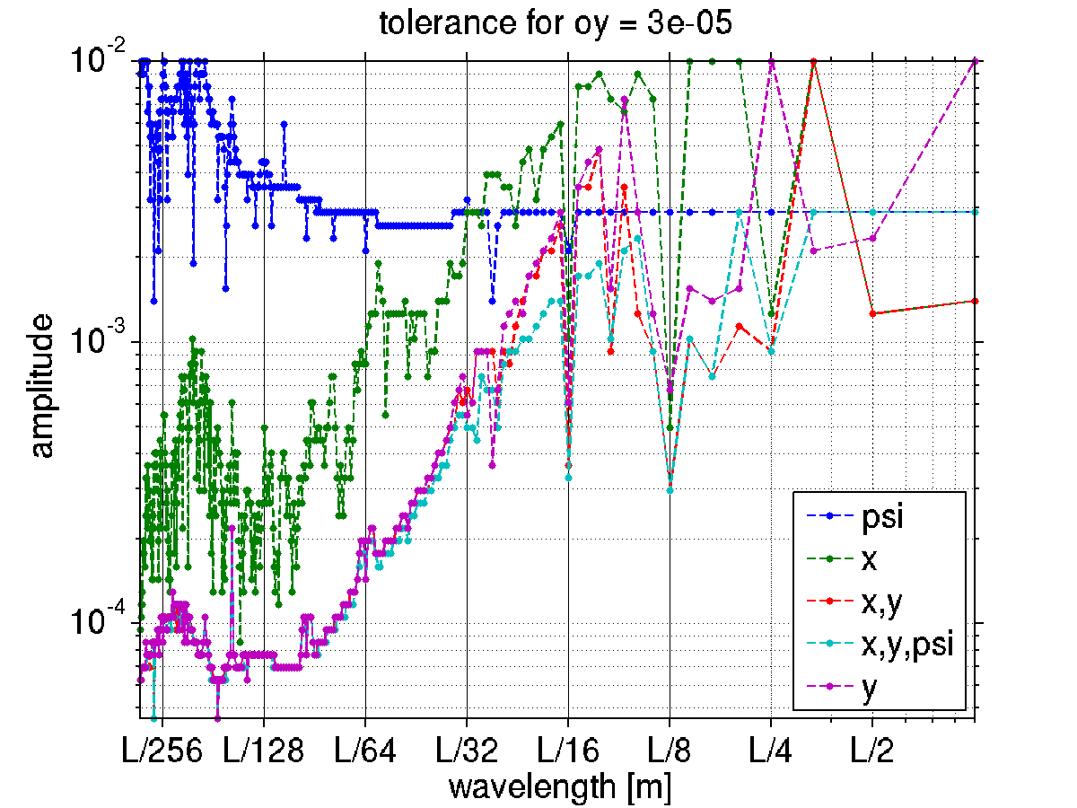
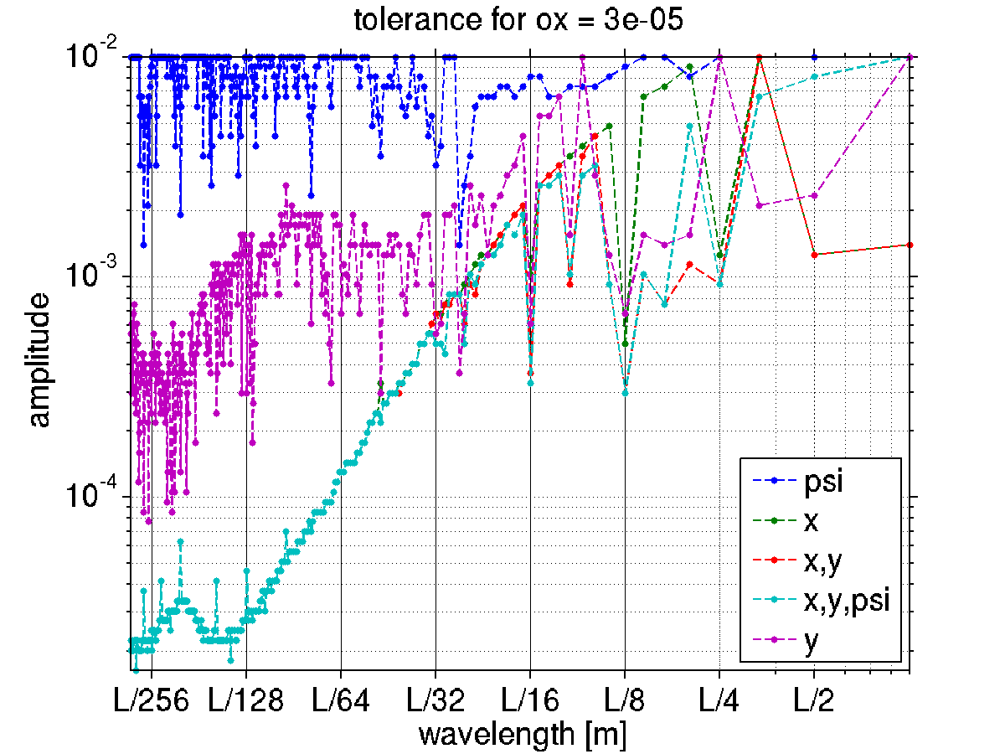
Comparison of various Error Sources to obtain 30 um orbit

Slide 30
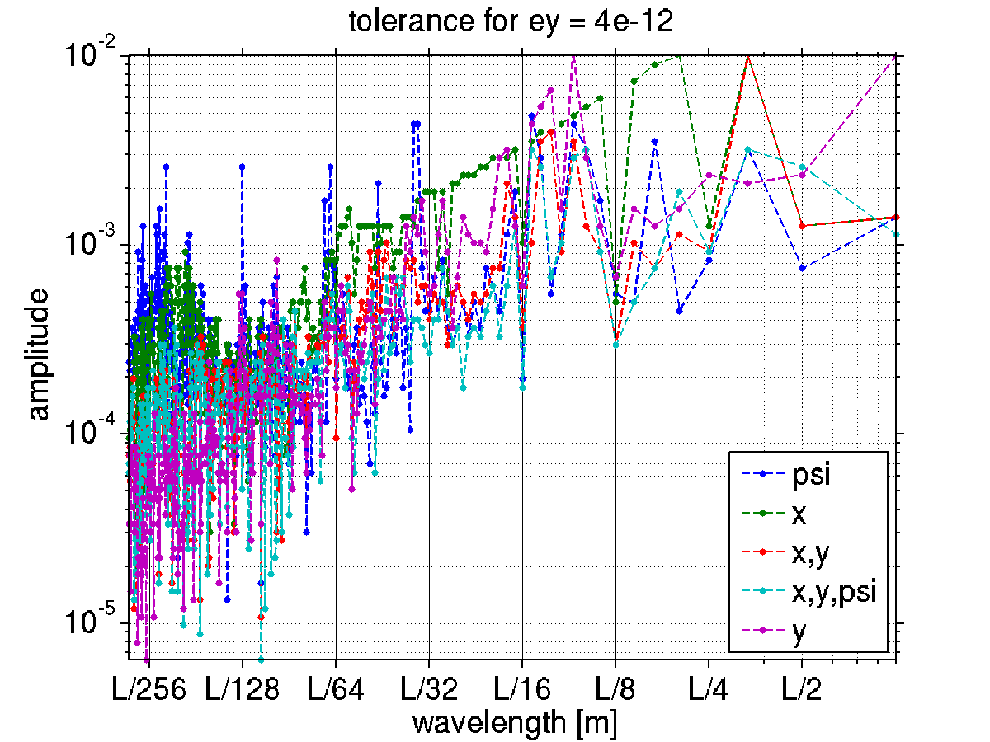
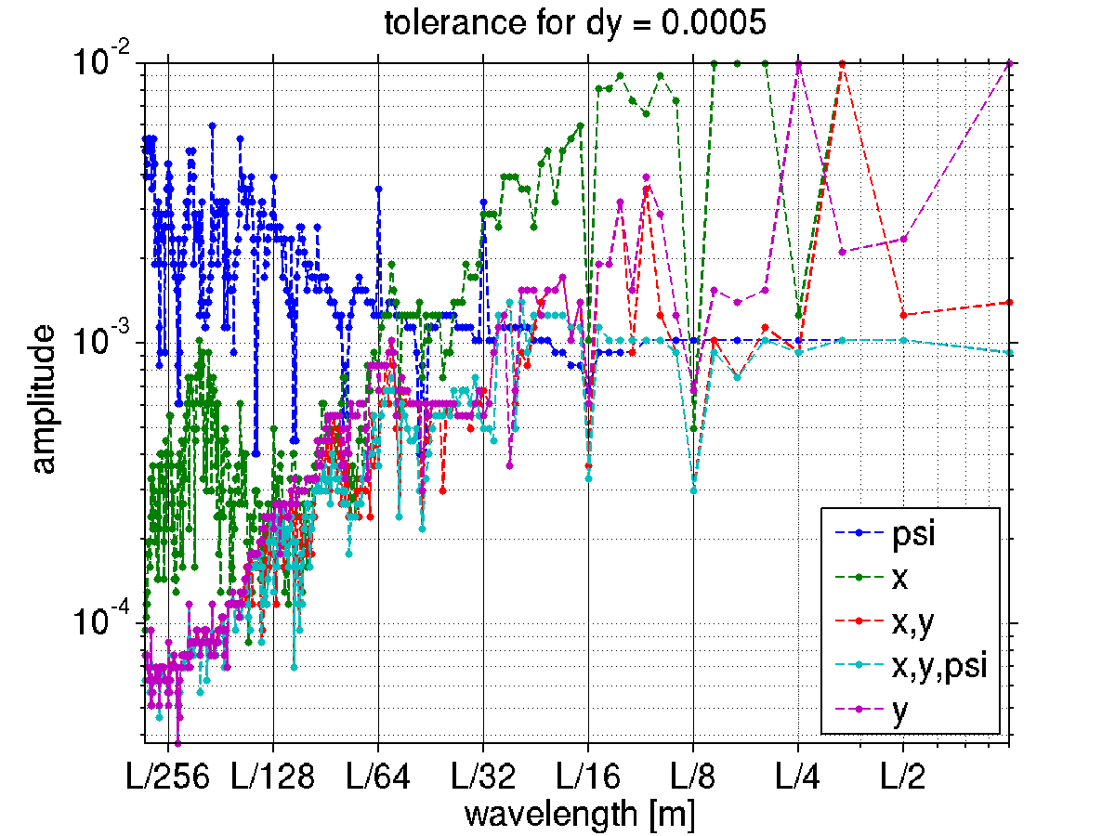
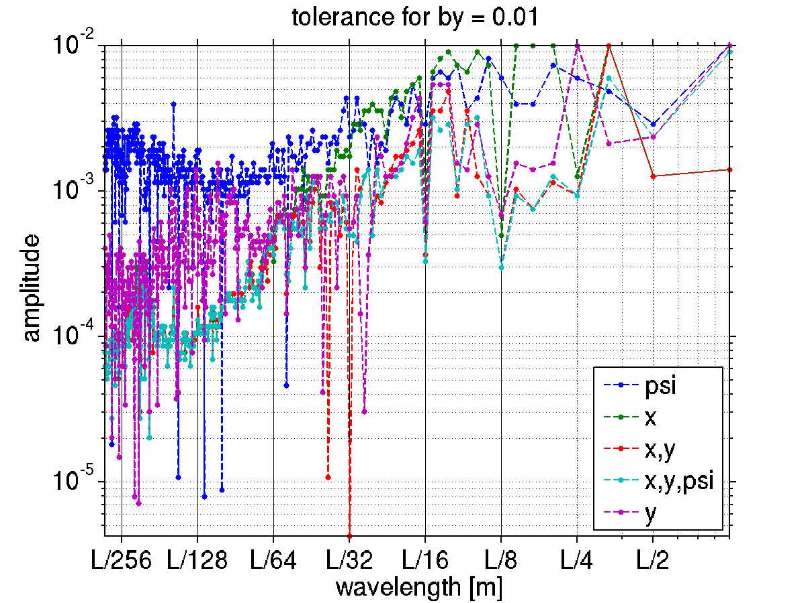
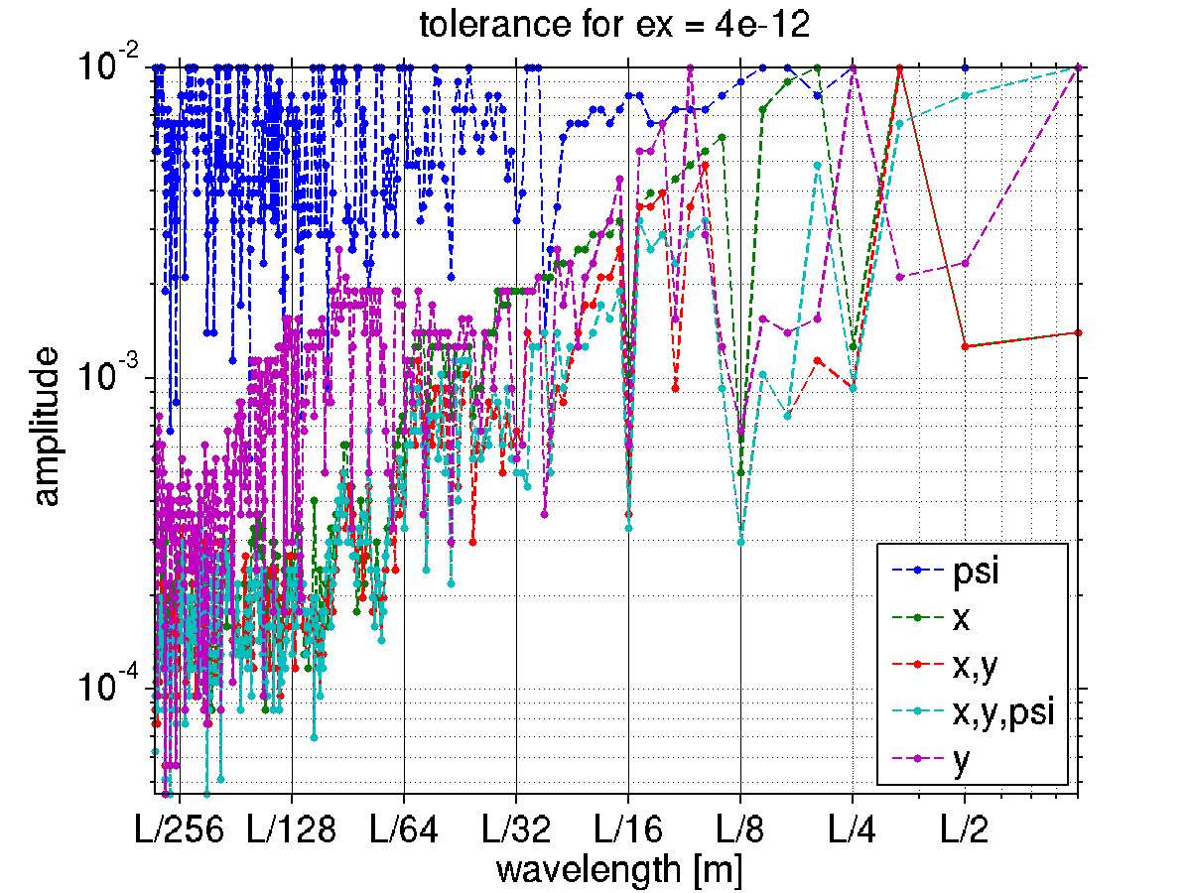
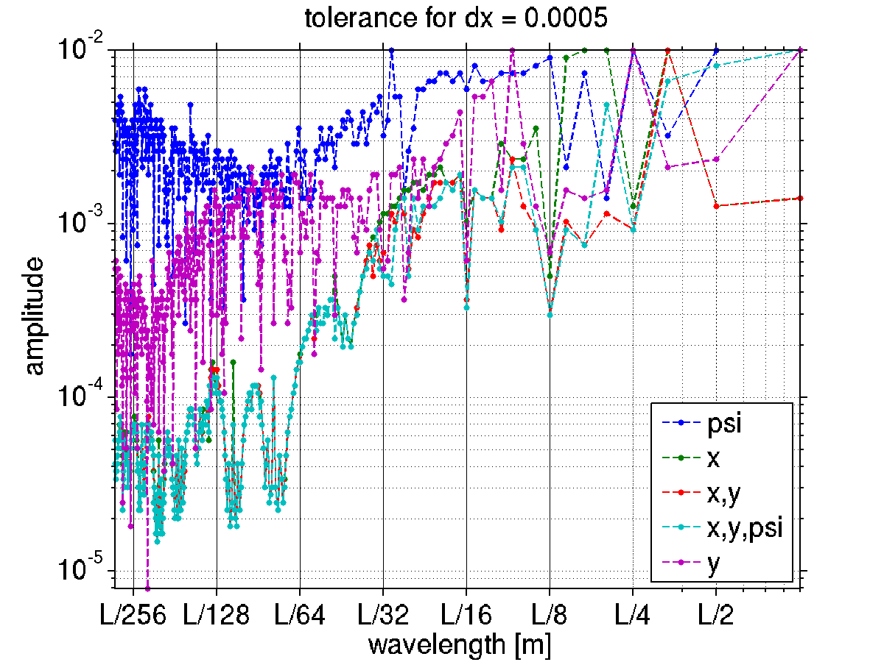
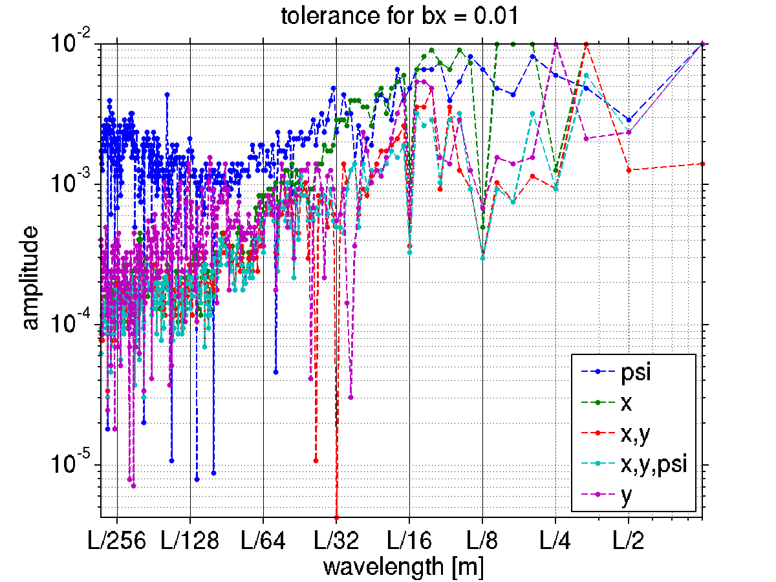
Comparison of various Error Sources (other parameters)

Slide 31
Girder to girder: an historical exchange after >2 years of simulations
Dear Alignment group colleagues,
we would like the girders to have an alignment error of
78.656 μm rms in the X plane
73.421 μm rms in the Y plane
Thank you
Best regards
Beam Dynamics people
Dear Beam Dynamics colleagues,
What do you mean?
2 girders one at the injection and one on the opposite side of the SR should be aligned within 75 μm?
We think it would be better to meet and discuss.
Could you give us the tolerated alignment envelope over 10cm, 1m, 10m, 100m, 1km?
By the way, X for us is the longitudinal direction.
Thank you
Best regards
Alignment people
Dear Alignment colleagues,
Indeed, we would appreciate a meeting on the topic.
Best regards
Beam Dynamics people
In purpose missing “Thank you”

Slide 32
Girder to girder: an historical exchange after >2 years of simulations
Dear Alignment group colleagues,
we would like the girders to have an alignment error of
78.656 μm rms in the X plane
73.421 μm rms in the Y plane
Thank you
Best regards
Beam Dynamics people
Dear Beam Dynamics colleagues,
What do you mean?
2 girders one at the injection and one on the opposite side of the SR should be aligned within 75 μm?
We think it would be better to meet and discuss.
Could you give us the tolerated alignment envelope over 10cm, 1m, 10m, 100m, 1km?
By the way, X for us is the longitudinal direction.
Thank you
Best regards
Alignment people
Lesson learnt:
TALK TO YOUR COLLEAGUES BEFORE RUNNING YEARS OF SIMULATIONS
Dear Alignment colleagues,
Indeed, we would appreciate a meeting on the topic.
Best regards
Beam Dynamics people
In purpose missing “Thank you”

Slide 33
Girder to girder: an historical exchange after >1month of simulations
Dear Alignment group colleagues,
we would like the girders to have an alignment error in the transverse plane with
L/1-L/8 wavelengths and up to 2mm amplitude on a closed trajectory.
Thank you
Best regards
Beam Dynamics people
Dear Beam Dynamics colleagues,
What do you mean?
What do you mean by “wavelength”?
We think it would be better to meet and discuss.
Could you give us the tolerated girder-to-girder alignment envelope over 10cm, 1m, 10m, 100m, 1km?
What about the longitudinal direction, X?
Thank you
Best regards
Alignment people
Dear Alignment colleagues,
Indeed, we would appreciate a meeting on the topic.
Beam Dynamics people
In purpose missing “Thank you”
In purpose missing “best regards”

Slide 34
Girder to girder: an historical exchange after >1month of simulations
Dear Alignment group colleagues,
we would like the girders to have an alignment error in the transverse plane with
L/1-L/8 wavelengths and up to 2mm amplitude on a closed trajectory.
Thank you
Best regards
Beam Dynamics people
Dear Beam Dynamics colleagues,
What do you mean?
What do you mean for “wavelength”?
We think it would be better to meet and discuss.
Could you give us the tolerated girder-to-girder alignment envelope over 10cm, 1m, 10m, 100m, 1km?
What about the longitudinal direction, X?
Thank you
Best regards
Alignment people
Lesson learnt:
speak the same language or
find an interpret or
first ask the right question.
Dear Alignment colleagues,
Indeed, we would appreciate a meeting on the topic.
Beam Dynamics people
In purpose missing “Thank you”
In purpose missing “best regards”

