Slide 1
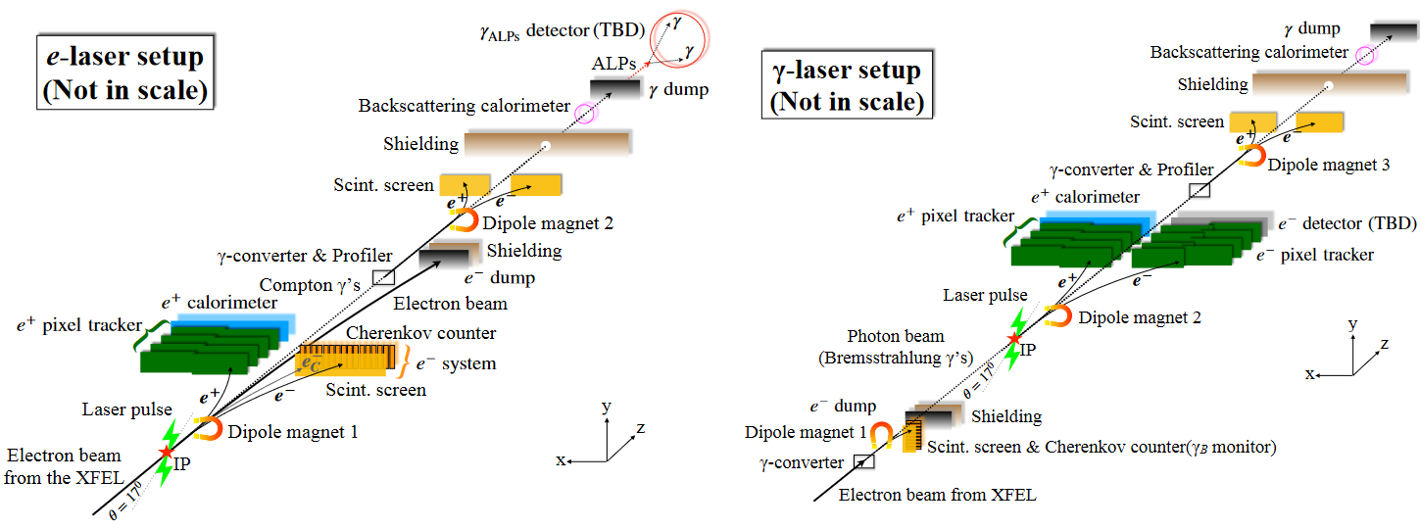
Sapphire sensors for LUXE Gamma Beam Profiler

Slide 2
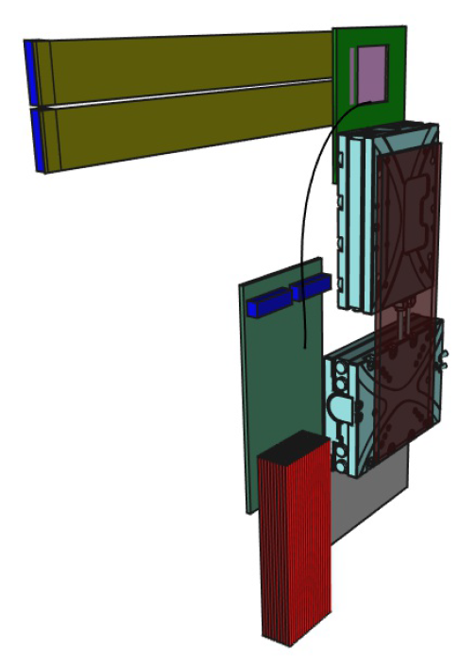
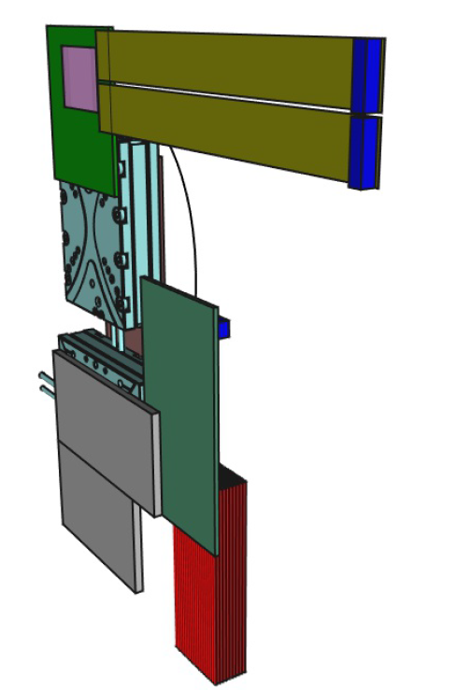
Gamma Beam Profiler Station (1 sensor per station)
Sapphire Sensor
Sensor frame
Connectors
Connection plate
(movable)
Flex Kapton cables
Piezo motors
Patch panel
Support plate
(fixed)
~2-3 m
or ~30 m
to Control
room
Coaxial cables (Kapton ø1.2 mm)

Slide 3
Gamma Beam Profilometer
Min 2 cm
Beam
X
Y
+Shielding box
with thin windows
for the beam
(2x Kapton 5 μm)
~2.5 m
Station cables
Patch-box
Cables to Control room
Floor

Slide 4
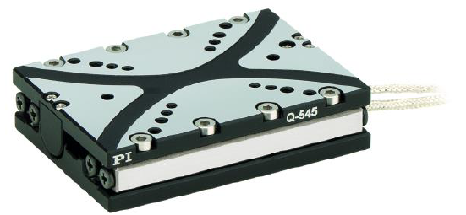
Physik Instrumente (PI)
www.pi.ws
https://www.physikinstrumente.com
Q-545.240
Drive force 7 N
Travel range 26 mm
Incremental sensor with nanometer position resolution
Maximal velocity 8 mm/s
Minimal incremental motion 6 nm
Bidirectional repeatability 200 nm
Cable length 2 m
Q-545.240
Q-Motion® Linear stage, piezoelectric inertia drive, 26 mm travel range, linear encoder, 1 nm resolution, 7 N drive force, dimensions 45 × 63 × 15 mm (W × L × H)
Physik Instrumente (PI) GmbH & Co. KG
Auf der Roemerstrasse 1 76228 Karlsruhe Germany

Slide 5
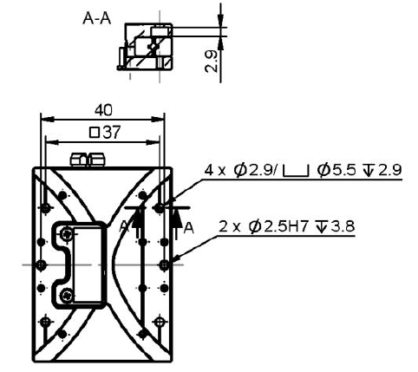
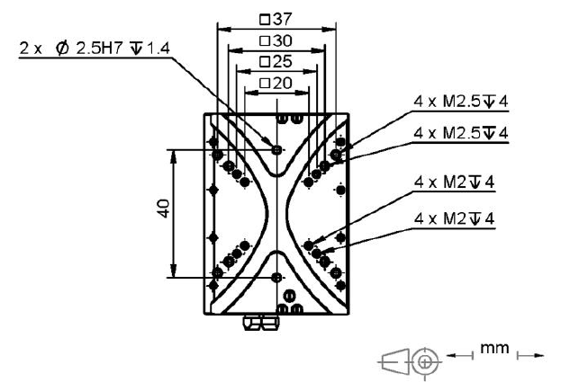
Q-545.240

Slide 6
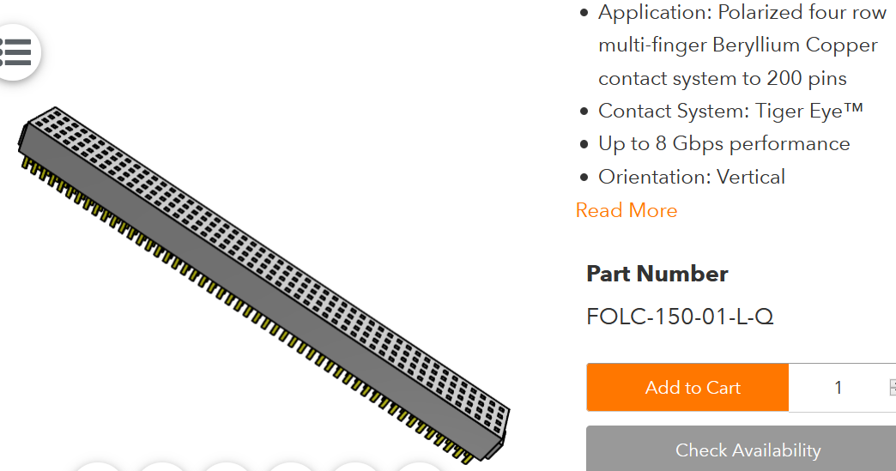
All connectors from
SAMTEC
Pitch 1.27 mm
100 Kapton ø1.2 mm
Coaxial cables

Slide 7
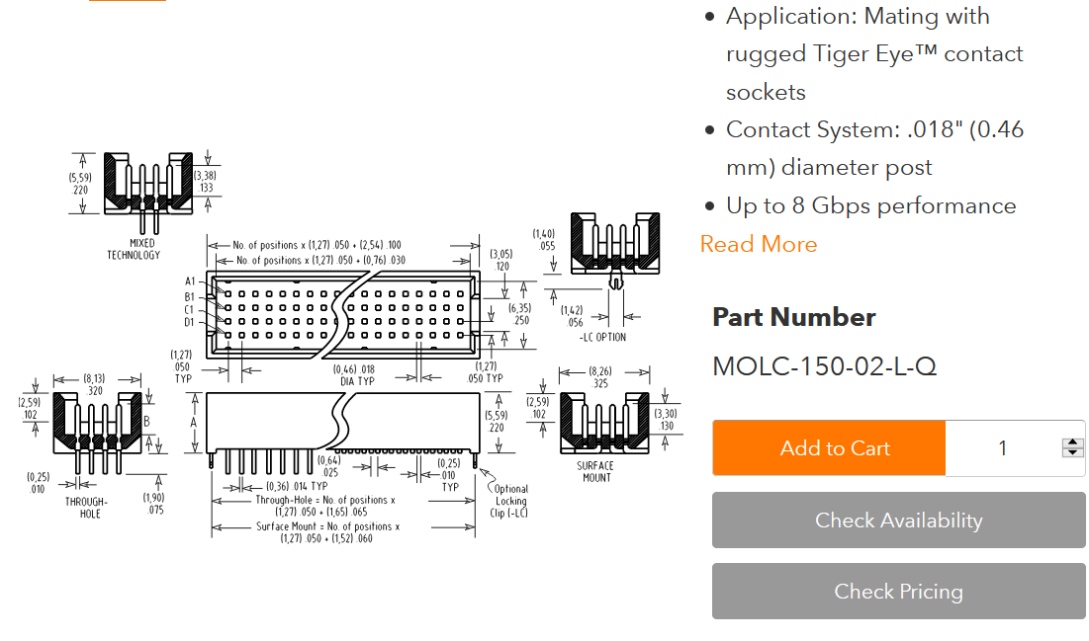
R/O electronics (or Patch-panel 2)
Signal inputs

Slide 8
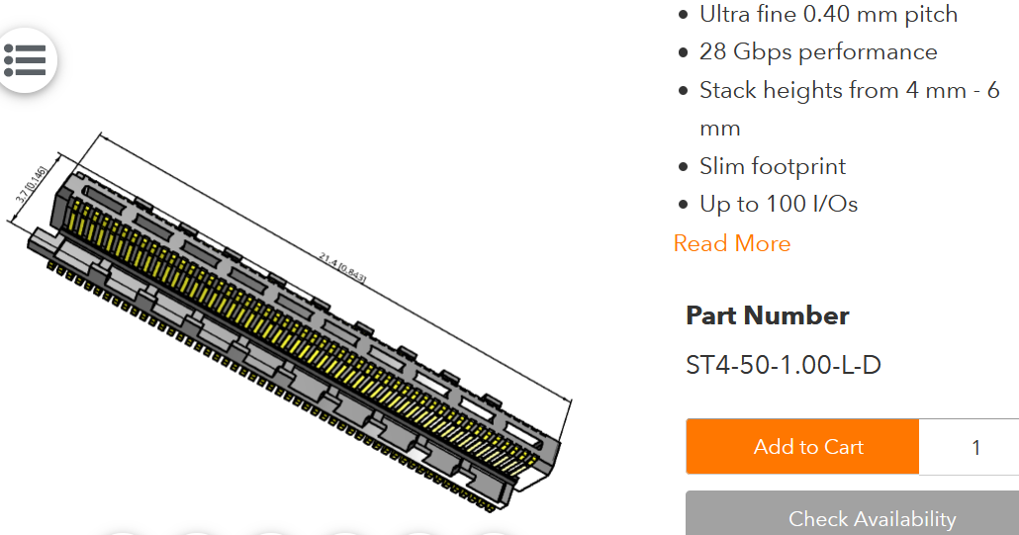
SAMTEC micro-pitch
Patch-panel 1
For flex Kapton cables

Slide 9
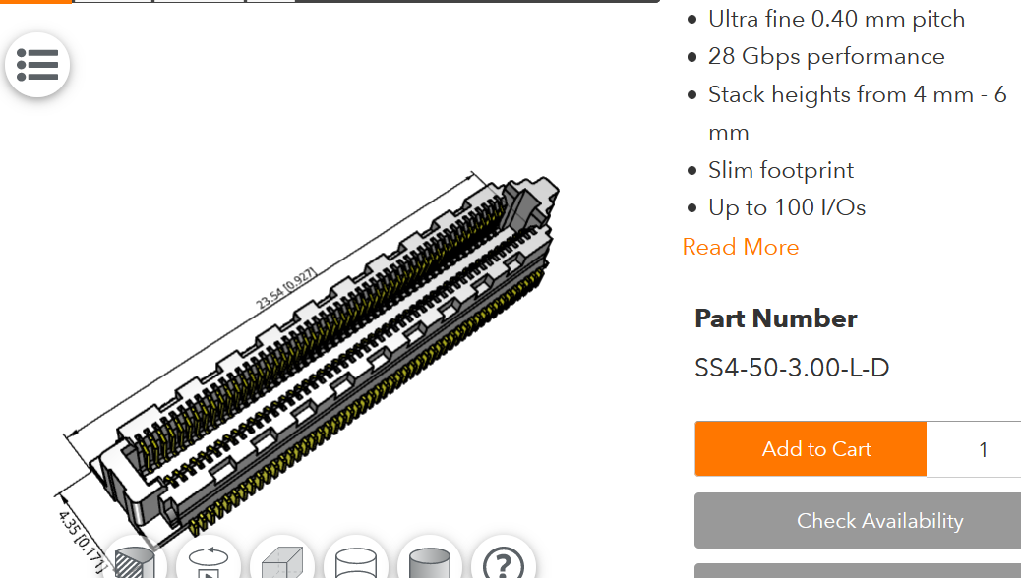
SAMTEC micro-pitch
Flexible Kapton cables

