Slide 1
General Info
M. Bruschi (INFN Bologna)

Slide 2
Next appointments
Next week: PRC meeting May 4th /5th
Decision by DESY directorate expected by end of this summer
Presentation to the INFN CSN1 (funding agency) on May 18th

Slide 3
Cable attenuation
30 m
Vin=1.6 Volt, 10 ns
Vout=0.68 Volt, ~ 100ns
The readout logic is based on peak stretcher or sample and hold
Probably a signal loss of factor ~ 2-2.5 should be considered (worsening of S/N must be measured)
The cost from the company is appealing:
750 euro (64 channels, 30 m) → total of 4500 euros for 3+3 cards (High Speed Interconnection company)

Slide 4
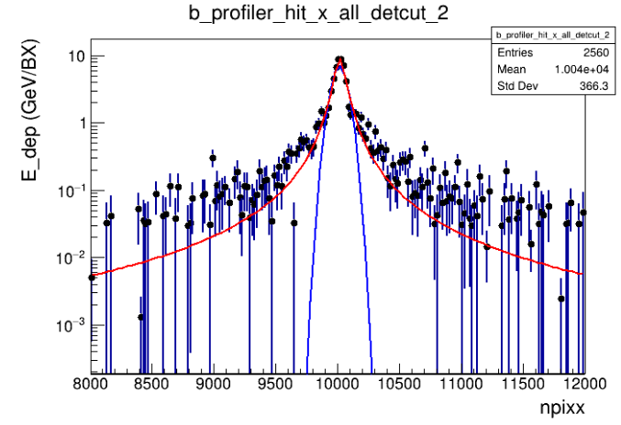
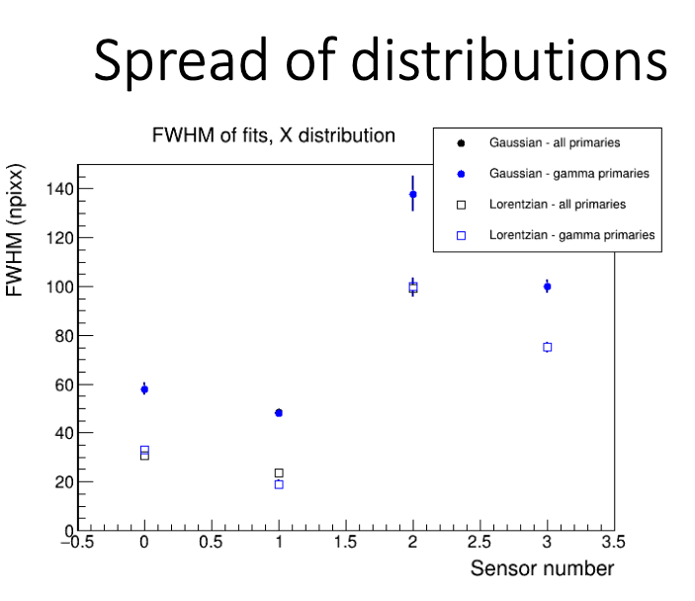
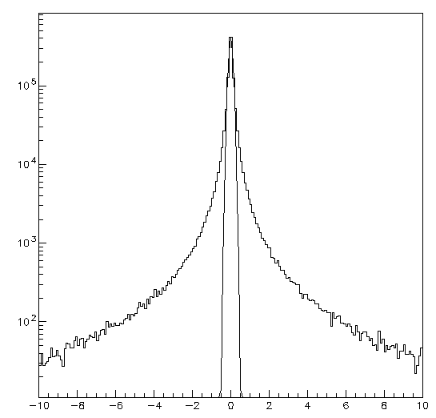
Method verification with Lorentz-Cauchy
D=6.7 m
D=11.8 m
Full G4 simulation from Kyle’s studies
FWHM (1st plane):30 npixx=0.150 mm
γ_{X}=FWHM/2=0.075 mm
X (mm)
γ_{x}=0.075 mm
σ_{x}(gaus)=0.111 mm
FWHM (gaus)=0.260 mm=52 npixx
Extrapolation to D=11.8 m → γ_{x}=0.130 mm

Slide 5
To be discussed at the next meeting on 05/10
inputs for the design of the mechanics
Quality test procedures for the sapphire wafers
Readout electronics positioning
Number of stations necessary (in the CDR they are 2, can we drop one with the new beam line?)
MC digitization
Others?

Slide 6
Questions for mechanics

Slide 7
Backup

Slide 8
Table of Risks
The table has been updated for the meeting with PRC
The table can be still changed
Please read carefully and send your comments

Slide 9
Timeline
The table has been updated for the meeting with PRC
Please read carefully and send your comments

Slide 10
Clean Room
LUXE TC asked for the need of a clean room
Apparently the situation is now frozen at DESY due to COVID emergency
How do we deal with this for the first tests at DESY on the delivered wafers?
The situation should change from 2023 (spaces will be allocated for us probably in XS1)
In any case we should formulate very soon a plan for our needs (area, facilities ...)

Slide 11
Test Beam
Tests will start in 2022
A plan should be made and start to contact the TB facilities
ELBE/FRASCATI/XFEL/RAL
Probably some inputs will come from today’s discussion

Slide 12
GBP collaboration tasks
Detector
Procurement (DESY, U. TOMSK, INFN PD)
Production (TOMSK)
Design and Integration (DESY, BELFAST, PD, BO, TOMSK)
Tests
Characterization in the lab (DESY, PD, BELFAST –laser tests at RAL-)
CCE uniformity (DESY, PD, TOMSK)
Test Beam (DESY, BO, PD, TOMSK, BELFAST)
Mechanics (PD)
Design (DESY, PD System Eng.)
Production
Tests, Commissioning
Electronics (BO)
Design
Production
Tests, Commissioning
Data Acquisition (milestones in the readout talk)
Slow control
HV,LV
Table movements (PD)
Calibrations (BO)
Data Quality (DESY, PhD)
MC
Detector performances (PD –PhD-, BELFAST)
Stand Alone
LUXE
Data Analysis (DESY, PhD, BELFAST)

Slide 13
Some thoughts about the measurement

Slide 15
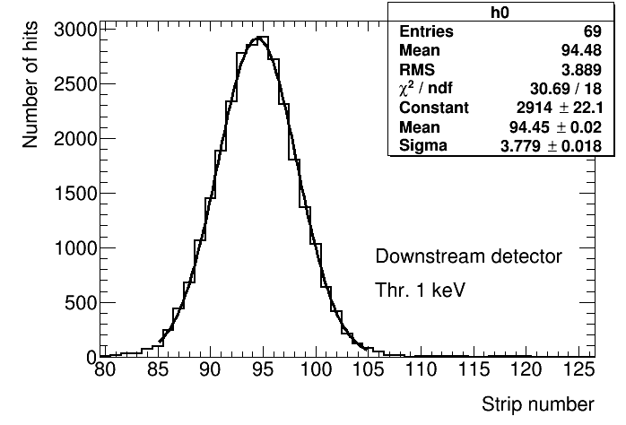
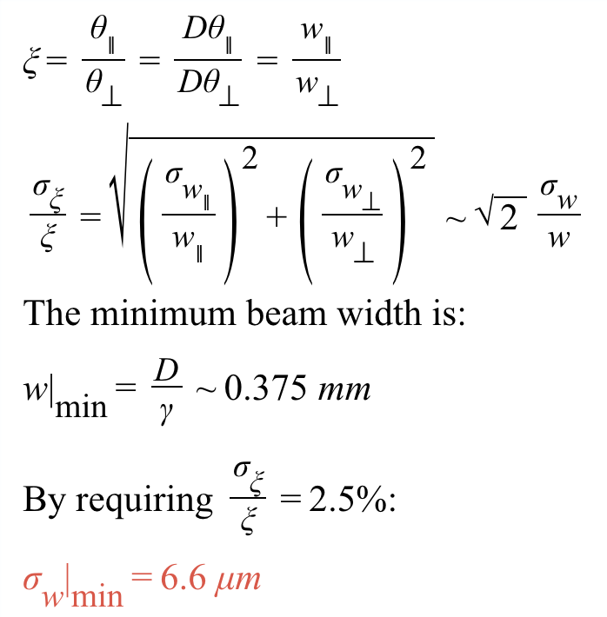
Precision on ξ
With Nγ=10⁷ (conservative)→ σ_{w|min}=1.8 μm
Simulation must be improved
Full simulation
Electronics noise
Charge collection effects
There is margin to keep σ_{w|min} <5 μm (σ_{ξ}/ξ<2.5%) once all the systematic effects will be included

Slide 16
An alternative approach
How is the beam width defined ?
For a gaussian beam shape the beam width could be defined as
profile standard deviation : σ
profile FWHM: $2\sqrt{2\text{ln}2}σ$
Area/Amplitude: $\sqrt{2π}σ$
In general: beam width $∝σ$
If the X and Y distributions belong to the same class of distribution
the proportionality factor cancels in the ratio
In this case, following the Area/Amplitude definition
$\frac{\frac{A(x)}{Amp(x)}}{\frac{A(y)}{Amp(y)}}=\frac{σ_{x}}{σ_{y}}$
And since A(x)=A(y), finally
$\frac{Amp(y)}{Amp(x)}=\frac{σ_{x}}{σ_{y}}$
Measuring the ratio of the peak amplitudes in the
X and Y strips will provide the value of ξ
The measurement could be in principle precise and many
systematics effects should cancel out
This could be tested with the full G4 simulation

Slide 17
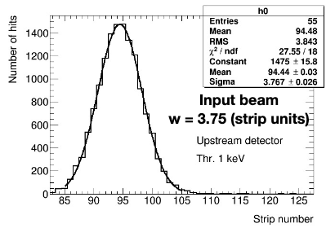
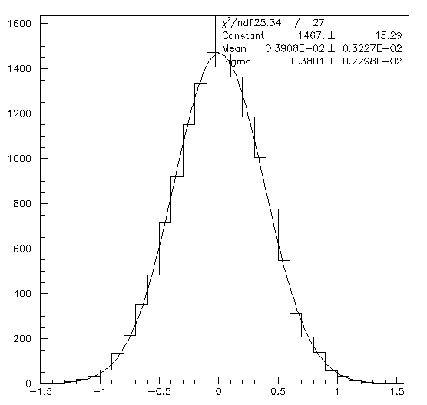
Cross check
Gaussian values (x,y) generated according to σ_{X}=0.375 mm
Agreement found with standalone MC distribution (10E7 gammas with E=5 GeV generated)
Compatible values found for chi2, parameters, and error on parameter
X (mm)

Slide 18
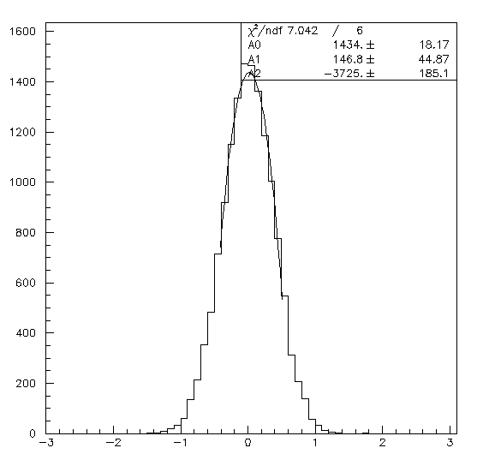
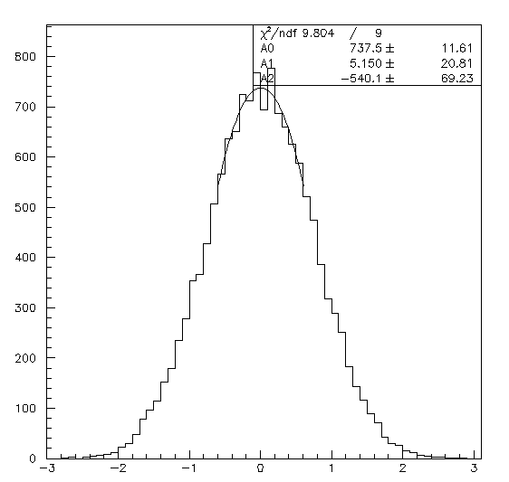
Method verification
Generated Y distribution with σ_{Y}=2 σ_{X}
Fit with parabolic function around the maximum
Simulation: 10E7 gamma, 5 GeV
$\frac{σ_{Y}}{σ_{X}}=\frac{A_{X}}{A_{Y}}=\frac{1434.2 ± 18.2}{737.5 ± 11.6}=1.945±0.039$ (2.0%)
Simulation: 10E9 gamma, 5 GeV
$\frac{σ_{Y}}{σ_{X}}=\frac{A_{X}}{A_{Y}}=\frac{148840±307.3}{74155±116.2}=2.007±0.005$ (0.25%)
X (mm)
The method works if beam is gaussian and σ_{x} > 0.375 mm
Y (mm)

Slide 19
Method verification with Lorentz-Cauchy
D=6.7 m
D=11.8 m
Full G4 simulation from Kyle’s studies
FWHM (1st plane):30 npixx=0.150 mm
γ_{X}=FWHM/2=0.075 mm
X (mm)
γ_{x}=0.075 mm
σ_{x}(gaus)=0.111 mm
FWHM (gaus)=0.260 mm=52 npixx
Extrapolation to D=11.8 m → γ_{x}=0.130 mm

Slide 20
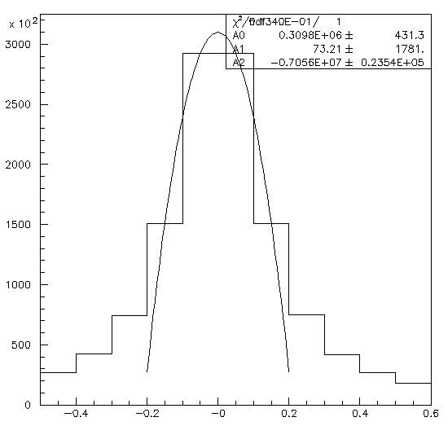
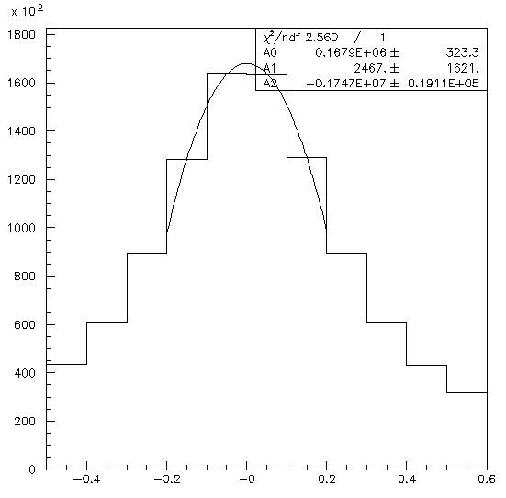
Further studies
A beam of Lorentz-Cauchy (LC) shape will be assumed
$P\left(x\right)=\frac{A}{1+{\left(\frac{x−x_{0}}{\text{g}\text{x}}\right)}^{2}}dx$
γ_{x}=0.130 mm
γ_{y}=0.260 mm
Fitting with parabola one gets
$\frac{σ_{Y}}{σ_{X}}=\frac{A_{X}}{A_{Y}}=\frac{309790±431}{167940±323}=1.845±0.0044\text{ (}\text{Δ}\text{\sim 35}σ\text{)}$
Fitting with LC in an interval $±3γ$
$\frac{σ_{Y}}{σ_{X}}=\frac{A_{X}}{A_{Y}}=\frac{333670±521}{170000±263}=1.963±0.004\text{3}\text{ (}\text{Δ}\text{\sim }9σ\text{)}$
Fitting with LC in an interval $±10mm$
$\frac{σ_{Y}}{σ_{X}}=\frac{A_{X}}{A_{Y}}=\frac{335610±501}{170360±252}=1.970±0.004\text{3}\text{ (}\text{Δ}\text{\sim }9σ\text{)}$
If the beam shape is LC the binning we have chosen is not enough for reconstructing beam widths (systematic of 2%)
Fitting with LC in an interval $±3γ$ and strip width =50um
$\frac{σ_{Y}}{σ_{X}}=\frac{A_{X}}{A_{Y}}=\frac{170350±263}{85678±133}=1.988±0.004\text{4}\text{ (}\text{Δ}\text{\sim }3σ\text{)}$

Slide 21
Comments
If the beam shape is more LC than gaussian (and if γ_{min}~0.130 mm) it looks like the strip pitch 100μm is not enough
In any case, to reconstruct the beam profile we will need to know very precisely which distribution should be used
In general, we would like to measure position and width with a method weakly dependent on theoretical assumptions (ideally, by using only the content of the strip with highest release of charge)
A detector with pitch 20 μm would allow to measure for each BX
Δx,y < 5.8 μm
Δξ/ξ ~ 1%

Slide 22
Wrap-up
The results obtained with this study should be redone with full MC simulation
Realistic beam parameters are fundamental to design the detector
If the results are confirmed
Can the distance by the two X-Y detectors be reduced to zero (from the actual ~2cm) and a second pair of detectors being added (at 2 cm distance)?
The first XY station will have 200+200 strips of 20 μm pitch
The second XY station will have 200+200 strips of 100 μm pitch
It will be used to position correctly the first station and to cross check results and tails behavior
Other things to be discussed
Position of the electronics
Baseline detector
Test procedures (see next slide)

Slide 23
List of discussion arguments for the round table (proposed by Mauro)
delivery of wafers to the labs: when and how
wafers test:
thickness measurements
uniformity with pair production by UVC radiation ?
light absorbance ?
surface characterization with an Atomic Force Microscope
do we need jigs to manipulate the wafers ?
wafers cut and metallization process
pads/test points besides strips ?
minimum tests performed at TOMSK before the detector are shipped
detector handling and shipment, schedule
characterizing the detectors in the lab: what to do, how, test setup
(if enough time) first ideas for test to be done on a beam

