Slide 1
T20 beamline design and beam-induced background studies for LUXE
Stuart Walker
DESY
2020-05-18
With gratitude to Nina Golubeva, Louis Helary, Sasha Borysov, Daniel Thoden and Stewart Boogert

Slide 2
Overview
T20 beamline and LUXE final focus
  History
  T20 beamline with beam spot at the IP
  T20 beamline with beam spot at the target
Beam induced background simulations for LUXE
  Simulation tooling
  T20 + LUXE beamline model
  Synchrotron radiation
  Beam halo
  Data into the reconstruction.

Slide 3
T20 beamline and final focus

Slide 4
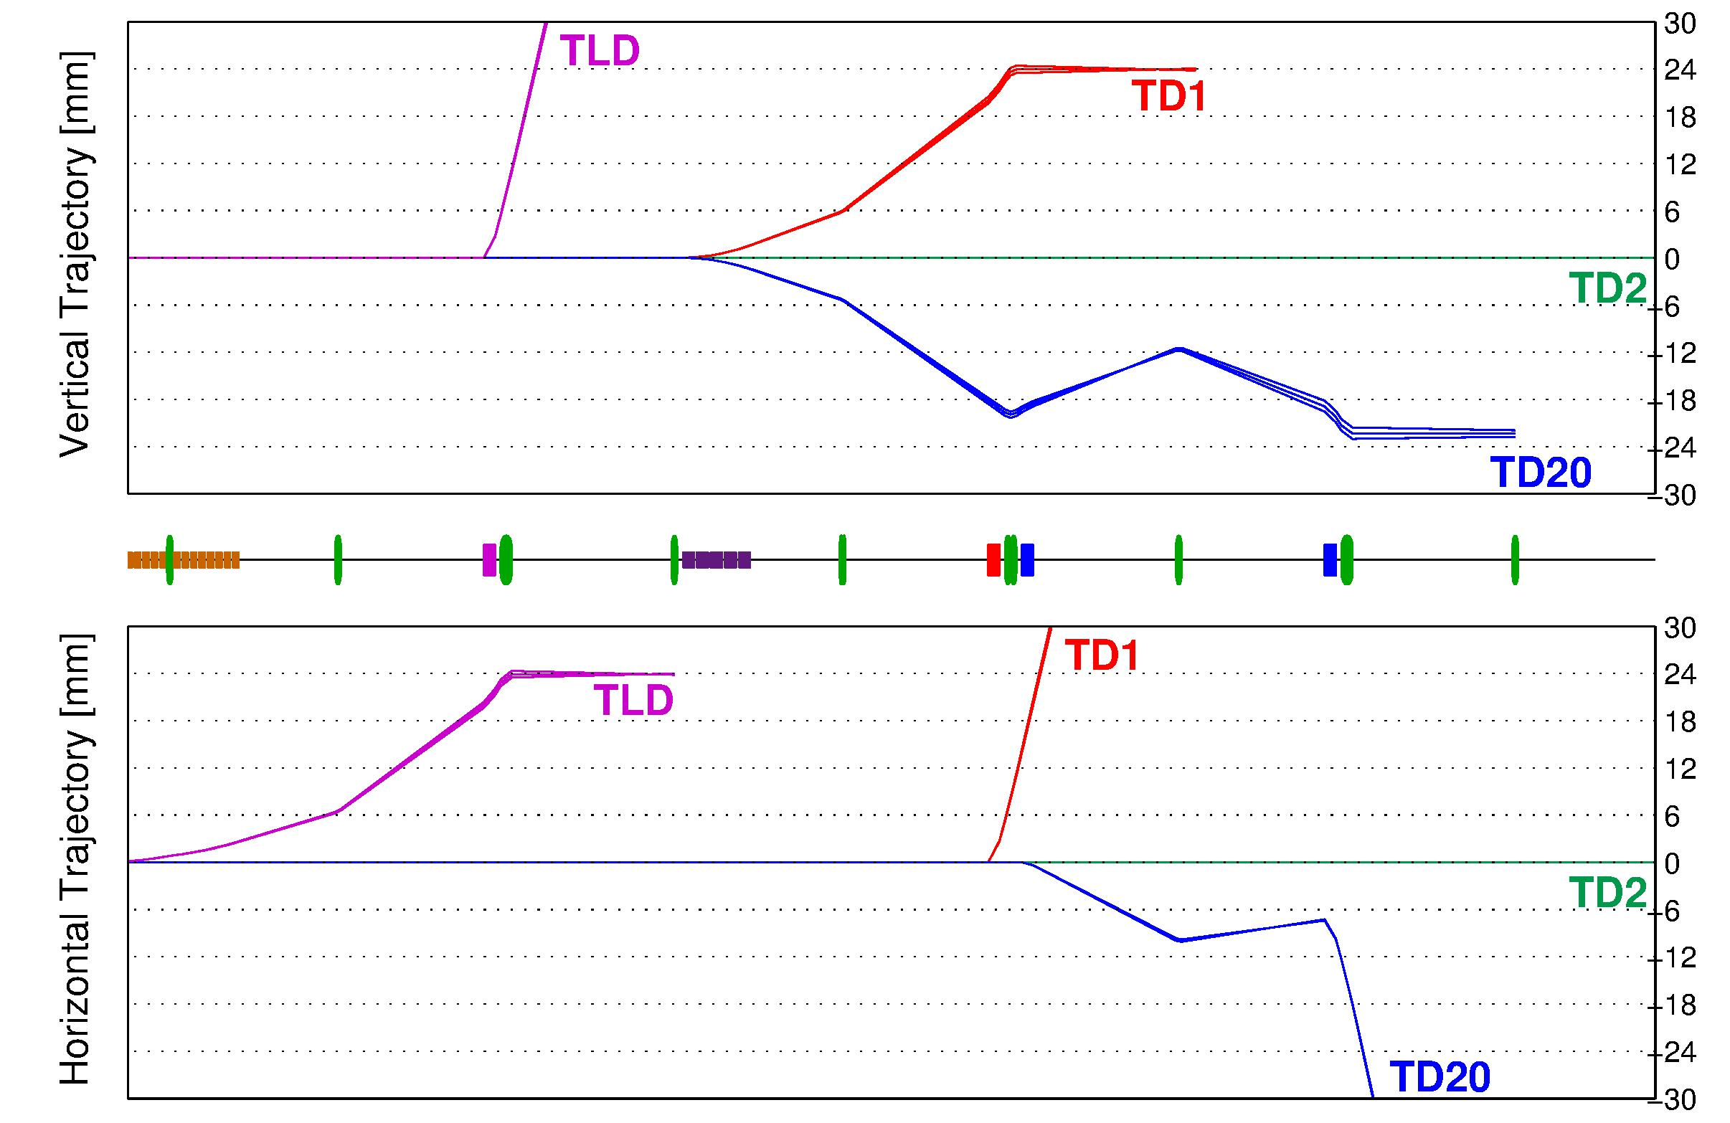
History
Initial design of the separation area at the XFEL
  extraction to the dump in the front of undulators (TLD)
  extraction to SAS2 (T1)
  extraction to a third beamline (T20)
  for the future upgrade (third set of undulators):
  not finalized, last iteration in 2011.
Me: so far 3 months as PDRA to work on LUXE (50%).
Not to scale
W. Decking, F. Obier, “Layout of the Beam Switchyard at the European XFEL”, in Proc. 8th Int. Particle
Accelerator Conf. (IPAC’08), Genoa, June 2008, WEOC073, p.2163
V. Balandin, W. Decking. N. Golubeva, “Tilted Sextupoles for Correction of Chromatic Aberrations in Beam Lines with Horizontal
and Vertical Dispersions ”, in Proc. 10th Int. Particle Accelerator Conf. (IPAC’10),
Kyoto, May 2010, THPE062, p.4656.
V. Balandin, W. Decking, N. Golubeva, “Optics for the Beam Switchyard at the European XFEL”, in Proc. 11th Int. Particle
Accelerator Conf. (IPAC’11), San Sebastian, September 2011, WEPC008, p.2016.
Thanks to: Nina Golubeva

Slide 5
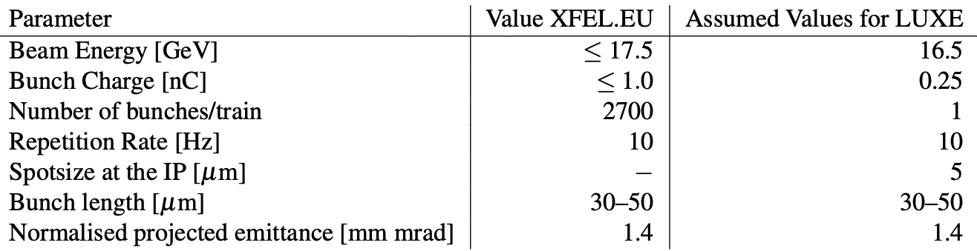
T20 beamline without final focus
End of dogleg
to IP
Target
Table 3.1, page 27 of CDR
Dipoles
Proportional
to variance of beam
transverse coords.
Quads
The lattice as inherited from Nina Golubeva.
Targeting the CDR values (Table 3.1):
  Normalised emittance 1.4 mm•mrad.
  Spot size 5µm.
Distances involved:
  End of arc to target: 12m.
  End of arc to IP: 19.5m.
Fitted.

Slide 6
T20 final focus at IP
Final focus
6 additional QH quadrupoles.
  Two for matching section.
  Four for inner triplet.
Goal: spot size 5µm → 𝛽_{x} = 𝛽_{y} = 0.58m.
Here: 𝛽_{x} = 2m, 𝛽_{y} = 1.52m.
Here: σ_{x} = 9.3µm, σ_{y} = 8.1µm.
Further optimisable.
Not fitted!

Slide 7
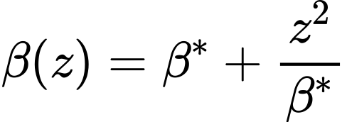
T20 final focus at target
Final focus
Goal: spot size 5µm → 𝛽_{x} = 𝛽_{y} = 0.58m.
Here: 𝛽_{x} = 0.47m, 𝛽_{y} = 0.68m.
Here: σ_{x} = 4.5µm, σ_{y} = 5.42µm.
Tighter focus at target than IP with same magnetic lattice.
Further optimisable.

Slide 8
Summary
A final focus system implemented for LUXE.
  Further optimization required to reach CDR spot size at IP.
  Any spot size achievable at the IP should at least be achievable also at the target.
Needs fitting (discussion with Daniel Thoden).
Outstanding questions
  How close to the target can we get with the final quadrupole?
  How fixed in position is the target?
Useful as baseline for beam background studies.

Slide 9
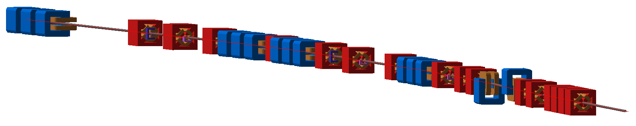
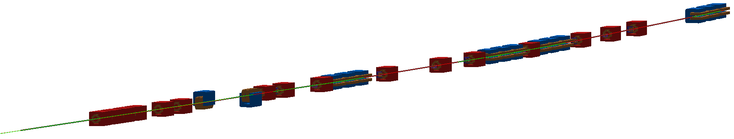
Beam-induced background simulations for LUXE

Slide 10

Beam-induced backgrounds
Incoming to the experiment:
products from residual gas interaction
leakage from collimation system
secondaries from beam loss
Can fake interesting physics in the detector! Need to understand.
shielding / rock
experimental hall
accelerator magnets
3
detector
2
4
2
1
1,3
Goal: Simulate far reaching particles into (or out if desired) of experiment and understand them Need: accurate magnetic particle tracking + interaction with matter
beam pipe
collimators

Slide 11


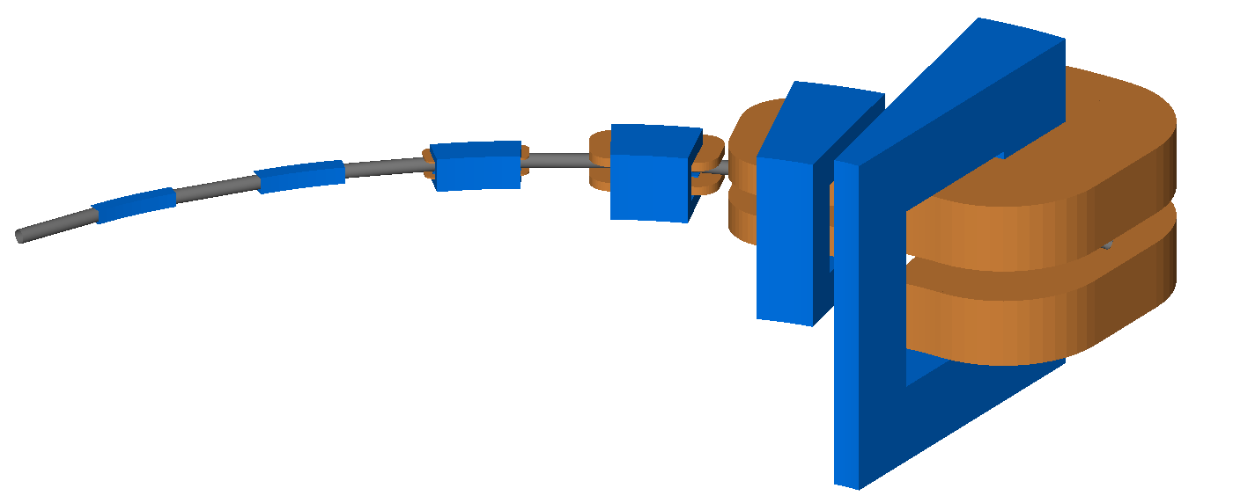
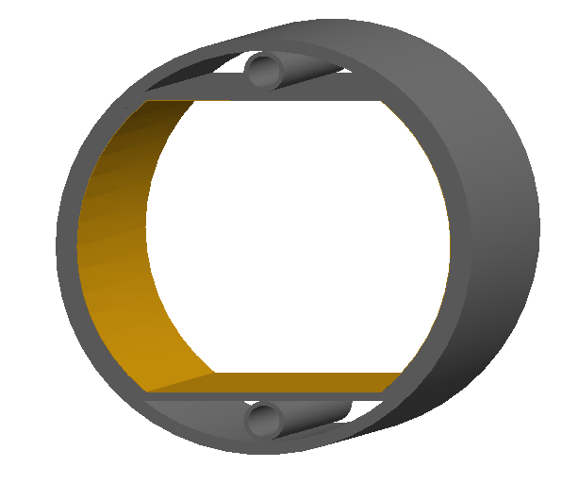
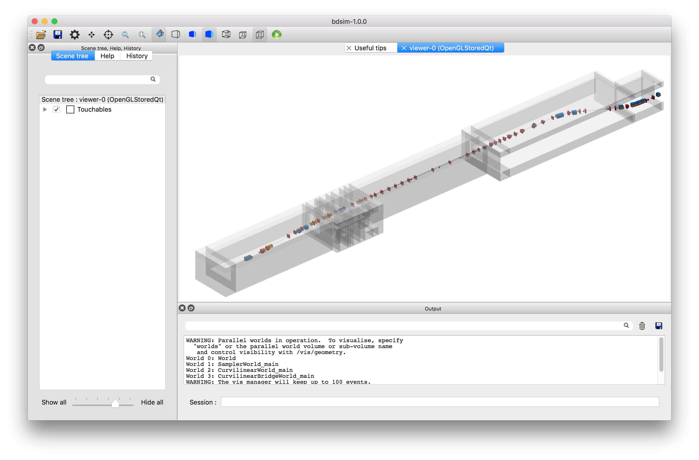
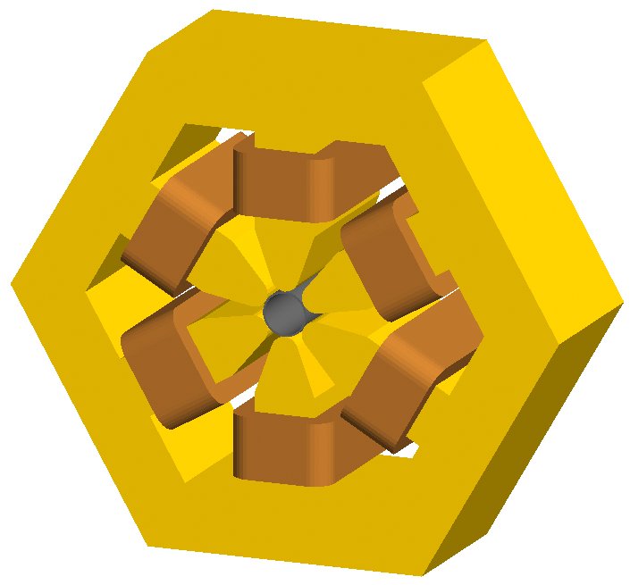
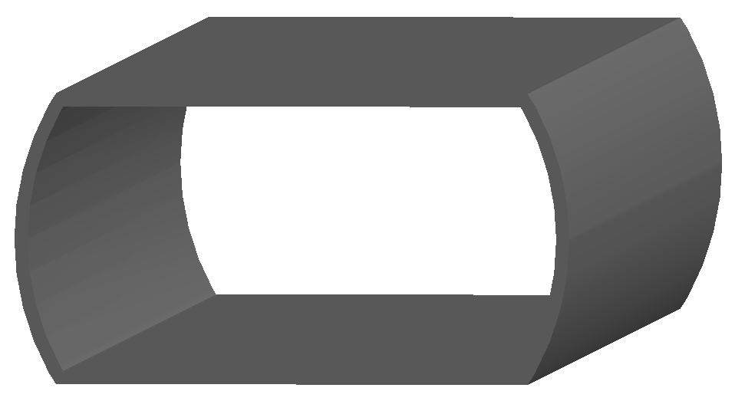
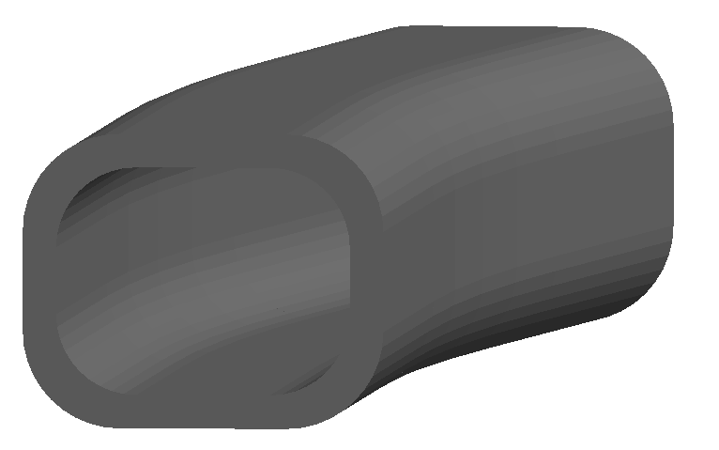
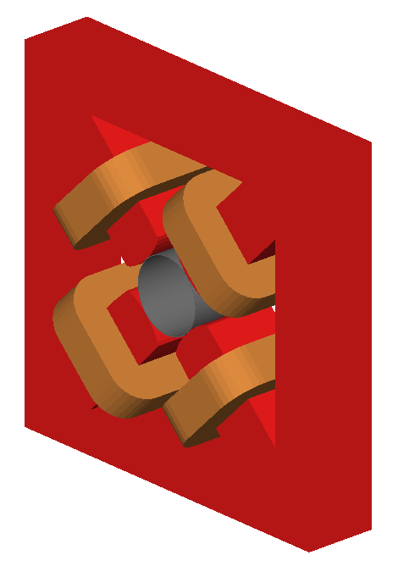
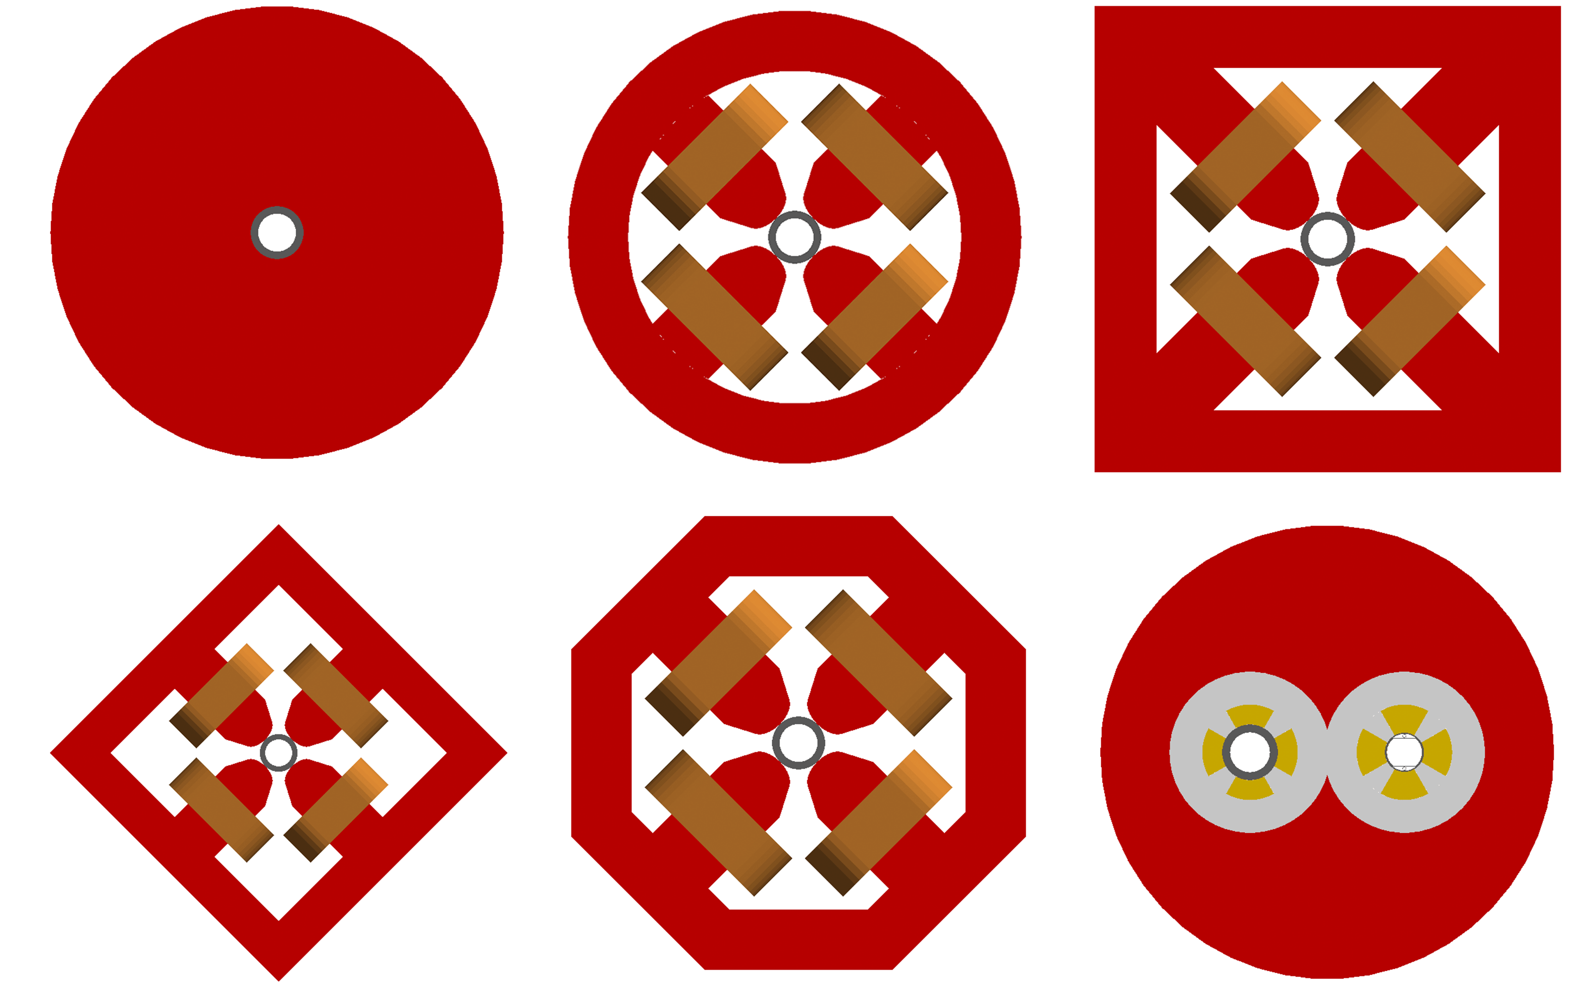
A Solution: Accelerator Tracking + Geant4 = BDSIM
Geant4 is a widely used open source C++ library for modelling detectors
Use this and add accelerator tracking
Accelerators are typically repetitive and similar in design
  add library of typical accelerator components with adjustable proportions
different aperture shapes
scalable geometry
different yoke styles
externally provided shielding added
complete accelerator from optical description
L.J. Nevay et al.
BDSIM: An accelerator tracking code with particle–matter interactions, https://doi.org/10.1016/j.cpc.2020.107200

Slide 12
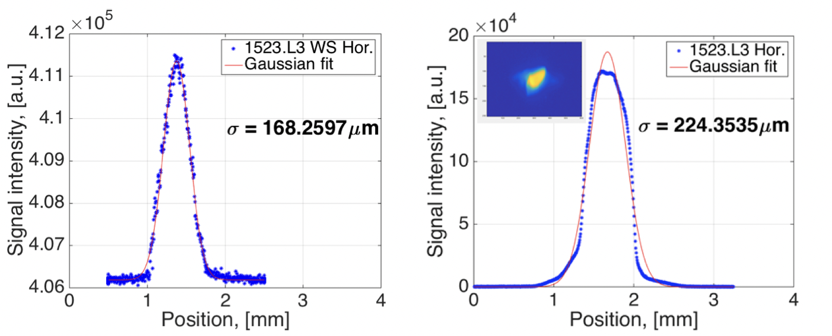
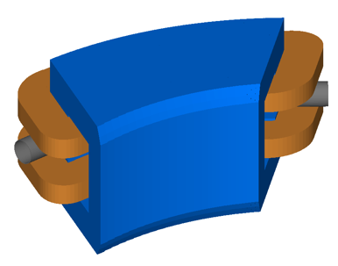
Possible sources of beam-induced backgrounds at LUXE
Synchrotron radiation
Beam halo
  Beam particles in the tails of the distribution.
Beam-gas scattering
  Beam particles scattering off of residual gas molecules in the vacuum
First beam halo measurements using
wire scanners at the European XFEL
https://accelconf.web.cern.ch/fel2017/papers/tup003.pdf

Slide 13
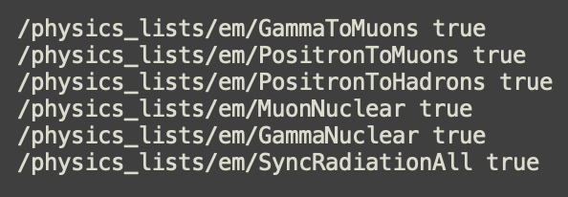
BDSIM model of T20 and LUXE
BDSIM model of LUXE
T20 beamline
Converted automatically from MADX optical description (previous slides).
Physics: g4QGSP_BERT_HP_EMZ (same as used in LUXE)
Additional physics G4 macro settings:
  Turn on “everything”.

Slide 14
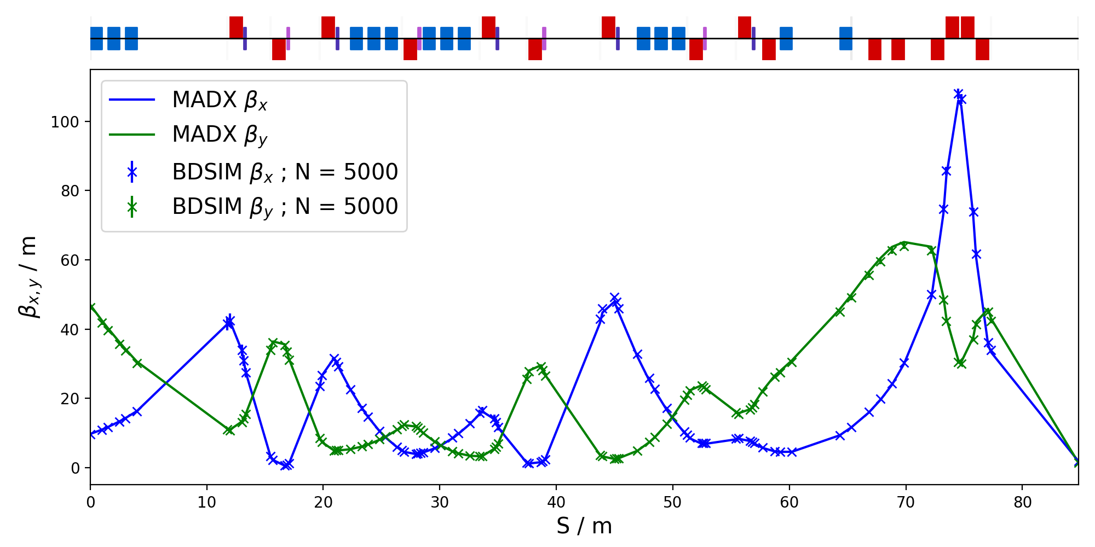
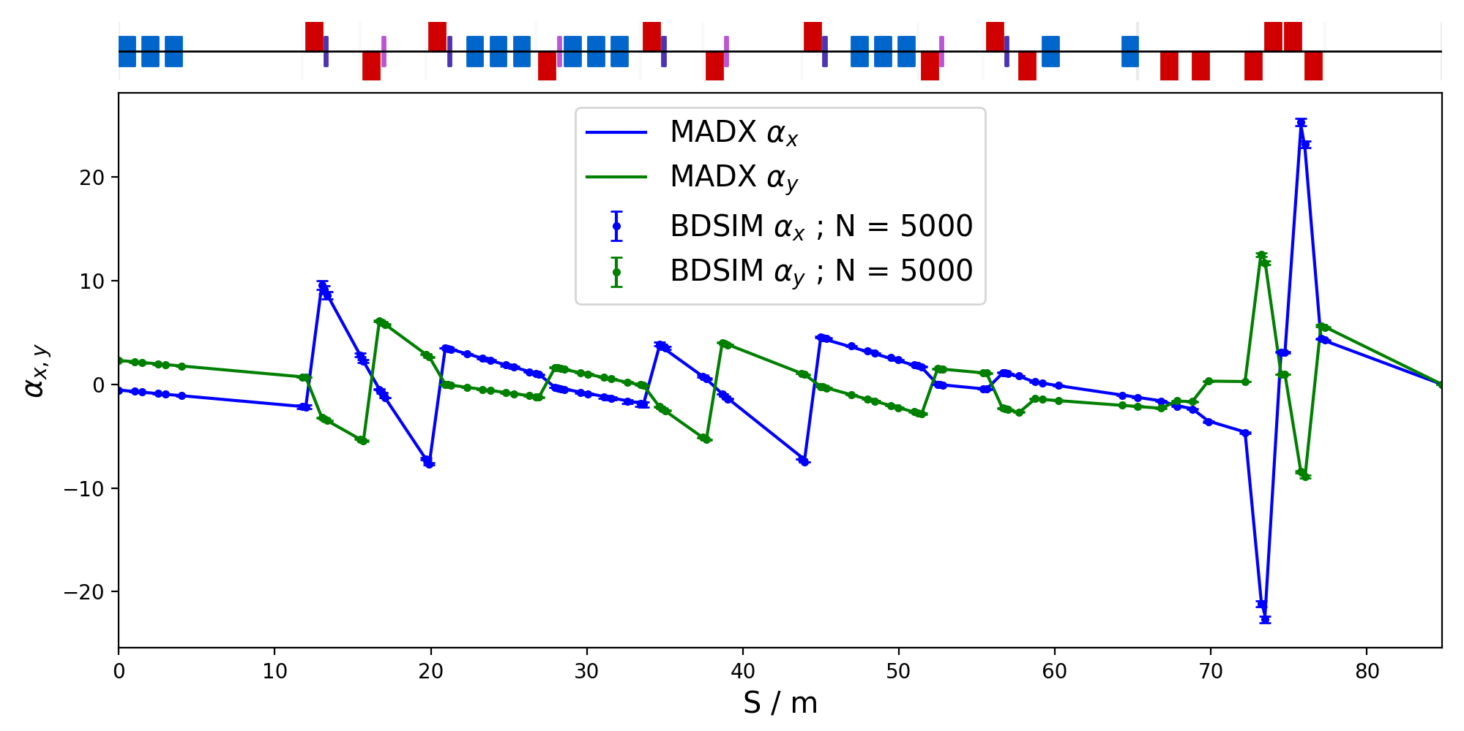
T20 BDSIM model Optics comparison with MADX
MADX: Standard linear optics code used in accelerator physics.
Beta ~ transverse beam size. Alpha ~ transverse beam divergence.
Excellent agreement.
Single particle (no collective effects).

Slide 15
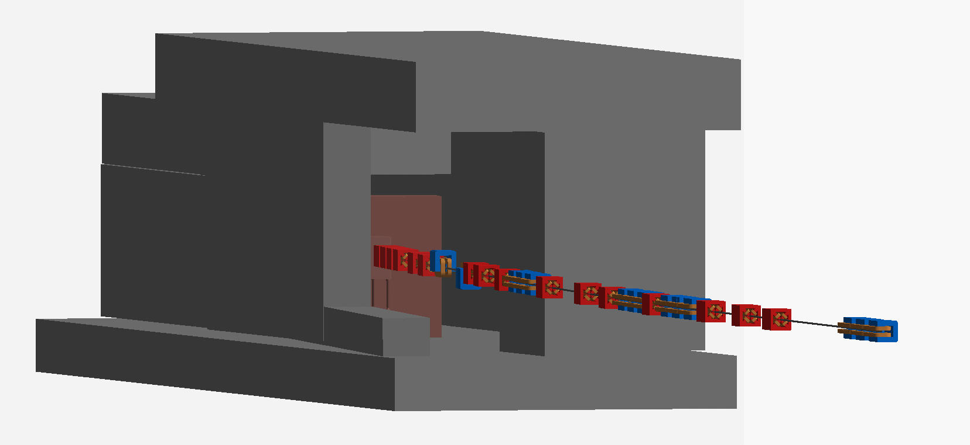
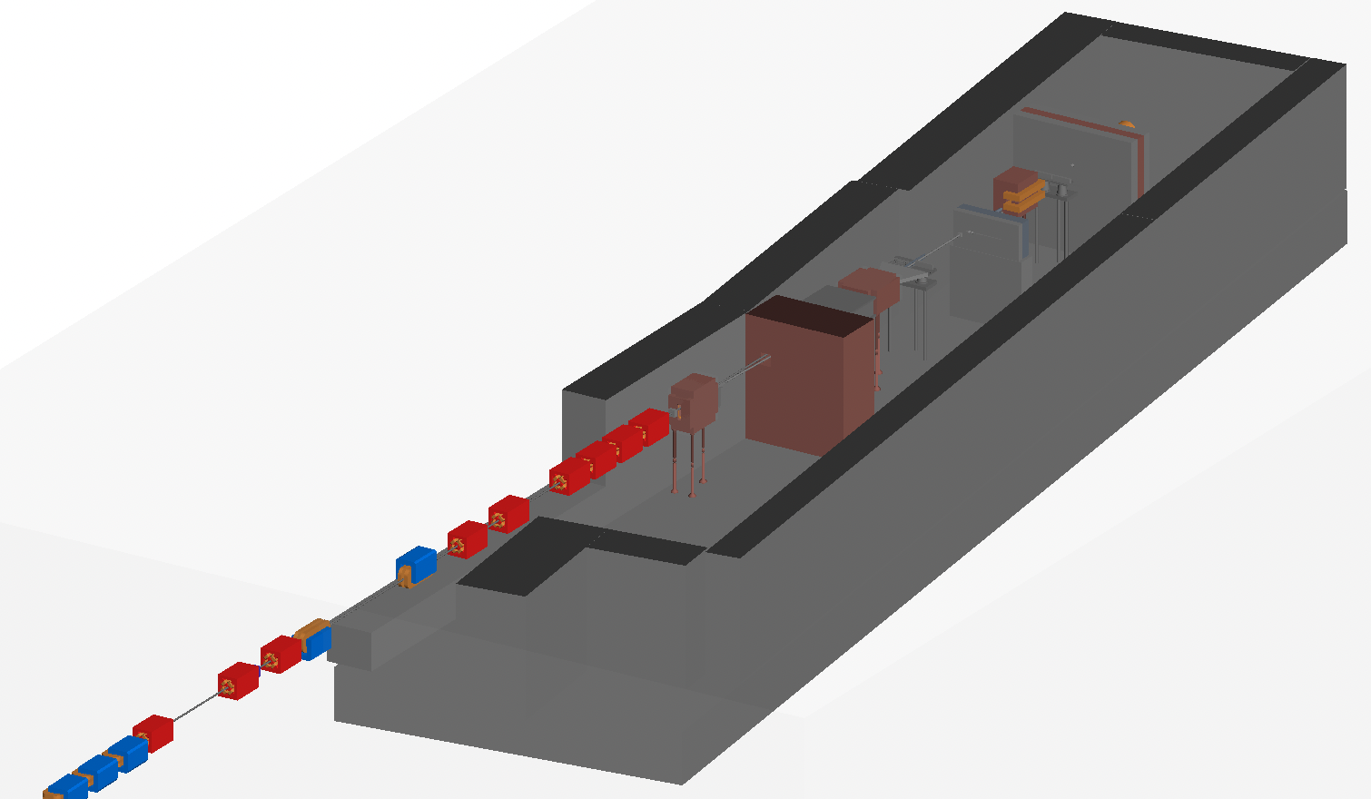
Geometry
Composable using LUXE GDML model.
Shielding not used in subsequent results due to minor technical issue (fix imminent).
Sampling (interface) plane 50cm upstream of target
  Recall: final quad 65cm upstream of the target.
Interface plane

Slide 16
Synchrotron radiation
Track beam core: ~7M primary electrons with syncrad switched on.
Gaussian beam profile.
Included beam core.
Shown right: Energy due to secondaries at the interface plane.
  I maybe need a bigger sampling plane….

Slide 17
Synchrotron radiation (including beam core)

Slide 18
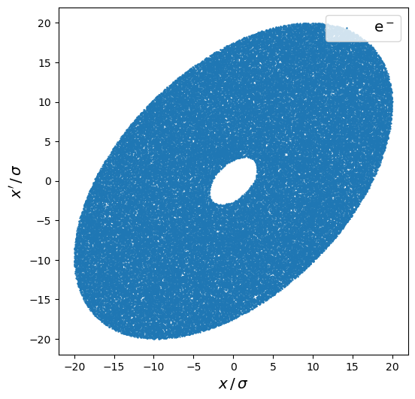
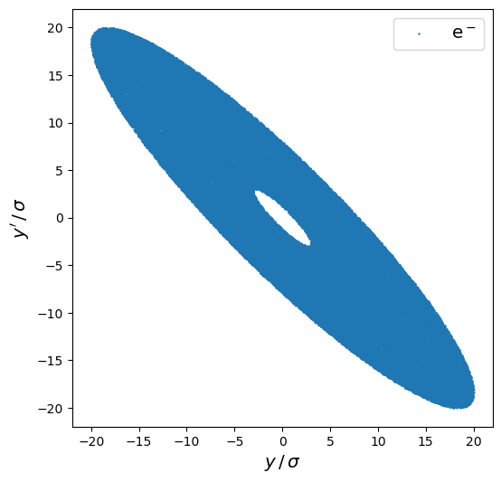
Beam halo
Beam halo has been measured up to 20σ from the centre of the beam after the collimation section.
Reasonable to therefore to assume halo up to 20σ at LUXE.
Exact profile not exactly known (measurement ongoing with work by Shan Liu and others) → fatter tails than a Gaussian.
Here sample flat phase space from 3σ to 20σ.
  Leave reweighting to the detector simulation (at least for now).
Running on the cluster now...
3–20σ beam halo distributions at start of the T20 beamline

Slide 19
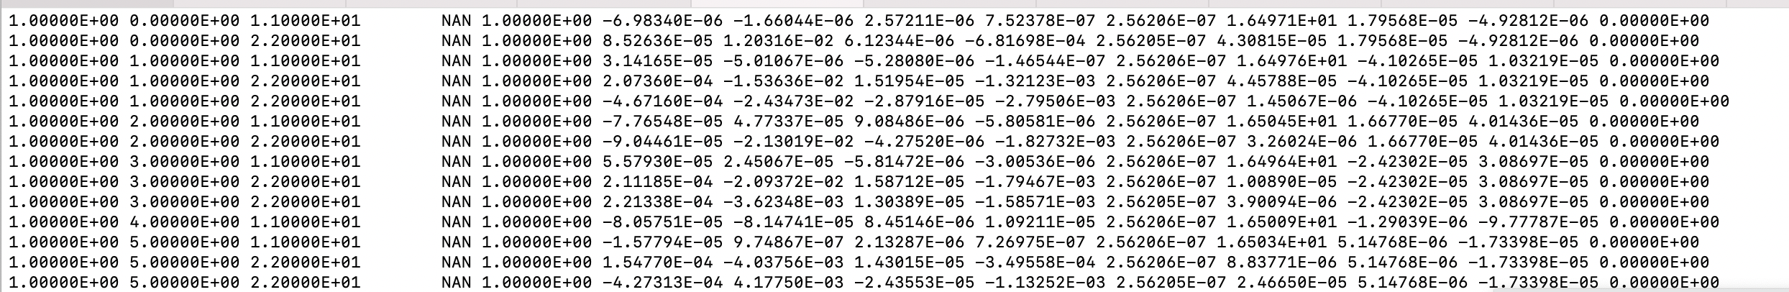
To your detector simulation
ASCII Columns at interface plane
BDSIM run number (seed)
Primary event number
geant4 particle type ID
Kinetic energy
Statistical weight
x
y
Directional cosine w.r.t X-axis
Directional cosine w.r.t Y-axis
Time since start of event
Total energy
x coordinate of primary at s=0
y coordinate of primary at s=0
z coordinate of primary at s=0
Record all particles at 7m circular plane 50cm upstream of the target.
ASCII: a bit rubbish.
Can switch to something better if you want.

Slide 20
Summary
Complete and integrated model of T20 beamline + LUXE experiment with shielding in Geant4.
  Further refinements possible, e.g. field maps etc.
  Other applications possible applications, suggestions?
Model applied to the simulation of beam-induced backgrounds at LUXE.
  Beam halo + synchrotron radiation.
  Could do beam-gas, just need an event generator (e- + atom)—suggestions?
  Also should simulate focus at the target scenario.

