Slide 1
From the CDR to TDR
Supposition : TDR by the end of 2021

Slide 2
ECAL status foreseen by the end 2021 (in red, important tasks for the TDR)
Status Tasks | Not started | On going | completed
Mechanics design |  |  | X
Mechanics production |  | X
Tungsten plane design |  |  | X
Tungsten plane production |  | X
FLAME-LUXE design |  |  | X
FLAME-LUXE production | X
FEB design |  | X
FEB production | X
Sensor material choice |  | X
Sensor material test |  |  | X
Sensor production | X
DAQ |  | X
tooling |  | X

Slide 3
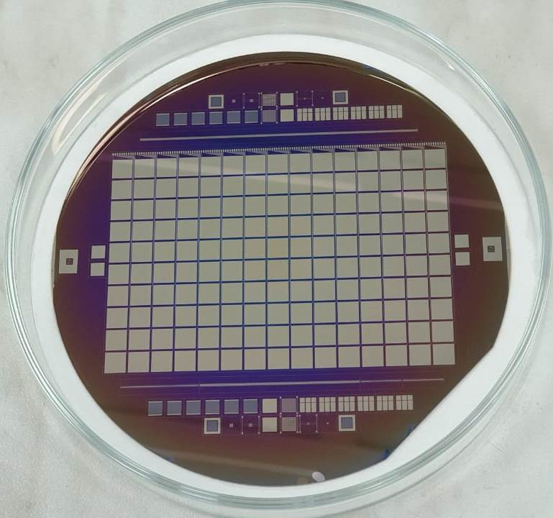
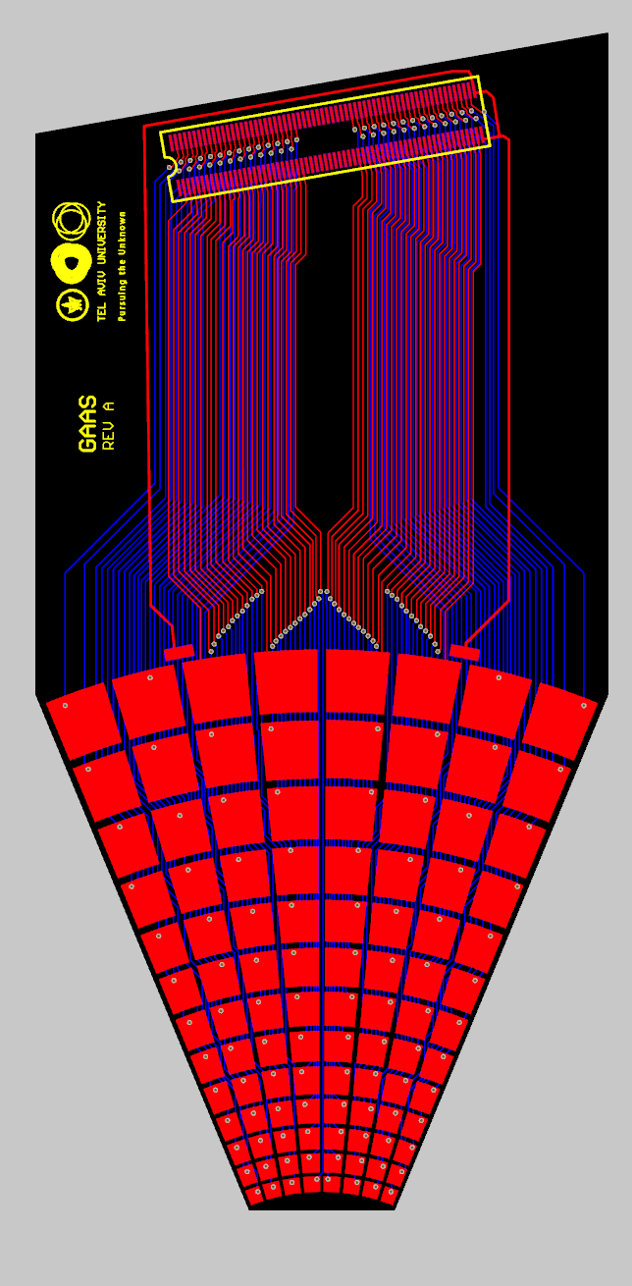
Sensor choice
Designed is defined
Two candidates : Si and GaAs.
GaAs, two designs:
With traces : designed and prototyped: on its way to be tested. PCB need to be designed.
No traces : designed, produced and tested. Fanout designed and almost in production (few days). Preference for this design if we have good results from TB
Si : designed (by CALICE), tests ongoing. Fanout designed and almost in production (few days)

Slide 4
2021 test beam
Sample of different options will be tested : Si, GaAs and GaAs with traces
FLAME ASIC for readout
DAQ (within the EUDAQ framework)
Choice of the sensor (beginning 2022)

