Slide 1
Bunch Compression Operation at the European XFEL
Bolko Beutner
Operator Training
June 2021

Slide 2
FEL Performance
FEL performance is determined by the peak current and the emittance – the charge density in 6D.
Low emittance and high peak current beams are required in the undulators, but not available at feasible electron sources.
Typically long beams are produced with low emittance and the compressed later.

Slide 3
Basic Principle

Slide 4
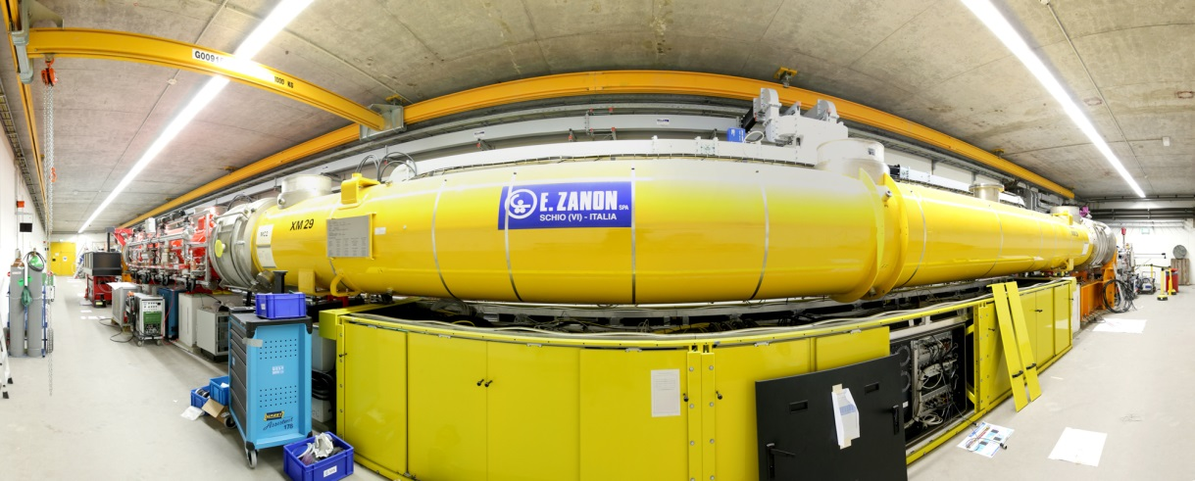
Energy Chirp Generation

Slide 5
“Non-linear” Compression
Linear Compression:
Non-Linear Compression:

Slide 6
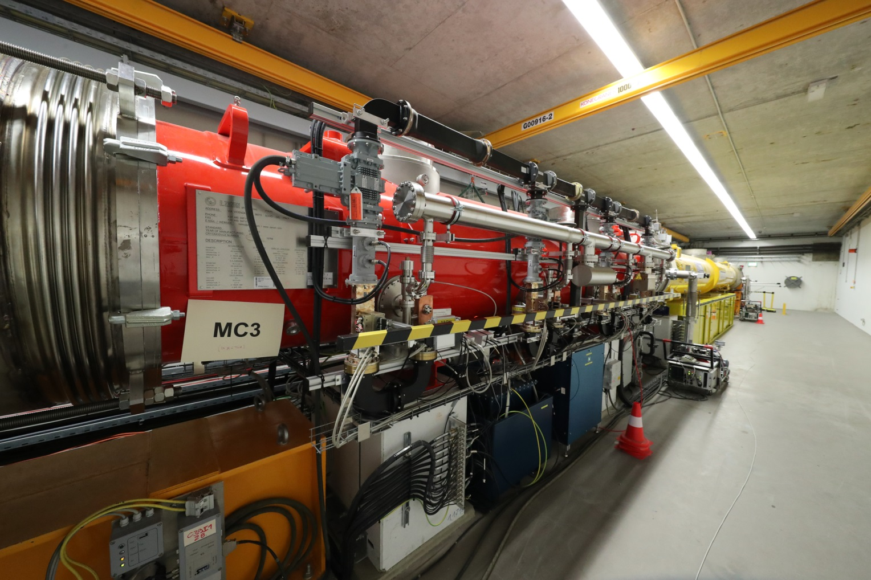
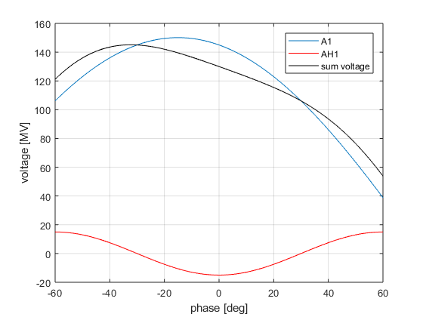
Phase Space Linearisation
Higher harmonic RF system is used to remove non-linear chirp
3rd harmonic (3.9GHz) at XFEL and FLASH

Slide 7
Sum Voltage
Setup of RF phase and voltages to get a certain energy chirp is cumbersome
RF parameters can be directly calculated from the Taylor coefficients (energy, chirp, curvature) at the beam position
Tuning one of the Taylor coefficients do not change the others, especially the beam energy is not changed (provided that the on-crest phases are correct)

Slide 8
Sum Voltage Effects
Chirp (mostly A1 phase):
Curvature (mostly AH1 voltage):
Third Order “Skewness” (AH1 voltage and phase):
Current profiles

Slide 9
Multi-Stage Compression
Too much compression at low energies will lead to space-charge dilution of the beam
Too little compression in the early stage lead to problems with transport of long beams
Too strong chicanes distort the beam due to synchrotron radiation emission
=> Multi-stage compression

Slide 10
BC0

Slide 11
BC1

Slide 12
BC1
Screen
station
Collimator
BPM

Slide 13
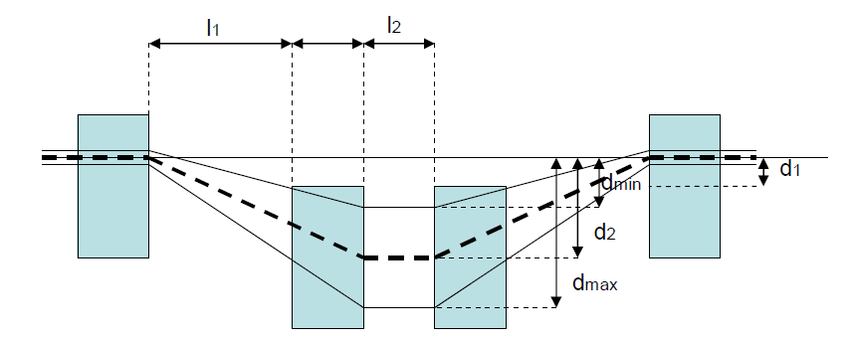
XFEL BC Overview

Slide 14
Chamber Overview
Screen
Collimator
Not to scale!

Slide 15
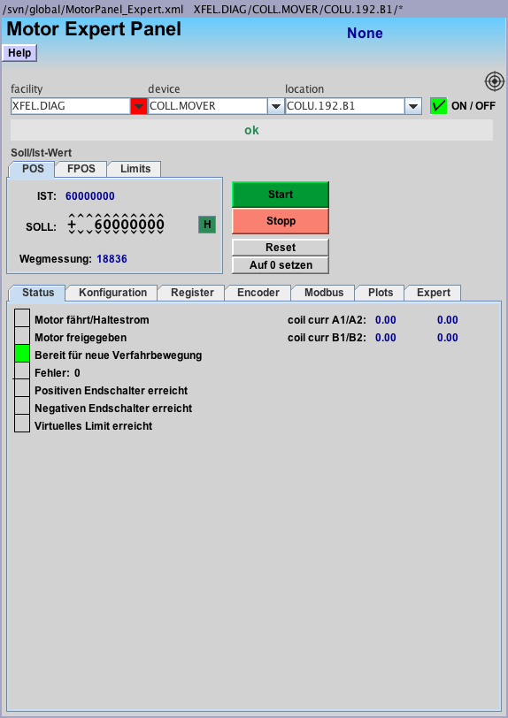
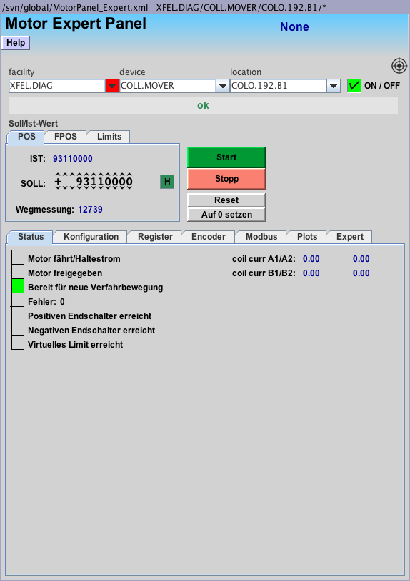
BC Collimator Control
Set “Sollwert” and the press “start”
Move collimators to in direction 0 to remove them
COLU is down “unten”, COLO is up “oben”

Slide 16
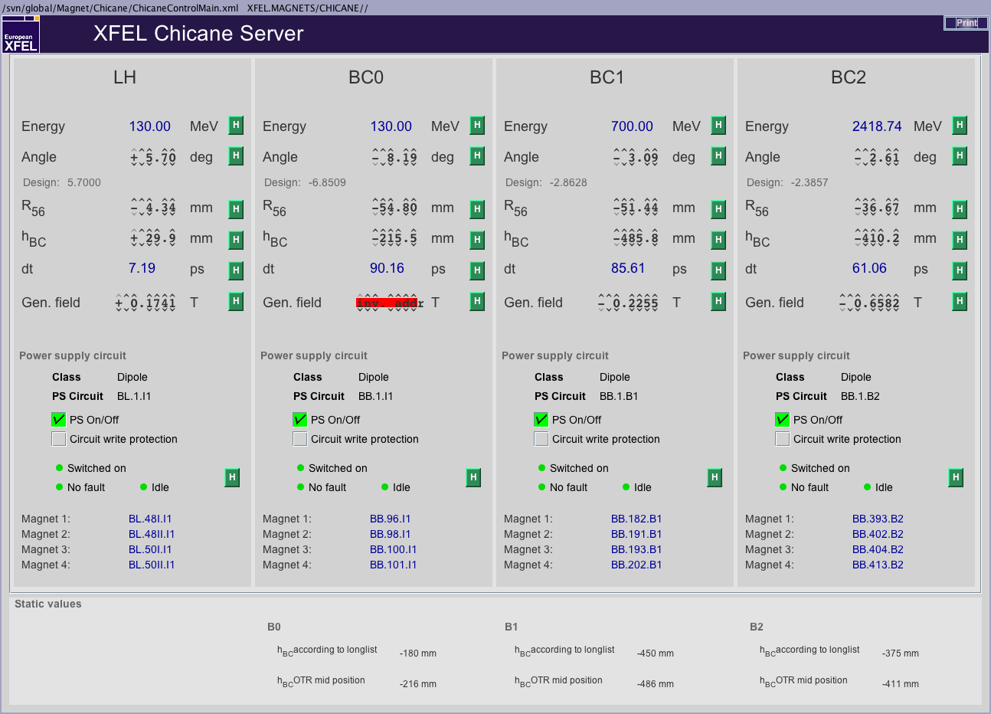
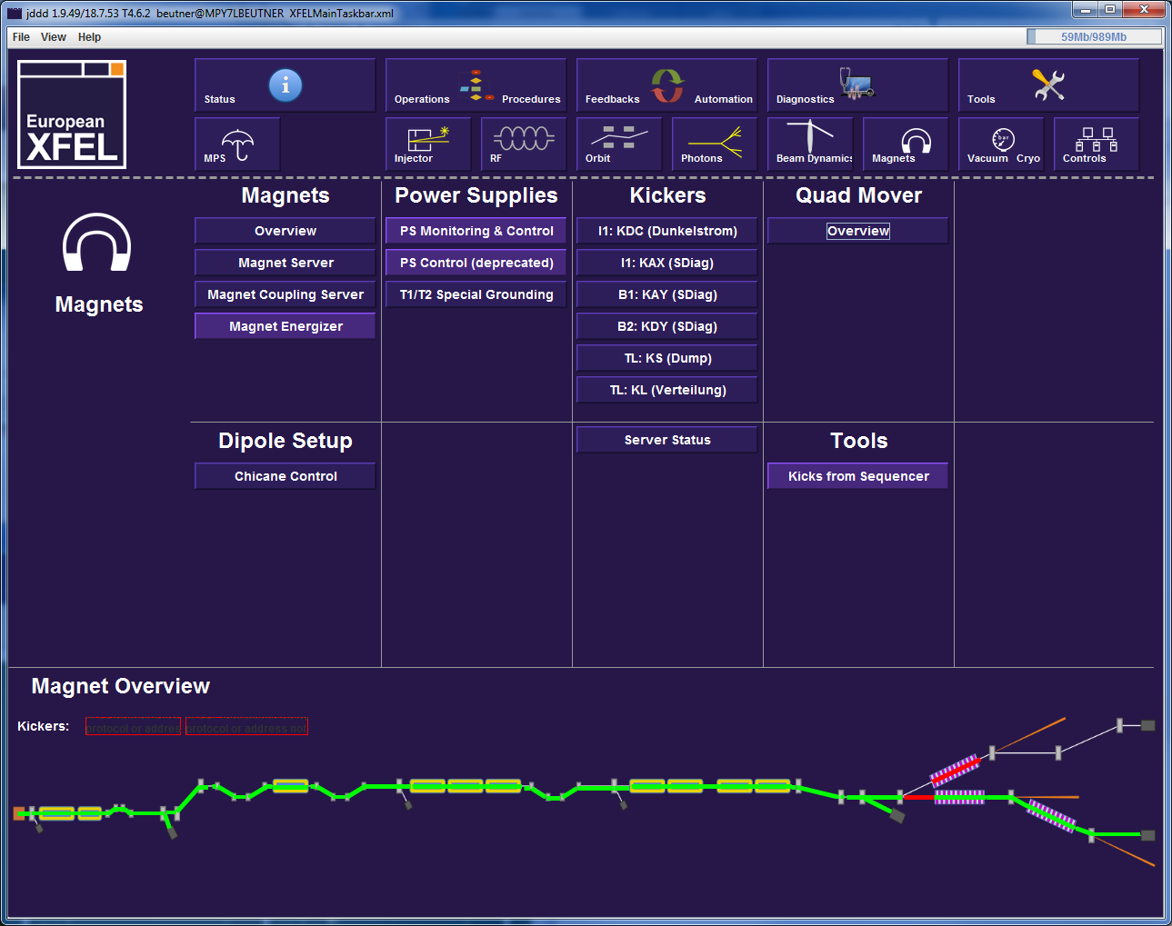
Dipole Setup
These Values are the design parameters, which do not necessarily reflect the current configuration!
Always use the current values defined by the run coordination (will be discussed later)

Slide 17
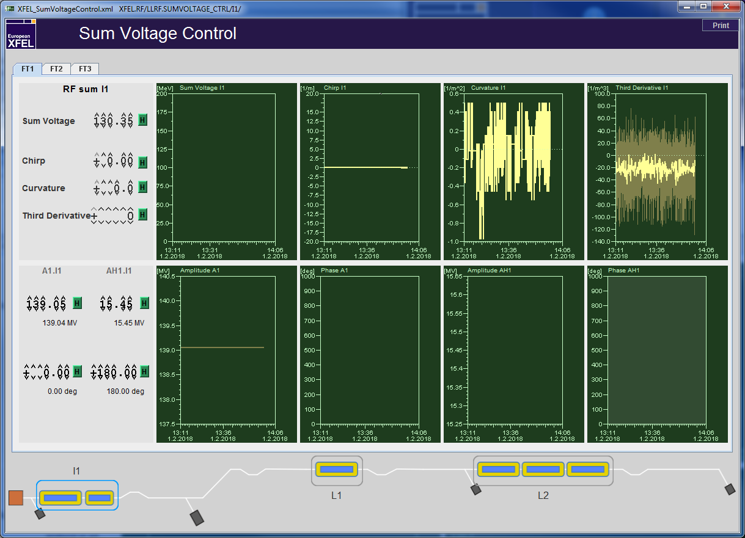
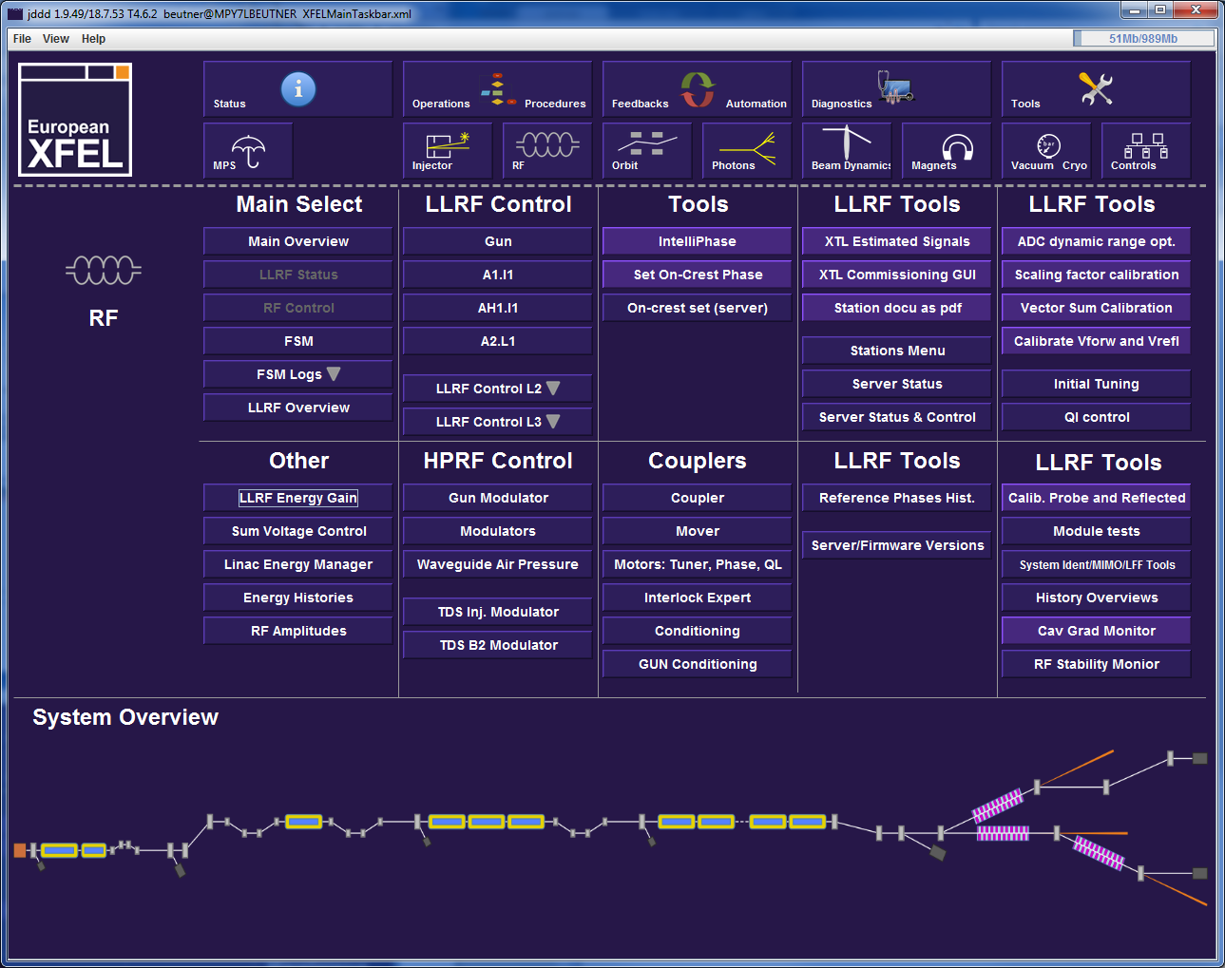
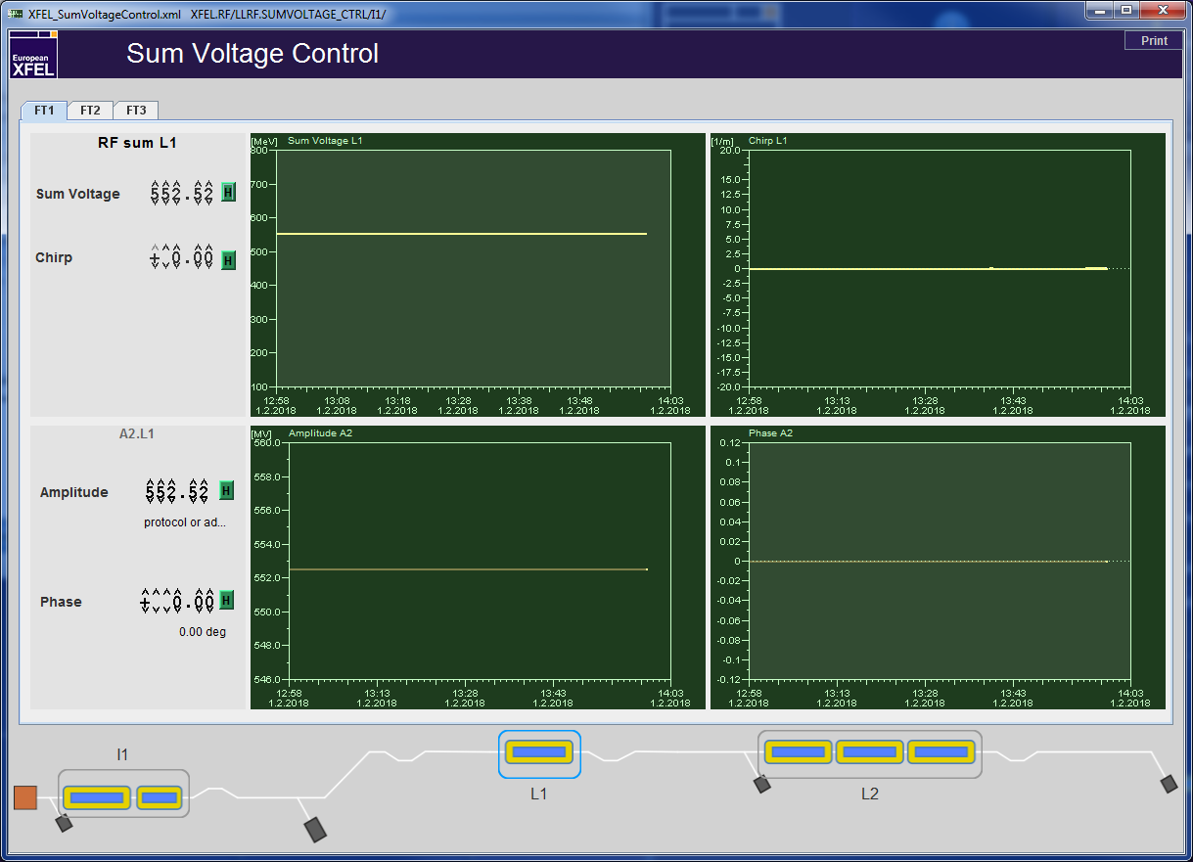
RF Setup and Tuning

Slide 18
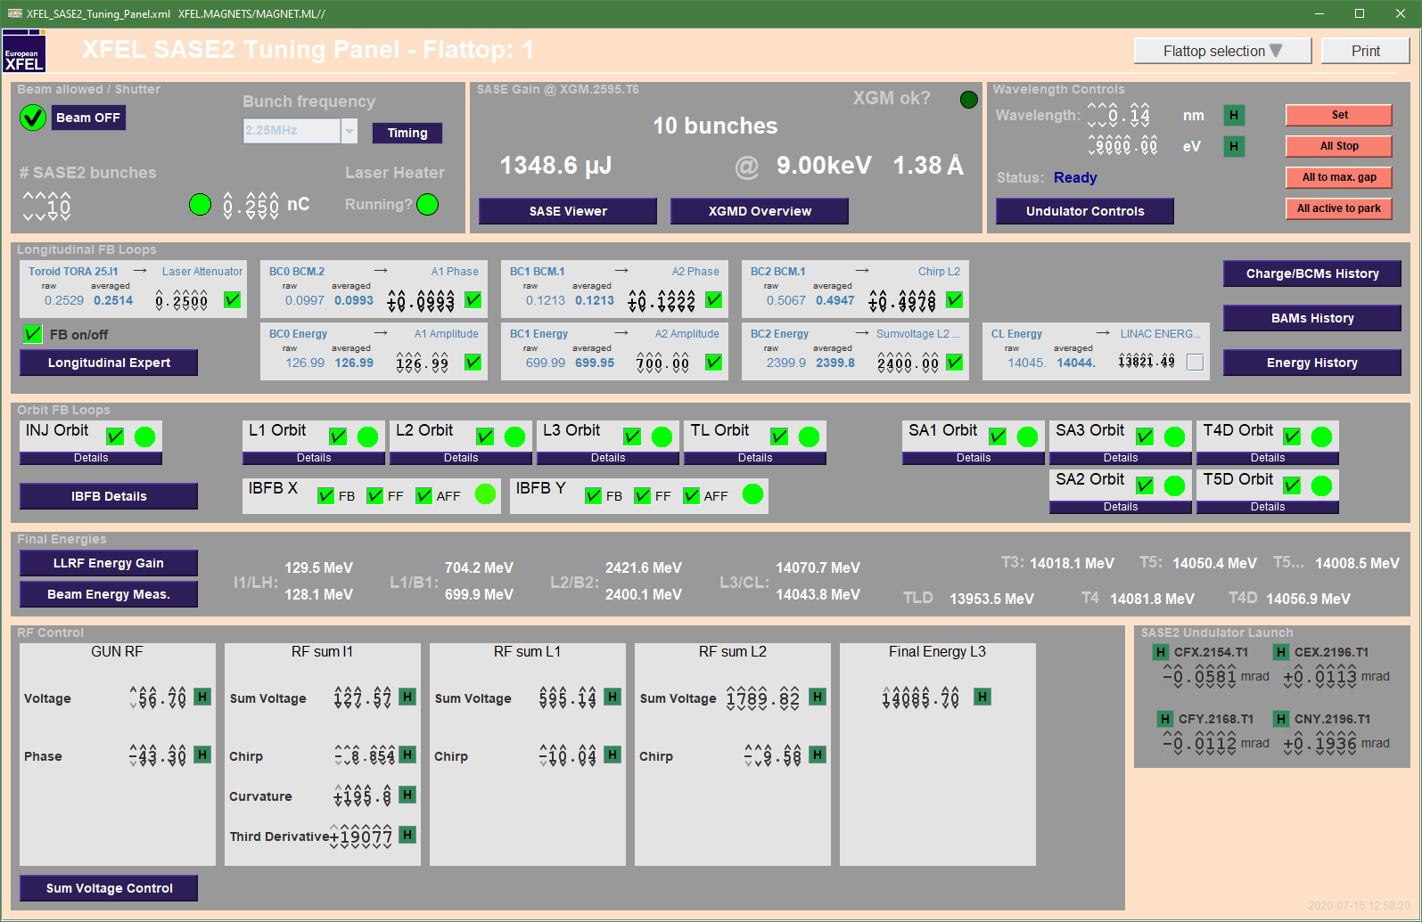
BCM
Diffraction Radiation downstream of the chicanes depends on compression
Diffraction radiators must be moved in
BCM Signals are kept to tuned values with the compression feedback – do not just switch the feedbacks on to unknown targets

Slide 19
Compression Setup Procedure I
Chicane Magnet Setup
Make sure BC dipoles are set correctly and cycled and the reference energy of the dipoles are correct (130MeV for BC0, 700MeV for BC1, and 2400MeV for BC2)
Set the correct optics for this bending angle is set in the machine
 | BC0 angle [deg] | BC1 angle [deg] | BC2 angle [deg] | BC0 R₅₆ [mm] | BC1 R₅₆ [mm] | BC2 R₅₆ [mm]
250pC | -7.83 | -3.05 | -2.36 | -50 | -50 | -30
100pC | -7.34 | -3.05 | -2.36 | -43.8 | -50 | -30
250pC | Inj76/XX Injector (a)symetric FODO 76/XX | BC2 2019
100pC | Inj76/XX Injector (a)symetric FODO 76/XX BC0 = -7.34 | BC2 2019
https://confluence.desy.de/display/XFELOp/Bunch+Compression+Setup+Procedure

Slide 20
Compression Setup Procedure II
RF Setup
Deactivate the compression feedbacks
phase scan to set on-(anti-)crest to A1,AH1,L1,L2 to 0(180)deg
Set the design configuration by using the Sum Voltage Knobs to (250pC/100pC):
The RC or an expert might suggest new values here. Alternatively parameters from a previous good SASE delivery run might be used.
scale the cold magnets between A1 and AH1 to the correct energy
 | sum voltage | chirp | curvature | third derivative
I1 | 130.0 | -9.1 / -9.8 | 270 / 265 | 25966 / 20000
L1 | 569.8 | -9.1 / -9.4 | - | -
L2 | 1698.7 | -12 / -8 | - | -
https://confluence.desy.de/display/XFELOp/Bunch+Compression+Setup+Procedure

Slide 21
Compression Setup Procedure III
confirm that beam energy is set to 130, 700, 2400MeV at I1, B1, and B2
Check with B1D and B2D or at least with the BPMS energy server if in hurry.
Correct by using the sum voltage knob in the corresponding linac (L1 or L2).
The I1T energy server should read 130 which typically corresponds to about 128MeV in the LH.
When set up the above values subtract up to 150 from the 'curvature' parameter in I1 do this in steps of max 10.
close compression feedbacks by transferring the current compression monitor reading to the target value (arrow button) and then set the activation checkbox.
https://confluence.desy.de/display/XFELOp/Bunch+Compression+Setup+Procedure

Slide 22
SASE Tuning
open longitudinal feedback loops
use chirps first L1, I1, and L2 in that order
I1 is the most sensitive tune in the 0.1 or 0.01 range
L1 should be tuned in with 0.1 steps
L2 is the least sensitive knob step sizes of 0.1 to 1 can be used. Make sure that the L2 phase does not exceed 30deg!
If chirp tuning is not successful adjust curvature in I1. Steps of 1 or 10.
The I1 third derivative knob can be used in steps of 100 or 1000. Smaller steps have no real impact!
After tuning is finished e.g. after reaching a new SASE optimum, close the longitudinal feedbacks after transferring the BCM signals to the target values using the arrow button.
https://confluence.desy.de/display/XFELOp/Bunch+Compression+Setup+Procedure

Slide 23
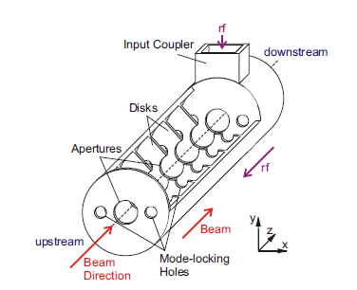
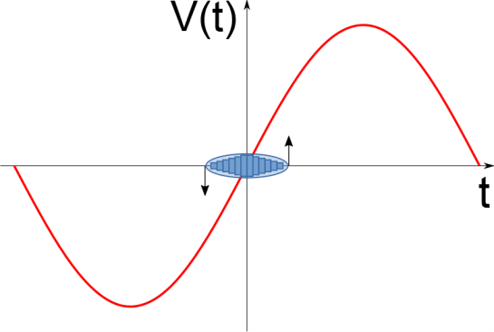
Transverse Deflecting Structure (TDS)

Slide 24
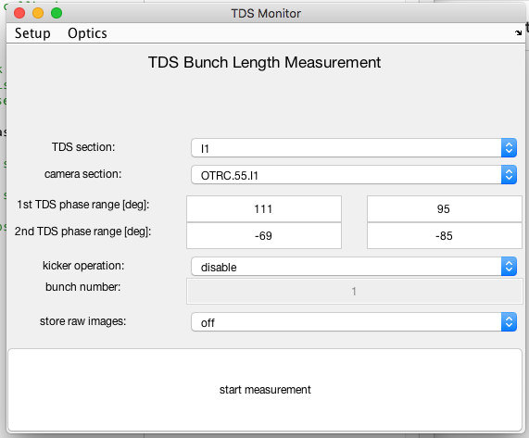
TDS Measurements
TDS Monitor (Main Taskbar-> Beam Dynamics->TDS Monitor)
1. Select TDS station
2. Select Camera
3. Find phase ranges manually
4. (optional) configure Kicker
5. Start Measurement

Slide 25
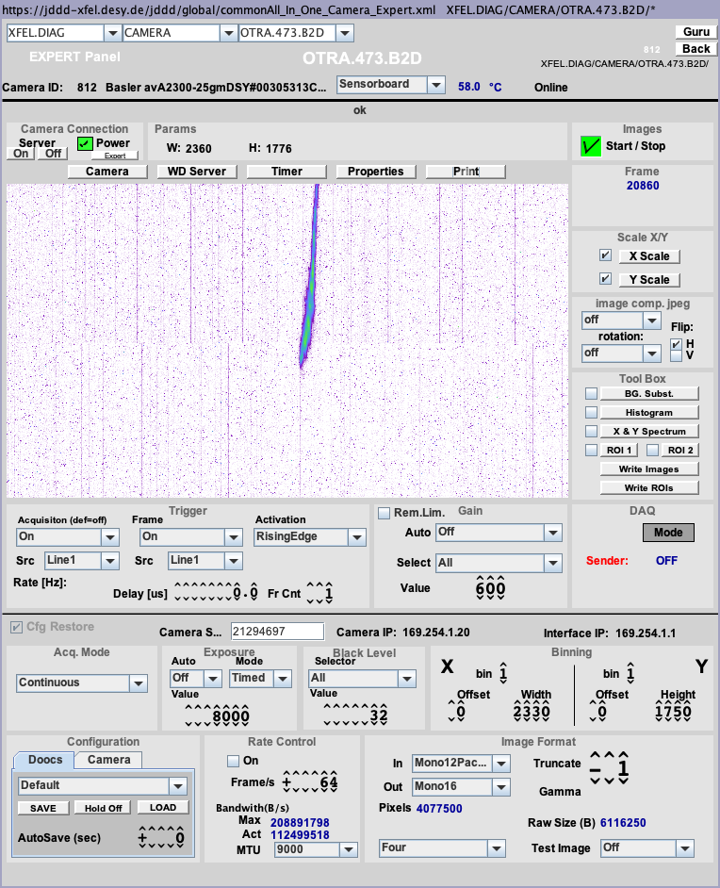
TDS Phase Range Setup
Example: B2 in spectrometer B2D in I1 the streak direction is horizontal
Move beam with phase (1st range)
“jump” by 180deg and repeat (2nd range)
leave “safety” margin

Slide 26
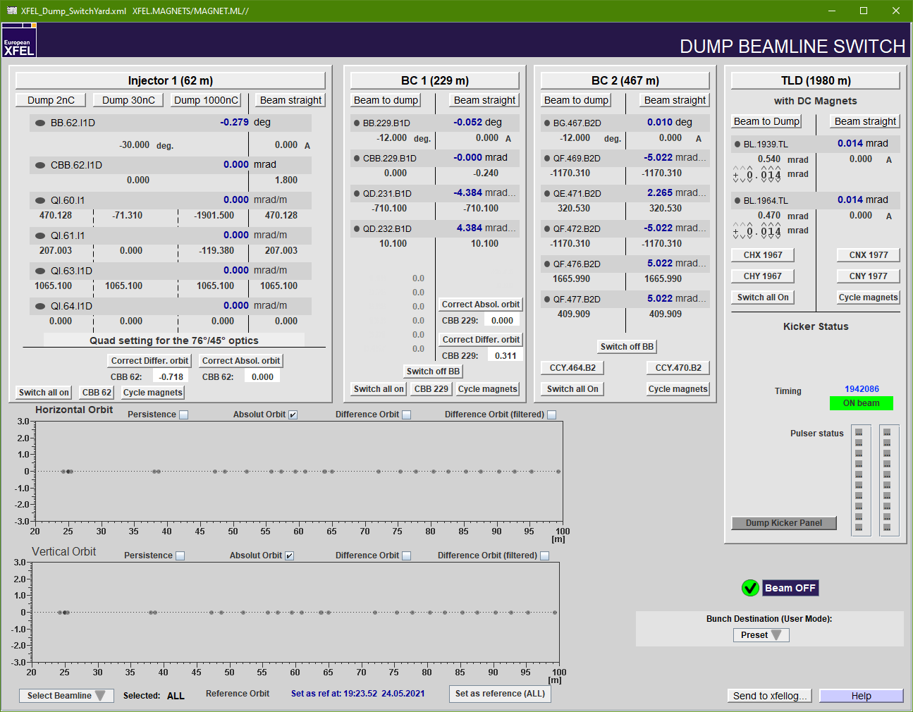
Setup B2D Measurements

Slide 27
Setup B2D Measurements
After Dump switch was used change from SASE delivery optics to High-res TDS optics – beta at TDS is increased to 200m set and cycle to selected design – reset when done with measurements

Slide 28
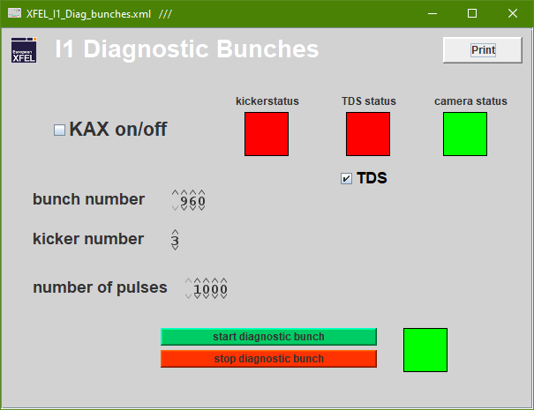
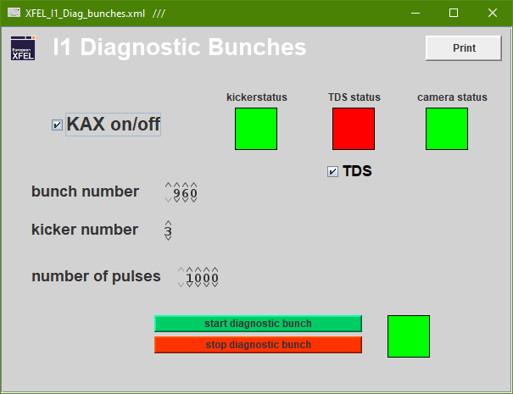
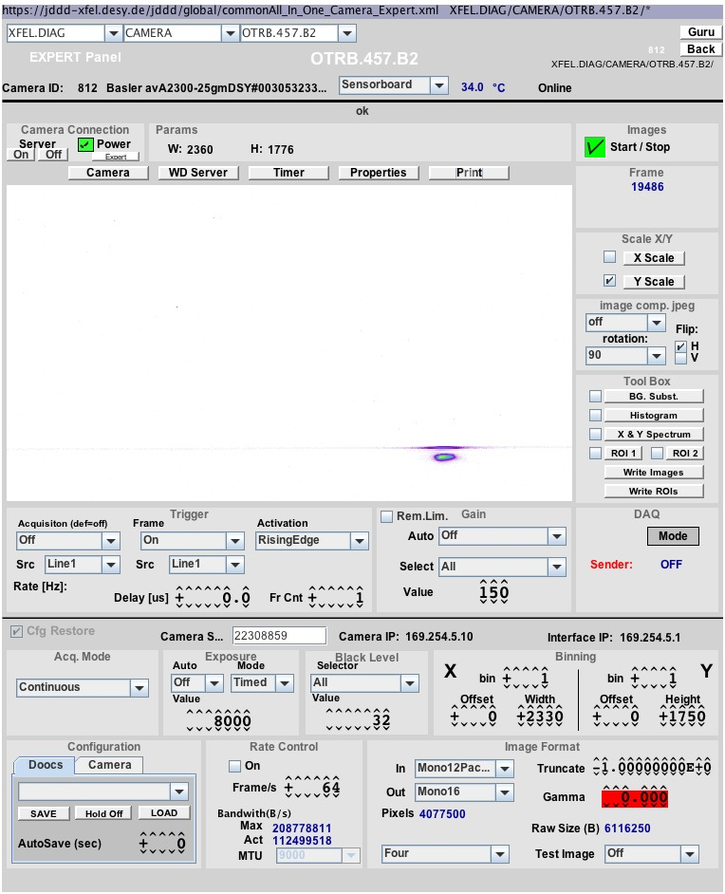
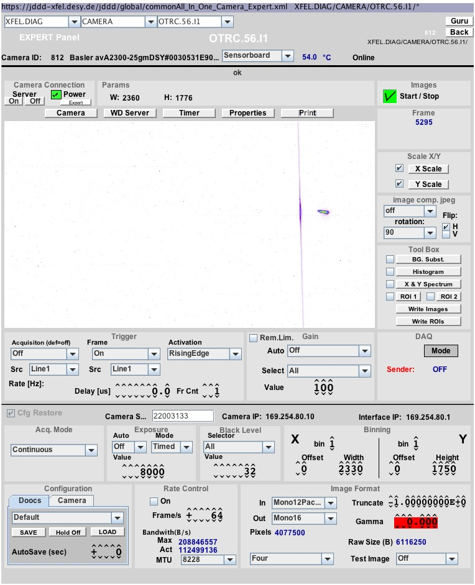
Off-Axis TDS Operation
(Main Taskbar-> Beam Dynamics->Diag Bunches Inj/BC2)
Activate Kicker (e.g. KAX on/off) => kickerstatus
Activate TDS FSM (required for TDS status)
3. Select bunch number (“pure” bunch number)
4. Select kicker: 1-4 for OTRC.55-59.I1 1 for 1st and 2nd for kicker pair in B2
5. Request number of shots
6. Start measurement
7. Stop when done (will stop after the requested number)

Slide 29
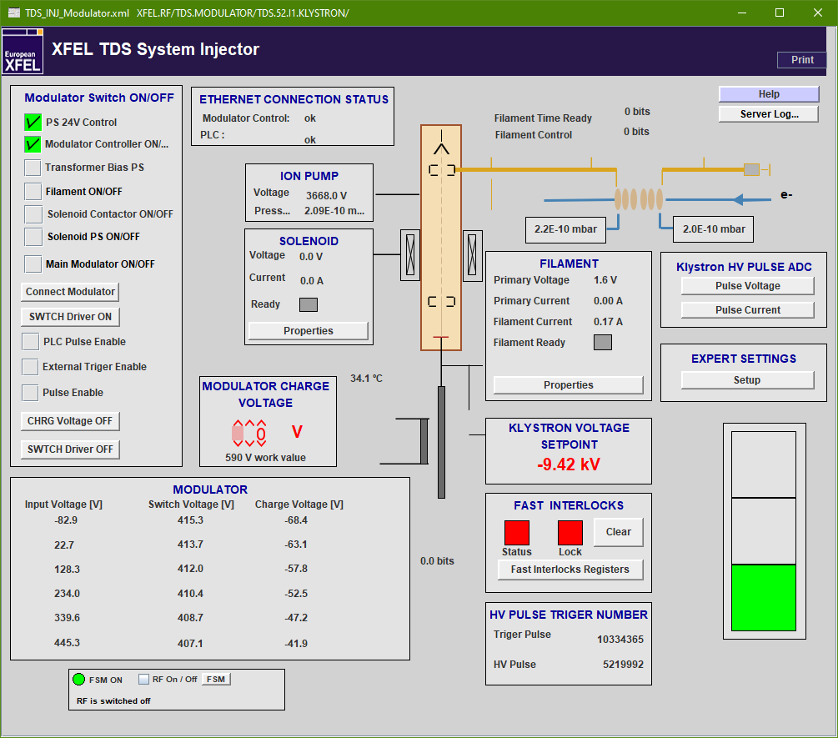
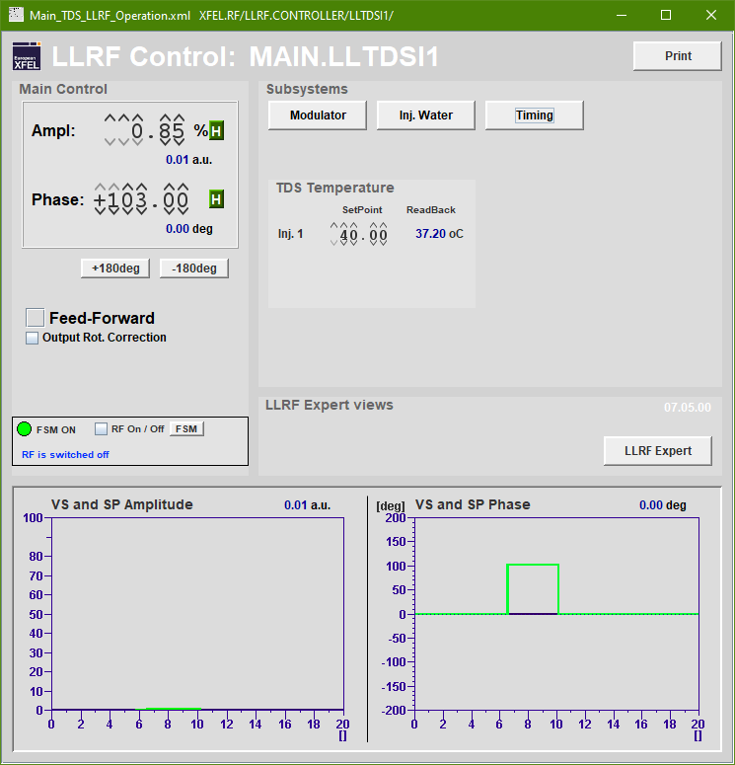
TDS Operation I1
RF system is switched on using the “FSM RF On/Off”-button

Slide 30
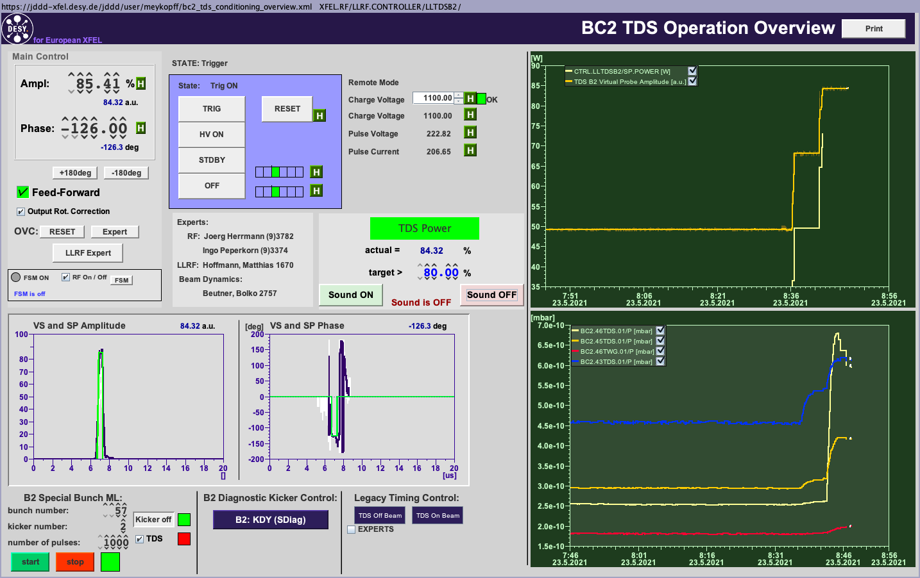
TDS Operation B2
Keep FSM off when not doing measurements
Manually switch RF on
Set “STDBY”, deactivate “Feed-Forward”, and “Ampl” to 0%
Set “Charge Voltage” to 900
Press “RESET”
Press “HV ON”
Wait if charge voltage is reached (otherwise repeat from reset)
Increase charge voltage to 1150 in steps of 10
Set “TRIG” and activate FF
Increase “Ampl” to about 95% while monitoring vacuum

Slide 31
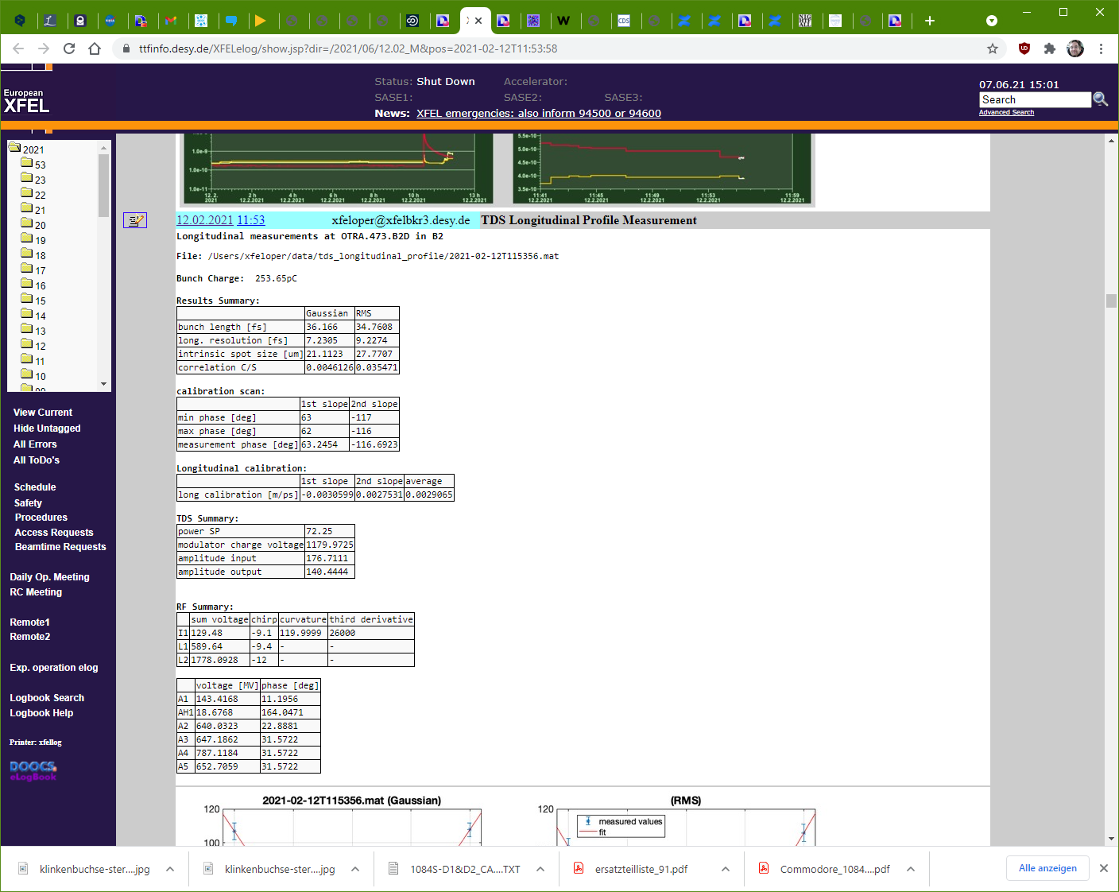
TDS Measurements Analysis
Results are directly send to elog
No summary screen in TDSMonitor GUI!
Additional data are send to elog (e.g. bunch charge, TDS LLRF)
Caution: Sum voltage and LLRF data are only stored for the first Flattop even in off-axis operation!

Slide 32
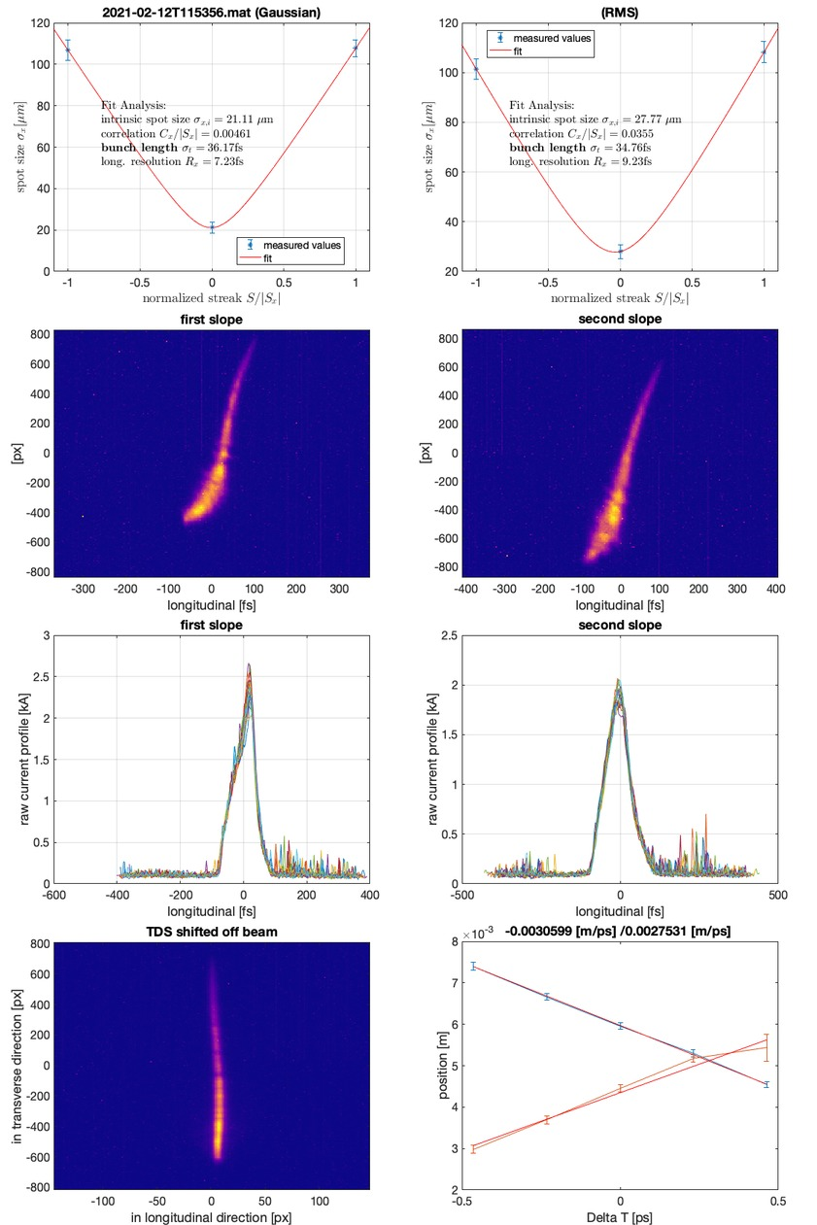
Is the compression properly setup?
Bunch length at B2 should be between 30-40fs for good SASE (250pC)
Longitudinal PS should look similar to the example
If unstreaked beam is “tilted” consider checking dispersion between injector and linac
A strong asymmetry between the spot- size of both “zero-crossings” is another indication for beam tilts

Slide 33
Thank You for Your Attention!

Slide 34
Questions?
Literature:
Igor Zagorodnov and Martin Dohlus, “Semianalytical modeling of multistage bunch compression with collective effects” Phys. Rev. ST Accel. Beams 14, 014403 – Published 13 January 2011
ICFA Beam Dynamics Newsletter No. 38, ( http://icfa-usa.jlab.org/archive/newsletter/icfa_bd_nl_38.pdf )
Various PhD theses: Frank Stulle ( http://www-library.desy.de/cgi-bin/showprep.pl?desy-thesis-04-041 ), BB (http://www-library.desy.de/cgi-bin/showprep.pl?desy-thesis-07-040 ), …
In-house Experts: Martin Dohlus, Igor Zagorodnov, Torsten Limberg, BB

Slide 35
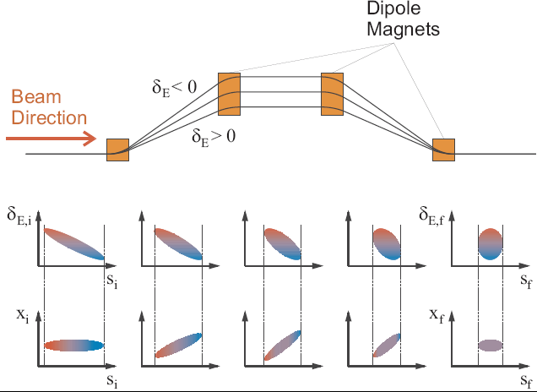
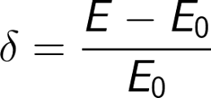
Bunch Compression – with Formulas

Slide 36
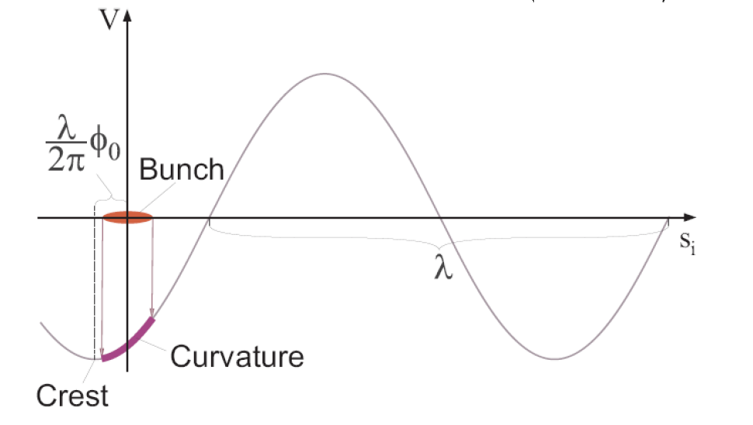
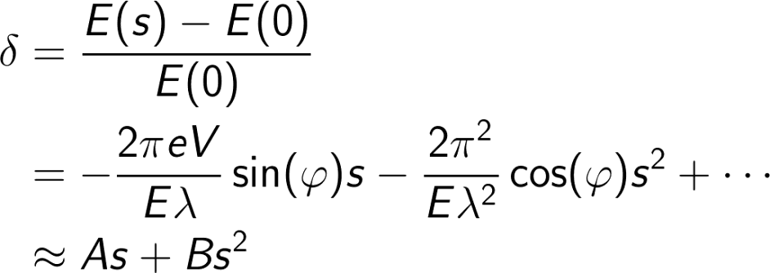
Energy Chirp Generation

Slide 37
Linear Compression
Full compression at , however C = 1/0 !

Slide 38
Linear Compression with Uncorrelated Energy Spread
each particle i has an individual “random” energy offset
Typically the “full” compression is avoided…

Slide 39
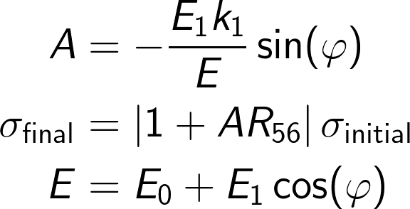
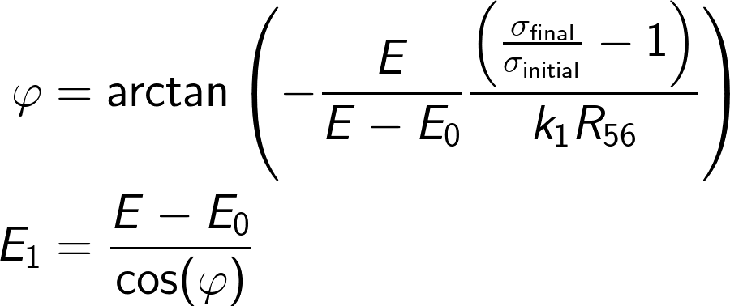
Simple Compression Setup
E₀,k₁,0 deg
E₁,k₁,phi
total energy E
Is this Ok?

Slide 40
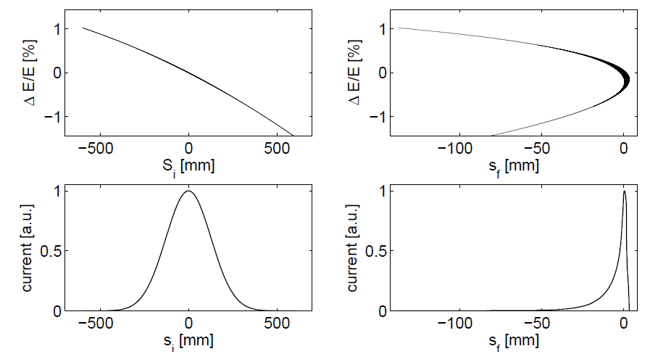
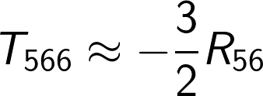
Non-linear Compression
E₀,k₁,0 deg
E₁,k₁,phi
total energy E
Can we tune the T₅₆₆-term to compensate the E₁ quadratic-term?
No since
This is NOT Ok!

Slide 41
Linarised Compression
E₀,k₁,0 deg
E₁,k₁,phi
E₂,k₂,180deg
total energy E

Slide 42
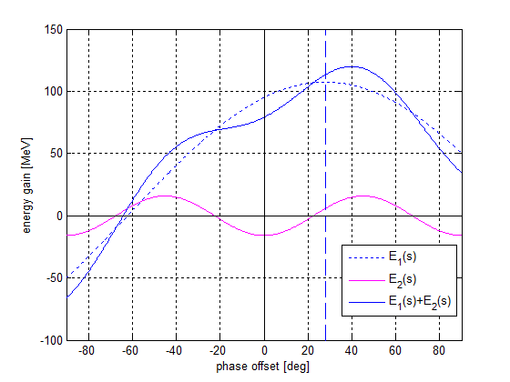
Energy Compensation
E₀,k₁,0 deg
E₁,k₁,phi
E₂,k₂,180deg
total energy E
Compensation of energy loss is required while the slope must be maintained.

Slide 43
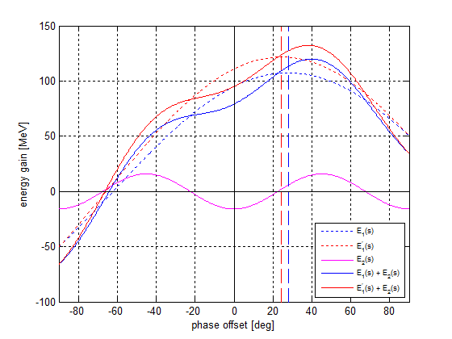
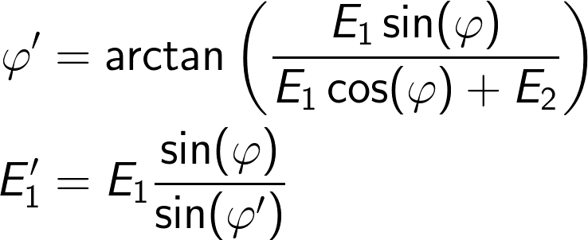
Energy Compensation
E₀,k₁,0 deg
E₁,k₁,phi
E₂,k₂,180deg
total energy E
Compensation of energy loss is required while the slope must be maintained.

Slide 44
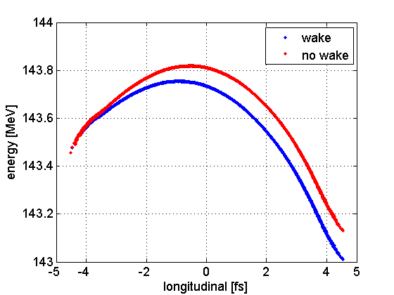
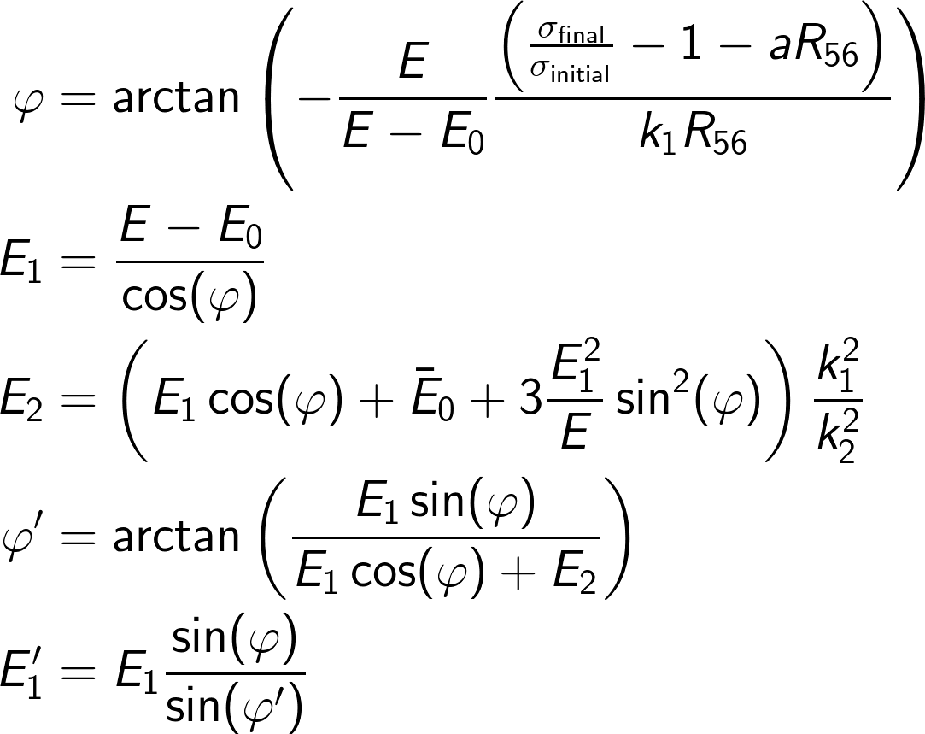
(Almost) General Solution for Single Stage BC
E₀,k₁,0 deg
E₁,k₁,phi
E₂,k₂,180deg
total energy E
head
If x-band is not operated “anti-on-crest” an additional linear compression term plays a role.

Slide 45
The End

