Slide 1
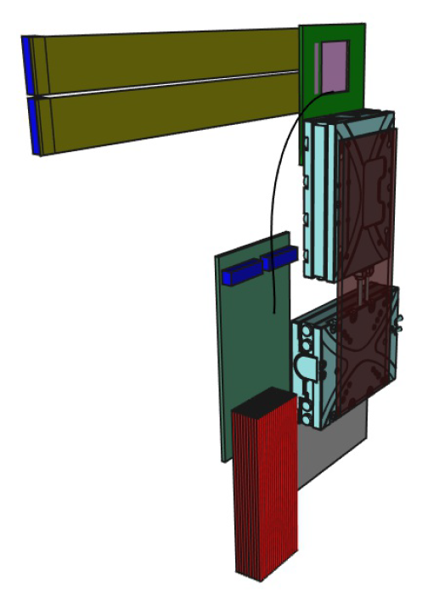
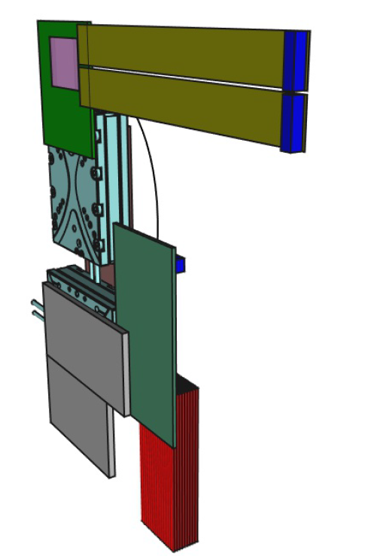
Gamma Beam Profiler design V(ersion)2
Maksim Skakunov (TSU), Sergej Schuwalow (DESY)
Sapphire Sensor
Sensor frame
Connectors
Flex Kapton cables
Connection plate
(movable)
Old Version V1,
1 sensor per station
Piezo motors
Patch panel
Support plate
(fixed)
~2-3 m
or ~30 m
to Control
room
Coaxial cables (Kapton ø1.2 mm)

Slide 2
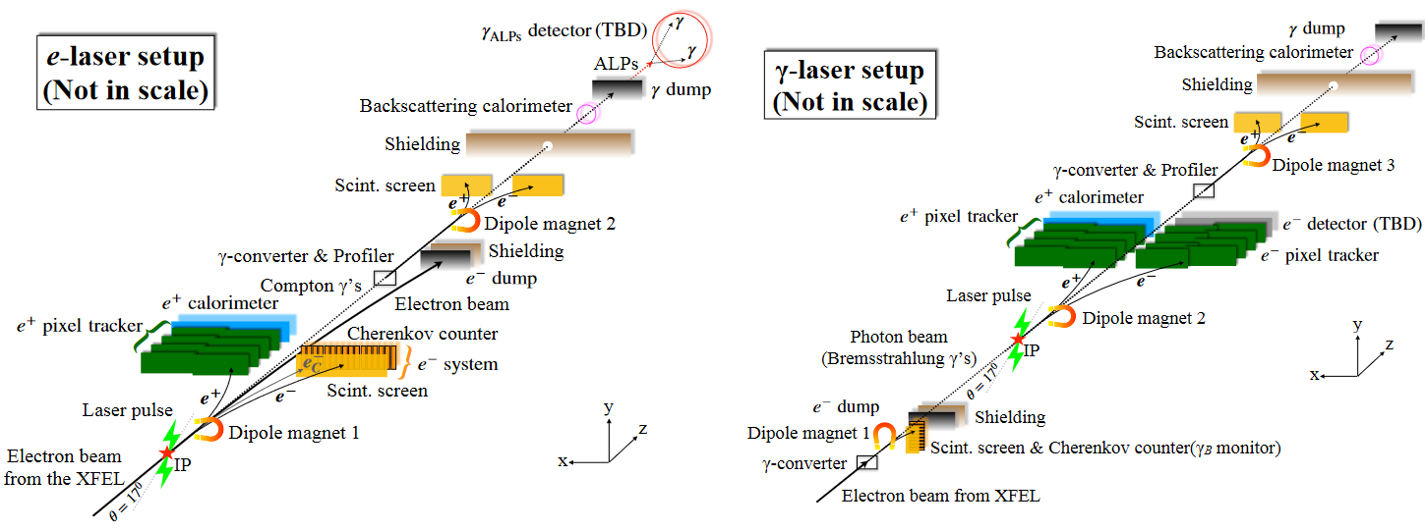
Sapphire sensors for LUXE Gamma Beam Profiler
2 sensors (1 double-station) baseline setup,
4 sensors (2 stations at different locations) – extended setup

Slide 3
Gamma Beam Profilometer
Min 2 cm
Now 1.5 cm
Beam
X
Y
Second
station?
Shielding box
with thin windows
for the beam
(Kapton 5 μm)
~2.5 m
+Small pitch
Si sensors
for periodic
beam control?
~1 min per week
Station cables
Patch-box
Cables to Control room
Floor

Slide 4
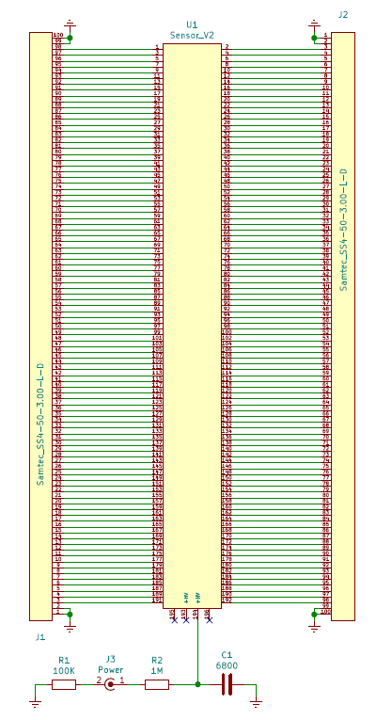
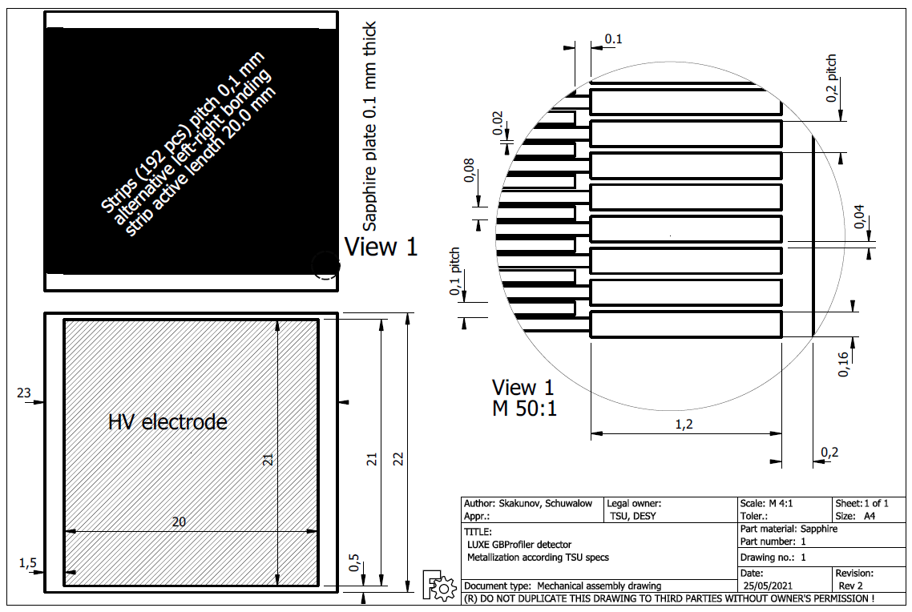
New sapphire sensor design

Slide 5
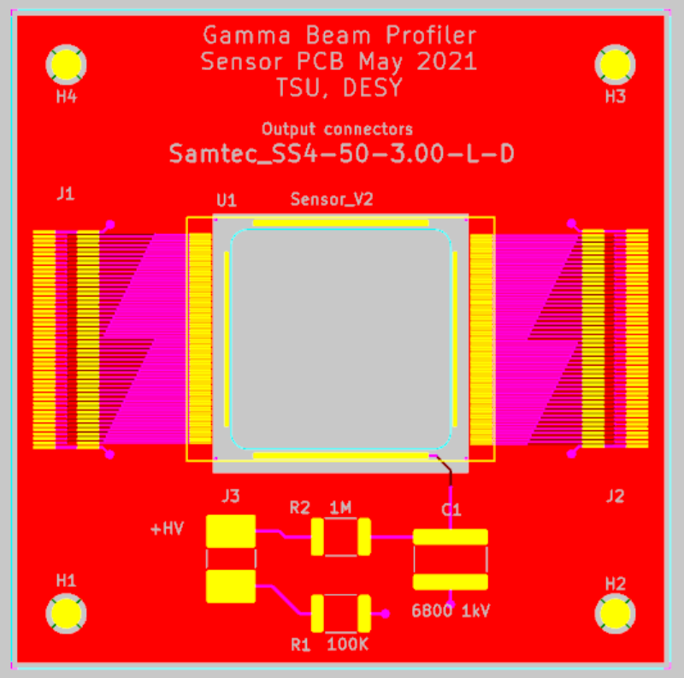
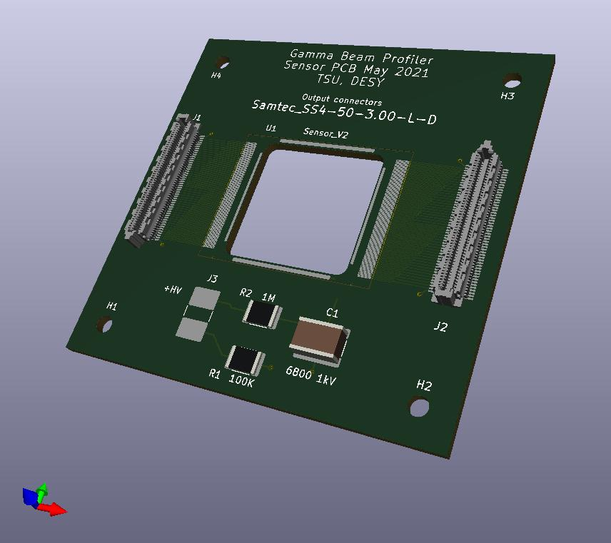
Sensor support PCB design

Slide 6
Sensor PCB
Outer size 60x60 mm²
Thickness 1.6 mm, 4 layers
Cutout 20x20 mm²
Two 100-pin connectors
for odd and even strips
HV cable (≥ 1kV)
Sensor is glued to PCB
(conductive glue for HV contact)
and wire-bonded to PCB

Slide 7
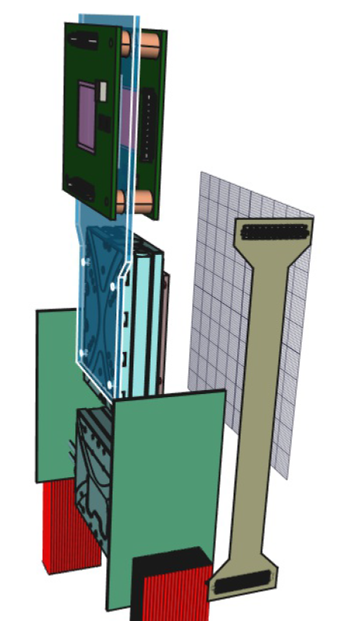
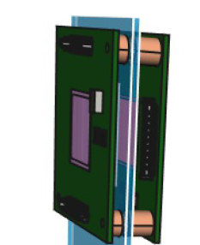
Station design (2 sensors per station)
Beam
dZ=15 mm
Patch
panels
V-strips
Flex Kapton cables (4 pcs)
H-strips
Coaxial
signal cables

Slide 8
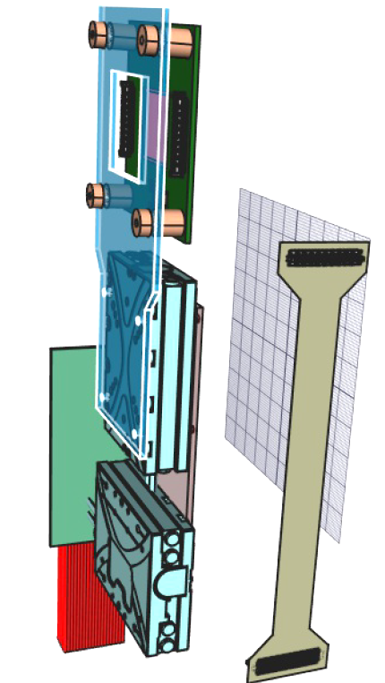
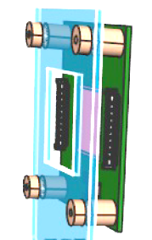
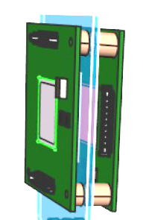
Station design (2 sensors per station)

Slide 9
Backup slides

Slide 10
Gamma Beam Profiler Station (1 sensor per station)
Sapphire Sensor
Sensor frame
Connectors
Connection plate
(movable)
Flex Kapton cables
Piezo motors
Patch panel
Support plate
(fixed)
~2-3 m
or ~30 m
to Control
room
Coaxial cables (Kapton ø1.2 mm)

Slide 11
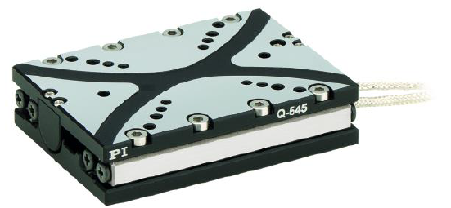
Physik Instrumente (PI)
www.pi.ws
https://www.physikinstrumente.com
Q-545.240
Drive force 7 N
Travel range 26 mm
Incremental sensor with nanometer position resolution
Maximal velocity 8 mm/s
Minimal incremental motion 6 nm
Bidirectional repeatability 200 nm
Cable length 2 m
Q-545.240
Q-Motion® Linear stage, piezoelectric inertia drive, 26 mm travel range, linear encoder, 1 nm resolution, 7 N drive force, dimensions 45 × 63 × 15 mm (W × L × H)
Physik Instrumente (PI) GmbH & Co. KG
Auf der Roemerstrasse 1 76228 Karlsruhe Germany

Slide 12
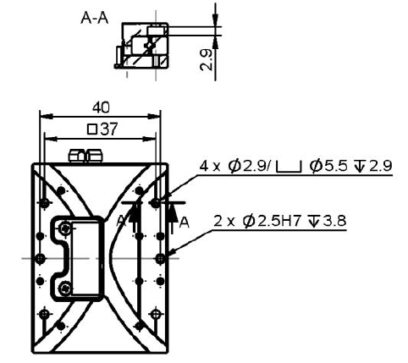
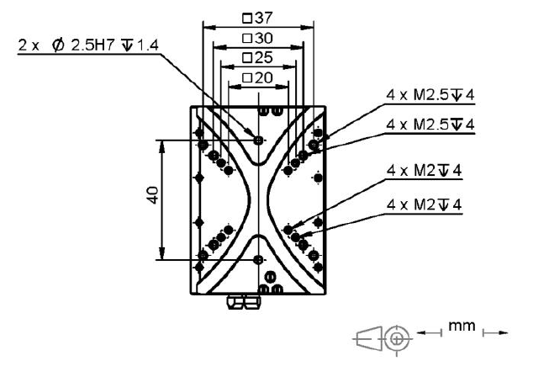
Q-545.240

Slide 13
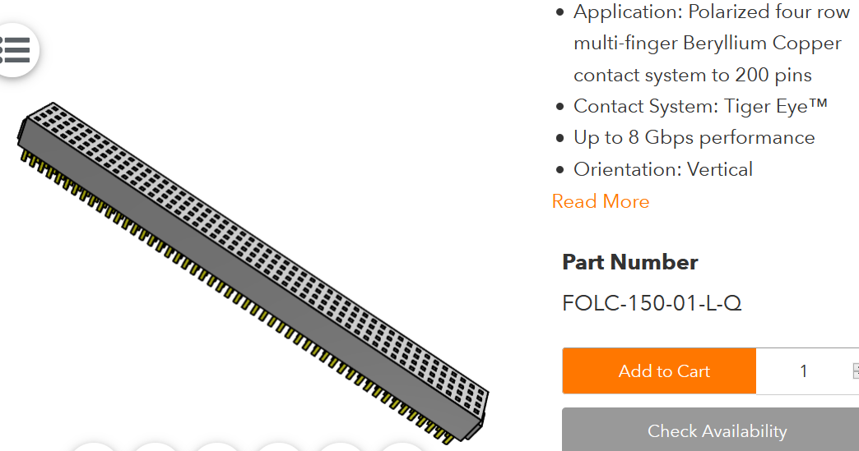
All connectors from
SAMTEC
Pitch 1.27 mm
100 Kapton ø1.2 mm
Coaxial cables

Slide 14
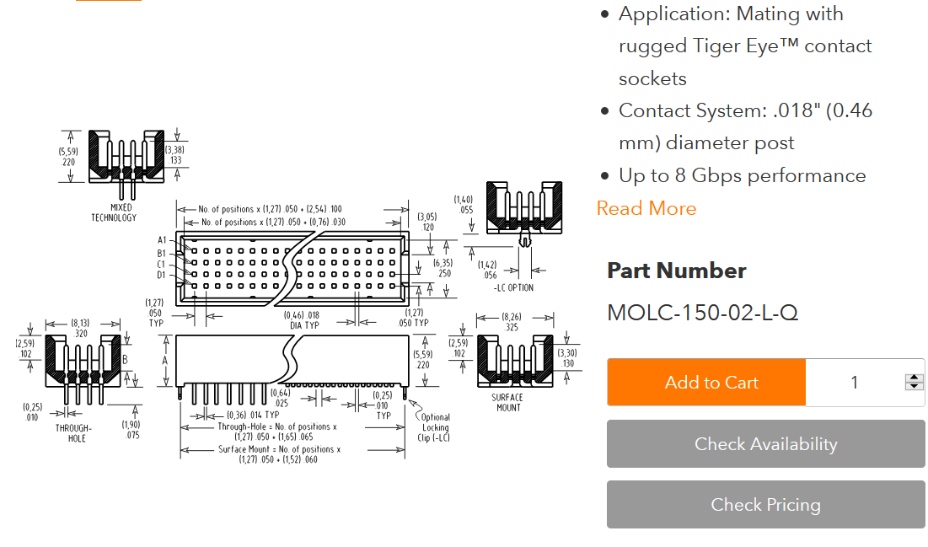
R/O electronics (or Patch-panel 2)
Signal inputs

Slide 15
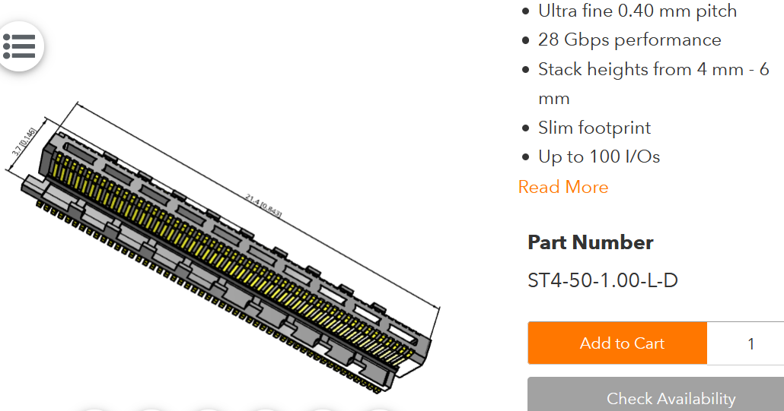
SAMTEC micro-pitch
Patch-panel 1
For flex Kapton cables

Slide 16
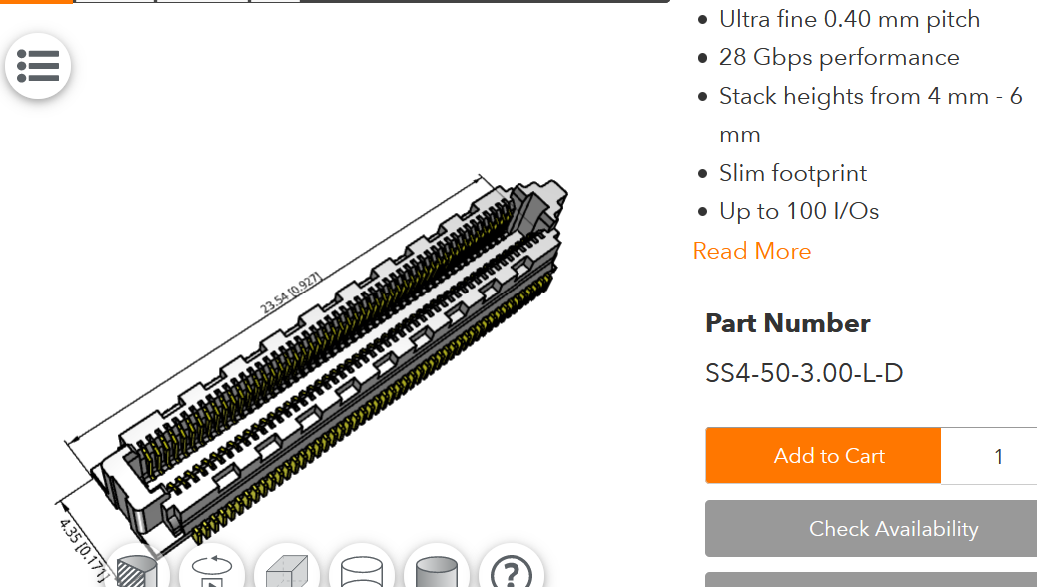
SAMTEC micro-pitch
Flexible Kapton cables

