Slide 1
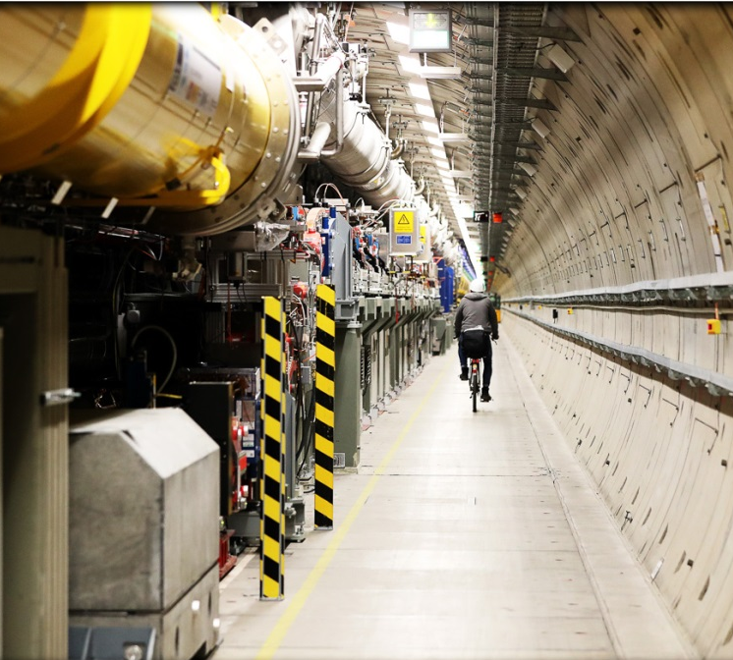
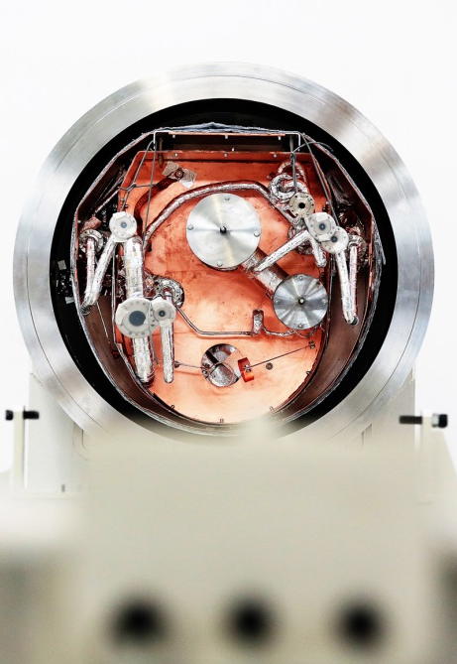
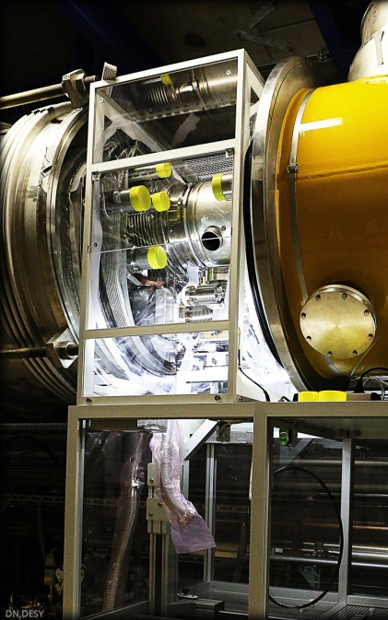
XFEL SASE tuning
Matthias Scholz
November 19, 2019

Slide 2
What is the aim of this operator training?
We will discuss how to find and maximize the SASE signal in all beamlines of European XFEL.

Slide 3
Assumed starting conditions
The electron beam can be transported through the undulator beamline.
It was verified that the electron beam quality is prepared/sufficient for SASE. A few critical items are:
beam optics matching in the injector.
correct magnet setup along the beamline.
closed dispersion in the injector.
proper compression settings in I1, L1 and L2.
All kind of feedbacks have to be operational e.g. trajectory and compression FB, IBFB etc.
There are no hardware errors from any undulator component.
The photon diagnostics in the respective beamline works (especially the FEL imager and the XGM including the HAMP).

Slide 4
Assumed starting conditions
These steps were covert in the operator training
Start-up procedure
The electron beam can be transported through the undulator beamline.
It was verified that the electron beam quality is prepared/sufficient for SASE. A few critical items are:
beam optics matching in the injector.
correct magnet setup along the beamline.
closed dispersion in the injector.
proper compression settings in I1, L1 and L2.
All kind of feedbacks have to be operational e.g. trajectory and compression FB, IBFB etc.
There are no hardware errors from any undulator component.
The photon diagnostics in the respective beamline works (especially the FEL imager and the XGM including the HAMP).

Slide 5
Beam optics matching and optimization
Optics match in the injector using the multi quad scan tool (See the emittance measurement and beam optics matching operator training).
Set all main magnets to design values and cycled them (use the design kick server panel).
Optimize the matching upstream the undulators using Ocelot with the prepared settings (e.g. SASE1 matching quad).
Last chance: One of the last tuning knobs can be the two air coils quads on the main solenoid in the injector.

Slide 6
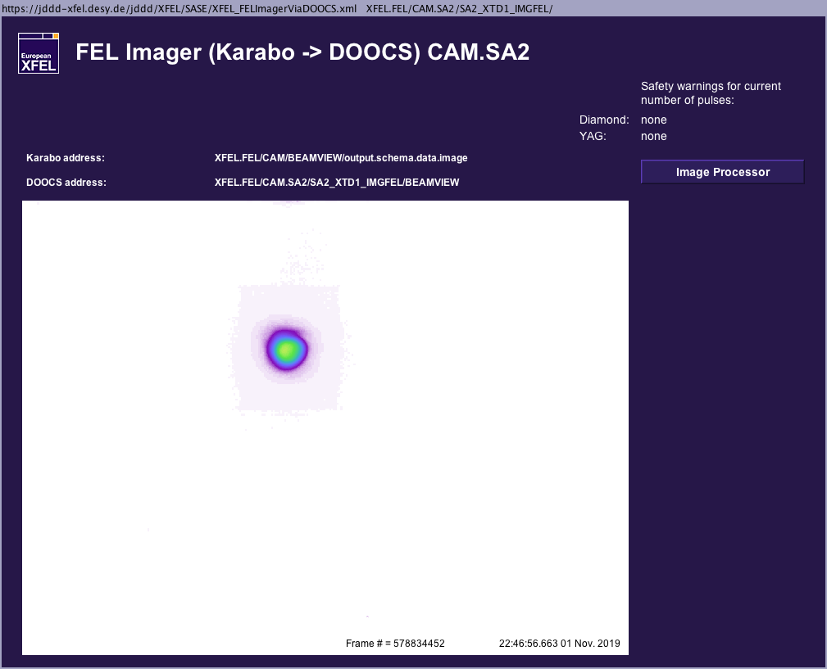
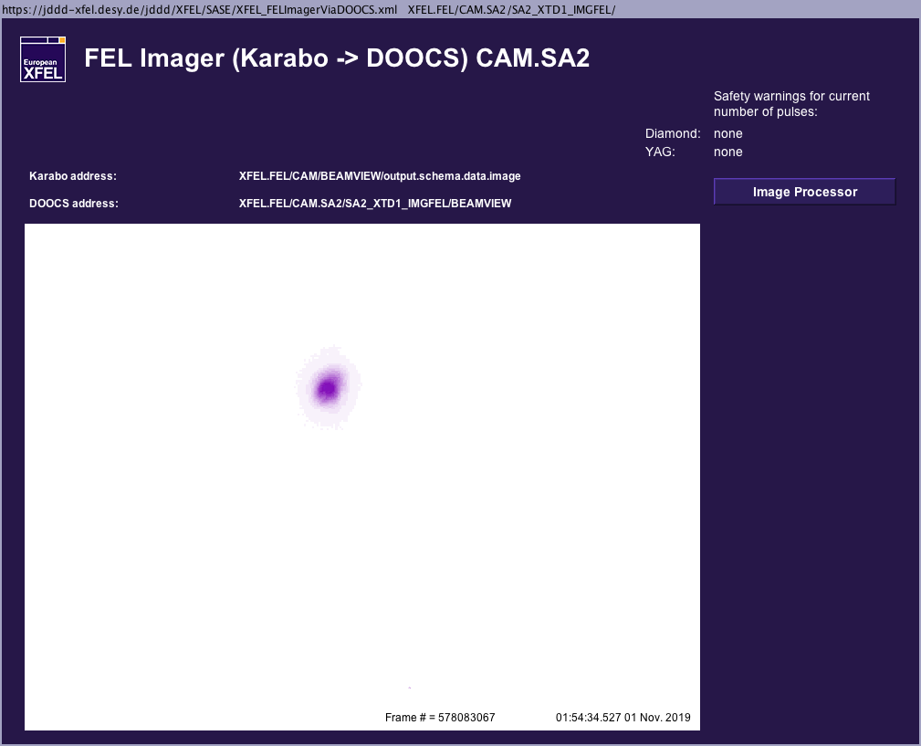
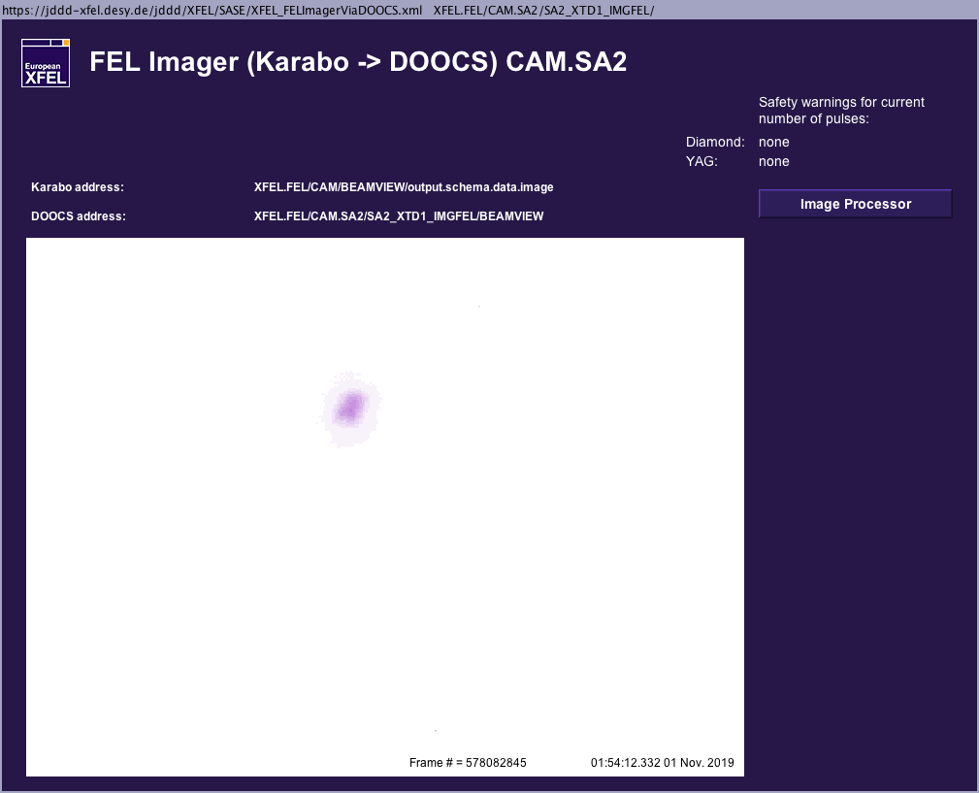
Crucial photon diagnostics devices, FEL imager
If you have no signal at all, you will need the FEL imager for sure.
The FEL imager is the device that will show you even the first glow of your signal.
In addition, the position on the screen gives a first indication on how to continue tuning with orbit modifications (launch).
The XGM will still show only noise when you have already a clear signal on the FEL imager like shown on the picture on the right hand side.

Slide 7
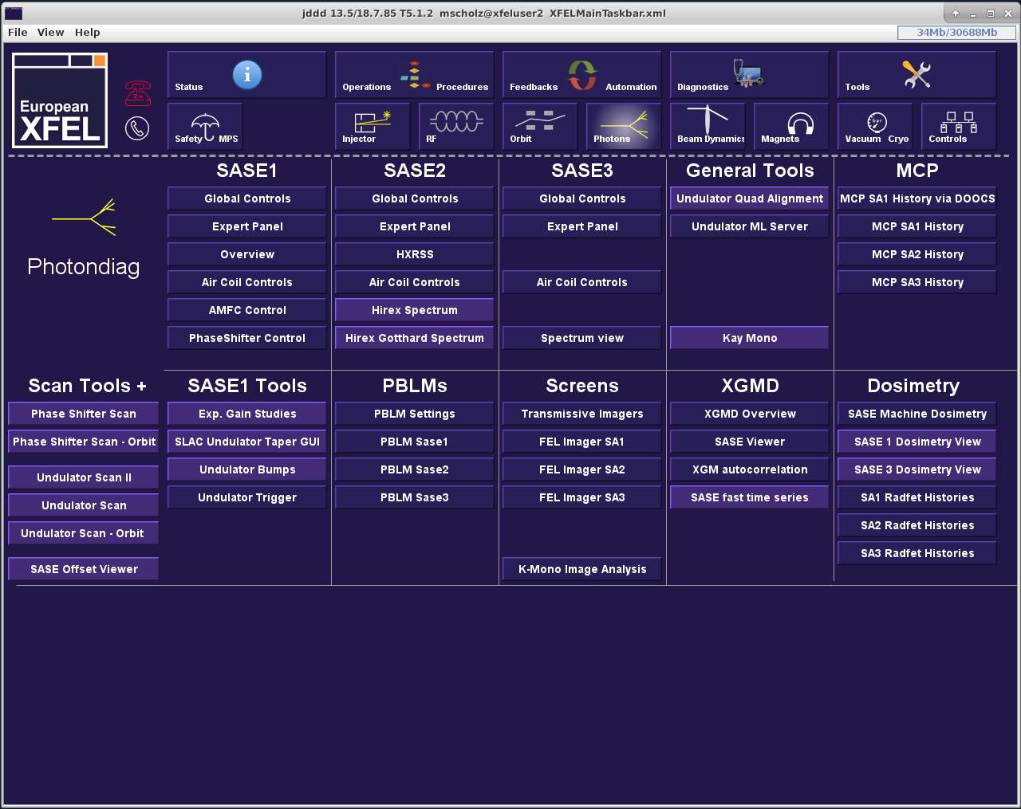
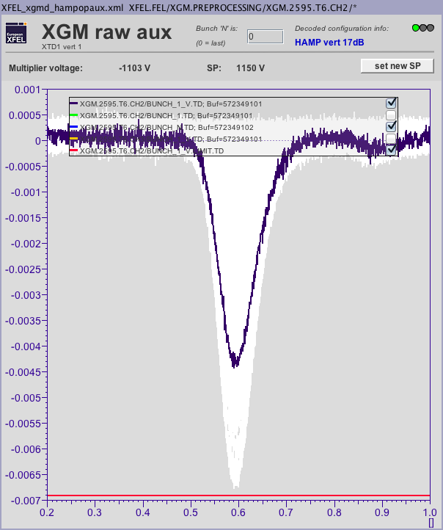
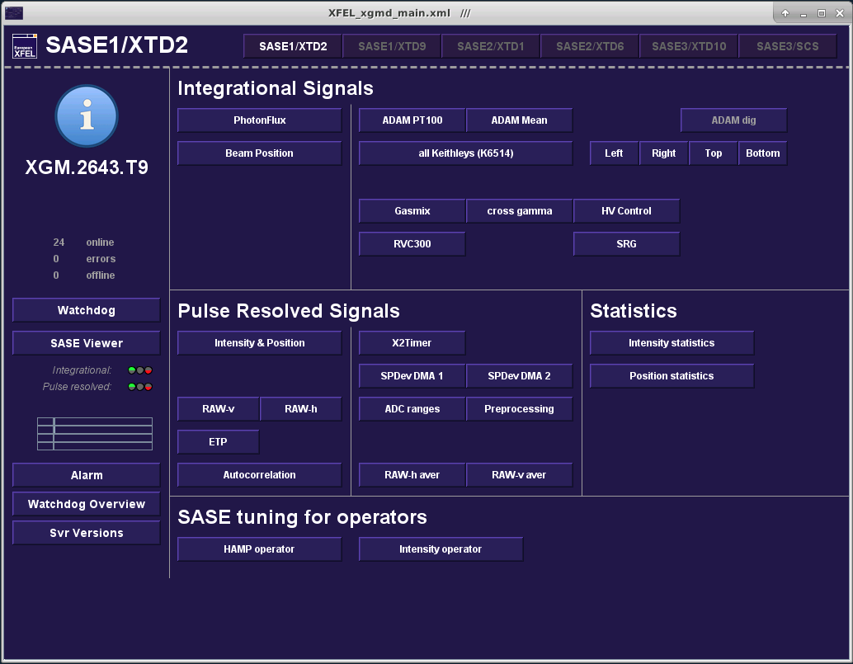
Crucial photon diagnostics devices, HAMP
The HAMP detector is also very sensitive to small SASE pulse energies.
Keep in mind that the maximum current of the HAMP must not exceed 7 mA!
That is also indicated by the red line at the bottom of the plot.
The maximum voltage setpoint is 1700!
Please do not forget to reduce the voltage when you are finished.

Slide 8
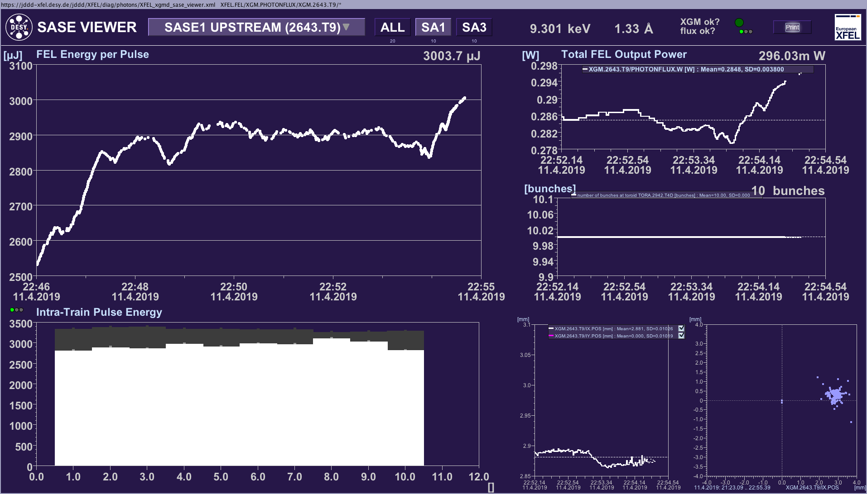
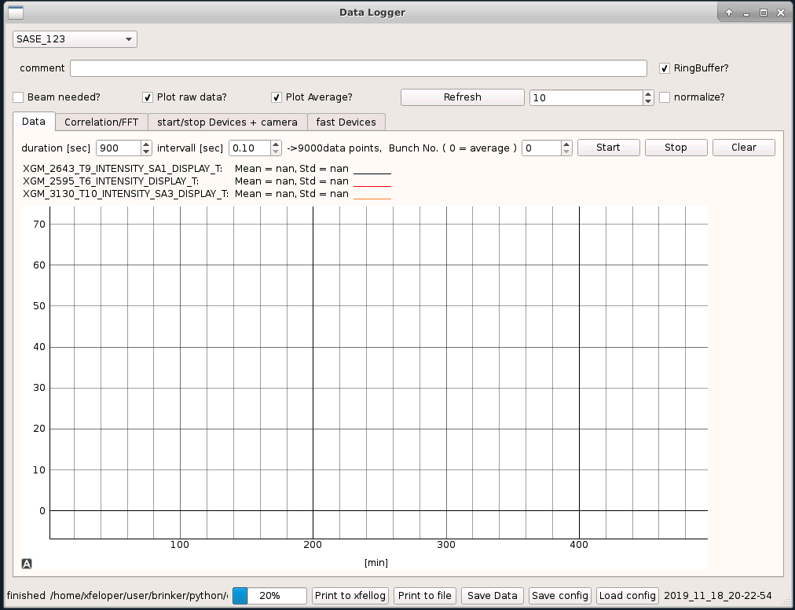
Crucial photon diagnostics devices, XGM signals
You can start using the following tools as soon as you have a decent SASE signal (>40 uJ).
SASE fast timing series
It shows fast signals (crucial for tuning).
You can follow all three beamlines which is helpful e.g. during compression tuning.
It is possible to show the SASE signals in normalized mode. That helps when the hard X-ray beamlines and SASE3 are at completely different levels.
JDDD SASE viewer.
Fast signals are shown in the bar plot bottom left. Change the repetition rate of this plot to 10 Hz!
You can see the impact on the different bunches along the pulse train when you use more than 2 bunches.

Slide 9
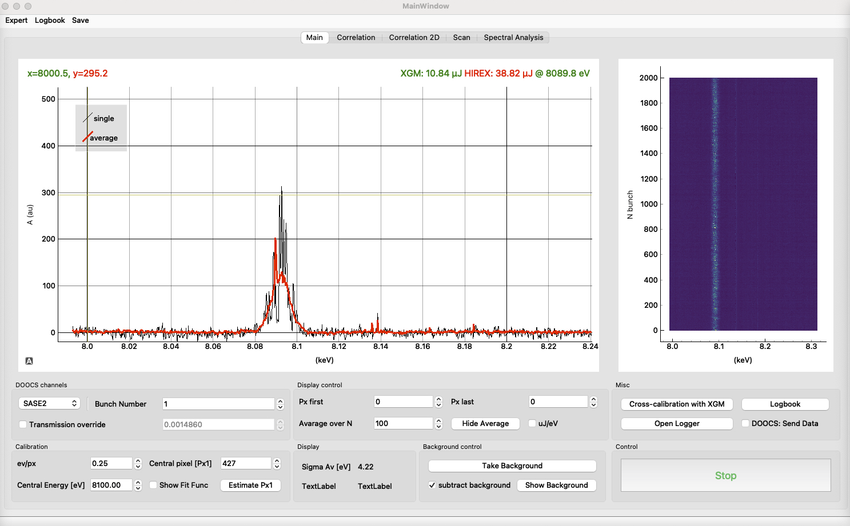
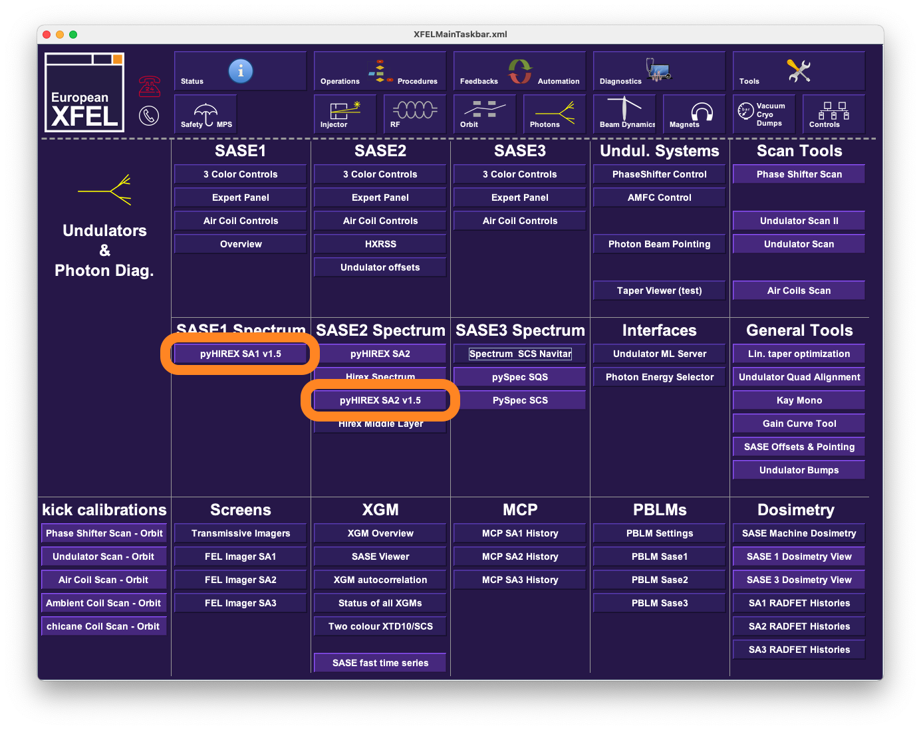
Crucial (future) photon diagnostics devices, PyHIREX
We will increasingly need to determine the exact photon energy using HIREX (in SASE1 and SASE2).
Currently, this is only possible with the help of trained experts, so this slide only serves as a preview of future tasks during SASE tuning.
The tool to use is called PyHIREX and can be found in the Main Panel under Photons.
Of course, we will provide appropriate trainings for HIREX and PyHIREX when the time comes that this tool can be used in BKR without expert knowledge.

Slide 10
Groups of actuators for SASE tuning
Launch corrector and aircoil settings
Bunch compression
Undulator taper settings
Phase shifter settings
Trajectory in I1, B1 and B2 (dispersion?)
Settings of matching quads (beam optics)
Intensity and position of the IR laser in the laser heater

Slide 11
General SASE tuning procedure
Machine setup from scratch
Ensure that the assumed starting conditions presented on slide 3 are fulfilled.
Remove all phase shifter offsets.
Chose an undulator trajectory that lased before and restore it using either the orbit correction tool or the FB including aircoils.
Apply the taper settings.
For SASE2: Scan the phase shifters upstream the chicanes. Start with the the second chicane.
Use the adaptive trajectory FB to improve SASE.
Check the bunch compression.
Check if the laser heater overlap is perfect.
Optimize the matching quad upstream the undulator section.
Adapt the taper settings if necessary.
Fine tuning with aircoils and phase shifters.

Slide 12
General SASE tuning procedure
Changing photon energy.
Before changing photon energy: switch on the undualtor orbit FB with either CA- or CB-type aircoils and fix the trajectory.
Remove all phase shifter offsets.
Adapt the taper settings. Rule of thumb: Higher photon energy -> start of power taper moves to larger numbers and vice versa. The other taper settings can stay the same.
For SASE2: Scan the phase shifters upstream the chicanes. Start with the second chicane.
Use the adaptive trajectory FB to improve SASE.
Adapt the taper settings if necessary.
Fine tuning with aircoils and phase shifters.
There is no need to:
Optimize compression nor the matching quads.
Change the beam’s trajectory through the undulator.
Scanning the aircoils should only help much if the photon energy was increased.

Slide 13
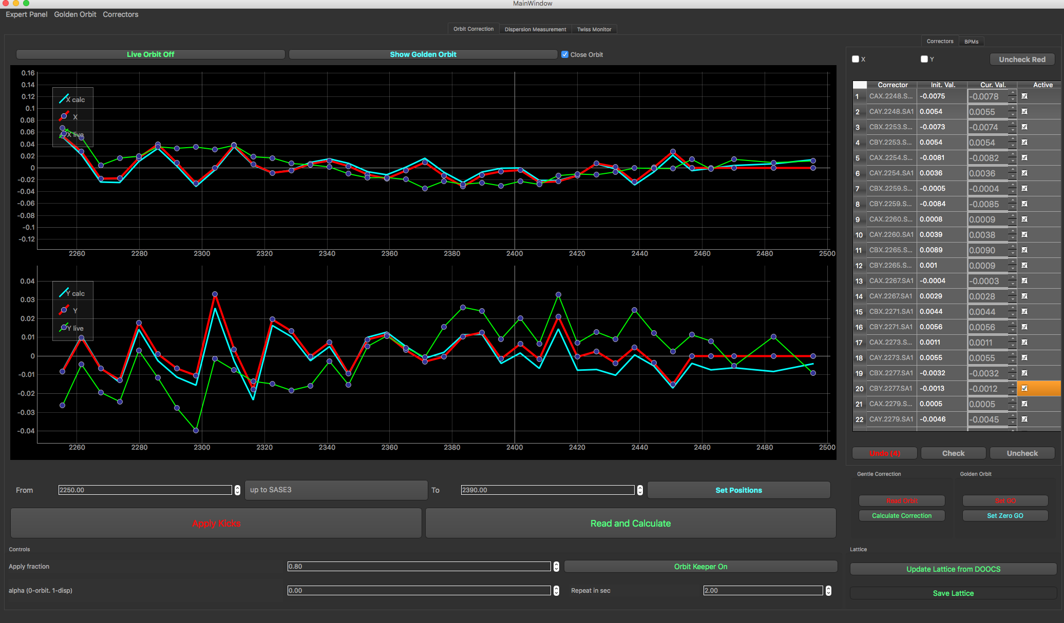
Trajectory in the undulator
-> how to set up the air coils in the undulator.
Case one: you have to start from scratch.
The best solution when starting from scratch is to establish the BBA orbit which means typically zero offset in all BPMs.
This can be achieved using the orbit FB.
Set the target orbit of the feedback to zero by pressing the respective button.
Start the feedback.
Configure the undulator orbit FB such that
Launch and undulator BPMs are selected.
Launch correctors and ONE type of air coils are selected.
As an alternative, you can also use the orbit correction tool to steer the beam to the zero orbit in the undulator.

Slide 14
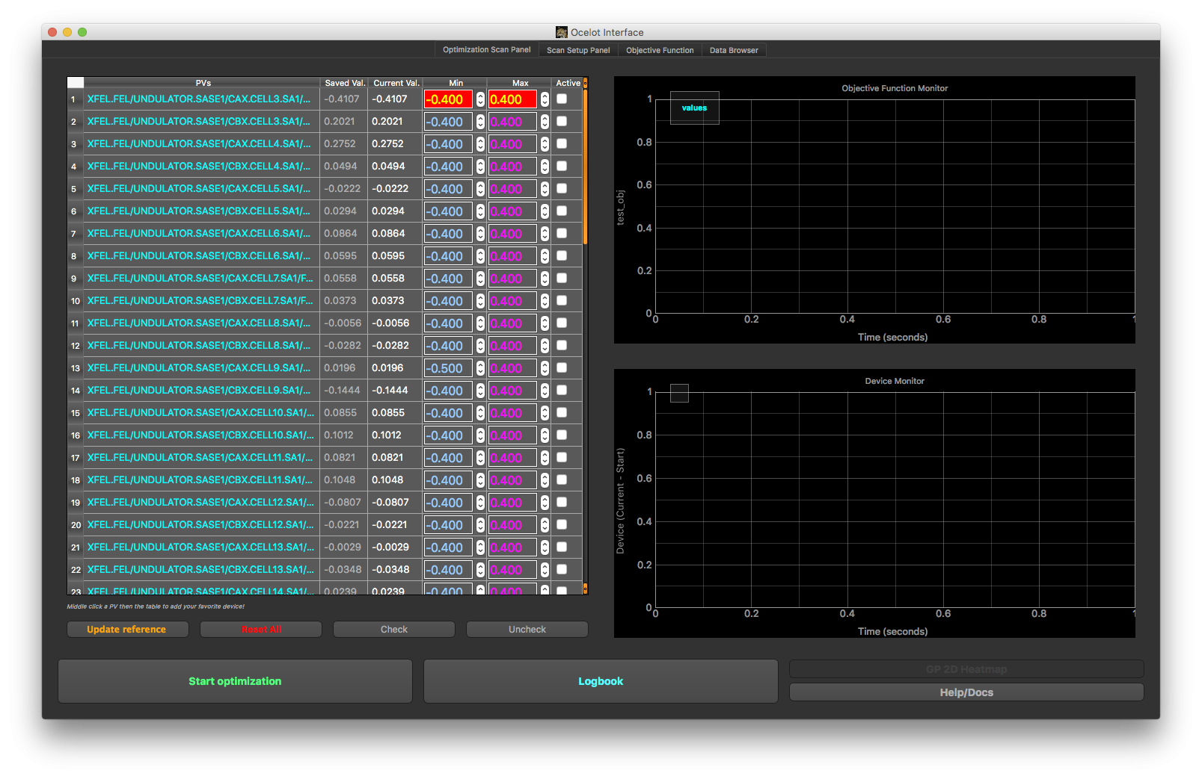
Trajectory in the undulator
-> how to set up the air coils in the undulator.
Case one: you have to start from scratch.
The trajectory achieved with the beam based alignment (BBA) should be good enough to get some lasing. But it does not necessarily have to be the optimum trajectory.
An optimization of aircoil settings is necessary.
The maximum number of aircoils in one optimization setup should not be larger than 8.
Start with aircoils in both planes. Use only aircoils in one plain in the second or third iteration steps.
Be careful that the section you are optimizing is not monitored by the orbit feedback.
Start with as few undulator cells closed as necessary to get lasing in the range of 100-200 uJ Add more and more cells during the optimization.

Slide 15
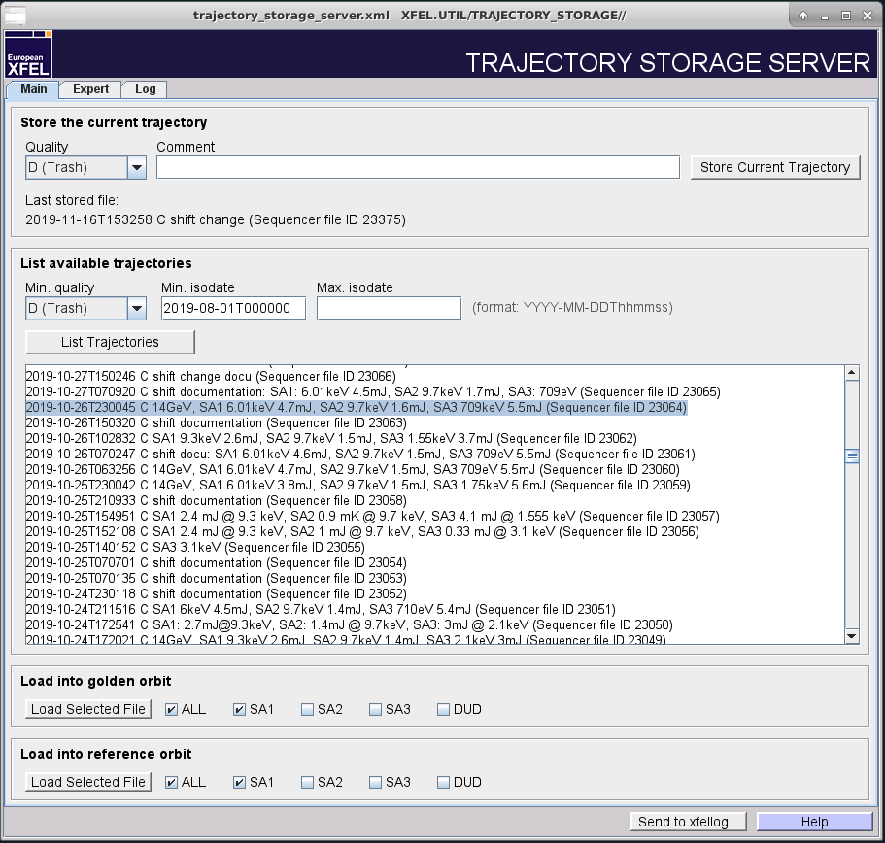
Trajectory in the undulator
-> how to set up the air coils in the undulator.
Case two: you have already a trajectory stored for the same (or for a higher) photon energy.
Select the file in the trajectory storage server.
Load the trajectory to the golden and to the reference orbit. Choose the respective subtrain (beamline) before.
Load the reference orbit into the undulator orbit FB by pressing the button ‘From Orbit serv.’
Start the FB without taking an additional golden orbit.
Configure the undulator orbit FB such that
Launch and undulator BPMs are selected.
Launch correctors and ONE type of aircoils are selected.

Slide 16
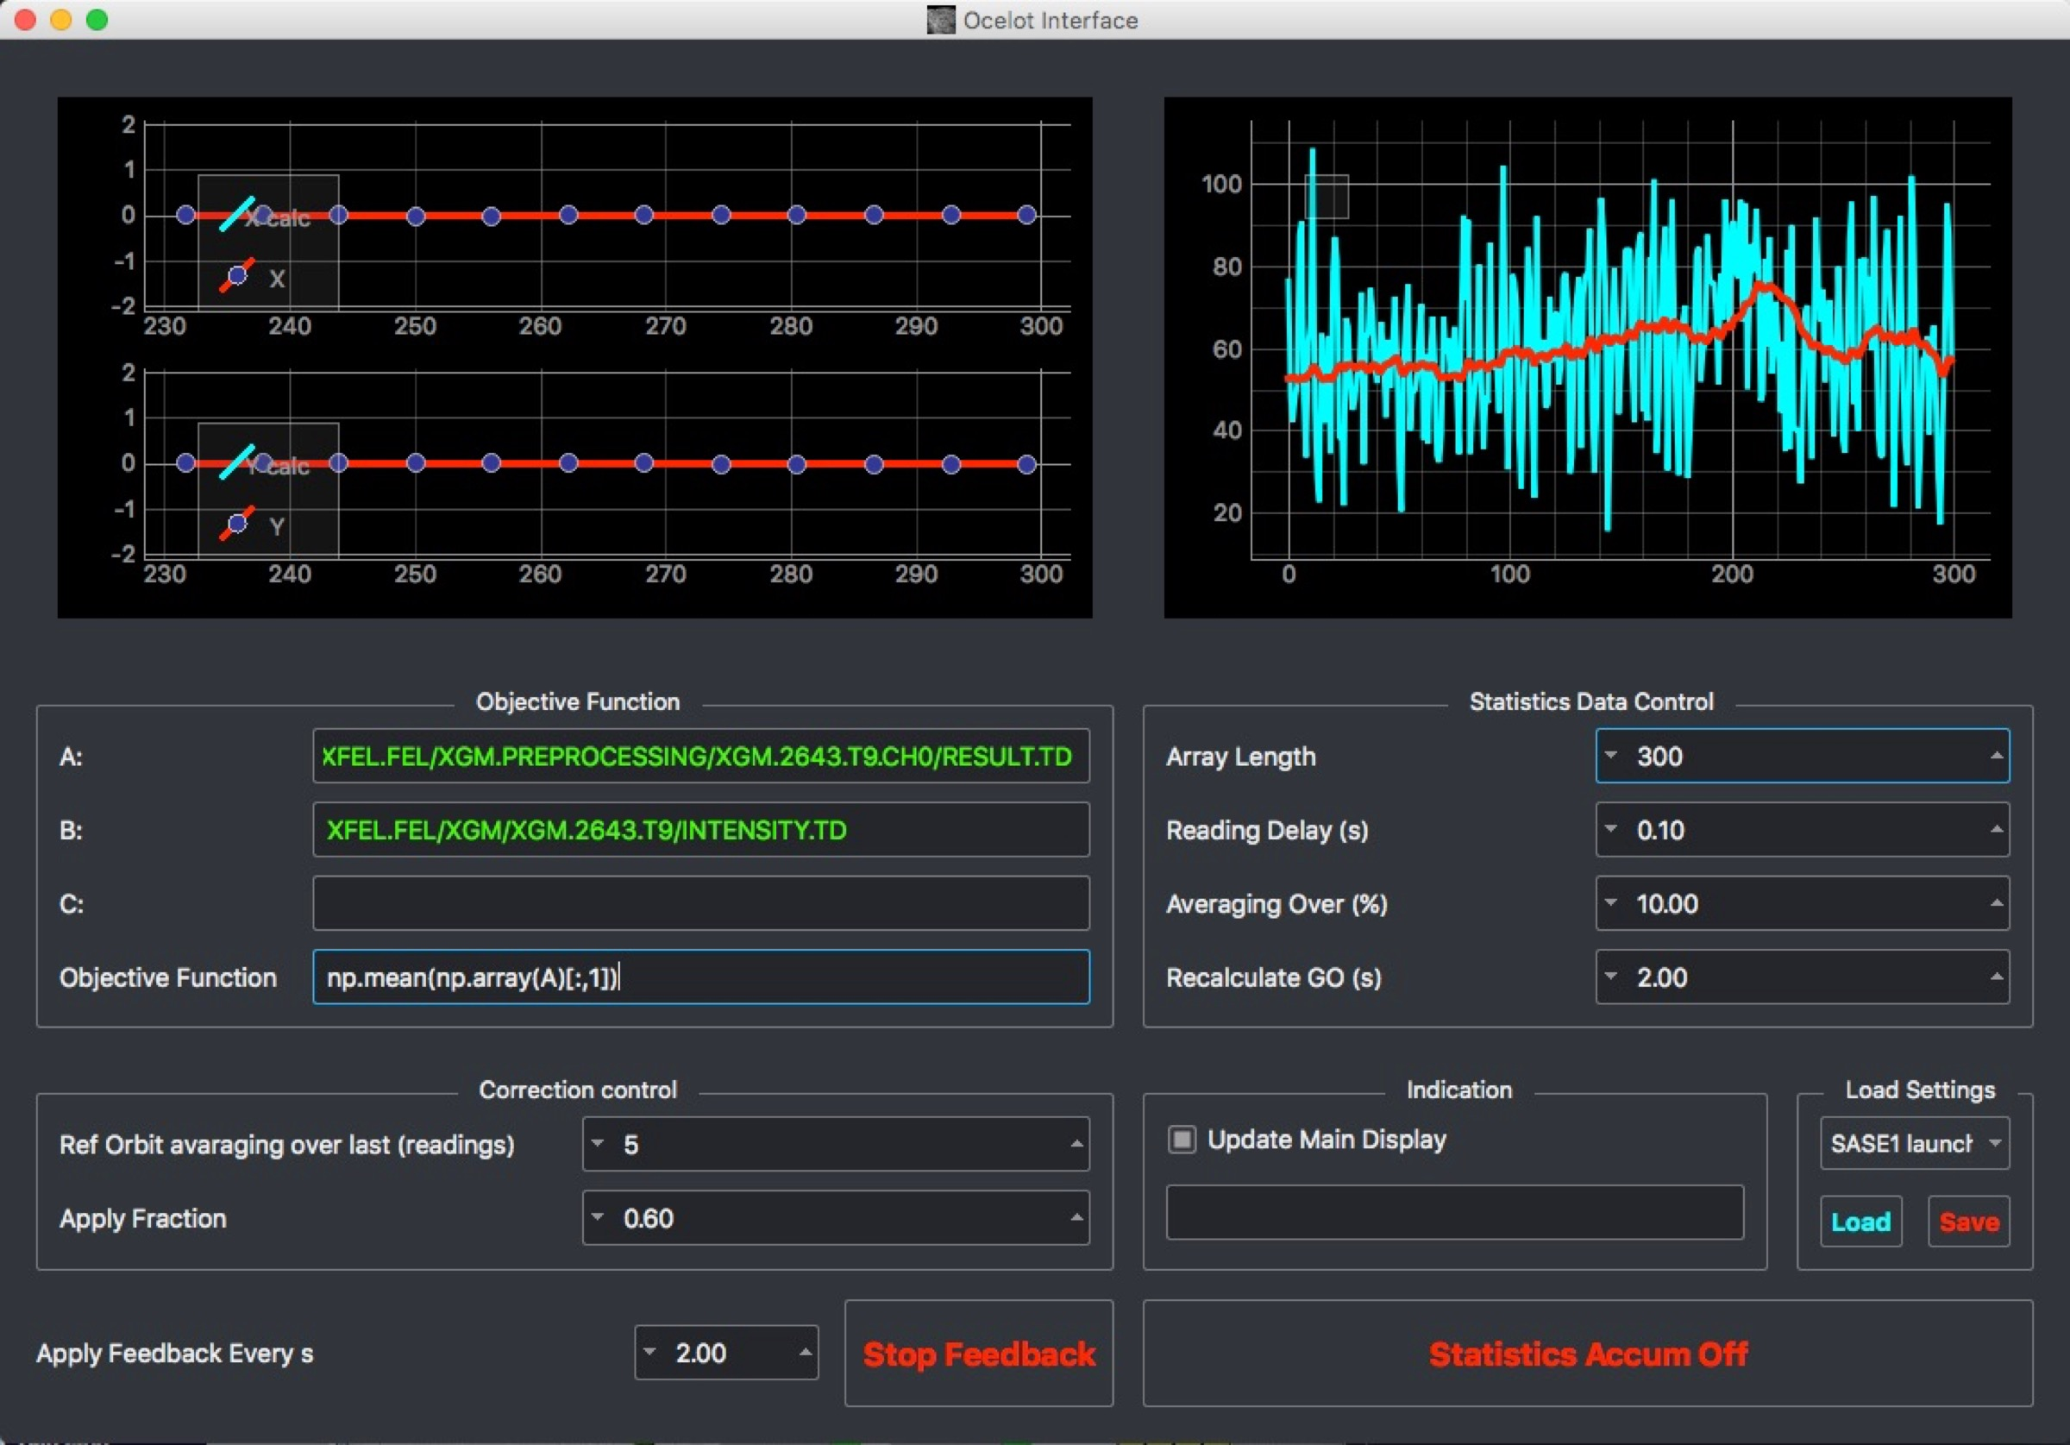
Trajectory in the undulator
-> how to set up the air coils in the undulator.
Case two: you have already a trajectory stored for the same (or for a higher) photon energy.
Switch off the default feedback.
Run the adaptive FB to optimize the launch trajectory into the undulator.
Remember that it always helps to assist the feedback with some induced orbit jitter using the correctors on the SASE tuning panels.
Take a new golden orbit with the default orbit feedback and run it again.

Slide 17
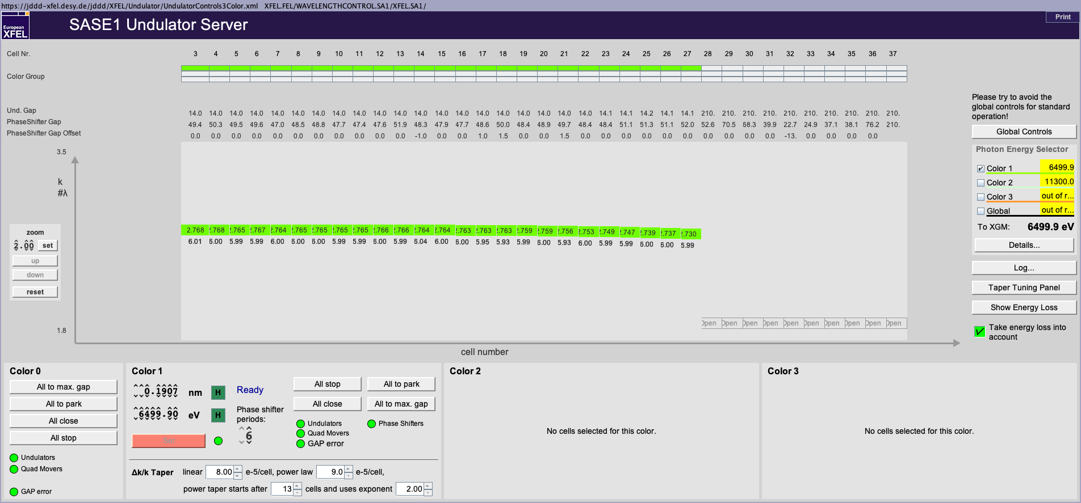
Undulator taper settings
Taper settings are currently often found by empirical tuning based on start values from previously used settings (wait for next slide).
Keep in mind that the start of the power taper moves downstream with increasing photon energies.
Try combinations like: reduce the quadratic taper but move it’s start one cell upstream.
Check the movement of all undulator cells! You can see that best on the ‘Taper Tuning Panel’ available via the button on the right.
Start a new photon energy always with zero offsets for the phase shifter gaps.
Check whether the chosen period of the phase shifters is suitable for the current combination of electron beam energy and photon beam energy.

Slide 18
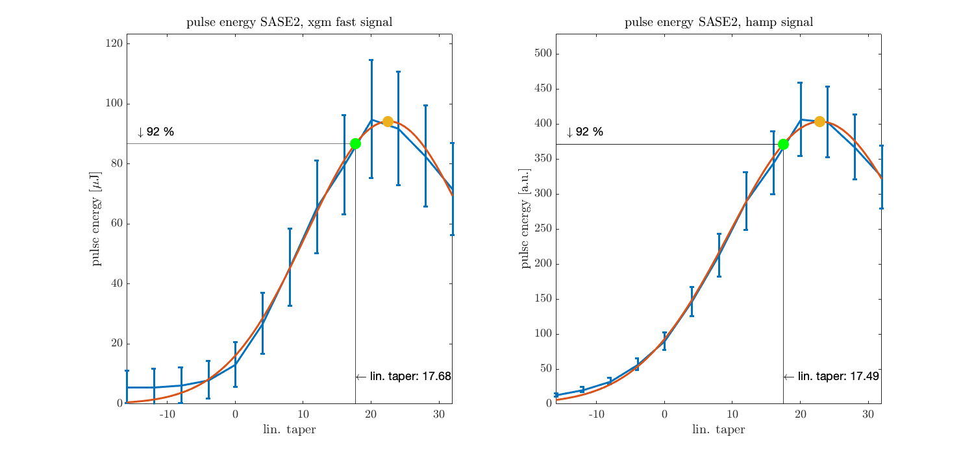
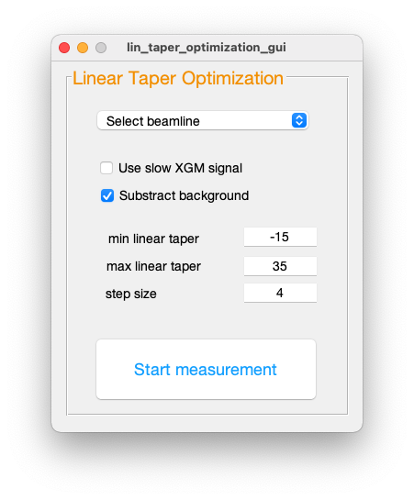
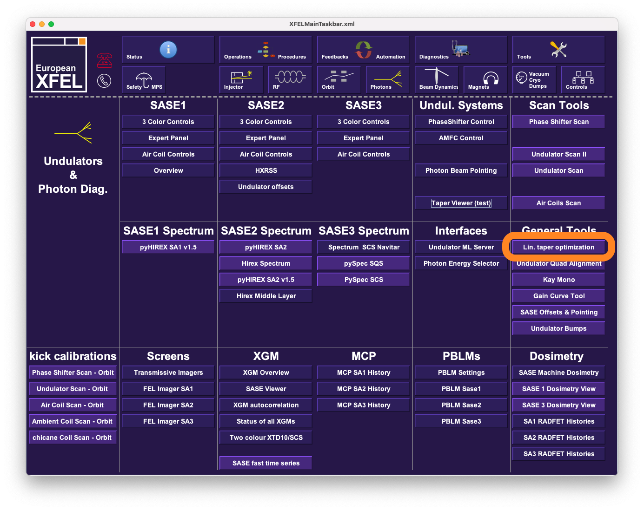
Finding the best linear taper
There is a scan tool available that scans the linear taper, evaluates the data and provides you with a proposal for the ideal linear taper.
You can find this tool here: Main Panel -> Photons -> Lin. taper optimization
Run this measurement:
Prepare HAMP in the corresponding beamline.
Open undulator cells until you have only 30-50 uJ left.
Use the background subtraction.
Switch off the undulator orbit FB.
Select a beamline and press Start measurement.
This measurement is time consuming and it is enough to check the correct taper setting once at the beginning of the week for a given undulator setup.

Slide 19
Bunch compression
A design bunch compression setup can be found in the procedures: confluence.desy.de/x/G4iXD
Remember that the calculated curvature has to be reduced by roughly 150 (e.g. 120 instead of 270). This difference was found by measurements.
The theoretical compression setting can be used as a start setting.
Compression setup using the BC2 TDS would be the ideal way how to prepare the bunch compression.
However, the practical experience is currently that the final setup is found by empirical tuning of chirps, curvature and third derivative.
There is also an operator training on bunch compression available on this page
https://confluence.desy.de/x/6qTkCQ

Slide 20
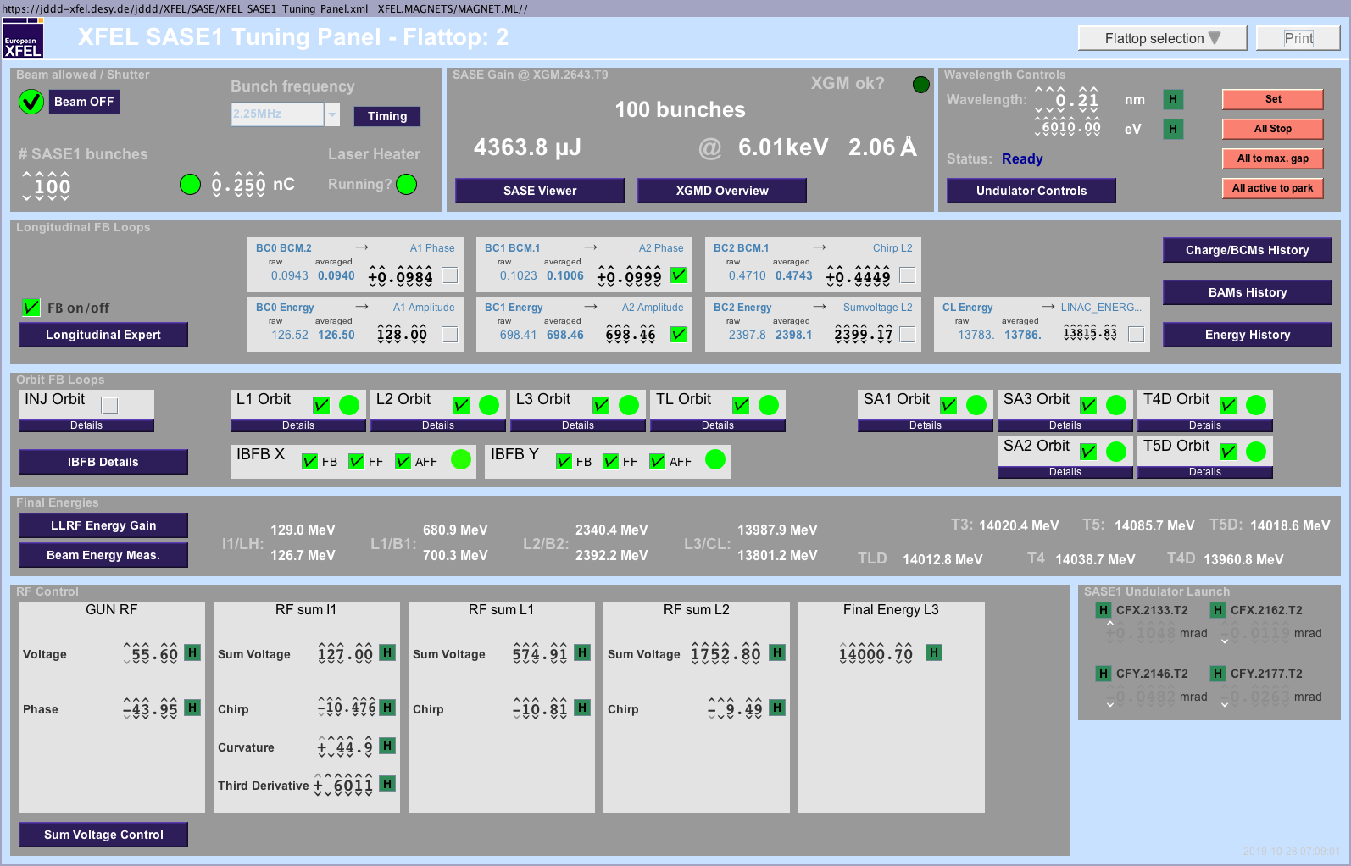
Bunch compression, details
Keep in mind that there is possibly more than one RF-flattop active!
Case one: No SASE signal at all
Use the BC monitor readback values to compare the actual settings with previous setups (for the same bunch charge).
Ensure that the bunches are not already over compressed (more chirp has to lead to higher BC monitor read back values).
Use the FEL Imager to look for the first SASE glimmer on the screen that no other device can already detect.
Case two: Improve an existing SASE signal
New distribution of compression between sections: reduce the compression in I1 slightly and compensate with the compression in L1. Redo the same with more compression in I1 and less in L1. Try also all possible combinations of I1, L1 and L2.
Change the curvature and compensate the compression with the chirp in I1. Redo the same with the third derivative.

Slide 21
Injector trajectory
It is well known that the wrong injector trajectory can suppress lasing completely.
Start with a corrector setup in the injector that was saved before while the machine was lasing.
Or correct the beam’s trajectory in the section to a golden/reference trajectory saved before when the machine was lasing.
We have indications that closing the spurious dispersion in the I1-section increases the SASE signals. This can be achieved with the Ocelot optimization tool using the prepared settings (horizontal dispersion and vertical dispersion in the injector).
You can also use the same correctors (those for dispersion correction) with the optimizer using the SASE signal as target function. Keep in mind that this does only work with about 15 seconds delay between the modification of the corrector’s currents and the data taking. This time is needed by the feedback systems along the beamline to restore the previous system setup (in this case mainly the beam’s trajectory).

Slide 22
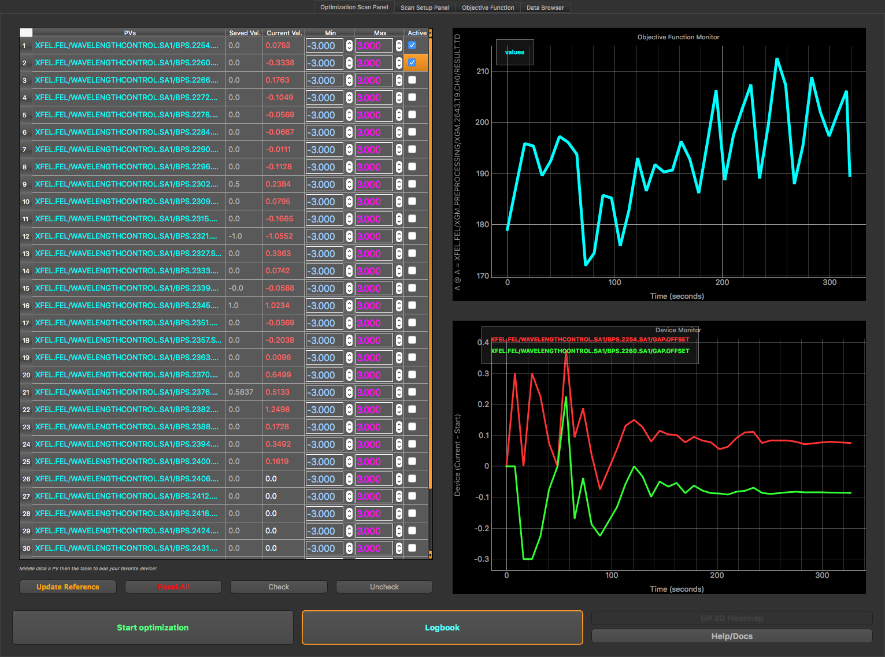
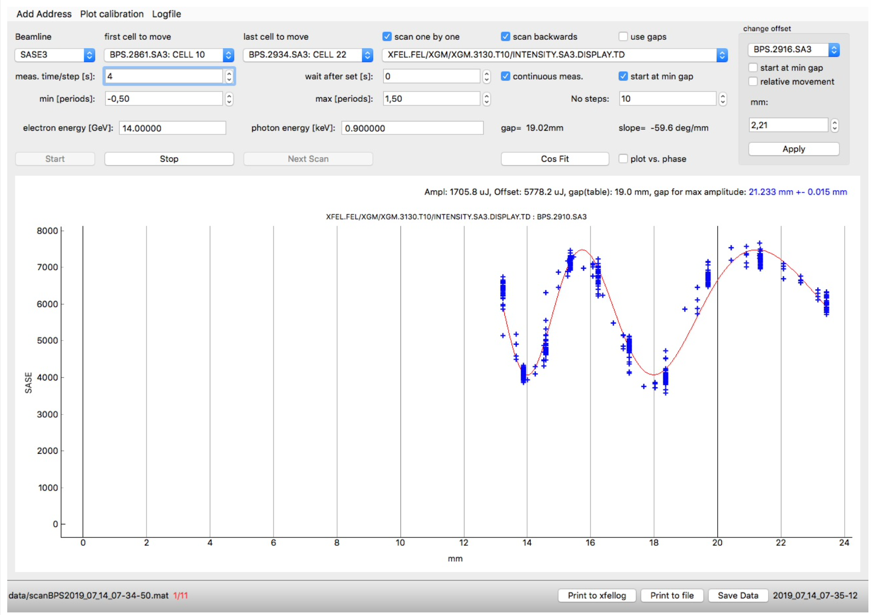
Phase shifter optimizations
We have learned in the past that the setup of phase shifters can have a tremendous impact on the SASE pulse energy.
There are currently two tools available to optimize the phase shifter’s setup:
The Ocelot optimizer using the prepared settings.
The phase shifter scan tool. Please start with the last closed cells when using this tool.
Keep in mind that the phase shifters are not completely steering free!
For that reason, the scanning/optimization of the phase shifters should be done with the trajectory feedback running using also the undulator BPMs as well as the CBX/CBY aircoils. Use the Matlab tool for this configuration.

Slide 23
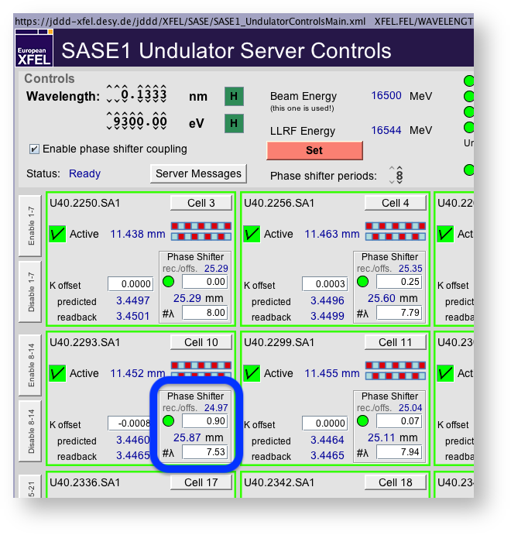
Important information for scanning the phase shifters
It is often the case that the phase shifter are set to values that make no sense and we also often experience that setting all phase shifter offsets to zero improves the SASE signal.
Be aware of this problem before you spend much time for phase shifter optimization scans!
The period of a single phase shifter (the lower number in the blue rectangle shown on the right hand side) should not deviate more than +-0.2 form the next integer value.
You can spare the time to scan the first 7-10 phase shifters. They typically do not improve the pulse energy by much. The same is true for the last closed cells. Find the most efficient phase shifters and improve only those!
Of course there is an exception for SASE2: Always scan the phase shiftesr upstream the chicanes first. Start with the second chicane.
https://confluence.desy.de/x/J8HqCg

Slide 24
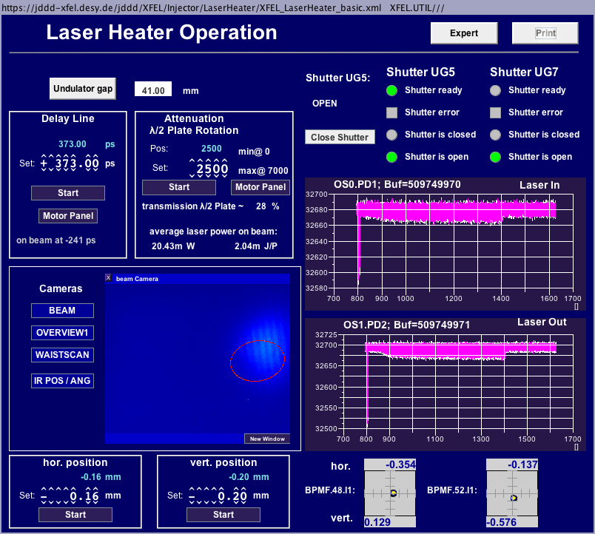
Laser heater setup
The laser heater can be currently used for optimization with 3 different parameters:
Intensity (change in steps of 100 – 1000).
Horizontal offset (change in steps of 0.01 – 0.1 mm).
Vertical offset (change in steps of 0.01 – 0.1 mm).
Test different settings like:
More power but also a lager offset and vice versa.
Different combinations of horizontal and vertical offsets.

Slide 25
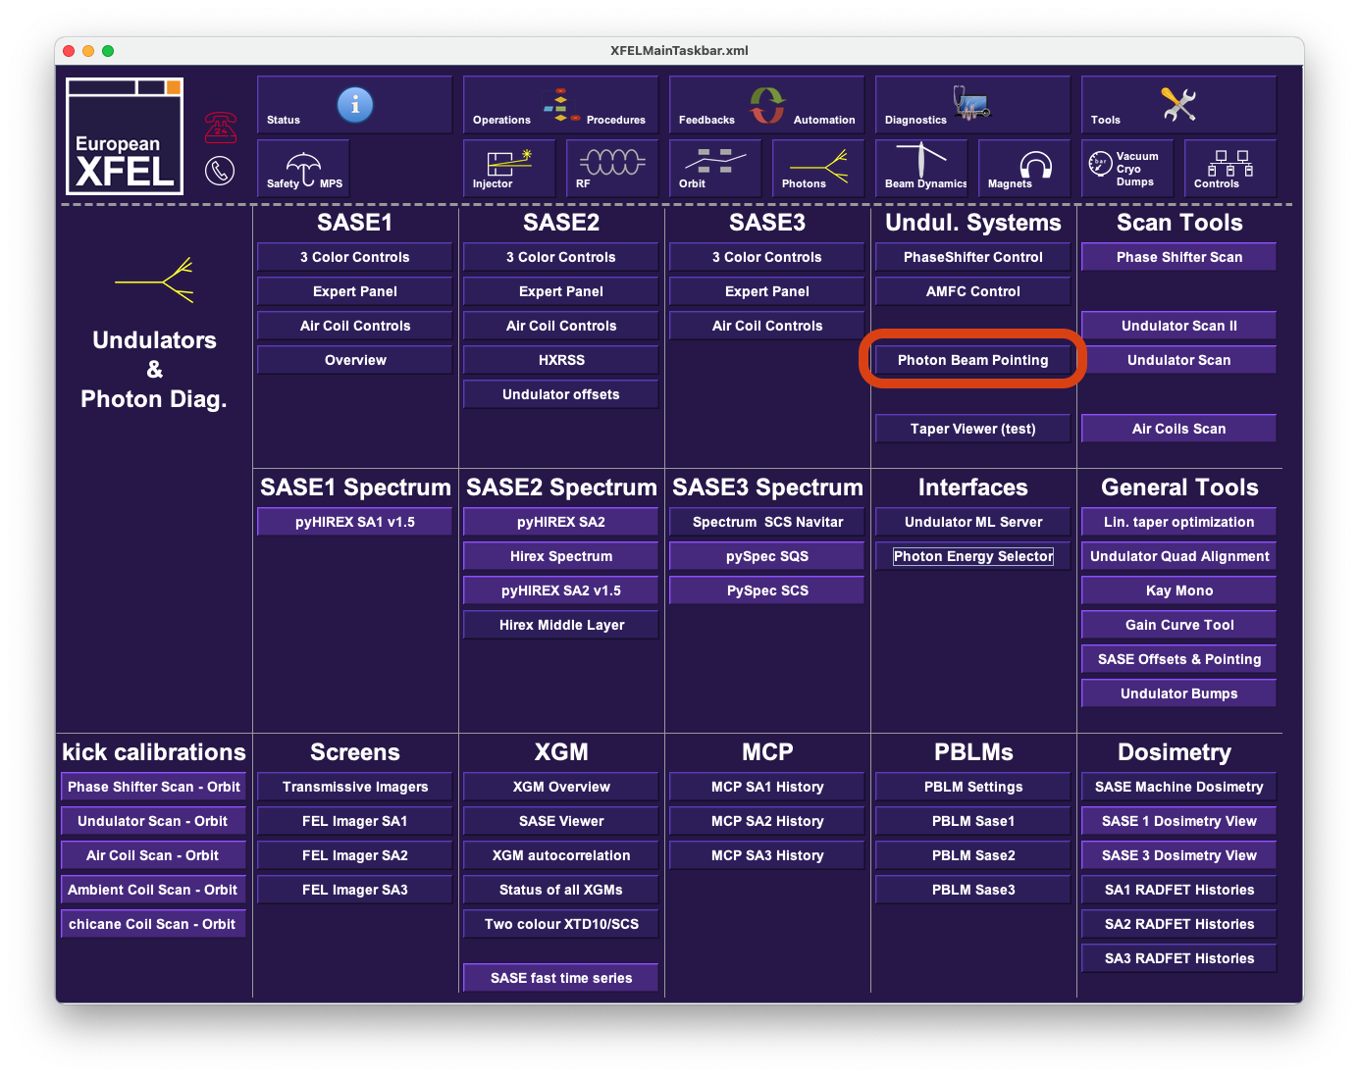
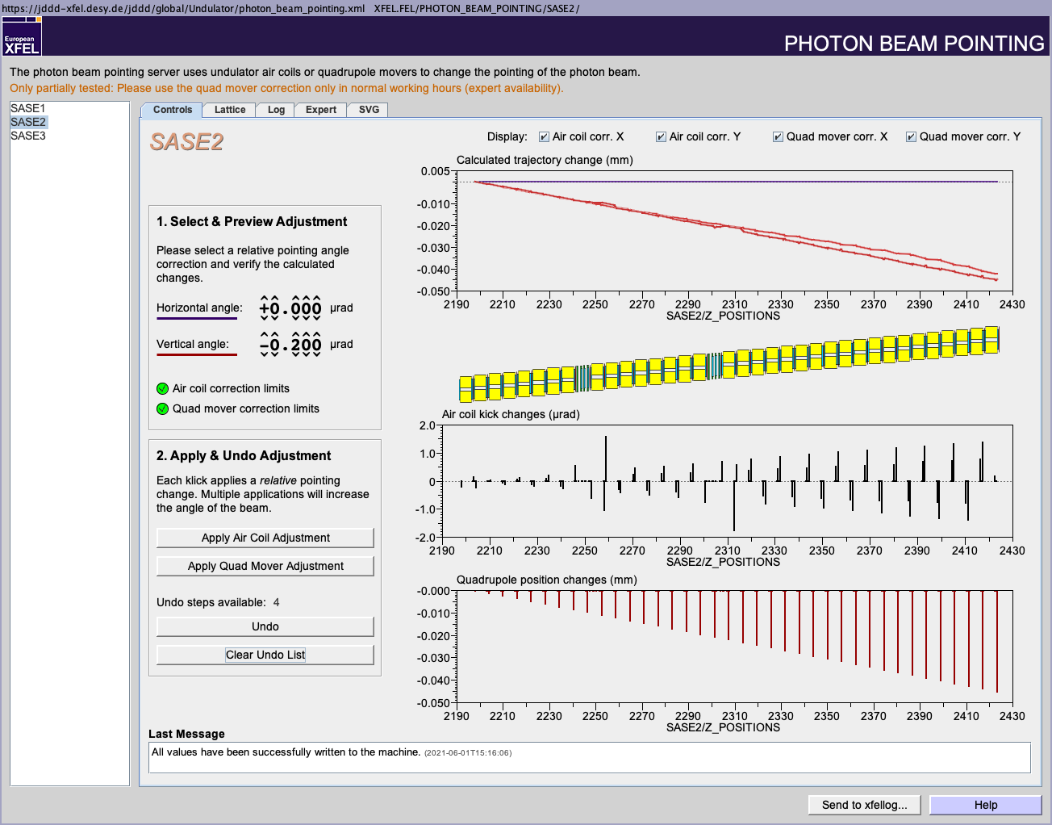
Beam pointing
The default tool for beam point changes is this one ->
It can be opened here: Main Panel -> Photons -> Photon Beam Pointing
Chose you beamline in the list on the left hand side.
Set the wanted relative kick angle individually for horizontal and vertical plane.
It is suggested to change the planes one after the other.
Press ‘Apply Air Coil Adjustment’ or ‘Apply Quad Mover Adjustment’ depending on how you want to change the pointing.
We suggest to use the air coils only for very small modifications (in the order of half a beam size on the FEL imager).
All other pointing changes should be carried out using the quad movers.

Slide 26
Thanks for your attention
And please read the operation blog!
https://confluence.desy.de/x/QJXeC

