Slide 1
Experience with EUDAQ and TLU
Yan Benhammou, Jakub Moron, Szymon Bugiel

Slide 2
TLU in test beam
Intensively used during the last 7 years
Receive signal from Scintillators+PMT located in the beam : generate trigger
Trigger sent to all the detectors (tracker and ECAL)
Receive busy from detectors so doesn’t send any new trigger

Slide 3
EUDAQ

Slide 4
DETECTOR
CENTRAL DAQ
MONITORING

Slide 5
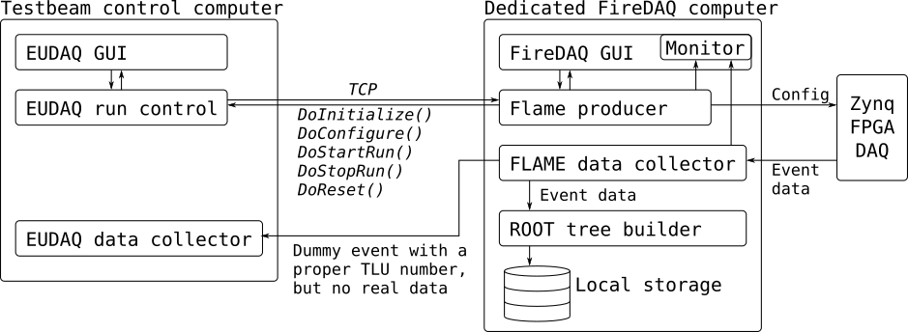
Test beam ECAL model

Slide 6
Why dummy event ?
for each TLU event (TLU number) EUDAQ has to get the event data package from all connected producers (detectors). If any of the detectors fails to send data with the given TLU number, the whole event is rejected as incomplete.
On the other side we decided to store FLAME data on the dedicated computer, instead of using main EUDAQ data collector, since we had previously some problems with it. But we have to send something to the main data collector, otherwise it will not store the data from telescope.
Then we synchronize the data with their TLU number

Slide 7
Question for LUXE
We should have different trigger : beam, laser, cosmic.
Is this still correct ?
All these triggers will be distributed by the TLU ? Latency of the system ? All detectors with the same type of trigger ?
BUSY signal from all the detectors ?
Detector Fails in sending data : event totally rejected ?
Monitoring and data quality ?

