Slide 1
The AIDA TLU
for
Timing/Tagging at LUXE?
David Cussans, LUXE DAQ meeting, 16/June/21

Slide 2
Outline
TLU for Triggering and Timing at Beam Tests
The AIDA(2020) Trigger/Timing Logic Unit (TLU)
  History
  Features
  Documentation
TLU at LUXE:
  Synchronization rather than triggering

Slide 3
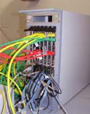
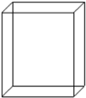


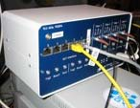

TLU at Beam Lines
Beam Telescope with “Detector Under Test”
  Need to correlate data from a single particle in all detectors
          Particle rate low enough to identify each particle individually
  Match tracks in telescope with hits in DUT
Sensors
AUX
board
DUT
e
-
Readout
From: Infrastructure for Detector Research and Development towards the International Linear Collider. https://arxiv.org/abs/1201.4657
GBit ETH
VME CPU
LVDS
Mechanics to position
the sensors
EUDAQ PC
USB
ETH
Trigger Logic Unit
Secondary PC

Slide 4
How?
Sensors in beam to detect passage of particles.
   Electrical signals  conditioning  binary signal
Combine binary signals from one or more beam sensor to produce a “trigger”
Two choices:
  Distribute a trigger signal to beam telescope and DUT readout systems.
    Correlate data based on trigger number
  Distribute central clock/time-stamp to beam telescope and DUT
    Correlate based on timestamps.
  … can mix time-stamping and triggering: TLU records both trigger-number and time-stamp
Implementation: Box with signal conditioning and an FPGA
Make available to use in home labs – ease integration at beam-line

Slide 5
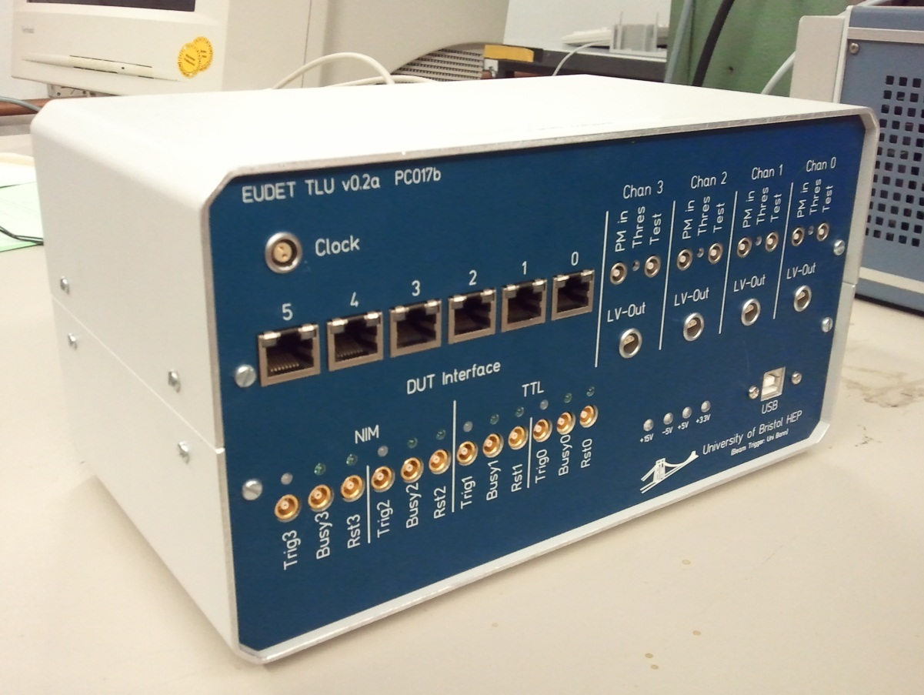
History - EUDET
EUDET TLU
  Supporting beam tests for linear collider detector development at DESY
    Low rate ( < 10kHz )
    Modest time precision
    RJ45 for trigger/busy
      LVDS
  See https://www.eudet.org/e26/e28/e42441/e57298/EUDET-MEMO-2009-04.pdf
  Many still in beam-lines and HEP institutes

Slide 6
History - EUDET
No common beam-test clock
  DUT and telescope asynchronous
Use trigger (TLU→DUT) / Busy (DUT→TLU) to synchronize
Optional transfer of trigger number
  Very useful to check trigger integrity. Many beam-tests saved from desynchronized data….
D0
D1
D2
Dn
Trigger
Busy
Trigger−Clock

Slide 7
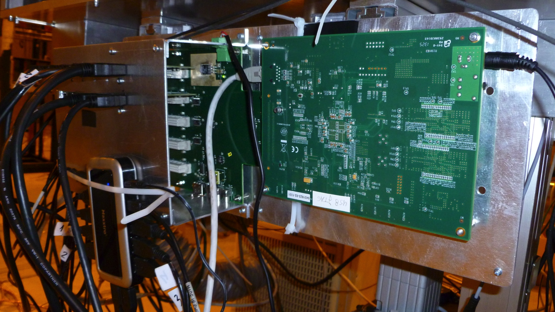
History - AIDA
Fanout for TLU signals
  Used with common clock
  Fans out triggers
  “OR” of busy signals from DUTs
Photo – in use in LHCb beam telescope at CERN
Design allows up to 30 DUT
Serves role of TLU

Slide 8
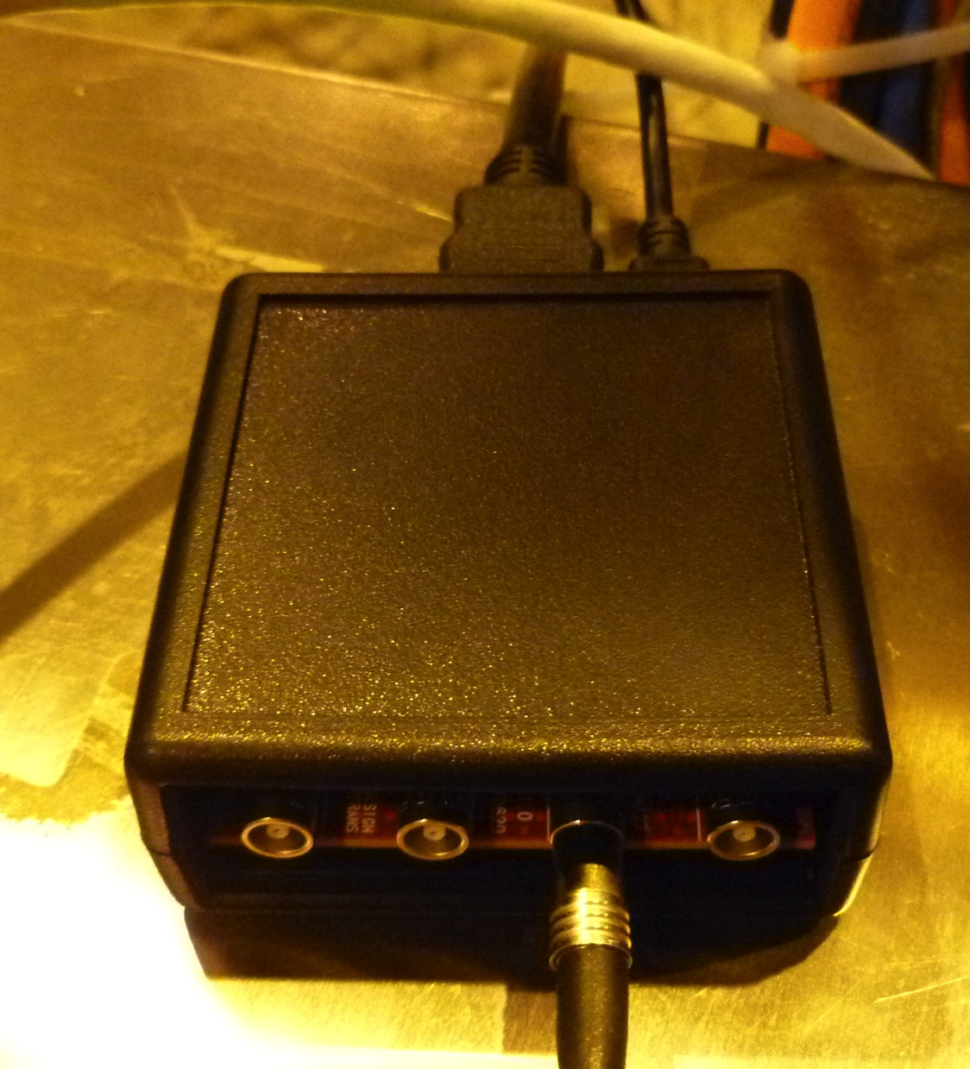
History - AIDA
LVDS ← → TTL converters exist
  This example from NIKHEF
  Other designs available
Allow DUT to use TTL on Lemo rather than LVDS on HDMI

Slide 9
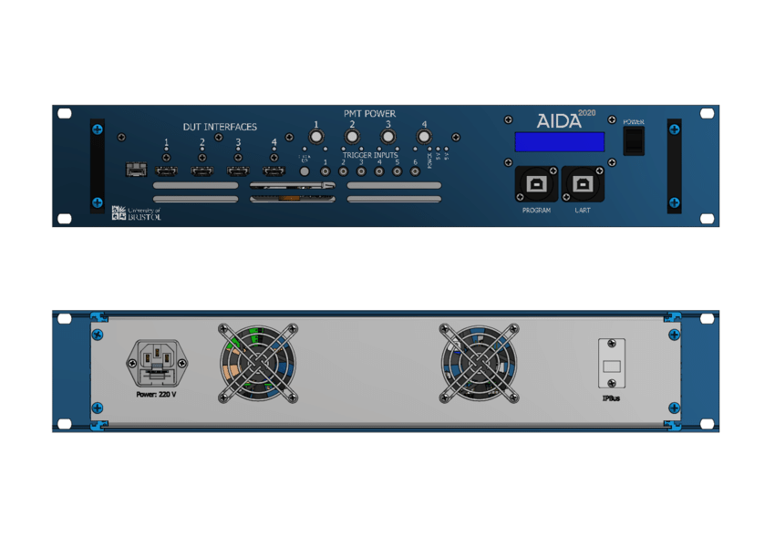
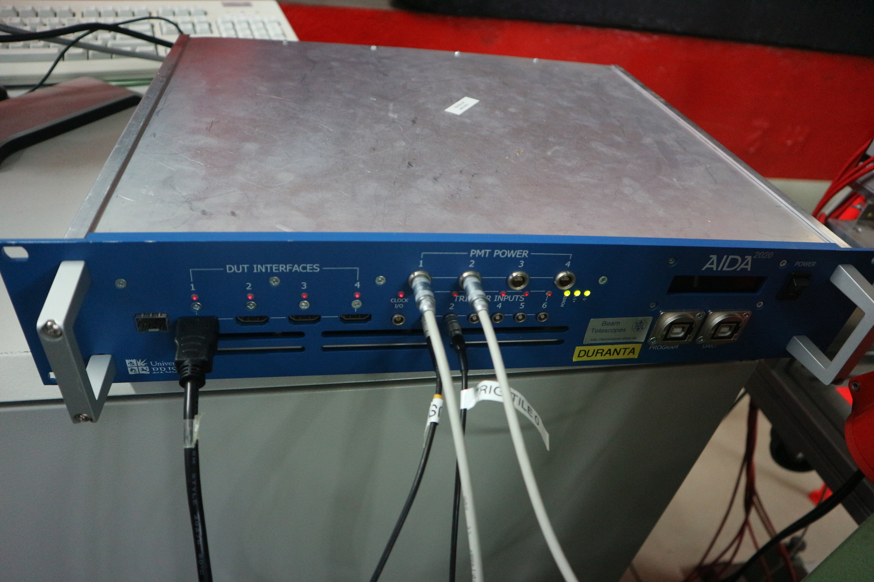
History - AIDA-2020
Current production version
6 trigger inputs
4 DUT connections
  CALICE HDMI pinout
    But direction of each line can be swapped in hardware to allow different firmware mapping
Low jitter clock
Hardware permits optical distribution of clock/trigger
In small desktop case or rack-mount case

Slide 10
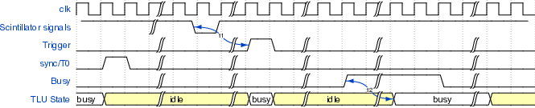
AIDA-2020 TLU – DUT Interfaces
DUT interfaces can be used in “EUDET mode”
  Trigger/Busy handshake
    Need passive HDMI – RJ45 converter
Can be used with a common clock
  Permits higher trigger rate
    No event-by-event handshake. Cross-check on trigger timestamps.

Slide 11
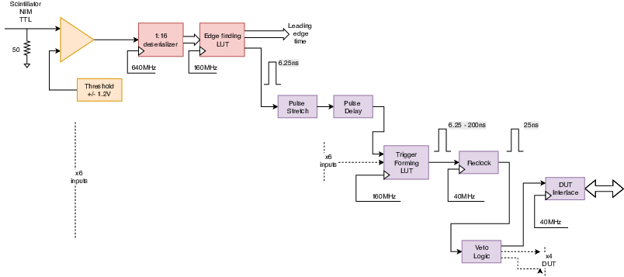
Trigger Logic
Inputs clocked at 160MHz (nominal)
Input signals can be delayed and/or stretched in units of 1/160MHz
Signals from the 6 inputs fed into a look-up table
LUT programmed with which combinations produce a trigger
Trigger output moved to clock fed to DUT (40MHz nominal)
State of all inputs recorded at point that trigger “fires”
  Can be used to tag events – e.g. Cherenkov information.

Slide 12
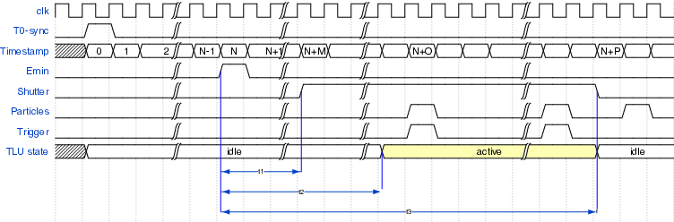
AIDA-2020 TLU
DUT “Shutter”
Some detectors can only capture data with a low duty cycle
In many beam-lines particle are only present a certain times
  DESY – 50Hz cycle
  CERN – SPS cycle
Detectors active period should occur when particles are present
→ Signal from accelerator can be used to generate a “shutter” signal sent to DUT

Slide 13
Documentation
https://doi.org/10.1088/1748-0221/14/09/p09019 “The AIDA-2020 TLU: a flexible trigger logic unit for test beam facilities” , JINST
Open Hardware project “AIDA-2020 TLU”
  https://ohwr.org/project/fmc-mtlu
  Hardware design files https://ohwr.org/project/fmc-mtlu-hw/
  Firmware source code https://ohwr.org/project/fmc-mtlu-fw/
User manual https://ohwr.org/project/fmc-mtlu/blob/master/Documentation/Main_TLU.pdf

Slide 14
Firmware
IPBus for control and readout of time-stamps
  UDP/IP 1 Gbit/s Ethernet
  See https://ipbus.web.cern.ch/
Ipbb build system
  Scriptable build. Working on CI
Open Source
  https://ohwr.org/project/fmc-mtlu-fw/

Slide 15
Software
All versions of TLU integrated with EUDAQ DAQ software.
  Run control
    Configuration
    Monitoring
  Readout of trigger timestamps

Slide 16
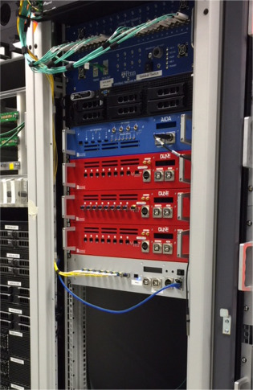
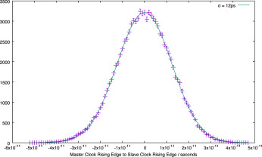
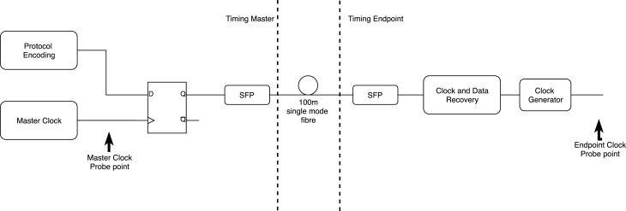
AIDA-2020 TLU
Synchronization over fibre
AIDA-2020 TLU used as synchronization and trigger distribution master in ProtoDUNE-SP tests at CERN
  Using DUNE firmware
Signals distributed over optical fibre
  1000Base-BX
Lab tests: Master → endpoint clock relative jitter σ ~ 12ps
Taken from Timing and synchronization of the DUNE neutrino detector, https://doi.org/10.1016/j.nima.2019.04.097

Slide 17
AIDA-2020 TLU
Synchronization over fibre
Timing fibre can be split 8 ways with passive optical splitter
Active fanout units available
    19-inch rack mount 2U units:
        8 outputs, each of which can be split 8 ways
    uTCA system with up to 96 outputs, each of which can be split 8 ways

Slide 18
AIDA-2020 TLU
Use at LUXE
XFEL – all particles arrive “at same time”
    Need synchronization but not triggering
    (Or will there be tests at low-rate beams?)
Provide common clock and synchronization signals to all components of detector

Slide 19
AIDA-2020 TLU
Use at LUXE - Questions
Maximum distance between parts of detector?
        Copper cables? Need Fibre?
Acceptable clock jitter?
        e.g. 100ps RMS cycle-to-cycle? (straight forwards) . 10ps ? (pretty hard) 1ps ? (very hard!)
What hardware synchronization signals?
        T0 at “run start”
        “spill” signal?
        “pre-spill” signal?
        Detector busy? (probably not useful – what could be done with this? Announce detector configuring/ready/dead in software?)

Slide 20
AIDA-2020 TLU
Use at LUXE
XFEL – all particles arrive “at same time”
    Need synchronization but not triggering
    (Or will there be tests at low-rate beams?)
Provide common clock and synchronization signals to all components of detector

Slide 21
BACKUP

Slide 22
AIDA-2020 TLU
F/ware, S/ware updates?
Use external RAM to buffer time-stamps
  Not useful for continuous beam (e.g DESY)
  Useful for high-rate CERN beam-tests
    Take high rate during spill, readout triggers between spills
Use of “carry chain TDC” implemented in FPGA
  See e.g. https://ohwr.org/project/tdc-core/
  Calibration of FPGA carry chain TDCs “fiddly”
  Likely accuracy of TDC ~ 50ps
    Current firmware – 781ps bins

Slide 23
AIDAInnova TLU
Aim: (tens of) Picosecond Timing (clock distribution and time-stamping)
  EUDET TLU – Precision ~ 100ns
  AIDA/AIDA-2020 – Precision ~ 1ns
Use TDC ASIC for time-stamping triggers?
  PicoTDC ?
  Carry-chain TDC inside FPGA probably not adequate (?)
Constant Fraction Discriminator and/or ADC for time-walk correction?
~ 8 inputs
>= 4 “DUT Interfaces
  Move away from HDMI → Display Port
    Passive adaptor HDMI ← → Display port
    More robust. Better signal integrity on trigger line

Slide 24
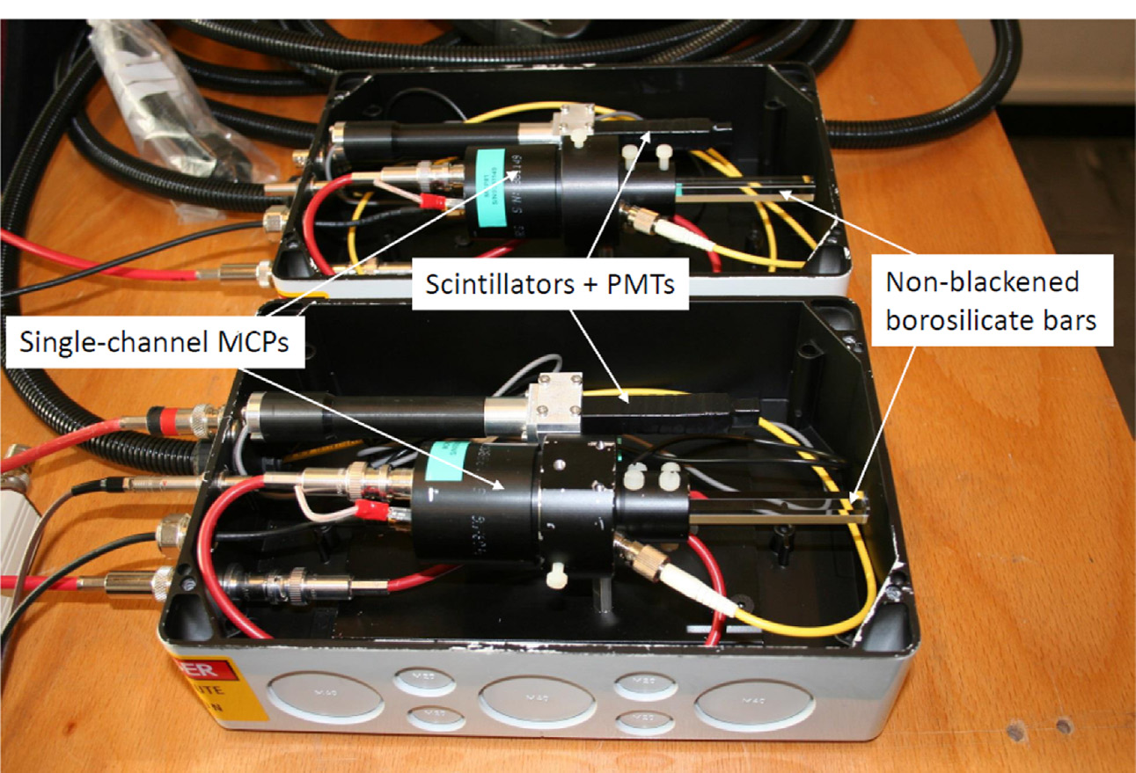
AIDAInnova TLU:
Why timing?
Increasing use of detectors with high timing precision to disentangle events in high-pileup beam-crossings.
  Testing pico-second detectors requires pico-second time reference
  Some beam-line users will bring their own time reference detectors. Some would benefit from precise time reference at beam-line
Could use, e.g. Cherenkov light and high speed photo-detector
  Used for “TORCH” LHCb upgrade beam-tests
  MCP-PMT single photon jitter 66ps FWHM http://www.photek.co.uk/pdf/datasheets/detectors/DS006%20Photomultiplier%20Tube%20Datasheet%20issue%202.pdf
Taken from http://dx.doi.org/10.1016/j.nima.2016.06.087

Slide 25
AIDAInnova TLU:
Why timing?
Increasing use of detectors with high timing precision to disentangle events in high-pileup beam-crossings.
  Testing pico-second detectors requires pico-second time reference
  Some beam-line users will bring their own time reference detectors. Some would benefit from precise time reference at beam-line
Could use, e.g. Cherenkov light and high speed photo-detector
  Used for “TORCH” LHCb upgrade beam-tests
  MCP-PMT single photon jitter 66ps FWHM http://www.photek.co.uk/pdf/datasheets/detectors/DS006%20Photomultiplier%20Tube%20Datasheet%20issue%202.pdf
        For many photons timing precision ~ 10ps
Taken from http://dx.doi.org/10.1016/j.nima.2016.06.087
Beam
direction

Slide 26
Summary
The AIDA family of TLUs provides a way of synchronizing detectors at beam-lines
Integrated with EUDAQ
Can be used in home-labs to simplify integration at AIDA supported beam-line
Open Source hardware/firmware
  Can be used for applications that require signal conditioning of pulses, clock distribution, FPGA logic.
    e.g. was used for ProtoDUNE timing system

