Slide 1
Updates of CDR: simulation and analysis
Simulation and analysis meeting
Beate Heinemann (DESY and University of Freiburg)
June 22nd 2021

Slide 2
Updates of CDR: simulation & analysis
Tom made new PTARMIGAN MC for the PRC review which showed problems with previous simulation
For the CDR we had used IPSTRONG MC (Tony) for
All results with pair production
Some results for compton
There was residual factor of two between IPSTRONG and PTARMIGAN
Want to now update all plots with PTARMIGAN MC
Tom recently prepared all files and I processed them

Slide 3
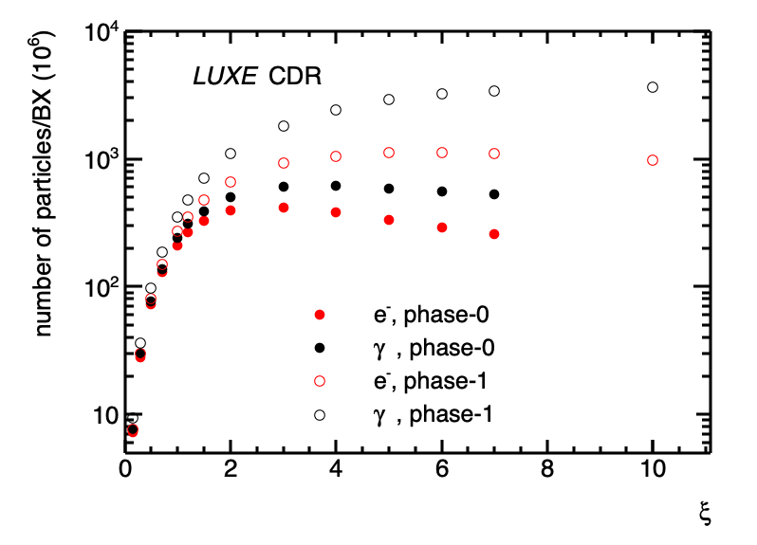
Comparison: Compton
New MC
200
200
Factor ~two visible for phase-0

Slide 4
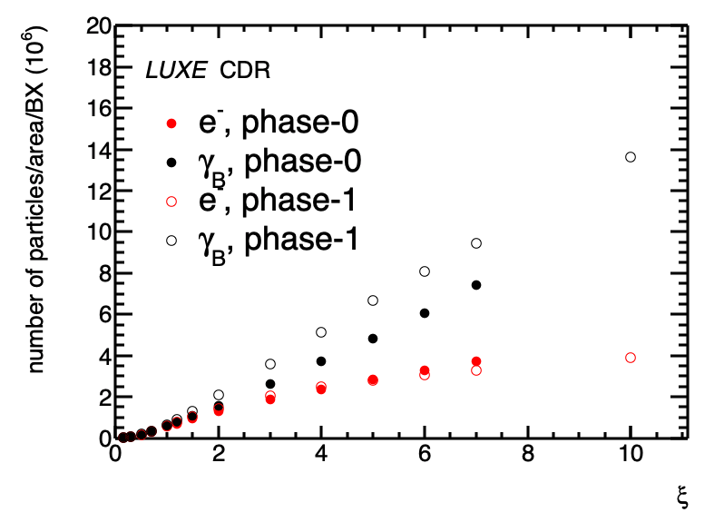
Comparison: Compton vs xi normalized
new
Plots normalized to area by $\frac{w_{0}^{2}}{\left(w_{0}^{2}+2σ_{beam}^{2}\right)}$
Had bug in left plot in addition to MC being wrong
Now: Phase-0 and phase-1 agree for electrons (as they should!)
For photons not as bias due to already existing interaction

Slide 5
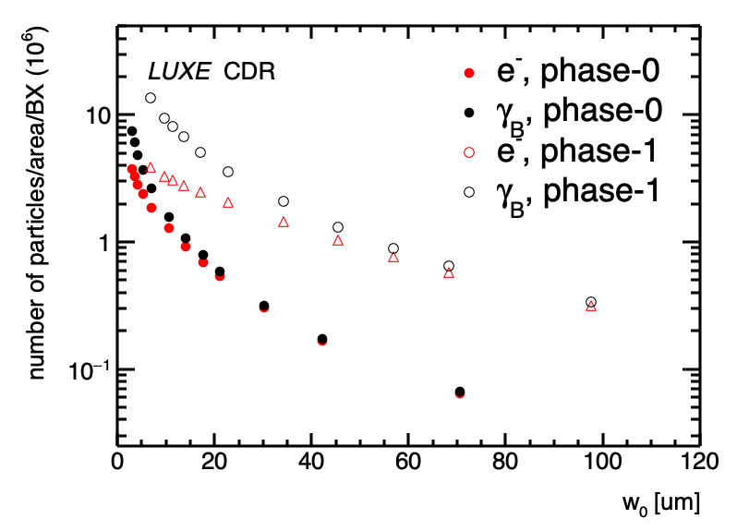
Comparison: Compton vs w0
New MC
Plots normalized to area by $\frac{w_{0}^{2}}{\left(w_{0}^{2}+2σ_{beam}^{2}\right)}$
Looks reasonable to me

Slide 6
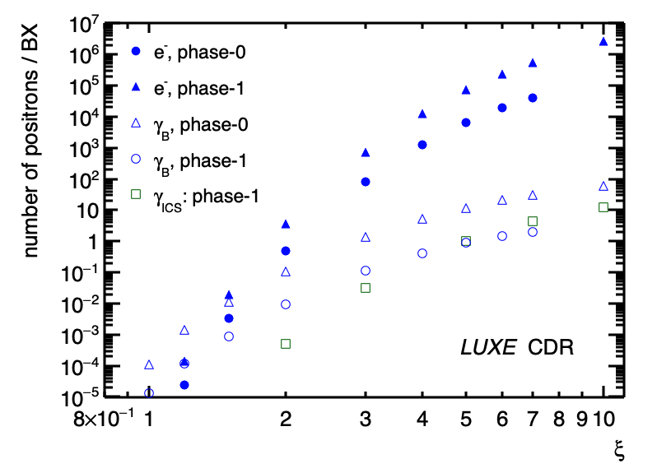
Comparison: Breit-Wheeler
100
100
New MC
Rate very much increased
New MC also goes to lower xi which is nice

Slide 7
Direct comparison
New e-laser MC
New rates a factor 10 higher than in CDR
This we had already realized during PRC preparation for gamma-laser case

Slide 8
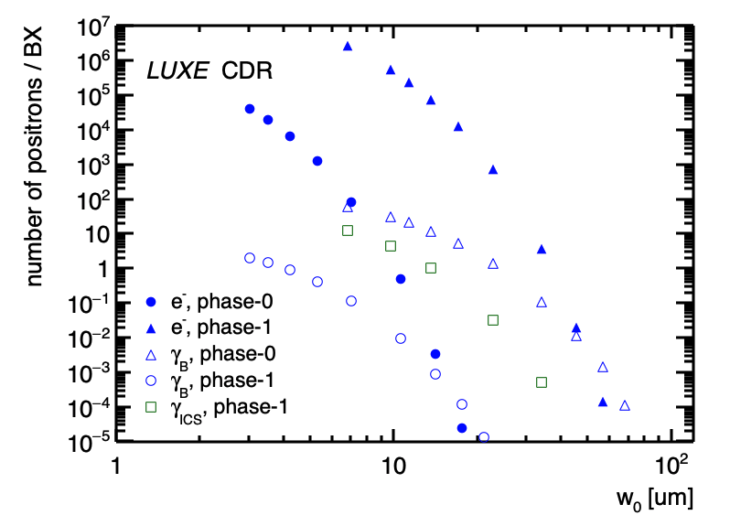
More Plots for CDR
Versus w₀
Normalized rate: by $\frac{1}{w_{0}^{2}}$
Looks reasonable
Agreement of normalized rates important
Did not work with the old MC files by IPSTRONG

