Slide 1
ILC – Central Integration SB 2009 Layout
Positron Source biased
Interpretation of available data into CAD 3D virtual model to serve as true scale graphical representation.
by N.Collomb

Slide 2
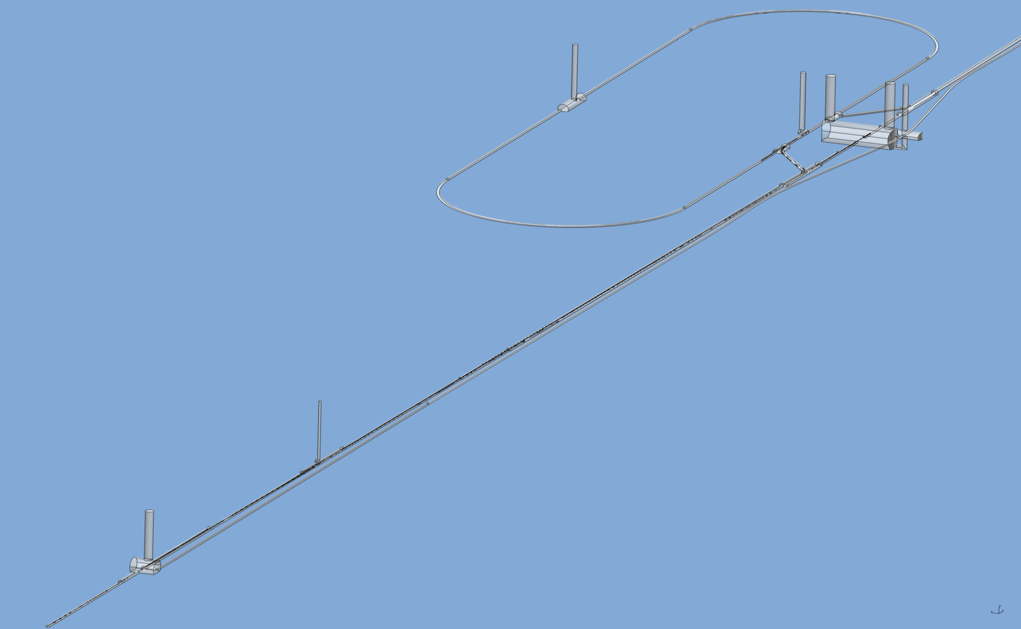
ILC – Central Integration SB 2009 Layout
Central Region layout. Positron Source side shown from the end of the Main LINAC.
Next slide
Racetrack shape
Damping Ring Tunnel
BDS Diagnostic Dump and Positron 5GeV Booster section
Detector Hall
Positron Production Area; incl. AUX Source, Remote Handling Area, Capture area and chicane and Pre - Accelerator
Slides 10 & 11
Electron Beam Delivery System Tunnel
Main LINAC
(just out of view)
Slides 12 - 16
Undulator Area
Slides 17 & 18

Slide 3
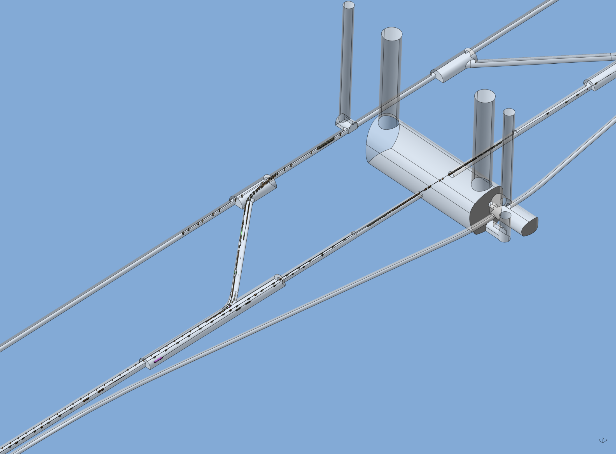
ILC – Central Integration SB 2009 Layout
ISO View Close up
Capable of making out some systems
Damping Ring Injection and Extraction Straight
Interaction Point (I.P.)
Electron BDS Tunnel
Damping Ring Transfer Tunnel
Detector Hall
Service Tunnel
Positron Main Dump

Slide 4
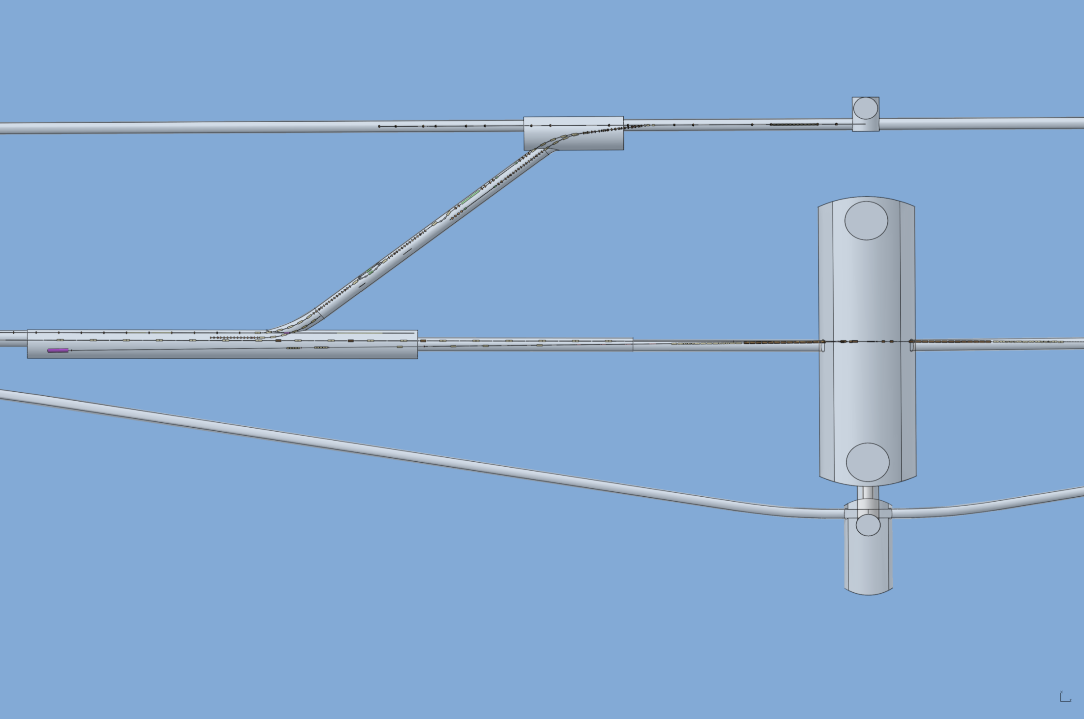
ILC – Central Integration SB 2009 Layout
Top View Close up
Positron Injection & Electron Extraction Septum Position at X=90m and Z=-80.9m
Next slide
Positron Beam Transfer direction
Electron Beam RTML direction
Damping Ring Offset = 90m
Electron BDS Beam direction pre-collision
+ve X
Positron Beam direction after collision
+ve Z
+ve Y,
Out of page
Interaction Point (I.P.) where X, Y and Z = 0 (zero)
Positron Beam Direction
Electron Beam Direction
Damping Ring offset change since Albuquerque

Slide 5
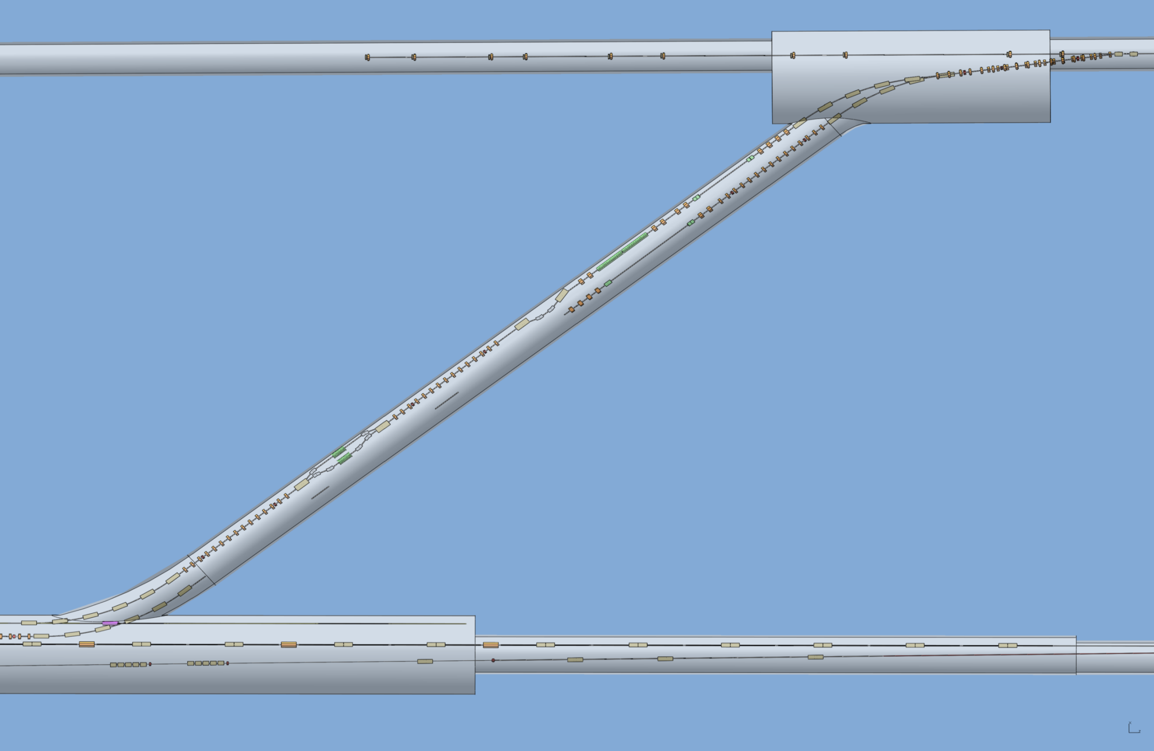
ILC – Central Integration SB 2009 Layout
Quite a bit of guess work going on at this moment.
There are 9 Beam Dumps, Collimators and Stoppers in the Transfer Tunnel?
Positron Elevator (Y = 0m to 1.3m)
R=30m, all Arcs, with Dipoles at 7.9316° spacing
Positron Energy compression (best guess)
Positron Spin Rotation relocated after Durham meeting.
(400MeV version shown, 5GeV requires larger Solenoids and Dipole magnets, will NOT change tunnel arrangement)
110 m between Dipoles
Electron Elevator (Y = 0m to 2m)
Damping Ring offset change since Albuquerque
Positron Beam Direction
Electron Beam Direction

Slide 6
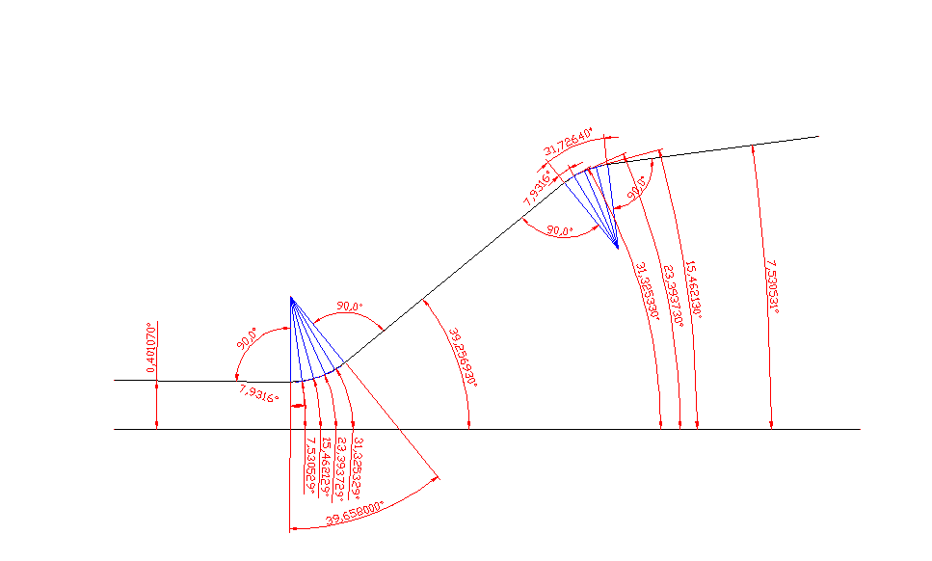
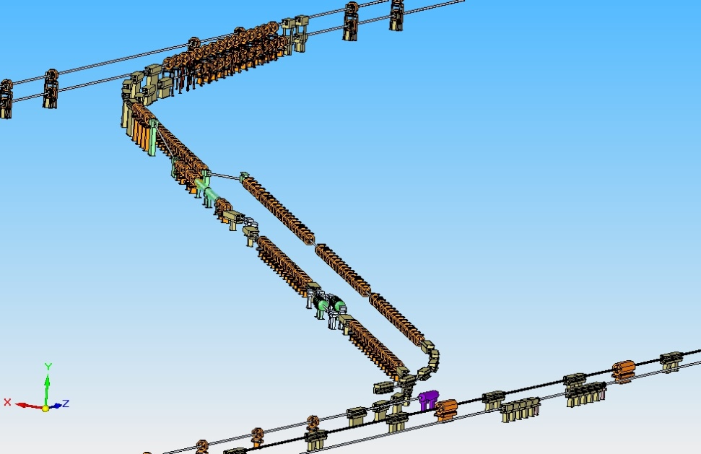
Theoretical PLTR
Info from DR WG defines Injection Point. Work backwards using info from PS (angles). Simple geometry workout.
DR Injection point at:
X= 90 m, Y= 1.3m and Z: -80.9m
Energy compression
Positron Spin Rotation

Slide 7
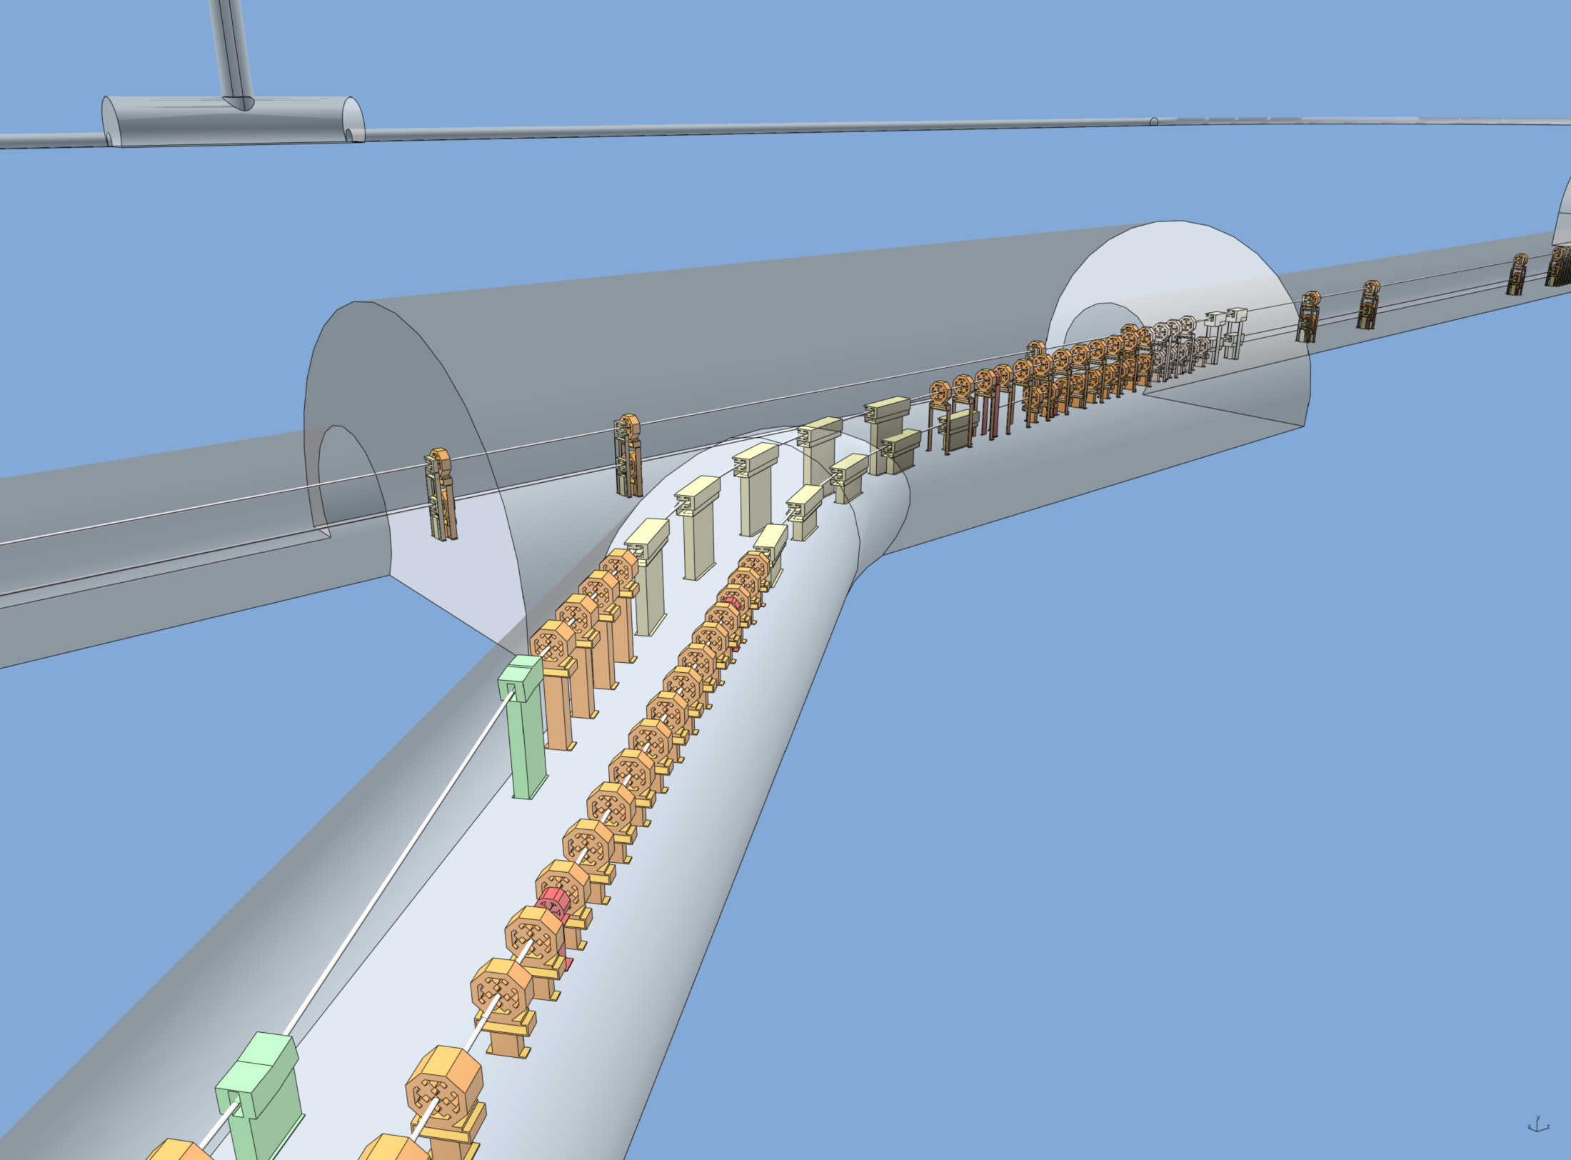
Positron Transfer Line components?
Positron Damping Ring
May need to be at bottom for 10 Hz option
5 off 2 m Dipoles?
Electron Damping Ring May be ‘sandwiched’ between 2 PS DR
Electron RTML
Positron Transfer Line elevator components?
Positron Beam Direction
Electron Beam Direction

Slide 8
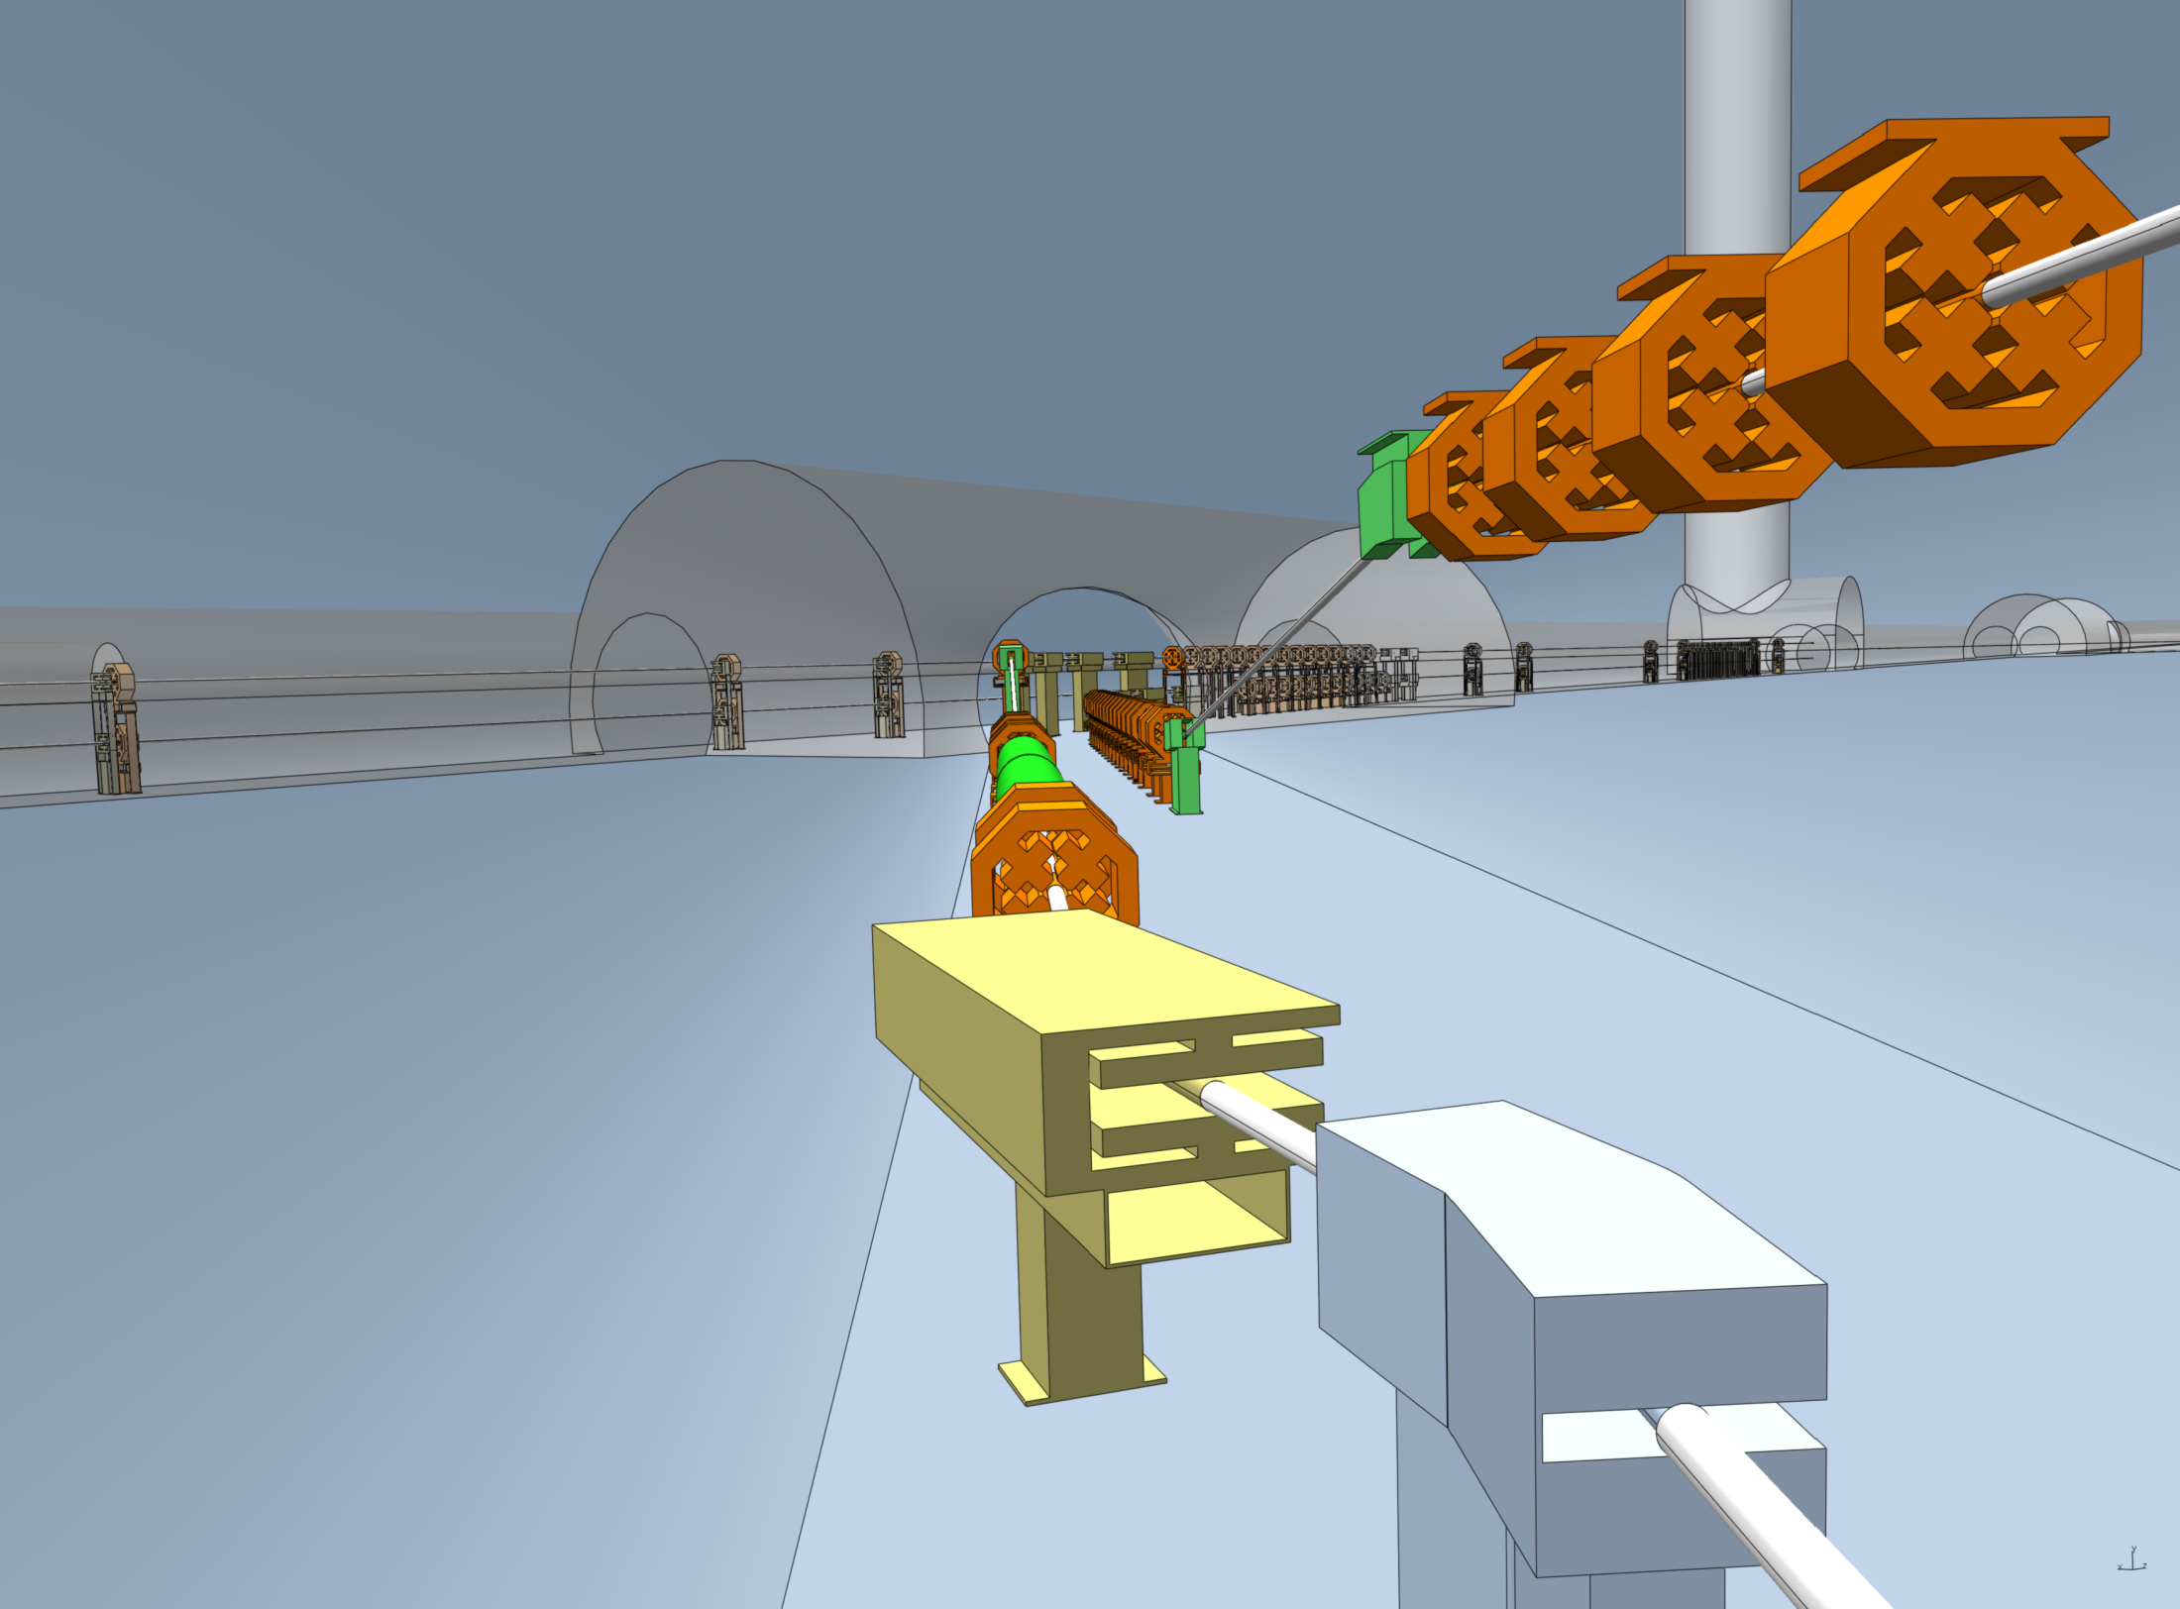
Positron Damping Ring
Electron RTML
Electron Damping Ring
Positron Beam Direction
Electron Beam Direction
Positron Line Transfer energy compression. Chicane and SC Accels

Slide 9
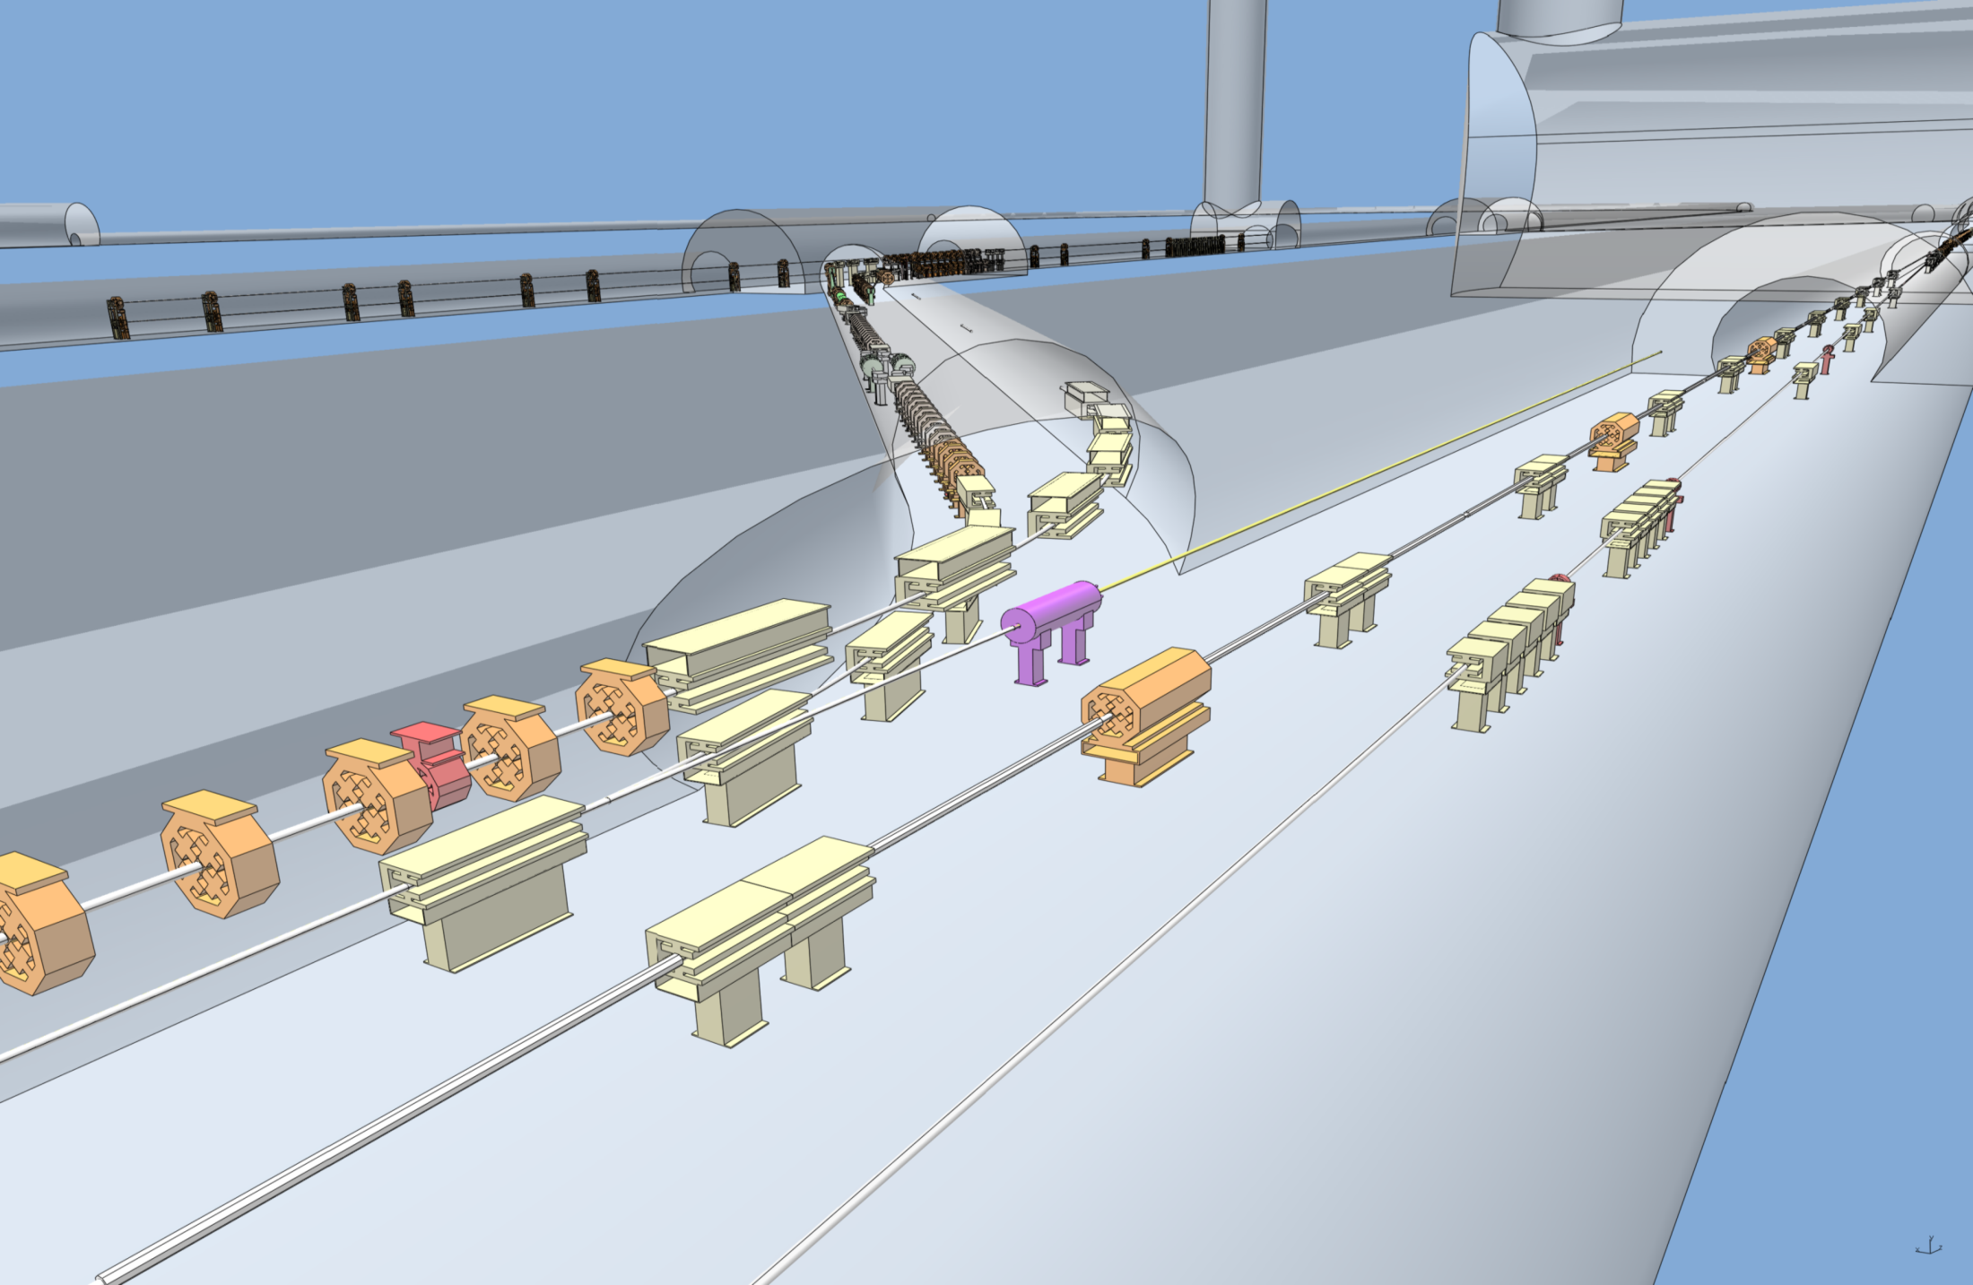
ILC – Central Integration SB 2009 Layout
Very busy tunnel
Positron Energy compression
Left verification line in model in error. Corrected!
Positron Damping Ring
Electron RTML elevator
Electron RTML
Electron Damping Ring
PTRAN Dump
Positron Spin Rotation
Electron BDS
Positron Main Dump
Positron Transfer Line
Positron Beam Direction
Electron Beam Direction

Slide 10
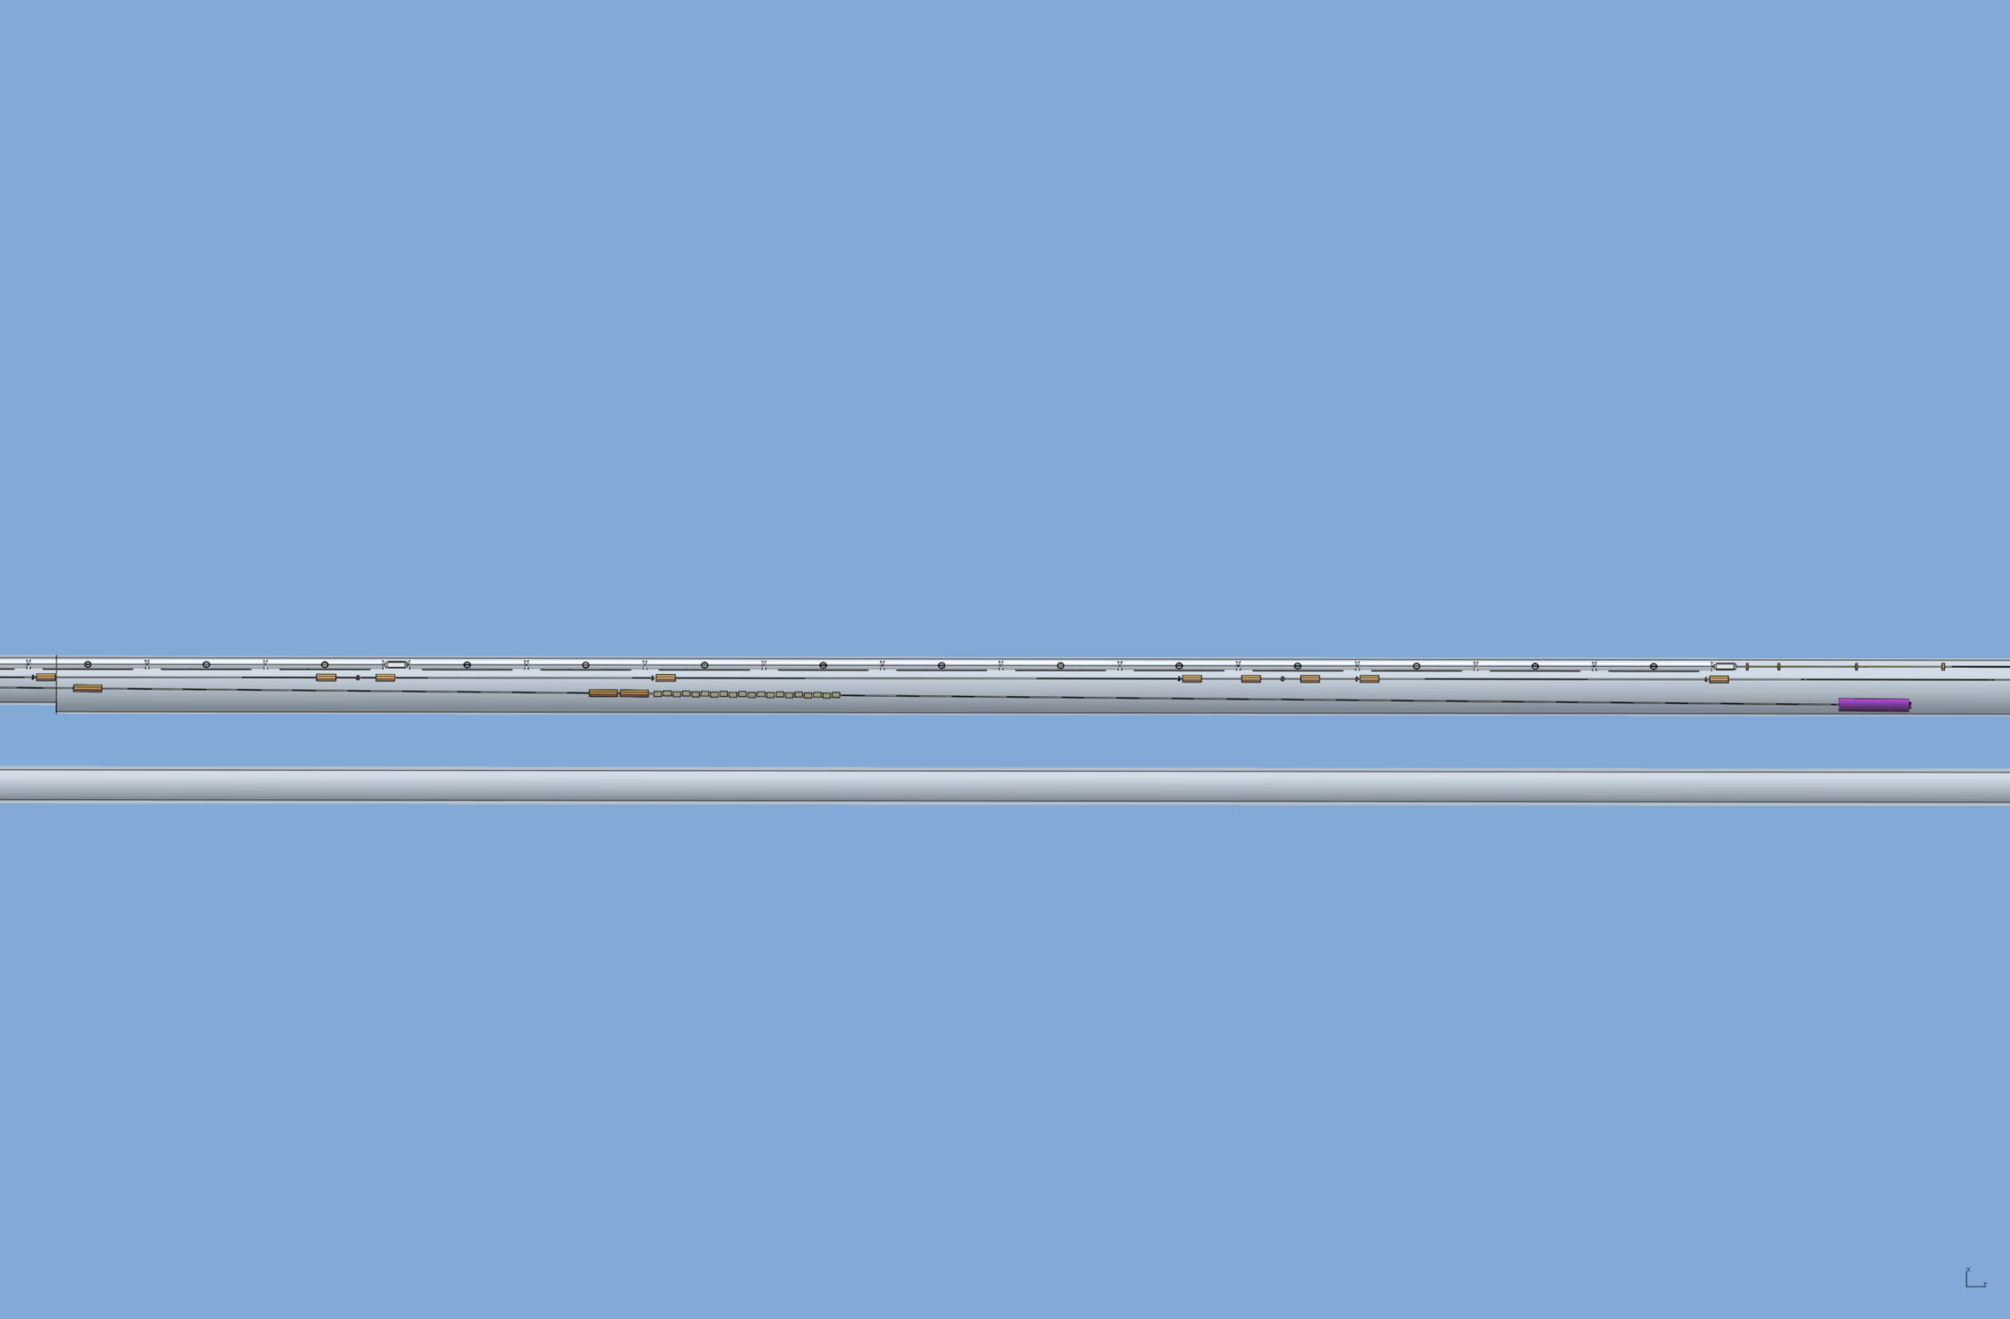
ILC – Central Integration SB 2009 Layout
No changes here since Albuquerque
Positron Transfer Line 5GeV Booster section
Electron RTML
Electron BDS
Positron Beam Direction
Electron Beam Direction
Electron BDS Diagnostic Dump.
5GeV Booster upstream of it (radiation concerns).

Slide 11
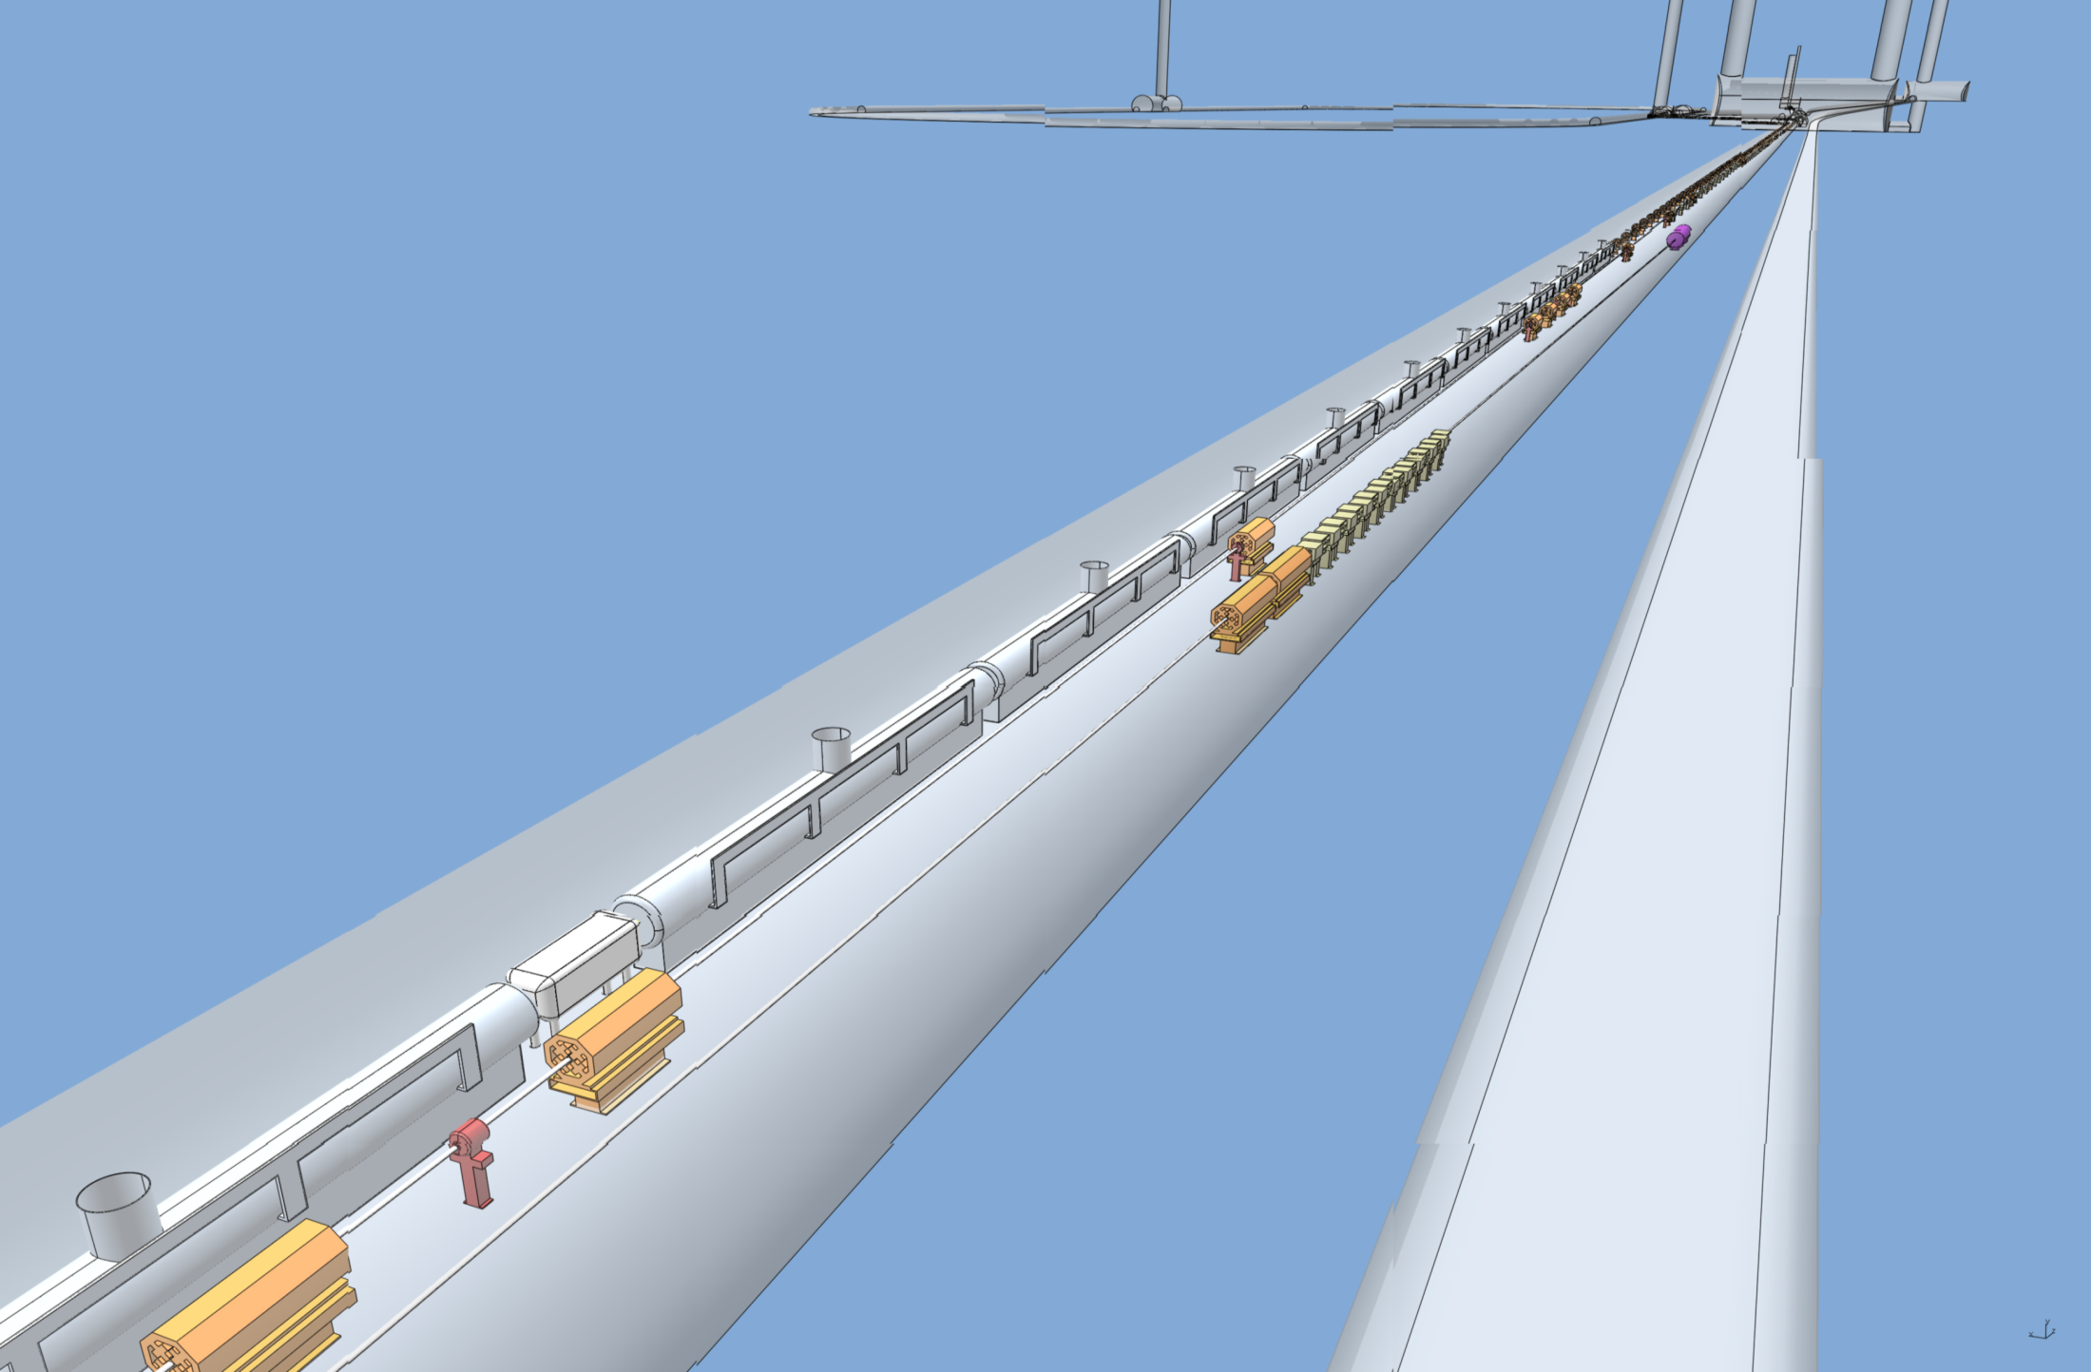
ILC – Central Integration SB 2009 Layout
No changes here since Albuquerque
Positron Transfer Line 5GeV Booster section
Positron Beam Direction
Electron Beam Direction
Electron BDS Diagnostic Dump
Electron RTML
Electron BDS

Slide 12
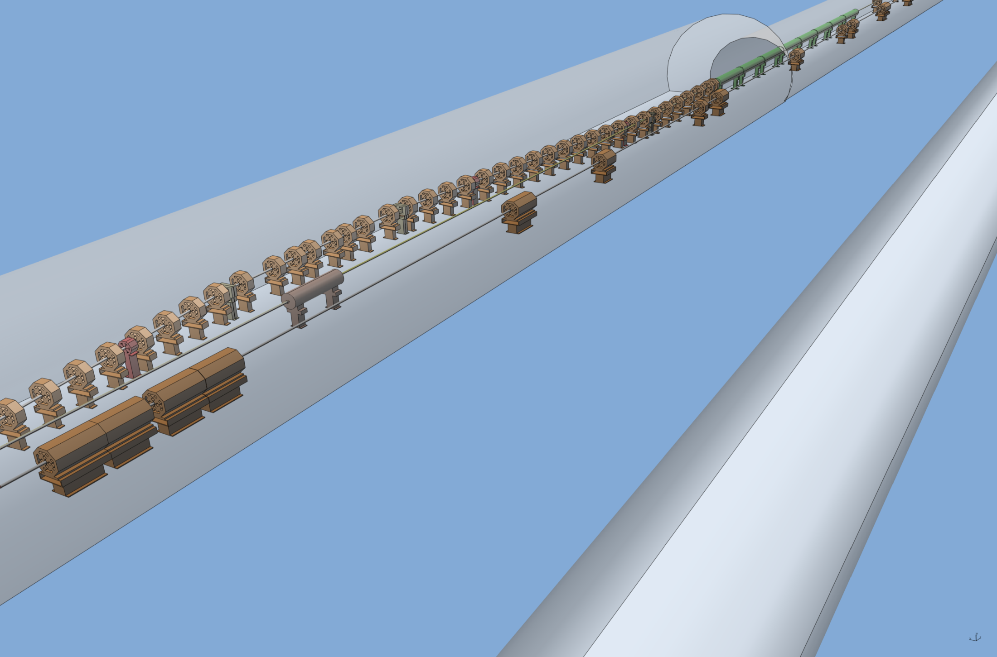
ILC – Central Integration SB 2009 Layout
Spin Rotation moved into Damping Ring Transfer Tunnel since Durham!!
Positron Capture Chicane
Positron 400MeV Travelling Wave Accelerator Section
Left verification line in model in error. Corrected!
Electron BDS
Photon Dump
Positron Beam Direction
Electron Beam Direction

Slide 13
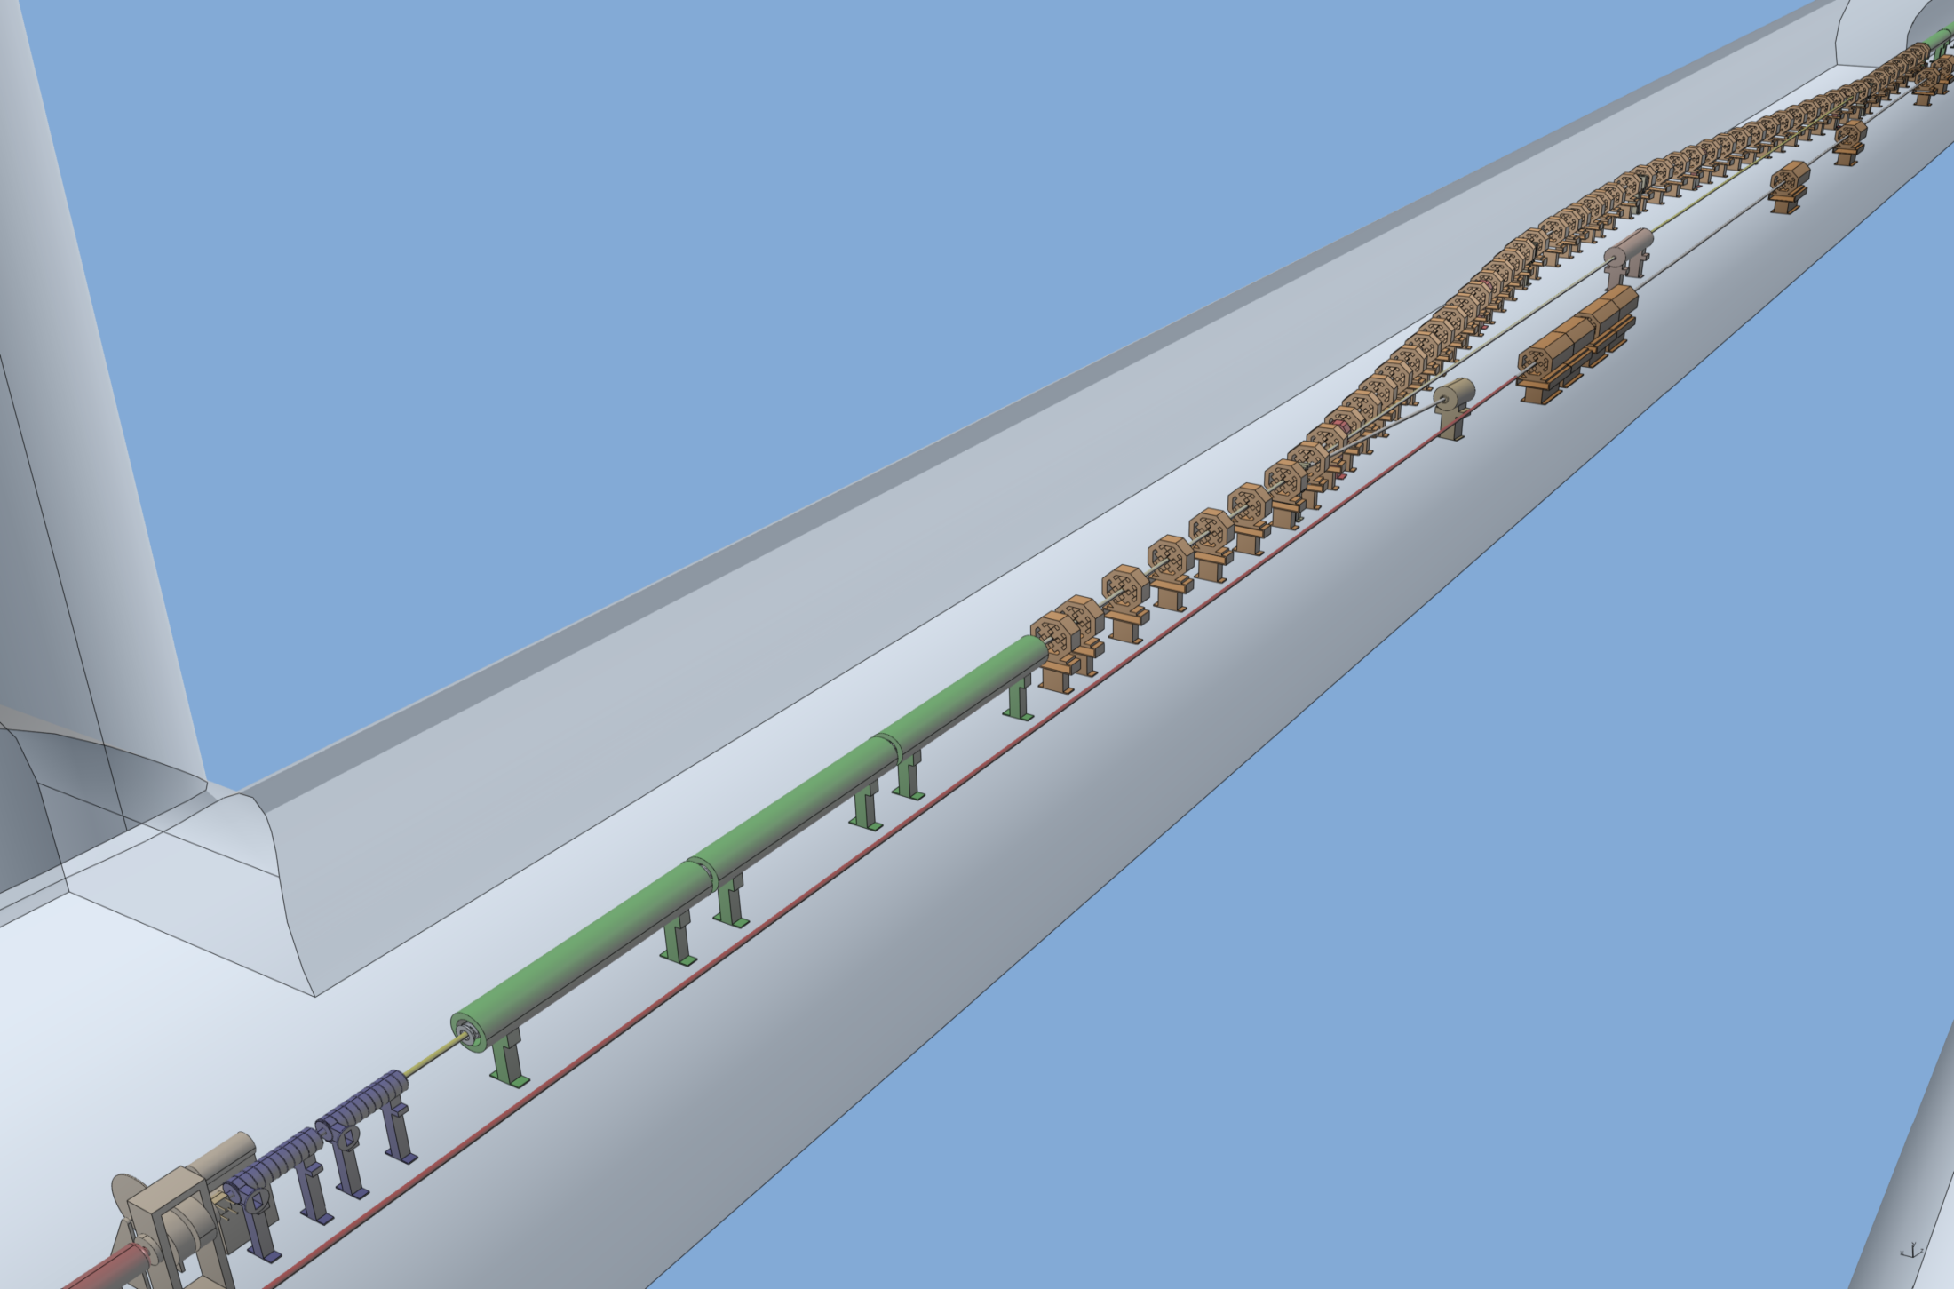
ILC – Central Integration SB 2009 Layout
Change. The additional Electron Dump requirement identified in Albuquerque!!
Left verification line in model in error. Corrected!
Positron Capture Chicane
Electron Dump
Photon Dump
Pre-Accelerator (Travelling Wave x3 modules)
Additional Electron Dump required due to AUX Source (somewhere here).
Electron BDS Long Drift
Positron Beam Direction
Electron Beam Direction

Slide 14
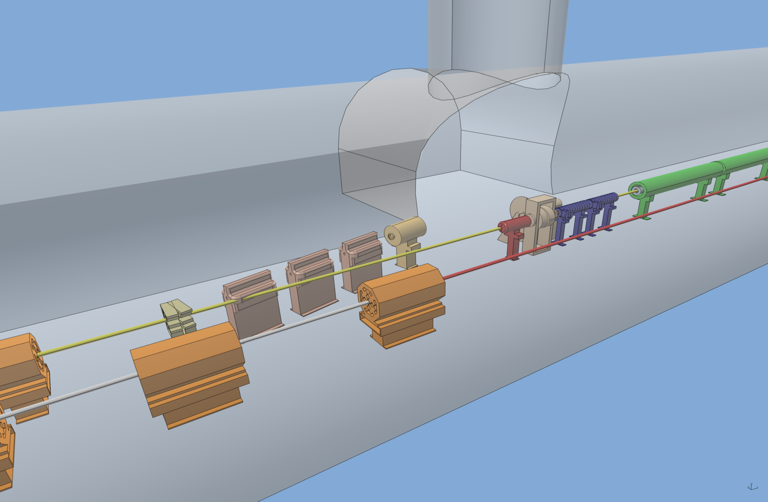
ILC – Central Integration SB 2009 Layout
Next slide
AUX Source Diagnostic Dump may mean that the Source needs to be moved further upstream due to close proximity or RH area.
Remote Handling Area

Slide 15
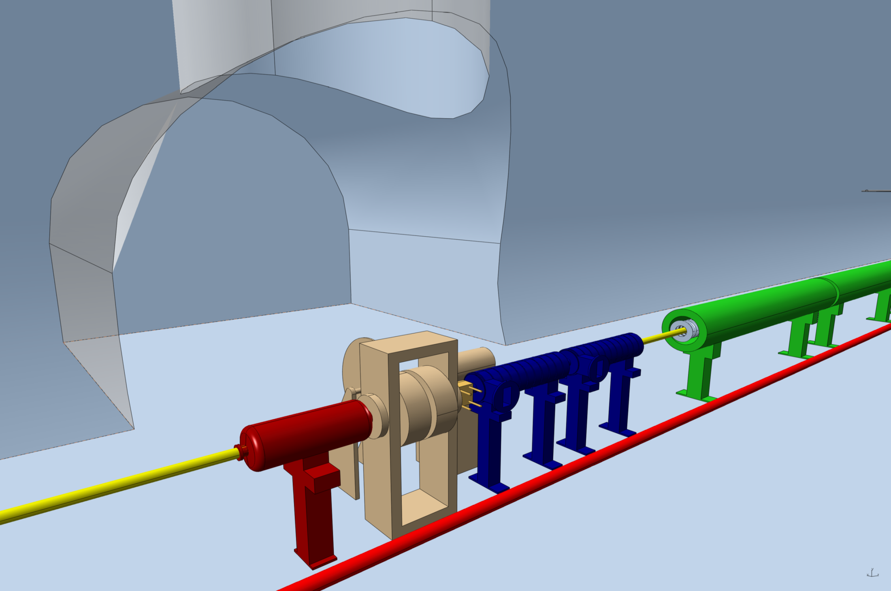
ILC – Central Integration SB 2009 Layout
Shielding removed for clarity.
Detail design for SW Accel. Modules now received. Remote Handling area currently under development.
Pre-Accelerator (Standing Wave x2 modules) in Remote Handling area (shielded).
Quarter Wave Transformer as Matching Device
Pre-Accelerator (Travelling Wave x3 modules)
Positron target
Photon Collimator also in shielded area
Electron BDS Long Drift

Slide 16
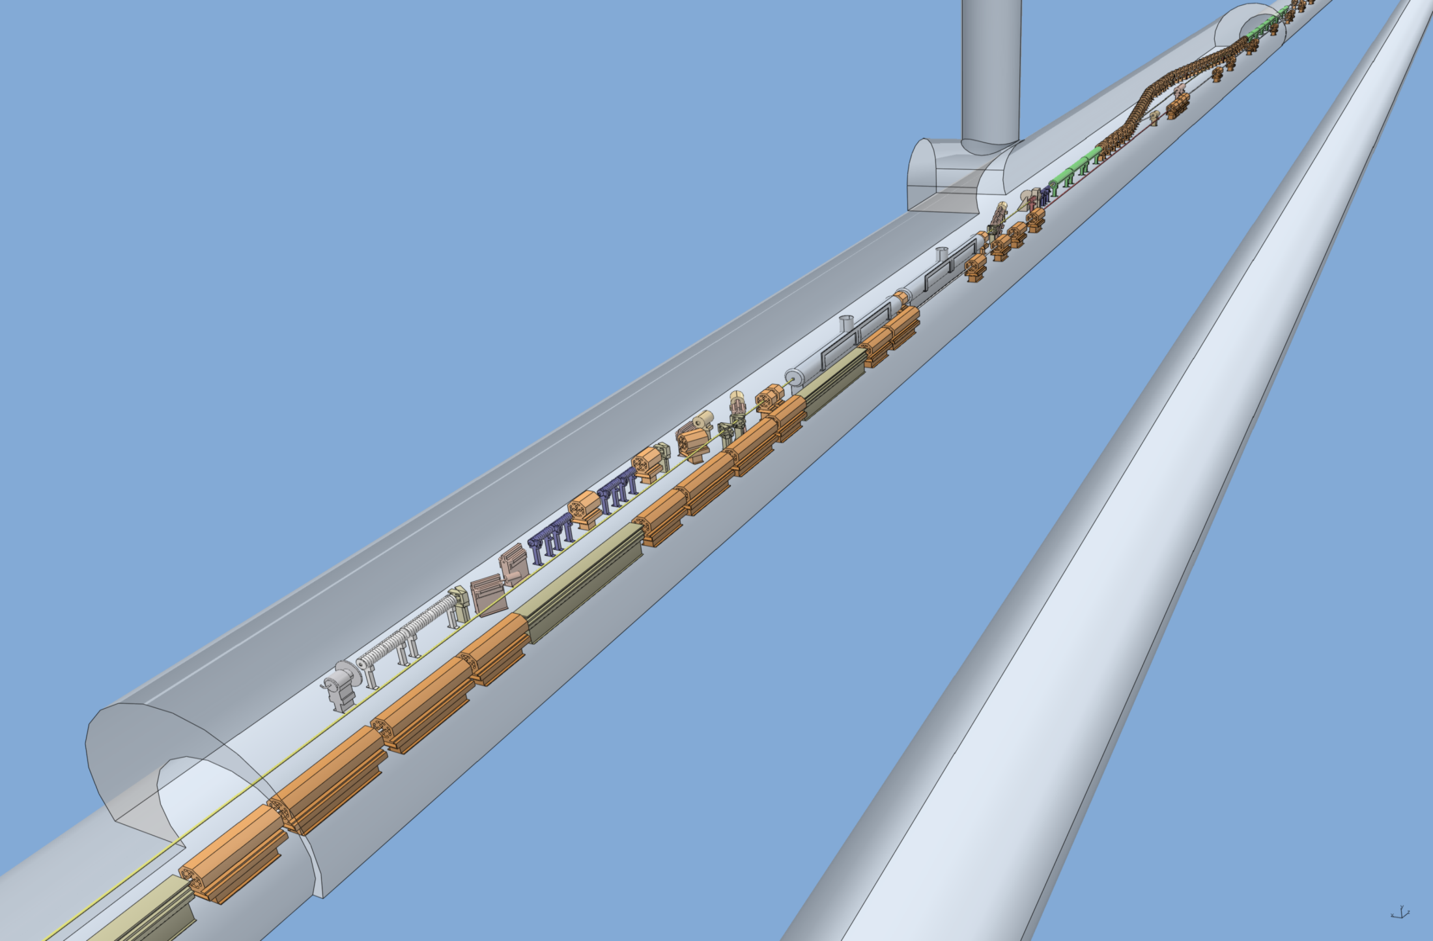
ILC – Central Integration SB 2009 Layout
AUX Source Diagnostic Dump may mean that the Source needs to be moved further upstream due to close proximity or RH area.
Additional Electron Dump required due to AUX Source (somewhere here).
AUX Source utilising Photon Beam pipe
Photon Beam pipe
Electron BDS ‘Dogleg’
Positron Beam Direction
Electron Beam Direction
Photon Beam Direction

Slide 17
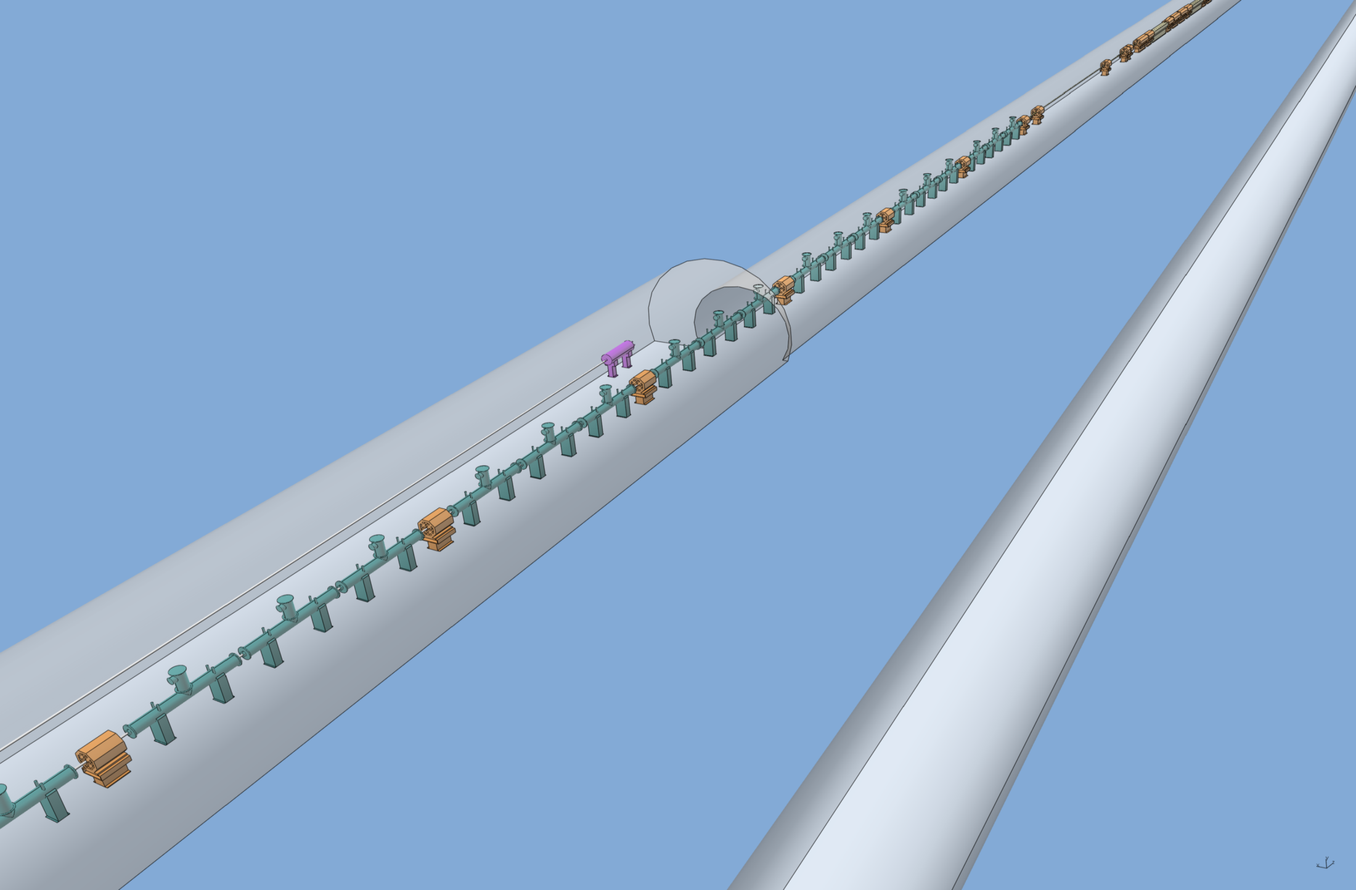
ILC – Central Integration SB 2009 Layout
‘Big’ change since Albuquerque.
3 additional Undulator modules + 1 Quadrupole magnet (= 1 string) due to ‘Low Energy requirement’ (may need 1 more string).
Fast Abort Dump approx 8 kW (few bunches only)
Consequence of this:
‘Pushes’ start of Positron Source further back from I.P. (14.538 m)
Undulator section
Quadrupole magnets are 1m long now
Positron Beam Direction
Electron Beam Direction

Slide 18
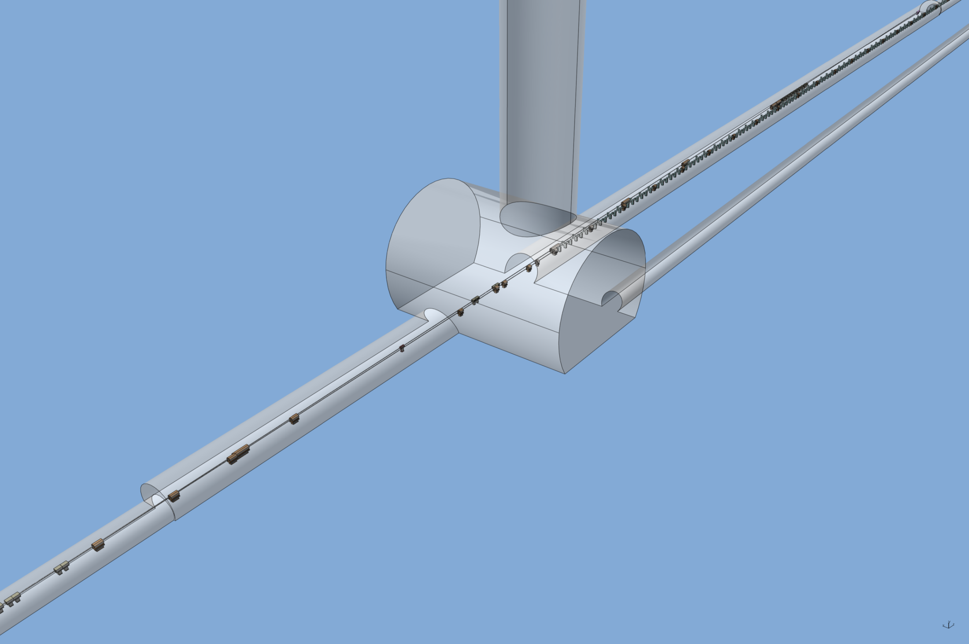
ILC – Central Integration SB 2009 Layout
The Fast Abort Line is taken straight out of the BDS lattice deck. It offers room for improvement as the length can be reduced and components removed.
Fast Abort Dump line
Undulator Access shaft and cavern
Undulator section start. 21 strings = 235.1 m effective undulator length for 306.3m physical length.
Fast Abort Dump line branching off
Service Tunnel start
Positron Beam Direction
Electron Beam Direction

Slide 19
ILC – Central Integration SB 2009 Layout
Summary:
Relatively small changes since Albuquerque and Durham – 1 additional Undulator pattern added (3 Undulators + 1 Quad) and Spin Rotation moved from 400 MeV location to 5 GeV in the Damping Ring Transfer Tunnel (PLTR).
To get model and layout done some (wild) guess work had to be made especially in the Damping Ring Transfer Tunnel. Components there are mainly place-holders awaiting confirmation.
We need to identify who will carry out a revised and optimised lattice design including all systems (i.e. Energy compression).
No concerns from CF&S with regards to Damping Ring Tunnel being too close to Target Hall. The geometry has been confirmed to be feasible.
Next level of detail can commence if all agree the solution presented is viable.
Many thanks to all who contributed or aided otherwise.

Slide 20
ILC – Central Integration SB 2009 Layout
Positron Source and Beam Delivery System acknowledgements:
Jim Clarke, Deepa Angal-Kalinin, James Jones and Andrei Seryi
Damping Ring acknowledgements:
Andy Wolski, Susanna Guiducci, Maxim Korostelev
RTML acknowledgements:
Nikolay Solyak
Civil Engineering acknowledgements:
John Osborne, Antoine Kosmicki (providing the presentation images), Thomas Lackowski and Vic Kuchler

