Slide 1
Status and prospects of the PUNCH4NFDI Consortium
Susanne Pfalzner (FZJ)
PUNCH4NFDI General Meeting
22nd June 2021

Slide 2
Recommendation for Funding
Official meeting of GWK at 2nd Juli 2021
Official letter from DFG expected end of July
Already funded:
- DataPlant
GHGA
KonsortSWD
NFDI4Biodiversity
NFDI4Cat
Newly funded consortia:
PUNCH4NFDI
DAPHNE4NFDI
FAIRMAT
MatWerk
berd-nfdi
NFDI4Chem
NFDI4Culture
NFDI4Health
NFDI4Ing
MaRDI
NFDI4Earth
NFDI4DataScience
Text+
NFDI4microbiota
PUNCH4NFDI | General Meeting | 22 June 2021 | SP

Slide 3
Who we are
PUNCH4NFDI | General Meeting | 22 June 2021 | SP

Slide 4
Now we have to become a functioning PUNCH4NFDI unit
PUNCH4NFDI | General Meeting | 12 May 2021 | TS
PUNCH4NFDI | General Meeting | 22 June 2021 | SP

Slide 5
PUNCH timeline
New resource plan with 30% cut
First funding period
October 2021 — September 2026
2022
2018
2019
2020
2021
Protpcol
Protpcol
First contact
Evaluation
Expert vote
Evaluation
Expert vote
Ext. abstract
Full proposal
Full proposal
Letter of intent
Letter of intent
Start of funding
Final vote GWK
Astronomy
Astro@ NFDI
PUNCH4NFDI
Application phase
Particles
Hadrons & nuclei
Astroparticles
PUNCH4NFDI | General Meeting | 22 June 2021 | SP

Slide 6
PUNCH timeline
First funding period
October 2021 — September 2026
2022
2018
2019
2020
2021
Protpcol
Protpcol
First contact
Evaluation
Expert vote
Evaluation
Expert vote
Ext. abstract
Full proposal
Full proposal
Start of funding
Letter of intent
Letter of intent
Final vote GWK
Astronomy
Tasks during this period:
Contracts with DESY
Budget
Governance
Timeline extremely short
Much of it will happen remotely
Particles
Hadrons & nuclei
Astroparticles
PUNCH4NFDI | General Meeting | 22 June 2021 | SP

Slide 7
Task areas
TA 3: Data transformations
TA 2: Data management
TA 1: Management and governance
TA 4: Data portal
TA 5: Data Irreversibility
TA 7: Education, training, outreach, citizen science
TA 6: Synergies & services
PUNCH4NFDI | General Meeting | 22 June 2021 | SP

Slide 8
Synergies between task areas
TA 3: Data transformations
TA 2: Data management
TA 1: Management and governance
TA 4: Data portal
TA 5: Data Irreversibility
TA 7: Education, training, outreach, citizen science
TA 6: Synergies & services
PUNCH4NFDI | General Meeting | 22 June 2021 | SP

Slide 9
“PUNCH”Lines
A leader in data management with expertise in big data, open data, FAIRification, use of hetero-geneous resources
PUNCH4NFDI – an open consortium by the community for the community - and beyond
Ready to go now!
Experience, expertise & work programme to take data manage-ment to the next level and solve the problems that others will have tomorrow
An asset for the entire NFDI
But beware – others are doing clever things too (experience with NFDI4Culture)
PUNCH4NFDI | General Meeting | 22 June 2021 | SP

Slide 10
MaRDI: micro-metadata schemes, statistical procedures, use cases
Synergies between consortia
Already funded:
- DataPlant
GHGA
KonsortSWD
NFDI4Biodiversity
NFDI4Cat
NFDI4Chem
NFDI4Culture
NFDI4Health
NFDI4Ing
NFDIxCS: easier access to
and use of HPC centres
NFDI4Ing: archetypes, ter-minology services, work on basic services, AAI, ...
NFDI4Microbiota: use cases, AAI and cloud standards
Newly funded consortia:
PUNCH4NFDI
DAPHNE4NFDI
FAIRMAT
MatWerk
MaRDI
NFDI4Earth
NFDI4DataScience
Text+
…
NFDI4Culture: legal aspects
of AAI and FAIR data management
NFDI4Chem: common work on metadata & data resusabiliy
DAPHNE4NFDI & FAIRMat & DPG: address physics-specific aspects
PUNCH4NFDI | General Meeting | 22 June 2021 | SP

Slide 11
PUNCH LUNCHes so far
Programme so far:
19 November: PUNCH4NFDI
3 December: PUNCH4NFDI and ESCAPE
14 January: the PUNCH Science Data Platform
28 January: PUNCH4NFDI and NFDI4Culture
11 February: PUNCH4NFDI and ESCAPE: data lakes
25 February: PUNCH4NFDI & university curricula
11 March: AutoML
25 March: Data irreversibility in the PUNCH world
8 April: PUNCH4NFDI and ESCAPE: Analysis platforms
20 May: Inferring disease dynamics of COVID-19
All events: https://indico.desy.de/category/743/
Information: send mail to sympa@desy.de with subject line “subscribe punch4nfdi-punchlunch
You have an idea for a PUNCH LUNCH, just contact the
executive board
PUNCH4NFDI | General Meeting | 22 June 2021 | SP

Slide 12
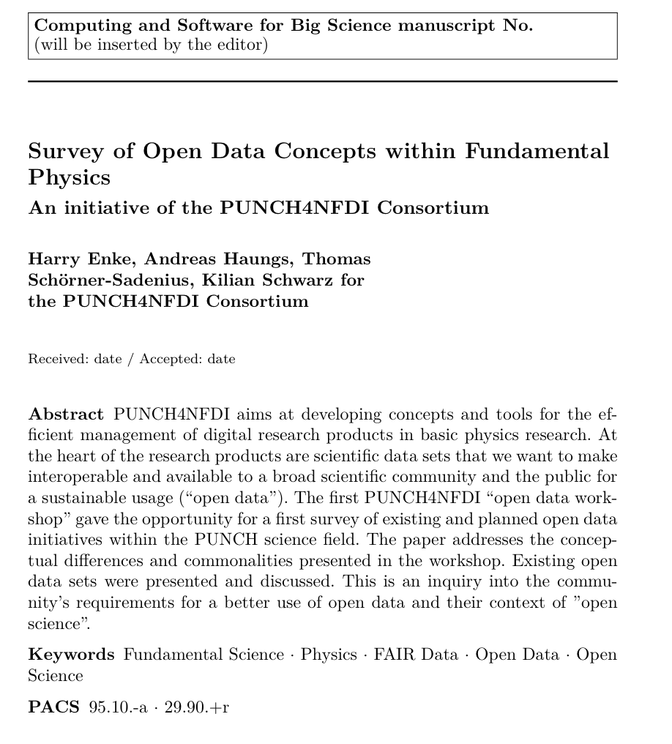
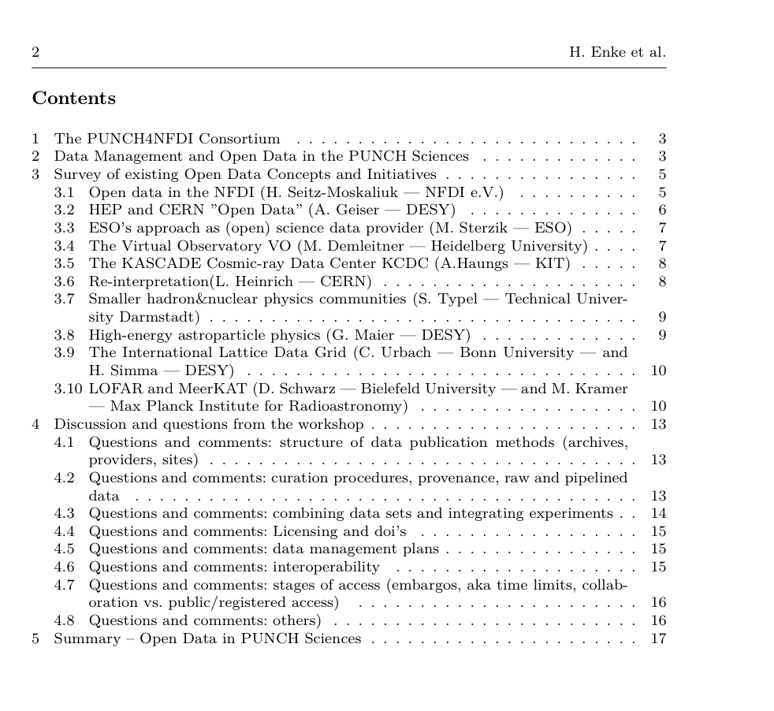
Open Data Activity
PUNCH4NFDI | General Meeting | 22 June 2021 | SP

Slide 13
Today
10:45 → 11:20 Funding cut situation (+discussion)¶ Speaker: Stefan Wagner (LSW, ZAH, U HD) 11:20 → 11:55 Formal and legal aspects (+discussion)¶ Speaker: Thomas Schoerner-Sadenius (CMS (CMS Fachgruppe QCD)) 11:55 → 12:10 Technical break 15m
12:10 → 12:45 Governance and committees (+discussion)¶ Speaker: Matthias Steinmetz (Leibniz Institute for Astrophysics Potsdam)
Discussion Leaders: Kilian Schwarz (GSI) and Andreas Haungs (KIT) 12:45 → 13:00 Next steps and farewell¶
Speaker: Thomas Schoerner-Sadenius (CMS (CMS Fachgruppe QCD))
PUNCH4NFDI | General Meeting | 22 June 2021 | SP

Slide 14
Thank you!
PUNCH4NFDI | General Meeting | 22 June 2021 | SP

