Slide 1
Formal and Legal Procedures Towards the Start of the Consortium
Thomas Schörner (DESY)
22 June 2021

Slide 2
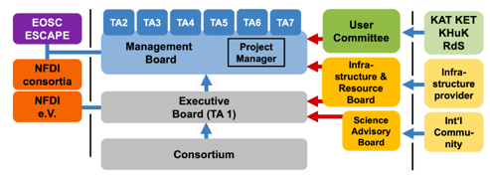
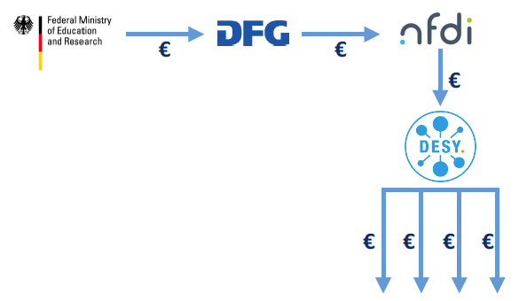
Resource Flow
Resources run from DFG over DESY as primary contractor (Zuwendungsempfänger) to co-applicants via sub-contracts
€
Lead applicant
Executive Board
Contracts between DESY and 19 co-applicant institutions
(Weiterleitungsverträge)
Co-applicants
(funded institutions, “Letztempfänger”)
Join NFDI e.V.!
Consortium Board

Slide 3
What is needed?
Contract DFG – DESY: “Bewilligungsschreiben” with “Verwendungsrichtlinie” as basis
When? → after the GWK meeting 2/3 July?
Probably zero freedom
Basis for receiving funds (at DESY) from the DFG.
Weiterleitungsverträge DESY – co-applicants (19 in number)
Basis for transfering funds from DESY to co-applicants
Formalise the governance (see Matthias’ presentation)
Template from DFG will be distributed early July (see timeline later) - we are clearly aiming for ONE contract, identical for all partners.
The funds to be distributed to the co-applicants are part of a new budget plan (attachment to contract)
Now work on
Budget plan (see Stefan’s presentation)
Governance model (see Matthias’ presentation) ➔ Both to be formally approved by acting Consortium Board (assembly of co-applicants) as soon as possible, and ideally unanimously.
Names, addresses of legal contacts, financial contacts, PIs, zeichnungsberechtigter Person

Slide 4
Suggested Timeline
22 June general meeting: governance, rough budget idea
6 July meeting of consortium spokespersons; information on template contracts
➔ one week for DESY legal department for checking / adapting templates
15 July sending template contracts to legal contacts of co-applicant institutions (if possible with final and adopted governance)
19 July NFDI workshop on consortium contracts
15 August Deadline for feedback on contracts from co-applicants
final cosmetics to contracts by DESY legal department
31 August start of collecting all signatures under contracts
15 Sept Contracts back to DESY
30 Sept All formal requirements satisfied; start of consortium on 1 October possible
15 October Kick-off workshop with determination of boards and positions following adopted governance
Budget plan????
(Draft today)
Governance????
(Draft soon)

Slide 5
Thank you!
The PUNCH4NFDI Consortium
Spokesperson: PD Dr. Thomas Schörner (DESY, thomas.schoerner@desy.de) DESY, Notkestr. 85, D-22607 Hamburg
Contact:
Mail: punch4nfdi@desy.de
Web: www.punch4nfdi.de
Twitter: @punch4nfdi

