Slide 1
Imaging ultrafast structural dynamics in molecules with electron diffraction
Martin Centurion
University of Nebraska-Lincoln
5th Workshop on Applications of Direct Laser Accelerators
September 27, 2021

Slide 2
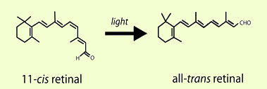
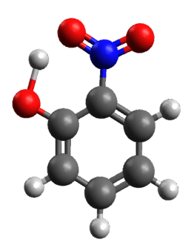
Energy conversion at the molecular level
Many molecular processes are driven by the conversion of photons into chemical energy (structure) and mechanical energy (heat).
Vision and photosynthesis: Isomerization (bond breaking and bond making).
Solar energy conversion and storage: Isomerization, ring-changing reactions.
DNA photoprotection: Ultrafast relaxation in nucleobases
Charge transfer reactions
Proton transfer
Many of these reactions take place on femtosecond time scales!

Slide 3
Making a Molecular Movie
Goal: Understand and control the conversion of light into other forms of energy at the level of single molecules.
Energy conversion takes place through atomic motions on femtosecond time scales.
We need to first observe a reaction as it takes place, on the relevant spatial and temporal scales.

Slide 4
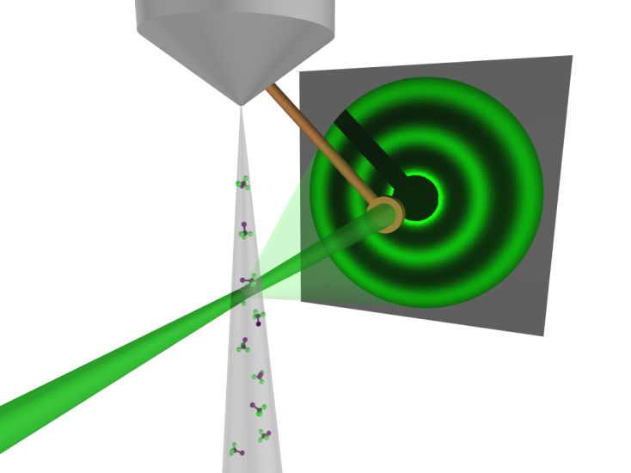
Gas Electron Diffraction
Total Scattering
Molecular Scattering
r_{ij} are the interatomic distances
High scattering cross section and small deBroglie wavelength
More than 10⁹ molecules in the interaction region (random orientation)
Compact setup with atomic spatial resolution.
First experiment by Marc and Wierl in 1930

Slide 5
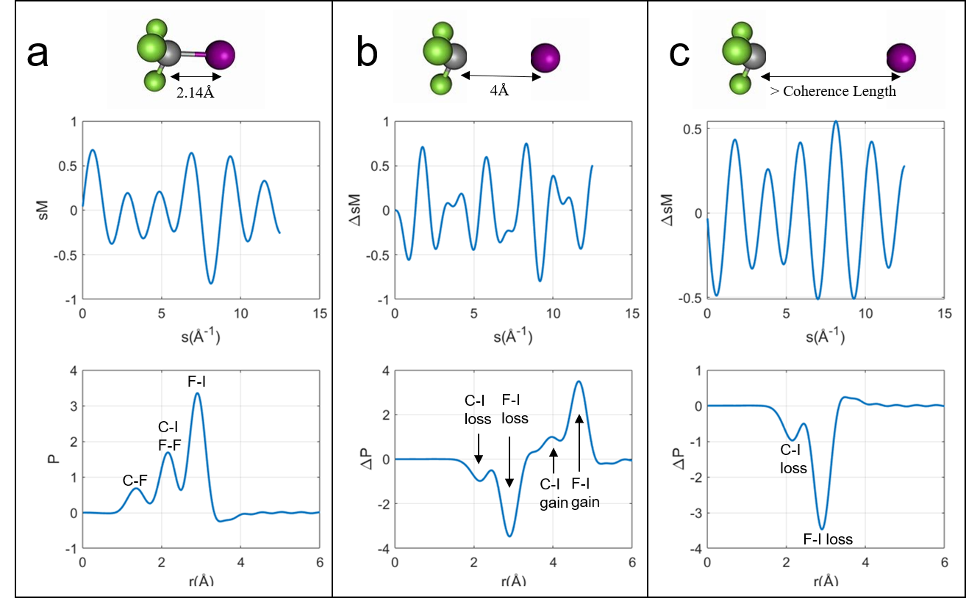
From diffraction to structure
Difference signal
Excited – ground state
Difference signal
Excited – ground state
Static signal
CF₃I molecule
Modfied Scattering signal
Fourier Transform
Pair distribution function (PDF)
Fig. from M. Centurion et al, Annual Reviews of Physical Chemistry (in press)

Slide 6

Gas phase Ultrafast Electron Diffraction (UED)
The main challenge for gas phase UED has been reaching the time resolution to capture coherent nuclear motions (< 300 fs)
Temporal resolution limitations
Limitations mitigated with high energy electrons
Group velocity mismatch
60 keV UED
_{hv}
hv
e⁻
$$e−$$
Δt_{VM} > 1ps
V_{e}=0.446 c
3 MeV UED
_{hv}
$$e−$$
time
Δt_{VM} < 10 fs
V_{e}=0.989 c
Space-charge repulsion
Electrons traveling at relativistic speeds experience less space-charge repulsion

Slide 7
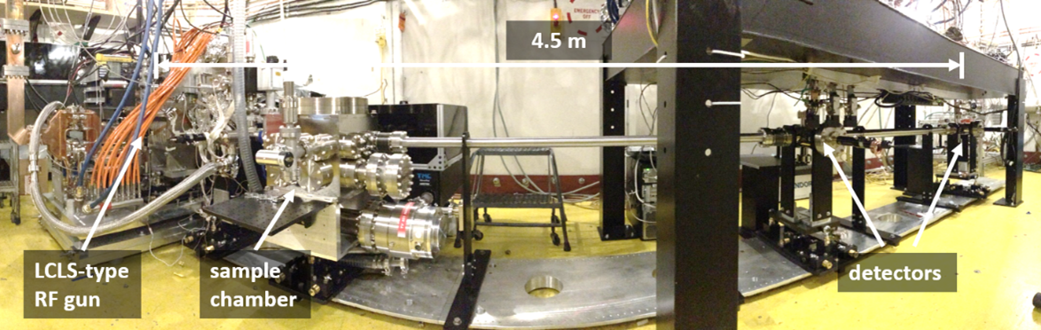
MeV UED Instrument at SLAC
Parameters | Values[*]
Rep. rate | 360 Hz
Kinetic energy | 3.7 MeV
Electrons/pluse on target | ~ 10k
Time resolution | 150 fs
Electron diameter | 200 um
Laser pump diameter | 300 um
Q range | 12 Å⁻¹
Sample delivery | Gas jet or flow cell
Proof-of-principle experiments (220 fs resolution):
"Diffractive Imaging of Coherent Nuclear Motion in Isolated Molecules“ PRLs, 117, 153002 (2016)
"Diffractive imaging of a rotational wavepacket in nitrogen molecules with femtosecond megaelectronvolt electron pulses“ Nat Commun 7, 11232 (2016).
λ = 0.3 pm
﻿Weathersby et al, RSI, 86, 073702 (2015)
*Shen et al., Struct. Dyn., 6, 54305 (2019)

Slide 8
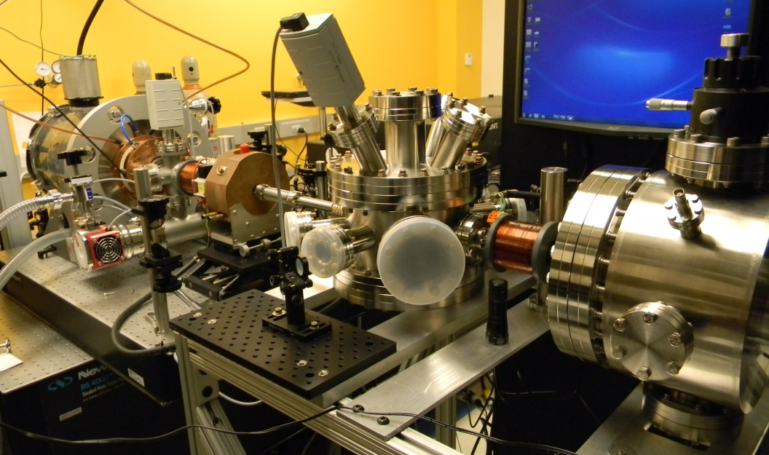
keV UED Instrument at University of Nebraska
90 kV DC accelerator
Parameters | Values[*]
Rep. rate | 5 kHz
Kinetic energy | 90 keV
Electrons/pluse on target | ~ 10k
Time resolution | 250 fs
Electron diameter | 200 um
Laser pump diameter | 200 um
Q range | 12 Å⁻¹
Sample delivery | Gas jet
Electron optics
RF compression cavity
Target chamber
Detector
The group velocity mismatch through the sample can be compensated using a tilted laser pulse to match the electron speed.
RF compression technology developed by Luiten and Siwick groups.
λ = 4 pm
*Xiong et al., Phys Rev Research 2, 043064 (2020)
Zandi et al, Structural Dynamics 4, 044022 (2017).

Slide 9
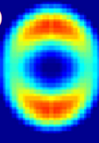
Outline
Application of gas phase MeV-UED to image a proton transfer reaction: Molecular movie of the ultrafast dynamics in o-Nitrophenol
Application of gas phase keV-UED to capture a rotational wavepacket: Proof-of-principle experiment on laser-aligned molecules.

Slide 10
Proton Transfer Reactions
Intramolecular proton transfer (IPT) is amongst the most elementary reactions involved in the control of fundamental processes:
Electron transfer in photosystem II
Proton pump bacteriorhodopsin
Light-emission in fluorescent proteins
IPT
Technological applications of IPT:
Sensors, laser dyes, organic LEDs, solar collectors, photo stabilizers, molecular logic gates
Despite its industrial and biological importance, the nuclear motions governing IPT have never been imaged on the atomic length and time scales.
Meyer et al, ﻿Angew. Chem. Int. Ed. 46, 5284 – 5304 (2007); Hayashi et al, Biophys. J., 83, 1281-1297 (2002); Tang et al, ﻿PCCP., 20, 12517—12526 (2018)

Slide 11






Intramolecular proton transfer in o-nitrophenol
Electron-withdrawing
O-nitrophenol is a prototypical molecule for the study of IPT
  Proximity between electron donating and withdrawing groups lead to strong charge transfer character and potentiates IPT
Electron-donating
Carbon
Nitrogen
Oxygen
Hydrogen
&
&
Ozone depletion
Photochemical smog
O-nitrophenol importance to atmospheric chemistry:
Speculated to be a photolytic source of OH and HONO radicals.
Pollutant associated with combustion and hydrolysis of pesticides^{[12]}
^{[12]}R. Atkinson Atmos. Environ., 34, 2063−2101. (2000)

Slide 12
What can we learn with UED?
Previous experimental results predict a wide range of quantum yield, products and reaction rates
Conflicting pathways purposed in the literature:
  Concerted IPT and HONO rotation?
  IPT followed by HONO rotation?
?
?
No direct experimental observation of the structural dynamics of leading to IPT and HONO rotation
  Which motions?
  What timescale?

Slide 13
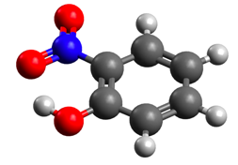
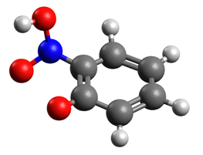
UED Data and AIMS simulations
Good qualitative agreement between exp. and sim.
  Signal amplitude consistent with 15 % excitation
Signal is best explained by the loss of planarity
  Out-of-plane torsion of the NO₂/HONO group
Ab-initio Multiple Spawning Dynamics (AIMS)
  FOMO(0.2)-CASCI(2,2) / 6-31g**
^{[18]} Nunes et al. (in preparation)
Ab-ignition multiple spawning (AIMS) simulations carried out by Monika Williams in the group of Todd Martinez

Slide 14
UED Data and AIMS simulations
ΔPDF
Changes in Pair distribution function
Exp – Theory comparison
Good qualitative agreement
Different temporal evolution of distances lost and gained
Three stage dynamics:
  Subtle motions
  Torsion of HONO group
  Reaction completion
Exp
Theory
^{[18]} Nunes et al. (in preparation)
Ab-ignition multiple spawning (AIMS) simulations carried out by Monika Williams in the group of Todd Martinez

Slide 15
From diffraction to 3D structure: Genetic Algorithm aided retrieval
Random pool of 1000 structures
GA retrieved geometry
Geometric model:
39 structural parameters
  14 interatomic distances
  13 angles
  12 dihedral angles
Constrained to avoid unphysical structures
GA routine
100 generations
Repeated 100 times
Selection
Crossover
Crossover selected parents to produce 760 children
Mutation
Parameters of 48 trial structure are randomly changed
Select top 50 based on lowest 𝜒²
1000 trial structures
Calculate ΔI/I(s,t) for trial structures and evaluate 𝜒² against exp. ΔI/I(s,t)
X 100
^{[18]} Nunes et al. (in preparation)

Slide 16
Observing the proton transfer motion
IPT reaction coordinate is most appropriately represented by the acceptor-donor distance (rO_{C}O_{N})
  Acceptor-donor compression lowers barrier to IPT
UED captured the transient acceptor-donor compression
Observed a delay between IPT and HONO rotation
UnexpectedLong delay
Proton transfer
O-O distance increase from HONO rotation

Slide 17
Relaxation to the ground state enabled by HONO rotation
Increase in dONCC from near planarity to 90° after ~450 fs
  Coincides with increase in rO_{C}O_{N} and feature γ
Exp.
Sim.
Correlation between S₁(ππ*) depopulation and dONCC torsion
  HONO rotation closes the S₀/S₁ energy gap
  dONCC can be used as a proxy for S₁/S₀ CI access
Delay between IPT and IC implies a significant slow down or trapping of the nuclear wavepacket along the reaction coordinate

Slide 18
Summary or reaction dynamics
Successfully imaged intramolecular proton-transfer in o-nitrophenol
Spatially and temporally resolved the nuclear wavepacket motion:
  Franck-Condon region
  Along IPT coordinate
  Through a local minimum
  Towards a conical intersection
  To the hot S₀
These mechanistic insights may inspire molecular design principles to tune the photo-reactivity of biologically and industrially relevant IPT reactions

Slide 19
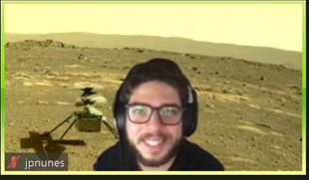
3D structure at key moments
Experimentally retrieved geometries
Sequence of events:
0 fs – Excitation
<100 fs – IPT
~200 fs – aci-nitro S₁ min
>500 fs – HONO torsion
~600 fs – CI crossing
>800 fs – hot S₀
Geometries from representative AIMS simulations
J. Pedro Nunes et al. (in preparation)

Slide 20
Molecular movie retrieved from experimental data
^{[18]} Nunes et al. (in preparation)

Slide 21
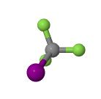
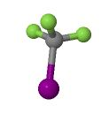
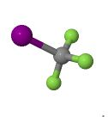
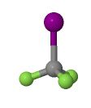
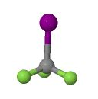
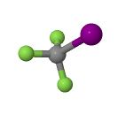
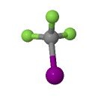
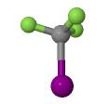
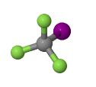
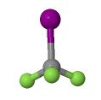
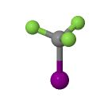
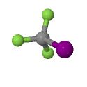
keV UED Proof-of-principle experiment: Diffraction from Aligned Molecules
Non-adiabatic (field-free) alignment
Molecules are impulsively aligned by a femtosecond laser pulse through an induced-dipole interaction.
The angular distribution is reflected in the electron diffraction pattern

Slide 22
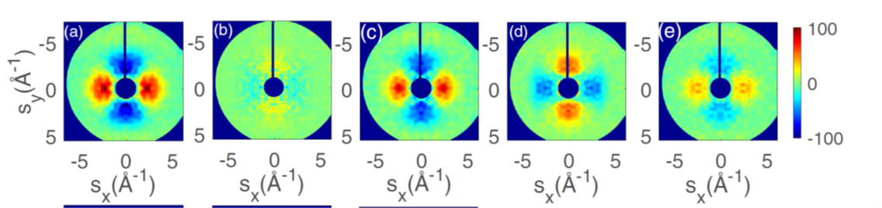

Molecular Alignment: Anisotropic diffraction patterns
$$ΔsM\left(t\right)=sM\left(t\right)−sM_{Ground}$$
Peak alignment
Anti-alignment

Slide 23
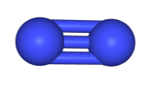
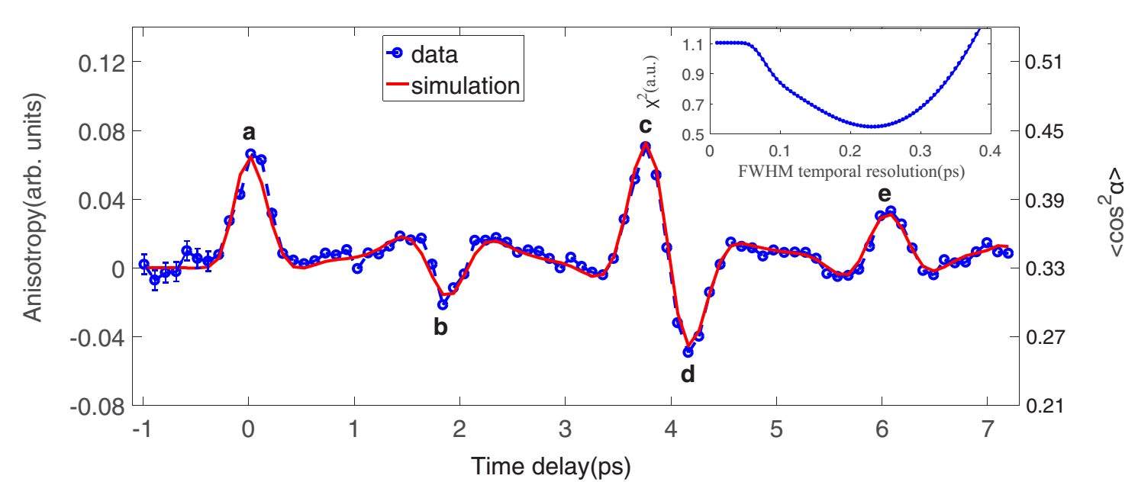
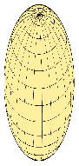
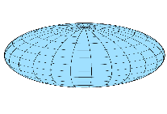
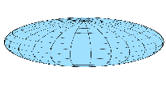
Alignment dynamics of nitrogen molecules
N₂
Temporal evolution of the nitrogen rotational wave packet
Anisotropy in diffraction pattern vs time

Slide 24
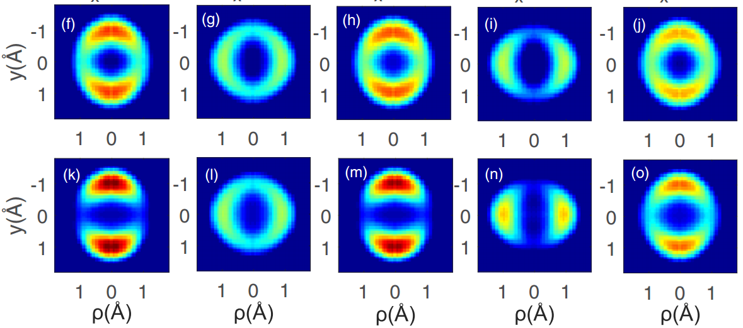
Retrieved Rotational Wavepacket
A slice of the 3D probability density. .
Experiment
Theory

Slide 25
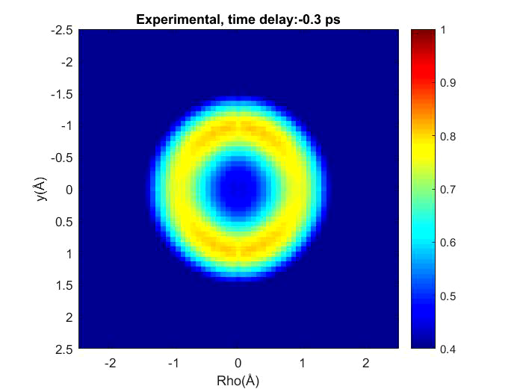

And finally a movie!
Yanwei Xiong et al, Phys Rev Research 2, 043064 (2020)
Slow motion movie: The frame rate is 10¹³ fps.

Slide 26
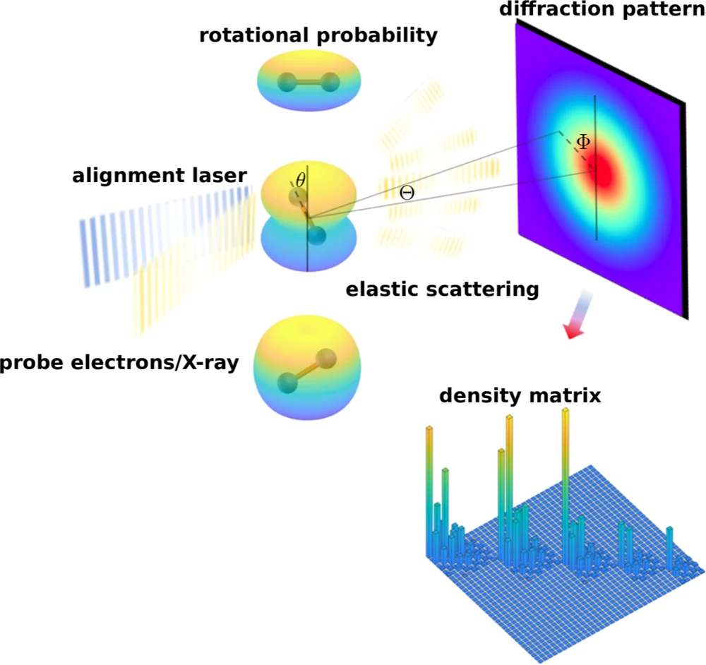
Tomographic retrieval from diffraction data
Quantum state tomography of molecules by ultrafast diffraction
M. Zhang et al, Nature Communications 12, 5441 (2021)
The full rotational wavepacket density matrix is retrieved from the time-dependent probability density
The method method is similar to chrystallographic phase retrieval (iterates from real and momentum space).
In principle can also be applied to vibrational wavepacket

Slide 27
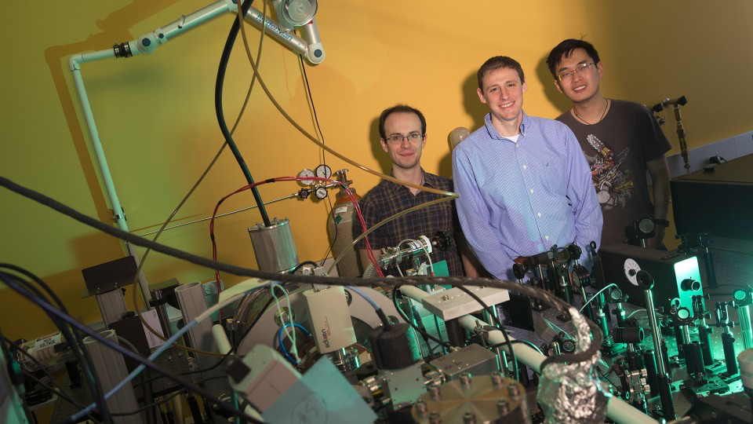





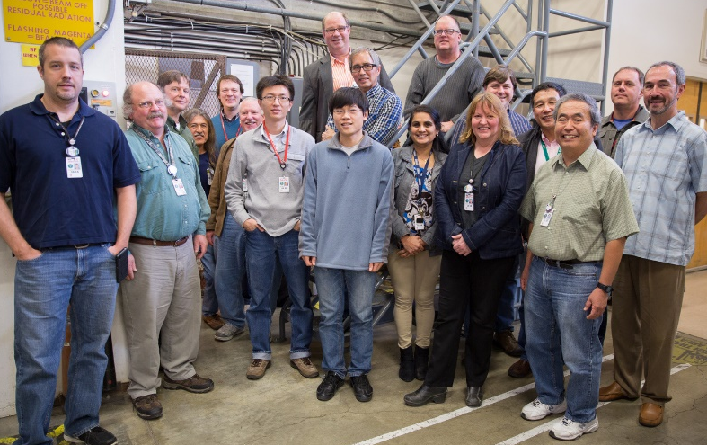

UED Acknowledgements
Experimental Team
University of Nebraska-Lincoln: Joao Pedro Nunes, Kyle Wilkin, Bryan Moore, Yanwei Xion, Omid Zandi.
SLAC MeV UED Team: Jie Yang, Xijie Wang, Renkai Li, Xiaozhe Shen, Stephen Weathersby, Keith Jobe…
Stanford Pulse Institute: Thomas Wolf, James Cryan, Mike Minitti, Ryan Coffee.
Potsdam University: Markus Guehr
Theoretical Support
Zheng Li (CFEL, Germany)
Xiaolei Zhu, Robert Parrish, Todd Martinez (Stanford Pulse Institute)
UNL
This work was supported by the U.S. Department of Energy Office of Science, Basic Energy Sciences under Award Number DE-SC0014170
SLAC UED

Slide 28
END
END

