Slide 1
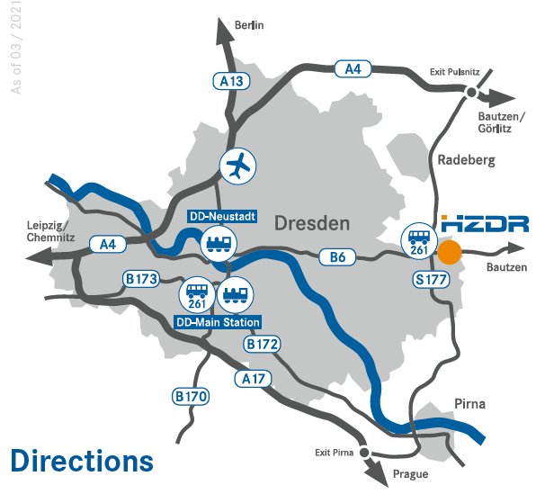
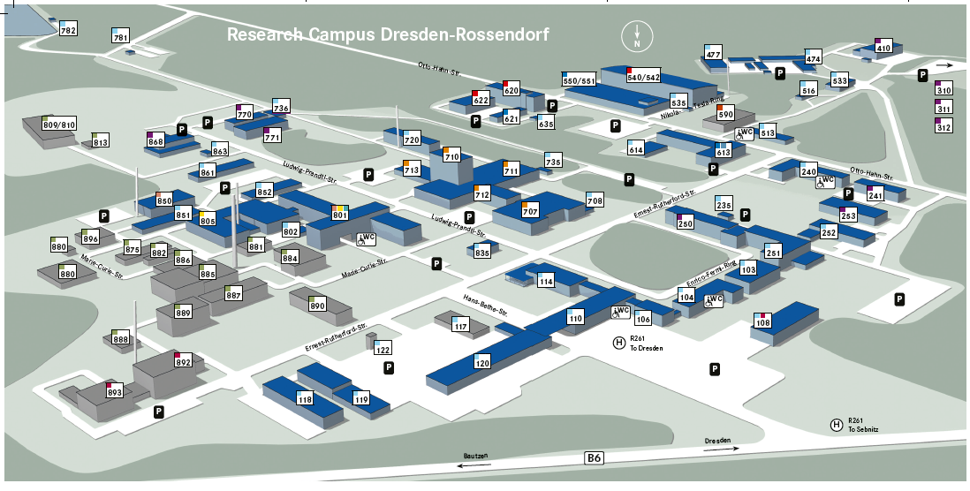
ELBE test beam
Dresden Rossendorf

Slide 2
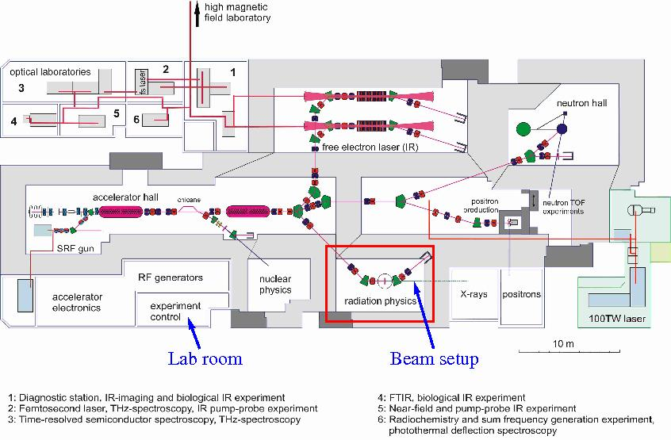
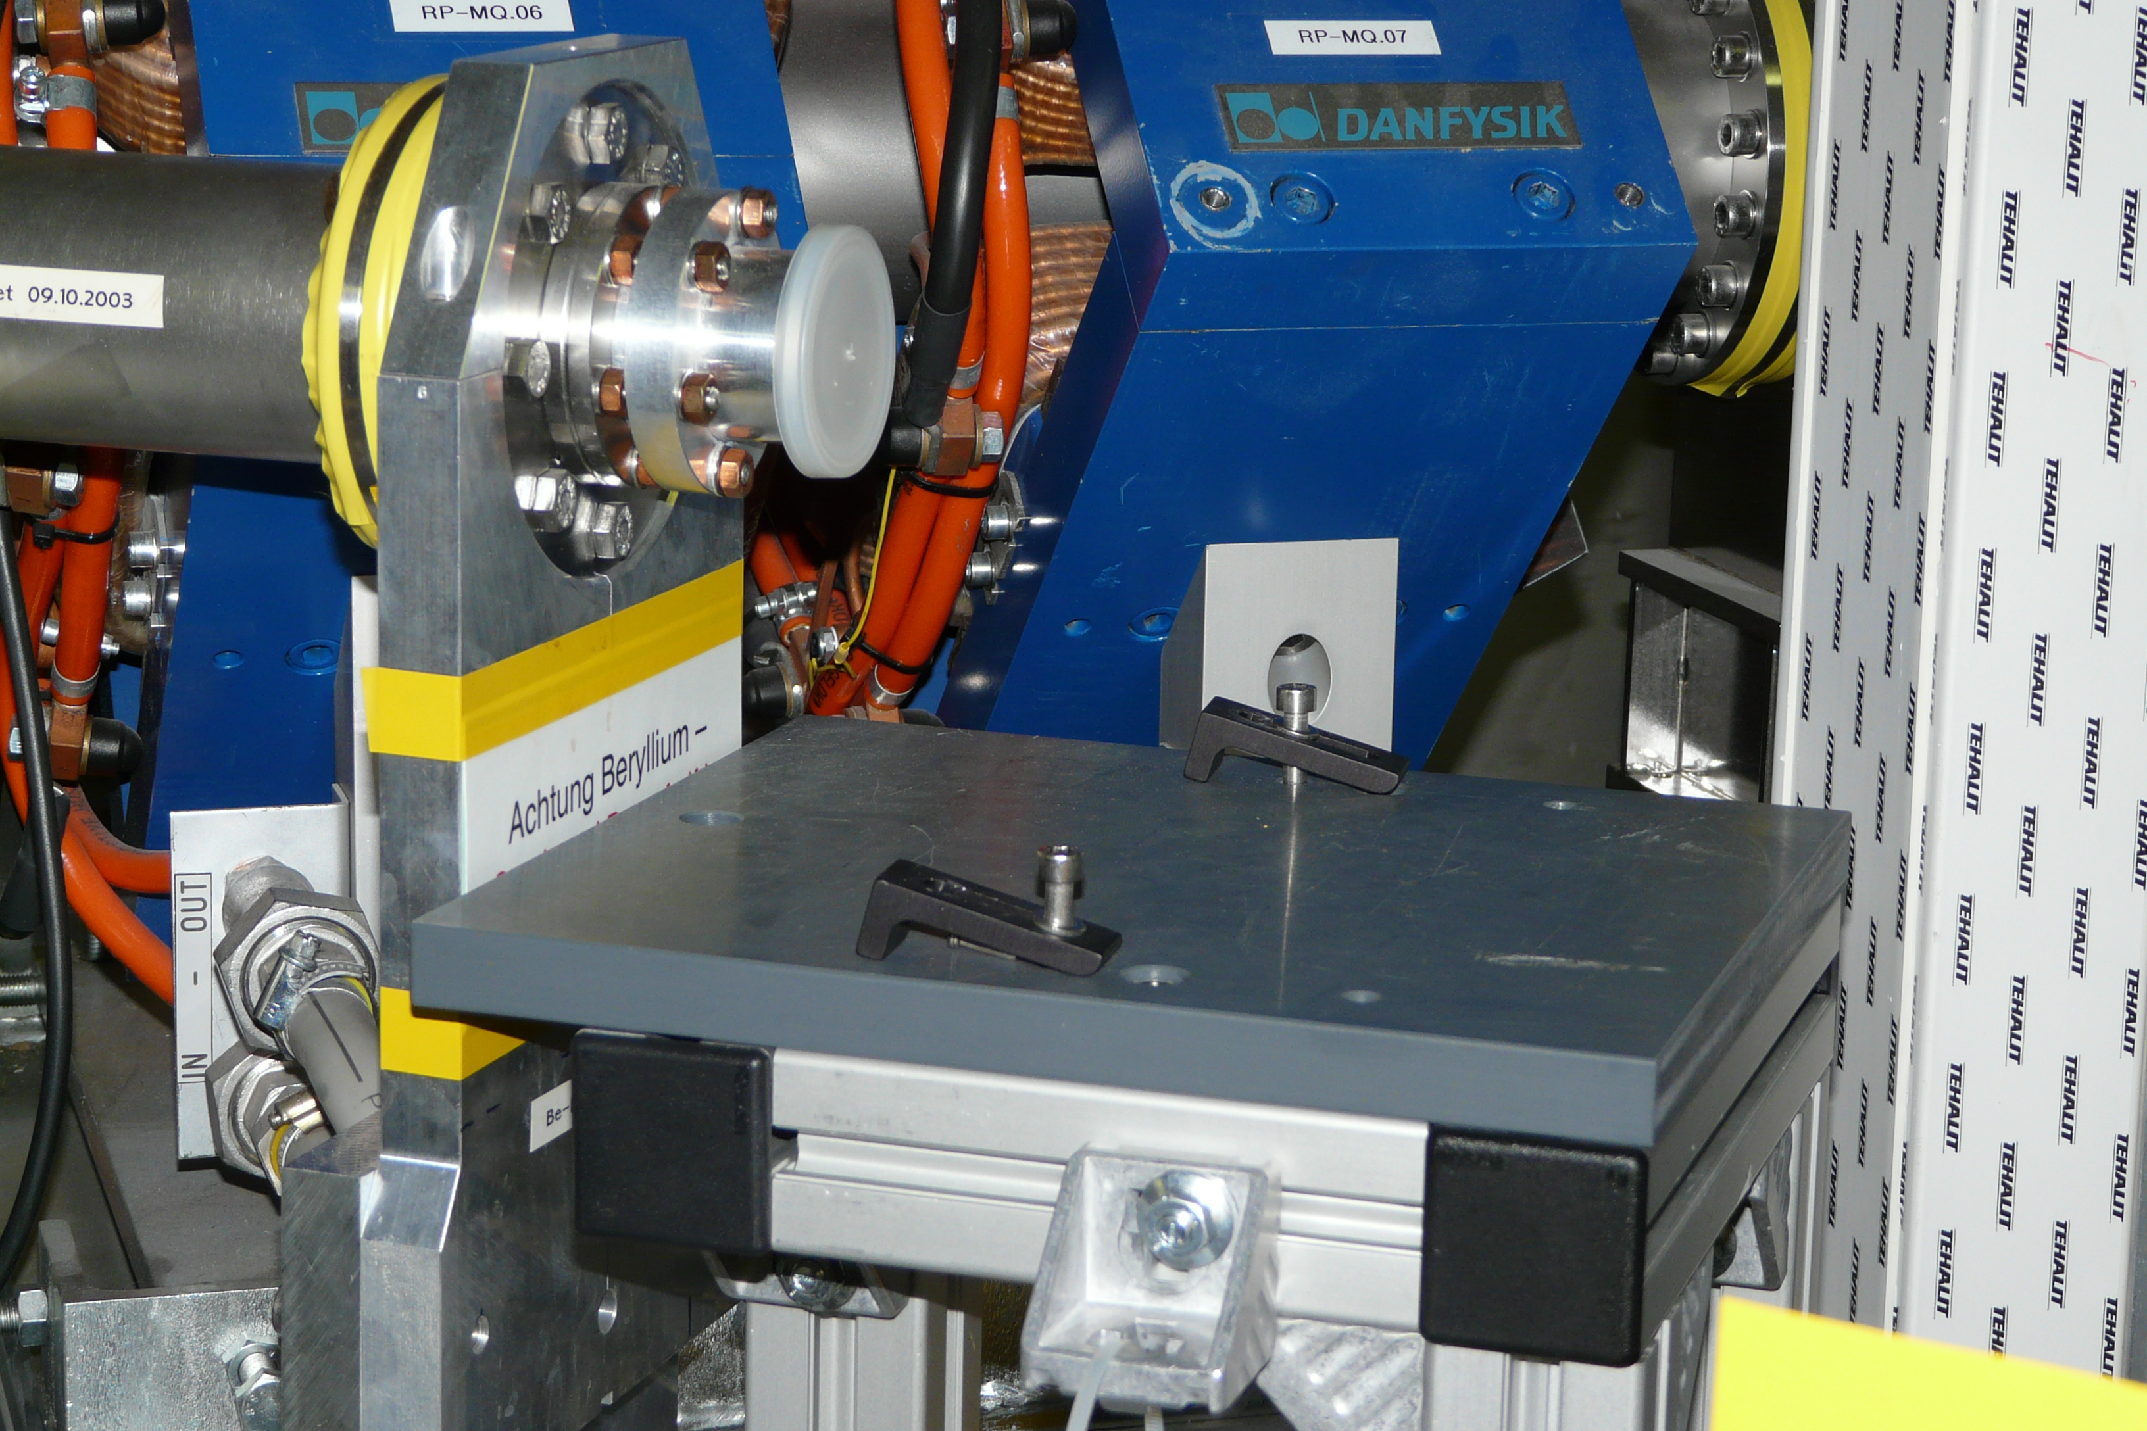
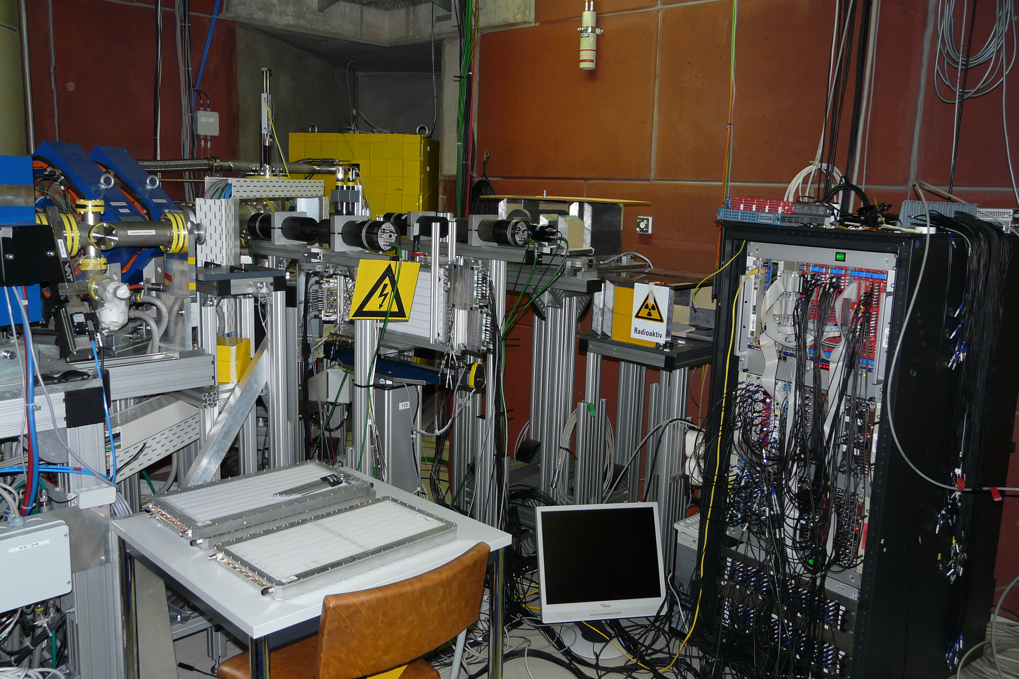
Electron-beam testing station for detectors
https://www.hzdr.de/db/Cms?pNid=3381

Slide 3
The most important features of the ELBE detector testing facility are listed in the following table
Property | Operation mode | Value | Remark
Electron beam energy | All | E_{kin} ≤ 31 MeV | This energy is near the minimum of ionization for several typical detector materials (freon RF-134 and vinyl toluene based plastic scintillators, e.g.)
Number of bunches / s | General (cw) | 26 MHz / 2^{n} (n = 1...7) | The repetition rate of 13 MHz is downscalable as needed.
 | Single-pulse | 1 - 1.3∙10⁷ | In case of bunch trains, the bunch repetition rate within the train can be set a for the general mode.
 | Single-electron | 1 - 10⁵ | The repetition rate of single electron bunches can be set as for the single-pulse mode.
Number of electrons / bunch | General (cw) | ≤0.1 mA (≤7.77pC/bunch) | The maximum permissible beam intensity in the detector testing electron beam line (0.1 mA) is lower than the maximum beam intensity of ELBE (1.6 mA) provided in other beam lines.
 | Single-pulse | ~1 fC - ~100 pC | The maximum bunch charge is limited by electron transport through detector testing beam line.
 | Single electron | 1 - 20 electrons | The number of electrons inside one bunch is limited to one or a few, as requested by the user. This allows to test a detector by just one or a very few minimum ionizing particles, if needed.
Jitter of timing reference | Single-electron | ~35 ps | The radio-frequency signal of the accelerator (~2 ps) is provided as time reference inside the detector testing cave. The measured jitter of this signal provided to the user is tyically 30-35 ps.

Slide 4
Additional information
Infrastructure and electronics provided
Internal and external users can benefit from a well-developed infrastructure for detector testing:
Gas mixing system for three gases (usually freon R134a, SF₆, and iso-butane) with bottle depot outside the experimental hall and tube and bubbler inside the experimental hall.
Patch panel (10 x SHV, 10 x BNC) connecting experimental hall and counting room
Cable-LAN internet access inside the experimental hall
VME TDC (25 ps) and QDC (25 fC) can be provided upon request, GSI MBS (multi-branch system) DAQ with RIO IV available, FPGA available
High voltage for detectors and setup can be provided, controllable from counting room
Remote controlled movable column (up/down, right/left) to scan various areas of a detector.
Video link to experimental hall can be provided upon request
Kitchen with microwave oven for shift personnel

Slide 5
Minimal experimental program:
Program:
Measuring of the detector signal pulse shape (at several HV values) for 2 non-irradiated sapphire sensors – probably trigger from the beam will be enough
Irradiation of 2 sensors up to 5 MGy dose (~10 nA beam current, 4 mm ø beam spot – do we need collimator?)
Repeating pulse shape measurement for both detectors
Continue irradiation of one of the detectors up to 10 MGy dose (high beam current ~10 nA)
Repeating pulse shape measurement for extra irradiated sensor
What to measure and needed equipment:
Shape of pulses from 2 strips of each detector – 4-channel oscilloscope, remote access
Remotely controlled HV source (2 channels)
Current consumed by detector from HV source (2 channels)
Collimator current
Faraday cup current
Thermoluminiscent dosimeters?

Slide 6
Expected dose
The dose can be calculated as follows:
$$1 Gy =1 joule {kg}^{−1}=6.24∙{10}^{12} MeV {kg}^{−1}=6.24∙{10}^{9} MeV g^{−1}$$
If detector is uniformly irradiated by ionizing particles, then
Dose$\left[Gy\right]=\frac{N_{e}∙{dE}/{dx}∙d∙ρ}{6.24∙{10}^{9}∙V∙ρ}=\frac{N_{e}∙{dE}/{dx}}{6.24∙{10}^{9}∙S}$
where $N_{e}$ - number of beam particles passed through the detector, $dE/dx$-specific energy
loss in $MeV∙{cm}^{2}/g$, $d,S,V$- detector thickness, area and volume respectively, $ρ$ - sapphire
density (units - g and cm). Experimentally the easiest way will be to measure the current
from Faraday cup induced by the beam, in this case one should use an integral of the
measured current and the collimator hole cross section. Dose rate in this case:
Doserate$\left[Gy/sec\right]=\frac{I_{FC}}{1.602∙{10}^{−19}}∙\frac{{dE}/{dx}}{6.24∙{10}^{9}∙S_{collim}}=\frac{I_{FC}∙{dE}/{dx}}{S_{collim}}∙{10}^{9}$
for uniform particle distribution over the collimator hole.

Slide 7
Expected dose 1
For 20 MeV beam we have $dE/dx = 1.8 MeV cm2/g$. Assume collimator hole diameter of $4 mm$, the irradiated area will be - $0.126 cm2$. To achieve the dose of $5 MGy$in reasonable time (~12-15 hours) we will need approximately 400 $kGy/hour$(~110 $Gy/sec⁡$) dose rate. Using above relation we get I _{FC}=7.7 nA . The collimator selects only some part of the beam, so one needs at least 20 nA of the beam current. If bunch repetition rate is 100 kHz, it corresponds to 200 fC of the bunch charge ( 1.25⋅10⁶ particles per bunch) .
These numbers should be checked with ELBE crew
We can increase beam current up to 0.1 mA and single bunch charge up to 100 pC.
What will be our choice?

Slide 8
Test structures on sapphire wafer (tbd)
Per 2-inch wafer:
2 Standard strip sensors
2 Test structures
23x10 mm
Configuration of electrodes
on the test structure could be
different from the nominal one.
Number of strips, width, pitch
are to be discussed ASAP.
23x22 mm

