Slide 1
General Info
M. Bruschi (INFN Bologna)

Slide 2
News
INFN Bologna and Padova groups belong now to the LUXE collaboration
A space in CONFLUENCE where to place GBP files is now available
https://confluence.desy.de/display/LUXE/Gamma+Beam+Profiler
Mail to uco@desy.de for access to the area
Confluence documentation only in German!
Is this an acceptable repository for our files or should we create a space in other platforms (Google docs, Sharepoint ... other ideas?)
Our next meetings will be on Thursdays at 14:00 (TBC)

Slide 3
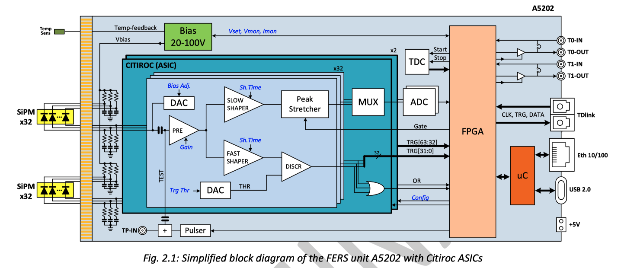
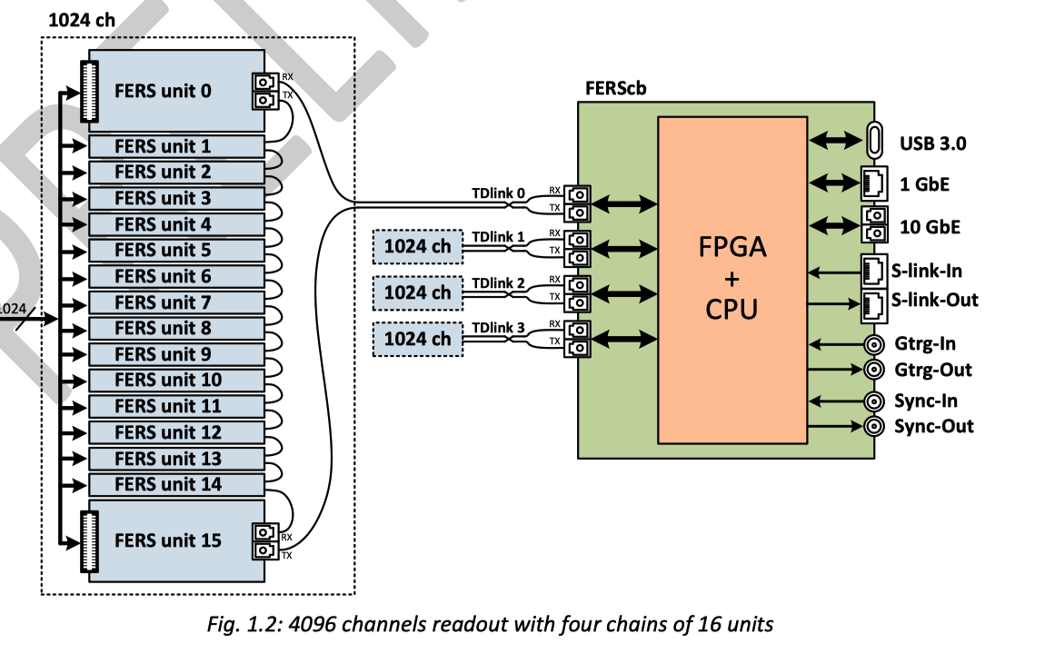
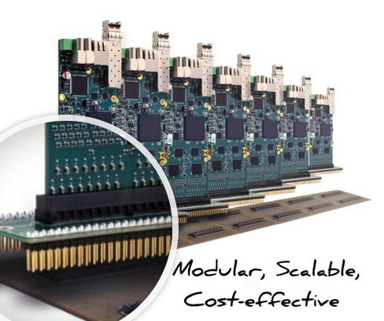
Readout Electronics
It is a rather straightforward design
Plenty of signal: ~30 pC/BX (peak on upstream detector)
Low rate: 10 Hz
Array of Sample-and-Hold capacitors
Control logic for switching and multiplexing the outputs to read them out
Read-out card: commercial solution existing
Modular reading system FERS-5200 developed by CAEN based on CITIROC
64 channels per card (13-bit dynamic range)
INFN Bologna will design and built a patch panel (PP) to distribute the detector signals to plugged-in readout cards
6 M.U. requested to INFN BO in 2022 for the PP design

Slide 4
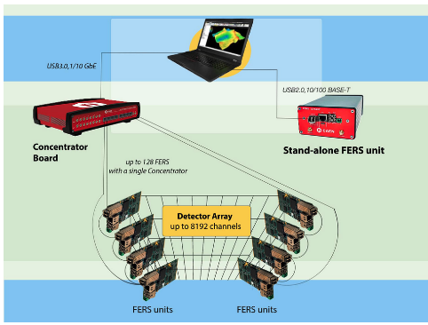
Readout system
DT5215 Concentrator Board for FERS-5200
A5202 64 Channel Citiroc unit for FERS-5200

Slide 5
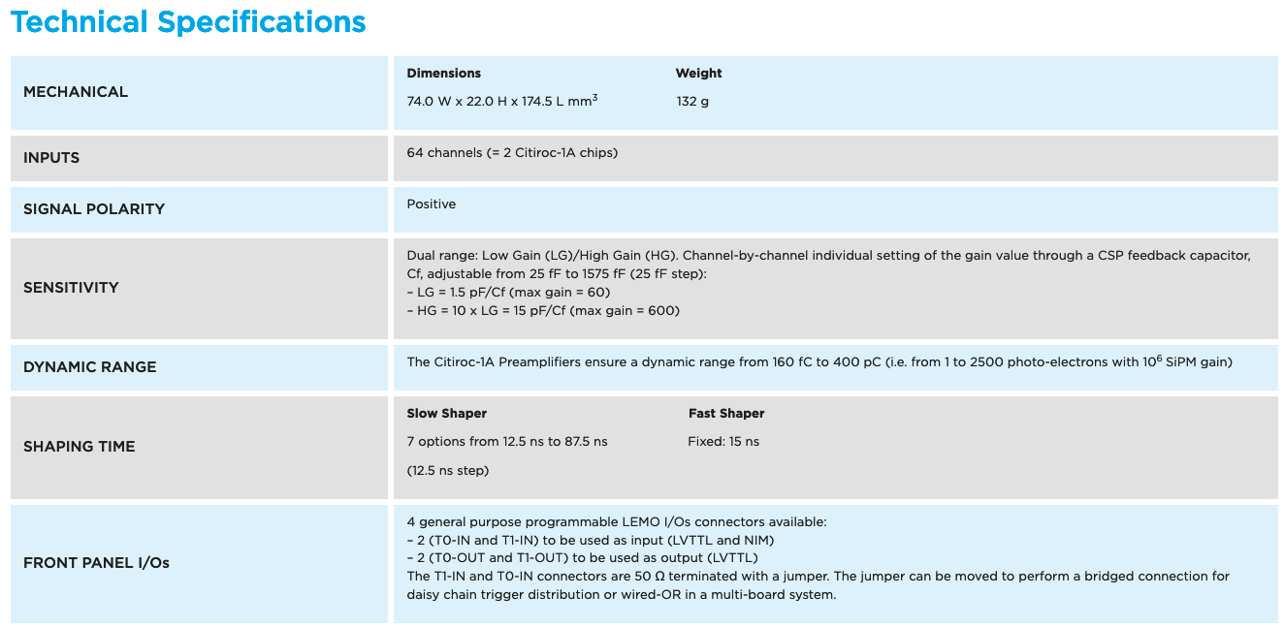

Slide 6
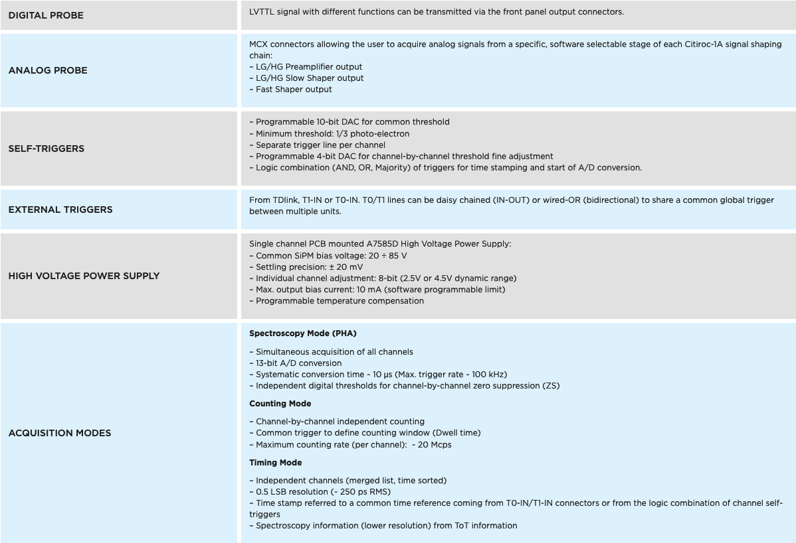

Slide 7
Electronics Noise (assuming CR-RC with τ=50 ns)
I_{L} < 1 nA
C_{T}<3.5 pF+2 pF
R_{S}< 10 MOhm
τ~ 50 ns
ENC_{P}~3.8E-3 fC
ENC_{S}~3.5 fC (??)
Peak signal on upstream detector ~ 30 pC (13-bit dynamic range)

Slide 8
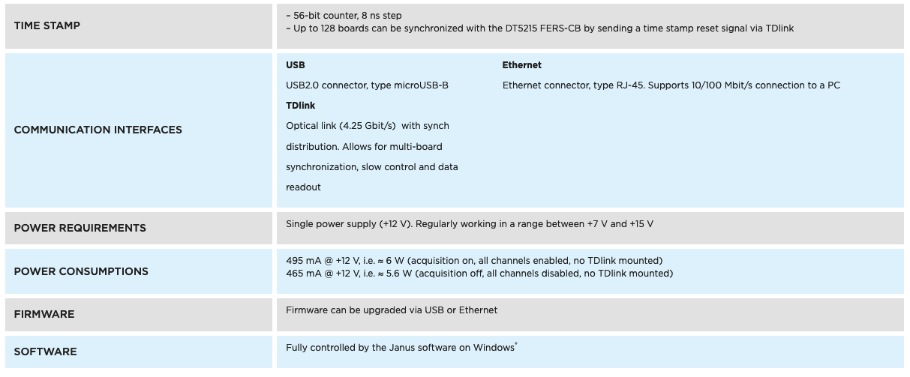

Slide 9
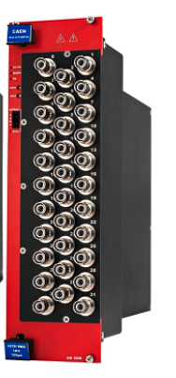
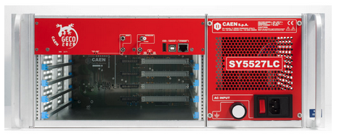
HV System
SY5527LC - 4 Slot LOW COST Universal Multichannel Power Supply System
A2519CA - SYx527 L.V. channels 15V 5A (50W) - DB37 - Individual Floating - Current Controlled (8 ch)
A7038 32/48 Channel 1 kV/100 µA Common Floating Return Boards

Slide 10
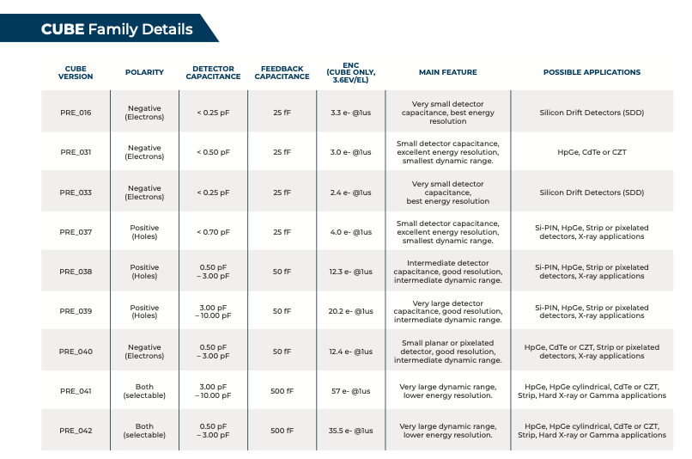
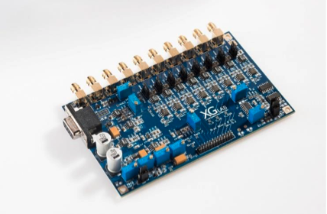
Very low-noise electronics to test sapphire
https://www.xglab.it/products/cube/
Strip capacitance: 1.84 pF
MIP signal:22 eh/um
Thickness: 100 um
CCE: 50%
Total signal: 1100 el
Total noise: 12.4 el
Starting kit:
5 CUBE (400 euros/piece)
1 Bias Board 8CH
(800 euros/piece)

Slide 11
Test Beam Needs
1 MIP in 100 um Sapphire : 2200x27 eV= 60 keV
LUXE Max Energy release in downstream detector per BX: 25 GeV
Number of MIPS per BX (LUXE) per strip: 4.2 x 10⁵
1 Year running LUXE ~ 35 weeks
Test beam duration ~ 1 week
Electron test beam intensity needed (per strip) ~ 35 x 4.2 x 10⁵ ~ 1.5 x 10⁷ /s
MC standalone simulation needed to plan test beam

Slide 12
Today’s program
Discussion
Status of the Delivery from DESY to Padova and Tomsk
Samples received by Padova from University
Report about first tests
PCB support for the detectors
Design/production (INFN Bologna experts started working on this)
Specifications for detector mechanics
Test Beam planning
Update on MC simulation
Others?

Slide 13
Backup

Slide 14
Questions from the Padova group
detector:
the minimum distance between metallization and edge of the PCB is 0.2 mm we wonder whether there is any reason to be so close to the edge or if it wouldn't be safer to keep of the order of 1mm gap.
it would help to have alignment crosses obtained with the metallization on the strip side of the detector, in a few positions where there is no metallization on the other side, so that the transparency of the sapphire makes it possible to see the corresponding markers on the PCB.
what is the minimum thickness of the metallization that can be deposited ?
PCB:
the current baseline electronics (EASIROC chips) seems to provide an AC coupling to the strips; in this case it would seem opportune to implement a polarization of the strips in the PCB: is there any reason why it has not been foreseen ?
it would seem beneficial to have all the the pads used for gluing the detector connected to the HV line and not just the bottom one
as mentioned for the detector, alignment markers could be included in the PCB design to match the ones on the detectors

Slide 15
Specifications for mechanics
Absolute reproducibility: 100 um ( this is the accuracy of the measurement provided by the survey group, I can't see reasons to do better than this, but maybe I'm overlooking something)
max. relative motion accuracy, within total motion in one direction < 2mm: 2 um (this is the requirement for the gamma beam scan)
min. motion range: 2 cm
max. mass to be moved: 200g + vertical stage mass in the horizontal direction
min. top movement speed: 1 mm/s possibility to switch off the liner stages ( this may reduce the noise, servomechanisms usually stay active to keep the positions)

Slide 16
TDR GBP
Scientific motivation
Detector Description
Sapphire detectors
Mechanics
Readout Electronics
Slow Control
Performances
test
MC simulation
Costs, Resources

Slide 17
Todo List for TDR
Detector performances using full G4 and realistic beam conditions
improved (not final) mechanical structure description
digitization
linearly polarized laser beam
Finalize conceptual design of
mechanics
readout electronics
Planned:
Quality tests and first lab tests on sapphire detectors
Uniformity of response using radioactive source
The level of advance of the planned points strongly depends on the economical support which will be given by the funding agency from now to the end of the year
Experiment and GBP presented yesterday (May 18th) at INFN CSN1
Internal Reviewing procedure will be started this year aiming, if succesfull, to financial support from 2022

Slide 18
Today’s discussion
Quality tests
Labeling scheme?
Wafer thickness (~10 points)
Weight (~0.8–1.2 g for 2” 100-150 μm thick wafers)
Optical tests (to be discussed)
Probe station tests (UV, Röntgen, source)

Slide 19
How to study charge carriers lifetime by optical methods?
Ideas are welcome!
Why optical? Allows to check wafers without metallization,
electrical contacts etc.
Röntgen pumping – visible light reflection
Optical-Pump/THz-Probe Spectroscopy
Double photon absorption – UV (~200 nm) light?
Something else?

Slide 20
Electrical methods?
Pump
HV
Sapphire
sample
Electrode with holes

Slide 21
Probe station + pumping
Pump
Sapphire
sample
HV
Sensitive region

Slide 22
Cable attenuation
30 m
Vin=1.6 Volt, 10 ns
Vout=0.68 Volt, ~ 100ns
The readout logic is based on peak stretcher or sample and hold
Probably a signal loss of factor ~ 2-2.5 should be considered (worsening of S/N must be measured)
The cost from the company is appealing:
750 euro (64 channels, 30 m) → total of 4500 euros for 3+3 cards (High Speed Interconnection company)

Slide 23
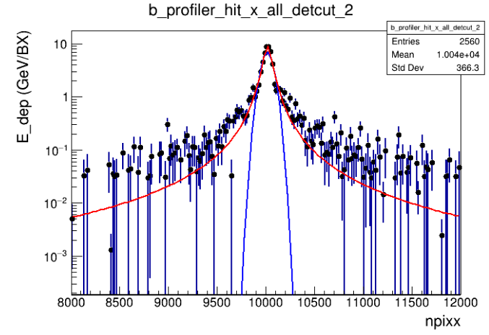
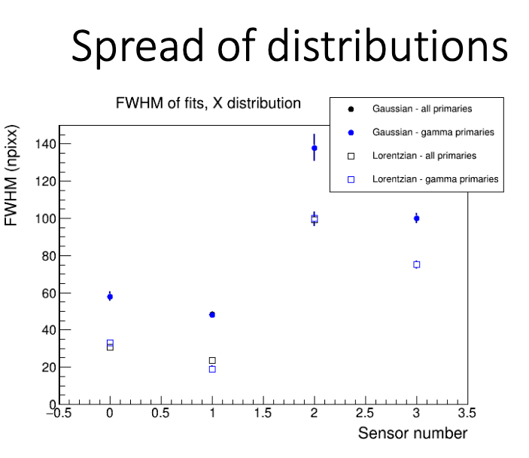
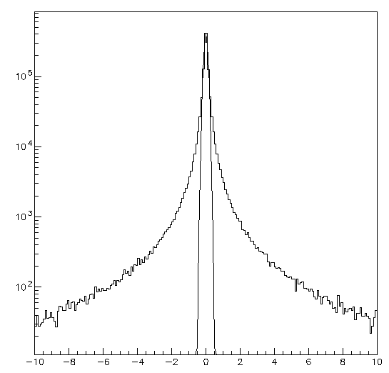
Method verification with Lorentz-Cauchy
D=6.7 m
D=11.8 m
Full G4 simulation from Kyle’s studies
FWHM (1st plane):30 npixx=0.150 mm
γ_{X}=FWHM/2=0.075 mm
X (mm)
γ_{x}=0.075 mm
σ_{x}(gaus)=0.111 mm
FWHM (gaus)=0.260 mm=52 npixx
Extrapolation to D=11.8 m → γ_{x}=0.130 mm

Slide 24
To be discussed at the next meeting on 05/10
inputs for the design of the mechanics
Quality test procedures for the sapphire wafers
Readout electronics positioning
Number of stations necessary (in the CDR they are 2, can we drop one with the new beam line?)
MC digitization
Others?

Slide 25
Questions for mechanics

Slide 26
Table of Risks
The table has been updated for the meeting with PRC
The table can be still changed
Please read carefully and send your comments

Slide 27
Timeline
The table has been updated for the meeting with PRC
Please read carefully and send your comments

Slide 28
Clean Room
LUXE TC asked for the need of a clean room
Apparently the situation is now frozen at DESY due to COVID emergency
How do we deal with this for the first tests at DESY on the delivered wafers?
The situation should change from 2023 (spaces will be allocated for us probably in XS1)
In any case we should formulate very soon a plan for our needs (area, facilities ...)

Slide 29
Test Beam
Tests will start in 2022
A plan should be made and start to contact the TB facilities
ELBE/FRASCATI/XFEL/RAL
Probably some inputs will come from today’s discussion

Slide 30
GBP collaboration tasks
Detector
Procurement (DESY, U. TOMSK, INFN PD)
Production (TOMSK)
Design and Integration (DESY, BELFAST, PD, BO, TOMSK)
Tests
Characterization in the lab (DESY, PD, BELFAST –laser tests at RAL-)
CCE uniformity (DESY, PD, TOMSK)
Test Beam (DESY, BO, PD, TOMSK, BELFAST)
Mechanics (PD)
Design (DESY, PD System Eng.)
Production
Tests, Commissioning
Electronics (BO)
Design
Production
Tests, Commissioning
Data Acquisition (milestones in the readout talk)
Slow control
HV,LV
Table movements (PD)
Calibrations (BO)
Data Quality (DESY, PhD)
MC
Detector performances (PD –PhD-, BELFAST)
Stand Alone
LUXE
Data Analysis (DESY, PhD, BELFAST)

Slide 31
Some thoughts about the measurement

Slide 33
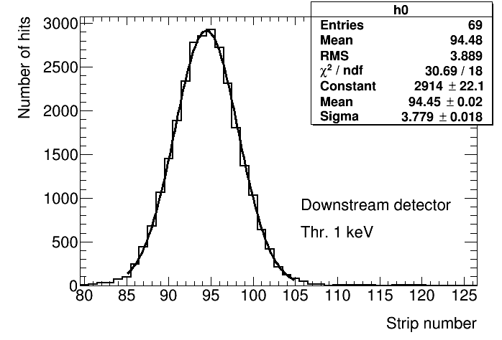
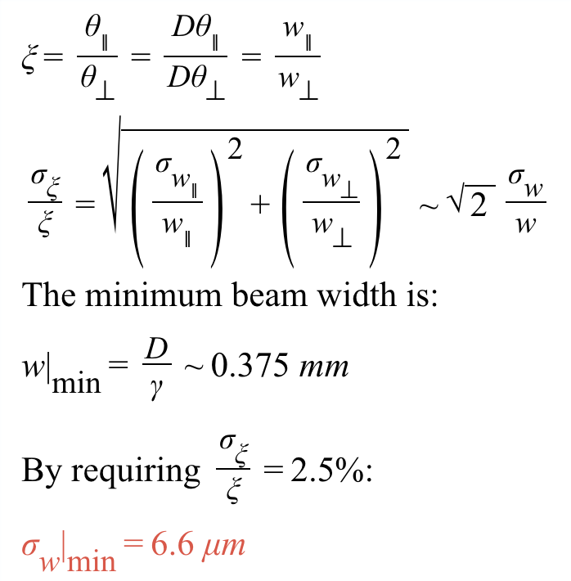
Precision on ξ
With Nγ=10⁷ (conservative)→ σ_{w|min}=1.8 μm
Simulation must be improved
Full simulation
Electronics noise
Charge collection effects
There is margin to keep σ_{w|min} <5 μm (σ_{ξ}/ξ<2.5%) once all the systematic effects will be included

Slide 34
An alternative approach
How is the beam width defined ?
For a gaussian beam shape the beam width could be defined as
profile standard deviation : σ
profile FWHM: $2\sqrt{2\text{ln}2}σ$
Area/Amplitude: $\sqrt{2π}σ$
In general: beam width $∝σ$
If the X and Y distributions belong to the same class of distribution
the proportionality factor cancels in the ratio
In this case, following the Area/Amplitude definition
$\frac{\frac{A(x)}{Amp(x)}}{\frac{A(y)}{Amp(y)}}=\frac{σ_{x}}{σ_{y}}$
And since A(x)=A(y), finally
$\frac{Amp(y)}{Amp(x)}=\frac{σ_{x}}{σ_{y}}$
Measuring the ratio of the peak amplitudes in the
X and Y strips will provide the value of ξ
The measurement could be in principle precise and many
systematics effects should cancel out
This could be tested with the full G4 simulation

Slide 35
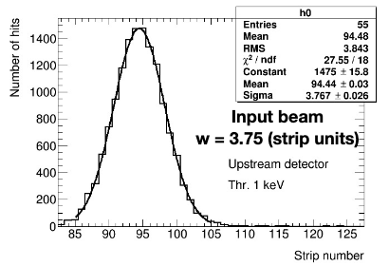
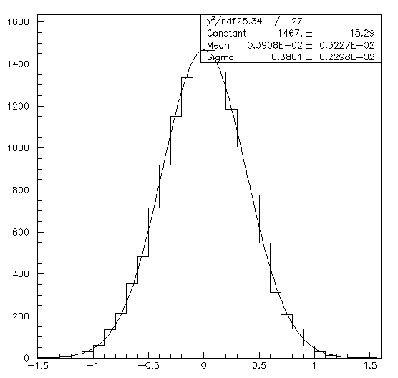
Cross check
Gaussian values (x,y) generated according to σ_{X}=0.375 mm
Agreement found with standalone MC distribution (10E7 gammas with E=5 GeV generated)
Compatible values found for chi2, parameters, and error on parameter
X (mm)

Slide 36
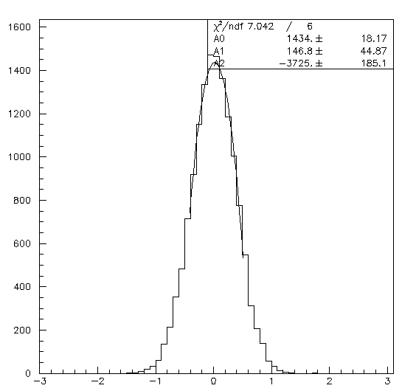
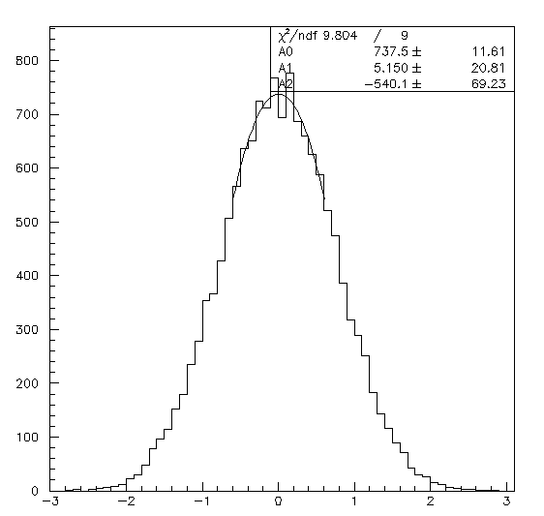
Method verification
Generated Y distribution with σ_{Y}=2 σ_{X}
Fit with parabolic function around the maximum
Simulation: 10E7 gamma, 5 GeV
$\frac{σ_{Y}}{σ_{X}}=\frac{A_{X}}{A_{Y}}=\frac{1434.2 ± 18.2}{737.5 ± 11.6}=1.945±0.039$ (2.0%)
Simulation: 10E9 gamma, 5 GeV
$\frac{σ_{Y}}{σ_{X}}=\frac{A_{X}}{A_{Y}}=\frac{148840±307.3}{74155±116.2}=2.007±0.005$ (0.25%)
X (mm)
The method works if beam is gaussian and σ_{x} > 0.375 mm
Y (mm)

Slide 37
Method verification with Lorentz-Cauchy
D=6.7 m
D=11.8 m
Full G4 simulation from Kyle’s studies
FWHM (1st plane):30 npixx=0.150 mm
γ_{X}=FWHM/2=0.075 mm
X (mm)
γ_{x}=0.075 mm
σ_{x}(gaus)=0.111 mm
FWHM (gaus)=0.260 mm=52 npixx
Extrapolation to D=11.8 m → γ_{x}=0.130 mm

Slide 38
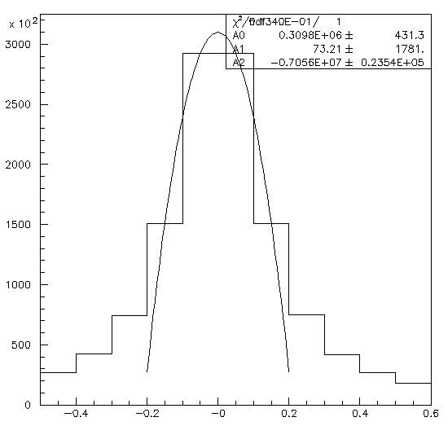
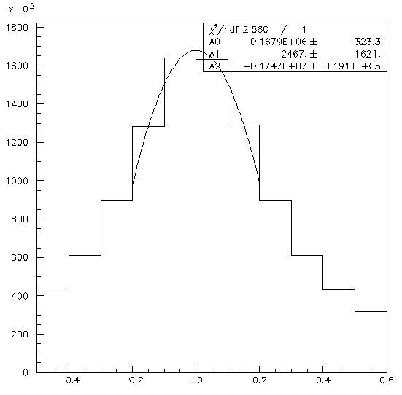
Further studies
A beam of Lorentz-Cauchy (LC) shape will be assumed
$P\left(x\right)=\frac{A}{1+{\left(\frac{x−x_{0}}{\text{g}\text{x}}\right)}^{2}}dx$
γ_{x}=0.130 mm
γ_{y}=0.260 mm
Fitting with parabola one gets
$\frac{σ_{Y}}{σ_{X}}=\frac{A_{X}}{A_{Y}}=\frac{309790±431}{167940±323}=1.845±0.0044\text{ (}\text{Δ}\text{\sim 35}σ\text{)}$
Fitting with LC in an interval $±3γ$
$\frac{σ_{Y}}{σ_{X}}=\frac{A_{X}}{A_{Y}}=\frac{333670±521}{170000±263}=1.963±0.004\text{3}\text{ (}\text{Δ}\text{\sim }9σ\text{)}$
Fitting with LC in an interval $±10mm$
$\frac{σ_{Y}}{σ_{X}}=\frac{A_{X}}{A_{Y}}=\frac{335610±501}{170360±252}=1.970±0.004\text{3}\text{ (}\text{Δ}\text{\sim }9σ\text{)}$
If the beam shape is LC the binning we have chosen is not enough for reconstructing beam widths (systematic of 2%)
Fitting with LC in an interval $±3γ$ and strip width =50um
$\frac{σ_{Y}}{σ_{X}}=\frac{A_{X}}{A_{Y}}=\frac{170350±263}{85678±133}=1.988±0.004\text{4}\text{ (}\text{Δ}\text{\sim }3σ\text{)}$

Slide 39
Comments
If the beam shape is more LC than gaussian (and if γ_{min}~0.130 mm) it looks like the strip pitch 100μm is not enough
In any case, to reconstruct the beam profile we will need to know very precisely which distribution should be used
In general, we would like to measure position and width with a method weakly dependent on theoretical assumptions (ideally, by using only the content of the strip with highest release of charge)
A detector with pitch 20 μm would allow to measure for each BX
Δx,y < 5.8 μm
Δξ/ξ ~ 1%

Slide 40
Wrap-up
The results obtained with this study should be redone with full MC simulation
Realistic beam parameters are fundamental to design the detector
If the results are confirmed
Can the distance by the two X-Y detectors be reduced to zero (from the actual ~2cm) and a second pair of detectors being added (at 2 cm distance)?
The first XY station will have 200+200 strips of 20 μm pitch
The second XY station will have 200+200 strips of 100 μm pitch
It will be used to position correctly the first station and to cross check results and tails behavior
Other things to be discussed
Position of the electronics
Baseline detector
Test procedures (see next slide)

Slide 41
List of discussion arguments for the round table (proposed by Mauro)
delivery of wafers to the labs: when and how
wafers test:
thickness measurements
uniformity with pair production by UVC radiation ?
light absorbance ?
surface characterization with an Atomic Force Microscope
do we need jigs to manipulate the wafers ?
wafers cut and metallization process
pads/test points besides strips ?
minimum tests performed at TOMSK before the detector are shipped
detector handling and shipment, schedule
characterizing the detectors in the lab: what to do, how, test setup
(if enough time) first ideas for test to be done on a beam

