Slide 1


Lepton + jets:
Top quarks at the LHC
Markus Cristinziani
German LHC Physics Workshop at DESY
September 30th, 2010

Slide 2
Plan for today
The top quark
  What we know from Tevatron
  Ingredients for a top analysis
  Potential at the LHC
Establishing the top quark at LHC
  Monte-Carlo simulation studies and yields
  Data-driven background estimates

Slide 3

Setting the scene: Top in the SM

Slide 4

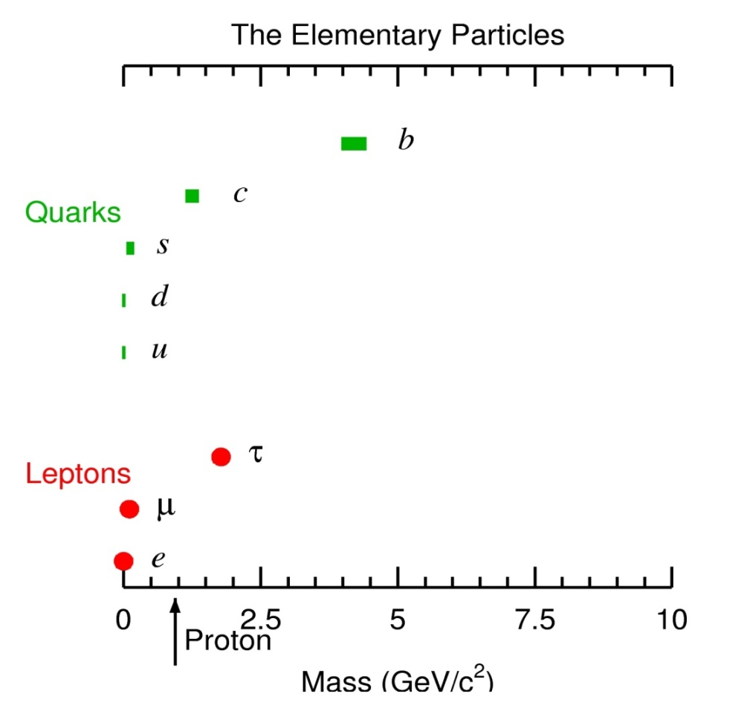
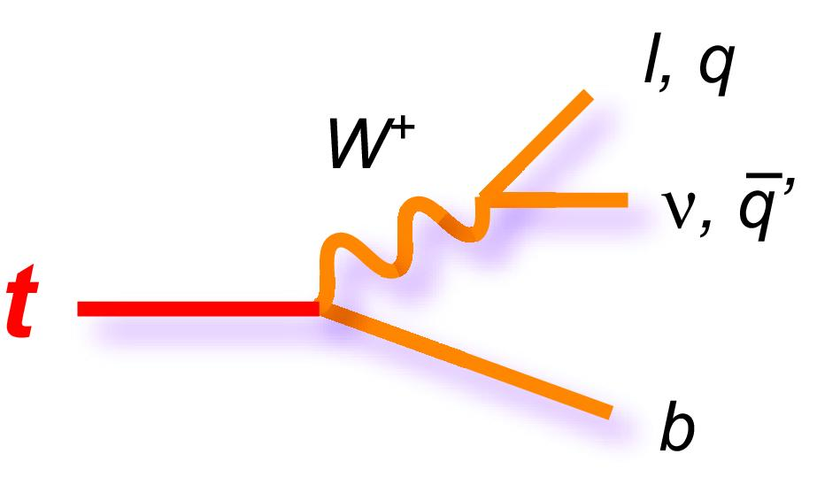
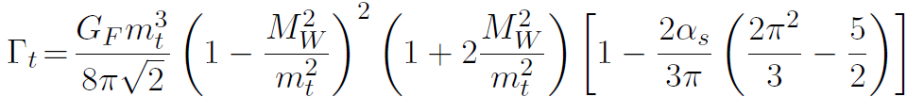
The heaviest quarks
t
173 GeV/c²
© particlezoo.net
Lifetime:
b quarks form hadrons <τ> (B hadron) = 1.5 ps
t extremely short lived, τ (top quark) = 4 · 10⁻²⁵ s

Slide 5
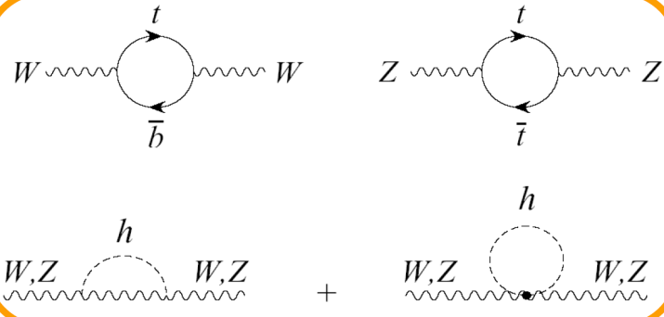
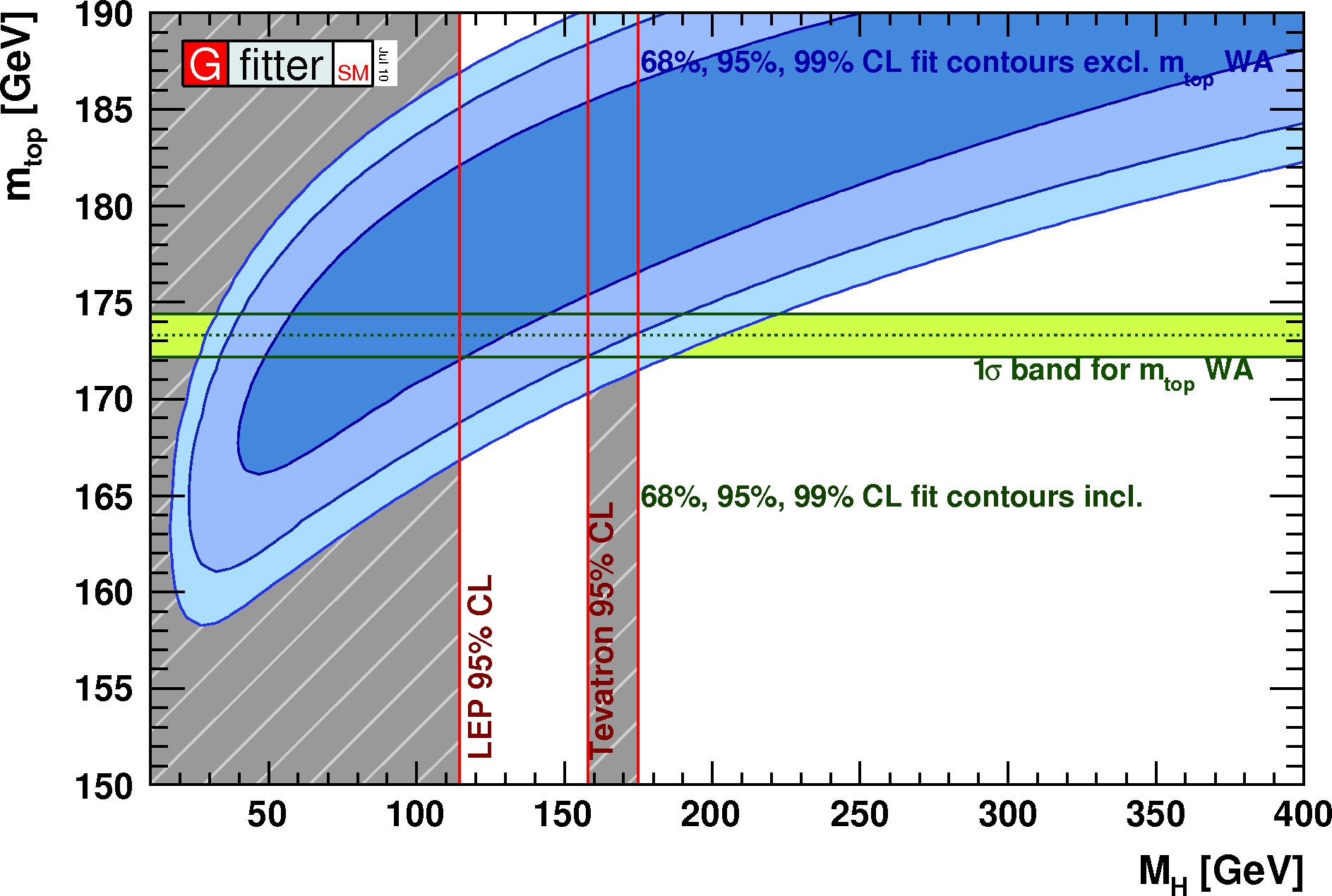
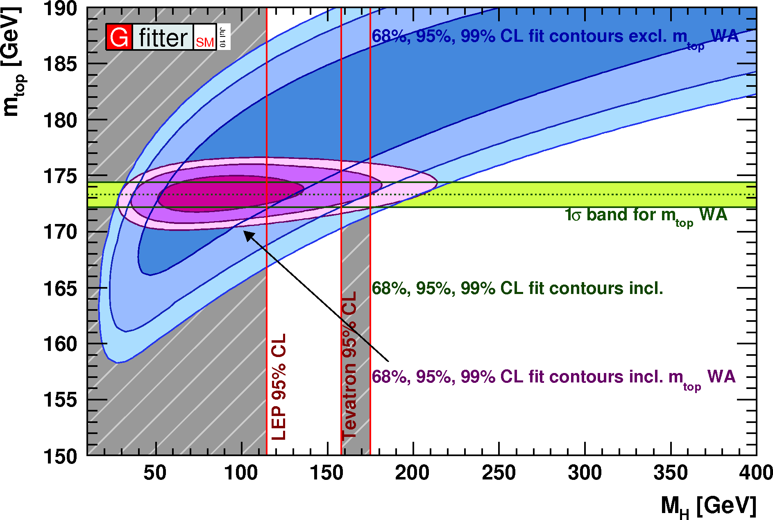
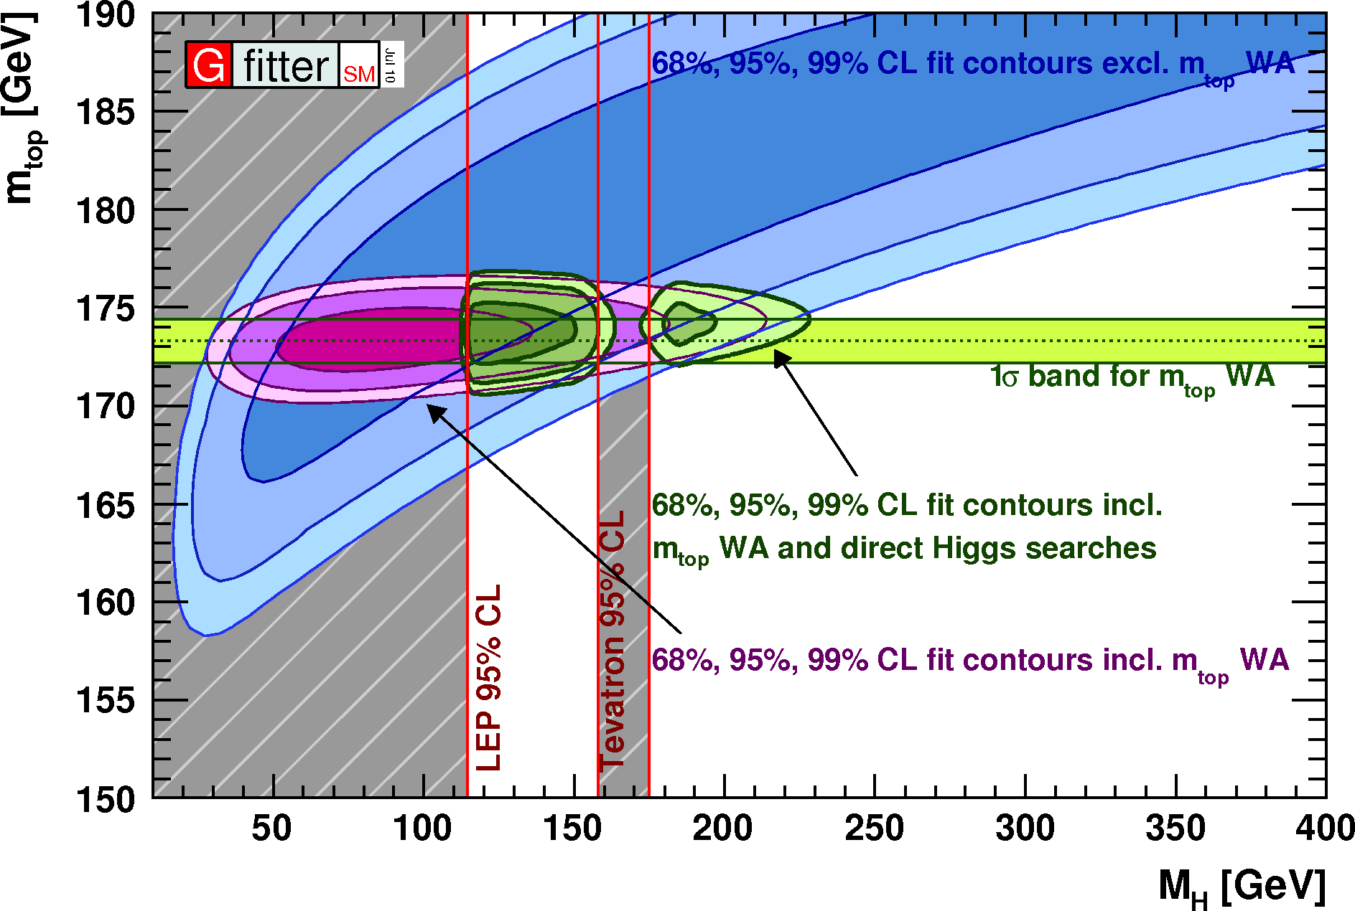
The top quark
Behavior is determined by the large mass
  m_{top} = (173.3 ± 1.1) GeV/c²
Late discovery at Tevatron (1995)
Short lifetime (no top hadrons)
  Spin information passed to decay products
Large coupling to the Higgs boson
  „Yukawa“ coupling y_{t} ~ √2m_{t}/v ~ 1
  Allows for stringent tests of SM
  Discovery potential of New Physics
Only O(10³) decays analyzed so far
  Many properties not precisely known
Radiative corrections
arXiv:1007.3178
Notes:
Massivstes Elementarteilchen, 40x b-Quark, so schwer wie ein Goldatom
Isospinpartner des b-Quarks postuliert, grosse Masse späte Entdeckung. Masse indirekt durch Strahlungskorrekturen vorhergesagt
Kurzlebig, zefällt direkt nach Produktion, einziges Freies Quark, Quantenzahlen direkt erhalten
Spiess umdrehen und Higgsmasse vorhersagen, bzw. auf Konsistenz prüfen.
Starke Kopplung durch Produktion, schwache Kopplung im Zerfall.

Slide 6
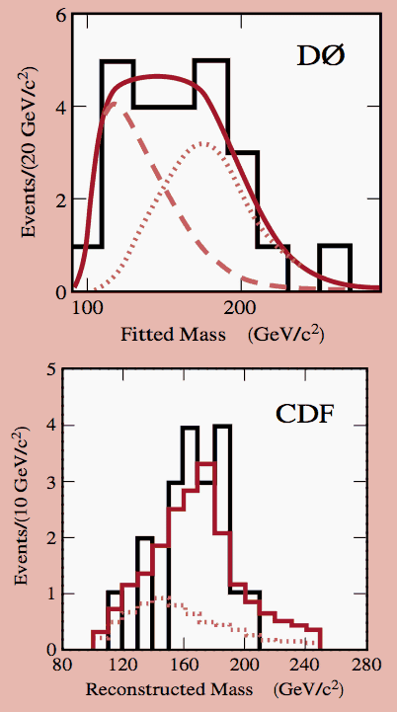

Top discovery
CDF 1994 evidence paper
1995
CDF: L_{int}= 19pb-1, √s=1.8 TeV
Phys. Rev. D 50, 2966–3026 (1994)
CDF + D0 Run I combined:
m_{top} = (178 ± 4.3) GeV/c²
Notes:
Top was discovered simultaneously by CDF and D0 experiments in 1995 at Tevatron with approximately the same number of produced top pair events as they are available today to the LHC experiments.
Signal appears here as an excess of events with four jets, requiring one of the jet to come from a b quark.
Alternatively the reconstructed mass distribution out of three jets is build and compared to simulation.

Slide 7
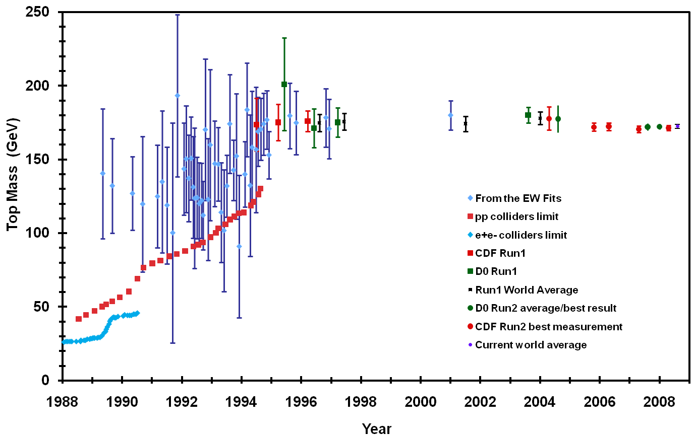
Top quark mass in time

Slide 8
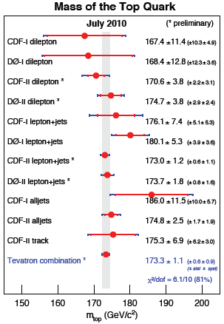
Top mass at Tevatron
Template analysis
  Observables sensitive to top mass
  Simulate ensembles at several masses
  Maximum likelihood fit
Matrix-element method
  Assign event probability (ME+PDF)
  Determine prob. for every event
  Multiply to one likelihood function
  m_{t} = 173.3 ± 0.6 ± 0.9 GeV
Outlook LHC
  b-tagging allows for ultimate precision
  need to explore alternative methods

Slide 9

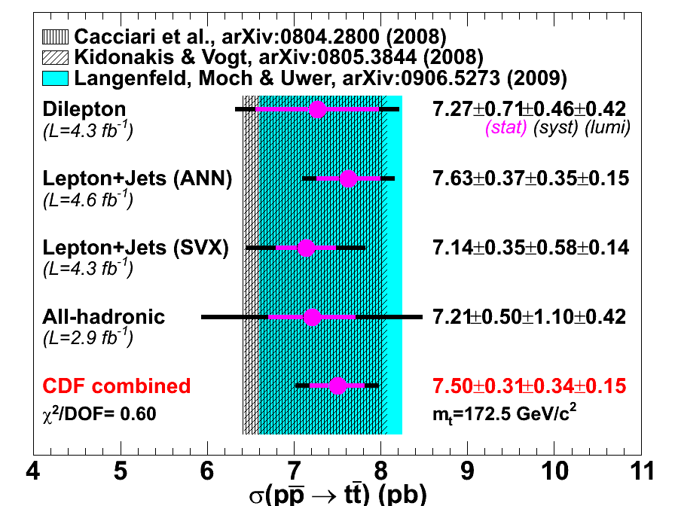

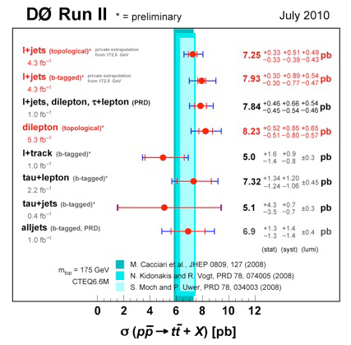
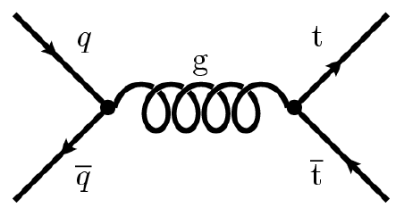
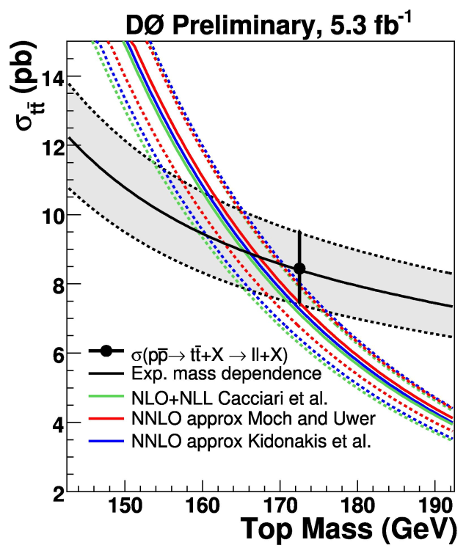
Production σ_{tt} at Tevatron
Conf. Note 9913
Measurements agree
  in different channels
  with theoretical prediction
  new: normalized to Z production
    Uncertainty due to luminosity reduced
  Total uncertaitny < 6.5%
Connection to top mass
D0 Note 6038-CONF

Slide 10
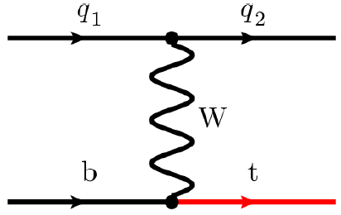
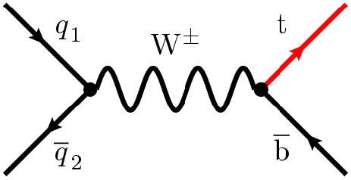
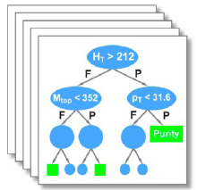
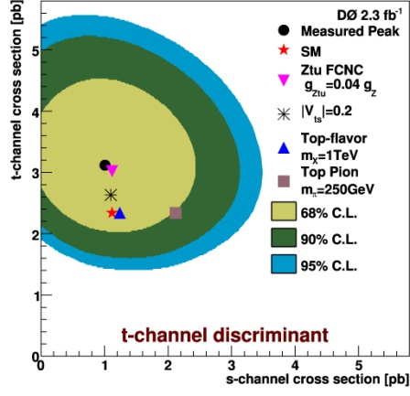
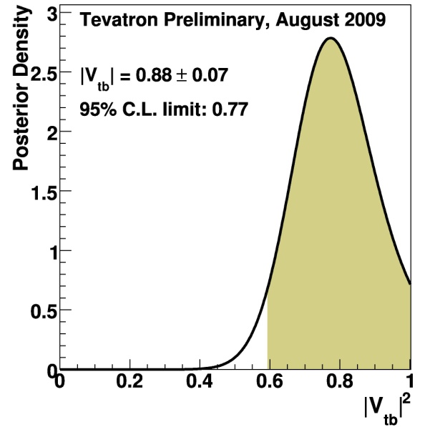
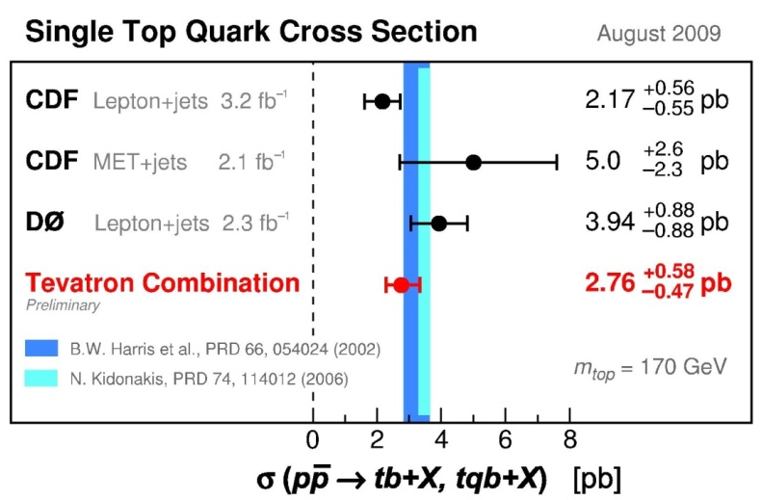
Single top at Tevatron
Electroweak production
  V_{tb}
  anomalous coupling
  W’,H⁺
Observation in 2009
  Extensive use of multivariate methods (NN, BDT)
arXiv:0908.2171
arXiv:0907.4259
|V_{tb}| = 0.91 ± 0.08
95%C.L. |V_{tb}|>0.77

Slide 11
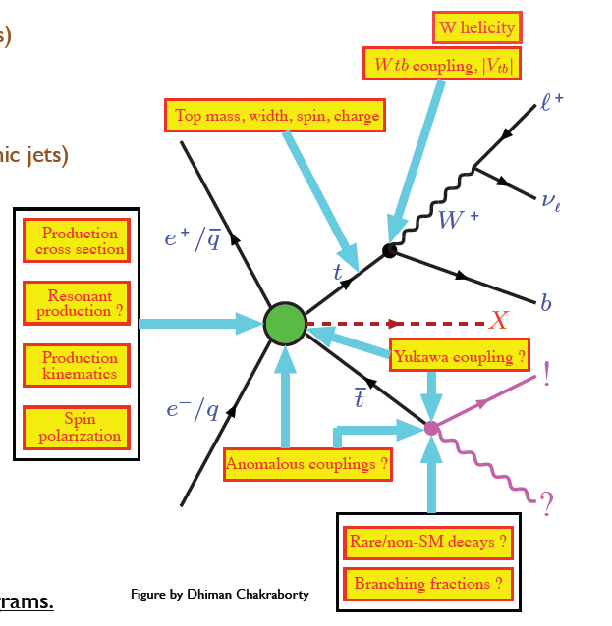
Further properties of the top quark
Summer ‘10 | CDF |  | D0
charge | Not 4/3e at 95% |  | Not 4/3e at 92% C.L.
width | < 7.6 GeV |  | 2.05 ^{+0.57} _{-0.52} GeV
m_{top}- m_{antitop} |  |  | 3.8 ± 3.7 GeV
F/B q asymm. | 15 ± 5 ± 2 % |  | 8 ± 4 ± 1 %
spin corr. | 0.32^{+0.55}_{-0.78} |  | -0.17 ^{+0.65} _{–0.53}
W helicity | f₀ = 0.590± 0.12 f₊ = -0.04 ± 0.05 |  | f₀ = 0.490± 0.136 f₊ = 0.110 ± 0.079
FCNC | t→ | Zq < 3.7% | σ_{tgu} < 0.20 pb σ_{tgc} < 0.22 pb
 |  | Zc < 13%
 |  | gc < 12%
 |  | γc < 18%
BF ratio | R(Wb/Wq) = 1.12 ± 0.25 |  | R(ll/lj) = 0.86 ± 0.18 R(tl/ll+lj) = 0.97 ± 0.31 R(Wb/Wq) = 0.97 ± 0.09
4th gen. | m(b’) > 385 GeV m(t’) > 335 GeV |  | m(t’) > 296 GeV
resonances | m(W’) > 800 GeV |  | m(Z’) > 820 GeV
limits on | ttH, t→H⁺b, H⁺→tb, t~₁t~₁
Analyzed up to ~5 fb⁻¹
Up to 5 fb⁻¹ analyzed

Slide 12
Plan for today
The top quark
  What we know from Tevatron
  Ingredients for a top analysis
  Potential at the LHC
Establishing the top quark at LHC
  Monte-Carlo simulation studies and yields
  Data-driven background estimates

Slide 13
Roadmap
Begin by understanding the basic objects:
  leptons, jets, b-tagging, missing transverse energy
  combine them to low-mass resonances, see lepton talks
Establish W and Z signal (see next talk)
  study vs #jets, estimate QCD background
  Measure ID and trigger lepton efficiencies, study backgrounds to top in W + jets and Z + jets samples
  Validate MET in complex final states
Look for the emergence of a top signal
  Study top final states (also background for many searches for physics beyond the Standard Model)
Higgs and / or beyond the Standard Model

Slide 14

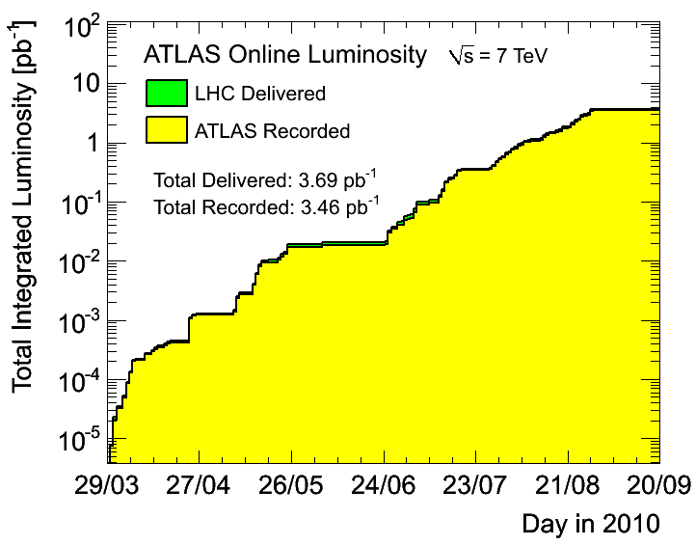
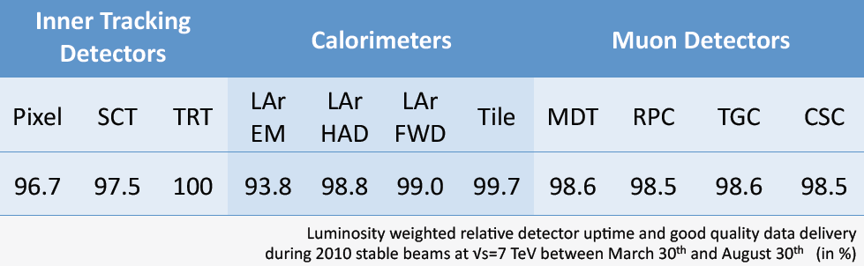
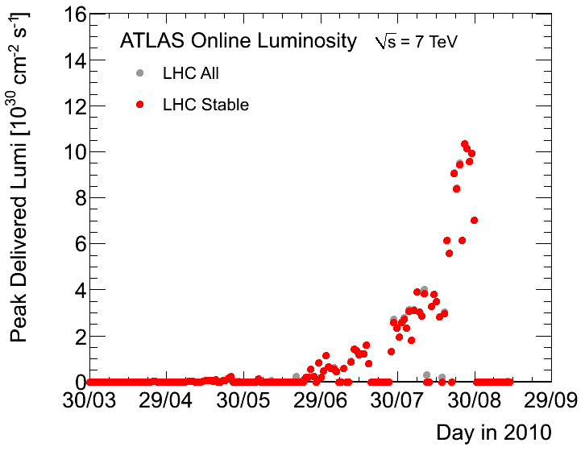
Data sample
Peak luminosity 2 10³¹/cm² sec
  First top candidates shown at ICHEP
  Background studies for HCP
  Present data sample should allow to see the top quark at significances exceeding 5σ
Excellent detector performance
Doubling time ~10 days
Last LHC talk on April 2010 on minimum bias events

Slide 15
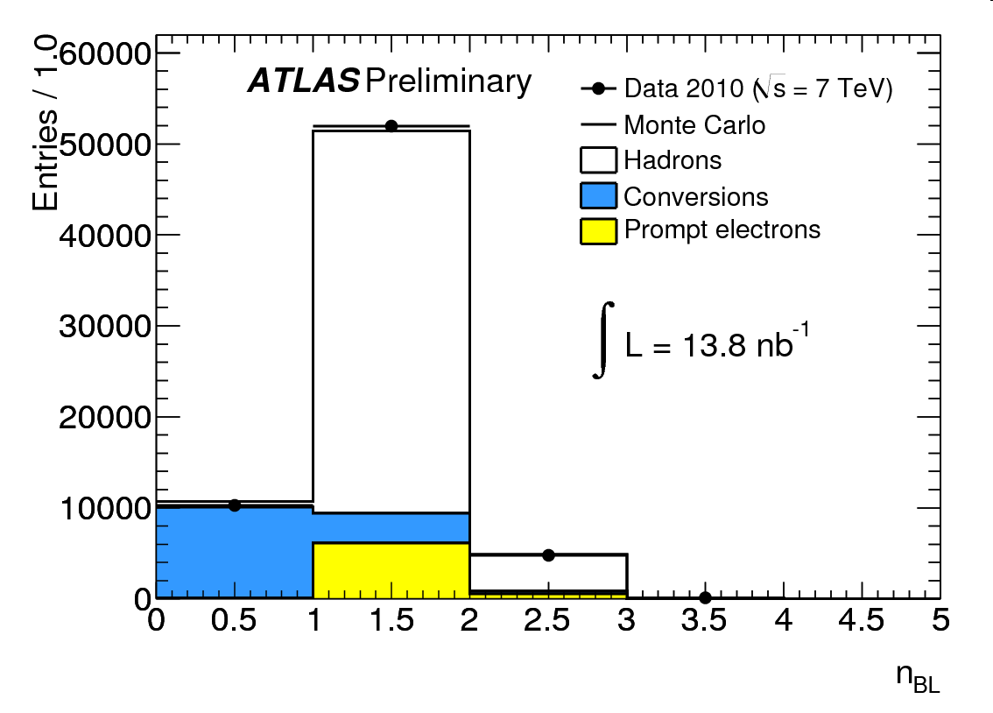
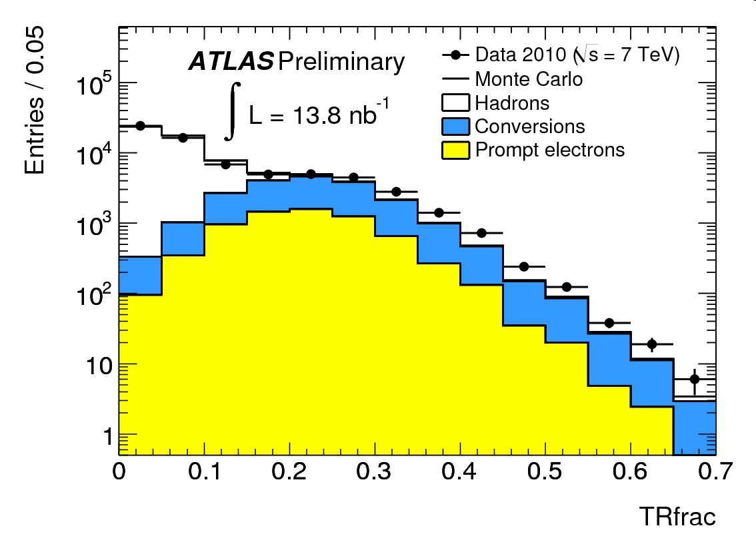
Electrons
Electron sources
  W/Z decays
  HF decays: b,c →eX
  γ conversions
  fakes from charged hadrons
Identification definitions
  Loose
    acceptance, min trk quality, EM shower width
  Medium
    additional shower shapes,
    hits in silicon, d₀, cluster-track matching
  Tight
    had leakage, E/p
    inner pix layer hits (n_{BL}), and TRT high thresh.hits
First data used to validate data/MC
rejection γ→e
ATL-CONF-2010-073
rejection h→e

Slide 16
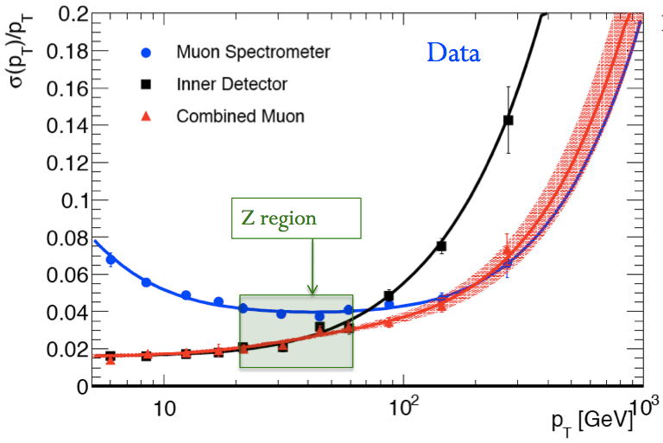
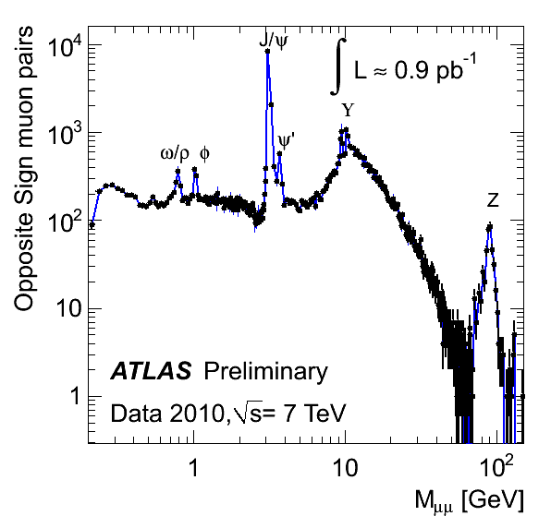
Muons
Muon sources
  W/Z decays
  HF decays: b,c→μX
  π/K decays in flights
  punch-through, cosmic rays
Reconstruction/ID using
  Inner Detector Tracker
  Muon Spectrometer
  ID+MS combined muons
    complete trk refit

Slide 17
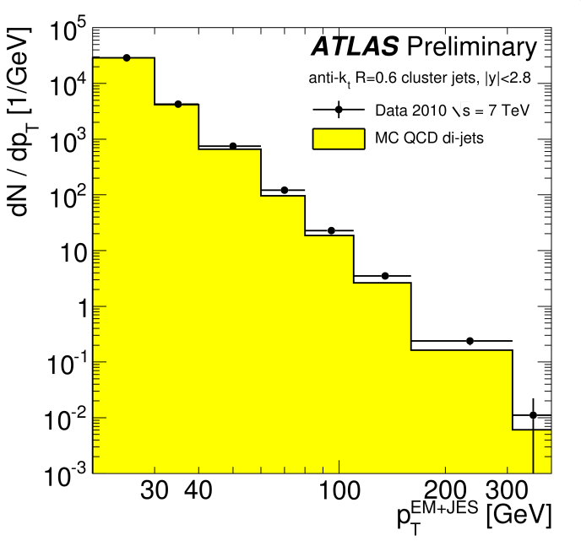
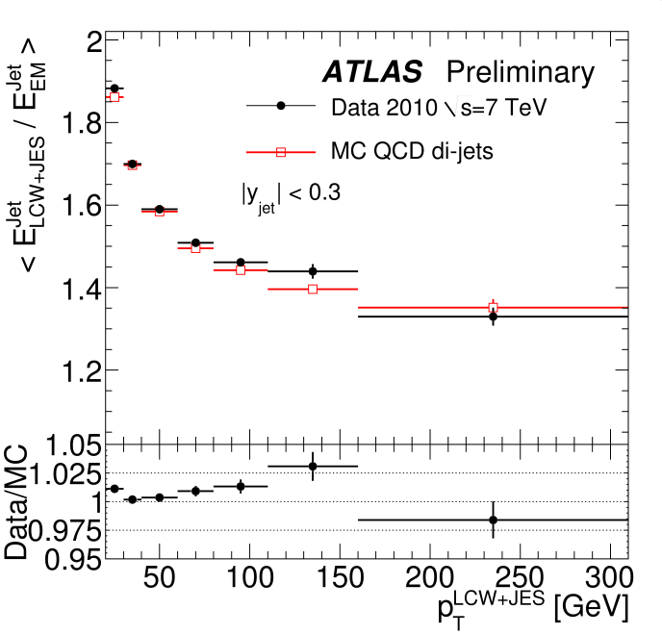
Jets
Anti-k_{T} R=0.4/0.6 jets
  use topo clusters as input: 3-D noise-suppressed clusters of cells
ATL-CONF-2010-053
Calibrations Schemes:
  EM+JES (baseline)
    simple p_{T}/η dependent calibration from MC
  GSC: Global Sequential Calibration
    use jet shapes
  GCW: Global Cell energy density Weighting
  LCW: Local Cluster Weighting calibration
Corrections in data/MC agree to few %
undergoing commissioning

Slide 18
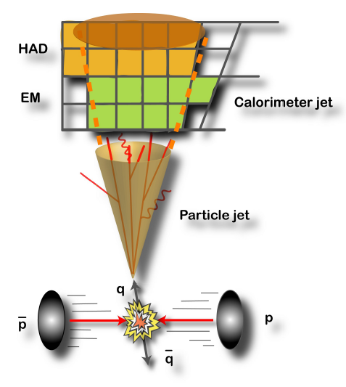
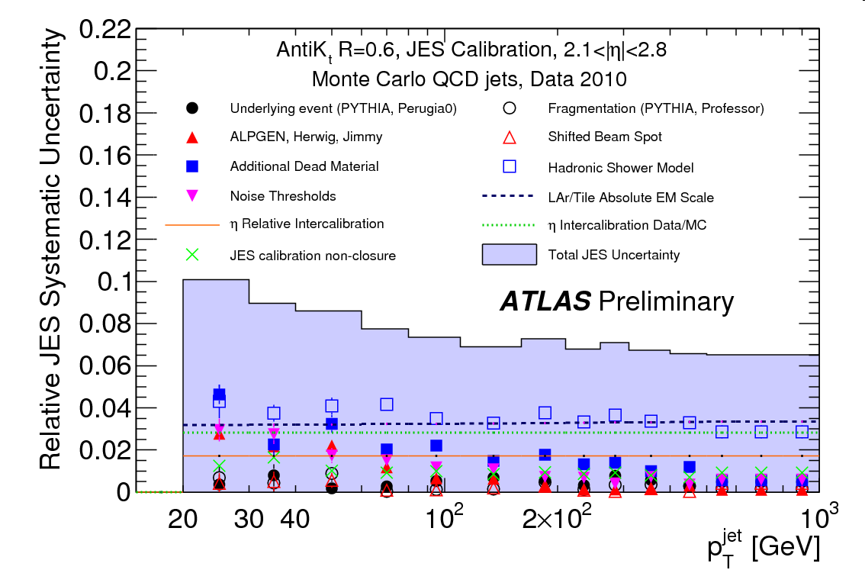
Jet energy scale
JES uncertainty from MC with alternative detector configurations, hadronic shower and comparing the relative response data/MC
Main uncertainty contributions
  dead material (~5%)
  showering model/noise (3-4 %)
  calorimeter absolute EM scale (3%)
  analysis dependent corrections
    topology/flavor dependent (up to 6%)
    pile-up ~1.2 %
anti-kt6, end-caps
JES unc., anti-kt4 jets | barrel | end-caps
low p_{T} (<60 GeV) | 8% | 9%
high p_{T} (>60 GeV) | 6% | 7%
ultimately from data (γ-jet, Z+jets, in-situ)

Slide 19
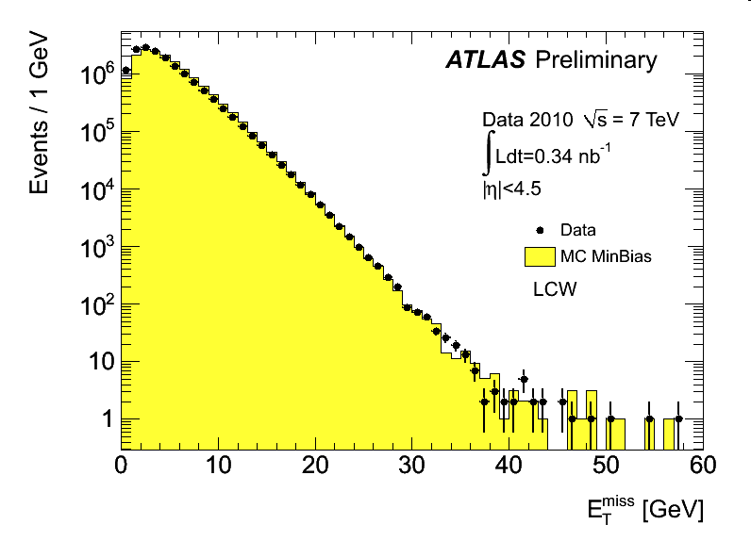
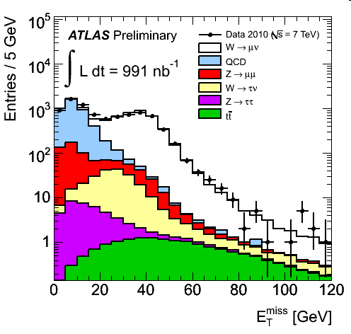
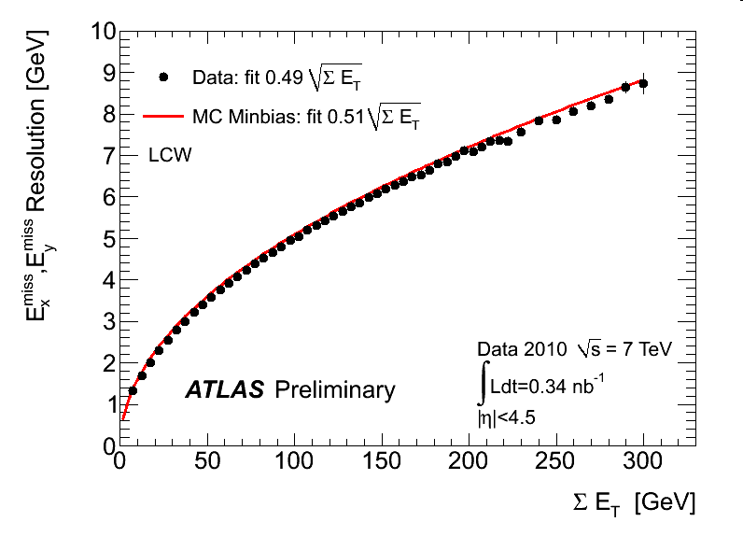
Missing transverse energy
Calculated from cells in topo clusters and refined according to
  global energy calibrations (various schemes)
  object refined measurements (e,γ,τ,jets,μ)
Calibrated E_{T}^{miss} well described by MC
  both for min bias and W events
E_{T}^{miss} resolution in MC
  correctly describe the data
ATL-CONF-2010-057
min-bias
W→μν

Slide 20
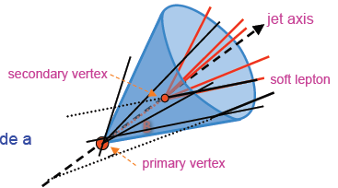
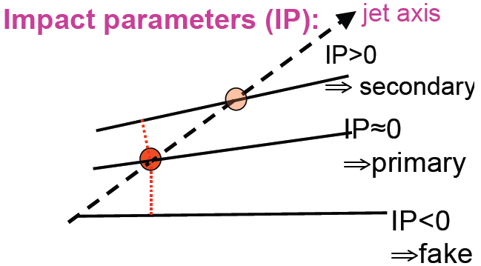
Tagging of b-jets
Goal: recognize b-jets with high efficiency ε(b) and rejection against light jets R(uds)
Lifetime based taggers
  B hadron flies few mm before decaying
    Tracks form a secondary vertex (SVx)
    Tracks inconsistent with p.vertex (IP)
Soft lepton taggers
  B decay include in ~40% of the cases a soft lepton (e/µ) from b→ ℓ or b→ c → ℓ
Complications
  Dense jet environment
  Primary vertex finding (pileup)
  Fake secondary vertex
  Charm quarks
Combine information for best performance

Slide 21
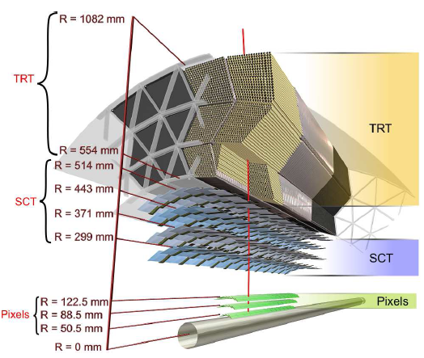
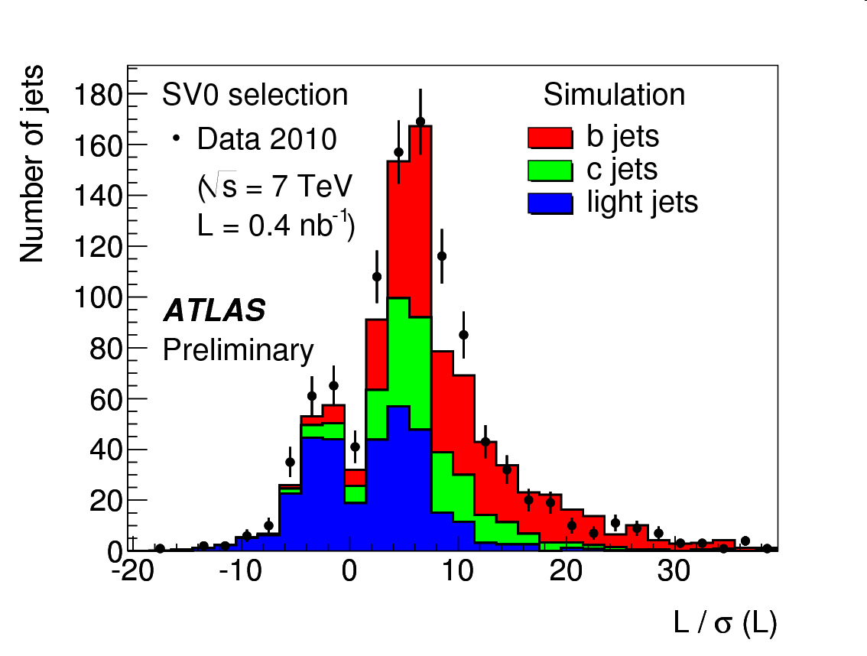
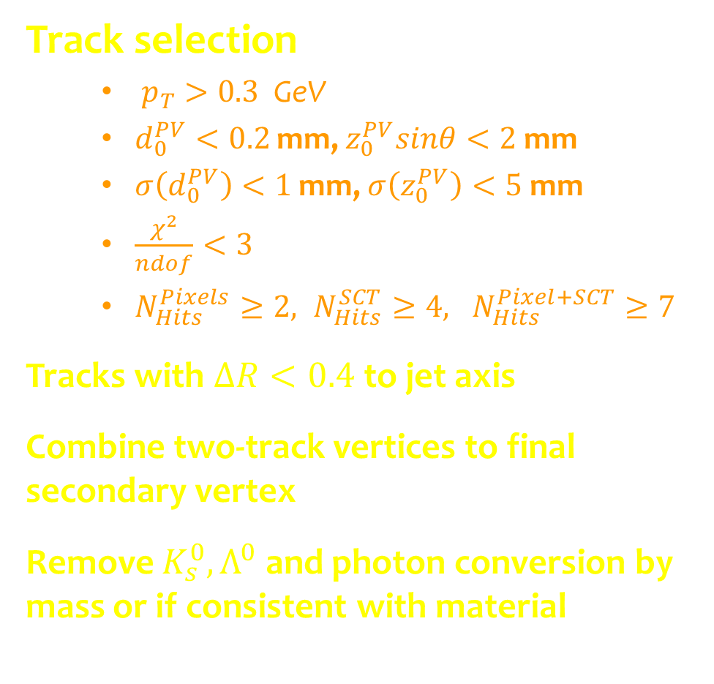
The SV0 algorithm
Track selection
  $p_{T}>0.3$GeV
  $d_{0}^{PV}<0.2$ mm, $z_{0}^{PV}sinθ<2$ mm
  $σ\left(d_{0}^{PV}\right)<1$ mm, $σ\left(z_{0}^{PV}\right)<5$ mm
  $\frac{χ^{2}}{ndof}<3$
  $N_{Hits}^{Pixels}≥2, N_{Hits}^{SCT}≥4, N_{Hits}^{Pixel+SCT}≥7$
Tracks with $ΔR<0.4$ to jet axis
Combine two-track vertices to final secondary vertex
Remove $K_{s}^{0},Λ^{0}$ and photon conversion by mass or if consistent with material
ATL-CONF-2010-042

Slide 22
Plan for today
The top quark
  What we know from Tevatron
  Ingredients for a top analysis
  Potential at the LHC
Establishing the top quark at LHC
  Monte-Carlo simulation studies and yields
  Data-driven background estimates

Slide 23
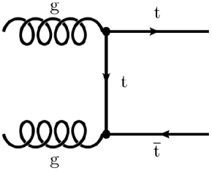
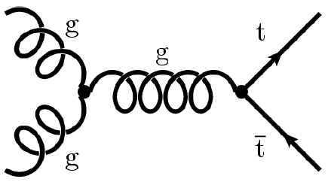
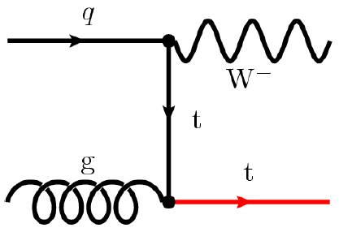
Top quark production at LHC
Pair production through strong interaction
  Cross section: ~850pb (14TeV), 160pb (7TeV)
  1Hz at 10³³ cm⁻²s⁻¹ (collisions at 40MHz) → top factory
Single top production through weak interaction
  Cross section : ~320pb (14TeV) [t-channel ~250pb]
  Directly sensitive to V_{tb}

Slide 24

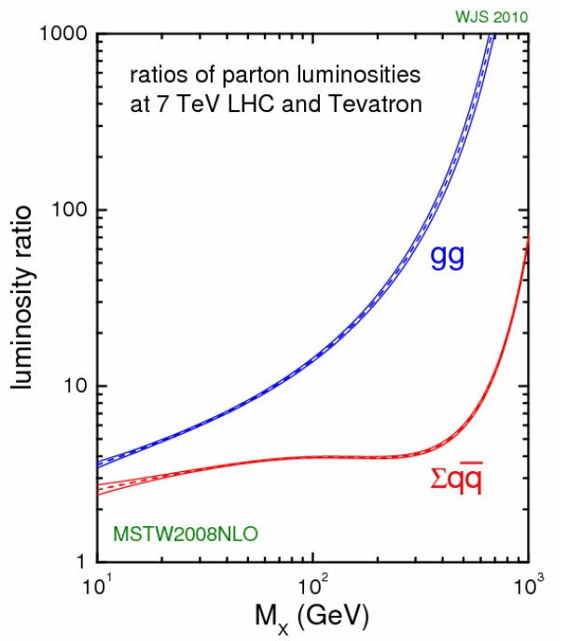
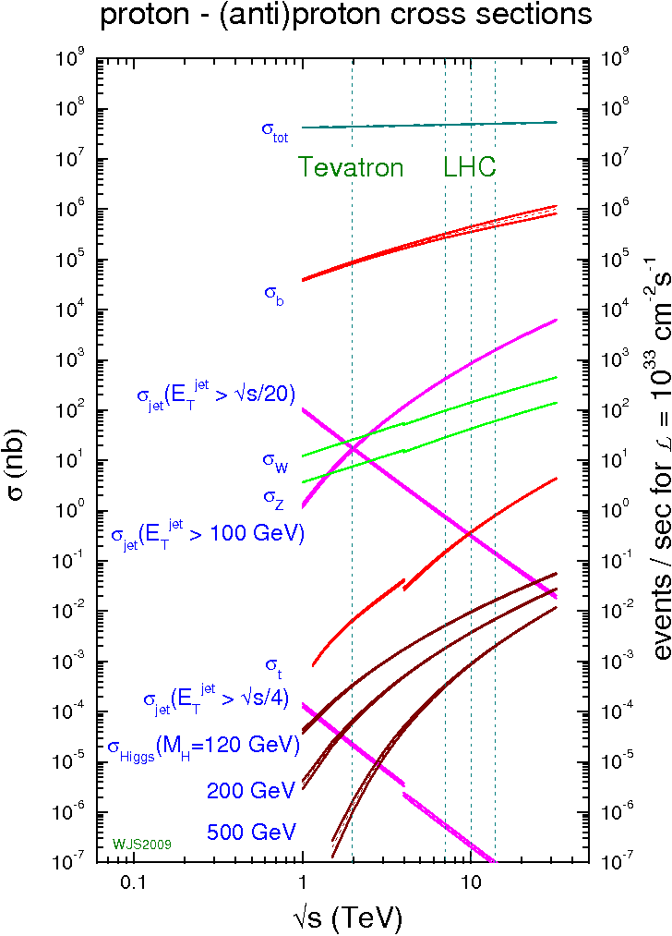
Top pair production
LHC is a top factory
  8M tt/yr at 10³³ cm⁻² s⁻¹ (14 TeV)
  still, bckgnd suppression O(10⁸) needed

Slide 25

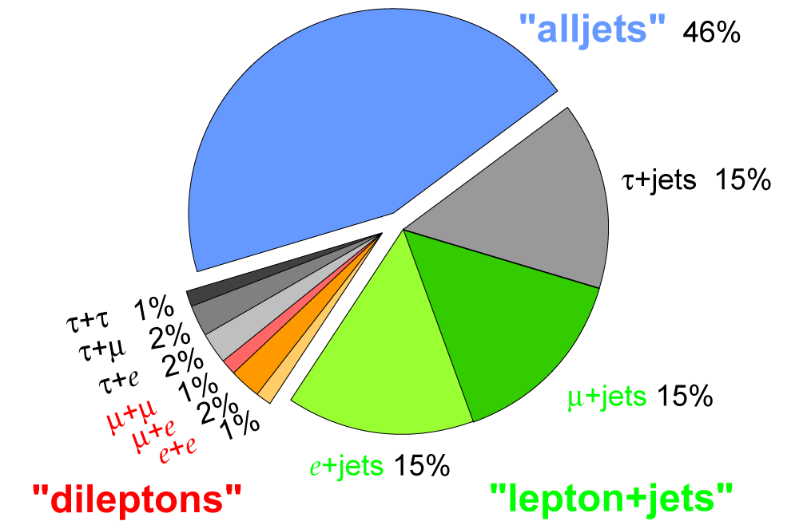
Top quark decay
Top quarks decay to Wb ~ 100%
Pair production signatures
  dilepton ( 2b + 2l + 2ν)
  lepton + jets ( 2b + 2q + l + ν)
  all hadronic ( 2b + 4q)
Single top signatures
  t - channel ( 1b + q + l + ν)
  Wt - channel ( 1b + 2q + l + ν)
  s - channel ( 2b + l + ν)
Top pairs

Slide 26
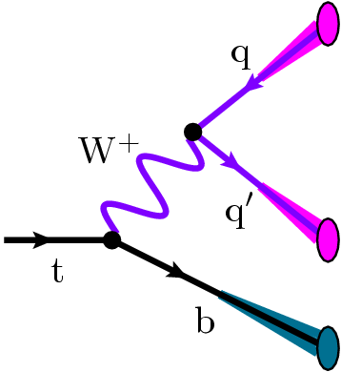
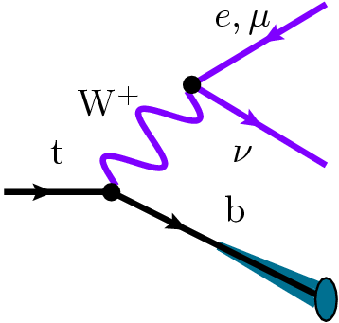
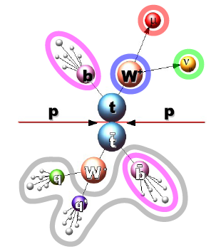
Top quark reconstruction
hadronic (probability ~ ⅔)
  + Kinematics of W and top fully determined
  - Combinatorics
leptonic (probability ~ ⅓)
  + Lepton conserves charge
  + Rejects QCD: lepton + E_{T}^{miss}
  - Information (partially) lost
Typical event selection
  Isolated lepton with large p_{T}
  Missing transverse energy and/or m_{T} W
  Additionally useful
    Second lepton
    b-jet identification
    Hadronic top decay (N_{jets}, m_{jj}, m_{jjj})

Slide 27
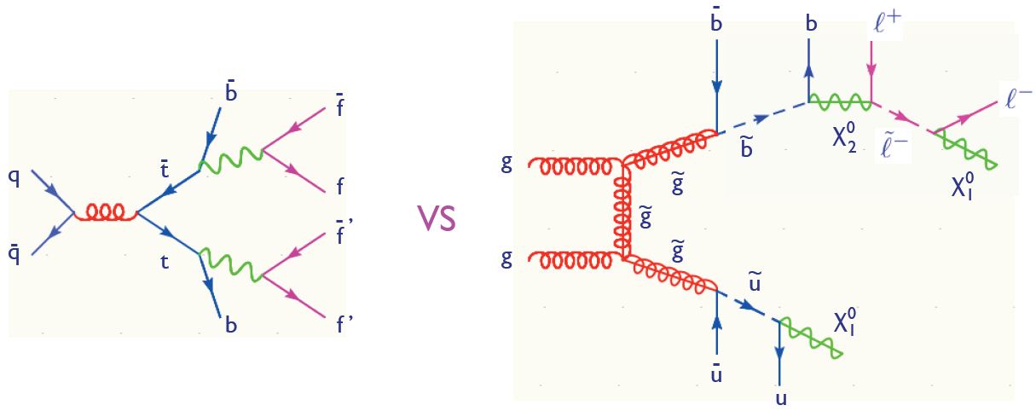
Top program at LHC
Huge sample eventually expected at 14 TeV
  Can be used to calibrate detector
Improve on Tevatron measurements
  Can e.g. measure single top in separate channels
Try to improve on top mass with new ideas
  e.g. B decay length method
Search for New Physics effects

Slide 28
Decays in SM extensions
Anomalous couplings in the tbW vertex
Decay to charged Higgs
  Present in in 2HDM , e.g. in MSSM
  If sufficiently light, expect t → bH⁺ decays, H⁺ → τν_{τ}, cs, cb
Decay to/of SUSY particles
  e.g. and subsequent decays
  Gluino decay or stop pair production
Flavor changing neutral currents
  t → c and t → u highly suppressed in the SM
  Signature at LHC would point to new physics

Slide 29

Outlook: What to expect in Run I
LHC upgrade plans
In Phase-0 produce ~160k top pairs, ~50k single top
Example 1: a first LHC top mass measurements
Example 2: single top studies

Slide 30





Top mass with early data: 1D
Reduce JES effect by normalizing to W mass
at 7 TeV stat. unc. ~ 50% larger

Slide 31

Top mass with 1fb⁻¹ : 2 dimensions
Add use of b-tagging and kinematic fit
2D fit to top mass AND jet-energy scale
cleaner sample (S/B~8)
more precise m_{top} determination
requires better detector understanding
1-D: Δm_{top}(√s=10TeV, L=.1fb⁻¹): ± 2 (stat) ± 4 (syst) GeV
2-D: Δm_{top}(√s=10TeV, L=1fb⁻¹ ): ±0.6 (stat) ± 2 (syst) GeV

Slide 32

Electroweak production
s (10pb)
t (250pb)
Wt (60pb)
Single top complementary to tt production : σ_{t}/σ_{tt} ≈1/3
Cross-section → |V_{tb}|
Potential for BSM physics discovery
1σ-bands
L=10fb⁻¹

Slide 33




Perspectives for single top
Pre-tag selection
  E_{T}^{miss} > 20 GeV
  only one lepton, p_{T} > 20 GeV
  2 or 3 jets, p_{T} > 30 GeV
  m_{T}(W) > 30 GeV
At least one b-tagged jet
  JetProb @ 45% efficiency
10 TeV t-channel@200 pb⁻¹
Analysis strategy
  Measure main backgrounds in 3 jets bin after pre-tag selection
    W+jets and tt
  Measure t-channel in 2 jets bin after tag selection
  Trust MC generators that they correctly model 3j/2j – rate ratios for the backgrounds
  Assume good MC knowledge of the W+jets HF fraction for a pre-tag to tag extrapolation
Neural Network against background
Control region
Signal region

Slide 34


Perspectives for single top
Neural network with input variables
  H_{T}; invariant mass of 2 and 3 jet combinations
  Δη of lepton and jets; Δη of jets
  cosθ of lepton and leading jet (in appropriate frame)
Extract MC/data scale factors
  tt (3.5% stat) and W+jets (2%)
  consider JES, PDF and single top admixture in control sample
Likelihood analysis with S/B~0.9 obtains 2.7σ and Δσ_{t}/σ_{t} ~ 40%

Slide 35
Plan for today
The top quark
  What we know from Tevatron
  Ingredients for a top analysis
  Potential at the LHC
Establishing the top quark at LHC
  Monte-Carlo simulation studies and yields
  Data-driven background estimates

Slide 36
First top cross-section measurement
What do we measure?
  tt cross-section in dileptonic (e or μ) or semileptonic final states
  include leptonic τ decays
Signal definition
  Consider only t → W → l (or → τ → l), i.e. get data-driven fakes
  BR(tt → ll) = 6.4%, BR(tt→ l+jets) = 34.2%
Strategy dilepton channel
  Simple cut-and-count analysis with
  N_{sel} = Lumi·σ_{tt}· BF·eff·acc + Bckgnd
  Determine eff·acc from signal MC, background from data and MC
  Use likelihood for combination of systematics and channels
Strategy single-lepton channel
  Baseline cut-and-count
  Likelihood fit to hadronic top mass

Slide 37


Typical top pair to l+jets analysis
Basic selection
  isolated leptons with p_{T}>20 GeV
  four jets
In addition
  combine jets to top decay (ε=35%)
  require W mass (10 GeV, ε=40%)
  missing transverse energy >20 GeV
W mass requirement

Slide 38





From diagrams to events
Additional jets due to gluon radiation
Jets can be misidentified as leptons (fakes)
Background processes
  W,Z + jets (W/Z + heavy quarks)
  QCD multijet production
  Dibosons (WW, WZ, WW)
  Single top

Slide 39

Lepton+jets: Simulation
Two approaches
  Cut analysis with ε~20%
    Background from data or simulation
  Fit to the hadronic m_{top} distribution
Sample | Electron | Muon
Signal | 1286+11 | 1584±12
W+jets | 455±20 | 637±27
single top | 81±6 | 98±6
Z+jets | 43±2 | 49±2
diboson | 7±1 | 9±1
top (allhadr.) | 10±2 | 5±1
Background | 598 | 799
S/B | 2.1 | 2.0
Anticipated result
  Δσ/σ = 3%_{(stat)}+ <15%_{(syst)}+ lumi
ATL-PHYS-PUB-2009-087
200pb⁻¹ @ 10TeV

Slide 40




Lepton+jets: data
primary vertex with ≥5 tracks
exactly one medium e/μ
  match with trigger object
  p_{T}>20 GeV, isolated
  require b-layer hit (reject γ→2e)
≥4 jets
  anti-kt4 @ EM+JES scale
  p_{T}>20 GeV, |η|<2.5
jet-lepton overlap removal
≥1 b-tag (SV0 @ 50% eff.)
E_{T}^{miss}>20 GeV
e+jets
mu+jets
7 candidates found in 295 nb⁻¹

Slide 41



Dilepton: simulation
Smaller branching fraction, but clean signature → promising at LHC
Leptons
  Excellent to trigger and reconstruct
Backgrounds
  Leptons from other SM processes
    Z→ℓ⁺ ℓ⁻ , Z → τ⁺τ⁻
  Secondary leptons
    E.g. from jets → Reject with energy isolation
ΔR (µ, jet)
electron
isolation
CERN-OPEN-2008-020
100pb⁻¹ @ 14TeV

Slide 42


Systematic uncertainties
Systematic uncertainties
  From data
    Drell-Yan events
    fake rate
    luminosity
  Detector effects
    trigger and lepton ID efficiency
    jet and lepton energy scale
  From theory/models
    Monte-Carlo model
    Background Cross-sections
    parton distribution functions
    gluon radiation
Result
  Statistical 3%
  Total syst. uncert. < 10%+L
Drell-Yan
Signal region
Side-bands
ATL-PHYS-PUB-2009-086
200pb⁻¹ @ 10TeV

Slide 43



Example: PDF uncertainty
Use reweighting technique
  based on parton flavor, mom. fraction and mom. transfer
  For MC@NLO in particular Q² = p²_{Ttop} + m²_{top}
  Hessian approach to evaluate the uncertainty for a set
Compare PDF sets
  CTEQ, MWST, NNPDF, …

Slide 44




Dilepton channel: data
dil-ee
Exactly two leptons
  oppsite charge
  isolated
  high p_{T}
  associated HLT object
≥2 jets
ee
  |m_{ee} – m_{Z}|>5GeV; E_{T}^{miss} >40 GeV
µµ
  |m_{µµ}–m_{Z}|>10GeV; E_{T}^{miss} >30 GeV
eµ
  H_{T}=Σ(p_{T}^{lep} + E_{T}^{jets})>150GeV
dil-eµ
2 candidates found in 295 nb⁻¹

Slide 45

“Platinum” top candidate event
Double b-tagged ttbar candidate in eµ channel
  purity in excess of 95%

Slide 46


How do we know it’s top?
Easy in single-lepton channel
  Invariant tri-jet mass
Full reconstruction difficult in dilepon channel
  need to distribute E_{T}^{miss} over the two neutrinos
Can use “stransverse mass”
  similar to W mass

Slide 47
Plan for today
The top quark
  What we know from Tevatron
  Ingredients for a top analysis
  Potential at the LHC
Establishing the top quark at LHC
  Monte-Carlo simulation studies and yields
  Data-driven background estimates

Slide 48
Data-driven backgrounds
Why data-driven methods?
  If the MC were perfect, no need, but at some level, detector simulation, matrix elements, PDF’s, will never be perfect, and proving they are good enough can be very hard
Early days: establish confidence in background estimates without relying on
  MC description of material, detector performance and complicated backgrounds: W+jets, Z+jets, multi-jets (QCD).
  Simulating many events (QCD)
Estimate and/or reduce backgrounds

Slide 49

Motivation
Several processes with high cross-section can reproduce the lepton+jets signature

Slide 50


Physics “fake” background
muons:
  Decays in flight of π or K meson in light jets
  Punch through muons
  Semileptonic decay in a heavy flavor jet
electron:
  Jet with high EM fraction
  Photon associated with a track, conversions
  Semileptonic decay in a heavy flavor jet
semileptonic channel
  QCD multijet
  gamma+jet
dileptonic channel
  W+jets: jet fakes isolated
  QCD multijet: two jets fake isolated leptons

Slide 51
Handles on “fake” background
calorimeter and track isolation (e, µ)
  Track iso is less sensitive to pile-up
d₀ for the µ’s and for the e’s
  Small d₀ for prompt e, µ; large for HF
TRT High Threshold (HT) hits (e)
  Large HT fraction for e’s, low for hadrons
Number of hits in different parts of the ID (pixels, SCT, TRT)
  Conversions will have no hits in the pixels
Δφ between MET and leptons, jets
  Same or Opposite direction for fake MET

Slide 52

CMS: Non-W/Z lepton background
Define a “fakeable object” with looser selection criteria
  much looser definition (statistics)
  collected with four jet triggers (E_{T} > 6, 10, 15, 30 GeV)
Definition of electron fakeable object: remove
  all of the 90%-efficient cut-based electron ID requirements
  cut on transv. i.p. wrt beam spot (normally < 400 μm)
Muon fakeable object definition
  χ²/ndof of global fit < 50 (vs. 10)
  Transv. i.p. wrt beam spot < 2 mm (vs. 200 μm)
  Relative energy in isolation cone <40% (vs. 15%)

Slide 53


CMS: dilepton fake contribution
Strategy: select lepton fakeable objects and determine the tight-to-loose ratio in bins of p_{T} and η
  found to be stable within 50% (per lepton)
  for dilepton cross-section measurement → 100%
muons
electrons

Slide 54





CMS 78 nb⁻¹ dilepton control plots

Slide 55

QCD background determination
Define a second electron category
  loose as superset of tight
  solve system of equation
N^{loose} = N_{fake} + N_{real}
N^{tight} = ε_{fake} N_{fake} + ε_{real} N_{real}
from QCD enhanced
control region
from Z→ ll
simulation
Other methods under scrutiny
Currently: QCD background syst. uncertainty ~30%

Slide 56





ATLAS l+jets 295 nb⁻¹ plots

Slide 57
QCD fakes in lepton+jets
For CMS in QCD multijet events
  “jet objects conspire to satisfy the W-boson selection” ☺
  normally MET is a good handle for that
  however: not easy to understand in first data
CMS does not use MET cut for lepton+jets selection
  carefully consider the QCD background
Three methods used in CMS
  can estimate systematics by the agreement/discrepancy of the prediction in the different methods

Slide 58



Method 1: ABCD (for µ+jets)
Use two uncorrelated observables to divide data in four sets with linear cuts and extract N_{A} from N_{A}/N_{B} = N_{C}/N_{D}
  here: relative isolation and transverse impact parameter
  verify absence of correlation in Monte-Carlo simulation
Systematic uncertainty
  driven by small amount of selected data in sample
  place 50% uncertainty
  verified by varying cuts
Results:
CMS 78nb⁻¹
simulation
No n_{jets} requirement
p_{T}(µ) in signal region

Slide 59


Method 2: Extrapolation
1-d extrapolation from background to signal region
  needs assumption about functional form
  works for both e and µ, e.g. with isolation variable
functional form for µ events
  Landau (empirical)
µ events
≥0 jets
µ events
≥1 jets

Slide 60


Method 2: Extrapolation
Electron events different bckgnd processes
  Significant contribution from conversions in CMS tracker →Use simple exponential function
e events
≥0 jets
e events
≥1 jets
Compare different fits
→ assign 50% uncertainty

Slide 61

Modeling kinematic shapes in µ+jets
Enrich sample in QCD events by reversing the isolation cut in µ+jets selection
  can have a handle on the shape of the distribution
  needs separate normalization (e.g. from ABCD method)
Predictions with different methods are not statistically compatible →assign 100% uncertainty from QCD rate

Slide 62
Method 3: Template fit in e+jets
Look for discriminating event-level kinematic quantities
  missing transverse energy (MET)
  scalar sum of lepton p_{T} and MET (H_{T,lep})
Extract QCD by fits in these variables with two models
  background electrons:
    marginally failing electron selection
  jet-electrons:
    jet objects with large em-fraction
  yield a ~99% pure QCD sample
  two methods give similar shapes
    can be used interchangeably

Slide 63

Method 3: Template fits in e+jets
Closure test
  Apply data-driven method on QCD simulation and compare with input
  uncovers a small bias
QCD in signal region using template sums from
  QCD model in background region
  W/Z+jets from simulation
Fits are repeated in different configurations
  the two variables MET and H_{T}
  selections with ≥0 jets or ≥1 jet

Slide 64

Dileptons: Estimation of fakes
Have three methods to estimate P(fake lepton | jet)
  Jet weighting
    extrapolate from loose (L) into tight (T) sample
    measured in dijet sample
  Matrix
    explicitly accounts for double-fake events (N_{FF})
  Fitting
    Use additional discrimination (e.g. TRT high-thr. hits, isolation)
    Templates for true leptons from Z
    Templates for fakes from jet triggers

Slide 65




Drell-Yan background
Veto dilepton pair if invariant mass close to m(Z)
  Currently m(Z) ± 15 GeV
Use events outside the Z mass region (“out”) and extrapolate using Monte-Carlo simulation
However, need to consider signal admixture also
  estimate it from eµ sample in data, assume lepton universality
  scale with e-to-µ efficiency ratio

Slide 66

Drell-Yan background
Conservative estimate of systematic uncertainty: 50%, based on
  detector calibration effects
  changes of R_{out/in} with increasingly stringent requirements
    additional jets
    missing transverse energy

Slide 67

W+jets background strategies
Monte-Carlo carries large uncertainties (Tevatron)
Prefer data-driven approach
Possible paths:
  Assume W/Z ratio well modeled in simulation
  Berends’ scaling : assume constant ratio R_{n} = W+(n+1)jets / W+n jets
  Use W charge asymmetry
7TeV 3pb⁻¹ | +0 jets | +1 | +2 | +3 | +4
W→$µ$ν | 6000 | 1200 | 360 | 90 | 27
Z→$µµ$ | 600 | 120 | 36 | 9 | 3
tt($µ)$ | 18

Slide 68

W+jets background from data
W+jets background is difficult to describe in simulation
Instead use: (W+jets)/(Z+jets)
  Control region CR(0-1 jet), signal region SR (≥4 jets)
  Assume: (W^{SR}/Z^{SR})/(W^{CR}/Z^{CR}) is well described in simulation
  Extract W^{SR} from data if
    Monte-Carlo predictions agree
    Data contains enough Z^{SR}
    W^{CR} is sufficiently pure

Slide 69



W+jets: Berends-Giele scaling
Statistics in Z+4jets is small
Additionally the following ratio is constant
  R_{n} = W+(n+1)jets / W+n jets
Can thus extrapolate
  need only Z+2jets
  smaller extrapolation necessary (W+2jets to W+4jets)
  theoretical uncertainty
Including b-tagging we can use
accounts for different HF fraction
and tagging probability

Slide 70



W charge asymmetry
W⁺ production enhanced in pp for large x (low s)
  sensitive to valence quarks
  r ~ 1.4 at NNLO
Signal is mainly charge asymmetric
  can extract W contribution; needs more data than few pb⁻¹

Slide 71

W charge asymmetry
Can determine N_{W} = R (D⁺ - D⁻)
  D⁺ (D⁻) events passing selection containing a positively (negatively) charged lepton,
  R = (r + 1)/(r - 1) and
  r = N(l⁺)-N(l⁻) evaluated for MC W+jets samples, using the same selection cuts as on data
Main systematics expected from pdf uncertainty
arXiv:1004.3404, C. H. Kom, W. J. Stirling

Slide 72
Heavy flavor fraction in W+jets
In lepton+jets ttbar analysis can require a b-jet
  W+b/c+jets background becomes dominant
  Also interesting for SUSY and Higgs analyses
Modeling in Alpgen, need to resolve issues
  e.g. same final state with different ME and PS (use MLM matching)
  have freedom in choice of parameters (scales, matching parameters
In the W+1jet bin CDF quotes a HF data/MC correction factor of 1.5 ± 0.3

Slide 73
Conclusion
Top quark is special within the Standard Model
  extremely heavy, yet fundamental
  studied as a bare quark
  probe of EWSB mechanism
LHC is a top factory
  expect to see top soon, then
  use it as a tool for calibration
  backgrounds modeled by data-driven approaches
  b-tagging yields ultimate precision measurements

Slide 74
Spares

Slide 75



Statistics combination dileptons
Based on the principle
Construct the likelihood as a product of PDFs
Calculate the profile likelihood
Extract confidence intervals
  Statistics only (red)
  Systematics included (blue)

Slide 76

Alpgen treatment of heavy quarks

Slide 77


Slide 78


