Slide 1
Predicting und Understanding SUSY with FITTINO
Xavier Prudent (TU-Dresden)
On behalf of the Fittino Collaboration
Advanced Topics in Statistics, 17-20 October 2010, Goettingen
Philip Bechtle, Klaus Desch, Xavier Prudent, Peter Wienemann, Mathias Uhlenbrock

Slide 2
Understanding the Standard Model and Beyond
Much work to test & understand the Standard Model:
very precise measurements (LEP, B, D factories, ...)
equally precise theoretical calculations (radiative corrections)
→ G_{F}, α_{s}(M_{Z}²), Δα_{em}(M_{Z}²), m_{Z}, m_{t}, m_{H}
If BSM physics is found: need similar efforts in fitting parameters of more extended theory
Among possible theories: Supersymmetry
additionnal symmetry boson<->fermion
this symmetry must be broken
to cure SM deffects, mass scale must be ~1TeV
sensitivity region of LHC, ILC, consequences on measurements at ~GeV
Xavier Prudent – Advanced Topics on Statistics – Goettingen 19th Oct. 2010

Slide 3
Understanding the Standard Model and Beyond (2)
Minimal SUSY SM: 105 parameters
Given low-energy constraints
lepton flavor violation,
CP violation,
mixing between generations,…
and assuming breaking scheme
➔ Nb parameters can be reduced to ~5
Assumptions behind! not a general model !
Example: mSUGRA:
tan β (ratio of Higgs VEVs)
A₀ (common trilinear coupling parameter)
M_{1/2} (common gaugino mass parameter)
M₀ (common scalar mass parameter)
sign(μ) (sign of Higgsino mass parameter)
Xavier Prudent – Advanced Topics on Statistics – Goettingen 19th Oct. 2010

Slide 4
Why Fitting the Lagrangian ?
Observables ≠ Parameters → you don‘t measure tanβ
Observables: masses, asymmetries, rates, …
Parameters: a_{s}, tan β, M₁, A_{τ}, ...
You need to constraint the Lagrangian parameters using observables
Why fitting?
Going from parameters → observables „straighforward“
Achieving highest precision is challenging
Technically: running a theory code (~ few seconds)
Going from observables → parameters, no possible inversion !
step by step search for each parameter value
Complex statistics tools, years of CPU (i.e. CO₂)
Xavier Prudent – Advanced Topics on Statistics – Goettingen 19th Oct. 2010

Slide 5
SUSY/BSM Fit Progams
MASTERCODE
Fittino (P. Bechtle, K. Desch, P. Wienemann, et al.) http://www-flc.desy.de/fittino
SFitter (R. Lafaye, T. Plehn, D. Zerwas, et al.)
Mastercode (O. Buchmüller, R. Cavanaugh, A. De Roeck, S. Heinemeyer, G. Isidori, F. Ronga, G. Weiglein, et al.)
(Gfitter) (H. Flächer, M. Goebel, J. Haller, A. Höcker, K. Mönig, J. Stelzer, et al.) http://gfitter.desy.de
Various other groups (e. g. B. Allanach et al.)
Xavier Prudent – Advanced Topics on Statistics – Goettingen 19th Oct. 2010

Slide 6
Fittino
C++ program for SUSY model testing and SUSY parameter analysis
Currently supported SUSY models: mSUGRA, GMSB, AMSB, MSSM24, NMSSM
Can handle many measurements from low energy experiments, LEP/SLC, Tevatron, cosmology, LHC and LC
Parameter analysis using full correlation information performed by either: - MINUIT - Simulated Annealing - Markov Chain Monte Carlo (MCMC)
Theory predictions from SPheno (W. Porod), Mastercode (O. Buchmüller et al.)
Limits from HiggsBounds (P. Bechtle et al.)
Xavier Prudent – Advanced Topics on Statistics – Goettingen 19th Oct. 2010

Slide 7
Fittino
Estimation of parameters with an iterative method
Experiment➔measurements
O^{m}_{i} ± ΔO^{m}_{i}
Compare ➔χ2
Start values ➔ rough estimates for parameters
P_{i} ± ΔP_{i}
SUSY calculation package, calculate
- Observables (+loop corrections) O^{c}_{i}
- Error matrix
New value for parameters P_{i}
Tricky part !
Xavier Prudent – Advanced Topics on Statistics – Goettingen 19th Oct. 2010

Slide 8
Fittino
Why tricky ?
First idea for estimation of parameter: grid
→ Cut the parameter space in n cubes of same size (e.g. n=1000)
→ Calculate the predicted observables at each point
1 parameter ➔ n = 1000 points
2 parameters ➔ n x n = 10⁶ points
4 parameters ➔ n⁴= 10¹² points
We have to deal with ~10 – 20 parameters
Smarter methods:
- Markov chain
- Simulated annealing
For 4 parameters, minimum can be found with ~millions points

Slide 9
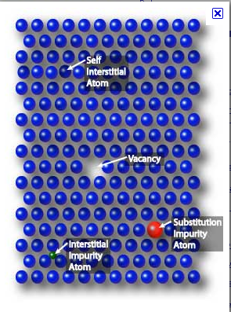
Simulated Annealing
„Annealing“: diffusion of atoms in a solid material when heated
Thanks to thermal fluctuation:redistribution of atoms, destroys dislocations
➔progression towards equilibrium (i.e. minimal energy)
➔ Interest for metal: softer, easier to work
Simulated annealing:
The χ2 surface is treated as a potential
Define temperature t
Define Boltzmann distribution→ probability of a movement in the parameter space upward in the potential
Xavier Prudent – Advanced Topics on Statistics – Goettingen 19th Oct. 2010

Slide 10
Simulated Annealing (2)
1 Pick a starting point
2 Pick a second point
3 Compare the 2 points
if χ2(2) > χ2(1), accept point 2
if χ2(2) < χ2(1), accept point 2 with proba
χ²
4 Repeat n times, then choose the point with lower χ2
5 Reduce the temperature
6 Repeat operation starting from the new point
2
- Effective scanning of large space
(coarse at large t, fine at small t)
- Robust, reliable
- Capable of escaping local minima
- Less dependant of starting point
- Slow, CPU consuming
- High initial t necessary
1
2
Parameter
Xavier Prudent – Advanced Topics on Statistics – Goettingen 19th Oct. 2010

Slide 11
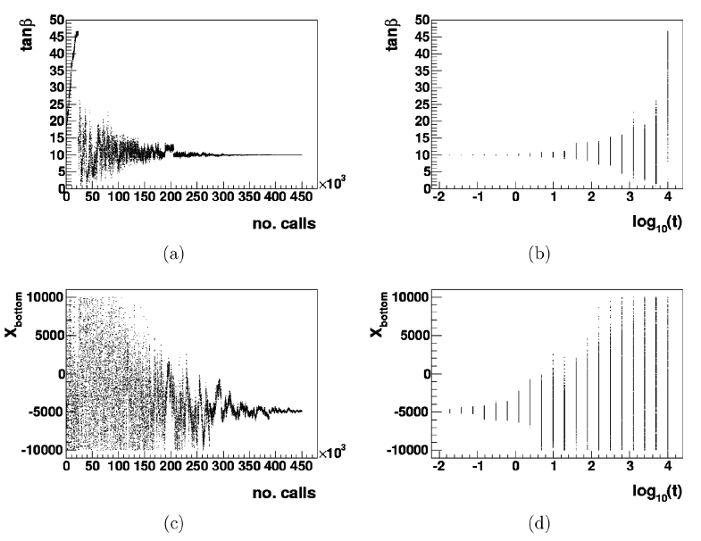
Simulated Annealing (3)
Large scanned area
Temperature lower around minimum
Fine scanning around minimum
Picked points
temperature
Temperature higher: because constraints weaker
Picked points
temperature
Xavier Prudent – Advanced Topics on Statistics – Goettingen 19th Oct. 2010

Slide 12
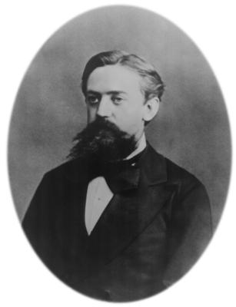
Markov Chains
1 Pick a starting point
2 Build a proposal distribution (Gaussian)
Andrei Markov
1856-1922
3 Pick a second point according to the proposal distribution
4 Compare the 2 points with
If L₁/L₂ > 1 : point 2 accepted (lower χ²)
If L₁/L₂ < 1 : point 2 accepted with a probability of L
χ²
χ²[2]
2
χ²[1]
1
χ²[2]
2
Parameter
Xavier Prudent – Advanced Topics on Statistics – Goettingen 19th Oct. 2010

Slide 13
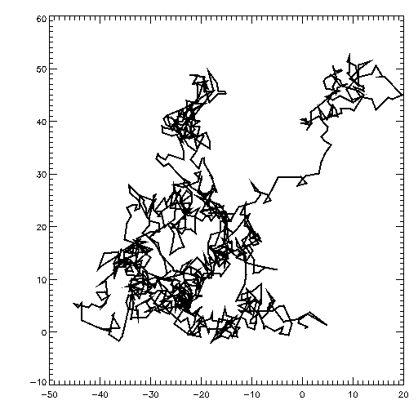
Markov Chains (2)
This algorithm (Metropolis-Hasting) gives out a suite of numbers, each depending ONLY on the precedent
Markov chain
Brownian movement
Higher density around minima
Possibility to accept points in a worse χ2 region
Allows scan of the surface
χ2
2
1
Secondary minimum
Absolute minimum
Xavier Prudent – Advanced Topics on Statistics – Goettingen 19th Oct. 2010

Slide 14
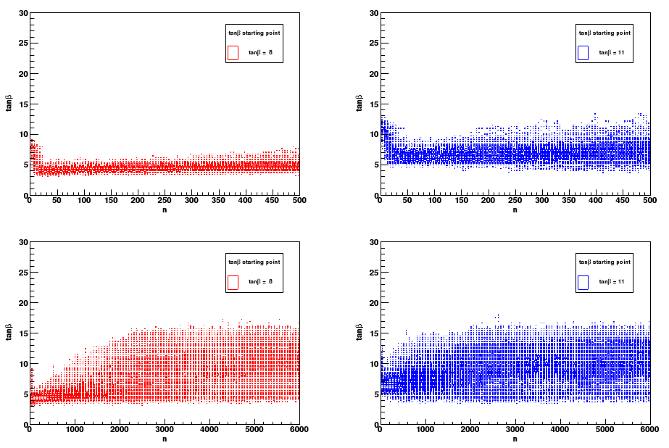
Markov Chains (3)
Behaviour of Markov chains for different starting values
Start value = 8
Start value = 11
# steps
# steps
# steps
# steps
For unbiased results: - long enough chain
- adapted proposal distributions („large“ width)

Slide 15
Fittino Results
Xavier Prudent – Advanced Topics on Statistics – Goettingen 19th Oct. 2010

Slide 16
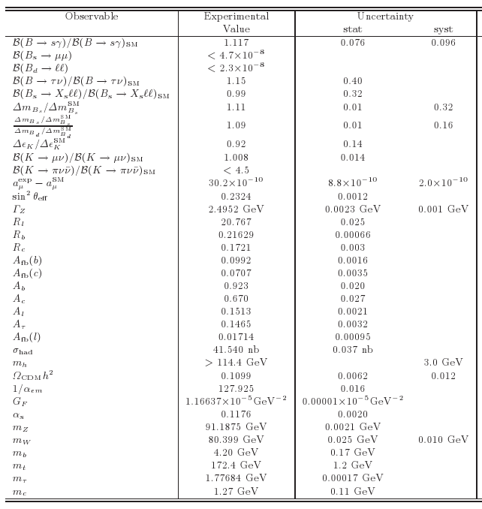
Low Energy Measurements
Effects from SUSY maybe already available
Data from LEP, Tevatron, SLC, B/K physics, (g-2)μ, astrophysics
Precision observables with high sensitivity to SUSY

Slide 17
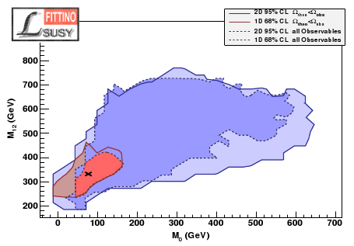
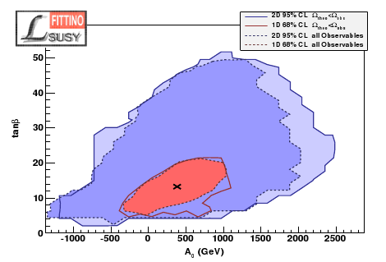
mSUGRA Parameters with Low-Energy Measurements
Fit of mSUGRA to the low energy measurements
Low energy data favours light SUSY
Xavier Prudent – Advanced Topics on Statistics – Goettingen 19th Oct. 2010

Slide 18
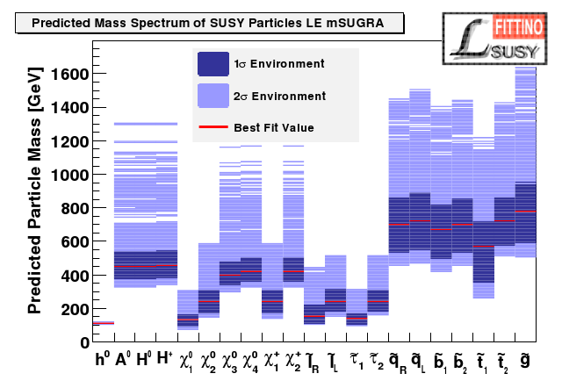
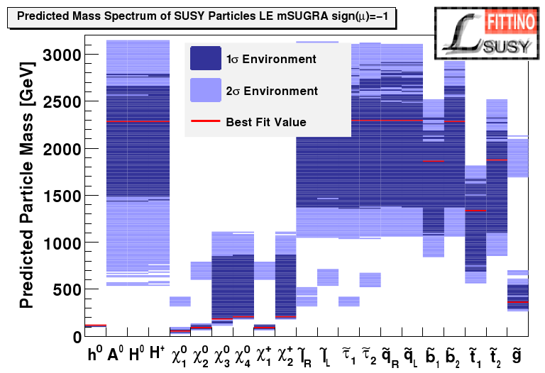
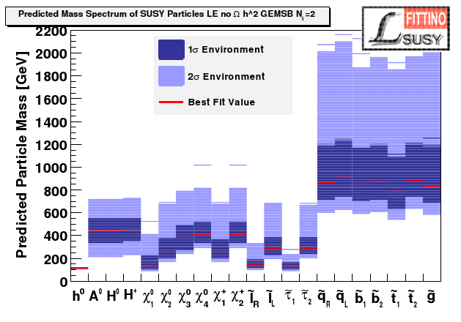
Predicted Mass Spectra with Low-Energy Measurements
mSUGRA, sign(μ)>0:
mSUGRA, sign(μ)<0:
P-value: 54 %
P-value: 9 %
GMSB, sign(μ)>0, N₅ = 2:
Tested different model hypotheses
Low energy data favours light SUSY
P-value: 57 %

Slide 19
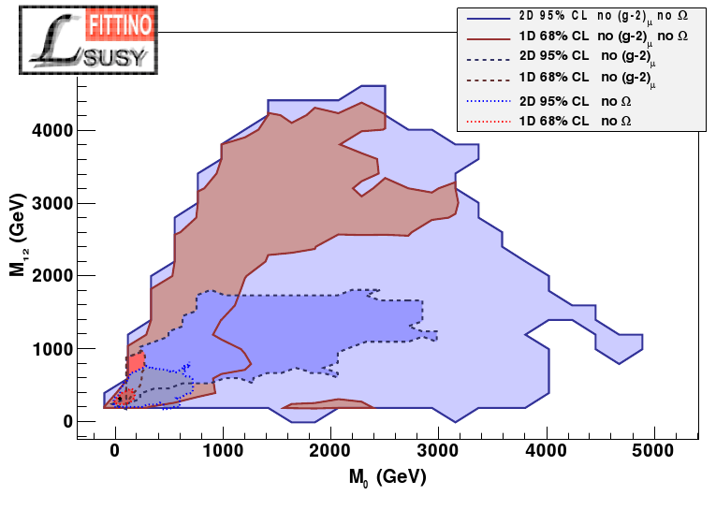
mSUGRA Parameters with Low-Energy Measurements (2)
Study the impact of individual observables
1D 68 % contours
Fits with all observables:
Fits without (g-2)_{μ} or/and Ωh²:
2D 95 % contours
No g-2 and no Ω
Preferred region rather stable
(g-2) is the most constraining
No g-2
No Ω

Slide 20
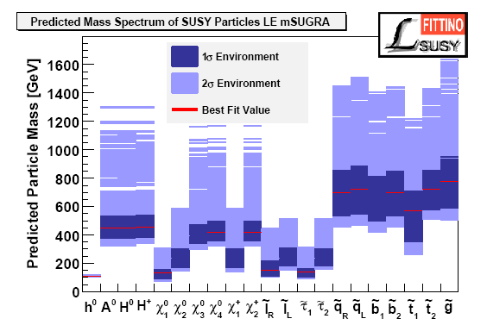
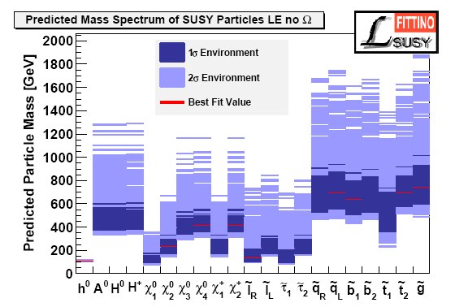
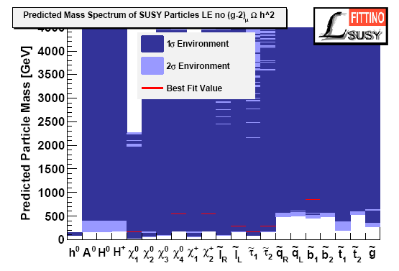
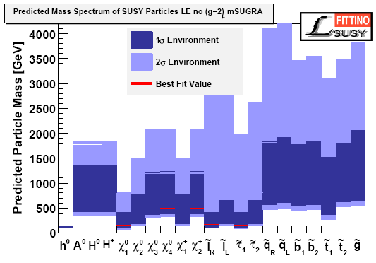
All
No Ω
No g-2
No Ω
No g-2

Slide 21
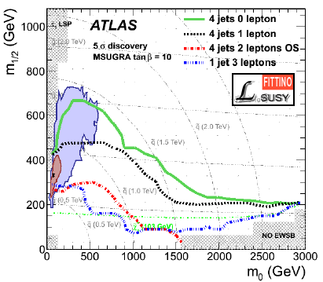
Comparison with LHC Potential
L = 1 fb⁻¹
14TeV
Good prospects for early BSM hints at LHC
Boundaries for 5σ discoveries
Bechtle, Desch, Uhlenbrock, Wienemann
Xavier Prudent – Advanced Topics on Statistics – Goettingen 19th Oct. 2010

Slide 22
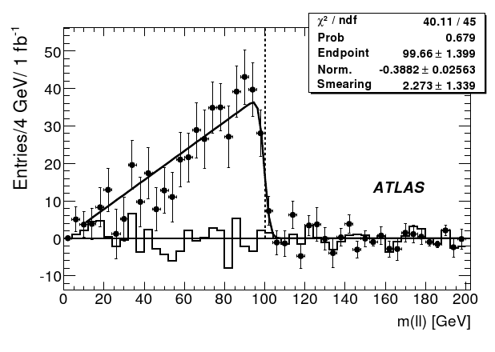
Understanding SUSY with LHC
Mass reconstruction at LHC
If R-parity conservation➔ no mass peak possible because of 2 escaping LSPs
However, kinematic constraints lead to mass edges
q
l
q
l
p
~
~
~
χ
g
q
0
~
~
2
l
χ
0
Endpoint sensituve to SUSY masses
1
~
g
p
Similar formulae for other endpoints
Xavier Prudent – Advanced Topics on Statistics – Goettingen 19th Oct. 2010

Slide 23
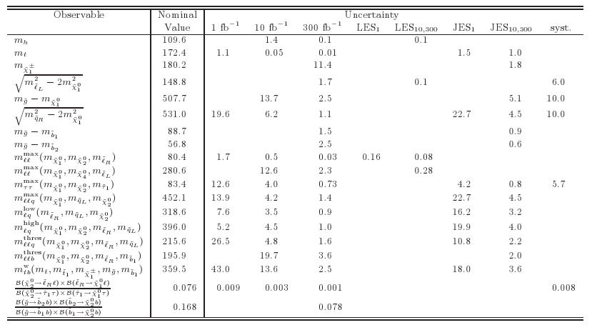
Understanding SUSY with LHC (2)
Observables list:
- No decay chain ambiguitis considered
- Theoretical uncertainties mostly not considered
- Mostly no information on LHC rates

Slide 24
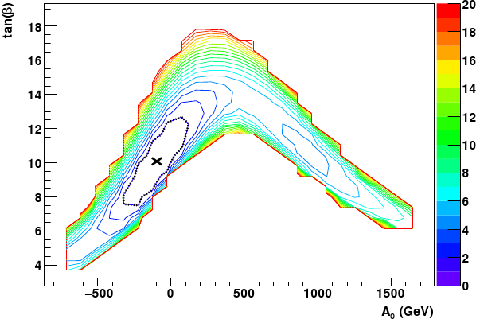
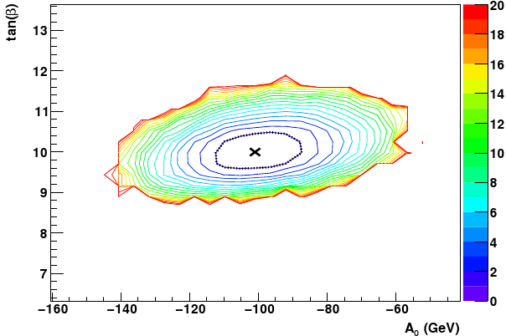
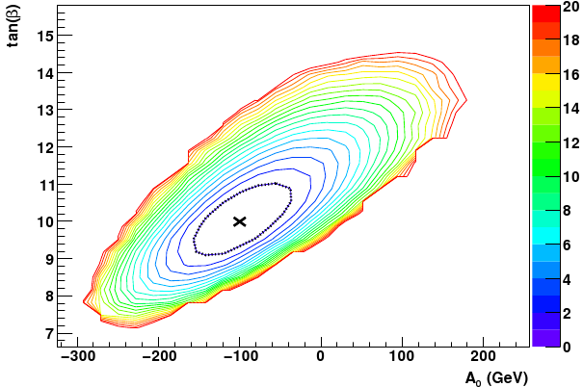
Understanding SUSY with LHC (3)
mSUGRA parameters for sign(m) > 0
Likelihood maps with contours of
1 fb⁻¹
SPS1a: tanβ = 10, A₀ = -100 GeV
300 fb⁻¹
10 fb⁻¹
Xavier Prudent – Advanced Topics on Statistics – Goettingen 19th Oct. 2010

Slide 25
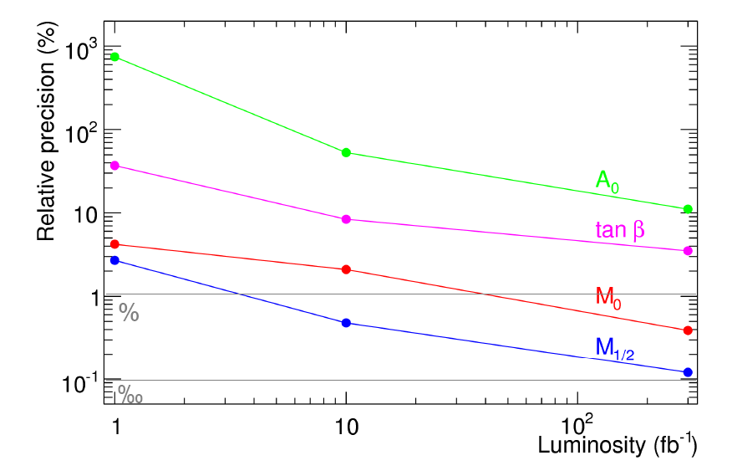
Understanding SUSY with LHC (4)
mSUGRA parameters for sign(m) > 0
Significant impact of high integrated luminosity
Xavier Prudent – Advanced Topics on Statistics – Goettingen 19th Oct. 2010

Slide 26
Understanding SUSY with LHC (5)
What about the sign of μ (SUSY Higgs coupling) ?
Build toy datasets by smearing observables within uncertainties
Apply fit on these toy datasets
Compare the correlation of χ2 for the fits with sgn(μ)><0
L = 1 fb⁻¹
L = 10 fb⁻¹
L = 300 fb⁻¹
➔ Any discrete parameter can be treated this way
Xavier Prudent – Advanced Topics on Statistics – Goettingen 19th Oct. 2010

Slide 27
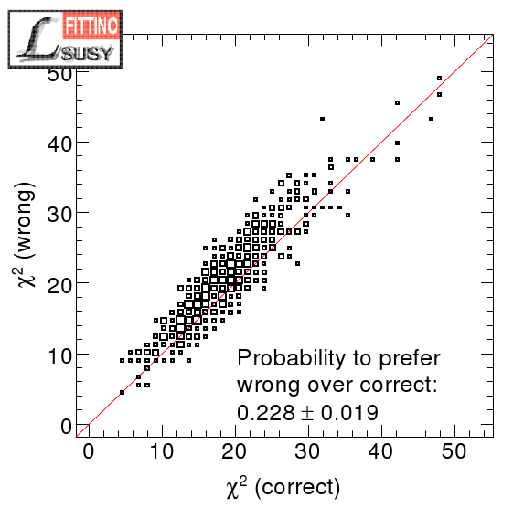
Understanding SUSY with LHC (6)
q
l
Impact of decay chain ambiguities
l
To 1 final state can correspond different possible decay chains
➔ Possibility of wrong assignement in the definition of the mass edge
~
~
~
0
q
χ
l
~
χ
L/R
2/3/4
L/R
0
1
Method: perform toy fits for all possibilities and choose best fit (smallest χ2)
10 fb⁻¹
Example:
Comparing the two possible interpretation
Some impact on reconstruction parameter, but effect small compared to uncertainty on parameter
Xavier Prudent – Advanced Topics on Statistics – Goettingen 19th Oct. 2010

Slide 28
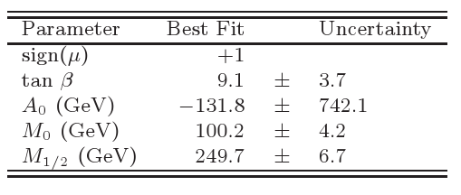
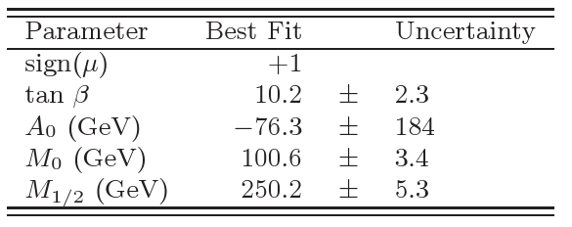
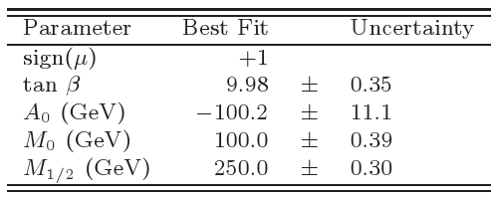
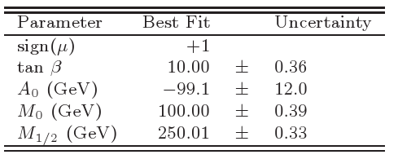
Understanding SUSY with LHC and Low-Energy Meas.
What would be the contribution of low-energy measurements in LHC era ?
LHC (1 fb⁻¹):
LE+LHC (1 fb⁻¹):
LHC (300 fb⁻¹):
LE+LHC (300 fb⁻¹):
Low-energy data may still be important in first years of LHC
Xavier Prudent – Advanced Topics on Statistics – Goettingen 19th Oct. 2010

Slide 29
MSSM18
So far all analysis assumed mSUGRA was true
➔ strong assumption on SUSY breaking mechanism
Studies MUST be performed in more general SUSY models
Assumptions:
no CP violation in SUSY sector (all phases = 0)
no mixing between sfermion generations
universality of same-type sfermion mass parameters in first two generations
MSSM18 (18 parameters)
Xavier Prudent – Advanced Topics on Statistics – Goettingen 19th Oct. 2010

Slide 30
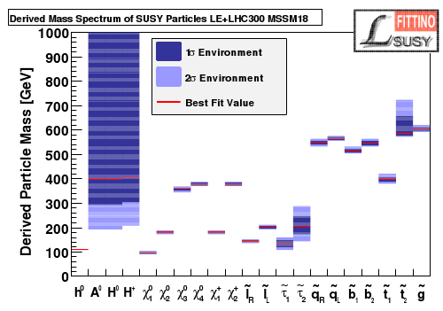
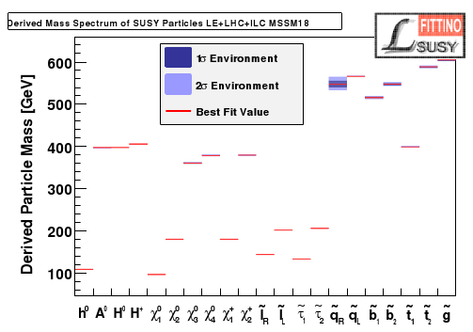
MSSM18 (2)
Mass spectra using low-energy and LHC observables (300/fb)
Comparison with additionnal contribution by ILC measurements
MSSM18, LE+LHC300:
MSSM18, LE+LHC300+ILC:
Complementarity of ILC to LHC
ILC reduces uncertainties by 1-2 orders of magnitude
Xavier Prudent – Advanced Topics on Statistics – Goettingen 19th Oct. 2010

Slide 31
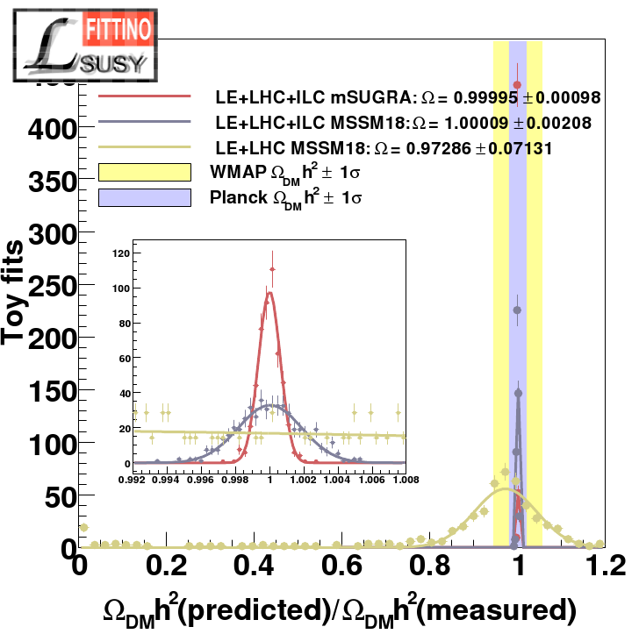
Cold Dark Matter Density
The CDM density can be inferred from collider measurement
➔ compatibility with astrophysics ? Nature of Dark Matter ?
Distribution of ratio
Predicted/measured for the toy datasets
ILC necessary to match collider precision with precision of direct measurement in MSSM18

Slide 32
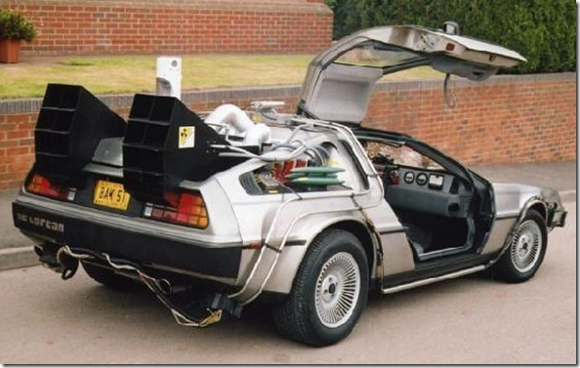
Future for Fittino,
Next steps…

Slide 33
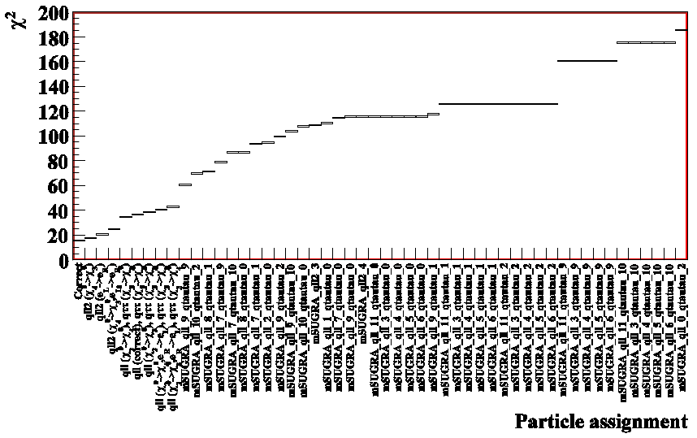
FUTURE in FITTINO: next steps
Kono
q
l
Consider all possible decay chain ambiguities
in parameter analysis of LHC data
First steps started:
l
~
~
~
0
q
χ
l
~
χ
L/R
2/3/4
L/R
0
1
Perform separate fit for each option
DESY
Correct assignment yields smallest χ²
Xavier Prudent – Advanced Topics on Statistics – Goettingen 19th Oct. 2010

Slide 34
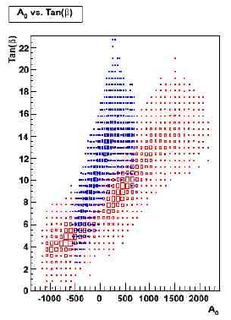
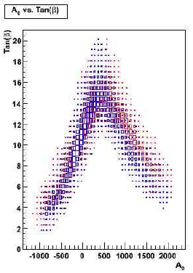
FUTURE in FITTINO: next steps (2)
Algorithm optimization for Markov chain
Parameter analysis is CPU intensive
Optimised algorithm settings are crucial
Example: Optimised proposal density distribution for Markov chain
Prudent
default proposal dist.
optimised proposal dist.
Dresden
Dresden
Short fixed chain length used for illustration
Start value 1
Start value 1
Start value 2
Start value 2
Xavier Prudent – Advanced Topics on Statistics – Goettingen 19th Oct. 2010

Slide 35
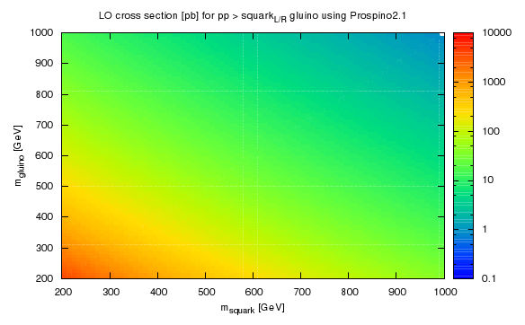
FUTURE in FITTINO: next steps (3)
Include the LHC production rates
Krämer, Lindert, O'Leary
Conventional calculation of production rates at LHC too slow.
Investigated way out:
Prospino look-up table (only 2 parameters: squark and gluino mass)
Calculation of BRs by SPheno/SDecay
Parametrised detector response
Aachen
Xavier Prudent – Advanced Topics on Statistics – Goettingen 19th Oct. 2010

Slide 36
FUTURE in FITTINO: next steps (4)
Inclusion of SUSY direct search limits from LEP and Tevatron (Mainz, Bonn)
Inclusion of indirect dark matter search results (Hamburg)
Systematic comparison of different RGE codes (Göttingen)
Inclusion of uncertainties/correlations of theory predictions (Würzburg, DESY, Heidelberg, …)
Calculator speed-ups (Würzburg)
Model discrimination studies (Dresden, DESY)
...
Lively activity
Much more planned
Powerful tool already developed, many new results coming soon
Joint efforts by experimentalists & theorists
Volunteers welcome
Xavier Prudent – Advanced Topics on Statistics – Goettingen 19th Oct. 2010

