Slide 1
GaAs with traces 15/7/21
Mainly Ibtisam

Slide 2
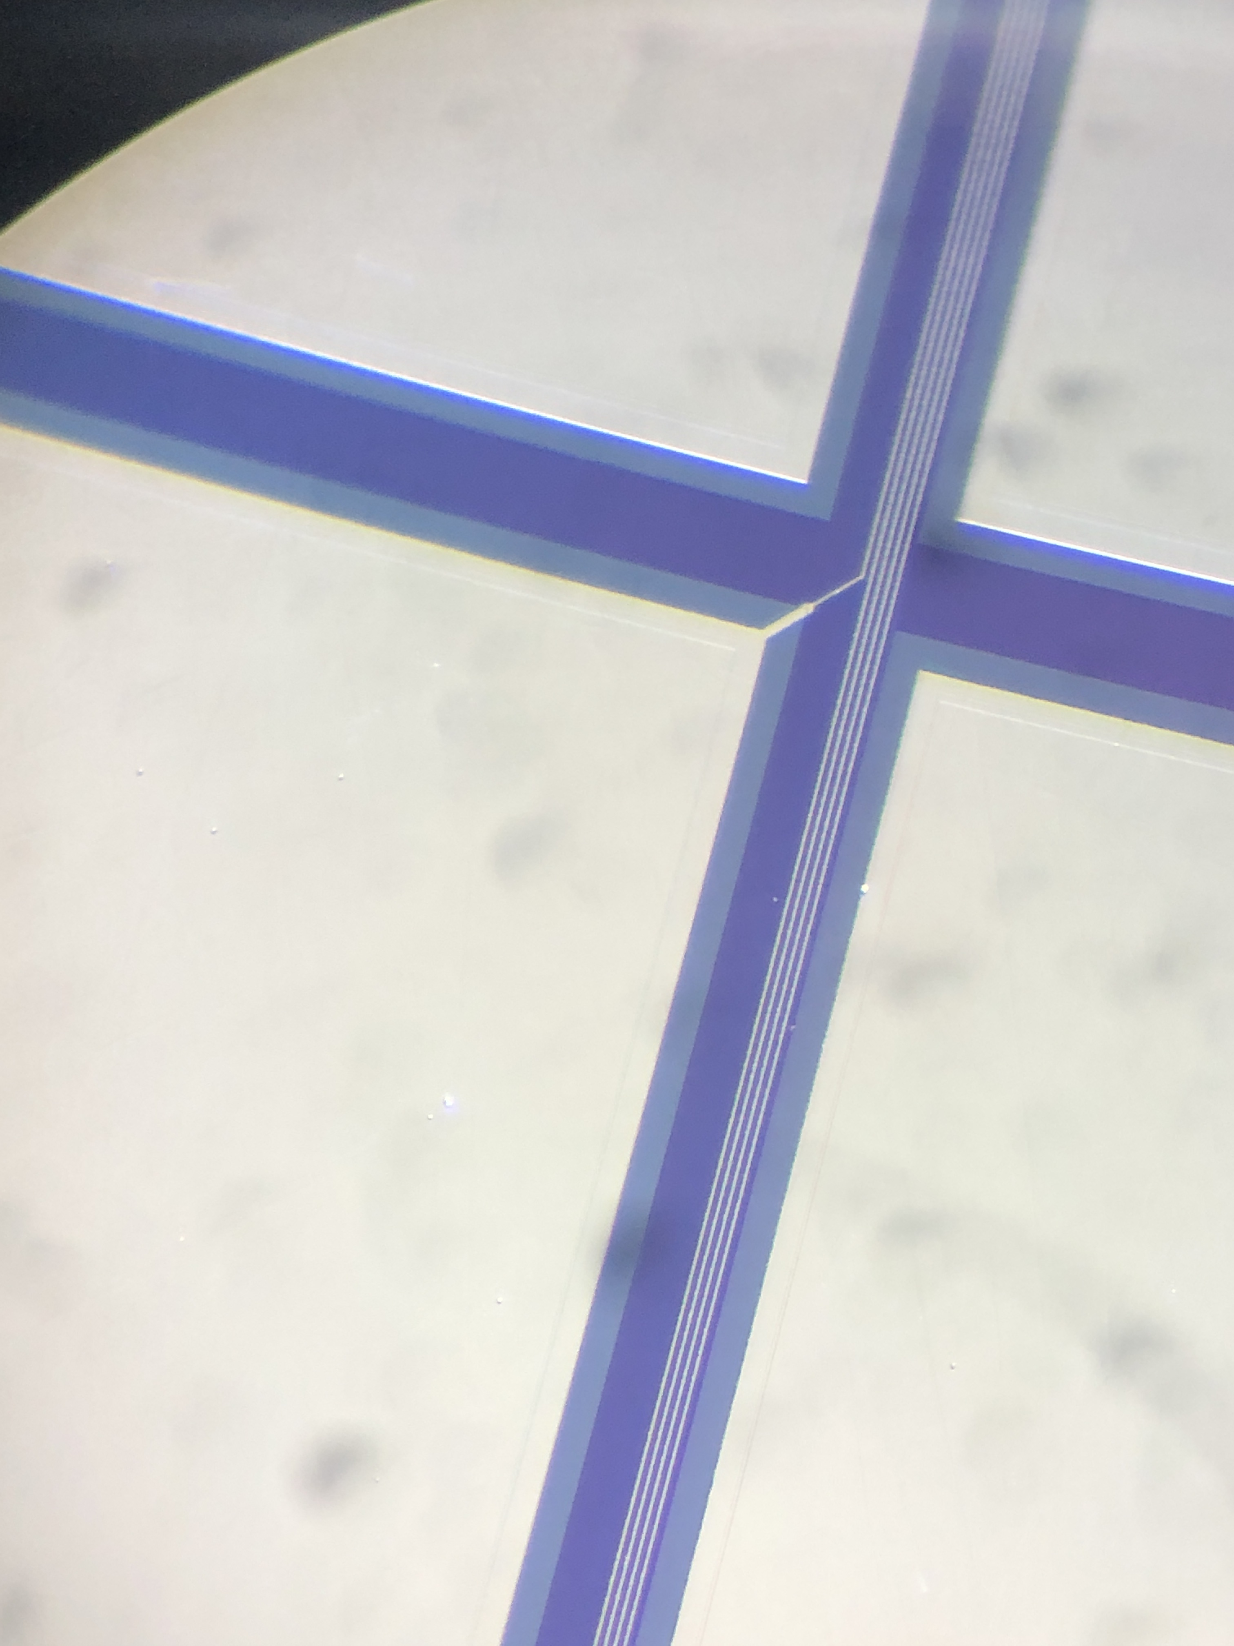
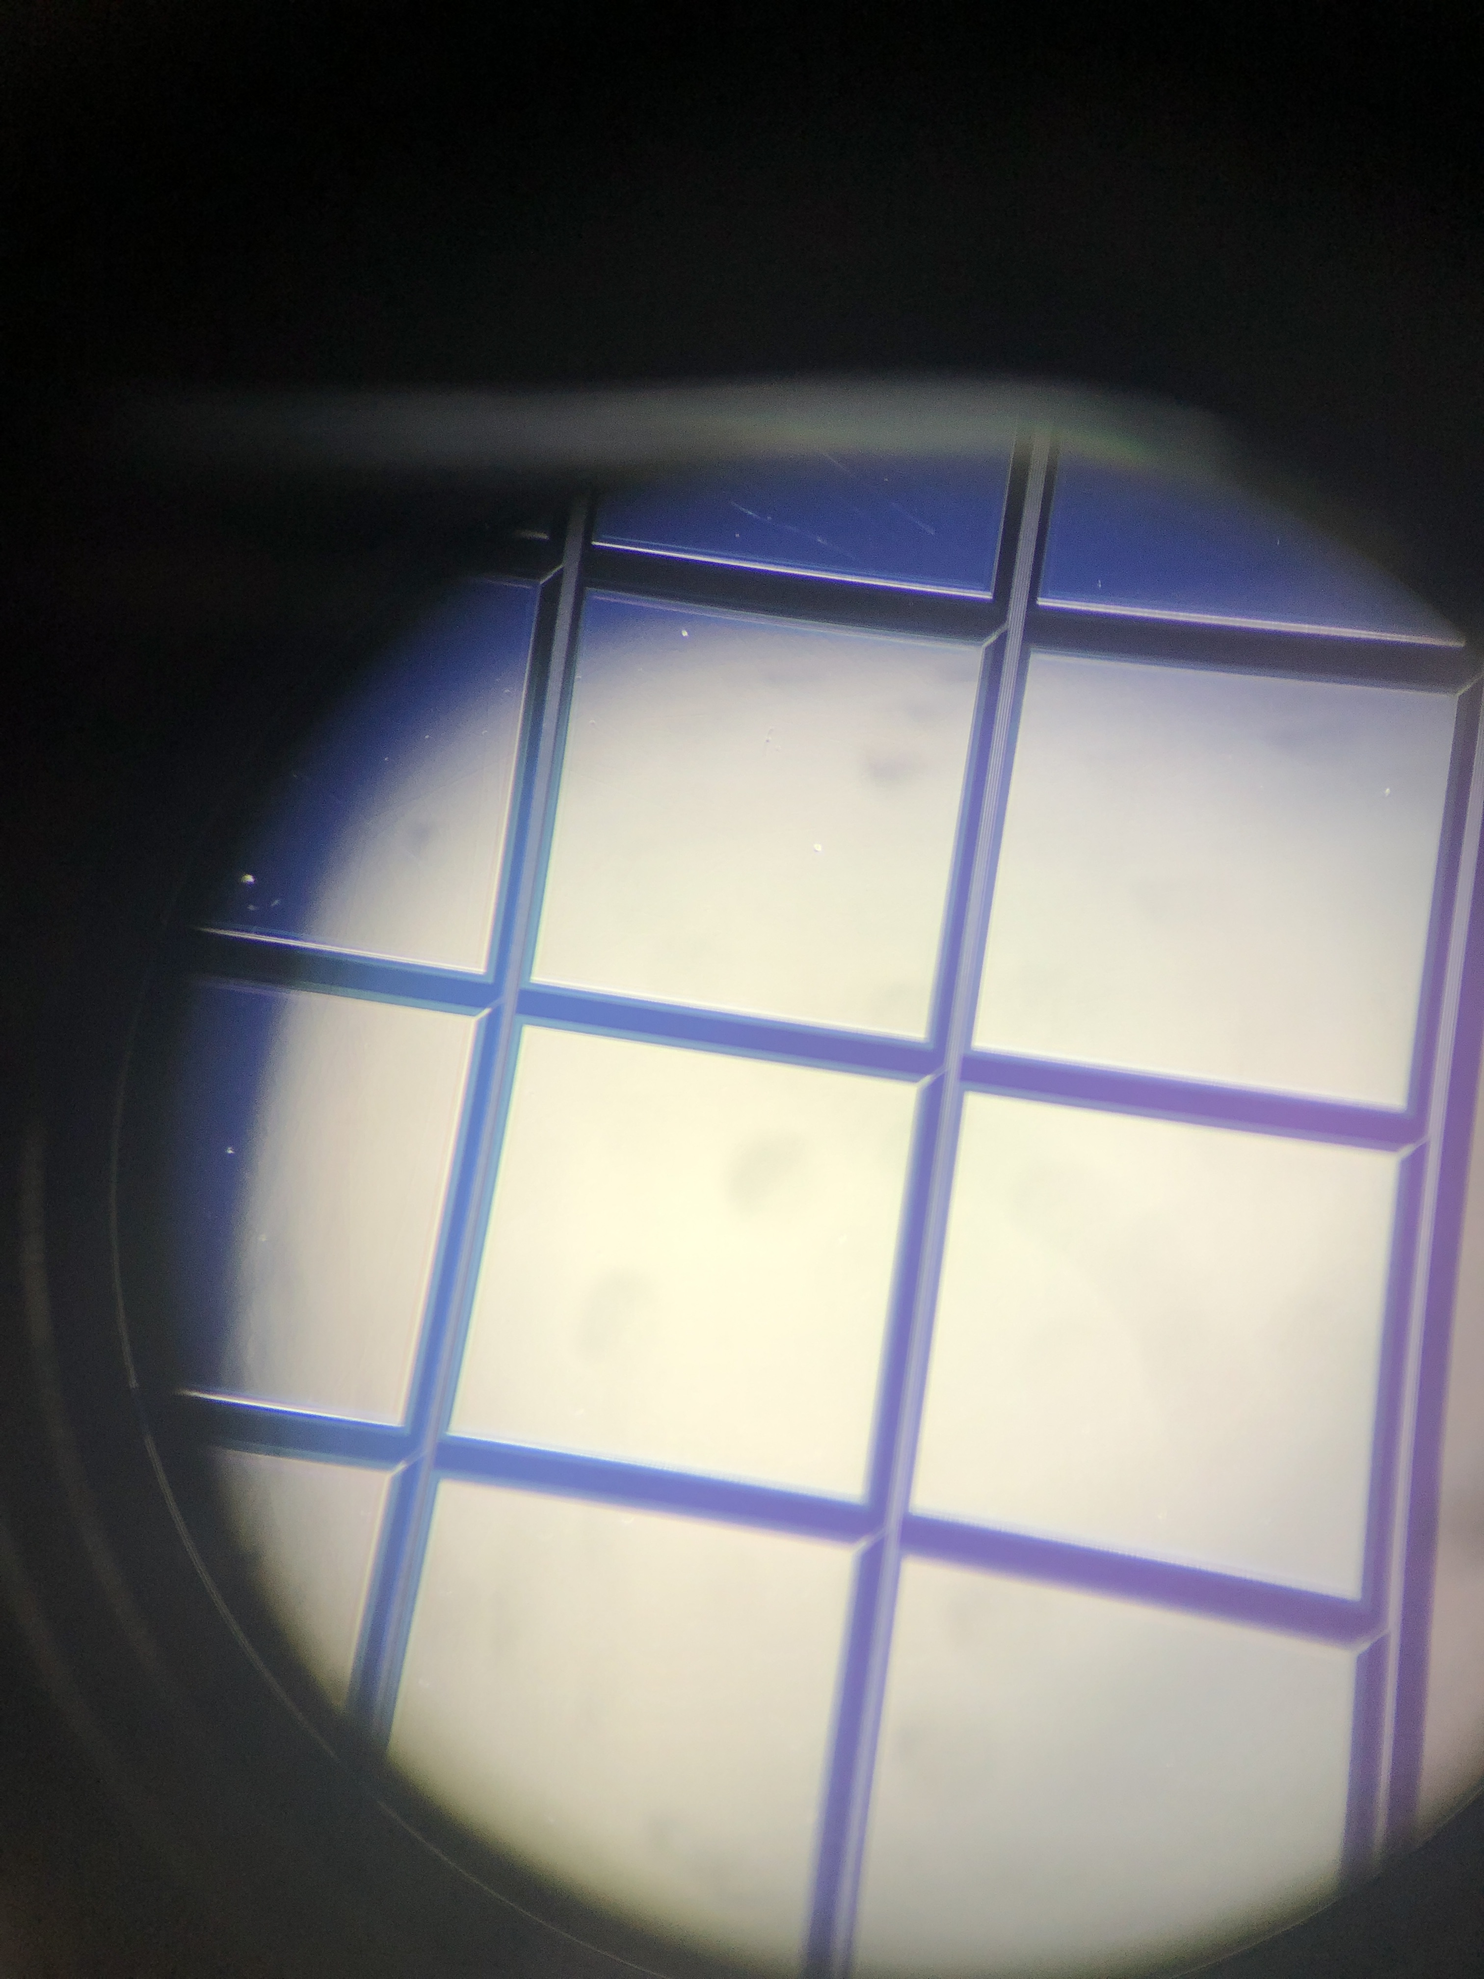
GaAs with traces
minipad
We received the sensors yesterday
Visual inspection : ok
pad

Slide 3
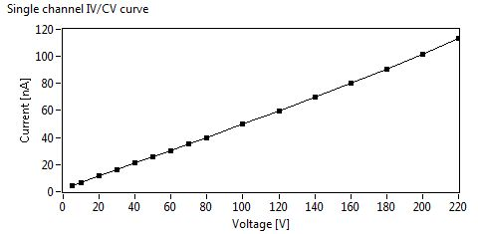
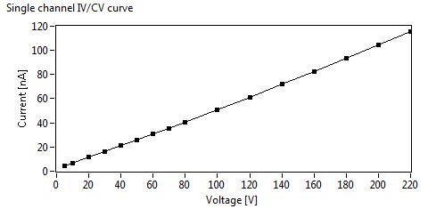
First IV test
For the first pads, we proceed to three way to measure :
All the needles are on the pads (signal+ground)
All the ground needles are on the pads and the signal needle is connected to the end of the trace
All the needles are connected to the end of the trace
Needle on the minipad (A,1)
Needdles on Pad (A,1)
No difference in the IV results

Slide 4
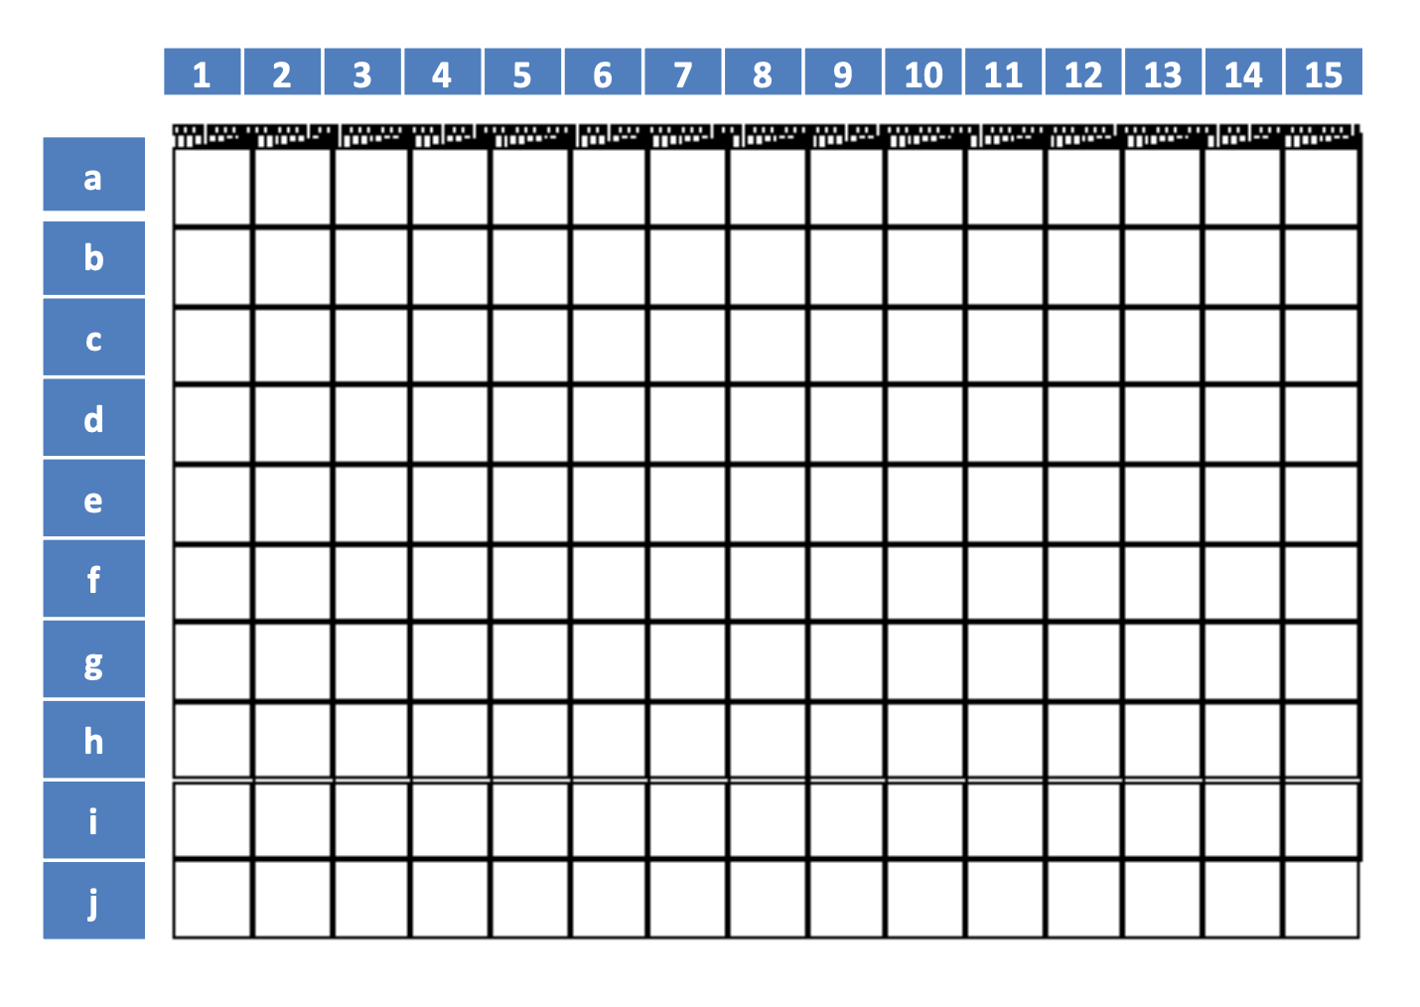
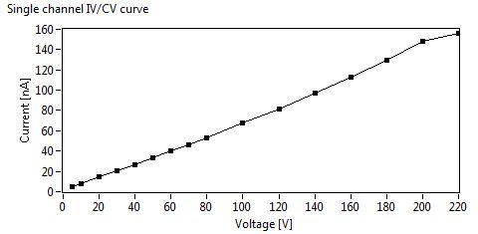
Current value @ 100V by Anton
26 degrees, 26% humidity
(A,1)
(C,4)

Slide 5
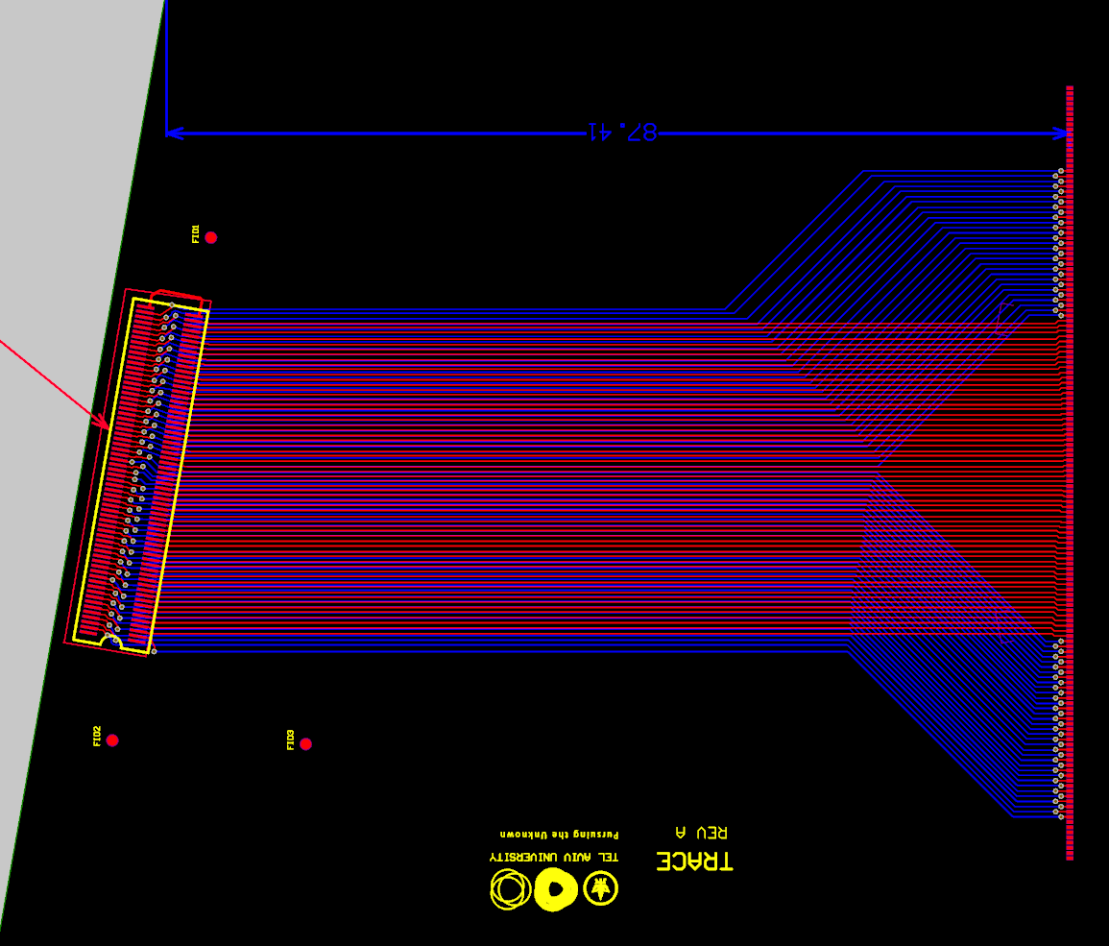
bonding
bonding
Flex for the test beam designed. Mechanics under study

