Slide 1
ATLAS Trigger Helmholtz Alliance: Physics at the Terascale 4th Annual Workshop 1. - 3. December 2010, Dresden
Rainer Stamen
Kirchhoff-Institut für Physik
Universität Heidelberg
Commissioning and Running 2009/2010
Upgrade Projects

Slide 2
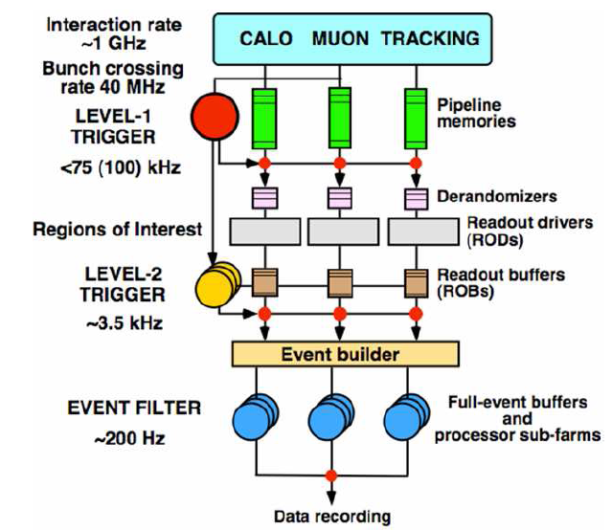
The ATLAS Trigger and DAQ System
Hardware :
Calo and Muon
Software:
all det. RoI guided
Software:
all det. RoI and fullscan

Slide 3
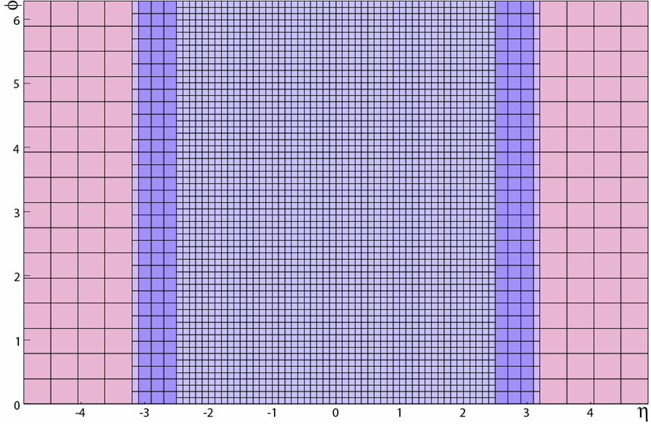
The Level-1 Calorimeter Trigger
Digitized transverse energy
e/γ, τ
Cluster
Processor
56 modules
Merging
8 modules
Calorimeter signals (~7200)
0.1×0.1
PreProcessor
124 modules
Jets, E_{Tmiss}
Hit counts and E_{T} results to CTP
0.2×0.2
Jet/Energy
32 modules
Merging
4 modules
φ
99.9% analogue channels available
digital part fully functional
η

Slide 4
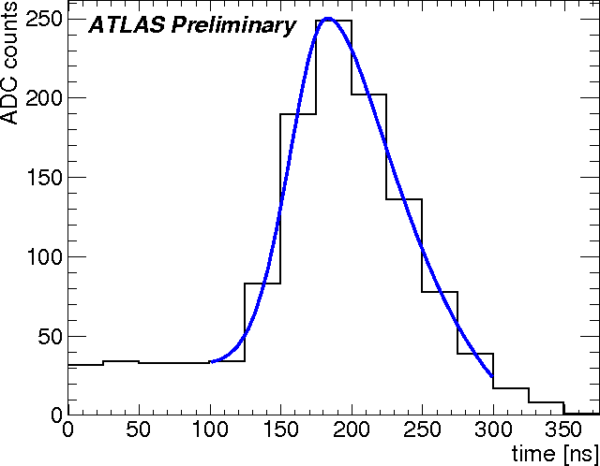
Synchronisation
System Synchronisation
Cable lengths compensation
Energy Calibration
Method
Fit pulses (empiric function)
Free parameters: Pulse height and position
Accuracy
± 2ns (from pulser runs)

Slide 5
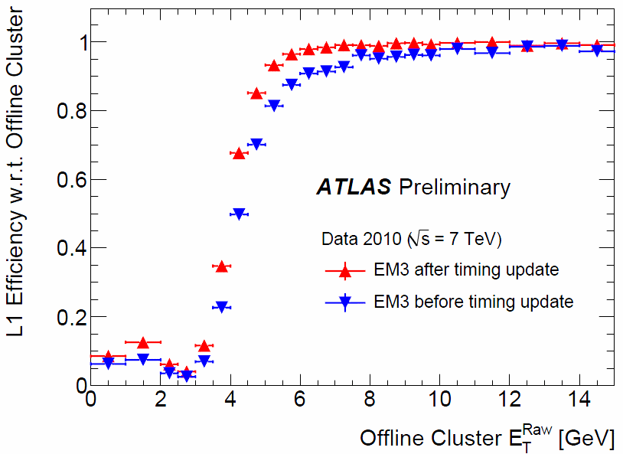
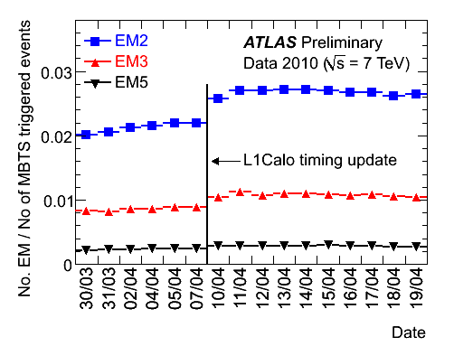
Synchronisation
Application of Timing
2009 splash events
2010 splash events
2010 collision data
Result
Increase of trigger efficiency
Increase of trigger rate
Future usage
Can follow LHC clock phase shifts on ns level
Will be used in monitoring

Slide 6
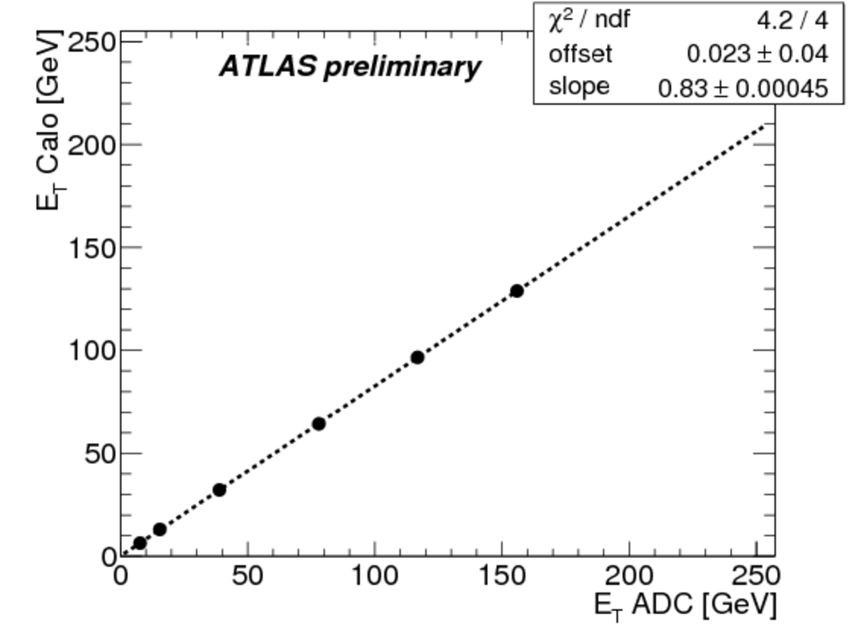
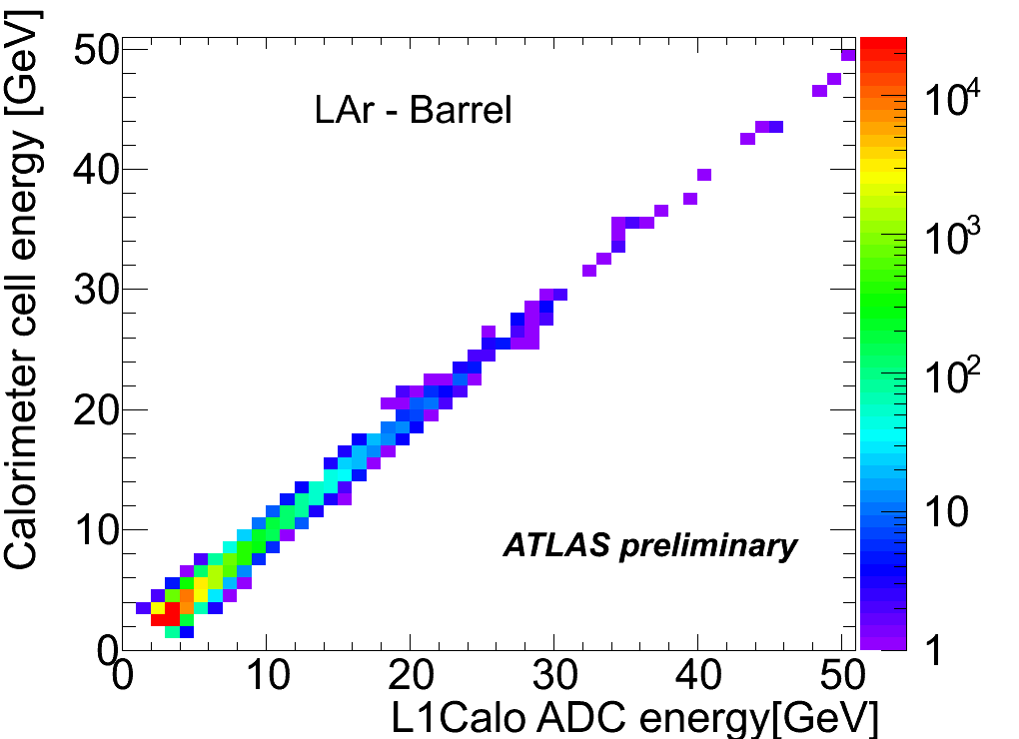
Calibration
In situ calibration
Compensate for signal attenuation in cables
Method
Pulser system
Calorimeter is reference
Result
Good correlation in data
Small offsets being corrected (pulse shape effects)

Slide 7
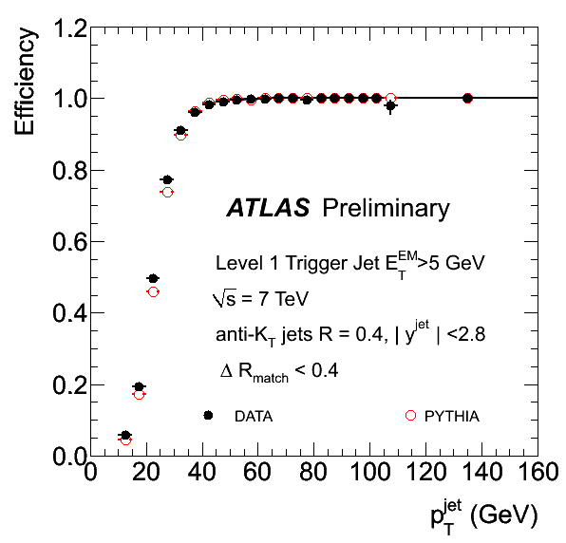
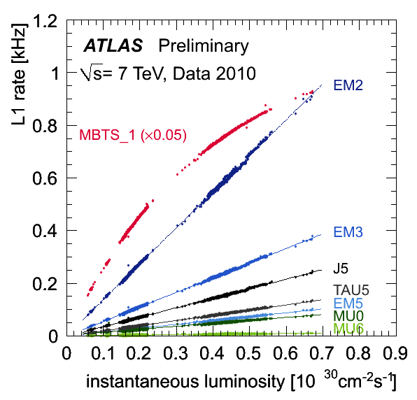
Calorimeter Trigger Performance
Sharp turn-on curves
Stable operation

Slide 8
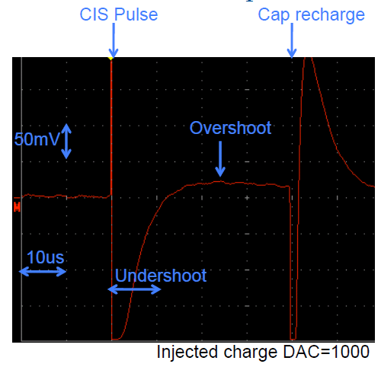
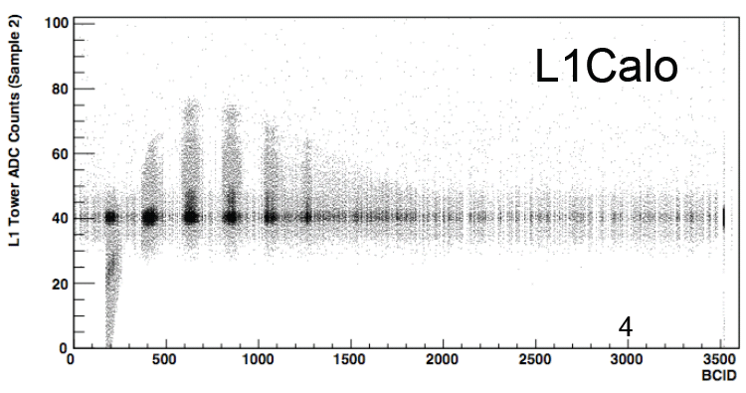
Upgrade Projects
PreProcessor MCM
Digitisation (FADC)
Digital Signal Processing (ASIC)
Stable baseline subtraction
Analogue signal behaviour
Tile: under- and overshoot (50 μs)
LAr: undershoot (0.4μs)
No effect on current and near future running
Will become important at high lumi running
Dynamic baseline subtraction very desirable

Slide 9
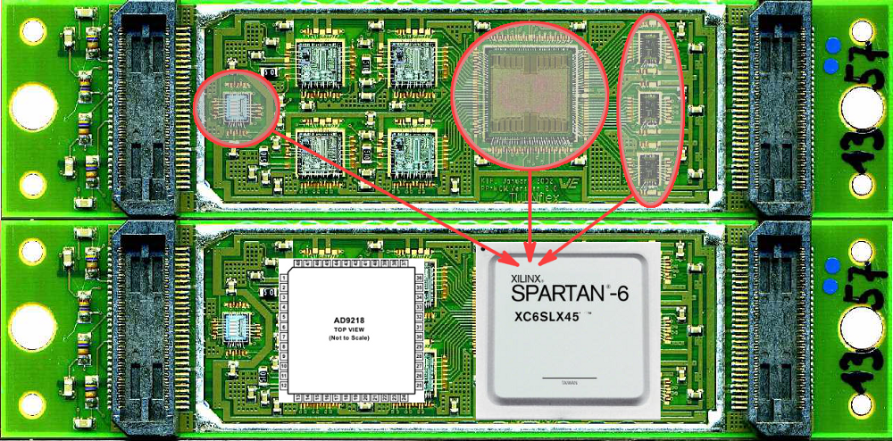
Upgrade Projects
The new PPr MCM (Heidelberg)
FPGA <-> ASIC
Add serialiser
Add fine synchronisation
Packaged ADC (10 bit)
Schematics and Layout ready
FPGA code tested on development board (25% ressources used)
Additional functionality to be designed

Slide 10
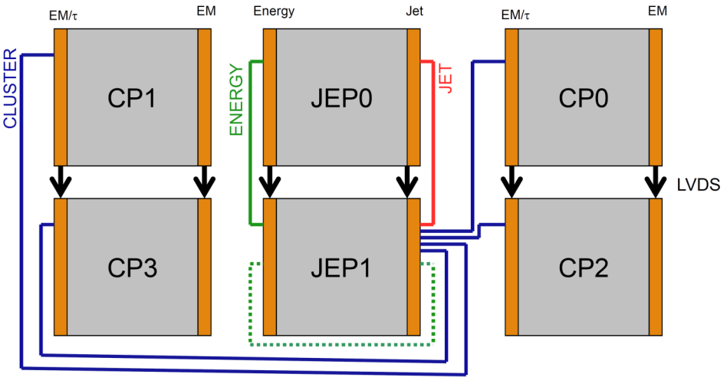
Upgrade Projects
Topology not available on Level-1
2 possible scenarios
L1Calo internal topology
Topology including muons
Hardware requirements
CMM++ (merger board in every crate)
Topolgical Processor
Heavy data transfer

Slide 11
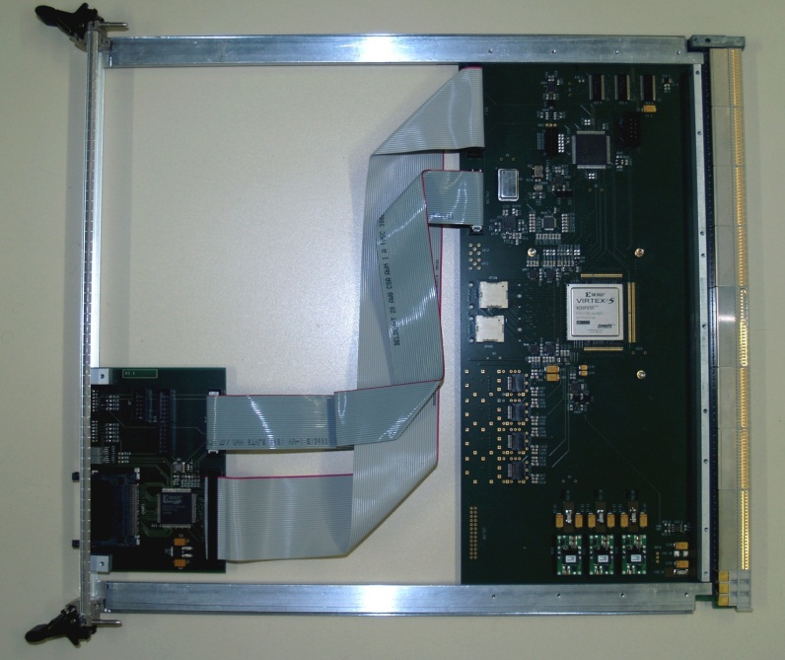
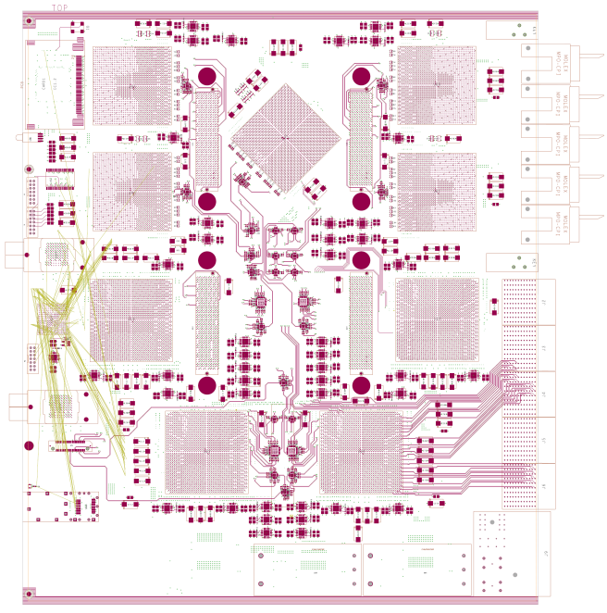
Upgrade Projects
BLT: Backplane Link Tester (Mainz)
Built in Mainz
Tested backplane data transfer up to 160 MB/s
GOLD: Generic Optical Link Demonstrator (Mainz)
Being developed in Mainz
Demonstrator for a topological processor
Various testing possibilities
Data replication schemes
Connectivity, Processing Power
In Design Phase

Slide 12
Summary
Trigger commissioning successful
The ATLAS Trigger worked very well in 2009/10
Various upgrade projects started
PreProcessor MCM2.0
Topological Processor
First demonstrators and prototypes will soon be available

Slide 13
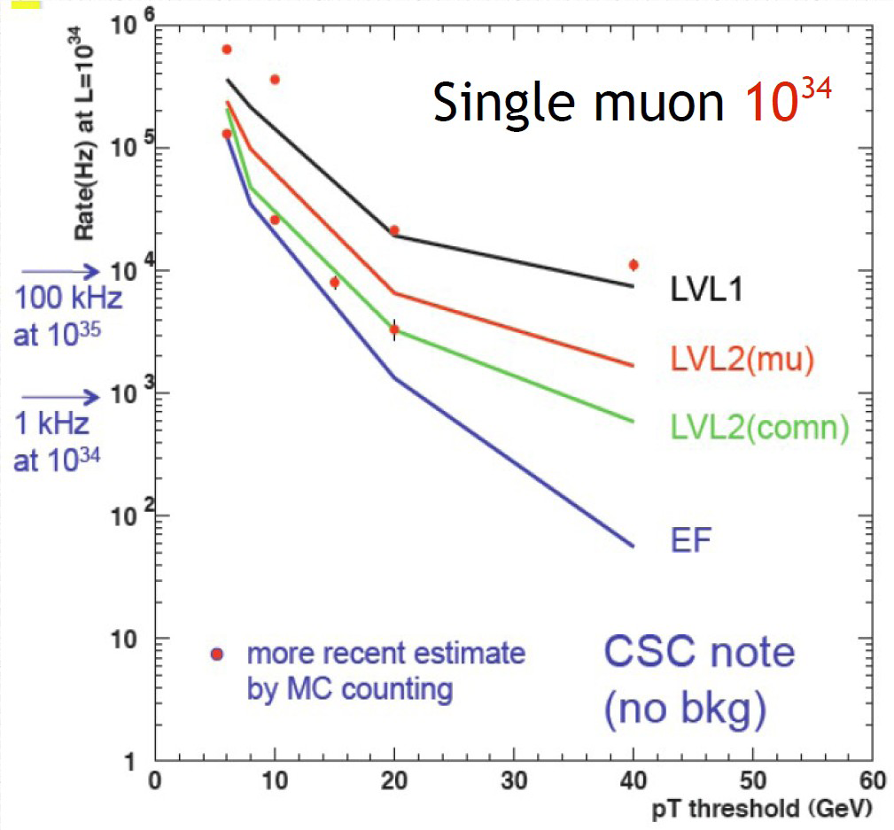
Upgrade Projects
Track Triggers
Not available currently
Motivation
Reduction of muon rate
Reduction of electron rate at L2: factor 3-5
Challanges
Data transport
Pattern recognition
Status
Various design studies (algorithms)
Data transfer studies (e.g. Wireless R/O)

Slide 14
