Slide 1
ACF test

Slide 2
ACF : anisotropic conducting film
Anisotropic conducting : only in the z direction
usage : chip connection without bonding (die) or lead balls (packaged)
How to use it :

Slide 3
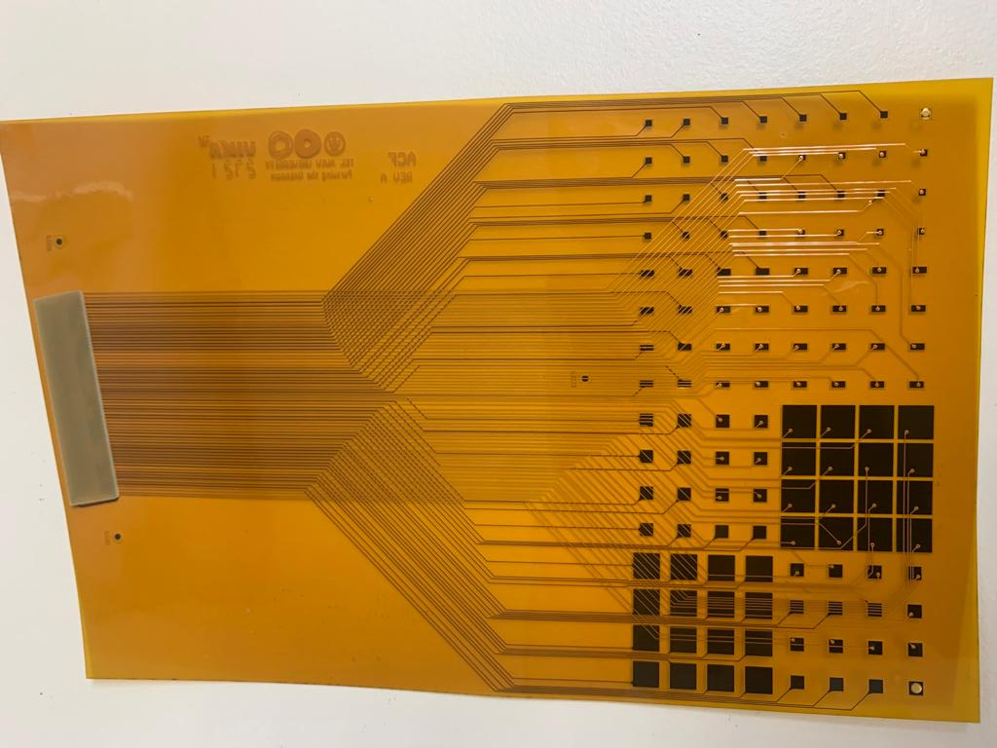
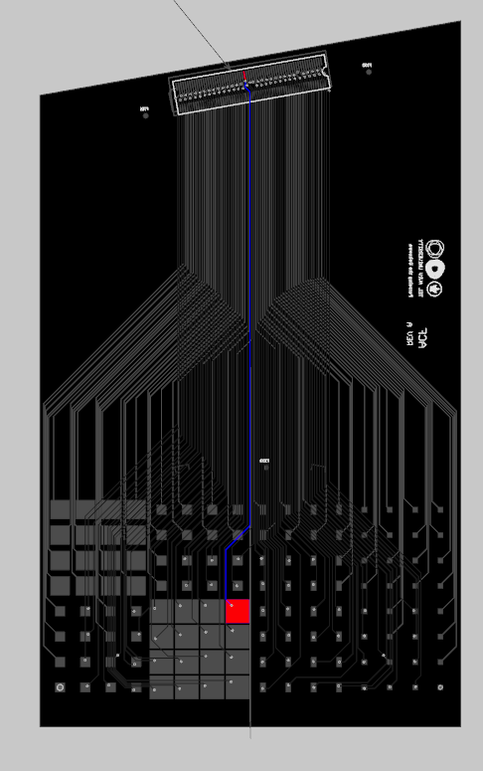
The aim : glue our sensor to the flex using ACF
We designed a special flex for R&D purpose (different pad sizes) to glue on the CALICE sensor
I worked in collaboration with Mateus Pinto from Geneva University: i was there beginning of august
2 types of ACF : 3M (50 um) and Dexerials (3 um after curing)

Slide 4
3M 9703 gluing
Really easy because doesn’t need any thermal curing or pressure, adesive layer is 50um
Insulation resistance ~3.410¹⁴ ohms, contact resistance <0.3 ohms
Advantage : can be remove, it is not an epoxy/cyanolite

Slide 5
Dexerials 18um thickness with 3um conductive particles
Need pressure and heat to cure it, two times:
First time to maintain the ACF on the support1
Second time, to glue the support1+ACF on the support2
1st step
2nd step

Slide 6
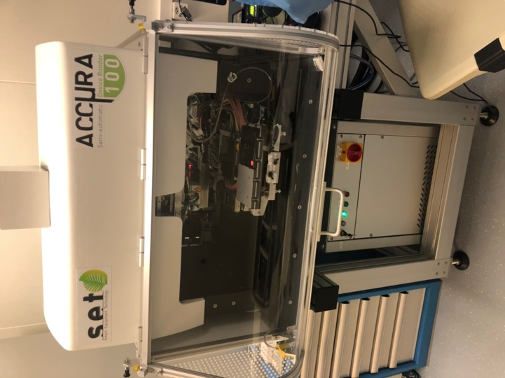
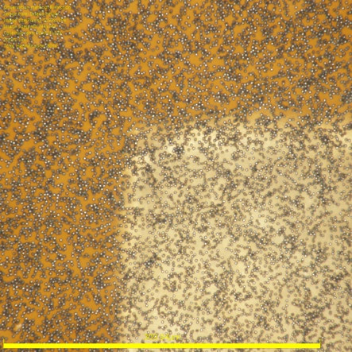
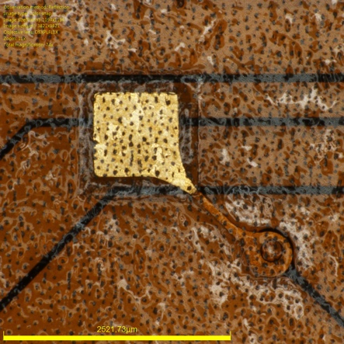
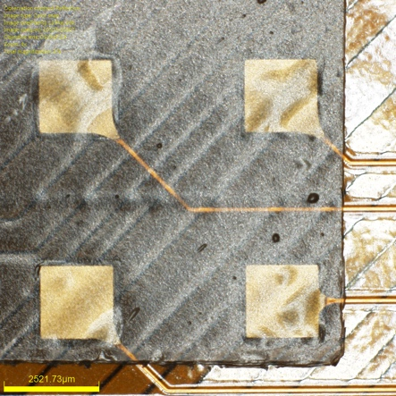

Slide 7
Problem with the flex
There is a overlayer on the flex :
When we try to glue the ACF on the flex :
ACF
No contact between the ACF and the flex
protection layer
air
protection layer
Cu pad
PCB

Slide 8
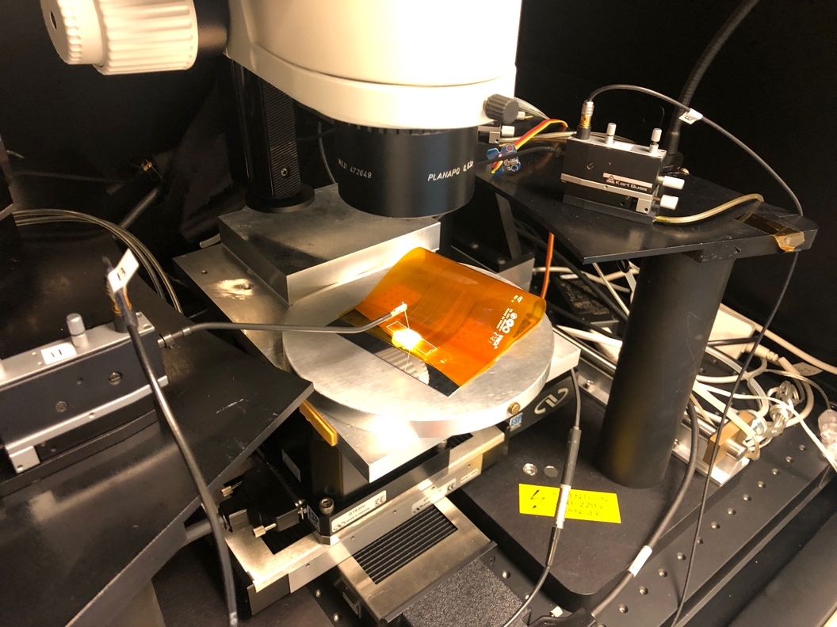
My idea : bricolage
Insert a hard material to bend the ACF
metal
ACF
protection layer
air
protection layer
Cu pad
PCB
kapton
metal
ACF
Tests with probe showed there was conductivity
protection layer
protection layer
Cu pad
PCB

Slide 9
Mateus idea : Electroless nickel immersion gold (ENIG)
metal plating process in order to increase the thickness of the metallic pads on the flex
Cu pad
protection layer
protection layer
PCB
Thanks to Rui, we got it on time!

Slide 10
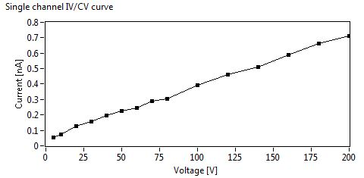
Test at TAU
We started to test the sensors at TAU. For the moment, only the bricolage and some 3M pads have been tested
Before the gluing
After the bricolage gluing

Slide 11
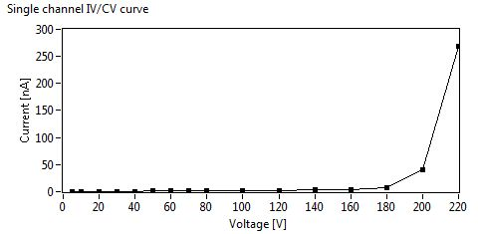
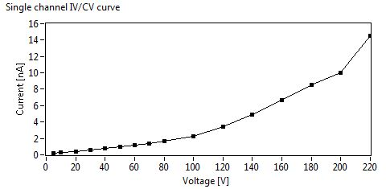
Test at TAU : bricolage
We have also bad contact
Pad (11,10)
Pad (10,12)

Slide 12
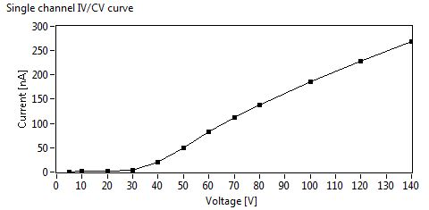
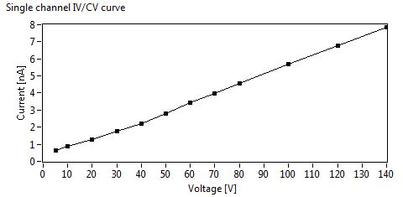
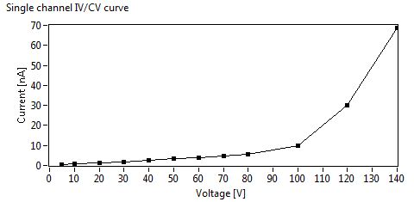
Test at TAU : 3M gluing
Need to check the IV shape as a function of the pad size

