Slide 1


Operational aspects of the gamma-ray profiler
Gianluca Sarri
g.sarri@qub.ac.uk
Marco Bruschi, Kyle Fleck, Niall Cavanagh, Massimo Benettoni, Oleksander Borysov, Umberto Dosselli, Mauro Morandin, Sergej Schualow, Antonello Sbrizzi, Anton Tyazhev
LUXE simulation meeting 31/08/2021

Slide 2
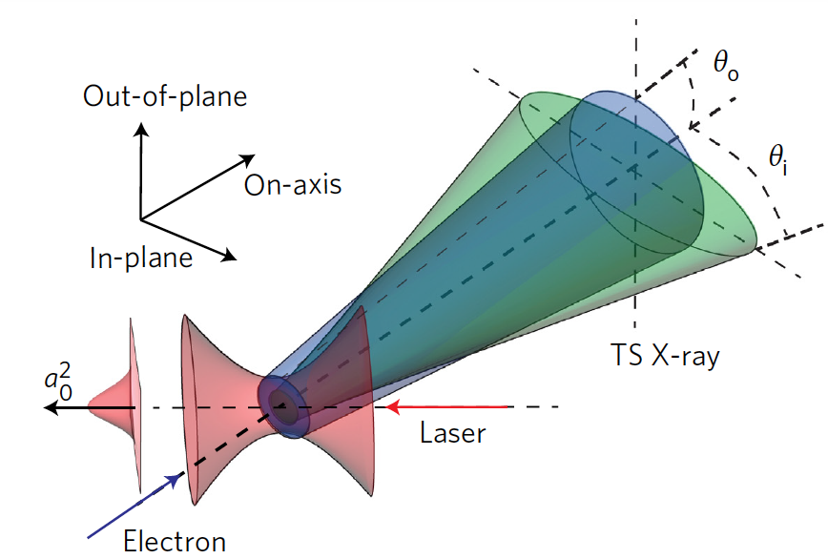
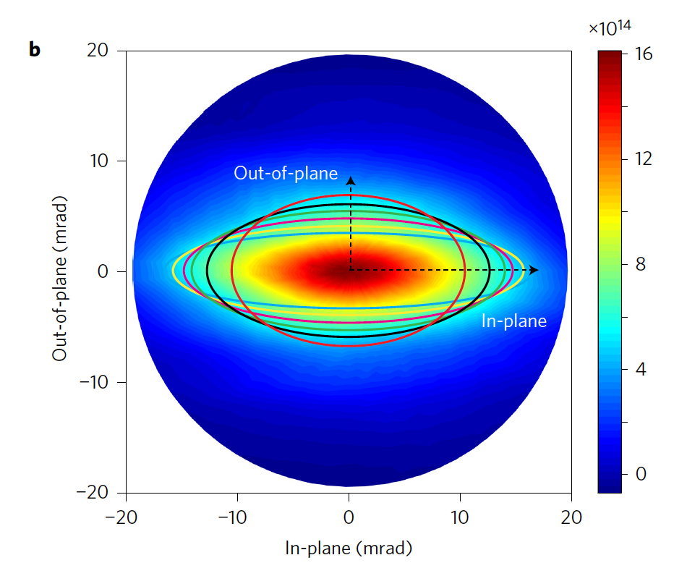


Scientific rationale
An electron oscillating in an intense laser field (dimensionless intensity ξ > 1) undergoes non-linear Thomson scattering
In a linearly polarized laser pulse, the cone angle of photon emission is and in the directions parallel and perpendicular to the laser polarization axis, respectively.
This leads to an elliptic transverse distribution of the gamma-ray beam, with the ellipticity being equal to the laser intensity experienced by the electron at the moment of emission.
$θ_{||}\sim ξ/γ_{e}$
$θ_{⊥}\sim 1/γ_{e}$
Simulation of the divergence of x-rays emitted during the interaction of 200 MeV e- interacting with a laser with x = 10.5. From
G. Sarri et al., Phys. Rev. Lett. (2014)
O. Har-Shemesh, and A. Di Piazza, A. Opt. Lett. (2012).
W. Yan et al., Nat. Phot. (2017)
LUXE simulation meeting 31/08/2021

Slide 3
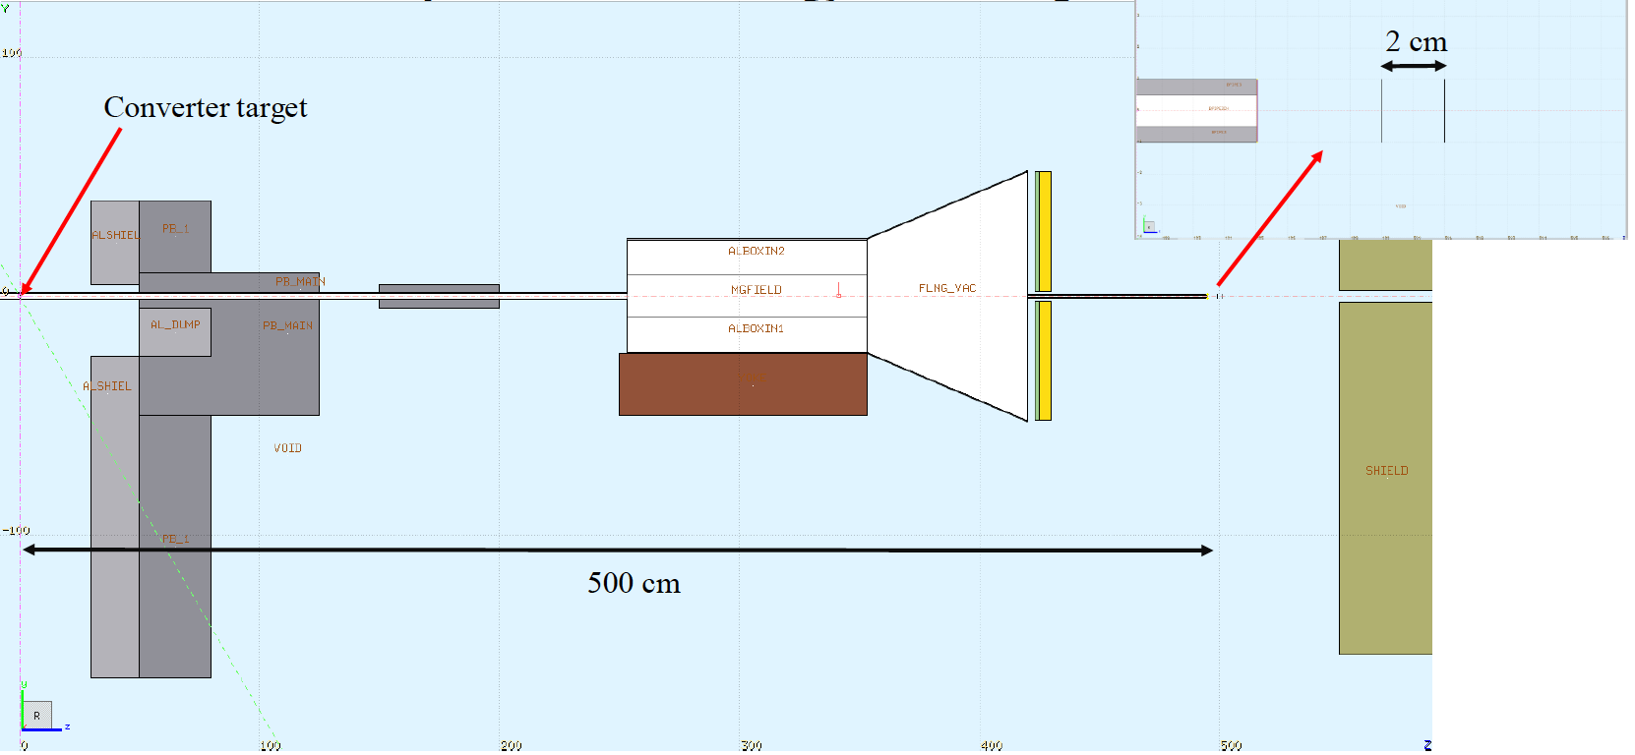
Proposed setup
The main purpose of a gamma-ray profiler is to provide the energy-integrated transverse distribution of the gamma-ray beam, either produced during Compton scattering or bremsstrahlung.
In the Compton-scattering case, the intention is to extract the normalized vector potential at the interaction point, by looking at the ellipticity of the gamma-ray beam (valid for a₀>1)
E_{e-} : 16.5 GeV
D_{e-}: 5 μm
θ_{e-} : 10 μrad
a₀ ~ 1 – 5
distance profiler: 11.5 m
Photon divergence: 30 x 150 μrad. ➔ Beam size at the profiler: 0.34 x 1.72 mm
LUXE simulation meeting 31/08/2021

Slide 4
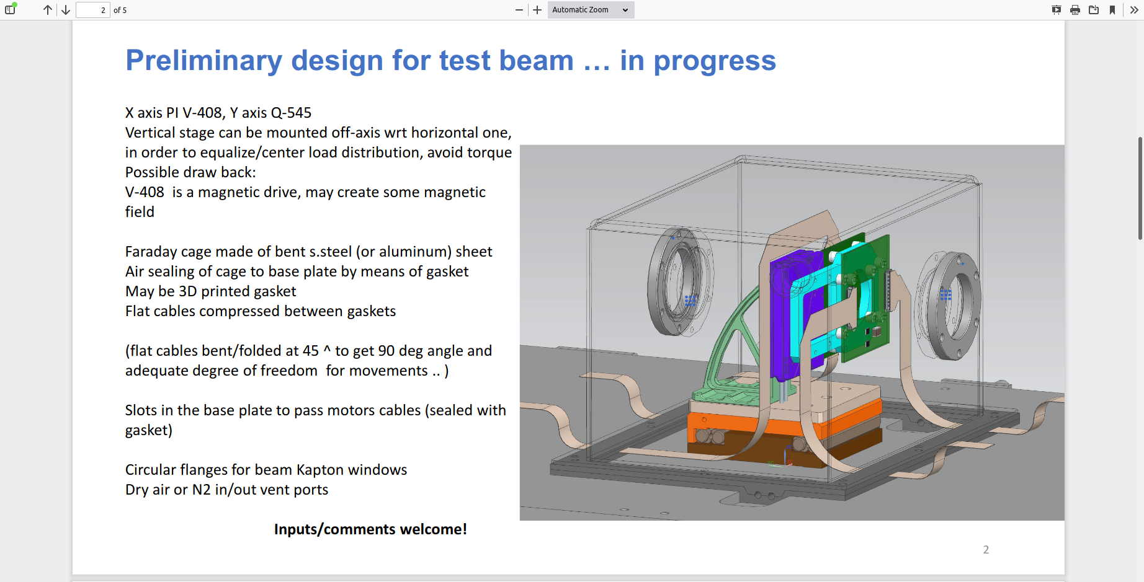
Prototype
- Full Monte-Carlo model of the detector’s response almost completed
(mostly thanks to Kyle, Sasha, and Antonio!)
Expected >pC charge per bunch crossing
For a 5% precision in retrieving the intensity, a ~ 5 μm spatial resolution is needed.
Test-beam proposals currently being evaluated by the group
LUXE simulation meeting 31/08/2021

Slide 5

Data analysis (no RR)
- Let us assume that the gamma-ray beam has a divergence of θ_{par} and θ_{perp} along the
directions parallel and perpendicular to the laser polarization.
- In the direction perpendicular to the laser polarization: θ_{perp} ~$\sqrt{{\text{q}}_{e}^{2}+1/γ^{2}}$
If the electron energy is known, this can be used to infer${ \text{q}}_{e}^{}\sim \sqrt{{\text{q}}_{perp}^{2} −1/γ^{2}}$
Then the maximum angle of electron emission is related to the laser intensity (neglecting RR effects) by:
Where ${ \text{q}}_{m}^{}\sim \frac{1}{2}\sqrt{{\text{q}}_{par}^{2} −{\text{q}}_{e}^{2}}$
The uncertainty in the intensity can then be estimated as:
O. Har-Shemesh and A. Di Piazza, Opt. Lett. 37, 1352 (2012)
LUXE simulation meeting 31/08/2021

Slide 6
Data analysis (with RR)
A model-independent method of extracting a₀ has been proposed by Tom and others:
where <γ> represent the average Lorentz factor of the electrons before and after interaction, and the σs are the standard deviations of the beam parallel and perpendicular to the laser polarization.
T. Blackburn et al., PRAB 23, 064001 (2020)
LUXE simulation meeting 31/08/2021

Slide 7
Thanks for your attention!
Gianluca Sarri
g.sarri@qub.ac.uk

