Slide 1
Gamma Group Meeting
Check-in
News: H.E.S.S. extension, ERC procedure
Working in Corona times
Group retreat / Betriebsausflug 23 September 2021

Slide 2
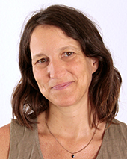
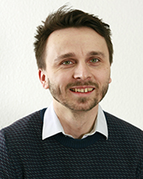
News
H.E.S.S. operations extended by 2 years (September 2024)
Smooth sailing operations only
DESY group by end of ‘22: 11 → 4 authors
Inline with a general push from end of next year on at the latest to focus even more on CTA
New DESY ERC procedure: Expression of Interest form for potential future grantees, deadline 13 September, DESY workshop planned to support goods candidates (October)
New permanent staff members of our group: Emma de Oña Wilhelmi and Merlin Barschke

Slide 3
News
New postdocs: Shashank Kumar, Sonal Patel, Constantin Steppa, Andrea Porelli (shuffle TAIGA → ULTRASAT), Tim Holch
New PhDs: Jonas Sinapius (DESY, variable blazars), Jowita Borowska (HUB, HESS + optical), Tim Geffke (HUB, MeVCube)
Maria Haupt back from maternity leave

Slide 4
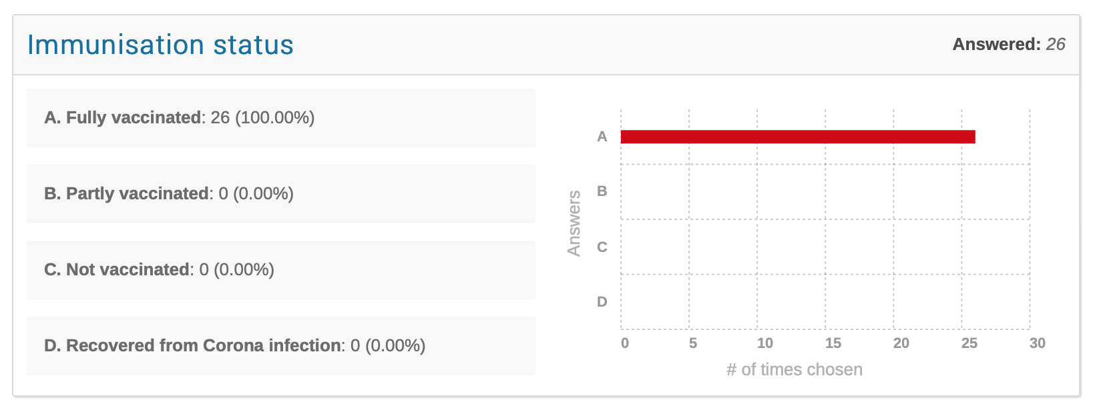
Survey
URL https://indico.desy.de/event/31270/
Results:

Slide 5
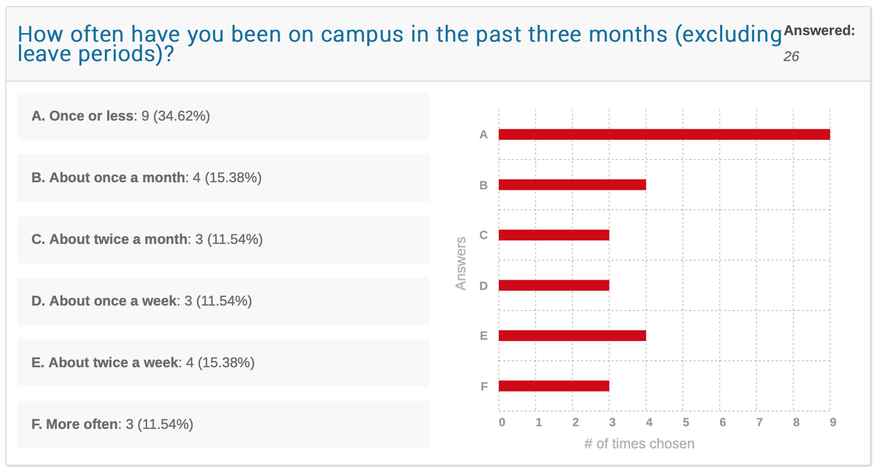

Slide 6
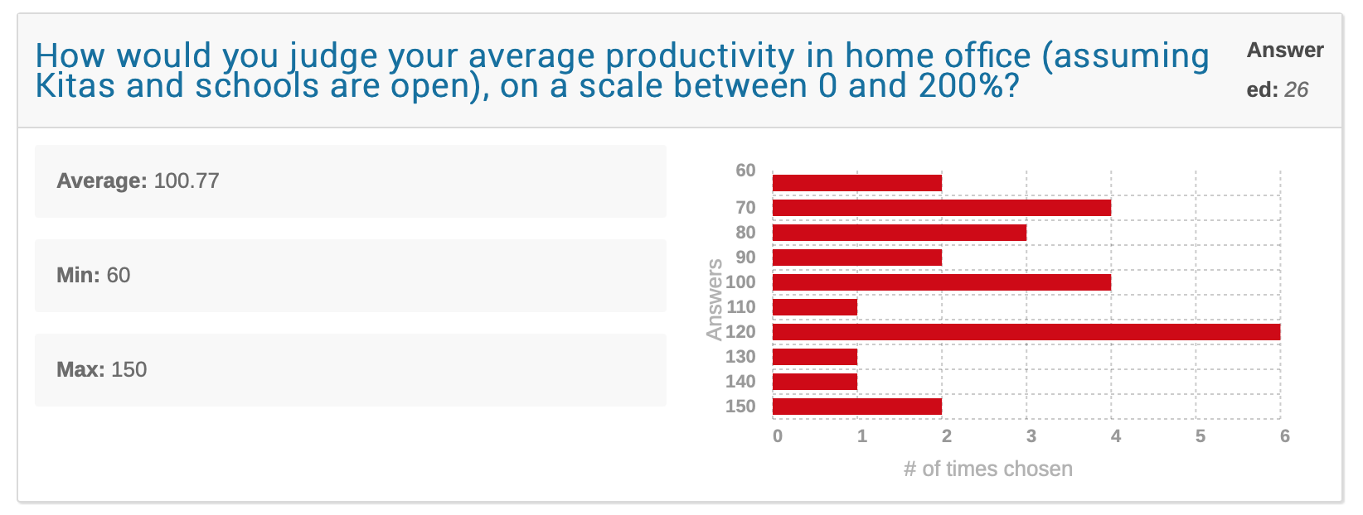

Slide 7
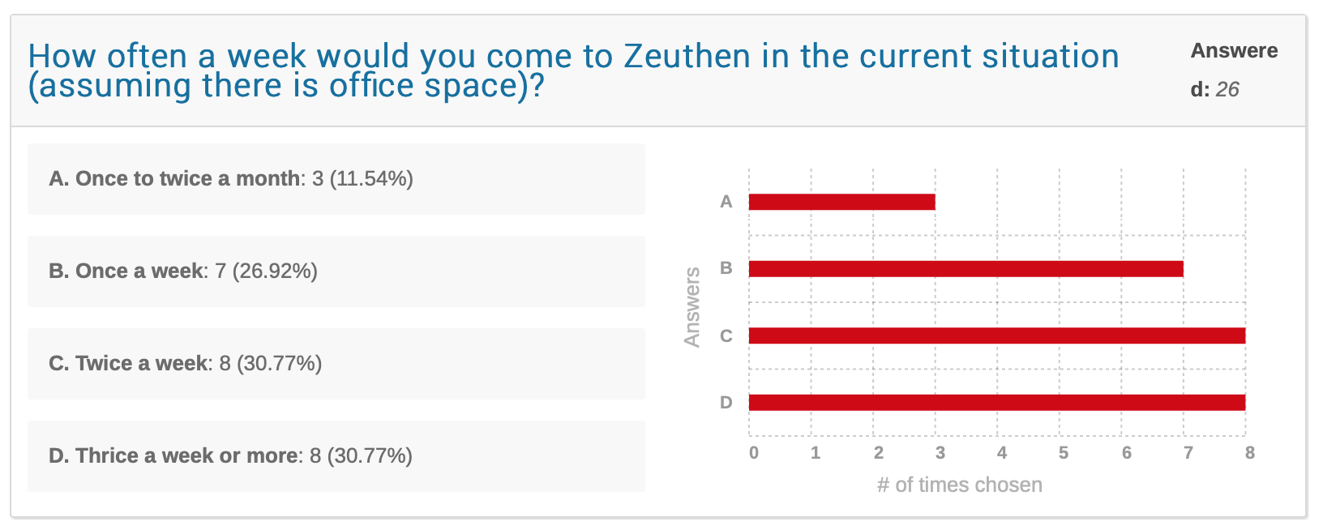

Slide 8
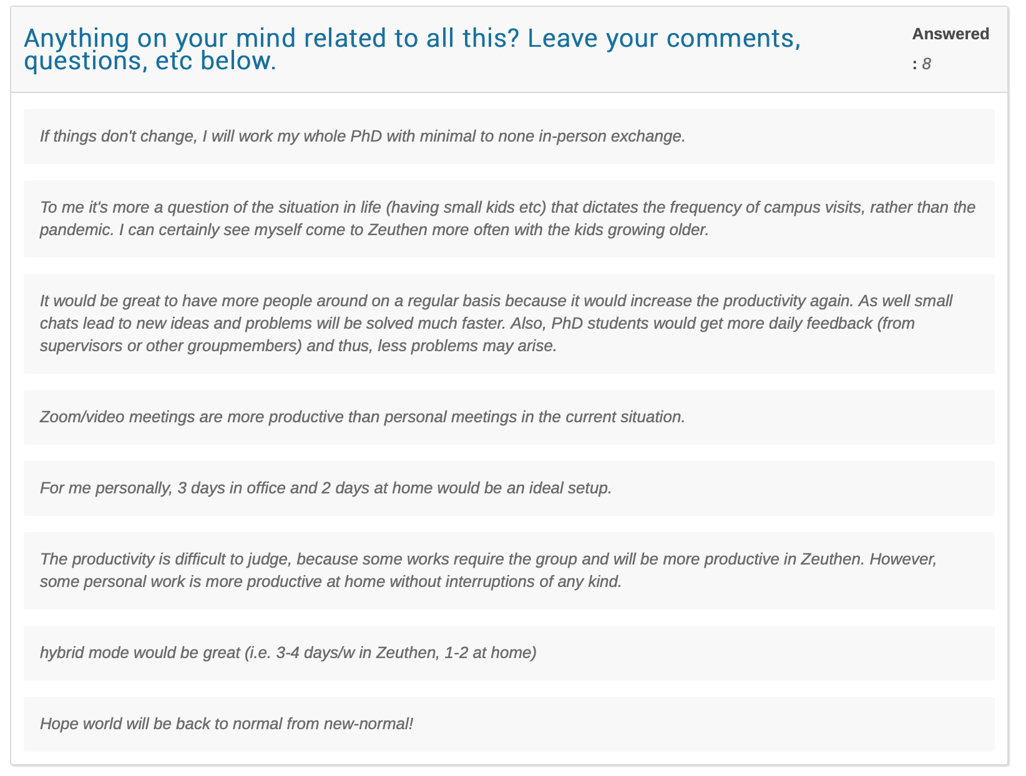

Slide 9
Working in Corona times
Essential to increase on-campus work ‘a little bit’
From my perspective, and the other staff researchers I talked to, we should establish a new Gamma group ’best practise’ of ~ 2 days a week on campus so that we start seeing each other again
Mandatory to make sure not to exclude people in home office from group meetings: have to stick to Zoom or hybrid meetings for regular events *if* not everyone directly involved on Campus
Of course, nothing against enjoying a meeting at the lake in person for something important and then offline persons are updated later, but make sure that in general you find ways to be inclusive
Main complication is the office space, the current rules are:
1 person per office (<= 20 sqm)
2 or more persons in offices possible for > 20 sqm; masks or air filters mandatory in these cases, plus frequent ventilation

Slide 10
Work mode suggestion
We need a real plan now, just stopping by and grab a free office won’t easily work if more of us come to Zeuthen
We will distribute the ca. 10 available air filters over the entire institute’s large offices
I will talk to activity leaders (CTA MST, MC, SST, HESS, VERITAS, ULTRASAT) about 1 fixed presence day a week
We can then look at the office situation on these days and suggest a regular plan
For now, we keep using the presence table at https://confluence.desy.de/display/DESYAstroparticle/Presence+table
Arrange / agree with each other please until we have a new suggestion (next week?)

Slide 11
Group retreat / Betriebsausflug
DESY-wide day for the restreat is 23 September
Suggestion is to do one for all of Gamma
So far Sonal and I will organise it
We will do a hike together somewhere near Zeuthen and end in the early afternoon with a picknick / lunch

