Slide 1
University of Science and Technology of China
National Synchrotron Radiation Laboratory
MicroTCA.4-based Beam Position Monitor Electronics Design for Storage Ring of HALF
Yu Liang
2021-12-09
10th Virtual MicroTCA Workshop for Industry and Research

Slide 2
Outlines
Introduction of the BPM system
Overall system design
--Hardware
--DSP algorithms
Test
Summary

Slide 3
Introduction of the BPM system
HALF
The Hefei Advanced Light Facility (HALF) is a fourth generation vacuum ultraviolet (VUV) and X-ray diffraction limited storage ring light source and has been under preliminary research since 2017.
Circumference [m] | 480
Energy [GeV] | 2.2
RF Frequency [MHz] | 500
Harmonic Number | 800
Current [mA] | >100
Natural beam emittance [pm• rad] | 85.1
Horizontal beam size [um] | >5
Vertical beam size [um] | >2
The beam orbit should be stable and fluctuates no more than 10% of the beam size
Horizontal: 500nm
Vertical: 200nm
submicron stability demands a beam position monitor (BPM) system with long-term submicron resolution.
DATA TYPE | REQUIREMENT | DESCRIPTION
FA data | 200 nm rms | 10KHz
SA data | 100 nm rms | 10Hz
01

Slide 4
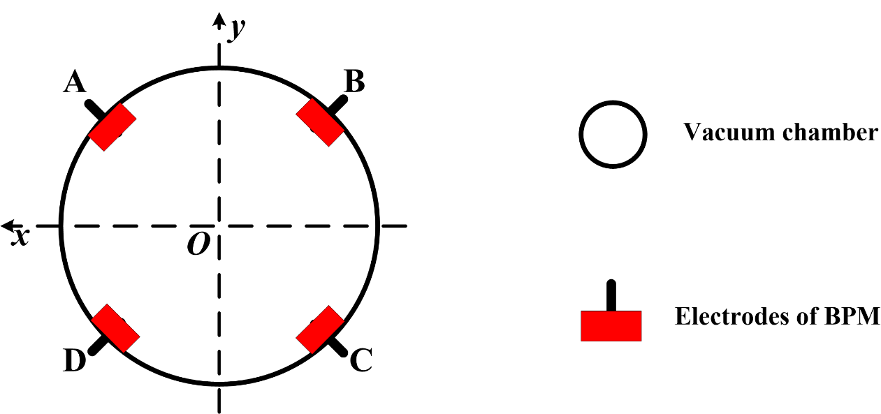
Introduction of the BPM system
Beam position monitor system is composed of BPM detectors, signal processing electronics and data acquisition.
The signals from BPM detectors need to be processed electronically to obtain the position information.
The amplitudes of the four signals reflect the intensity of the beam at the positions of the four BPM electrodes. According to the difference-over-sum($∆/$∑) algorithm, the beam position can be calculated.
02

Slide 5
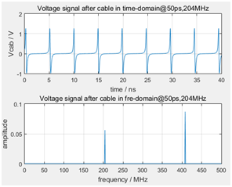
Introduction of the BPM system
HLS II
BPM electronics is designed according to the parameters of HLS II and the beam tests are conducted on the storage ring of HLS II since the HALF is still under preliminary research.
Energy | 800MeV
RF Frequency | 204 MHz
Harmonic Number | 24
Current | 360mA
Circumference | 66m
The beam under test is a narrow pulse with a repetition frequency of 204 MHz. Considering the interference lead by the high frequency cavity of the accelerator, second harmonic(408 MHz) is chosen as the input signal to calculate beam position.
03

Slide 6
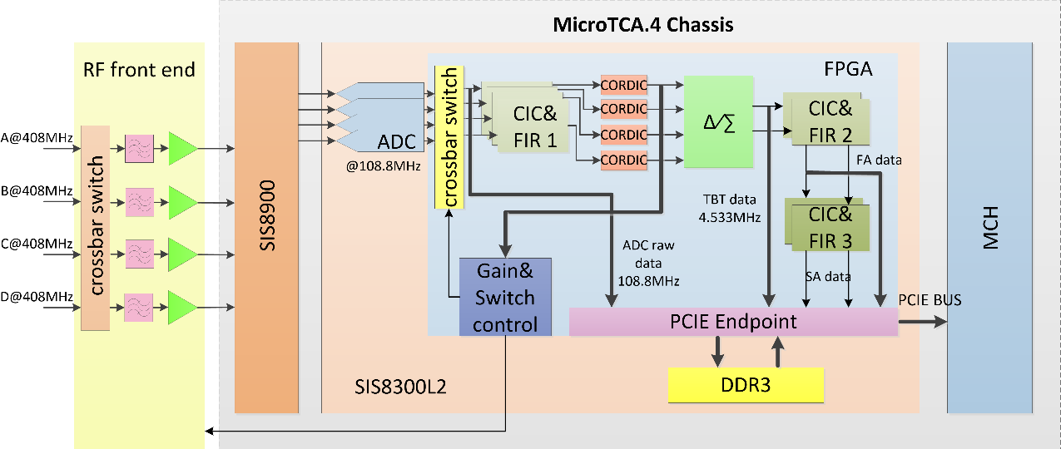
Overall system design
an MicroTCA.4 module
--a chassis
--a power supply
--SIS8900
--SIS8300L2
…
a customized RF front end module
a frequency synthesizer
RF front end
adjustable gain → increase the dynamic range
crossbar switches → eliminate the gain drift of individual channel
ADC
IQ sampling scheme
digital signal processing (DSP)
FPGA → filtering, decimation, CORDIC algorithm, difference-over-sum algorithm…
04

Slide 7
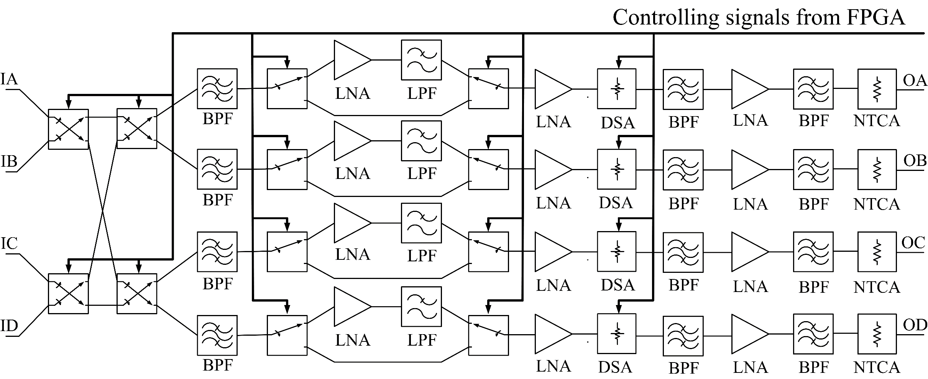
Overall system design -- hardware
RF front end module
customized to adjust the signals from the four BPM electrodes before the SIS8900 RTM card
composed of a crossbar switch and four identical RF channels
manufactured using a FR-4 laminate of four layers
housed in an Al enclosure for the electromagnetic shielding
05

Slide 8
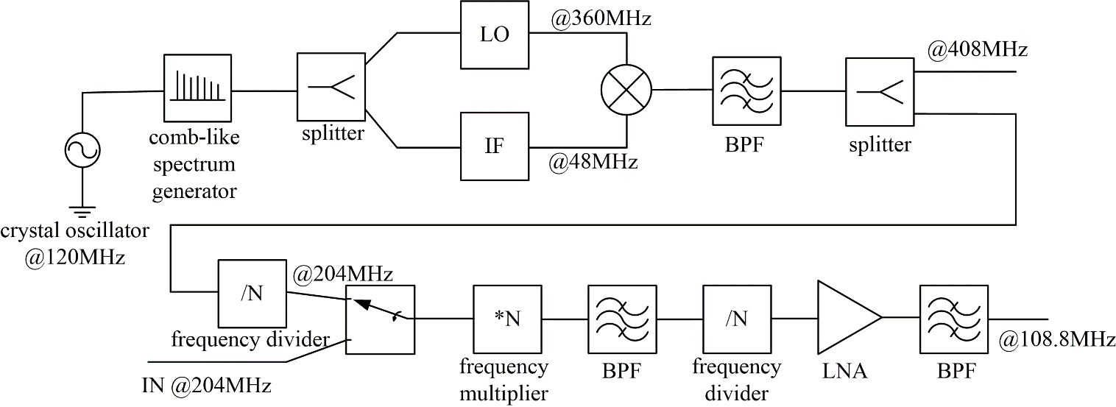
Overall system design -- hardware
Frequency synthesizer
a low jitter ADC clock signal for the BPM electronics
a 408 MHz RF signal for offline tests
External and Internal reference signals
06

Slide 9
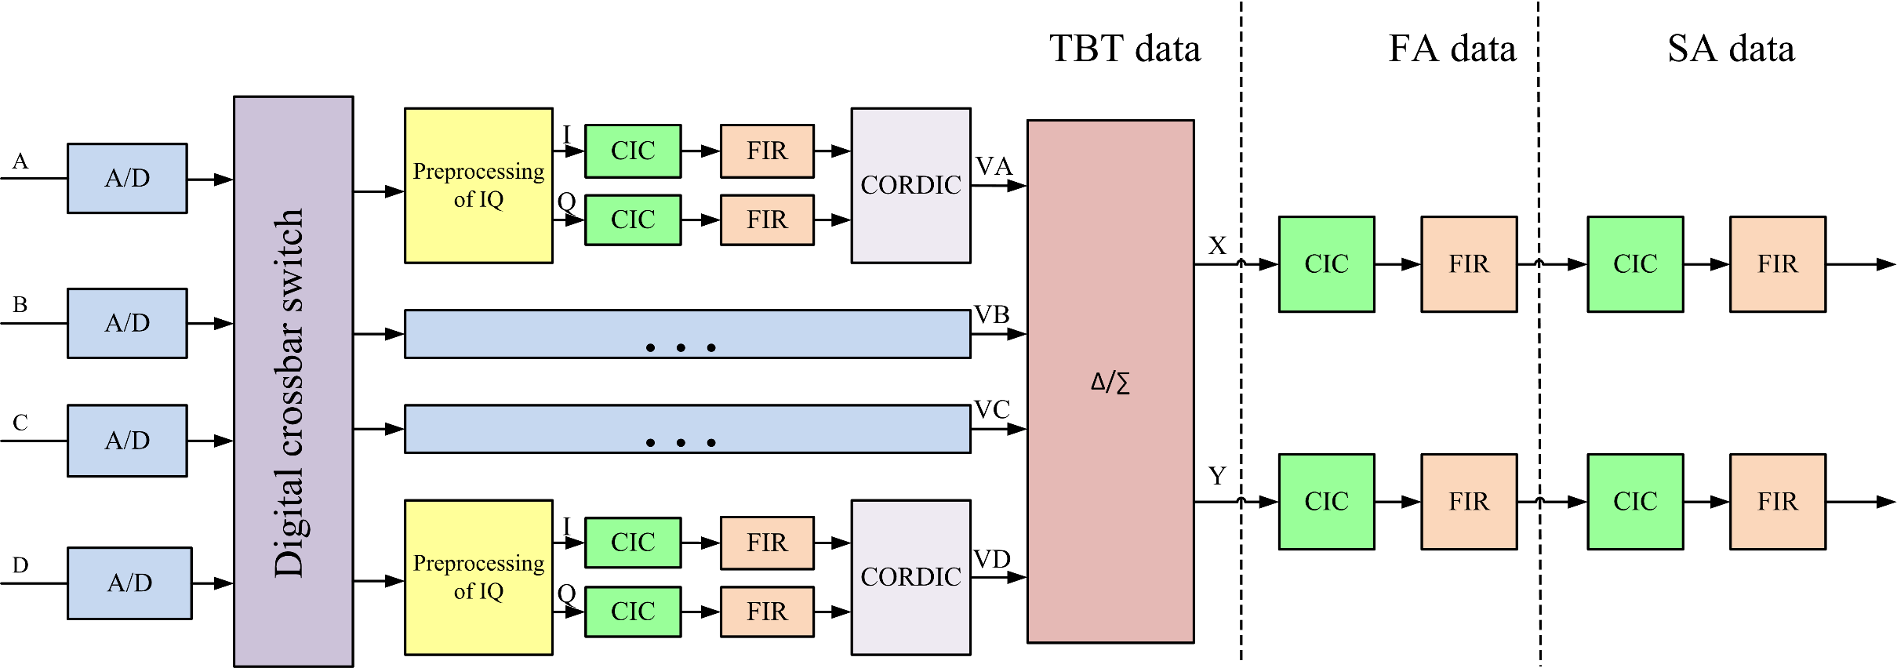
Overall system design -- DSP algorithm
DSP algorithm
A digital switch : redirects the four permuted signals back to their original channel orders
Preprocessing of ADC raw data : obtain IQ orthogonal streams
Filtering and decimation (CIC & FIR filters) : avoid the high-frequency component aliasing
CORDIC algorithm : calculate the signal amplitudes
Difference-over-sum algorithm : calculate the beam position
07

Slide 10
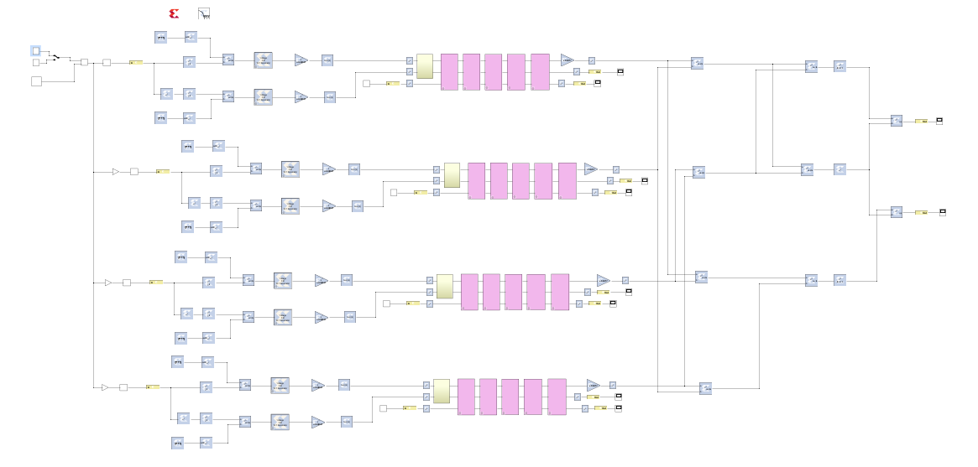
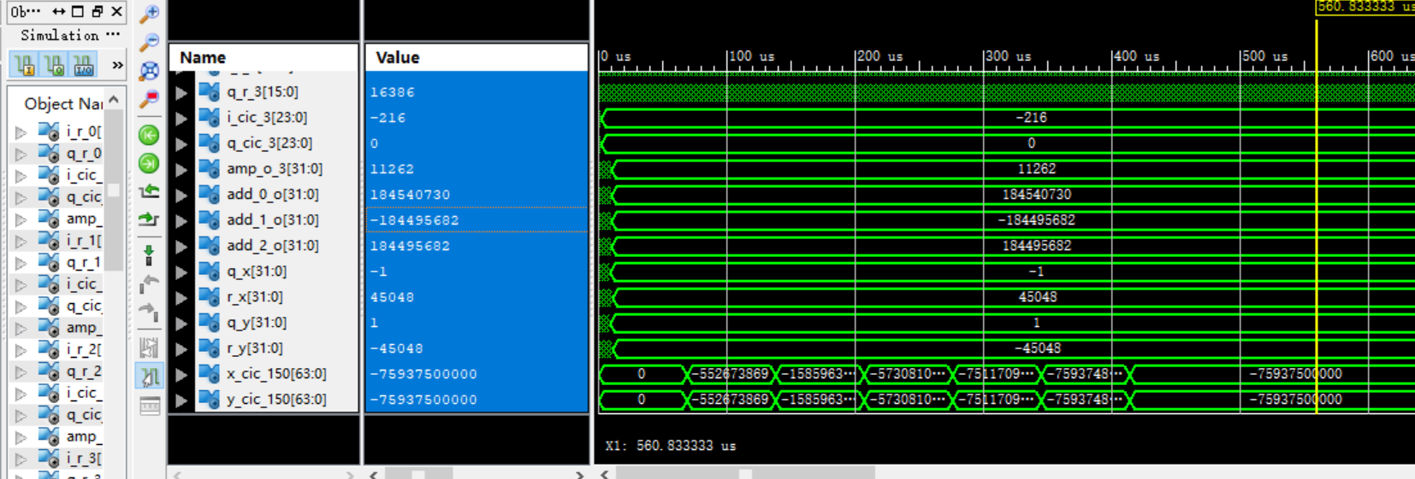
Overall system design -- DSP algorithm
Implement of DSP algorithm
Overall design in Simulink
Results of function simulation
08

Slide 11
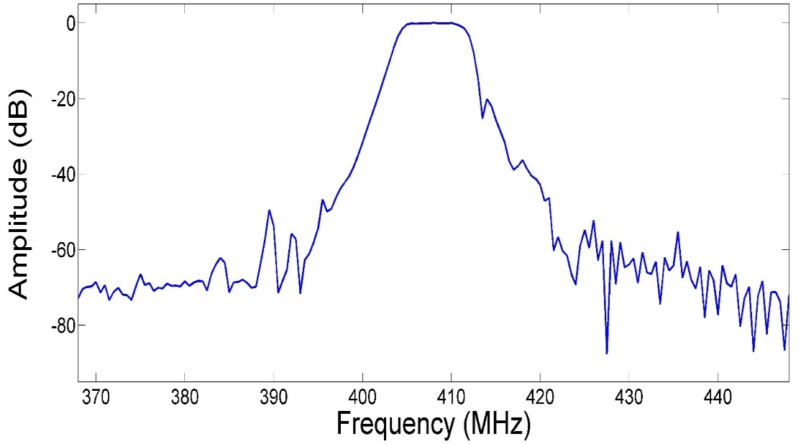
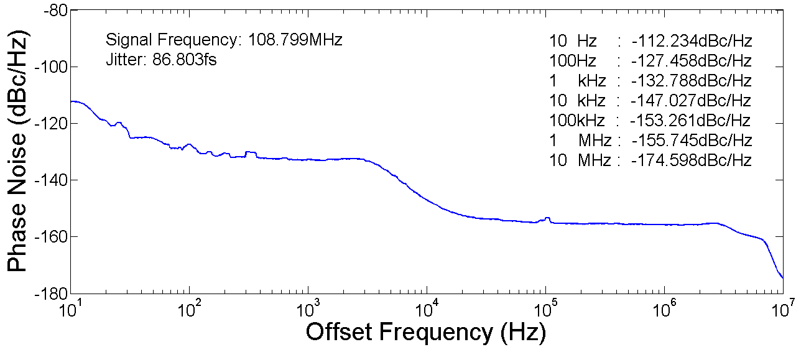
Test – bench test
Bench test --RF front-end & frequency synthesizer
The S21 parameters of the RF front-end channel (368MHz to 448MHz) and the out-of-band suppression is better than 65dB .
The ADC clock RMS jitter of frequency synthesizer (10~10M Hz) is 86.8 fs
09

Slide 12
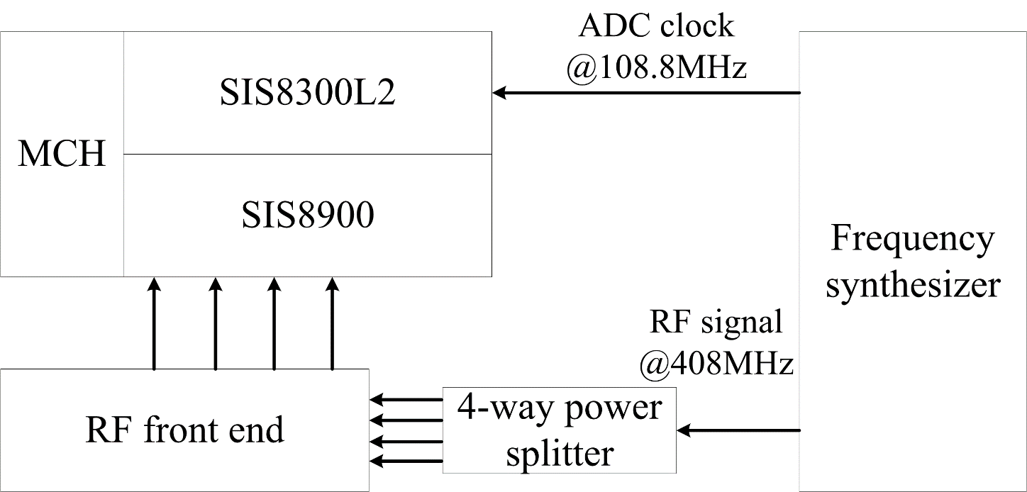
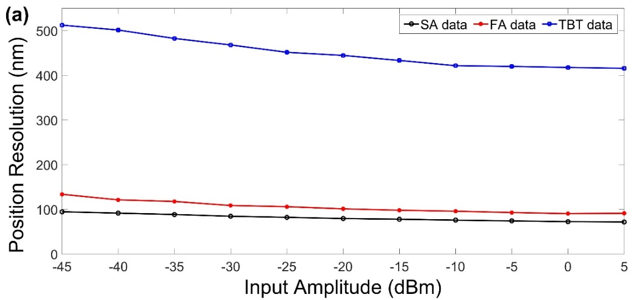
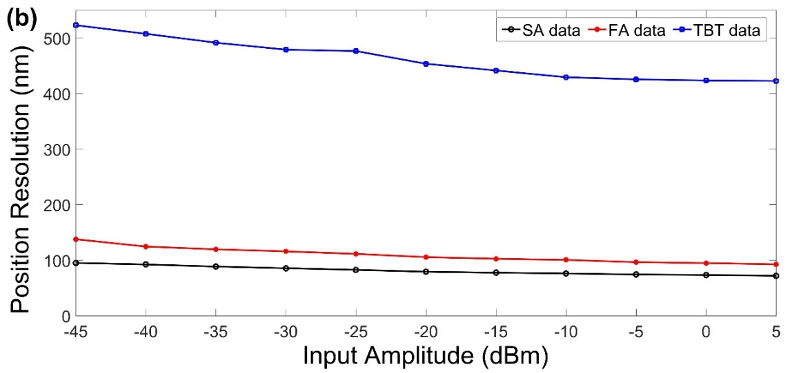
Test -- offline test
Test system:
The RF signal at 408MHz and ADC clock at 108.8MHz are generated by a frequency synthesizer. The RF signal is split into four by a power splitter and then feed as input signals into the RF front end. The 108.8MHz ADC clock is sent directly to SIS8300L2.
with the position coefficients Kx, Ky are set to 10mm, the TBT data resolution is better than 600nm, the FA data resolution and the SA data resolution are better than 150 nm, 100 nm respectively.
10

Slide 13
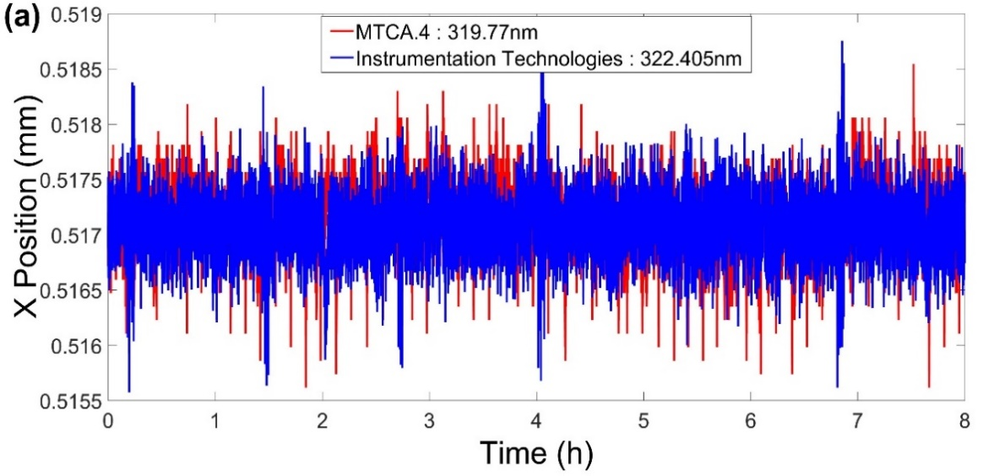
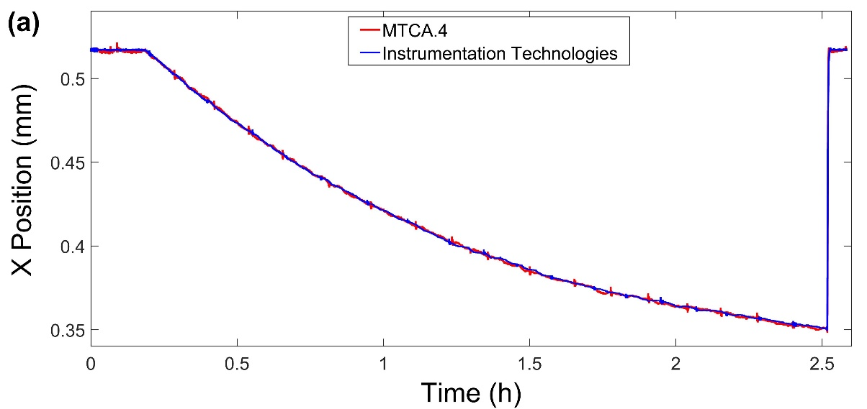
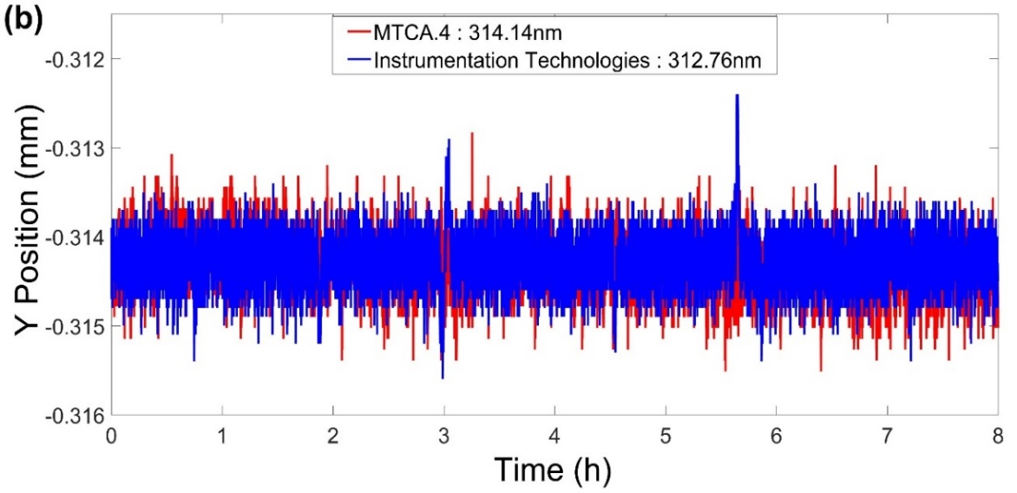
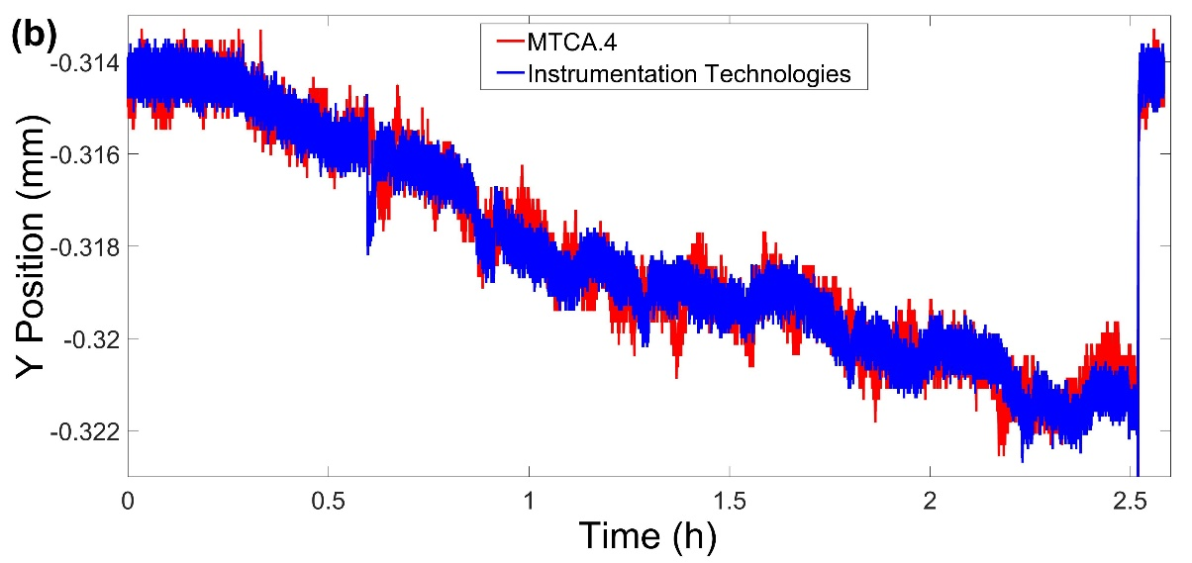
Test – beam test
with the slow orbit feedback system on
with the slow orbit feedback system off
Kx and Ky of HLS II storage ring is 20.088mm and 16.381mm respectively
11

Slide 14
Summary
1.Overall system design has been completed
--Hardware
SIS8900 & SIS8300L2
Customized RF front-end
Frequency synthesizer
--DSP algorithm
Filtering & decimation
CORDIC algorithm
difference-over-sum algorithm
2.Long-time position resolution test
FA data resolution and SA data resolution are better than 150 nm, 100 nm respectively
3. Beam test based on the storage ring of HLS II
12

Slide 15
Thank you for your attention！

