Slide 1
XFEL operation statistics
Hands on and some background
Raimund Kammering
Hamburg, 28. Sep. 2021

Slide 2
Outline
How it started
From the initial idee, to …
the early days at FLASH
Some technical background
The TTFelog
XSLT and such ugly stuff
The modern days
From first elogbook based statistics at FLASH to
these days statistics at XFEL
Operators: Now it’s your job
What it’s used for
Reports and the Statistics Dashboard
Live presentation
What’s missing
Other statistics
Shortcomings and a look to the future
Questions?

Slide 3
How it started
The very early days
Already for the Tesla Test Facility TTF there was the attempt to follow performance parameters, like:
Downtimes of “NEW” Tesla type cavities, but also
other devices
For tracking cavity performance already in the first days of TTF a Oracle based database (DB) has been set up: the cavity DB
UI interface has been an Oracle based forms application
That days all shift accounting has been done using this Oracle forms, but this was simply getting very clumsy

Slide 4
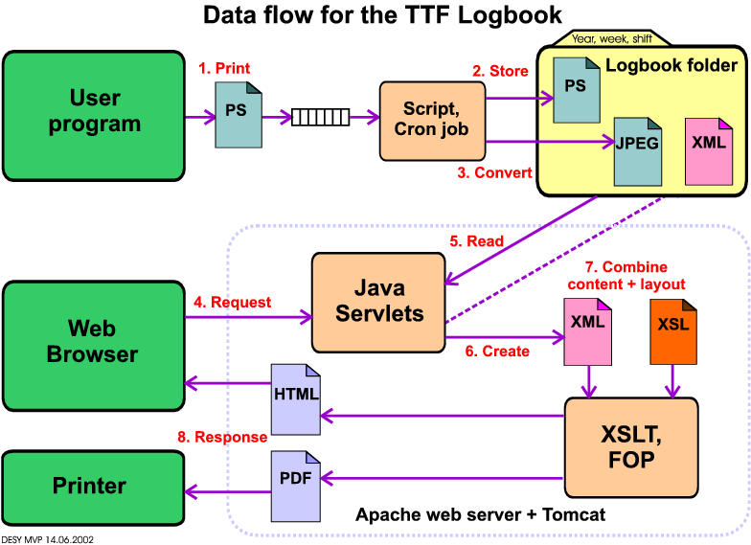
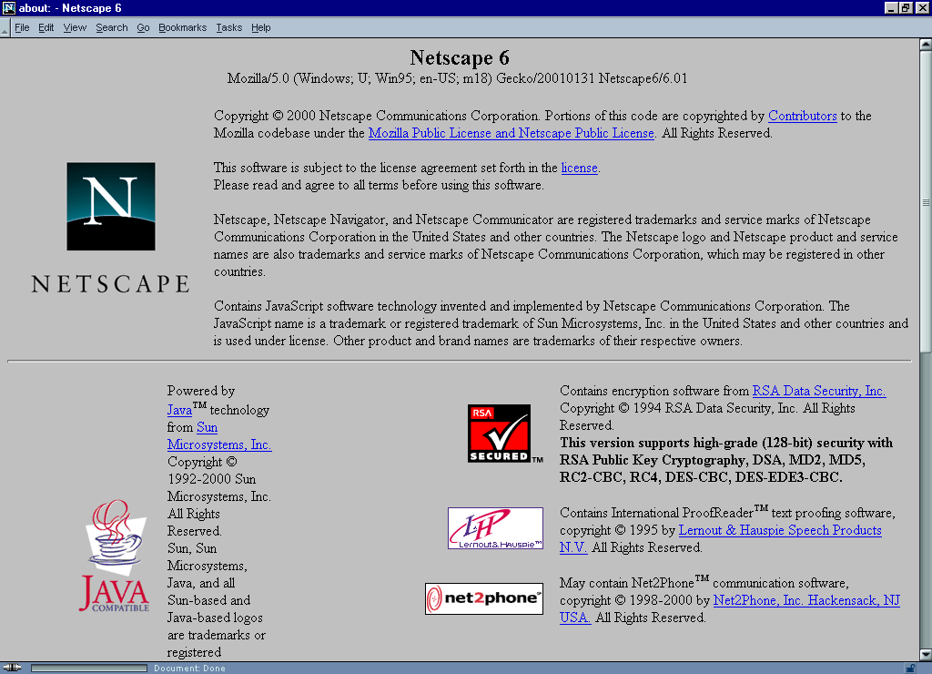
Some technical background
The TTFelog
In 2001 the TTF electronic logbook was born
Idee to more easy and better document actions taken on the facility
Paper based logbooks where hard to maintain and there was strong increase in electronic based controls (remember that days TTF has been operated from Hall 3 extension, with oscilloscopes, …)
Build on the idea of using a printer queue to push content to some service and a web browser to view this content together with the new XML technology

Slide 5
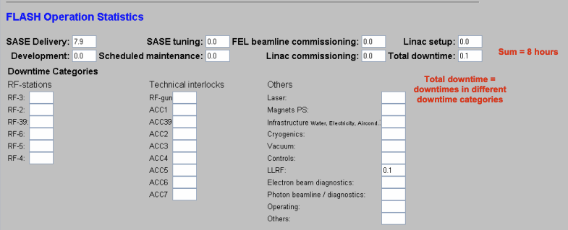
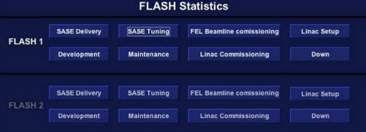
The modern days
From first elogbook based statistics at FLASH to
The initial idea
In general an logbook is meant for logging events, or actions
First ideas to do so using jddd buttons to fire commands to elogbook system to create a timestamped event entry
In cooperation with K. Honkavaara and B. Faatz we developed the first panels and the backend for this approach in - hm was it 2011, or …

Slide 6
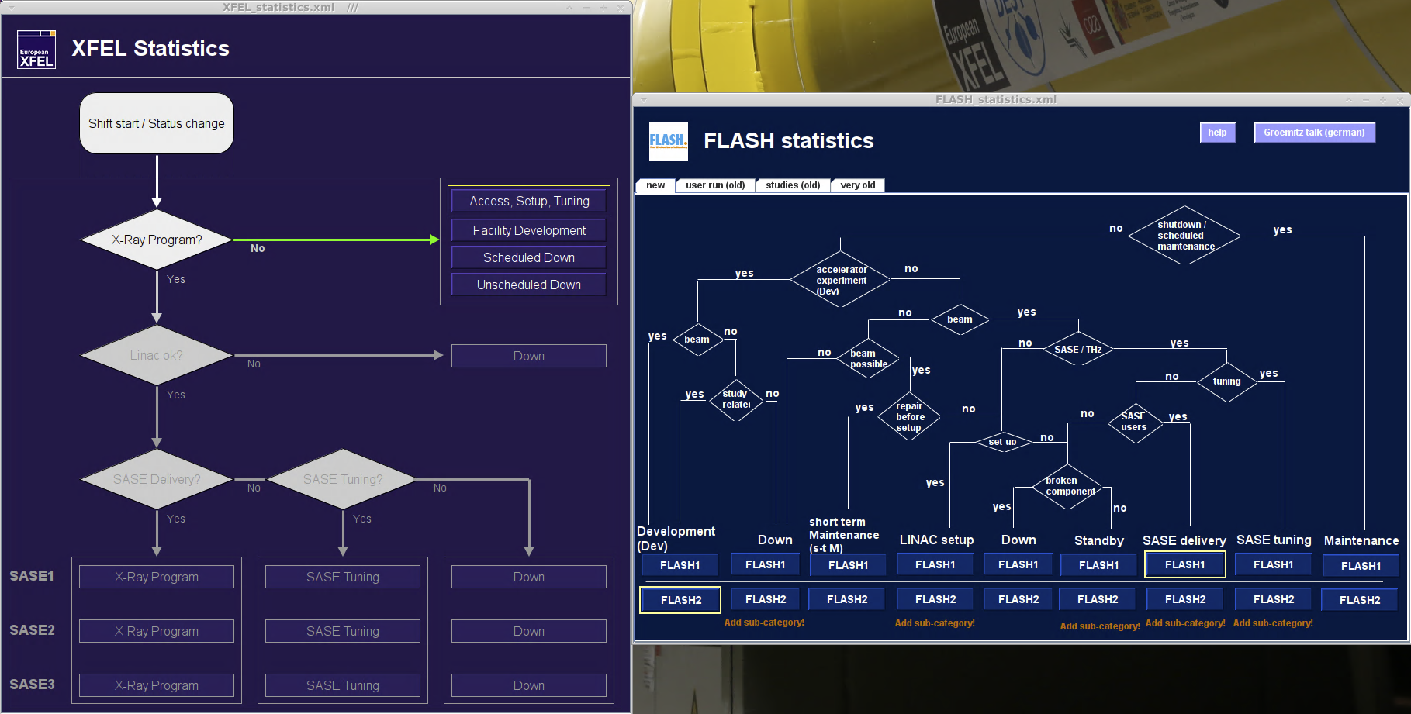
The modern days
these days statistics at XFEL
FLASH and XFEL are technically identical!
Underlaying technique for both is still the same
Much more categories exist at FLASH
K. Honkavaara and J. Rönsch-Schulenburg set up lots of documentation on how to select categories
With XFEL entering x-ray delivery Winni and me consolidated these and reduced the categorization dramatically

Slide 7
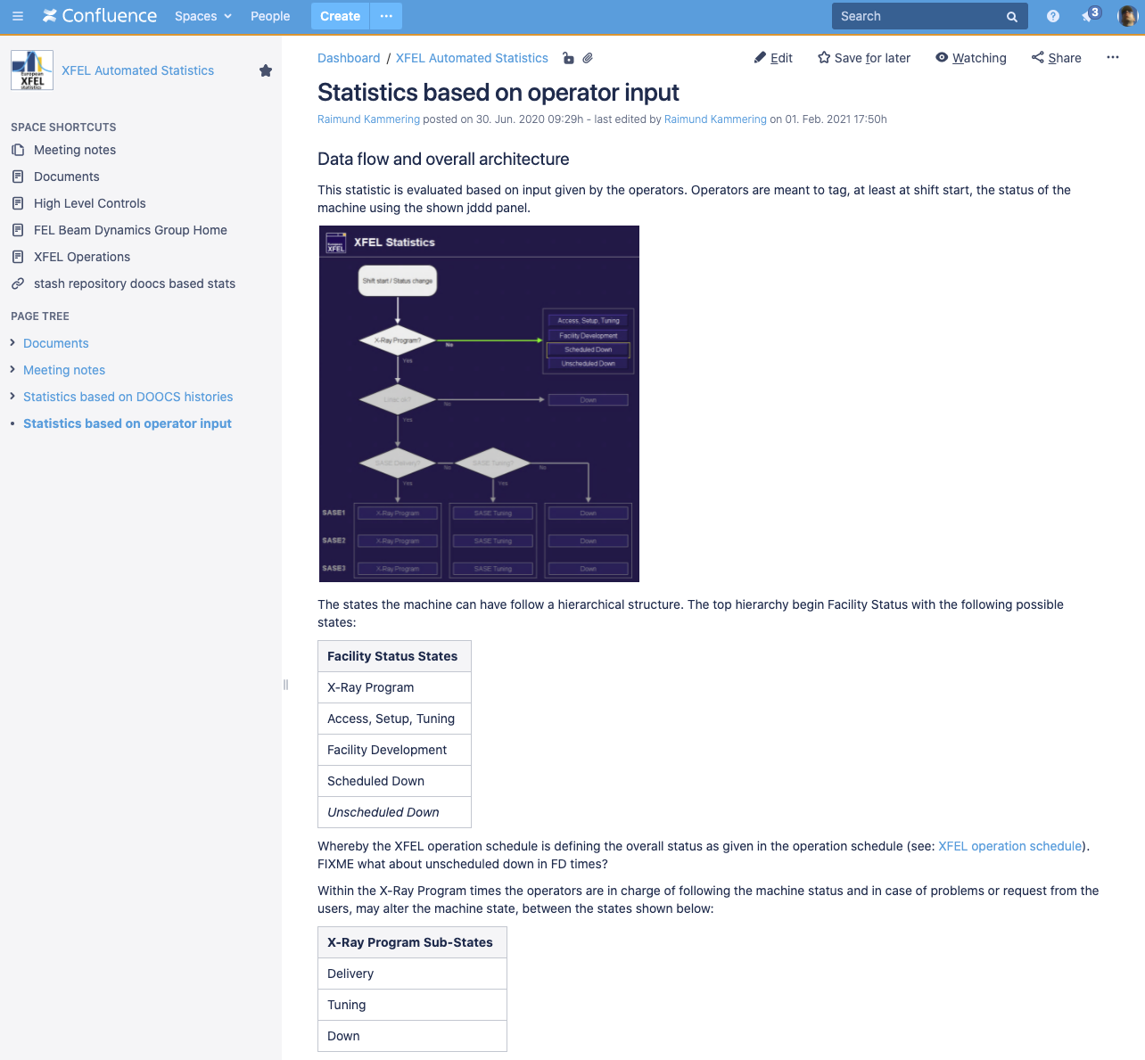
The modern days
these days statistics at XFEL
FLASH and XFEL are technically identical!
Underlaying technique for both is still the same
Much more categories exist at FLASH
K. Honkavaara and J. Rönsch-Schulenburg set up lots of documentation on how to select categories
With XFEL entering x-ray delivery Winni and me consolidated these and reduced the categorization dramatically

Slide 8
The modern days
Operators: Now it’s your job Overview of all categories
Facility Status States automatically derived from Facility schedule
X-Ray Program | Access, Setup, Tuning | Facility Development | Scheduled Down | Unscheduled Down
X-Ray Delivery Sub-States “always two there are” ;) no kidding: 3 possibilities
Delivery | Tuning | Down
Tuning Categories please select one!
not_set | Wavelength_change | Quality | Pointing | Pulse_energy | Special_mode
Down Categories this can be the tricky part
not_set | Beam distribution or dumps | Controls | Coupler Interlocks | Cryogenics | Diagnostics | Experiments | Gun | HPRF
Infrastructure | Laser | LLRF | Magnets | MPS or EPS | Operation | Undulator | Vacuum | Scheduled maintenance

Slide 9
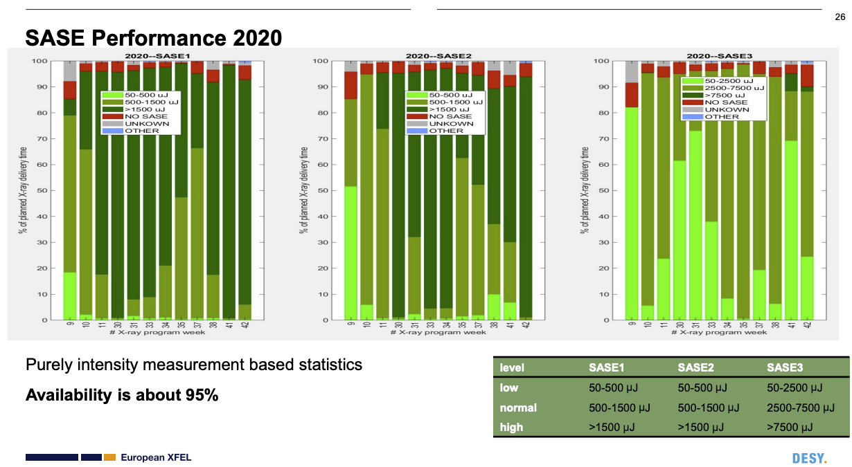
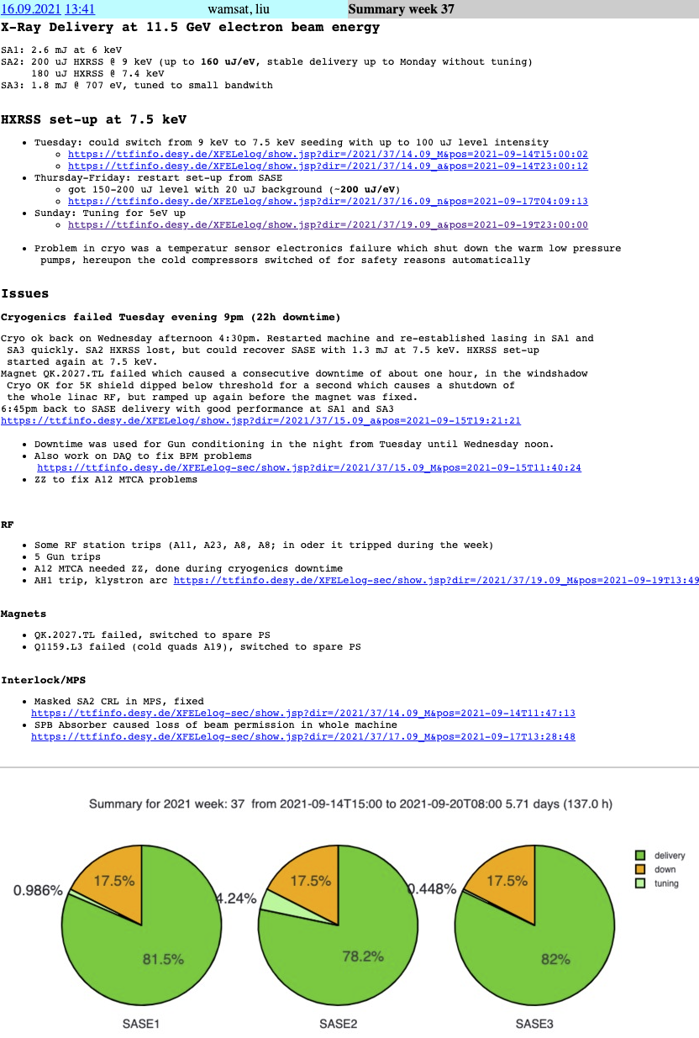
What it’s used for
Reports and the Statistics Dashboard
Reports
hmmm - did not find it in the XFEL MAC reports
FLASH uses this as main figure of merit in terms of availability to be presented in MAC and Betriebsseminar
Dashboard
At least here it is used in the weekly summary
Used Excel download to compare with N. Walker for Linac RF downtimes

Slide 10
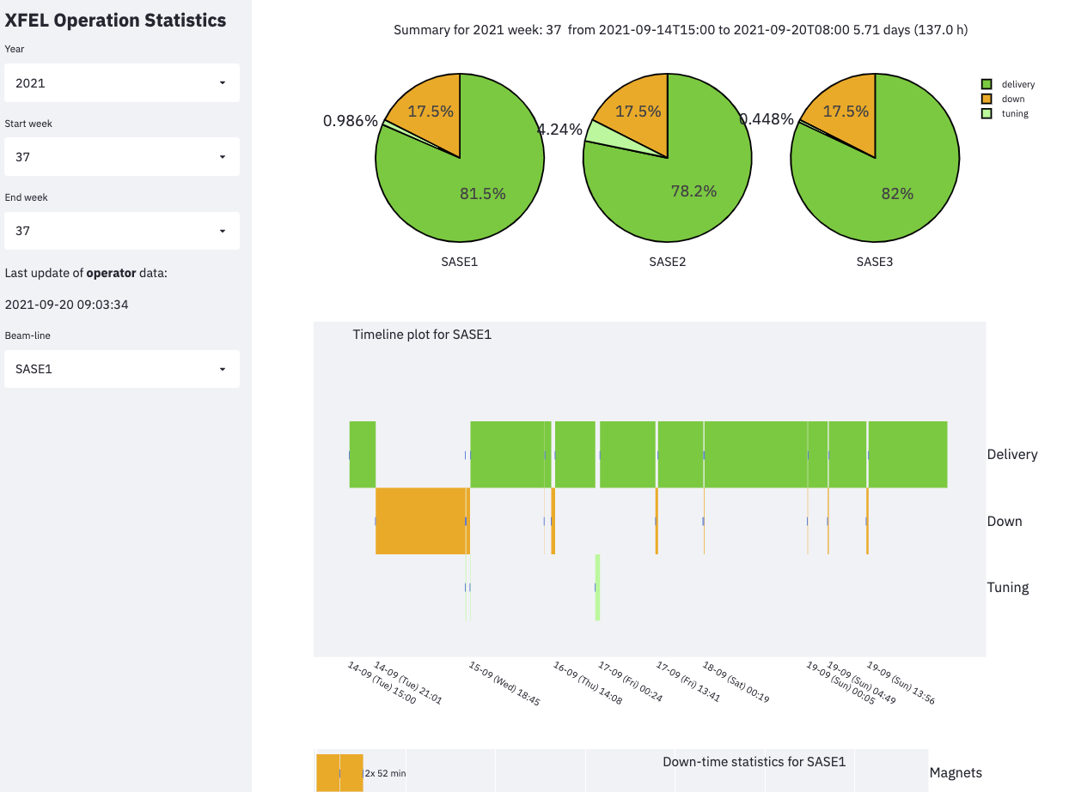
What it’s used for
Reports and the Statistics Dashboard
The Dashboard
Let’s have a look in real live:
https://flashwebsvr3.desy.de/XFEL-Statistics/

Slide 11
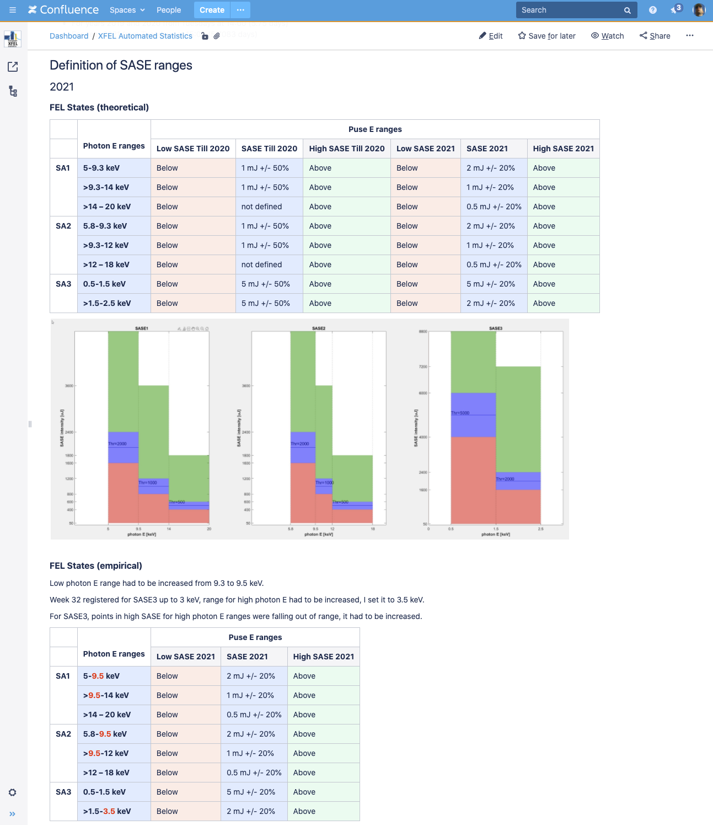
What’s missing
Other statistics
There is a completely different approach using purely XGM intensity based data
Developed by Elena Castro using Matlab
took some time to get into agreement with operator based statistics, but now it’s quite fine
offers much deeper insides into SASE performance, but …
here no details about down and tuning times
well documented in confluence:
https://confluence.desy.de/display/XAS/Statistics+based+on+DOOCS+histories

Slide 12
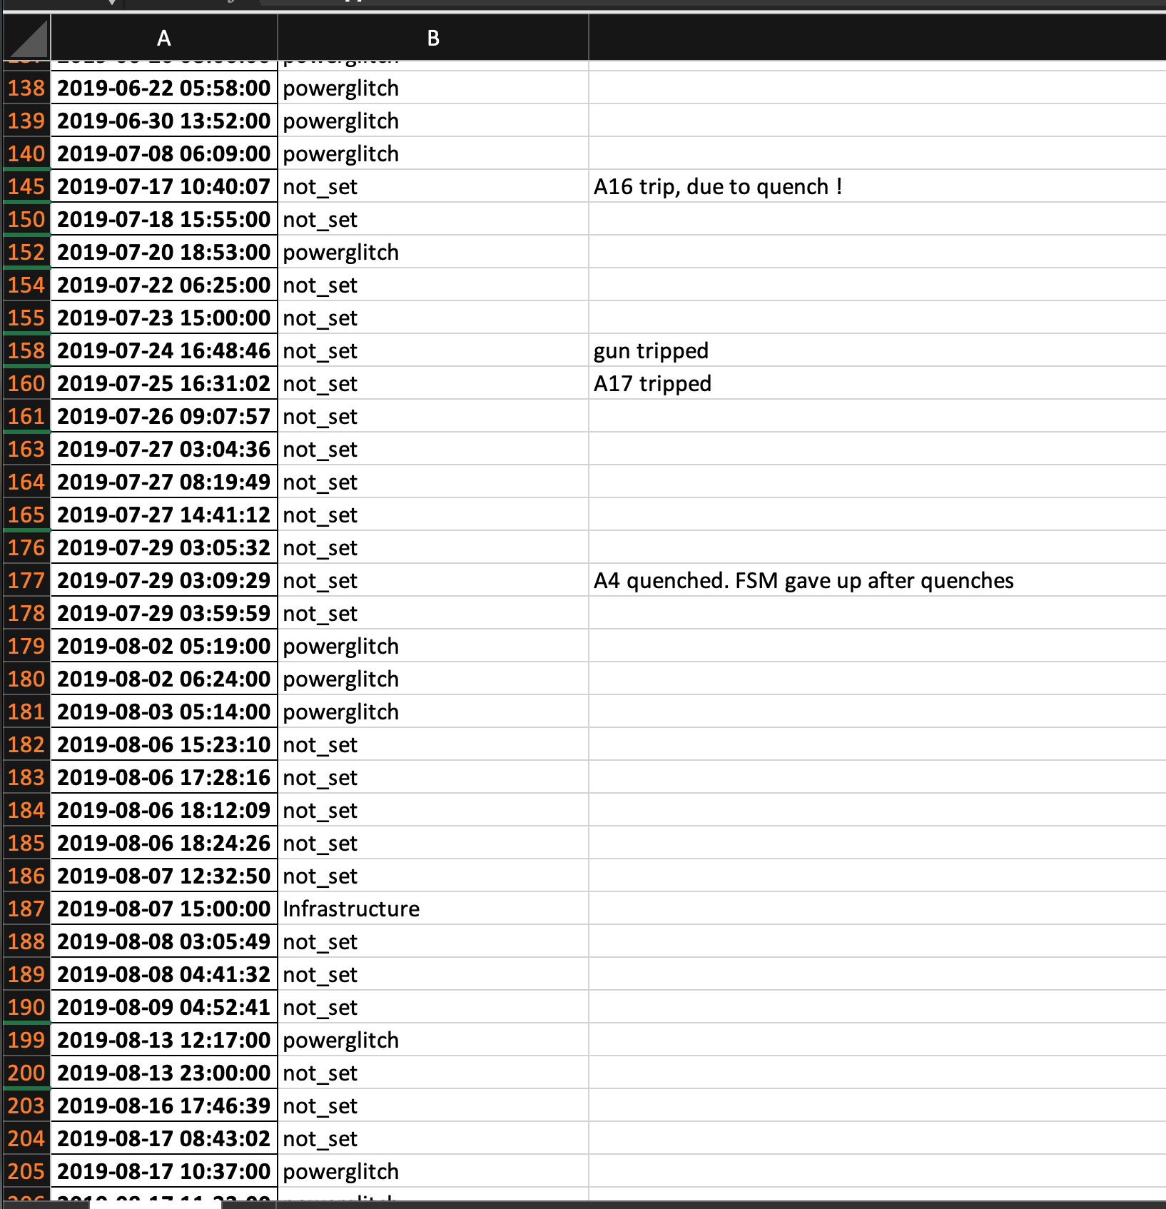
What’s missing
Shortcomings and a look to the future
Just last week question came up
“Are we less suffering from power glitches/cuts?”
Browsed through downtimes looking for
Infrastructure
merged with ‘Netzwischer’ statistics from MKK
tried to match timestamp of ‘Netzwischer’ with down (any category)
This failed completely for 2019, 2020 partly okay for 2021
Reason - just one example:
‘Netzwischer’ on Monday, recovery took 20 h, still not ‘leaking’ into x-ray delivery time → not traceable with this approach!

Slide 13
Thank you for your attention!
Questions/Comments?

