Slide 1
ALBA-I status and ALBA-II proposal
09/11/2021

Slide 2
On behalf of RF group
Jesús Ocampo - jocampo@cells.es
  Cavities and Waveguides
Agustín Gómez- agomez@cells.es
  High power transmitters - IOT & SSPA
Ignasi Bellafont - ibellafont@cells.es
  Beam dynamics
Pol Solans- psolans@cells.es
  LLRF & Coordination

Slide 3
Outline
ALBA-I status
  Incidences
  Tuner manager
  Calibration GUI
  Arc detector issues
ALBA-II proposal
  Main RF system: 500 MHz
  3rd harmonic system: 1.5 GHz
Summary

Slide 4
ALBA-I
Storage ring
Energy
3 GeV
Frequency
500 MHz
Circunference
268.82 m
Booster RF
Nominal current
250 mA
α_{c}
8.8E-4
Synchrotron frequency
8.53 KHz
RF voltage
3 MV
Storage Ring RF
Total losses
1.15 MV
Cavities
NC-HOM RI
Transmitter
2x 80 kW IOT
Booster
Cavities
5-cell PETRA
Transmitter
50 kW SSPA

Slide 5
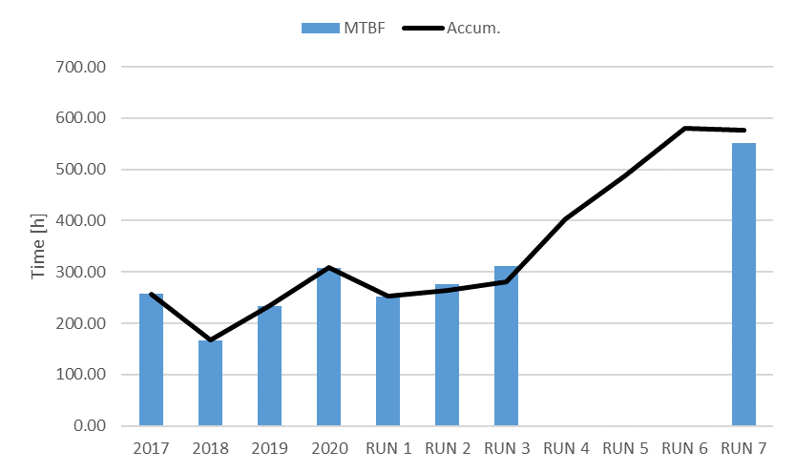
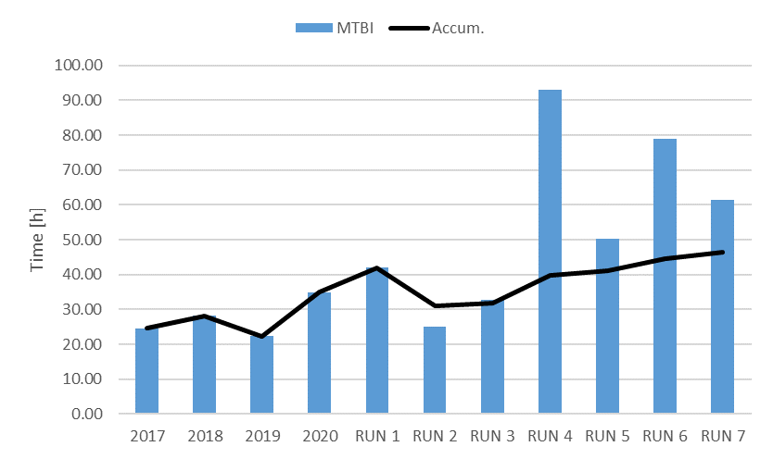
ALBA-I: 2021 incidences
One beam loss due to RF every 550 h.
  RF system calibrated every shutdown.
  2 trips in a row. Python script to tune the cavities after one cavity is lost.
One incidence every 60 h.
  Arcs represents the 65 % of the total amount of incidences.
    Estimation is that 85 % are fake arcs.
    We cannot forget about the real arcs.

Slide 7
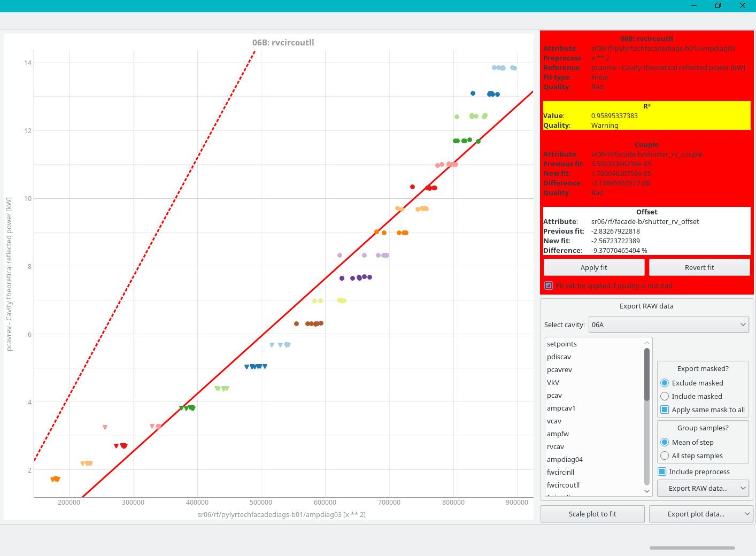
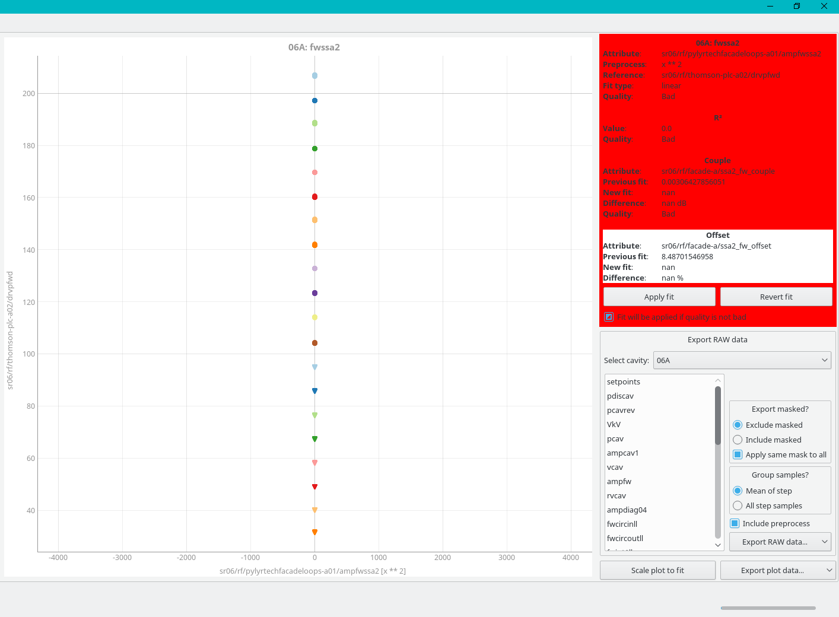
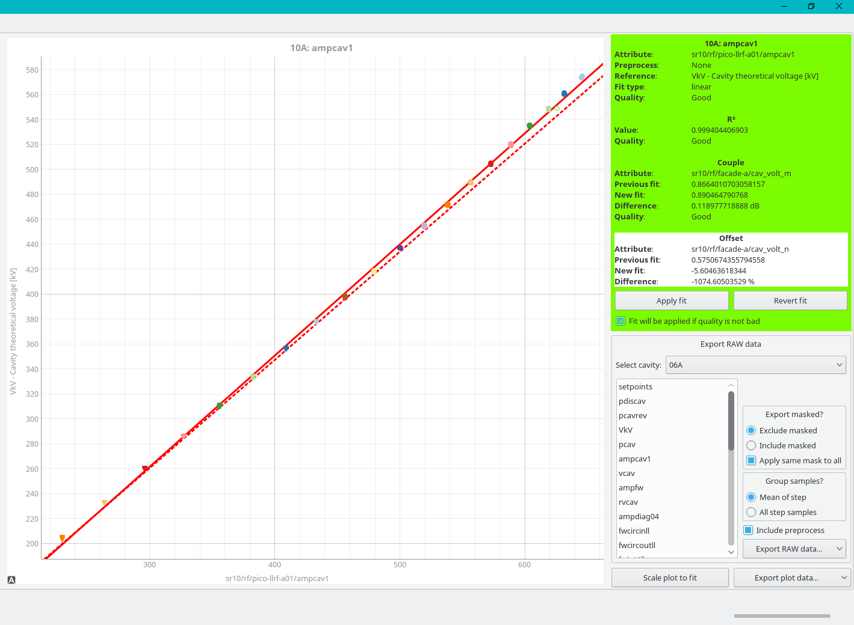
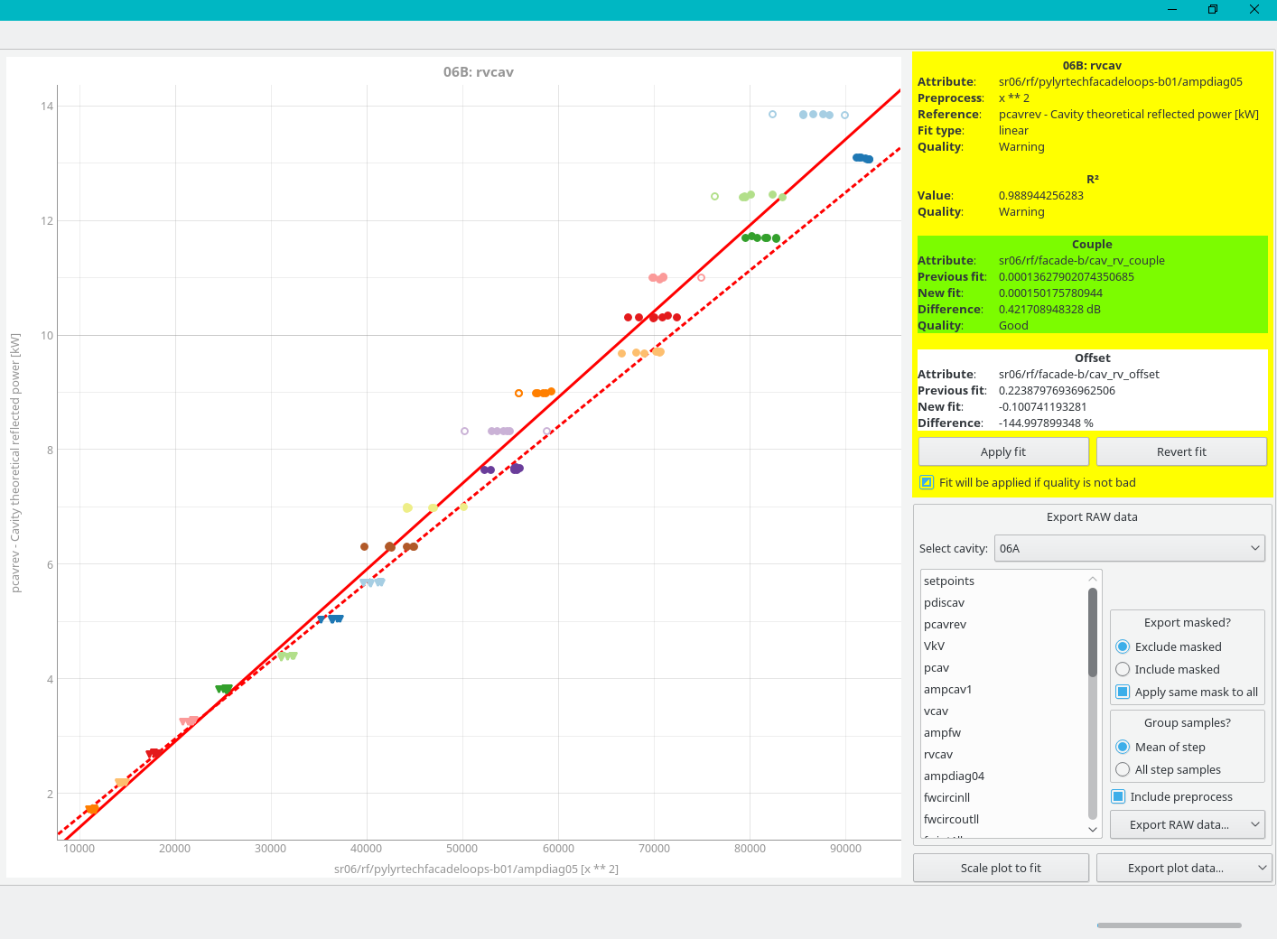
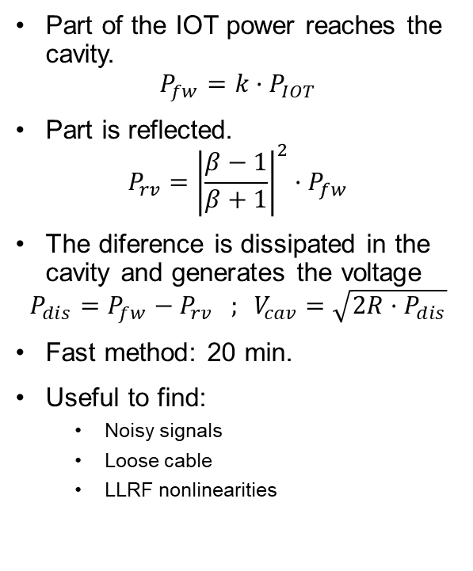
ALBA-I: Calibrations GUI
Part of the IOT power reaches the cavity.
$$P_{fw}=k·P_{IOT}$$
Part is reflected.
$$P_{rv}={\left|\frac{β−1}{β+1}\right|}^{2}·P_{fw}$$
The diference is dissipated in the cavity and generates the voltage
$$P_{dis}=P_{fw}−P_{rv} ; V_{cav}=\sqrt{2R·P_{dis}}$$
Fast method: 20 min.
Useful to find:
  Noisy signals
  Loose cable
  LLRF nonlinearities
Developement: J. Ocampo
BACK

Slide 8
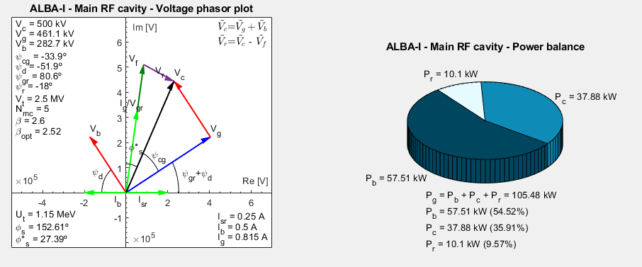
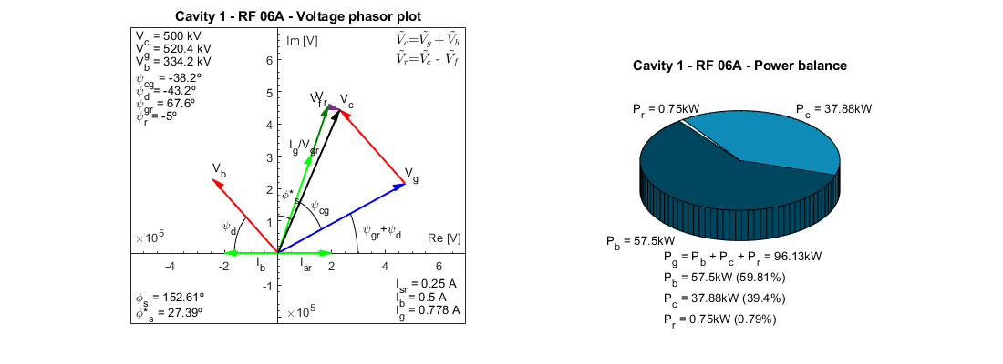
ALBA-I: Tuning manager .py
Usual operation with detuning at -18º to better survive a cavity trip.
  Less passive cavity loses.
  Trip compensation: +20 Deg feed forward control signal.
High amount of reflected power in normal operation.
The script tunes the remaining active cavities to 0º after one cavity is lost.
Forward power with 5 cavities and 6 cavities remain the same.
Reflected power decreased drastically.
Nominal
After trip detuned
After trip tuned
BACK

Slide 9
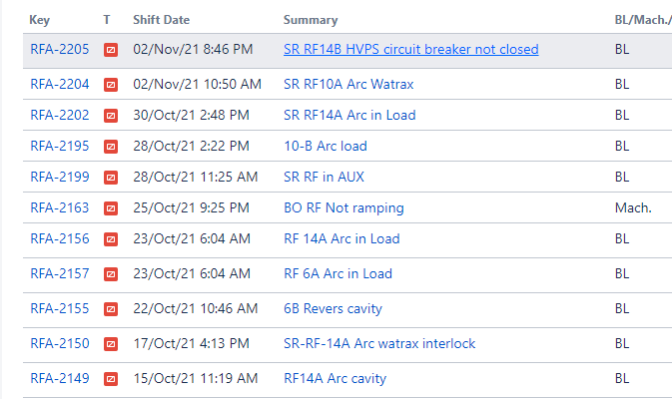
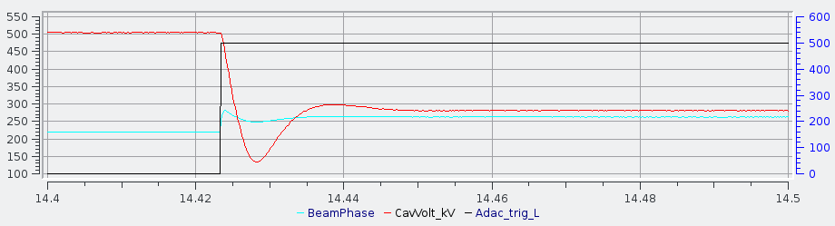
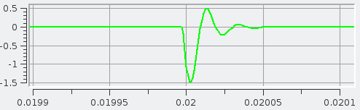
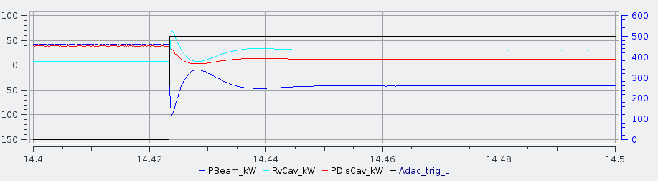
ALBA-I: Arcs
1
Arcs are spread overall components and cavities: CaCo, Circulator, Load (~10 kW), WaTrax and cavities.
LLRF post-mortem data does not show reflected power before the interlock in many cases.
Light detector analogue output connected to ADC.
Solutions: Double detection, electronics insulation, manufacturer replacement…
2
3
4
5
6
7
out of 11 ≈ 65 %
LLRF post-mortem
BACK

Slide 10
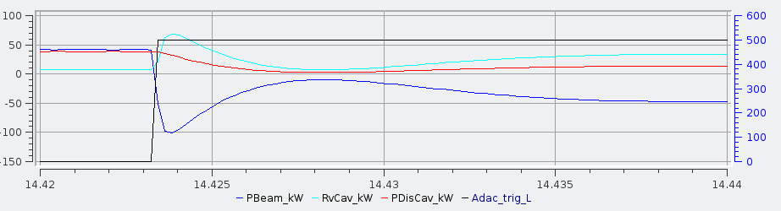
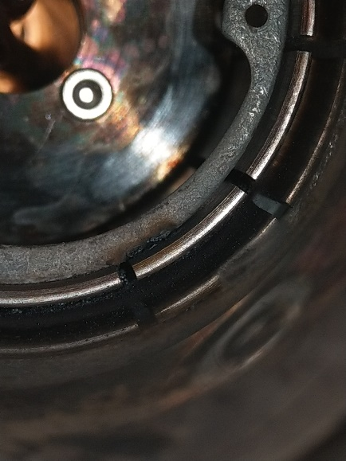
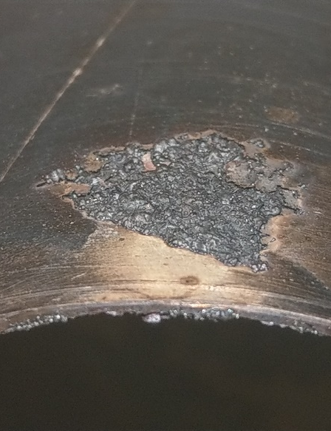
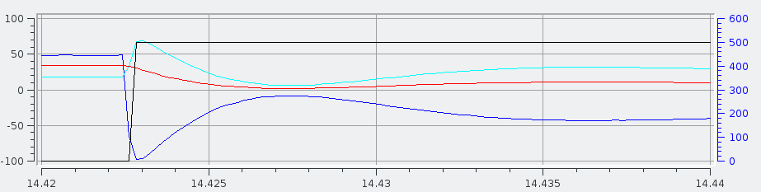
ALBA-I: Arcs
The 2nd July 2021 we got 3 arcs n a row in 14B WaTrax.
Cavity was parked the weekend and WaTrax replaced next maintenance day.
Arcs disable not allowed
Fake
Real

Slide 11
ALBA-II proposal

Slide 12
ALBA-II RF system
Parameter
ALBA-I
ALBA-II
Main cavities and waveguide components wants to be re-used.
Active components updated.
Low voltage due to RF acceptance specification leads to beam loss in case of cavity trip. Main voltage increased.
The low losses and low momentum compaction factor leads to have a lower synchrotron frequency and a small bunch length (5.5 ps natural BL). 3HC mandatory.
Cavities
NC-HOM
NC-HOM
RF transmitter
2x 80 kW IOT
SSPA
Nominal current
250 mA
300 mA
Total losses
1.15 MeV
1.08 MeV
α_{c}
8.8E-4
0.8E-4
Synchrotron frequency
8.53 KHz
> 2.0 KHz
RF voltage
3 MV
3 MV
RF acceptance
2.75 %
9.5 %
3HC voltage
-
800 kV
Lengthening factor
-
2.55
Bunch length
17.5 ps
14 ps

Slide 13
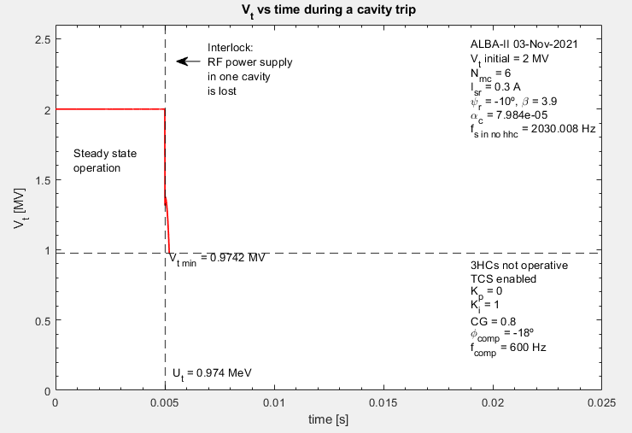
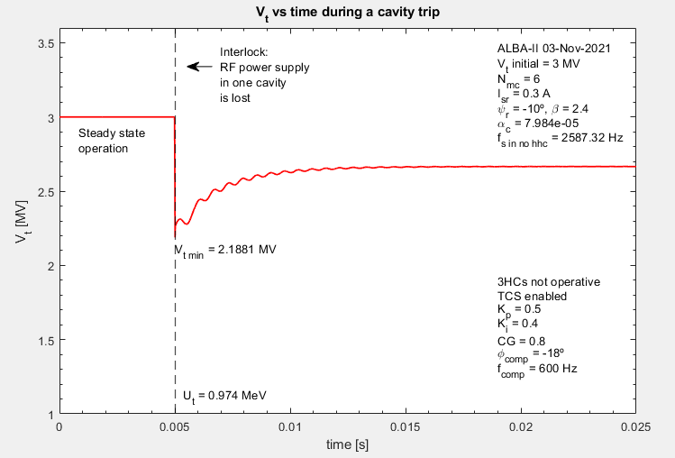
ALBA-II RF system: Main cavity trip
Transient simulations for ALBA-II shows that beam is lost in these conditions.
Due to beam loading, total voltage seen by the beam is below threshold voltage.
In order to survive a trip, the total voltage must be set to 3 MV.
Feed forward compensation signal must be sent by the LLRF.
Beam lost
Simulation: I. Bellafont
Simulation: I. Bellafont
Beam survive

Slide 14
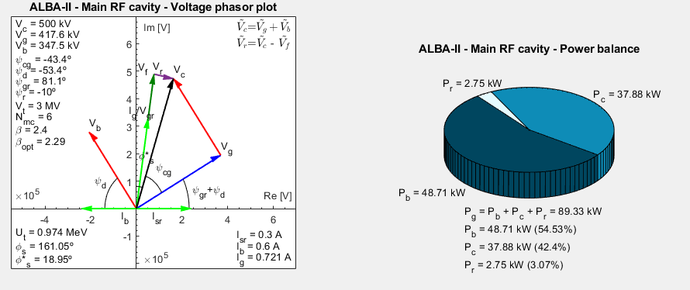
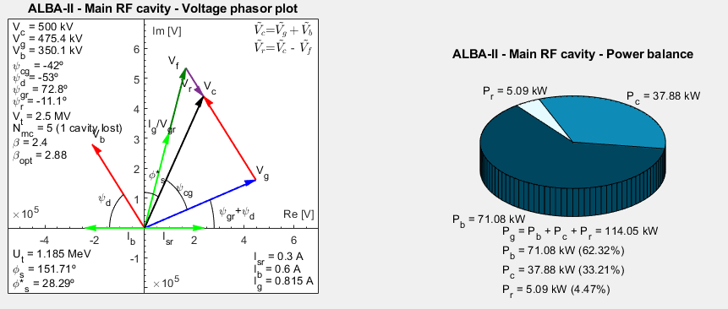
ALBA-II RF system: Main cavity trip
Power balance after cavity trip.
For 3 MV the power are still below maximum ratings for coupler and WaTrax.
Before trip
After trip

Slide 15
ALBA-II RF system: 3rd harmonic cavity
Main voltage provides power to the beam.
3HC provides bunch lengthening.
ALBA-II 3rd harmonic voltage is 800 kV resulting in a bunch lengthening factor of 2.55.
New bunch length goes from 5.5 ps to 14 ps.
3HC is stealing power from the beam that must be compensated with the main system.

Slide 16
ALBA-II RF system: 3HC trip
Before the trip each main cavity provides 95 kW due to 3HC losses.
After a trip the loses increase 50 keV due to tuning between beam and passive 3HC.
After the trip each main cavity provides 97 kW, i.e. 2 extra kW per cavity.
Beam survives. No trip compensation needed.
Before trip
After trip

Slide 17
ALBA-II RF system: 3rd harmonic cavity
200 kV of 3HC voltage lost.
Bunch lengthening factor decreased from 2.55 to 1.66.
Bunch length after trip is 9 ps.

Slide 18
Summary
ALBA-I opeartion is realiable but total amount of trips must be decreased, particullary the arcs.
ALBA-II main voltage is kept to 3 MV, assuring the needed RF acceptance and the reliability in case of one main cavity is lost.
3rd harmonic system is mandatory for ALBA-II in order to increase the bunch length up to 14 ps, close the nominal value of ALBA-I.
Further considerations have to be done in order to assure the performance in case of a 3HC trip.
Thank you

