Slide 1
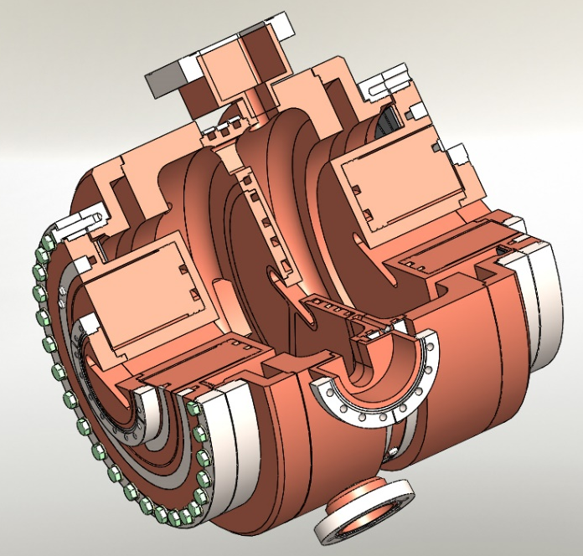
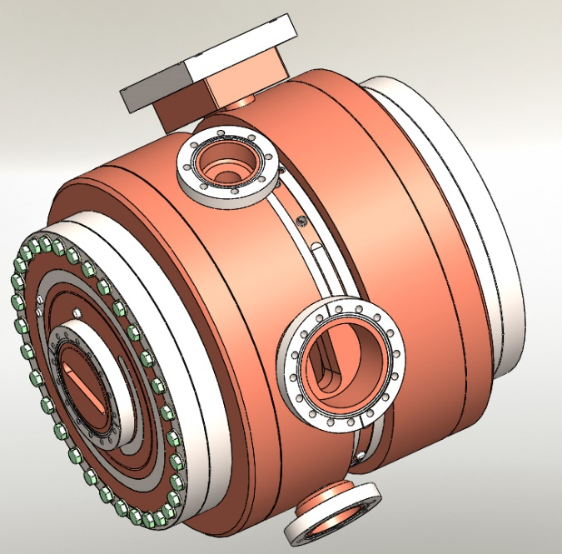
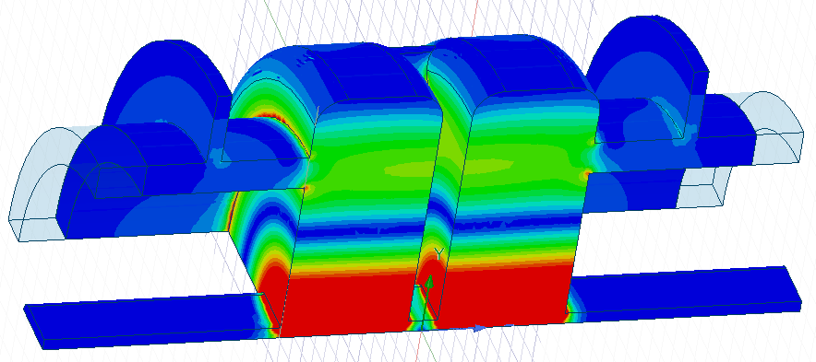
Design status of a 4th Harmonic cavity for ESRF-EBS
A. D’Elia, J. Jacob and V. Serrière - ESRF

Slide 2
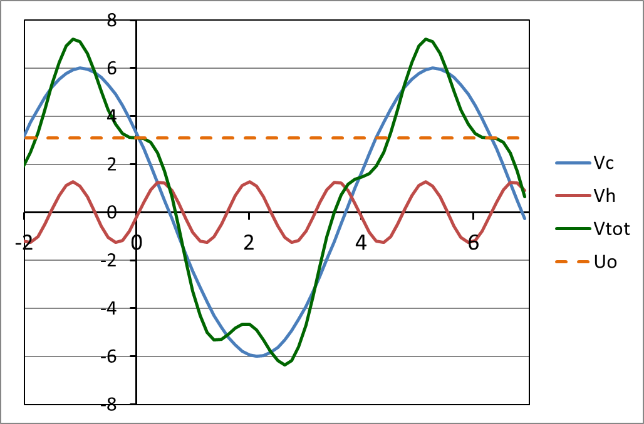
ESRF-EBS motivations
Harmonic RF system at 1.41 GHz
    Bunch lengthening by a factor 2.5 to 3
    1st Priority for high I / bunch (16b and 4 x 10 mA)
    Reduced Touschek scattering, IBS and microwave instability:
      Increased lifetime → less frequent injections, reduced loss rate and radiation load
      Improved overall stability
      Room for smaller In-Vacuum ID gaps
      alleviate possible impact from future lattice developments like mini-beta straights
      Reduced emittance and energy blow up
    Reduced heat-load and stress of critical chambers, like ceramic chambers or In-Vacuum IDs
      Today maximum 35 mA in 16 bunch and 16 mA in 4 bunch operation
    2nd step: for multibunch operation
    Intrinsically less Touschek scattering, very low IBS, no MWI
    7/8 filling → strong transient beam loading (TBL) almost impossible to avoid
      Phase transients spoil bunch lengthening
      Minimize R/Q of harmonic cavities
      Longer term study: R&D anti-TBL broadband cavities [N. Yamamoto / KEK]
Objective:
    Implementation on EBS in about 3 years
V [MV]
Vtot
Vc = 6.5 MV
Uo = 2.52 MV
Vh,opt = 1.49 MV
ω_{RF} t
Principle: 4th harmonic RF system for bunch lengthening on EBS

Slide 3
Preliminary considerations
4th Harmonic:
Provide a bunch lengthening by a factor between 2.5 and 3
V_{opt,h}=1.49MV* for a 4th harmonic system, to be compared with V_{opt,h}=1.98MV* for a 3rd harmonic
* Considering V_{main RF}=6.5MV and U=2.52MeV/turn, this optimum harmonic voltage reduces to 1.35MV considering the present EBS nominal voltage of 6MV. However in the following all calculations will be referred to V_{main RF}=6.5MV.
The use of a TM020:
less sensitive to the transient beam loading than TM010*
allows to mitigate the tight tolerances and the mechanical difficulties arising from the reduced size of the structure
* N. Yamamoto et al., Phys. Rev. Accel. Beams 21, 012001
A multicell structure:
reduces the number of auxiliaries and facilitates their distribution all over the cavity, simplifying the mechanical integration;
is more compact longitudinally which will ease to fit it inside the available space of ~1.8m in cell 25.

Slide 4
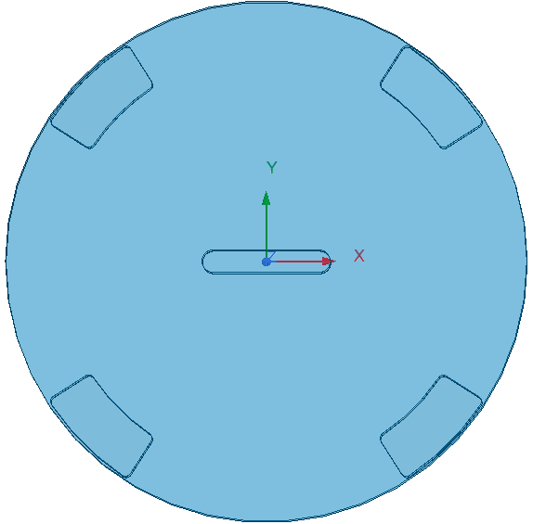
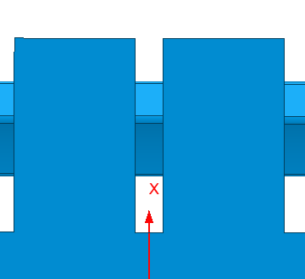
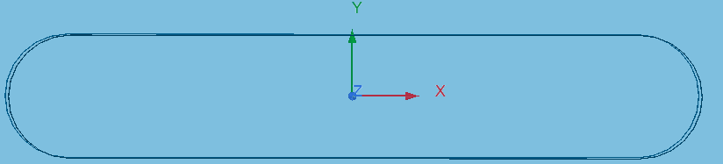
the standard cell
106.35mm
The X-ray trace imposes a horizontal minimum radius of the beam pipe of 45mm. The minimum space needed to insert an adequate cooling system fixed the number of slots (four), their position and wall thickness.
20mm
45°
45mm
8mm
R/Q is negligibly impacted by the racetrack shape providing for a sufficient reduction of the vertical dimension. The presence of a nose cone does not remarkably improve the shunt impedance and is not adopted in the design.

Slide 5
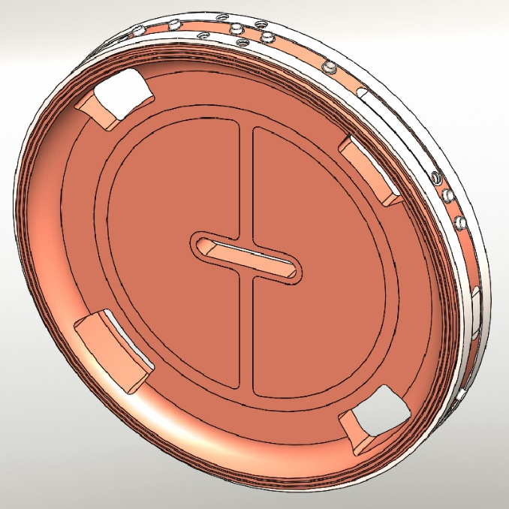
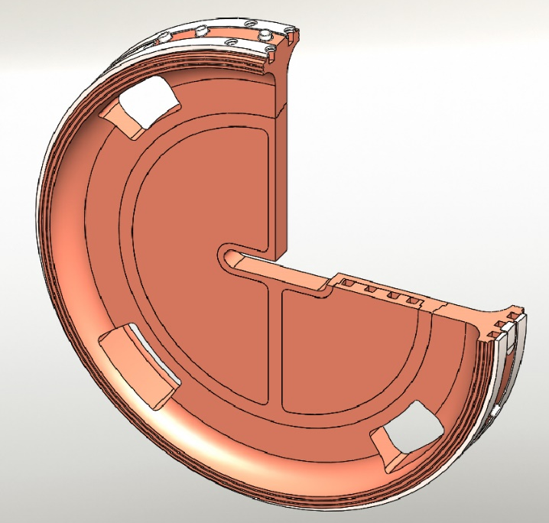
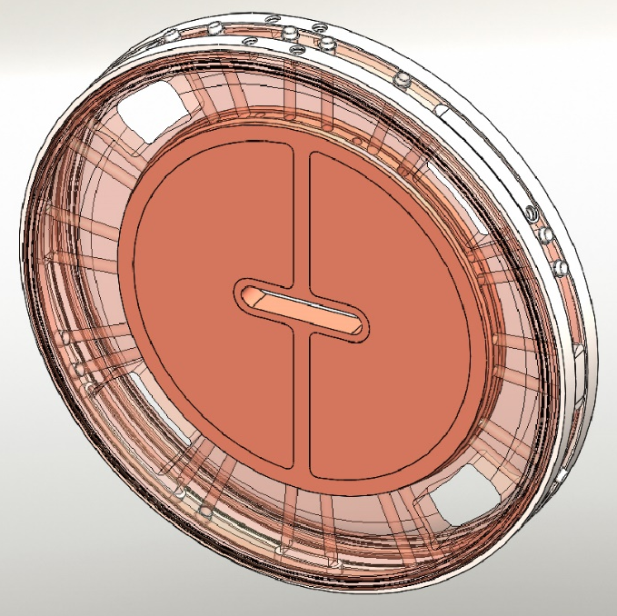
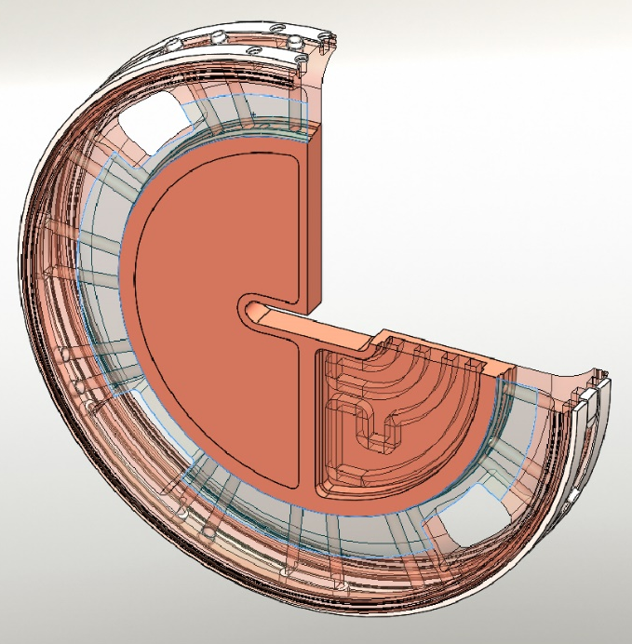
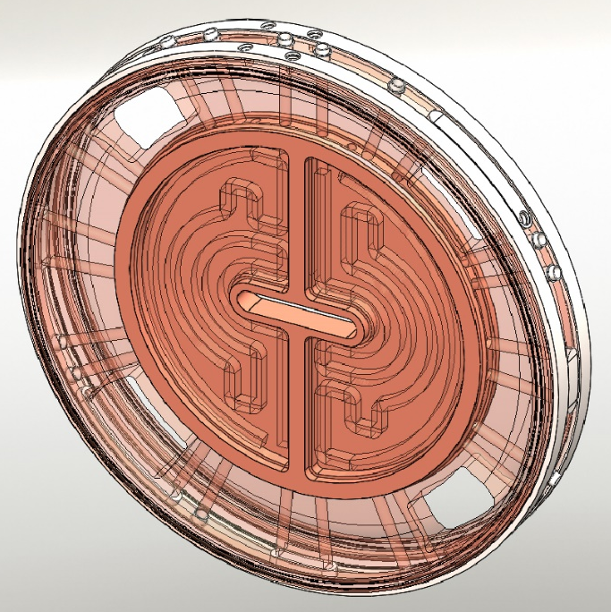
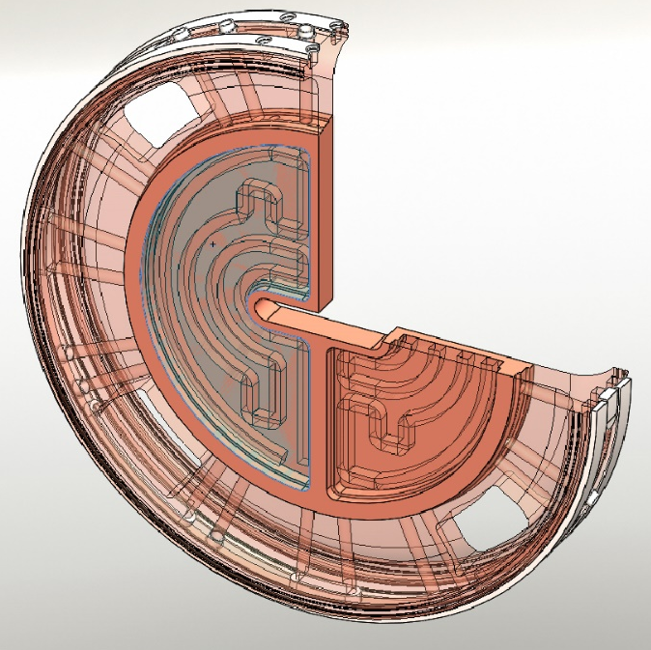
Mechanical integration of the standard disk

Slide 6
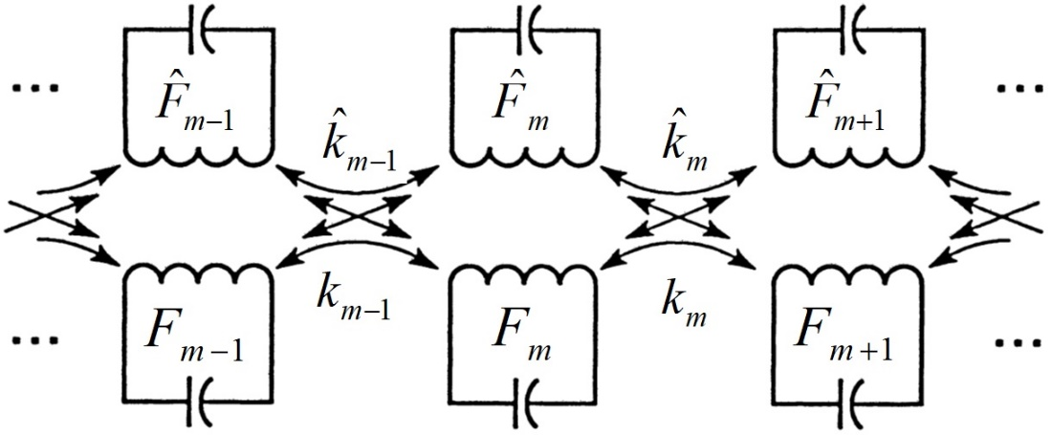
TM020 Lumped circuit model
A circuit model is of fundamental importance to guide the design of a multicell structure. Indeed, a chain of resonators when coupled, loose their individuality and the whole system can resonate only at certain frequencies each one characterized by its own field phase advance from cavity to cavity.
We use a double chain of coupled resonators*. Indeed, the TM020 band interacts with its closest neighbour TE band and this interaction needs to be included in the model.
TE
TM
Relation dispersion can be promptly found considering all parameters independent on the cell number m. F is the single cell frequency, f the modal frequency with phase advance φ from cell to cell and k the coupling constant.
* K. Bane and R. Gluckstern, SLAC-PUB-5783, slightly modified to our purposes.

Slide 7
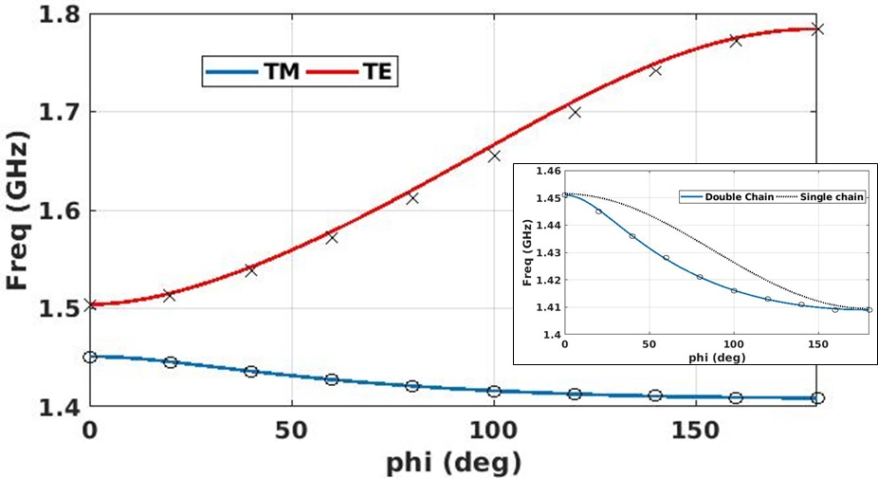
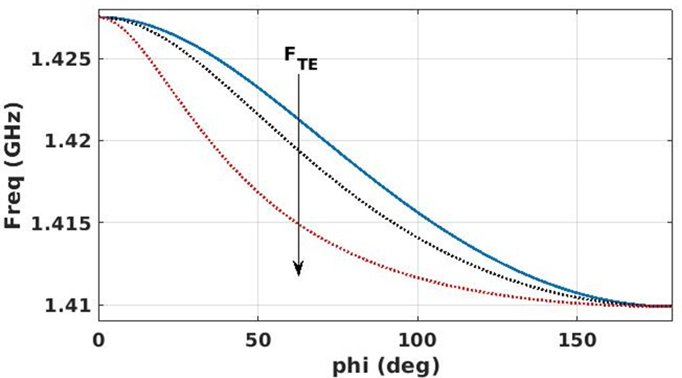
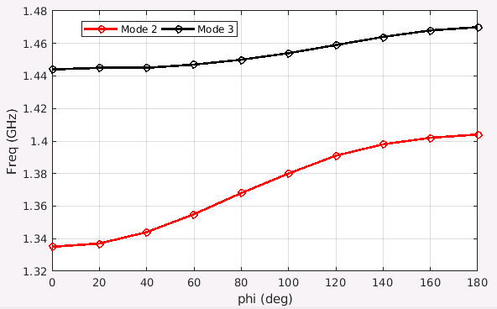
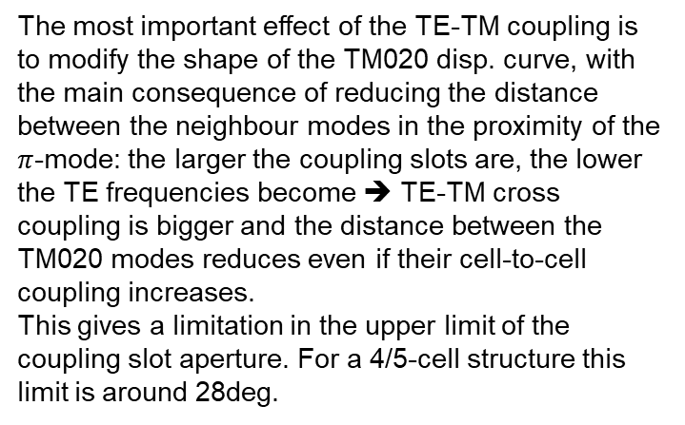
Main Consequence of the TE-TM coupling
Disp. curves prediction vs HFSS data
TM disp. curve modification when TE freq. decreases
numerical experiment
The most important effect of the TE-TM coupling is to modify the shape of the TM020 disp. curve, with the main consequence of reducing the distance between the neighbour modes in the proximity of the $π$-mode: the larger the coupling slots are, the lower the TE frequencies become ➔ TE-TM cross coupling is bigger and the distance between the TM020 modes reduces even if their cell-to-cell coupling increases.
This gives a limitation in the upper limit of the coupling slot aperture. For a 4/5-cell structure this limit is around 28deg.
Band mixing
Disp. curve prediction vs simulation data
TE
TM020
TM020
Mixing region
TE

Slide 8
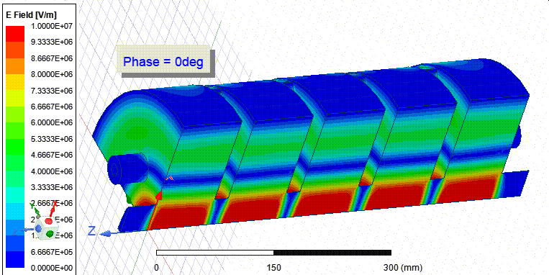
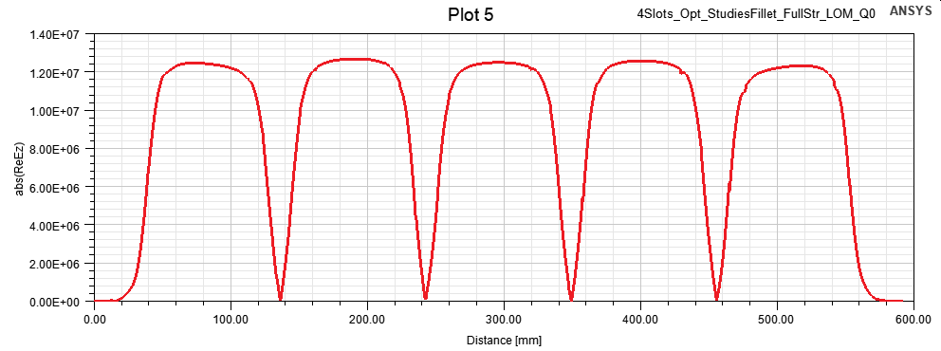
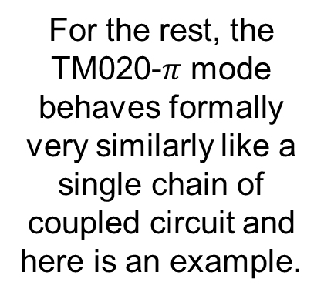
π-mode E-field
For the rest, the TM020-$π$ mode behaves formally very similarly like a single chain of coupled circuit and here is an example.
|E_{z}-Field|

Slide 9
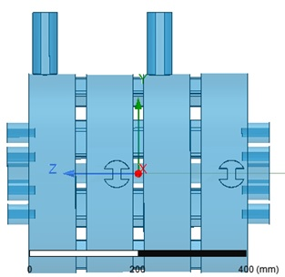
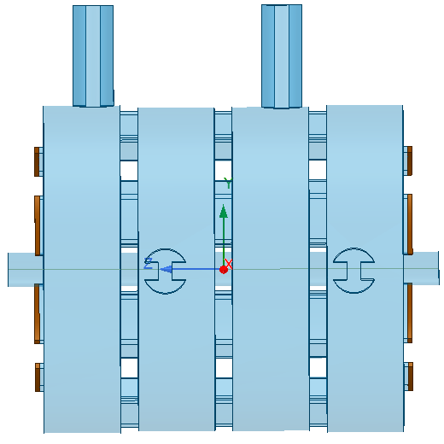
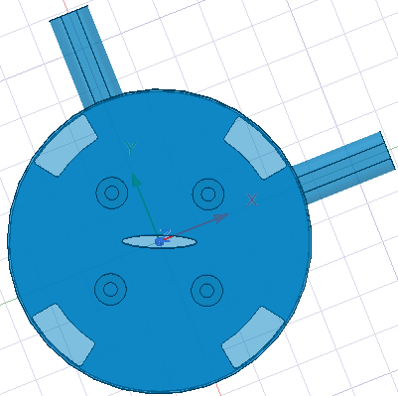
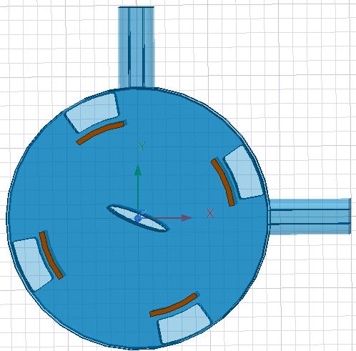
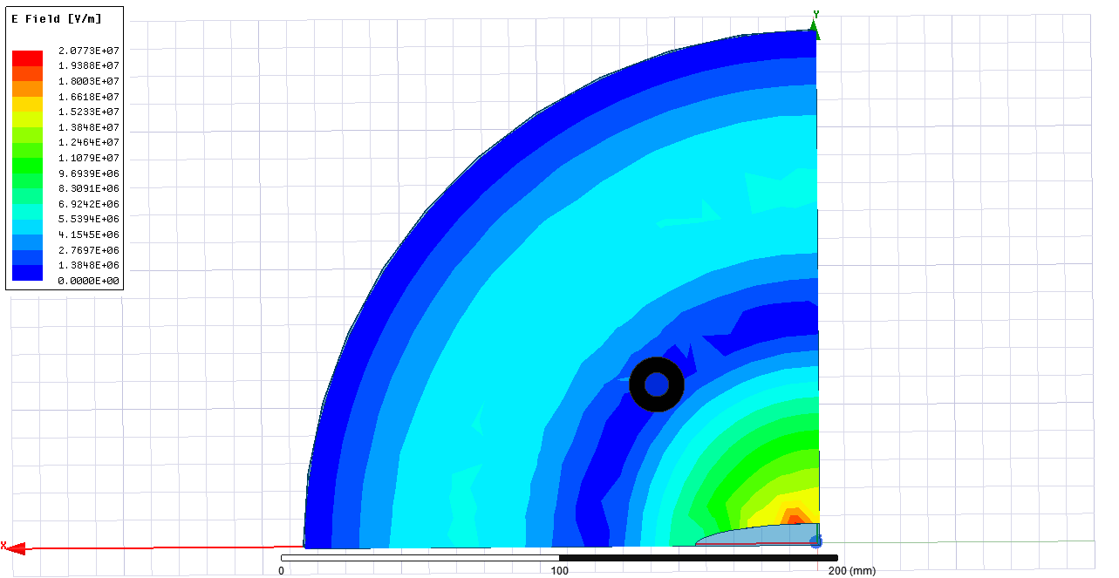
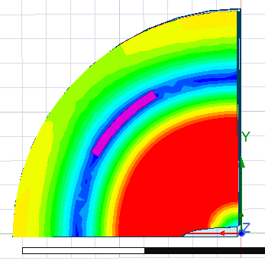
LOM+hom damping mechanism
To enhance HOM’s dilution
To remove the LOM

Slide 10
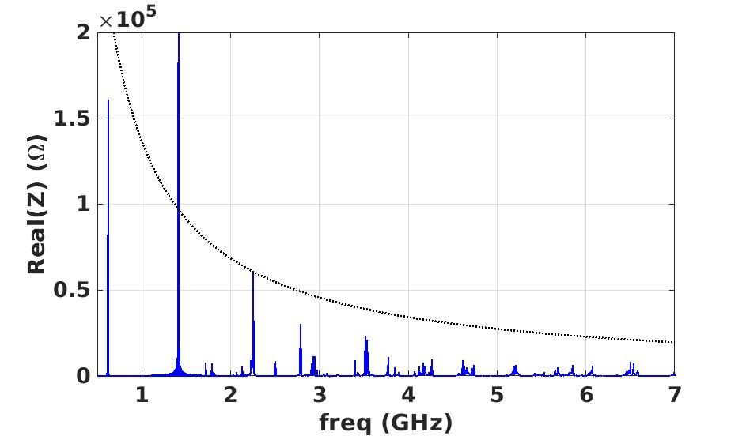
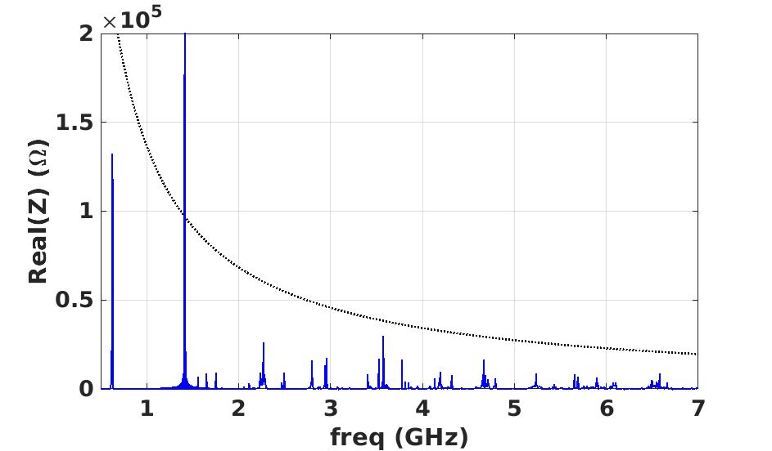
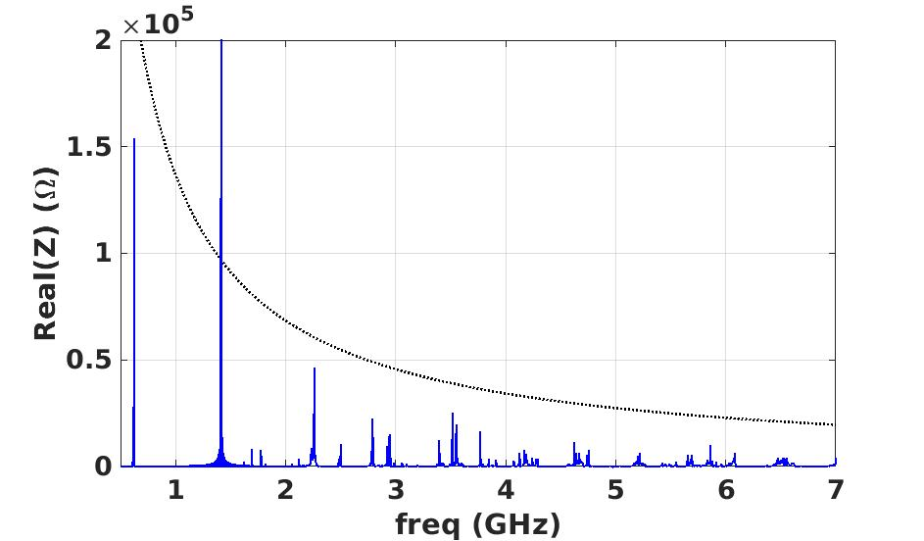
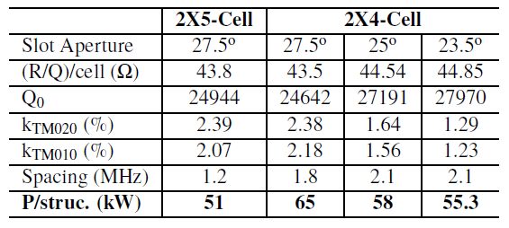
LOM-HOM Damping (coaxial pick-ups)
23.5deg
25deg
27.5deg
The 2X5-Cell structure exceeds the LCBI threshold and is rejected for the final design.

Slide 11
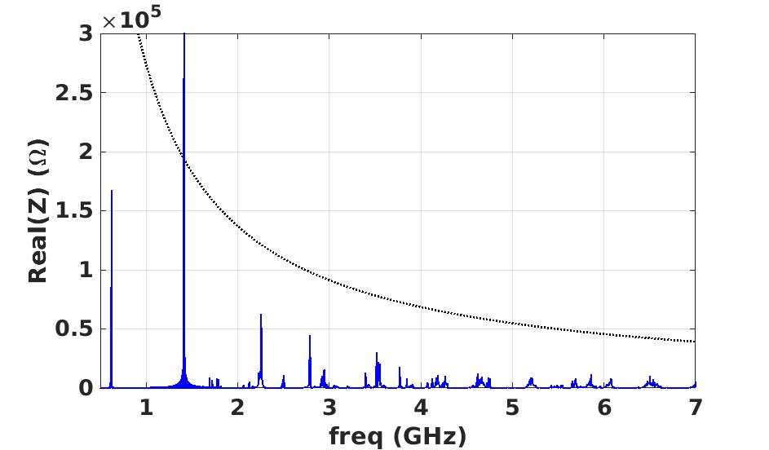
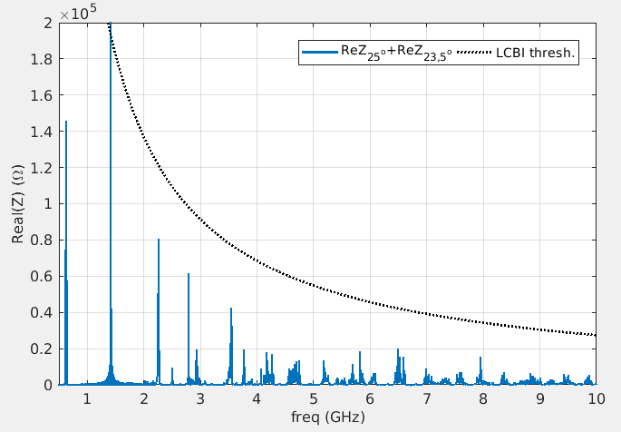
Lom+hom damping enhancement: detuning
Coax Antennas
Ferrite slots
23.5deg+25deg
Rather than providing for 2 identical structures, we can enhance the damping of the unwanted modes by building 2 different cavities. In this case what is used for the detuning is the coupling slot aperture.

Slide 12
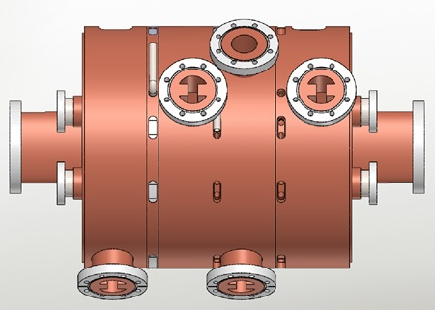
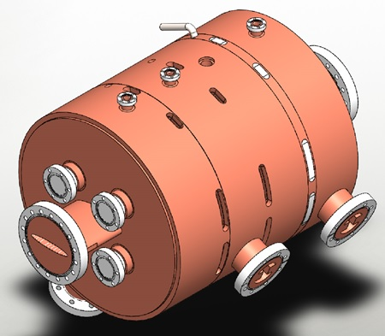
Mechanical integration
Both structures met all criteria and, as you have seen, the mechanical integration of the standard cell was done* but not easy to integrate the LOM absorbers:
Coax antennas: needed a very high precision positioning and difficulties to cool them down (water cooling needed);
Ferrite slots: needed also a very high precision positioning and at the limits of the capability of the ferrite in terms of sustainable density power
*A. D’Elia et al., “DESIGN OF 4TH HARMONIC RF CAVITIES FOR ESRF-EBS”, proc. of IPAC21

Slide 13
Alternative solution: choke mode cavity

Slide 14
a simple transmission line model
Choke reflection frequencies:

Slide 15
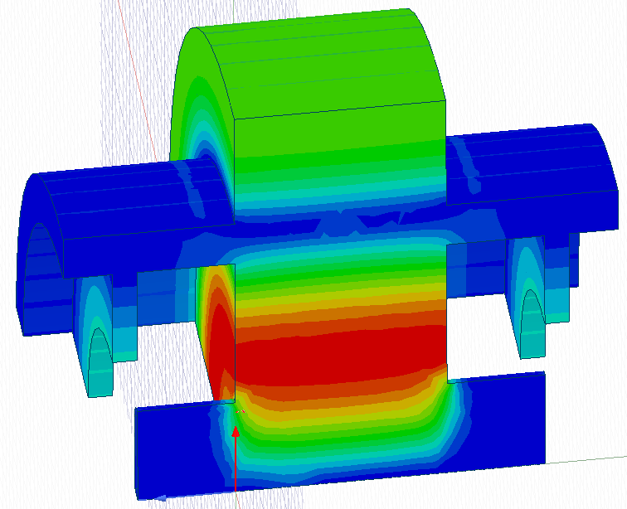
tm020 Variation
H-Field
Standard
New design
At the very beginning of the design we had already considered choke-mode cavities but the dissipation in the radial line was not negligible and we abandoned.
When we encountered strong difficulties in the mechanics of the LOM dampers, Vincent proposed this design in which, profiting of the fact that our working mode is a TM020, we could put the choke on the H-field node and this leaves the Q0 unperturbed. The price to pay is a longer structure and to provide for an efficient cooling of the choke part.

Slide 16
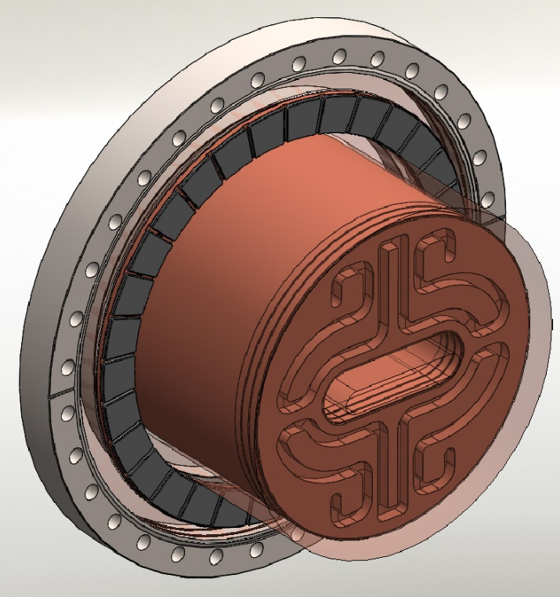
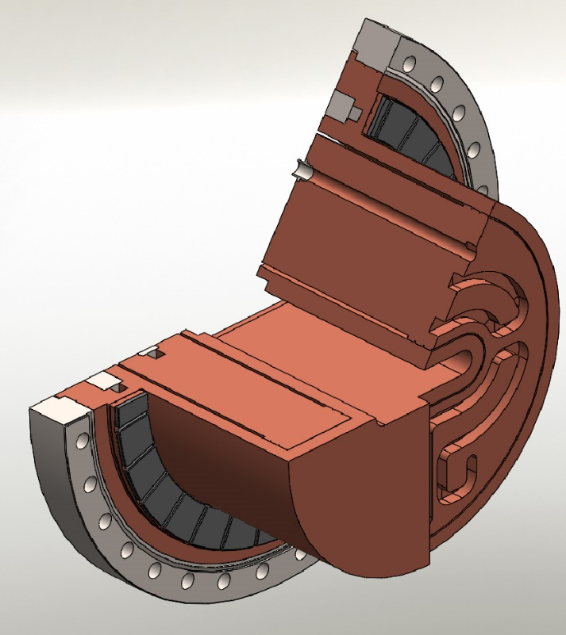
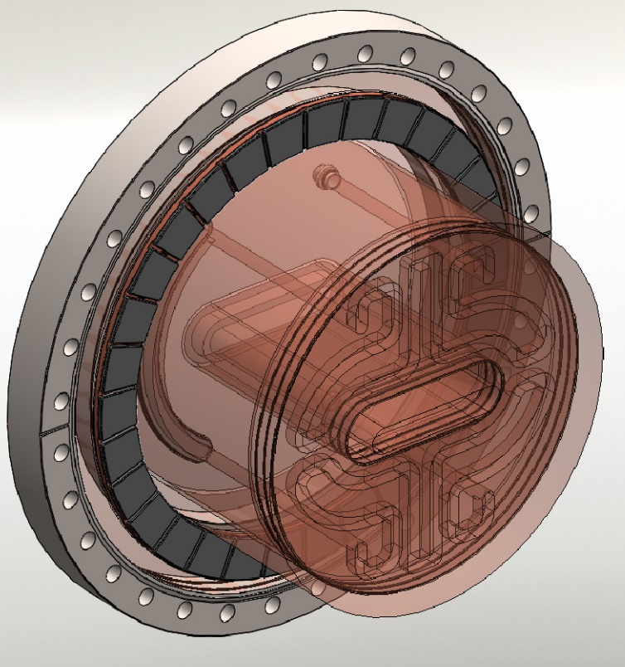
Mechanical integration of the ferrite loads and cooling

Slide 17
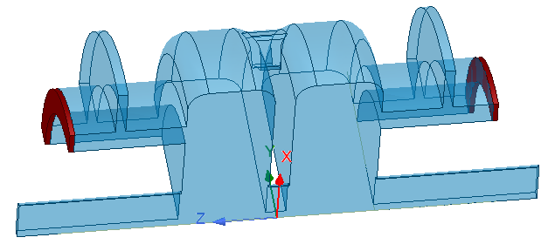
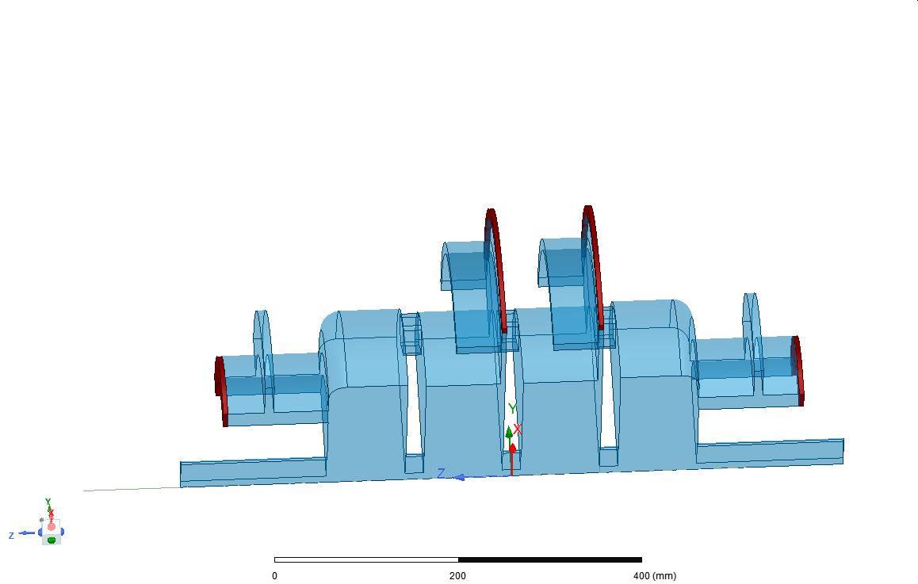
Possible configurations
2-Cell Choke Mode Cavity
N-Cell Choke Mode Cavity
=
+
…
It is worth noting that the standard cell is the same as in slide #4 ➔ mechanical integration and cooling system of the disks do not change w.r.t. the former design.

Slide 18
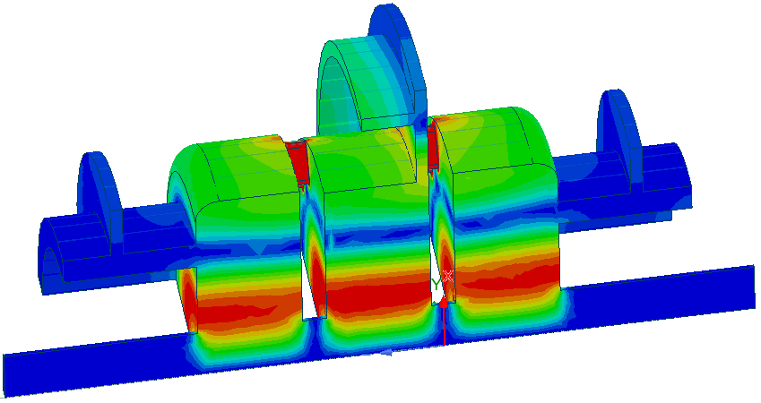
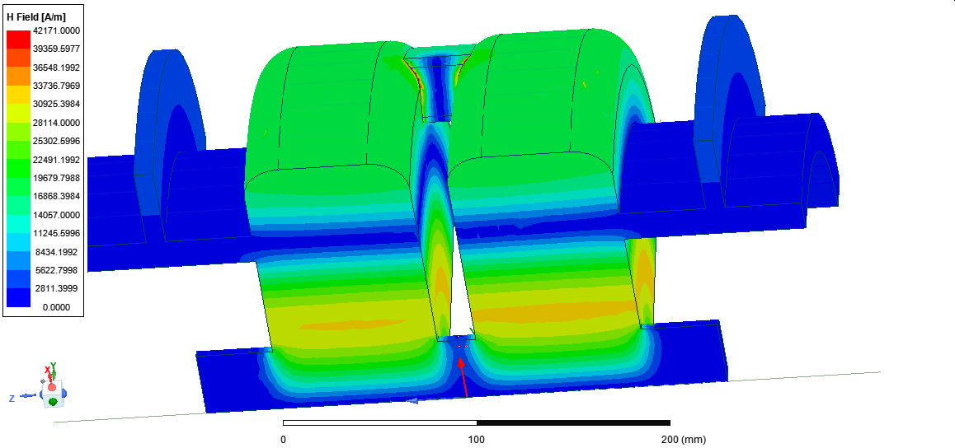
Figures of merit
H-Field
H-Field
Cavity type | 2-Cell Choke |  | 4-Cell Choke | 3-Cell Choke
Number of cavities | 3 | 4 | 2 | 3
R/Q (Ohm)/cell | 43.4 | 43.4 | 43.7 | 43.14
Q₀* *Does not include Power coupler/s and Tuner/s | 29735 | 29735 | 24500 | 25500
Rs (MOhm)/cell (Ohm Convention: Rs=V²/2P) | 1.29 | 1.29 | 1.07 | 1.1
Total Power (kW) | 144 | 108 | 130 | 112
Power/cavity (kW) | 48 | 27 | 66 | 38
Vincent’s trick can be applied only to the end cells, middle cells open on high H-Field regions. A 4-Cell choke exhibits already a non negligible degradation of the Q0 and will not be considered in the following.

Slide 19
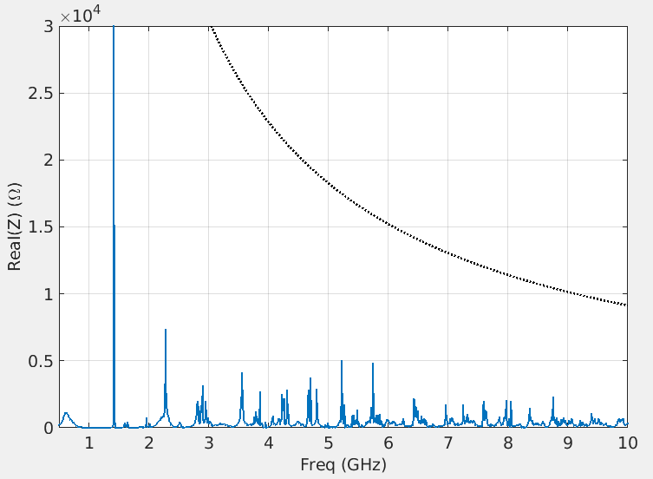
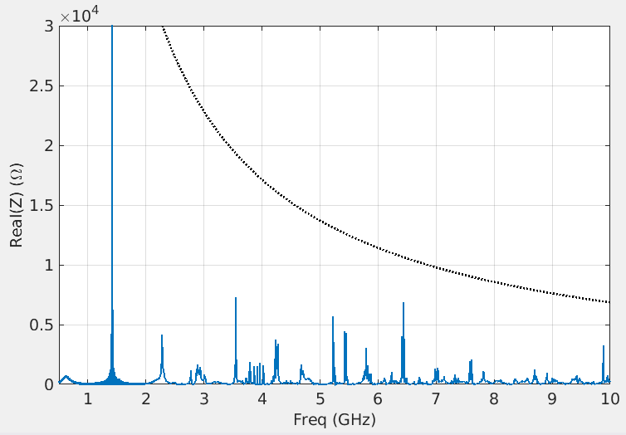
LOM+HOM Damping: no additional Hom dampers are needed
3X3-Cell Choke
4X2-Cell Choke
Both meets the requirements but we will focus on the 2-Cell that exhibits the highest Rs. Important remarks:
The mechanical design and cooling system of the choke is the same for all configurations as well as the cooling of the standard disks;
The drawback of a 2-Cell is the larger total length, that is why we are considering also a 3-Cell design as a possible back-up in case of problems.

Slide 20
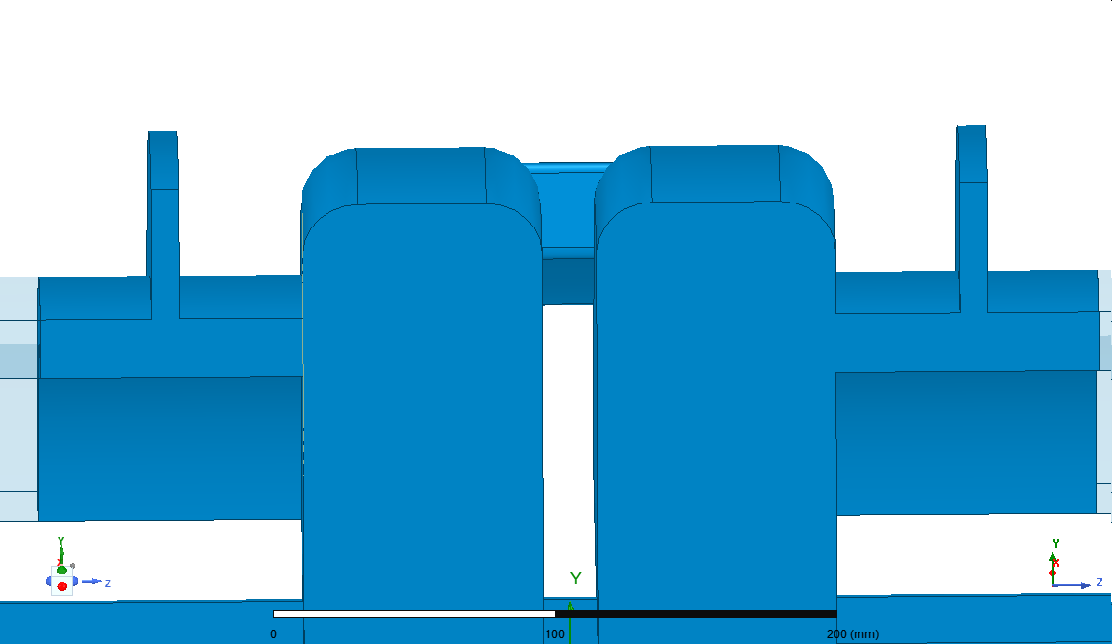
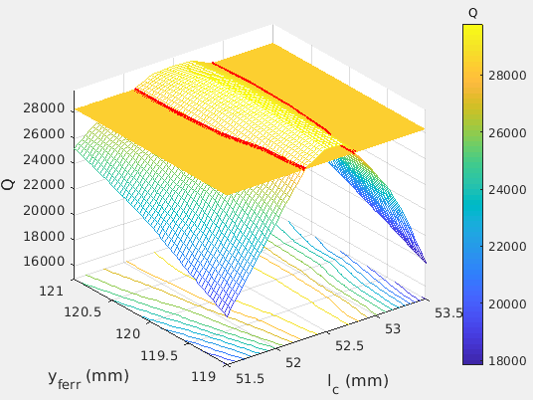
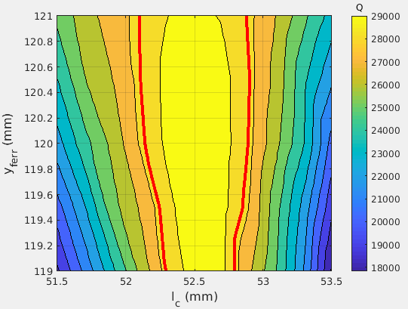
excellent mechanical stability
Compared to the solution with antennas or ferrite slot LOM absorbers, the integration of the choke structure benefits of an excellent mechanical stability. Here below is an example.
The flat surface identifies a Q reduction of 5% from nominal.
l_{c}
y_ferr
52.3
52.8
The plots show that the positioning of the choke structure (y_ferr) is negligible with respect to the errors in the length of the choke (l_{c}). And, if we allow for a Q reduction of only 5%, the tolerance for l_{c} is of +/-0.2mm, which is in line with the standard tolerances in this frequency range.

Slide 21
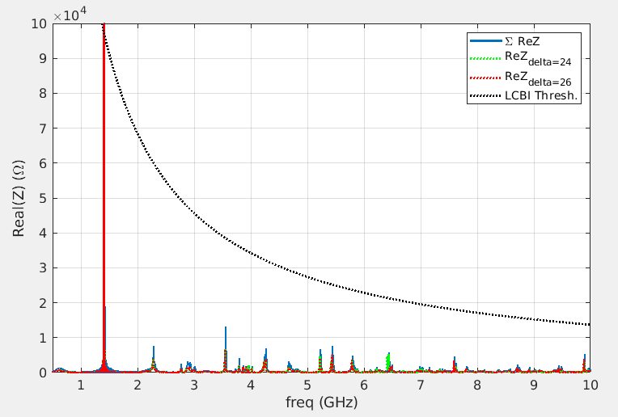
LOM+HOM Damping: detuning
delta
2x2-Cell_{delta=24mm} + 2x2-Cell_{delta=26mm}
Also in this case, we can further enhance the damping of the unwanted modes by a light detuning. In this case the detuning is obtained by varying the size of the coaxial section (as shown inset). The choice of this geometrical parameter relies on the fact that, in this way, all the structures will exhibit same longitudinal quotes and all the brazing/welding planes will keep same references.

Slide 22
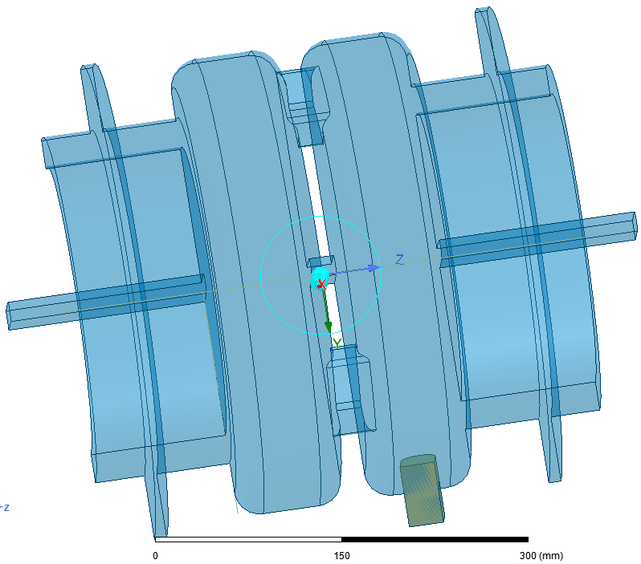



Tuner
28mm
30mm
Tuner parameters after optimization: by choosing 5mm of tuner penetration the tuning range is symmetric but, more important, that minimizes the additional losses on the piston surface (Q0 reduction of ~2%)
Tun_pen
ΔF=700kHz
Retuned working point
1409.46
Retuned working point
ΔF=800kHz

Slide 23



Impact of the tuner on the longitudinal impedance
~1.5MHz
Nominal position: Tun=+5mm
The longitudinal impedance relies below the threshold on the whole tuning range

Slide 24


Multipacting within the choke: coating?
Working region
Multipacting free region
The region above Vcav=120kV shows SEY>1. In particular there is a clear barrier centred at about Vcav=250kV and a second one at about Vcav=550kV. If this barrier can be conditioned or not, it is difficult to say but the presence of multipacting in the operation region (Vcav around 372.5kV) with a strong barrier just before it, that may be definitely a strong limitation. That is why we foresee a coating in the choke region.

Slide 25
Mechanical integration of the whole cavity
Coupler port
Tuner port
The mechanical integration of the whole assembly is at the 80%:
Water cooling system is done as well as the integration of tuner port and of the ferrite loads;
The coupler design is ongoing therefore the coupler integration might change;
The vacuum system studies showed that there are no major difficulties to pump down the cavity, the mechanical integration of the system is ongoing.

Slide 26
Status of the design and conclusions
The highest priority is to finalize the cavity design to launch asap the call for tender (beginning of the next year);
The cavity we intend to build is a 2-Cell Choke;
The e-m design of the cavity itself is done;
The impact of the integration of the subsystems on the e-m design is complete for tuner and vacuum ports;
The coupler design (waveguide type) is ongoing and for this device we decided to revert the strategy: we first want to fix the mechanical design, especially for the ceramic windows and then we will integrate it on the e-m design;
The number of cavities, 3 or 4, will depend upon the maximum power that can flow through the coupler;
The mechanical design and engineering integration is quite advanced, we estimate to be at 80% of the cavity design: cooling circuit for disks and coaxial end cells are complete, the integration of the tuner port is done, vacuum subsystem integration is proceeding well
As a final remark: we have also a 3x3-Cell Choke option for any case

