Slide 1
The RF of PETRA IV.
Stefan Wilke, DESY MHF-e
25th ESLS rf meeting Hamburg, 8th/9th nov 2021

Slide 2
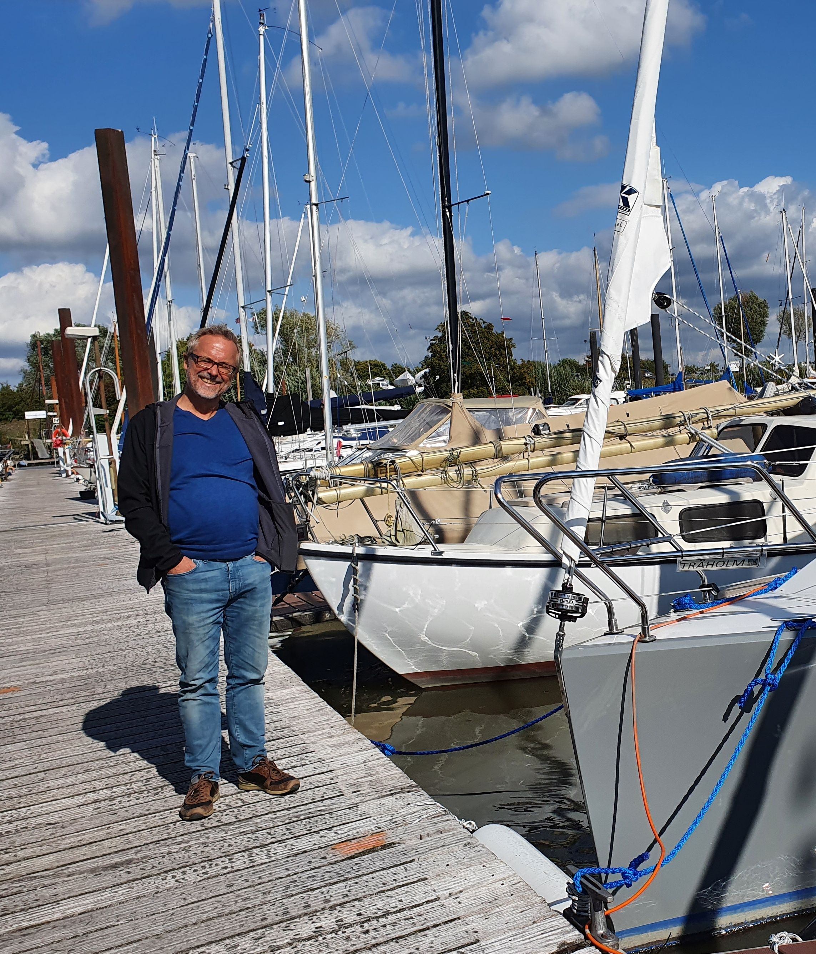
We miss him so much.
Michael Ebert (+ 2021-03-06)

Slide 3
The RF of PETRA IV.
Overview
- Lots of activities at DESY
- Short view on the present RF-system at P3
- CDR P4
main parameter of the machine
RF parameter
active 3rd harmonic RF
- RF at DESY IV
- Tests of P4 RF components in P3

Slide 4
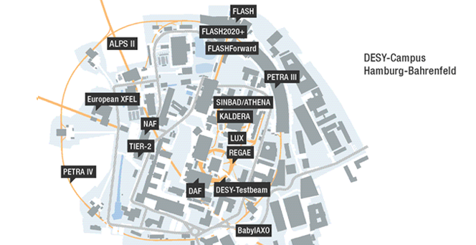
Lots of activities at DESY.
Some major competitions to PETRA IV
24/7 operating of XFEL, PETRA3, DESY2, FLASH
FLASH2020+: new undulators, new rf-modules Operation from 2025
KALDERA: A high-power laser for plasma accelerators. Operation from 2026

Slide 5
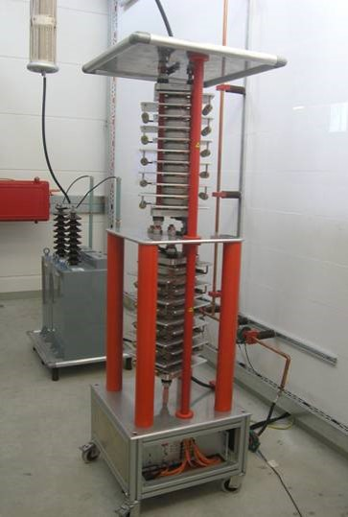
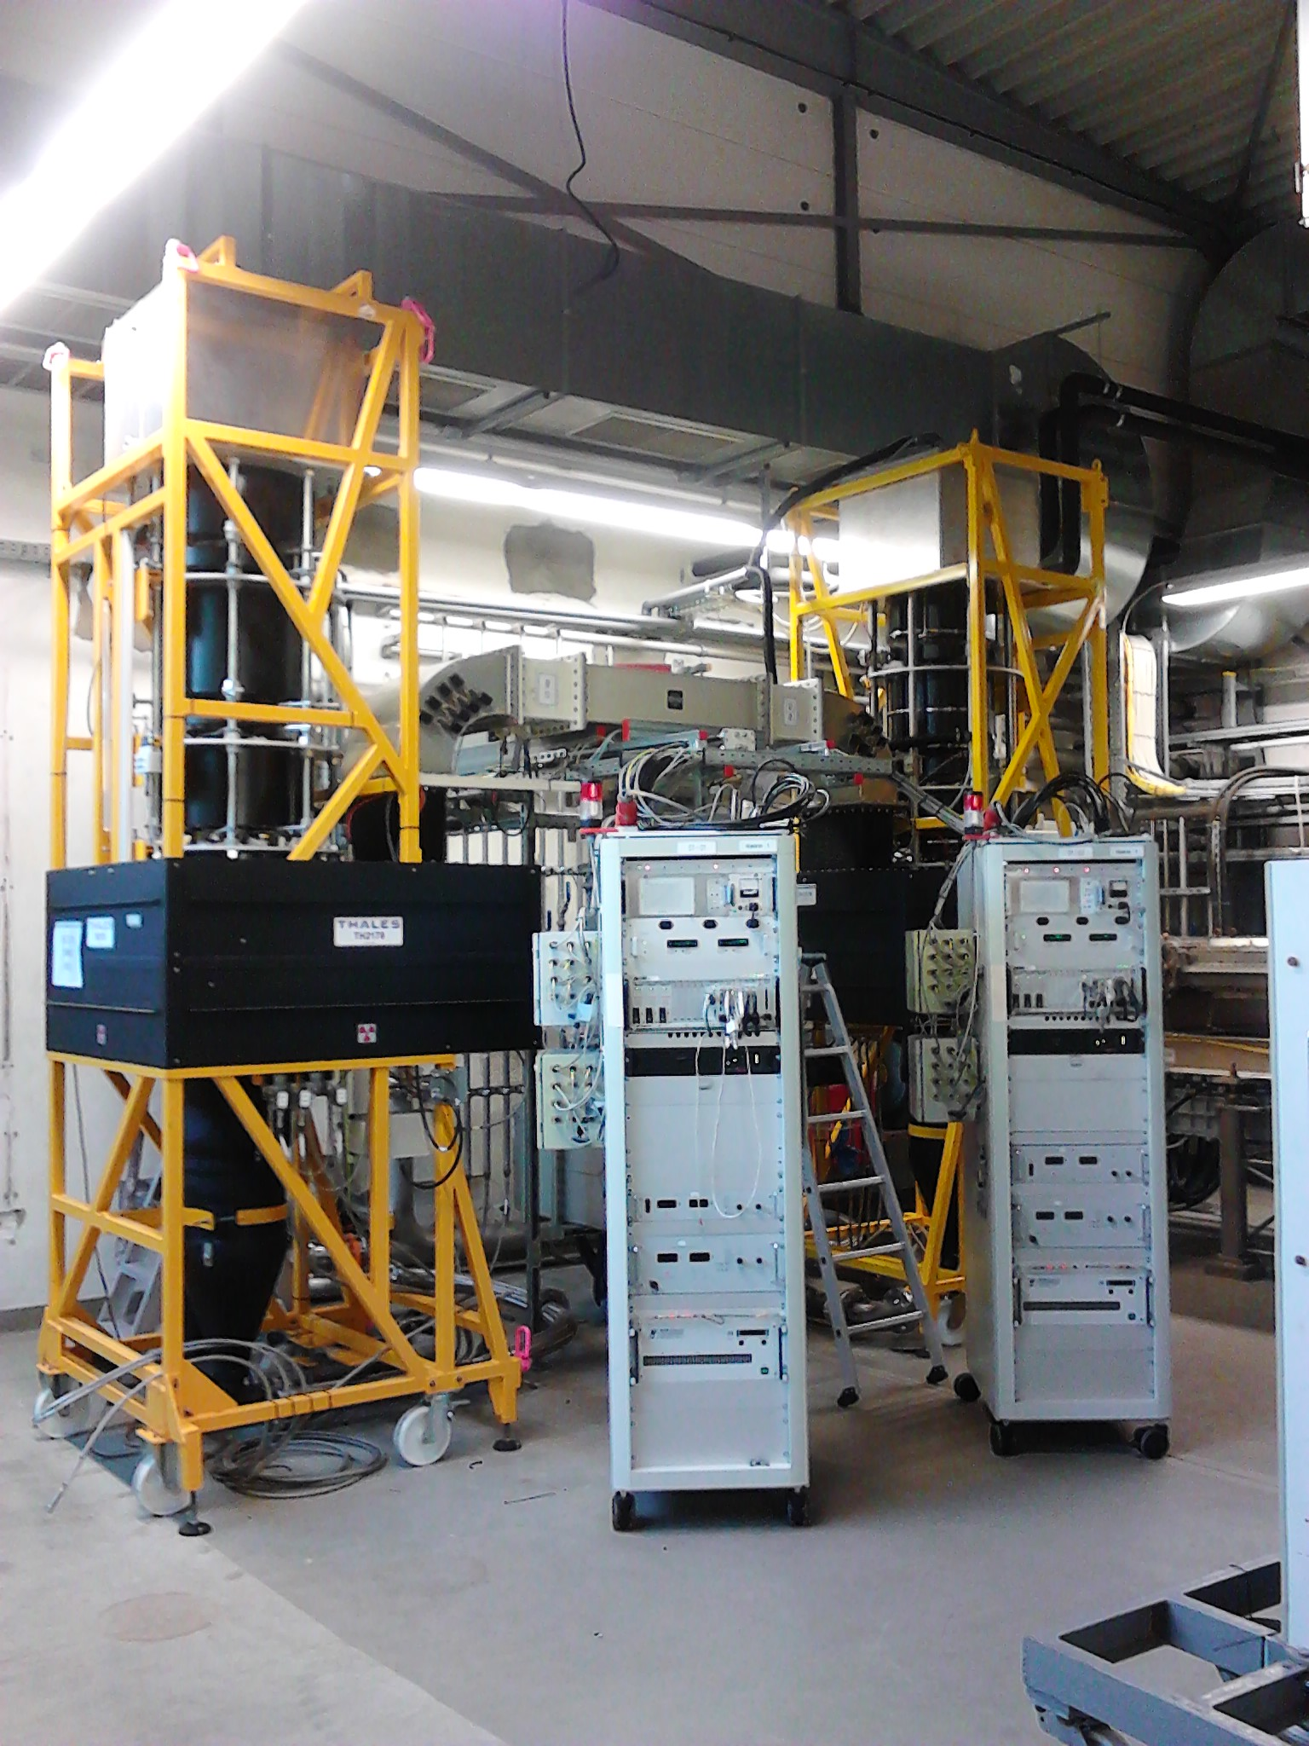
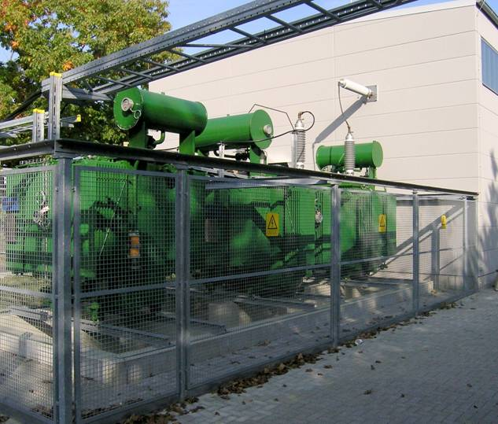
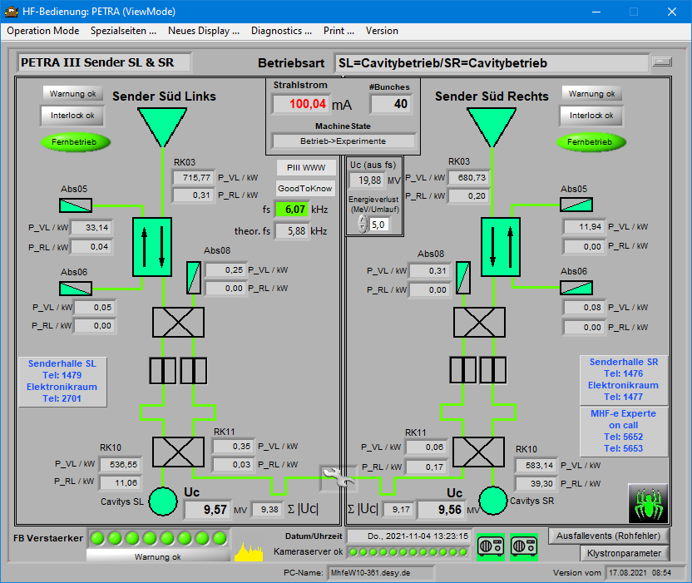
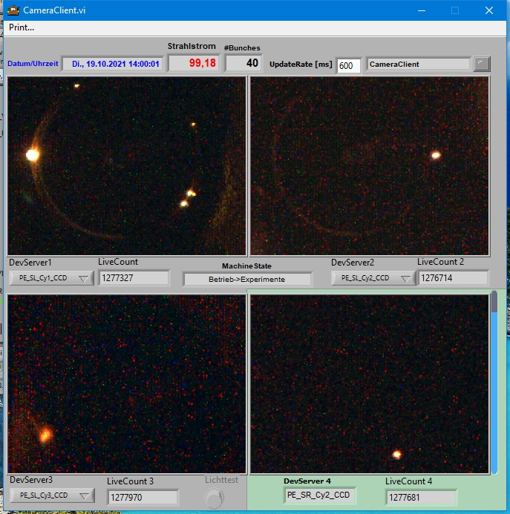
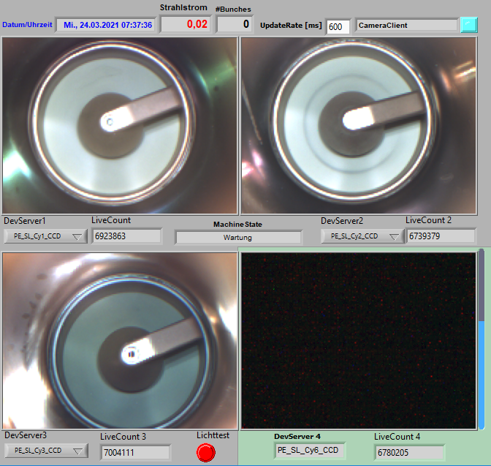
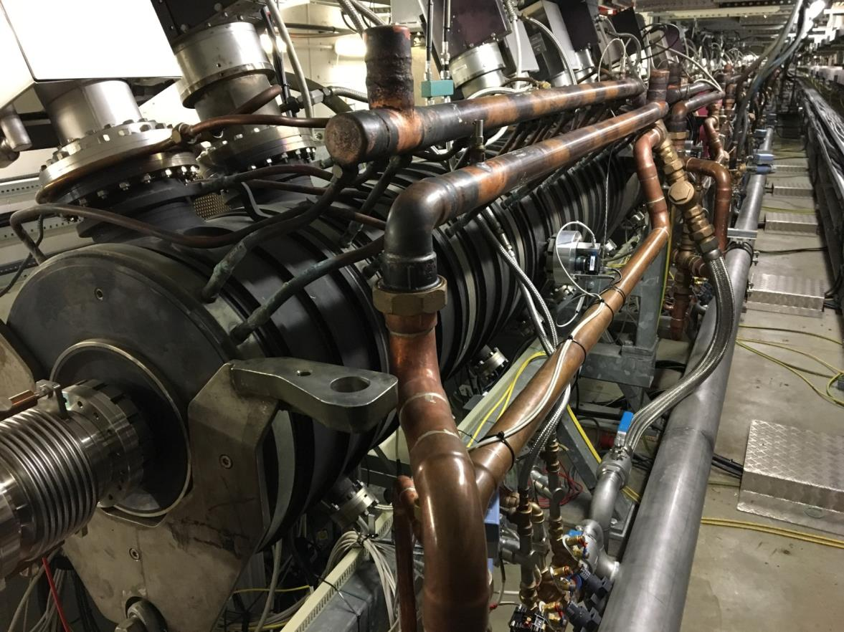
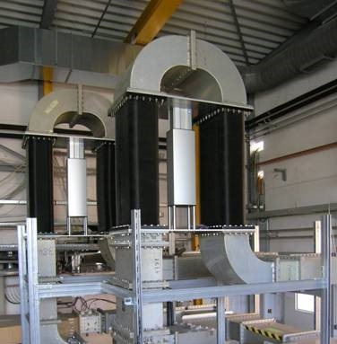
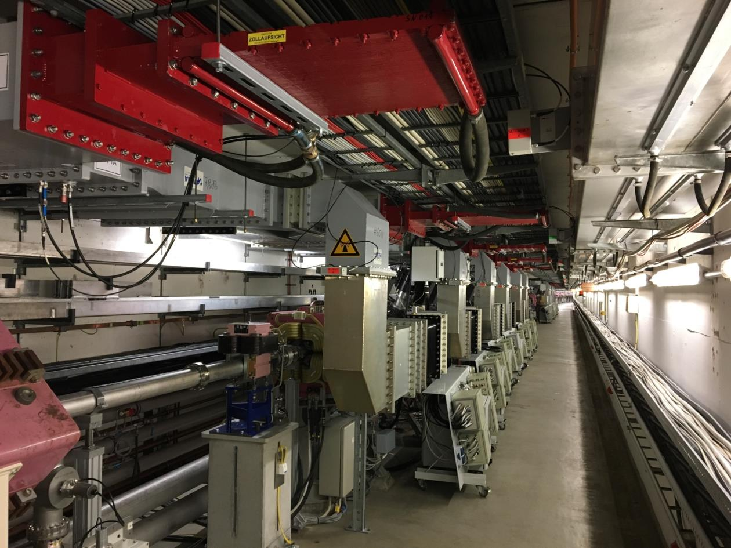
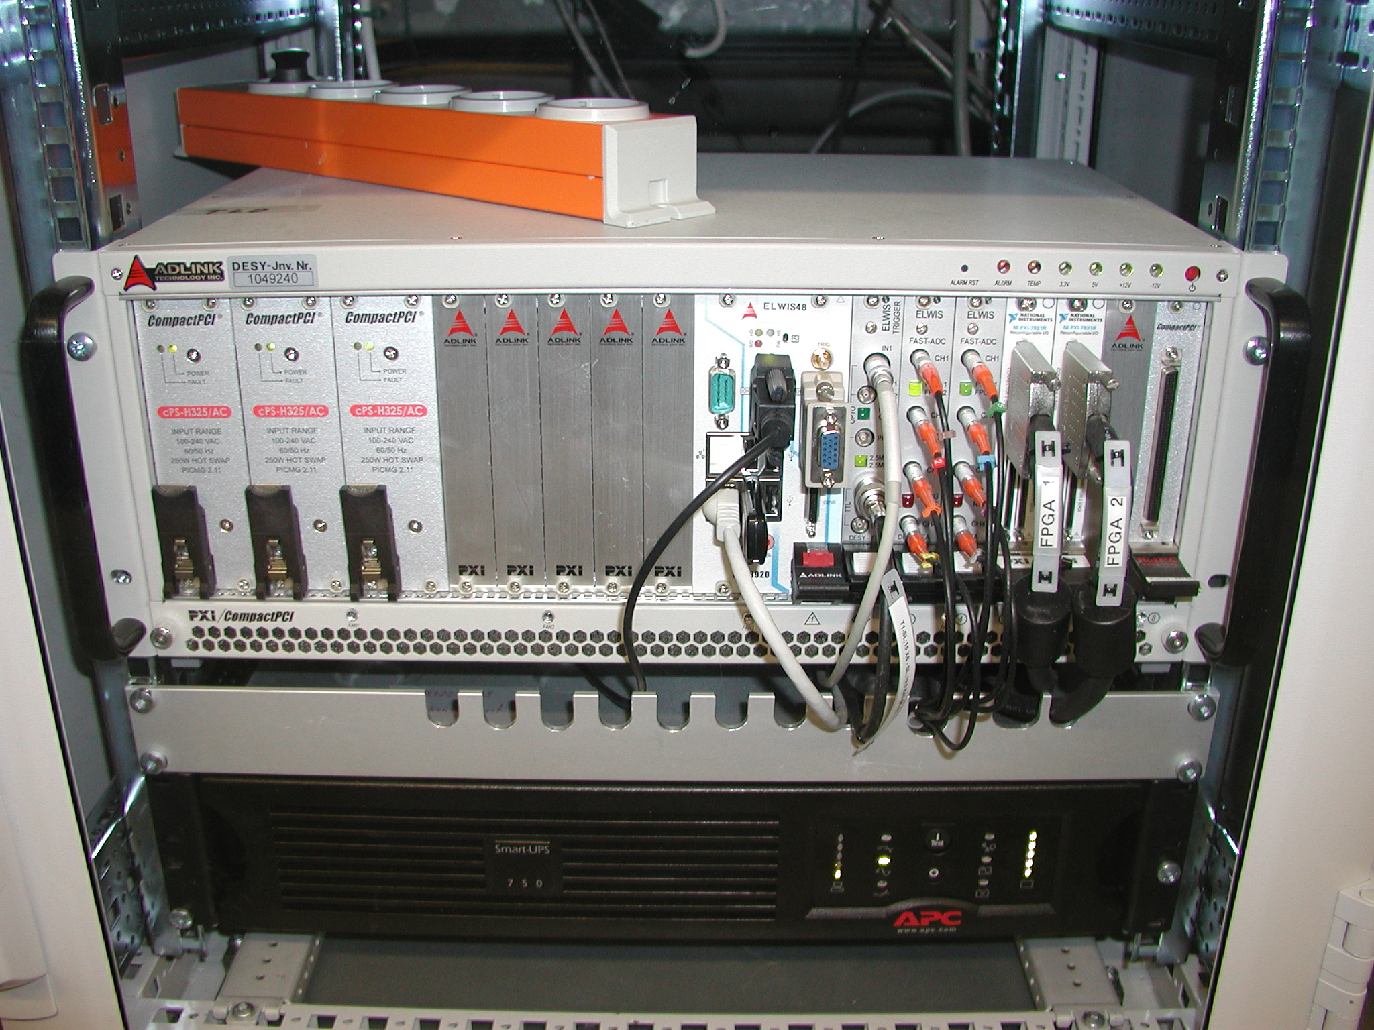
The existing RF system.
PETRA III
RF parameters
frequency: 499.664 MHz
harmonic number: 3840
20 MV cavity voltage
12 × 7 cell nc cavities
RF power: up to 4 × 800 kW (2 Thales and 2 Philips klystrons)
ELWIS: modular control system based on PXI crates (Windows, LabVIEW, TINE)
tunnel
transmission line to the other side

Slide 6
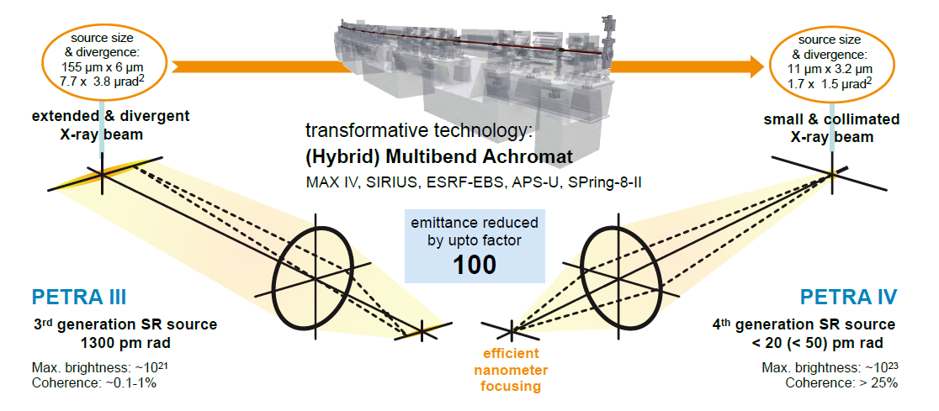
PETRA IV.
The future from 2028 (Dark time: 2026-27)

Slide 7
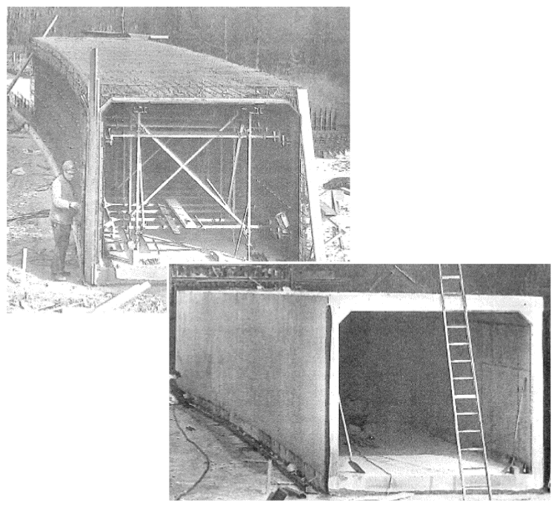
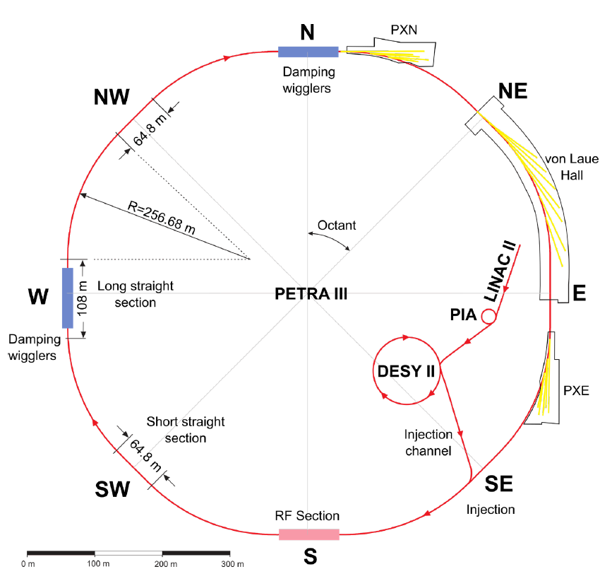
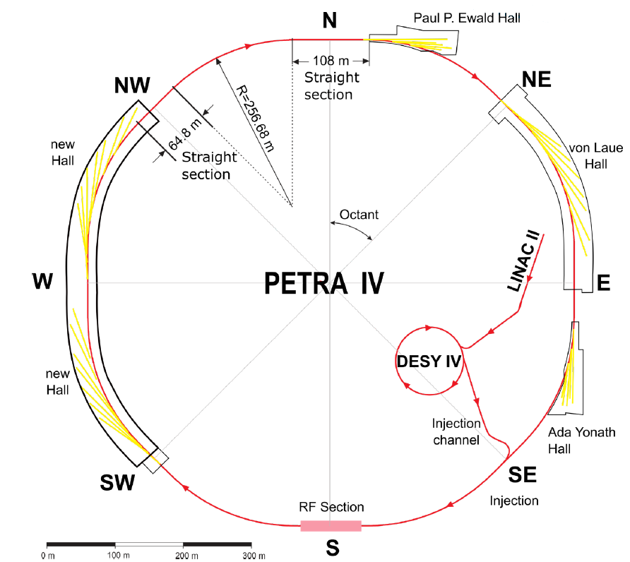
PETRA III vs PETRA IV.
mostly reuse of the
old tunnel segments
of PETRA 1 from 1976
Thanks to
Michael Bieler

Slide 8
Some main parameters in comparison.
 | PETRA III | PETRA IV (CDR)
Energy / GeV | 6.08 | 6.08
Circumference / m | 2304 | 2304
Revolution frequency / kHz | 130.121 | 130.121
Beam lines | 26 | 30
Number of bunches (timing-, brightness mode) | 40, 480 | 80, 1600
Beam current / mA | 100, 120 | 80, 200
Bunch current / mA | 2.5, 0.25 | 1, 0.125
Emittance (hor./vert.) / pm rad | 1300 / 10 | <50 / 10, <20 / 4
Energy loss (ID closed) / MeV per turn | 5 | 4.024
Momentum comp. factor | 0.001127 | 0.00001485
RF voltage / MV | 20 | 8 + 2.4
Synchrotron frequency / kHz | 6 | 0.421
RF frequencies / MHz | 499.6 | 499.6 + 1500
Harmonic number | 3840 | 3840

Slide 9
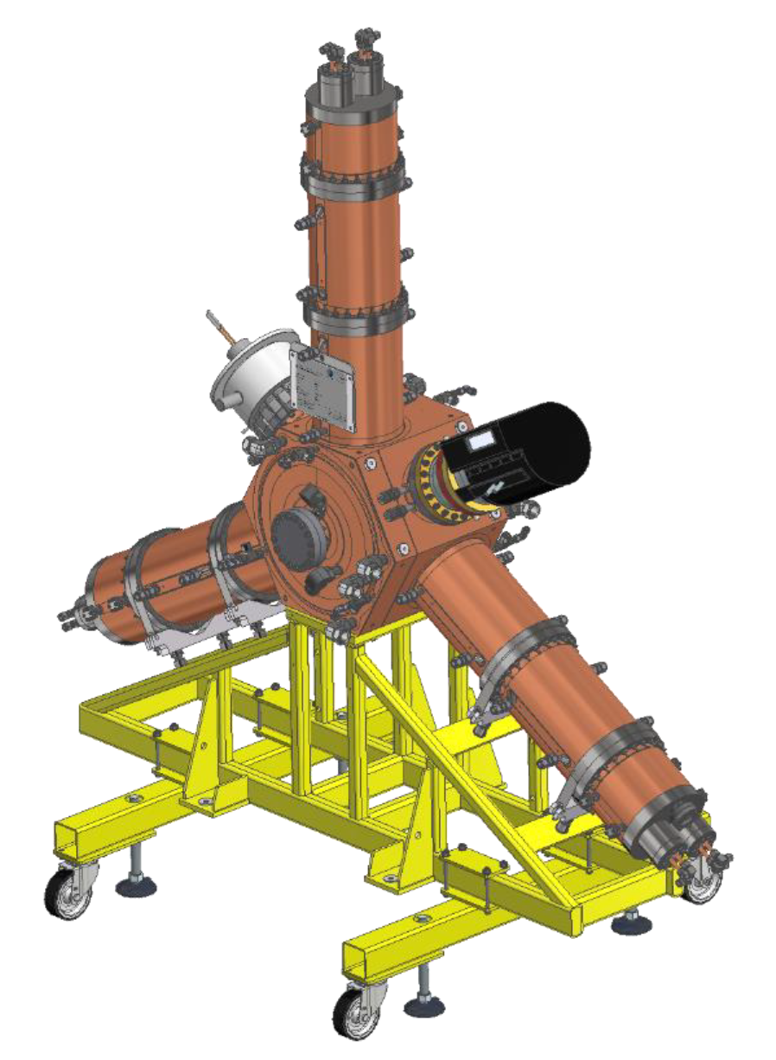
PETRA IV RF.
fundamental
Parameters for the PETRA IV fundamental RF system:
500 MHz single cell nc cavity
HOM damped
reuse of plungers and couplers
see presentation
‚Plunger Refurbishment‘
(Nils-Oliver Fröhlich)
Main (fundamental) RF frequency | 499.65 MHz
Total voltage main RF | 8 MV
RF voltage per cavity | 476 kV
Transit Time Factor | 0.7
RF voltage per cavity seen by the electrons | 333 kV
Cavity wall loss | 16.3 kW
Quality factor (unloaded) | 29600
Cavity coupling factor | 3.0
Shunt impedance R_{s}=V²/(2P) | 3.4 MΩ
Loaded quality factor | 7400
Number of main RF cavities | 24
Synchronous phase | 30.2$°$
Synchrotron frequency | 421 Hz
Total wall loss in cavities | 392 kW
Total beam loading power | 800 kW
Nominal transmitter power per RF station | 110 kW
Beam tube aperture | 74 mm
Length of cavity (flange to flange) | 500 mm

Slide 10
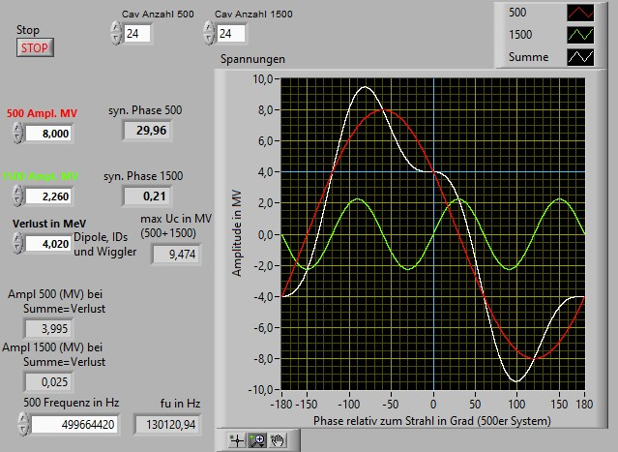
two frequencies.
lengthen the bunch with a second active RF-system
corrected: 23 ps (7 mm)
Bunch length:
- without a 2nd RF-system: 5 ps (1.5 mm)
- with an additional RF-system (3rd harmonic): 65 ps (ca. 20 mm)
So the single bunch current could be increased
The required harmonic RF voltage for a flat potential at the bunch transition is
n: order of the harmonic (PETRA IV: 3) U₀: energy loss per turn (4.0 MeV) V_{rf}: voltage of the fundamental RF system (8.0 MV) q_{e}: elementary charge (1.602 * 10⁻¹⁹ C)
This gives an optimum value for the harmonic voltage of V_{HHC,opt.} = 2.26 MV. With some safety margin, the system is designed for V_{HHC} = 2.4 MV.
corrected:
60 ps (18 mm)
$$VHHC, opt.=Vrf \sqrt{\frac{1}{n^{2}} − \frac{1}{n^{2} −1}∗{\left(\frac{U0}{ qe Vrf}\right)}^{2}}$$

Slide 11
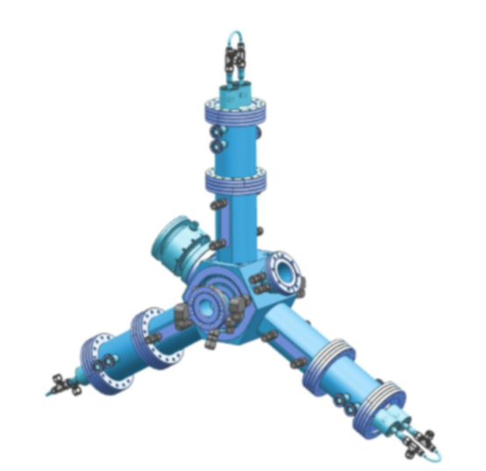
PETRA IV RF.
third-harmonic
Parameters for the PETRA IV third-harmonic RF system:
3rd harmonic RF frequency | 1498.995 MHz
Total RF voltage | 2.4 MV
RF voltage per cavity | 100 kV
Cavity wall loss | 3.3 kW
Quality factor (unloaded) | 17000
Loaded quality factor | 2700
Total wall loss in cavities | 71 kW
Cavity coupling factor | 5.3
Shunt impedance R_{s}=V²/(2P) | 1.5 MΩ
Number of RF stations (cavity/SSA) | 24
Nominal transmitter power per RF station | 10 kW
Beam tube aperture | 46 mm
Length of cavity (flange to flange) | 313.6 mm
Collaboration ALBA/HZB/DESY
Development of a 3rd harmonic HOM damped cavity
1/3 scaled and optimize from 500 MHz
see presentation tomorrow (Jesús Ocampo)
In addition there are some ideas of alternatives
see presentation of Peter Hülsmann

Slide 12
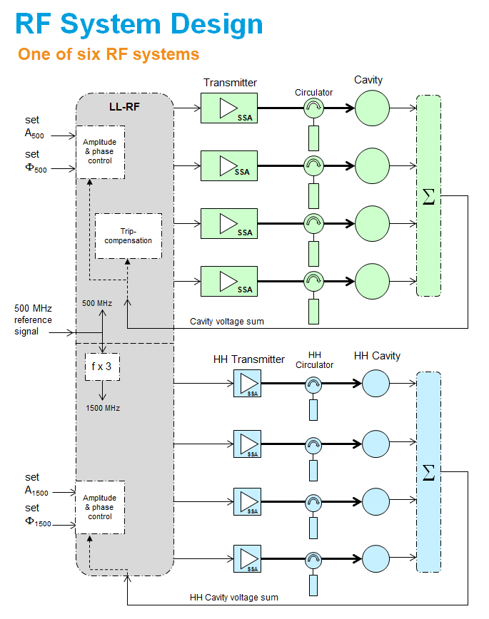
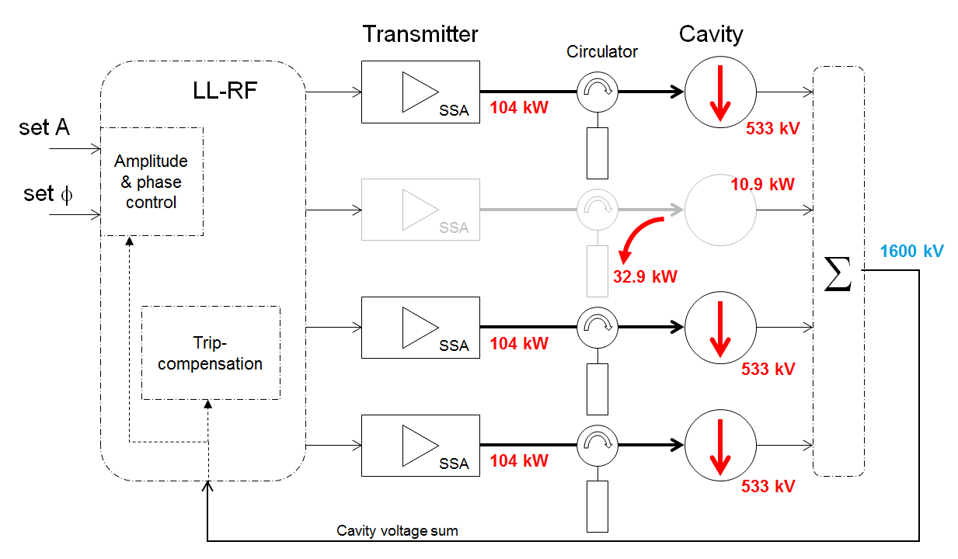
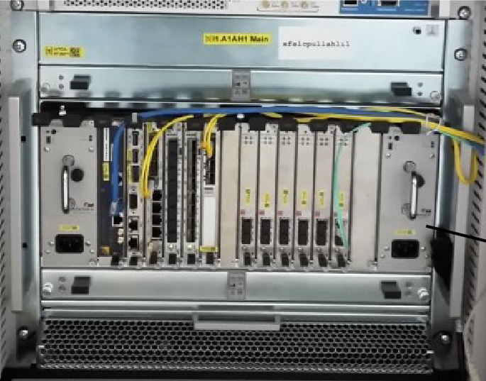
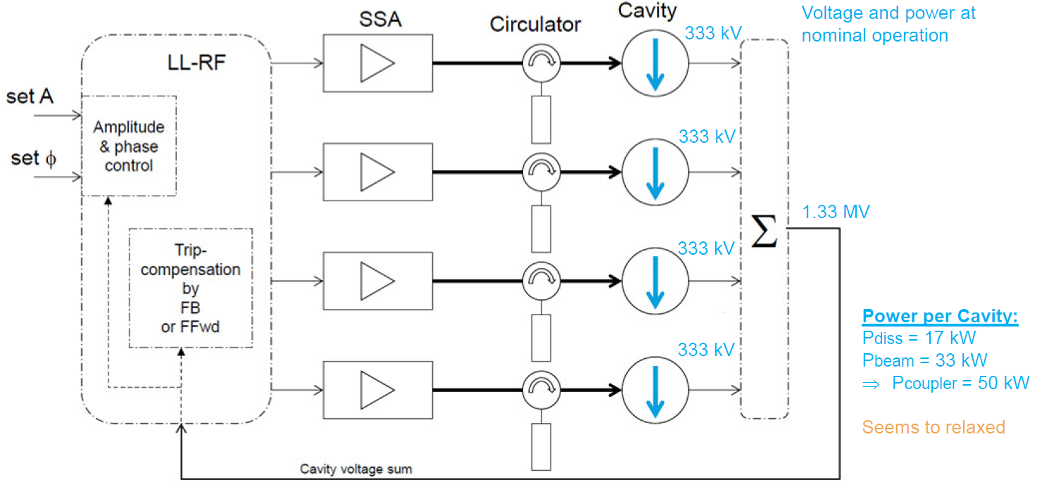
RF System Design.
A worst case scenario (200 mA beam current):
Only 5 of the 6 systems (each a group of 4 SSA/Cav) running
and in addition a failure of one sub-system (SSA/Cav).
This brings the cavities to their limit.
Each of the 24 cavities is powered by its own Solid State Amplifier (SSA) and we want to control them in 6 groups of 4 pairs of cavity/SSA.
µTCA crate
More details see presentations tomorrow
(Frank Maschewski, Arvid Eislage)

Slide 13
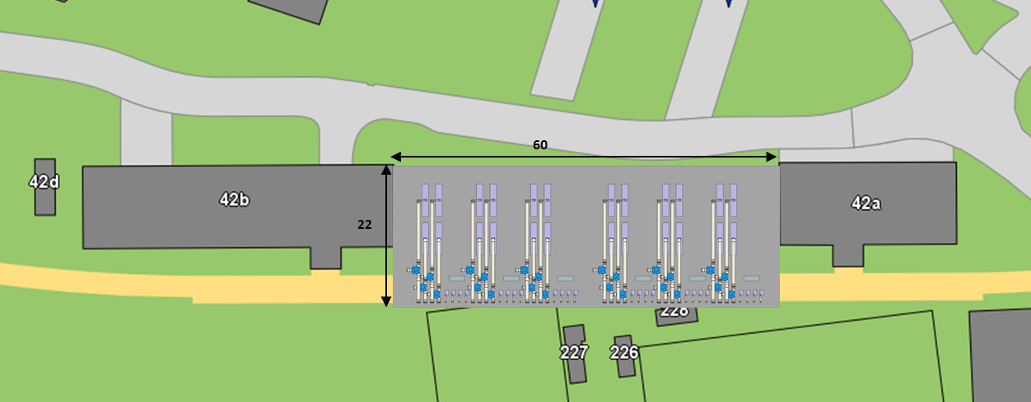
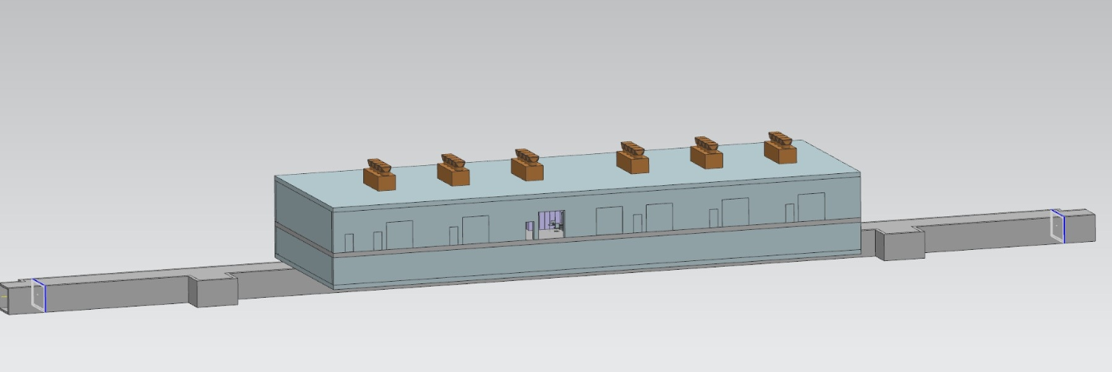
RF implementation in PETRA IV.
new tunnel segment and new hall: 24 + 24 cavities and 24 + 24 SSA
tunnel

Slide 14
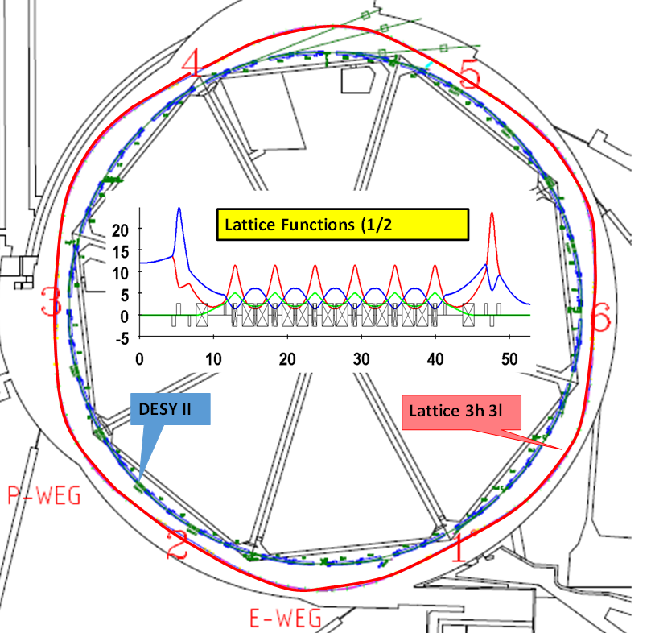
DESY IV.
Booster parameters:
Circumference: 316.8 m
Harmonic number: 528
Repetition rate: 2 Hz to 5 Hz
Momentum compaction: 3.30 × 10−3
Beam energy at 6 GeV 700 MeV
Energy loss per turn 4.04 MeV 0.748 keV
A new machine (DESY IV) in the same tunnel as
the existing and remaining DESY II.
RF:
9 (grouped in 3 locations) 5-cell 500 MHz nc cavities
each powered by a SSAs
Frequency | 499.65 MHz
Total RF voltage | 12 MV
RF voltage per cavity | 1.3 MV
Cavity wall loss | 59 kW
Quality factor (unloaded) | 29500
Cavity coupling factor | nyd
Shunt impedance R_{s}=V²/(2P) | 15 MΩ
Number of RF 5-cell cavities | 9
Beam tube aperture | 120 mm
Cavity length (flange to flange) | 1800 mm

Slide 15
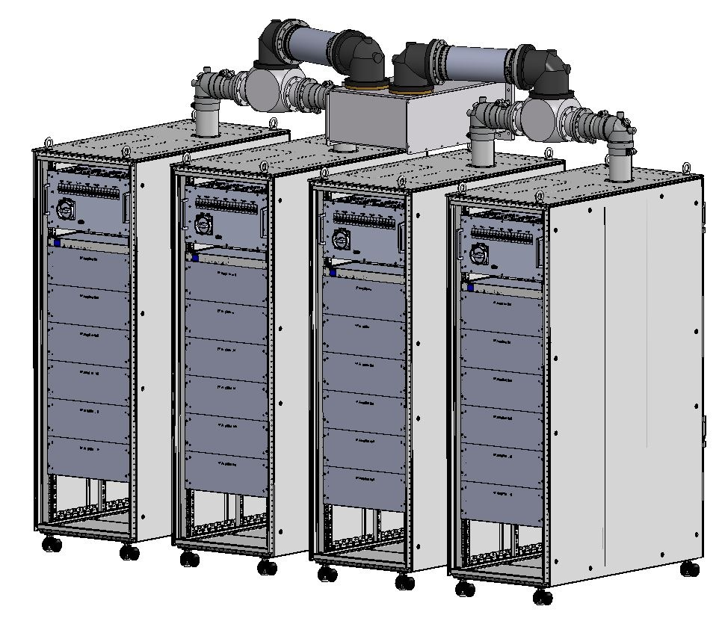
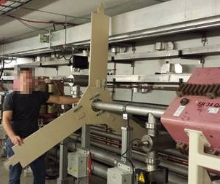
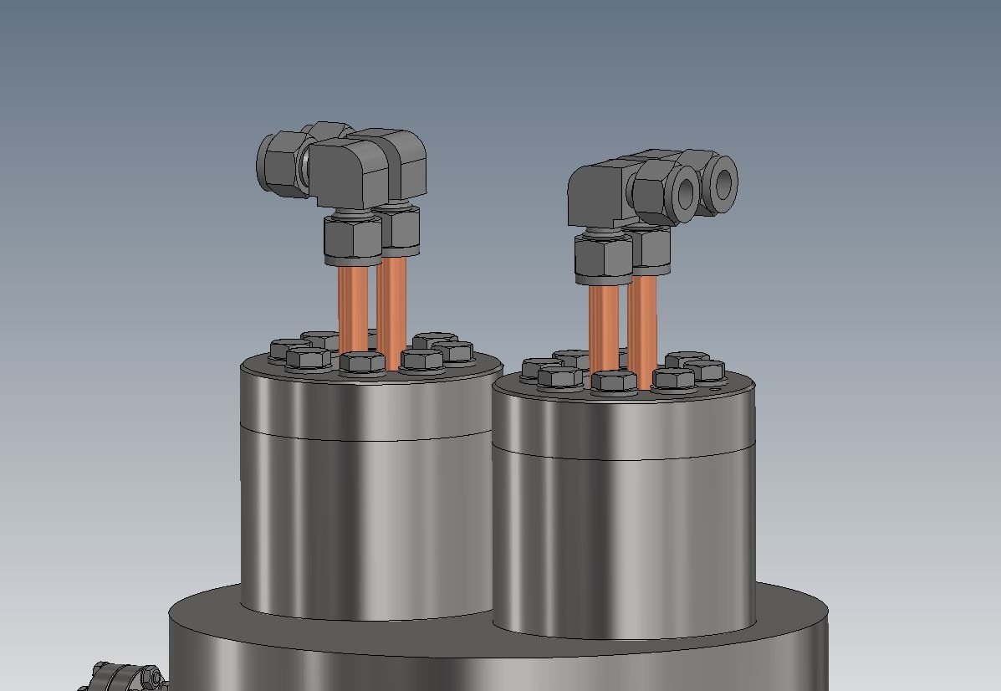
Tests of P4 RF components in P3.
One prototype SSA and one prototype HOM damped 500 MHz single cell cavity
Delivery SSA: July 2022
Delivery cavity: March 2022

Slide 16
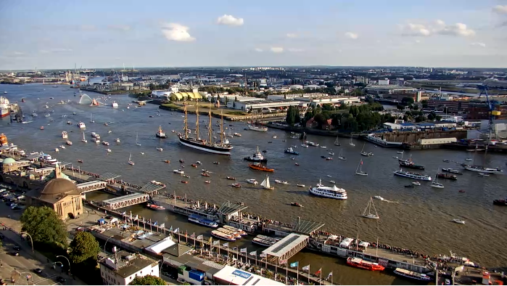
Thank you for lending your ears.
Additions or questions?
Sailing vessel (four-masted barque) „Peking“ back in Hamburg 2020-09-07

Slide 17
Stefan Wilke
DESY, MHF-e
stefan.wilke@desy.de
049/40/8998-1836

