Slide 1


Status of Solaris RF system
Krzysztof Guła
e-mail: krzysztof.gula@uj.edu.pl

Slide 2
Outline
Overview of Solaris
Current RF projects
Issues
Future activities

Slide 3
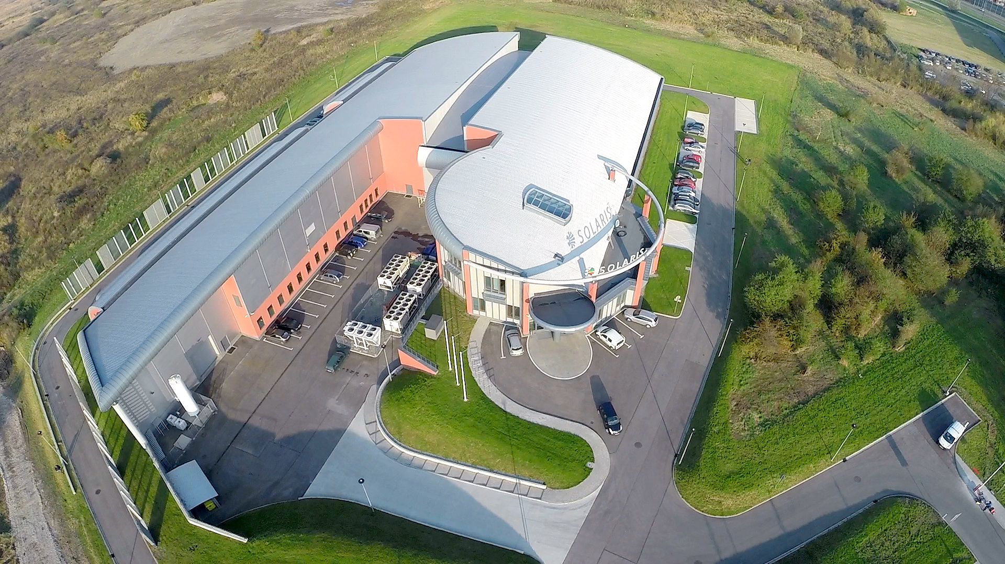
Overview of Solaris
SOLARIS National Synchrotron Research Centre
First light source infrastructure in Poland.
Build with unique collaboration between MAXIV Laboratory and Jagiellonian University.
Green field project financed from EU Funds.
Located at Jagiellonian University Campus in Krakow.
Design&installation: 2010-2015
In operation since May 2015.
First Users: October 2018
Staff in 2021: 96 Employees
Accelerator Department: 15 Employees
RF Section: 3 Members

Slide 4
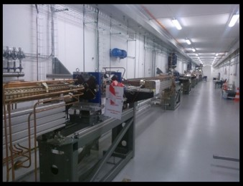
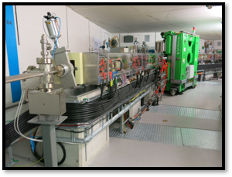
Overview of Solaris
Accelerators
Injector Parameters | Value
Energy max | 600 MeV
Bunch charge | 0.1 nC
Emitance (geom, rms) x/y | 3.1 / 2.0 nm rad
Energy spread (rms) | 0.23%
Bunch length (rms) | 3.68 ps
Injection repetition rate | Up to 10 Hz (linac up to 100Hz)
600 MeV Linac
RF Thermionic Gun
6 S-band 2998.5 MHz accelerating structures
Accelerating gradient 20 MeV/m
3 RF Units & SLED cavities
Dog-leg vertical transfer line
In operation since Dec. 2014
Storage Ring Parameters | Value
Energy | 1.5 GeV
Current | 500 mA
Circumference | 96 m
Horizontal emittance (bare lattice) | 5.982 nm rad
Coupling | 1%
Tunes Q_{x}, Q_{y} | 11.22, 3.15
Natural chromaticities ξ_{x}, ξ_{y} | -22.96, -17.14
Momentum compaction | 3.055 x 10⁻³
Momentum acceptance | 4%
Overall Lifetime | 13 hrs
1.5GeV Storage ring
12 DBA Cells – 96 m circumference
Space for ID’s (10 sections) ~ 3.5 m
10 straight sections for IDs
100 MHz RF system
300 MHz Landau Cavities
Injection dipole kicker
Ramping
In operation since May 2015

Slide 5
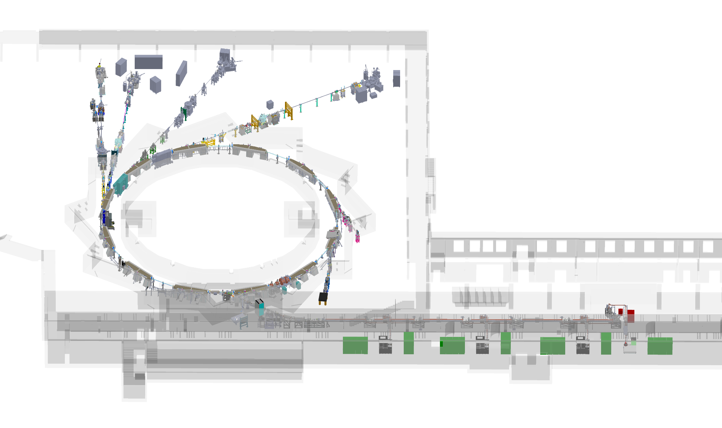
Overview of Solaris
Experimental hall
DEMETER
XAS
UARPES
PHELIX
4 fully operational beamline
2 fully operational diagnostic line
1 beamline under construction
1 beamline under commisioning
Experimental hall extension planned 2022
POLYX
PINHOLE
SOLABS
LUMOS

Slide 6
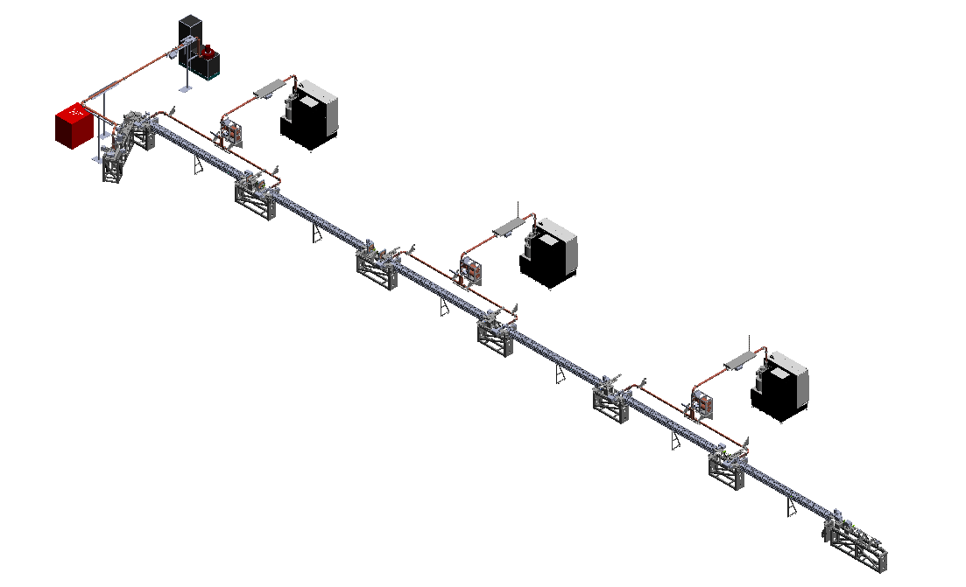
Overview of Solaris
SOLARIS RF System
Klystron with modulator for gun.
3 klystrons with mdulators for accelaration
3 accelerating units with SLED
Thermionic gun
6 accelerate structures
Injector

Slide 7
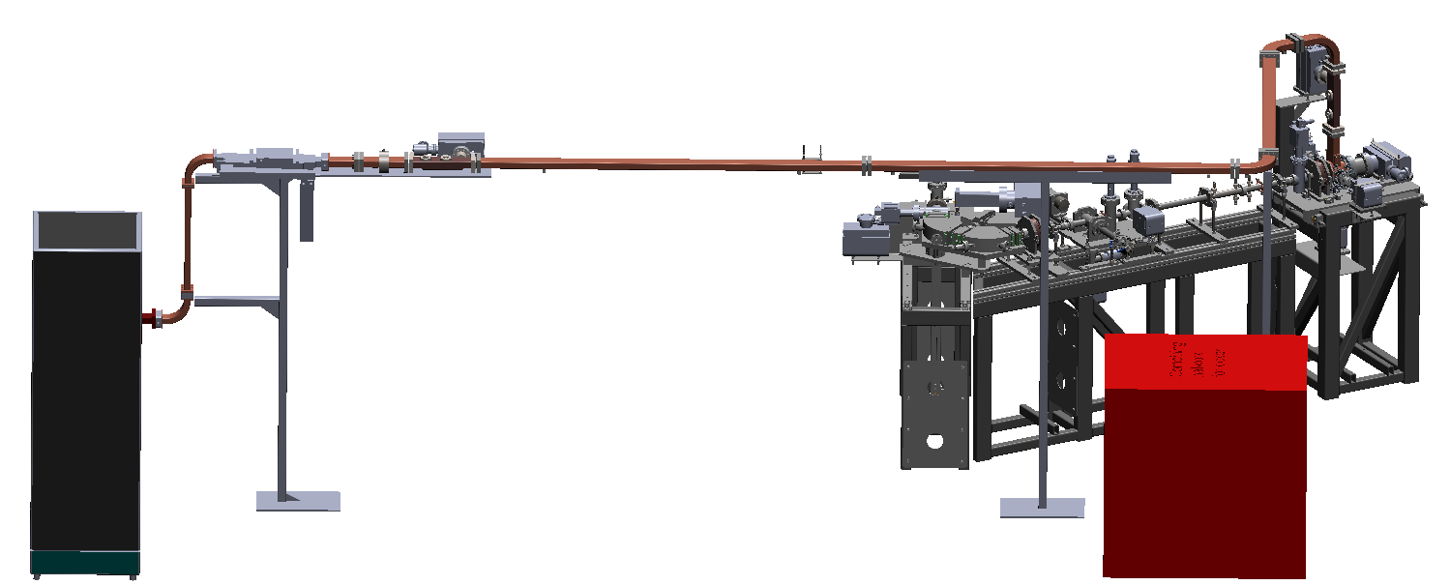
Overview of Solaris
SOLARIS RF System
Thermionic gun
Munufacturer: MAX IV Lab.
Cathode BaO
Beam Energy: 1.5 – 3 MeV
Rep. Rate: 10Hz
Chopper striplines
Munufacturer: MAX IV Lab.
Circulator (isolator)
Munufacturer: AFT
FWD peak power: 20MW
FWD Avg. Power: 5MW
Reverse power: 100%
Filled with SF6
Pre-Injector
S-band 3GHz RF unit for gun
Munufacturer: ScandiNova
Solid-state modulator
RF freq.: 2998,5 MHz
RF peak power from klystron: 8 MW
Pulse lenght: 3µs
Repetion rate: 0-10Hz
Klystron: Thales TH2175A-1

Slide 8
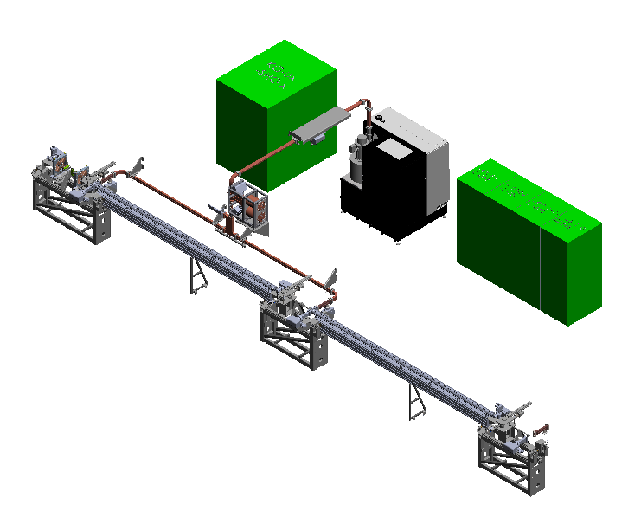
Overview of Solaris
SOLARIS RF System
S-band 3GHz RF unit for accelerating section
Munufacturer: ScandiNova
Solid-state modulator
RF freq.: 2998,5 MHz
RF peak power from klystron: 37 MW
Pulse lenght: 4.5µs
Repetion rate: 0-100Hz
Klystron: Toshiba E373110
Waveguides
Munufacturer: IHEP
Size: WR284
Flanges: LIL for UHV
LLRF for each RF unit in the Linac
Munufacturer: MAX IV Lab.
Pulse shaping
Phase adjustment
180° phase swap for SLED
Rep. Rate: 10Hz
Open loop, no feedback
SLED cavity with 3dB hybrid coupler
Munufacturer: Research Imstruments
Q (unloaded): 98000
Accelerating structure
Munufacturer: Research Imstruments
Acc. Gradient: 20MeV/m
Lenght: 5m
Accereating unit

Slide 9
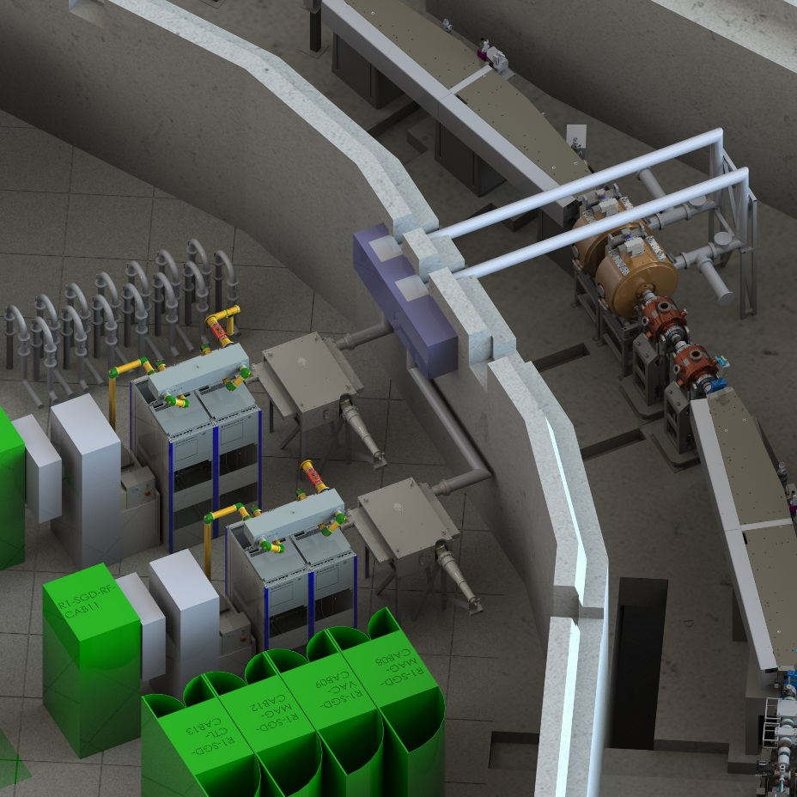
Overview of Solaris
SOLARIS RF System
100 MHz Main Cavity
MunufacturerResearch Instruments
Resonant freq.: 99.93 MHz
Tuning range: ± 540kHz
Gap voltage: 300kV
6 1/8” EIA rigid coax line
with directional coupler
Munufacturer: Exir Broadcasting AB
300 MHz Landau Cavity
MunufacturerResearch Instruments
Resonant freq.: 99.93 MHz
Tuning range: ± 550kHz
Gap voltage: 450 kV
Circulator (isolator)
Munufacturer: AFT.
FWD peak power: 120kW CW
REV power: 100%
100Mhz RF transmitter THR9
Munufacturer: R&S
Technology: Solid State
RF freq.: 99.93MHz
RF peak power: 61.2 kW
Digital LLRF for SR
Munufacturer: Alba
Comercial µTCA board (Nutaq picodigitizer)
Control of amplitude and phase cavity voltage
Control of resonance frequency (cavity tuning)
Safety interlock
I/Q demodulation technique
Tango device server for setting-up
RF power system for Storage Ring
Plunger
Munufacturer: Measline
Tuning range: ± 500kHz

Slide 10
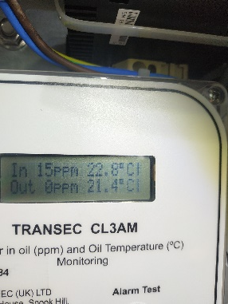
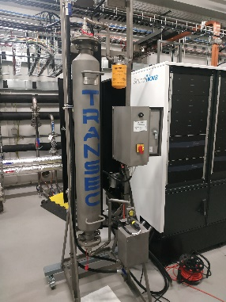
What has been done
Plans for 2020/21 (Slide from Marcin Knafel presentation ESLS 2019)
Linac
Replacement of capacitors in HVPS modules and HMI panels in all modulators.
Portable oil dehydration unit for the klystron galery.
SR
A test & repair rig for PHR amplifier modules.
Probing the market for eventual replacement of AFT circulator with a different one, any suggestions welcome.
Introduction of FDL, software is ready, it needs to be tested on a spare LLRF setup before uploading it into the machine.
Bunch by bunch feedback – plans and documentation needed from MAX IV
On request from BL group – a device to clean optical elements of beamlines with RF-induced plasma.
Other
Since 2020 is planned for expanding the experimentall hall, new, bigger RF lab might be possible
Need more RF staff – difficult due to high market demand, literally across the street (Nokia, Motorola, Ericson)
DONE!
DONE!
IN PROGRESS
IN PROGRESS
IN PROGRESS
IN PROGRESS
TESTS
IN PROGRESS
IN PROGRESS

Slide 11
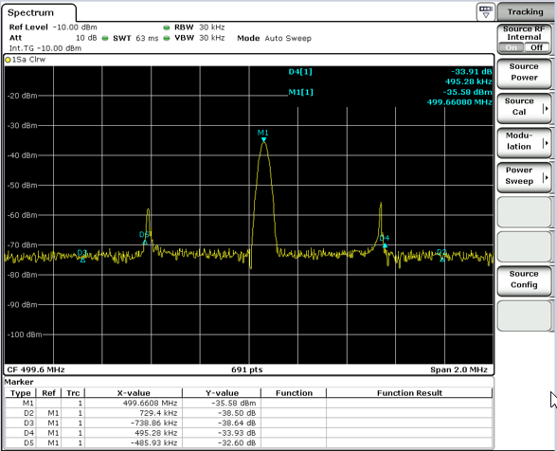
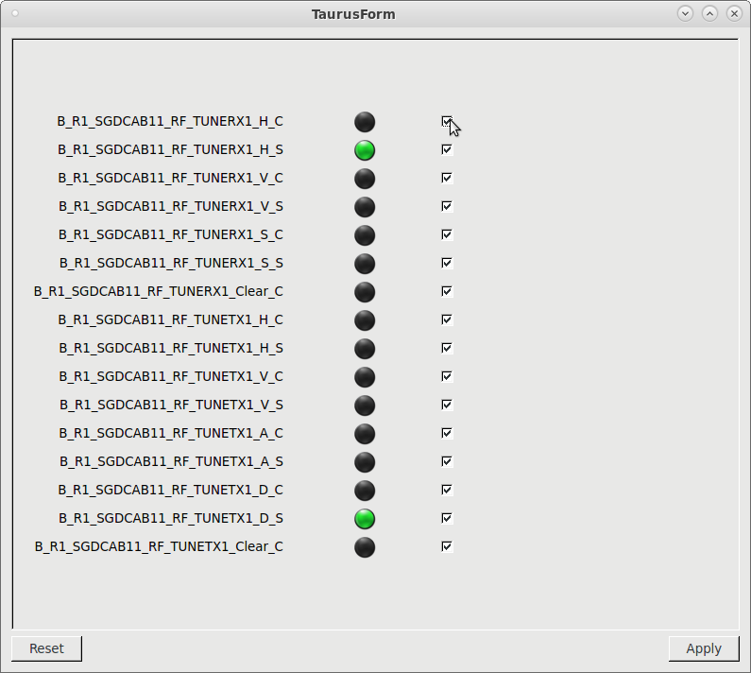
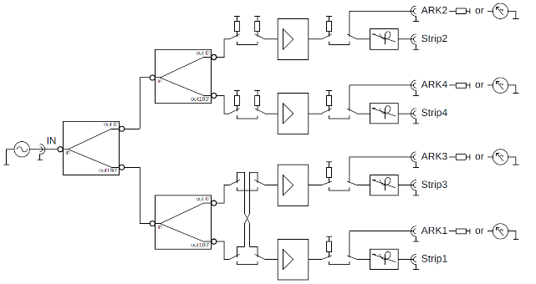
Current RF Projects
Tune measurement device.
Built based on documentation from MaxLab with own modifications.
Stripline feeding network and reciever network operational.
The set up is currently under tests and is going to be implemented next weeks.
The controll GUI should be re-build

Slide 12
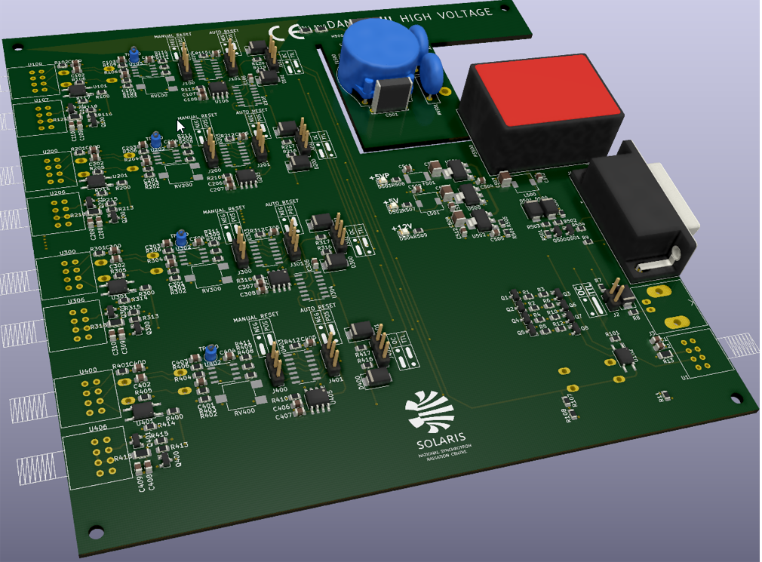
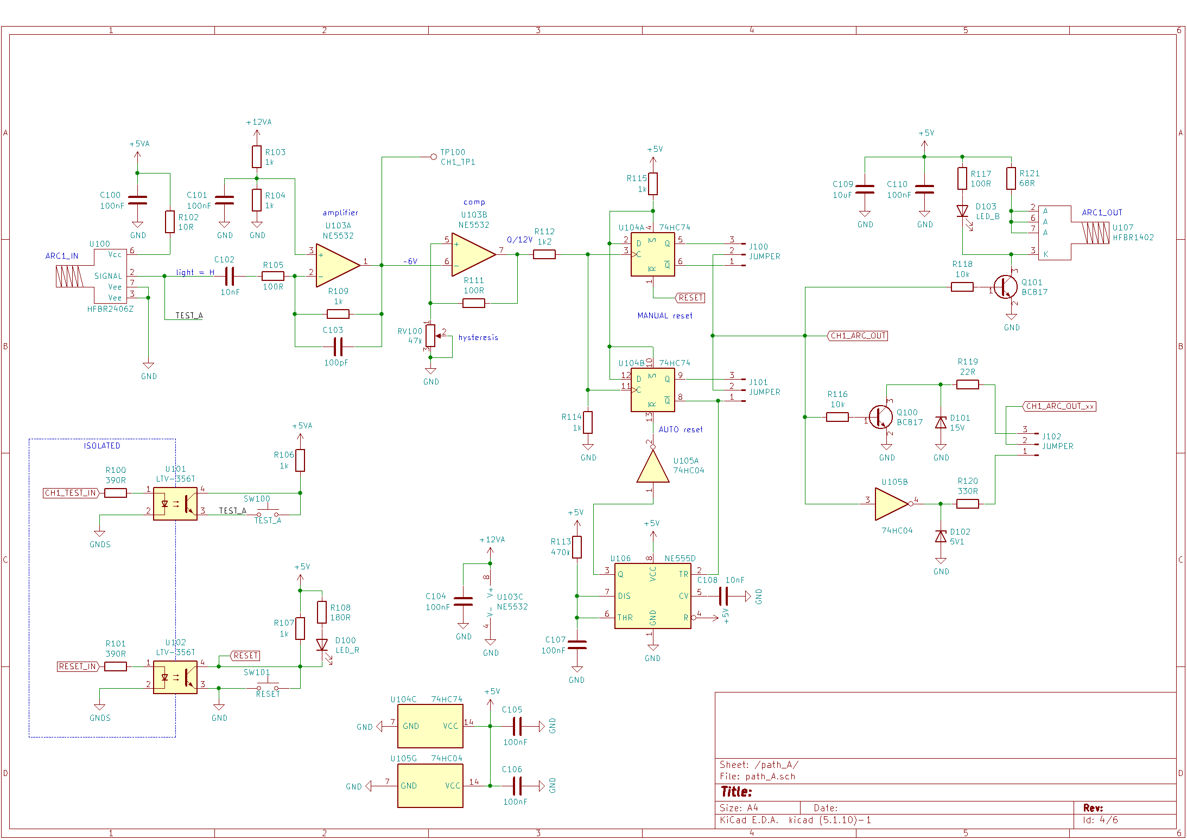
Current RF Projects
Four channel arc detector (for a circulator 100MHz).
Design based on AFT device.
Custom schematic and PCB design
PCB project is ready for the production order.

Slide 13
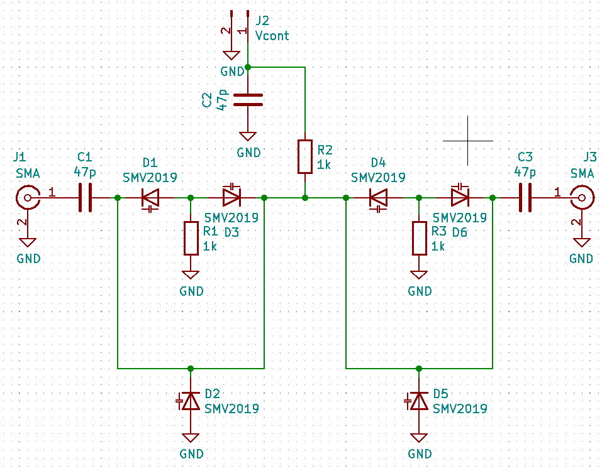
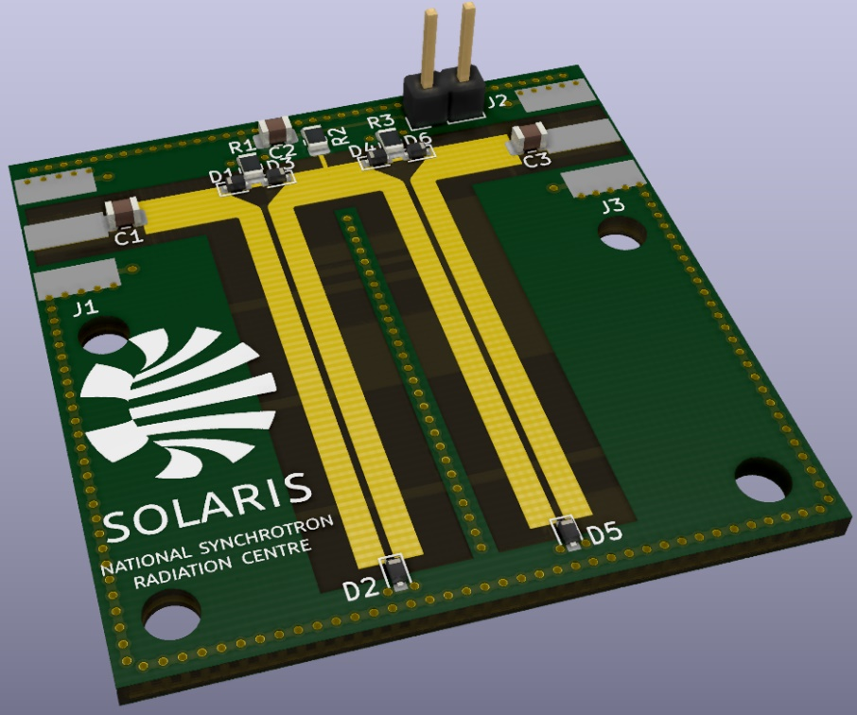
Current RF Projects
Phase shifters for Linac
We don’t have any spare PS
Last failure
Custom schematic and PCB design

Slide 14
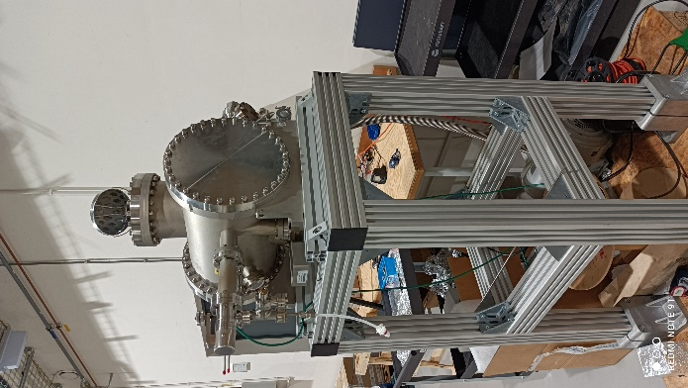
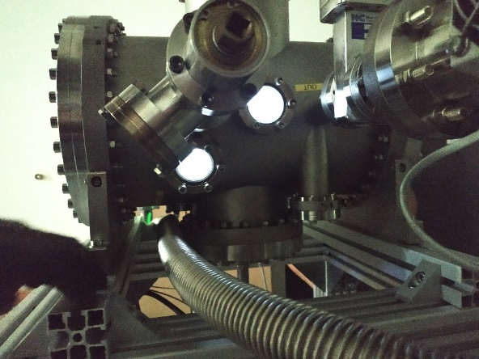
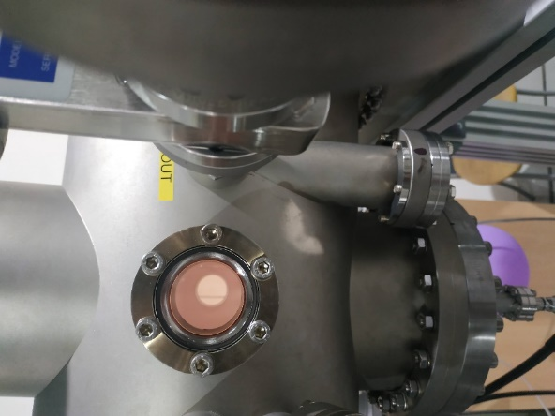
Current RF Projects
Plasma cleaning chamber
Project owner: Tomasz Sobol – Phelix beamline, Solaris.
The plasma cleaning station will mainly used to clean the optical components used in the beamlines, from carbon contamination. The plasma generated in the chamber will allow to remove carbon layers in a controlled manner, potentially restoring the basic parameters.
Two ways of cleaning process:
Chemical cleaning – Nitrogen/Oxygen plasma
Chemical/ mechanical cleaning – 95%-99% of Nitrogen, 1%-5% noble gas (Argon)
RF system already tested.
f~14MHz, RF power ~20W (will be changed)
Waiting for functionality tests forseen soon

Slide 15
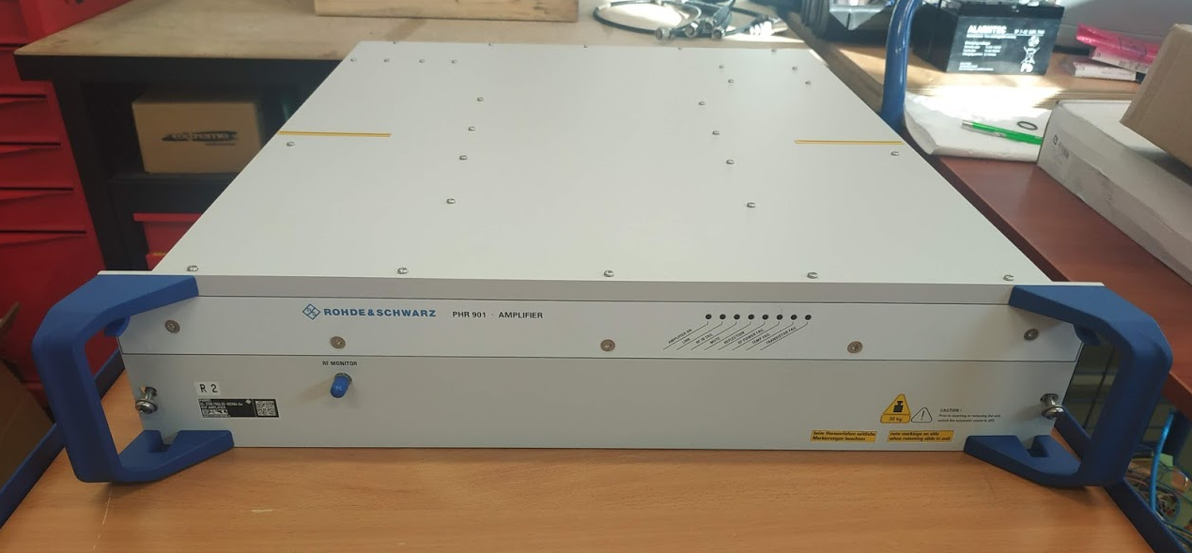
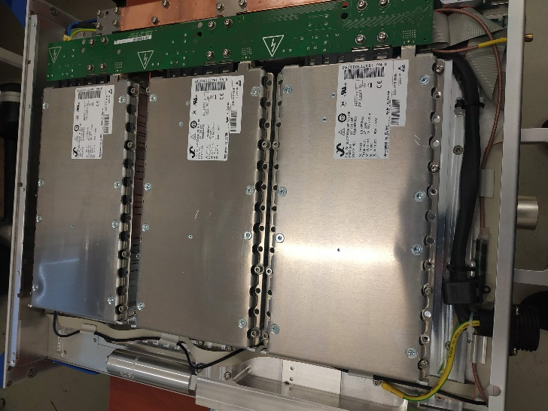
Issues
Trasmitter failure.
Amplifiers notoriously fail due to PSU. Rarely for other reason.
Harmless problems with a control unit .
Plan for build test stand at Solaris in order to diagnose and repair the PHR amplifier modules
Purchased warranty extension to March 2022
Purchased a spare power supply module for the amplifier
The spare transmitter, circulator, load and RF Cavity is included in a budget plan for 2021-2025

Slide 16
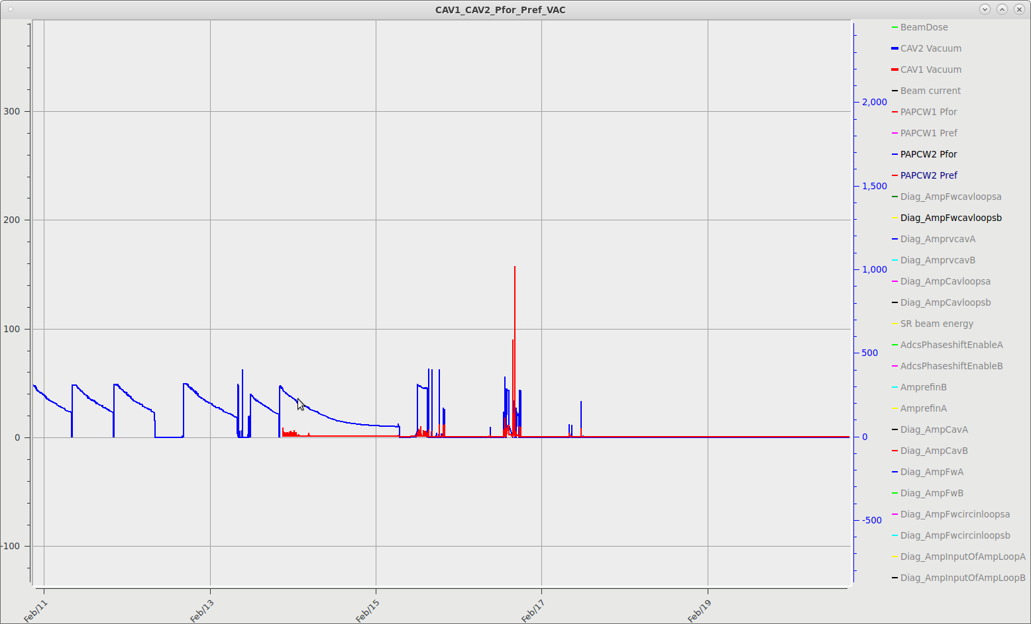
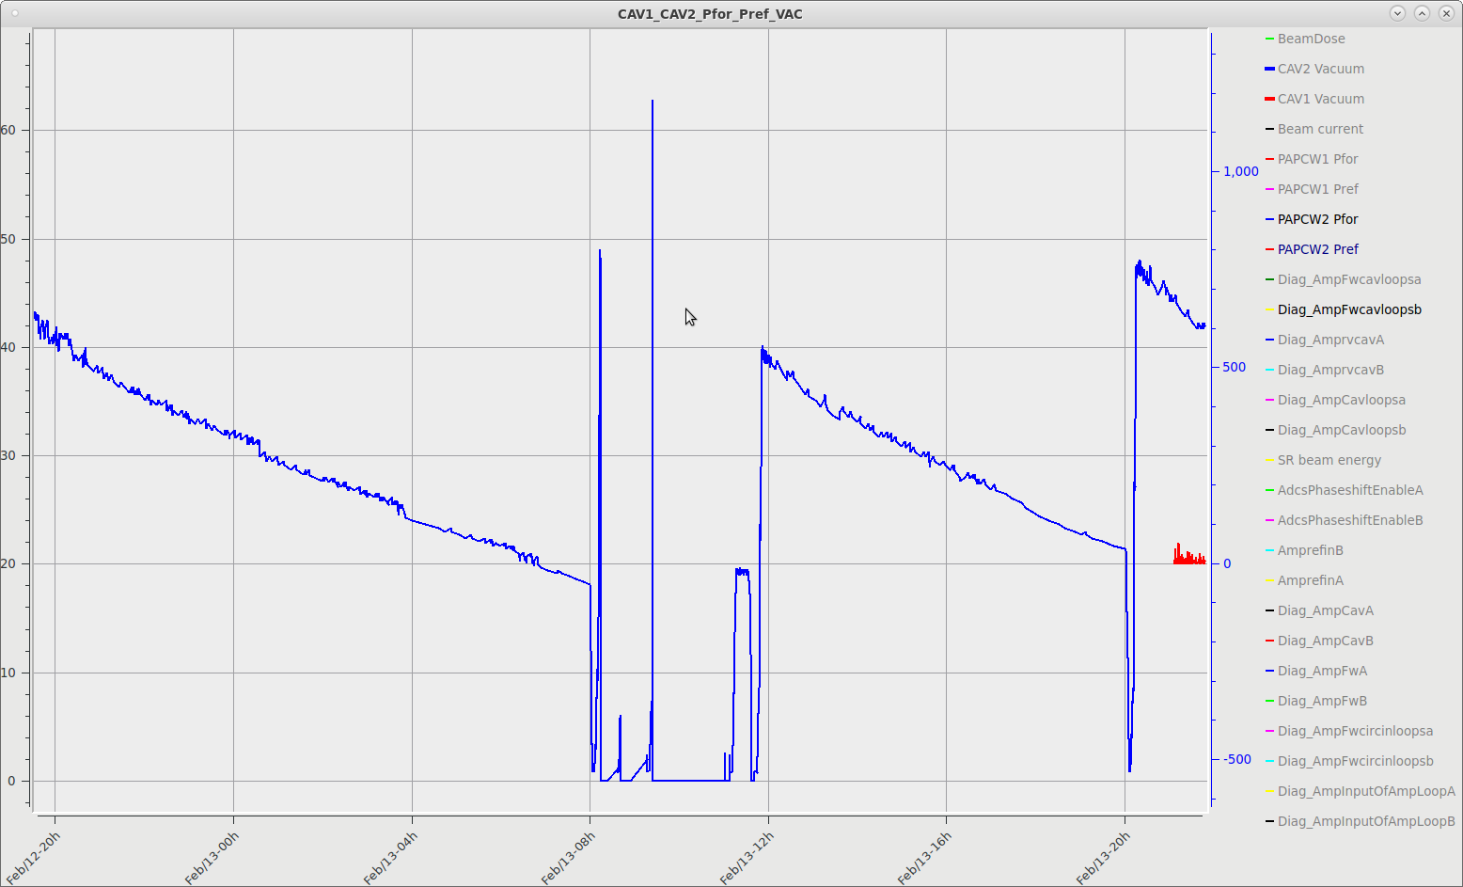
Issues
Trasmitter failure (February 2021)
The first symptoms of a fault (high power peaks)

Slide 17
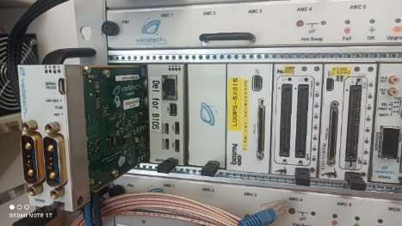
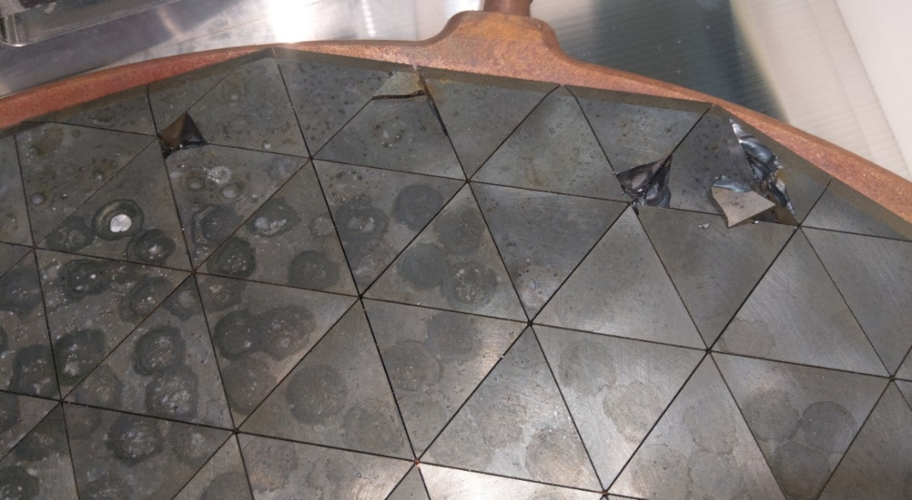
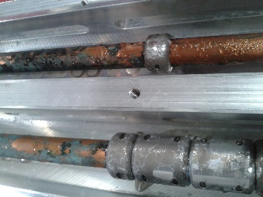
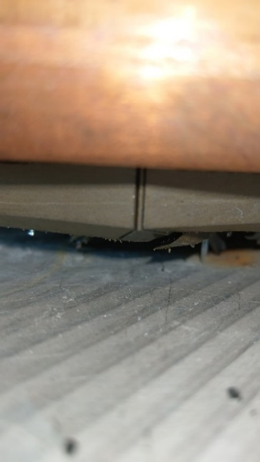
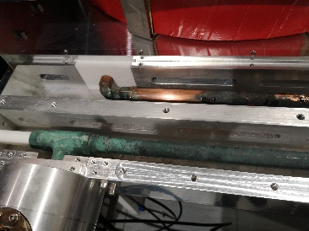
Issues
Trasmitter failure (February 2021)
Diagnose RF systems and looking for a reason of fault.
- LLRF – replaced power supply module in Nutaq picodigitizer
- Coaxial line (checking connections, cleaning inside a pipes)
- Transmitter (power sensor calibration, test with load)
A test with the circulator with shorted output port and RF power directed to the load, caused arcs inside the circulator.
The circulator has been damaged!
We suspect that the original cause of the damage was previous problems with unsealing and leakage of cooling water, and subsequent acid contamination.
Attempting to repair and ordering ferrite modules by ourself.
- AFT did not want to sell these modules.
Decision was taken to repair it in AFT factory.
In the near future new isolator is planned to be purchased. (2022 – 2025).

Slide 18
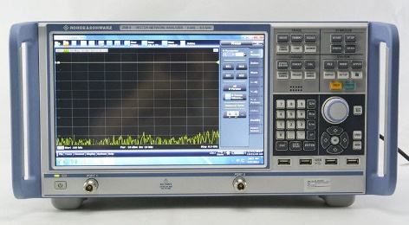
Issues
Trasmitter failure (February 2021)
After the repairs of isolator by AFT (May 2021), problem was not resolved! ☹
Last suspect– Directional Power Coupler in the second cavity.
Replacement of PC has been scheduled for summer ’21 shutdown.
Complicated task - never done before by existing team – lack of basic knowledge.
Measurements done before replacement (high temp, low temp, Vacuum and no Vacuum)
R&S Vector Network Analyzer 8.5GHz; 2 ports
Directional Power Coupler
6 1/8’’ coaxial line
„N” -> 6 1/8’ Port
Cavity

Slide 19
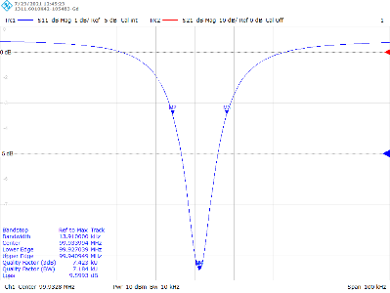
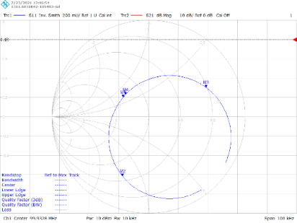
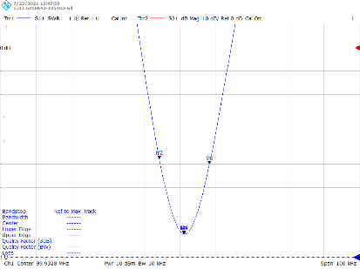
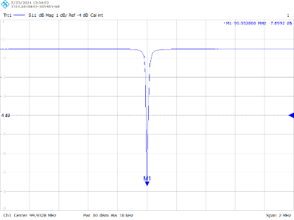
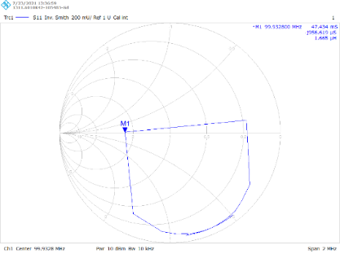
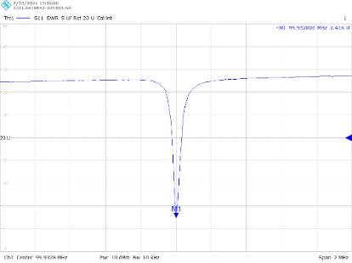
Issues
Trasmitter failure (February 2021)
After the repairs of isolator by AFT (May 2021), problem was not resolved! ☹
Last suspect– Directional Power Coupler in the second cavity.
Replacement of PC has been scheduled for summer ’21 shutdown.
Complicated task - never done before by existing team – lack of basic knowledge.
Measurements done before replacement (high temp, low temp, Vacuum and no Vacuum)

Slide 20
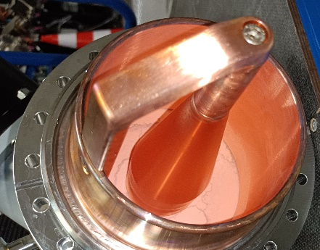
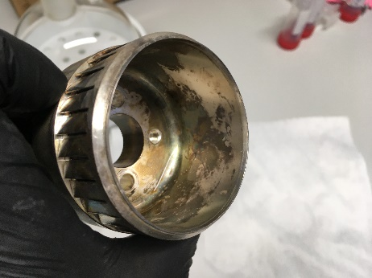
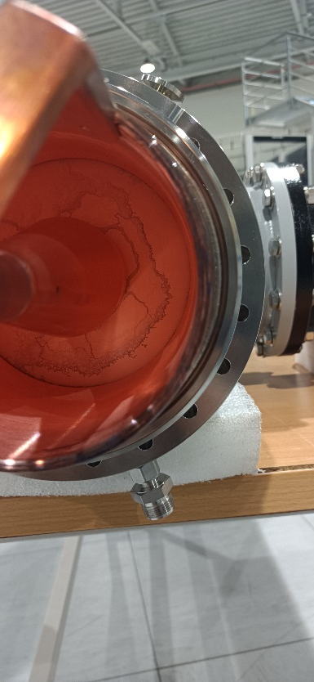
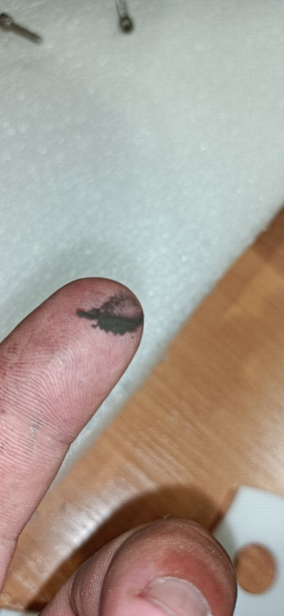
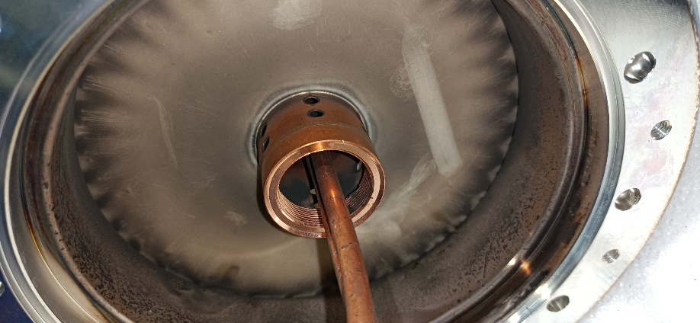
Issues
Trasmitter failure (February 2021) – Power Coupler replacement (Summer ’21)
Disassembly done without problems.
No visible signs of damage
- after disassembled power coupler into parts, some black dust has been noticed.
Source of this dust is under investigation.

Slide 21
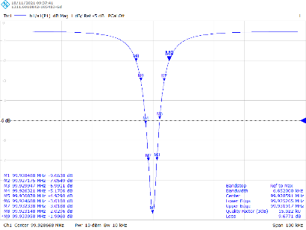
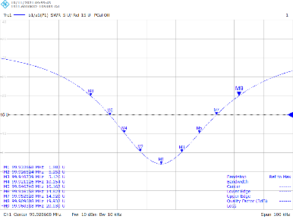
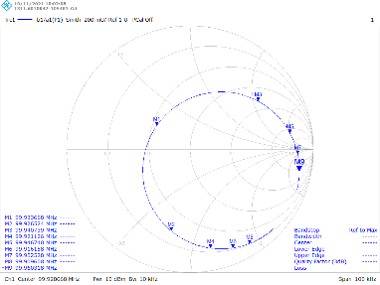
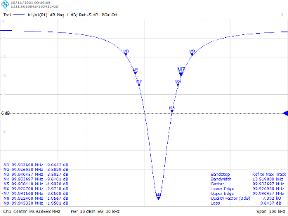
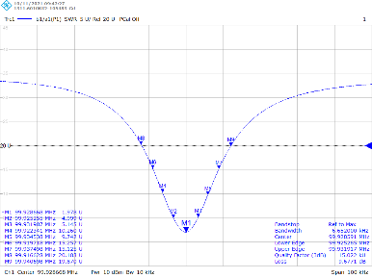
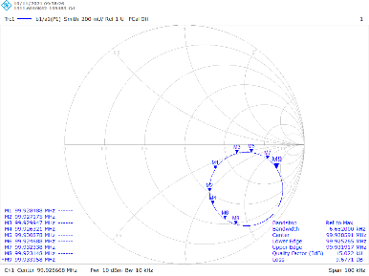
Issues
Trasmitter failure (February 2021) – Power Coupler replacement (Summer ’21)
Instalation of new power coupler without problems.
Tuning to Beta = 2 performed incorrectly. – Retuning must be performed. It is scheduled for winter shutdown.

Slide 22
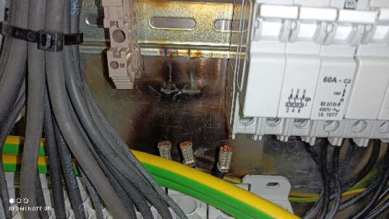
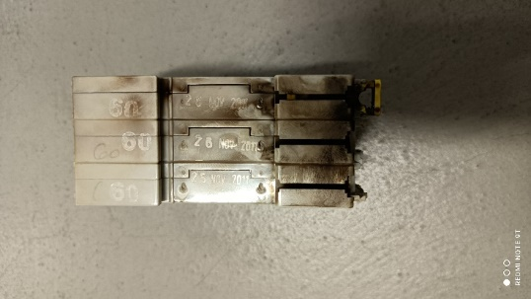
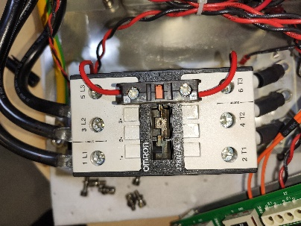


Issues
Failure of the Modulator K00
Power failure. Automatic fuse has been burned.
The diagnostic showed that there is a short circuit in one of the PSU. (arc near contactors)
Decision to repair in-house
4 Capacitor, diode bridge and contactor has been replaced. The interior has been cleaned.
Problem has been fixed!

Slide 23


Issues
Energy mismatch between Linac and Storage Ring – Phase shifter failure.
Changing of Linac (Modulators) phases was needed for effective injection.
One of phase shifter has shown no effect on linac energy.
Investigation of a phase shifter.
Damaged DC/DC converter, and bad solder has been discovered.
Phase shifter has been repaired
Development and building of new phase shifters in house is ongoing.

Slide 24
Future activities
Accelerators
Re-tuning of power coupler
Thermal isolation of waveguides
Build phase shifters for modulators
Build arc detector
Start of BBB fedback development
Extension of linac. (discussions, preliminary design, simulations)
Other
Finishing of plasma cleaning station project
Planned for expanding the experimental hall, new, bigger RF lab might be possible.
Looking for staff for RF group. (technicians, specialists and senior specialists)

Slide 25
Summary
Solaris is constantly under development, building new research beamlines and labs.
The RF group has been developed from scratch.
The RF group is still learning a lot of RF theory – especially in the accelerator aspect.
After 6 years of operation, more and more devices fail, but we are able to repair them in-house.
In order to be able to repair and test the devices faster and better, we want to create special test stands
… even though we are able to deliver the beam for beamlines without (long) interruptions.

Slide 26





SOLARIS
RF Members Team
Grzegorz
Piotr
Krzysztof
Eryk
Thank you for your attention
Marek
(has retired in June 2021)

