Slide 1
PETRA-IV LLRF and wired Interlocks
First ideas to connect the RF-System
Frank Maschewski
DESY MHFe group
ESLS 2021 @ virtual DESY Hamburg

Slide 2
PETRA-IV LLRF and wired Interlocks
First ideas to connect the RF-System
Topics
Overview RF-System
LLRF signal flow
External Interlocks
RF synthesis
Slow Interlocks
Next steps

Slide 3
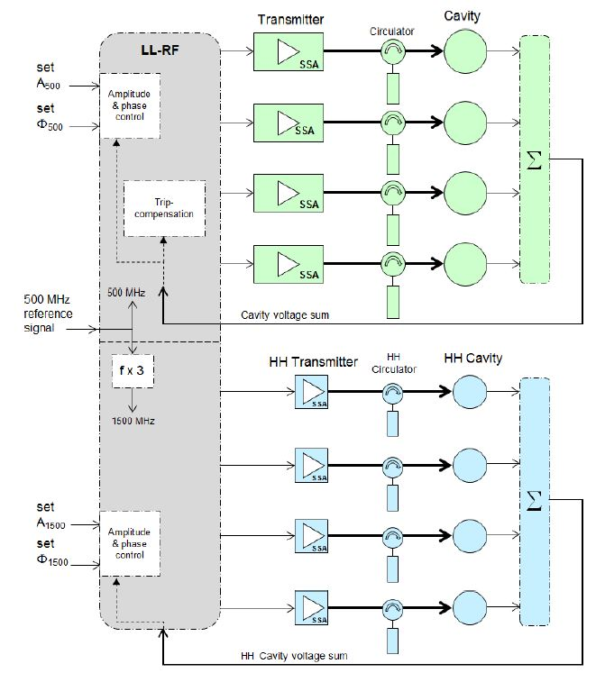
Overview RF-System
One of six RF-Systems
One system consists of
4 transmitter for 500 MHz
and 4 transmitter for 1.5Ghz.
Each group of 4 has it`s own µTCA-System
Selection from PE-IV CDR 2019 page 188/189

Slide 4
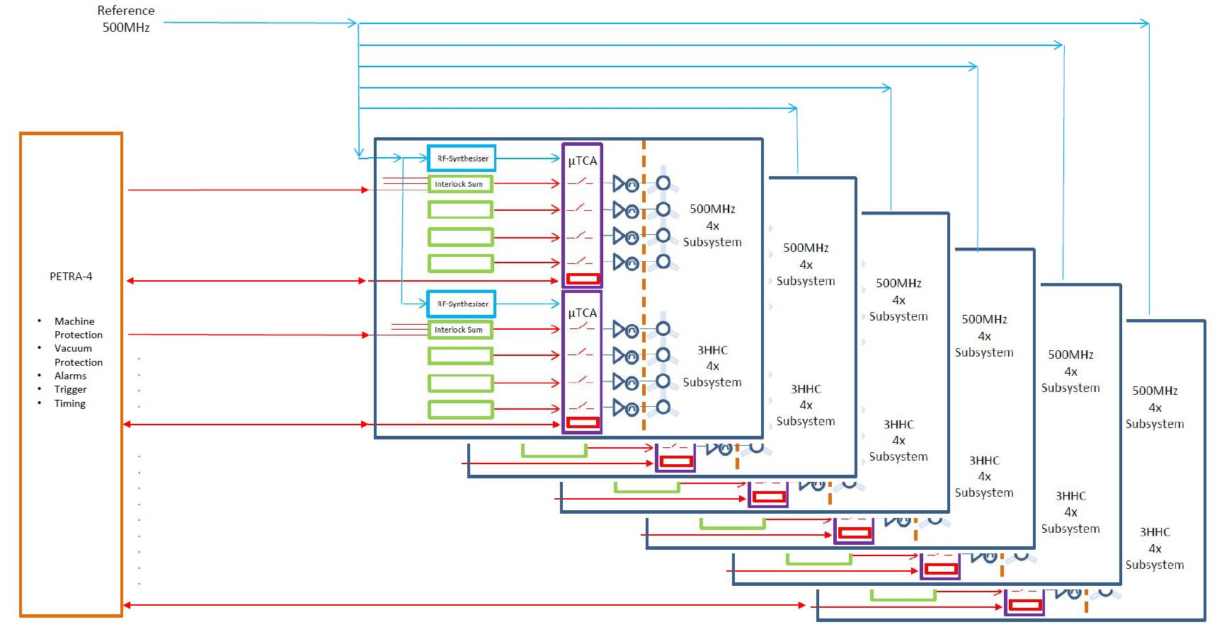
Overview LLRF signal flow
Signals connected to µTCA
RF distribution
External Interlocks
Star topology
System 1
System 2
System 3
System 4
System 5
PETRA-IV MPS
(Machine Protection System) communicates with an
FPGA-card in the µTCA-crate.
System 6

Slide 5
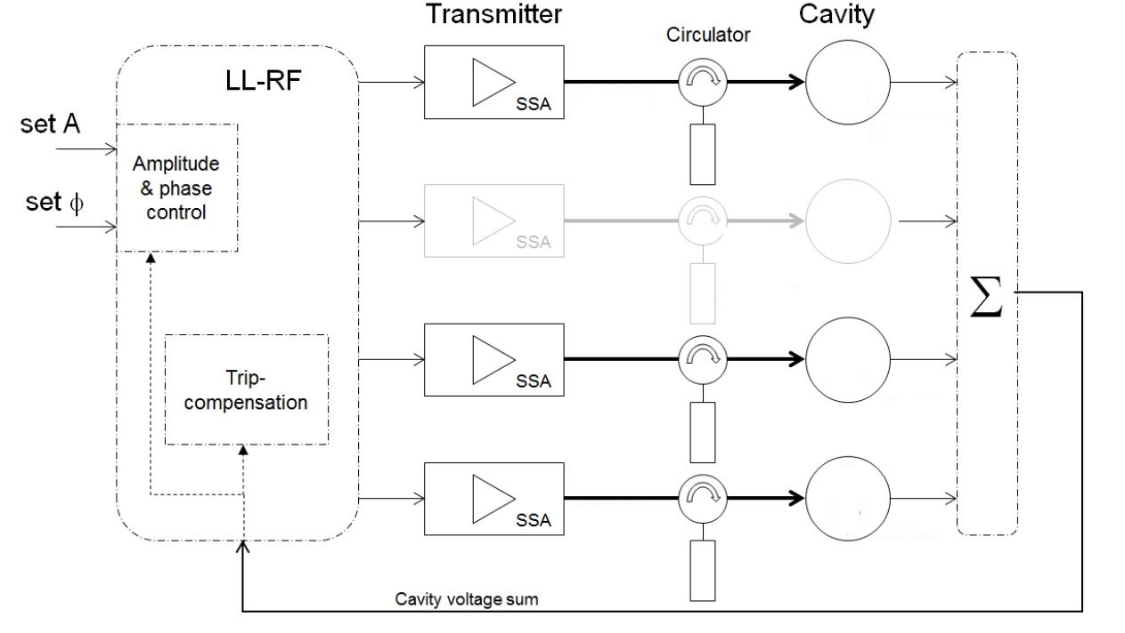
Trip compensation
One of four fails
If one sub-system fails,
the remaining three
sub-systems must increase the output power.
It`s necessary to have constant cavity voltage.
Selection from PE-IV CDR 2019 page 188/189

Slide 6
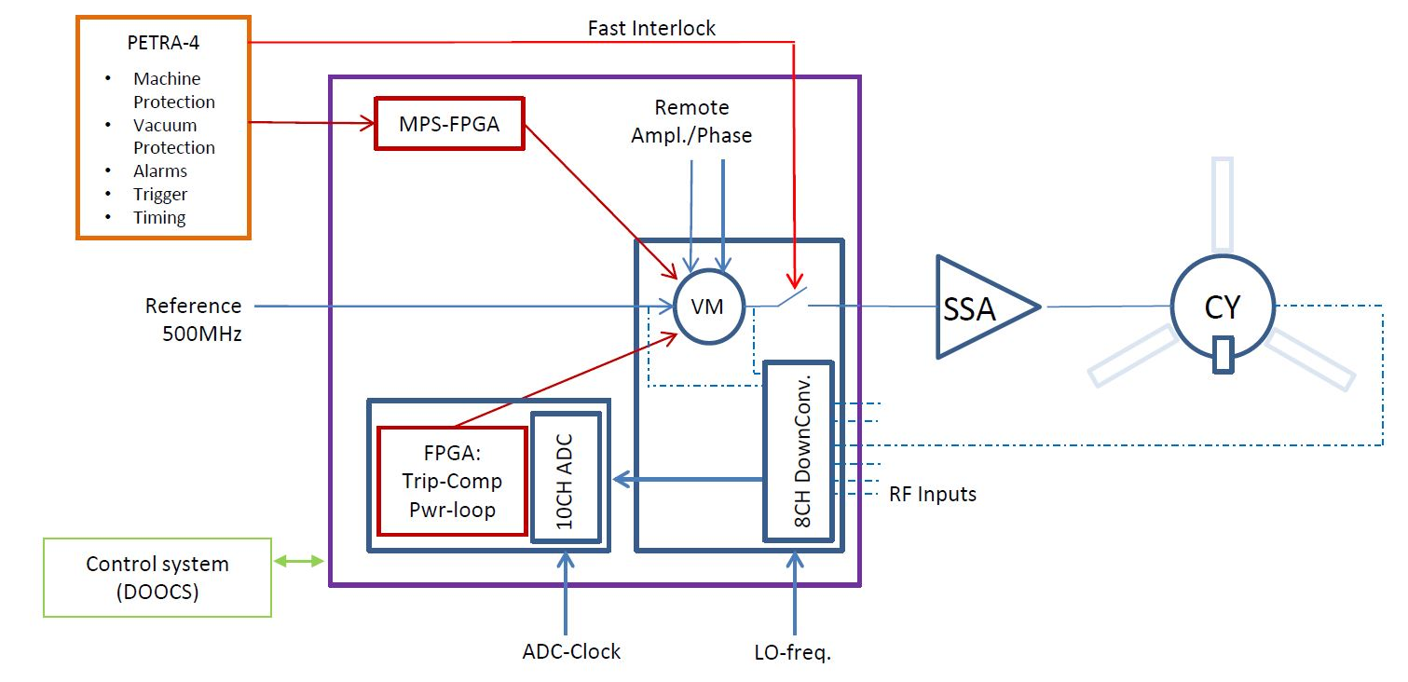
LLRF signal flow
Signals connected to µTCA
RF distribution
External Interlocks
Trip compensation
Amplitude and phase loop
PETRA-IV MPS could use 2 ways to dump the beam.
A fast Kicker system and/or with the RF switch.
The trip compensation acts on the vector modulator to set amplitude and phase.
µTCA
P_forward
P_reflected
Cavity-voltage
RF-Reference
.
.

Slide 7
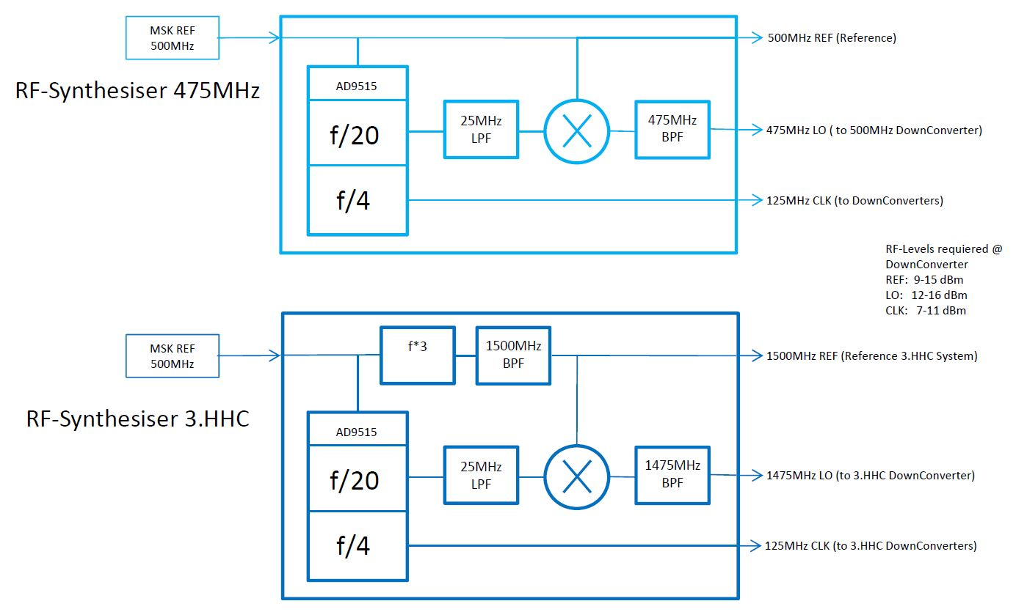
LLRF Synthesis
Generating LO-Frequency and Clocks
1st option:
Old school handmade
Sideband suppression:
-75 dBc
Simple design
Simple components
Easy to repair
Used for our tests.

Slide 8
LLRF Synthesis
Generating LO-Frequency and Clocks
2nd option:
DESY MSK Group develops a new device with PLL
Wide various reference frequency input
from 400 MHz … 6 GHz
and many other options
More Information:
techlab.desy.de

Slide 9
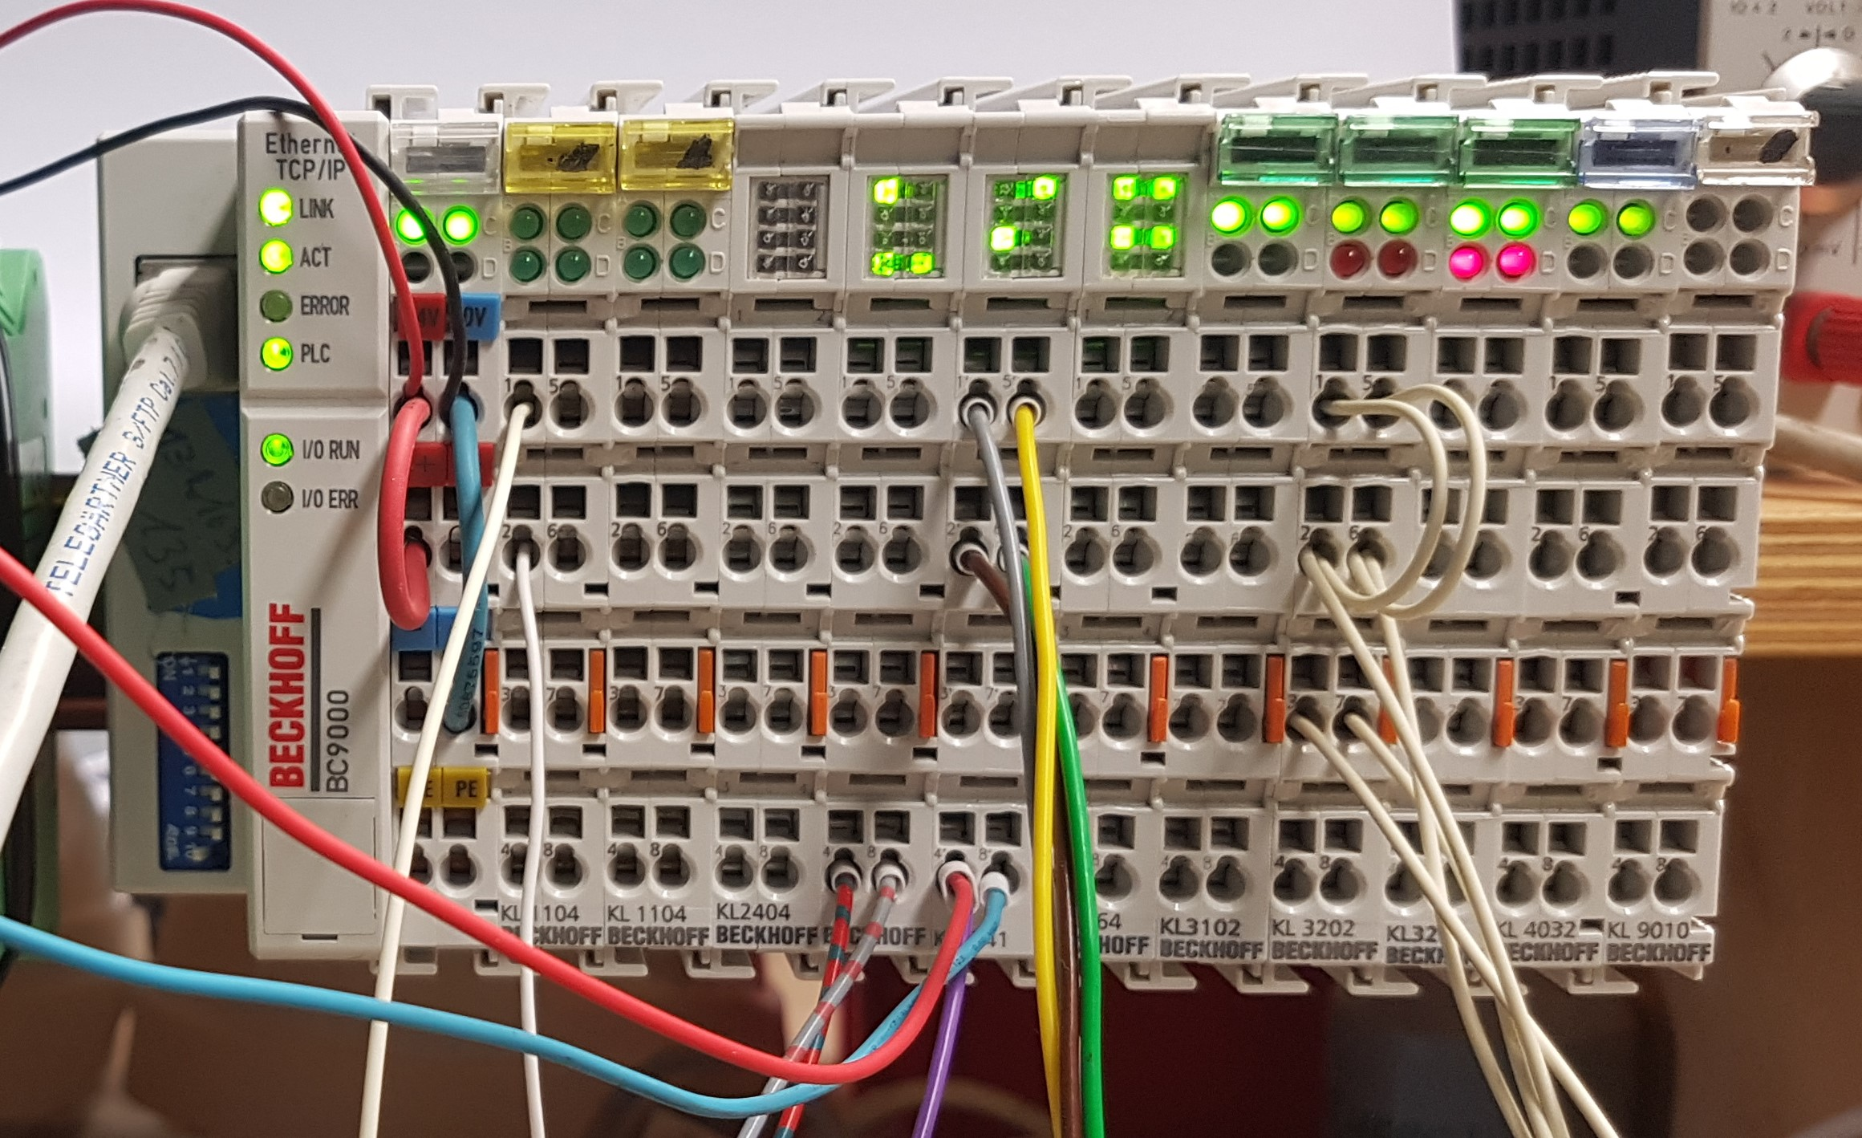
Slow Interlocks
What is Beckhoff?
Beckhoff system:
Used at XFEL and FLASH
Easy connection to Control system (DOOCS)
Fieldbus system (ModBus, OPC UA)
Various controllers and terminals available (A/D-IN and OUT)
Easy use with Hat rail

Slide 10
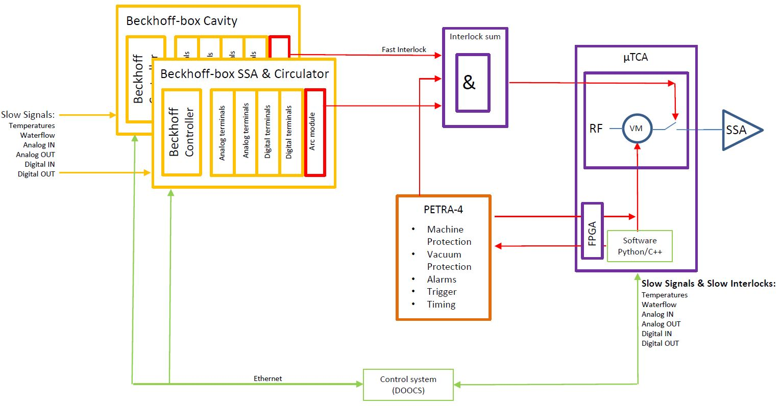
Slow Interlocks
Signals connected to Beckhoff

Slide 11
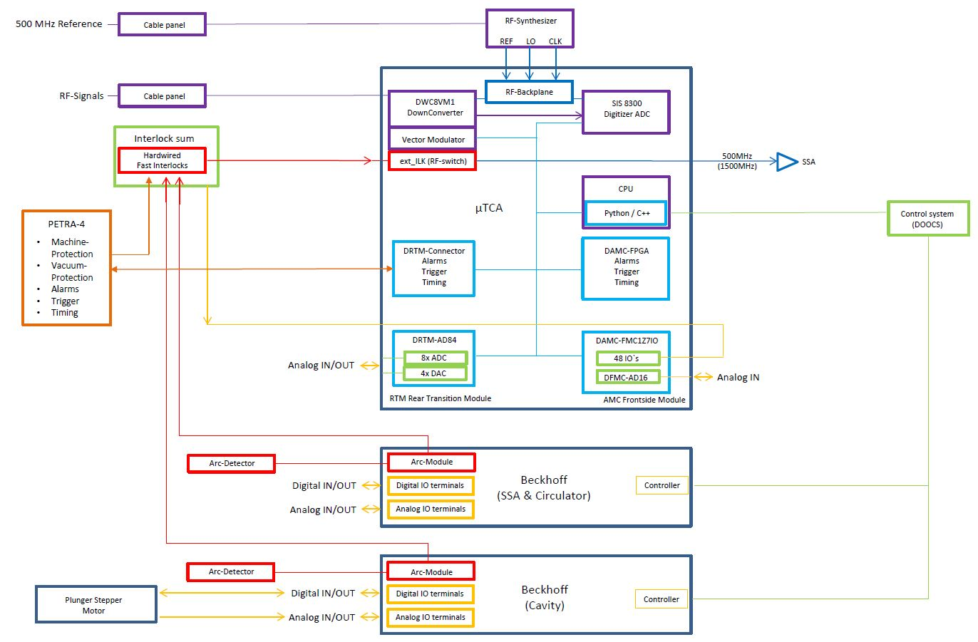
Signal flow inside
Detailed connection
Some components and connections around and inside the µTCA and Beckhoff system.

Slide 12
What’s next?
Some steps
Purchasing an µTCA System for operating SSA and HOM-damped-Cavity for test system in PETRA-III.
Get prototypes from SSA and HOM-damped-Cavity in operation for PETRA-III.
Improving the Amplitude and phase loop with the µTCA System.
Connecting the components of the µTCA System to the Control system.
Testing the Beckhoff System.
However, due to the world market situation, it is not easy to get components.

Slide 13
Thank you.

Slide 14
Frank Maschewski
MHF-e
Frank.maschewski@desy.de
+49 40 8998 3330

