Slide 1
F and Q Measurements on Normal Conducting HOM Damped Cavity
Shivaji Pande
On behalf of DLS RF Group

Slide 2
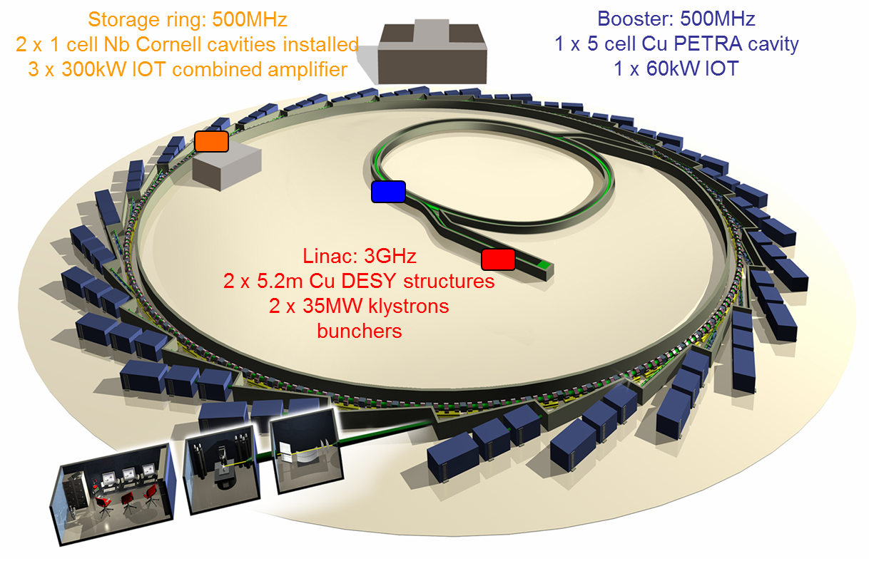
RF at Diamond Light Source
3GeV 300mA third generation synchrotron light source
Diamond has been operating for users since January 2007

Slide 3
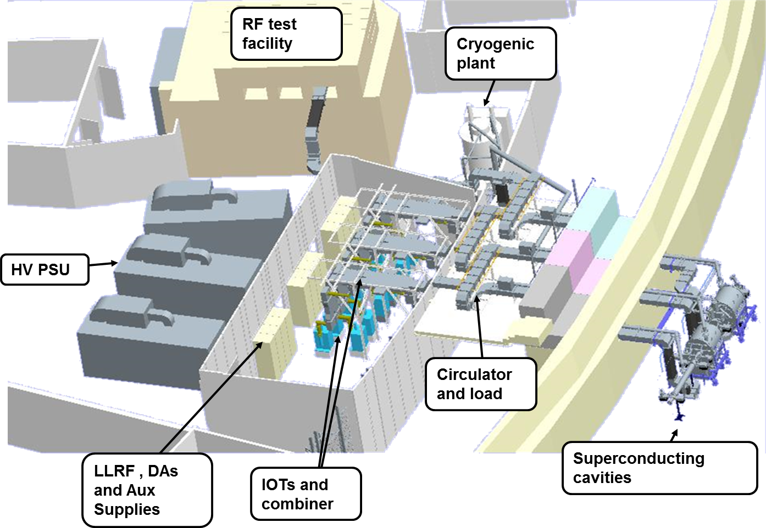
Storage Ring RF
One high voltage power supply supports four IOTs which are then combined
Superconducting cavity supported by Air Liquide cryogenic plant
Space for three cavities in RF straight, usually two operational
Two extra EU HOM damped cavities installed in 2017-2018

Slide 4
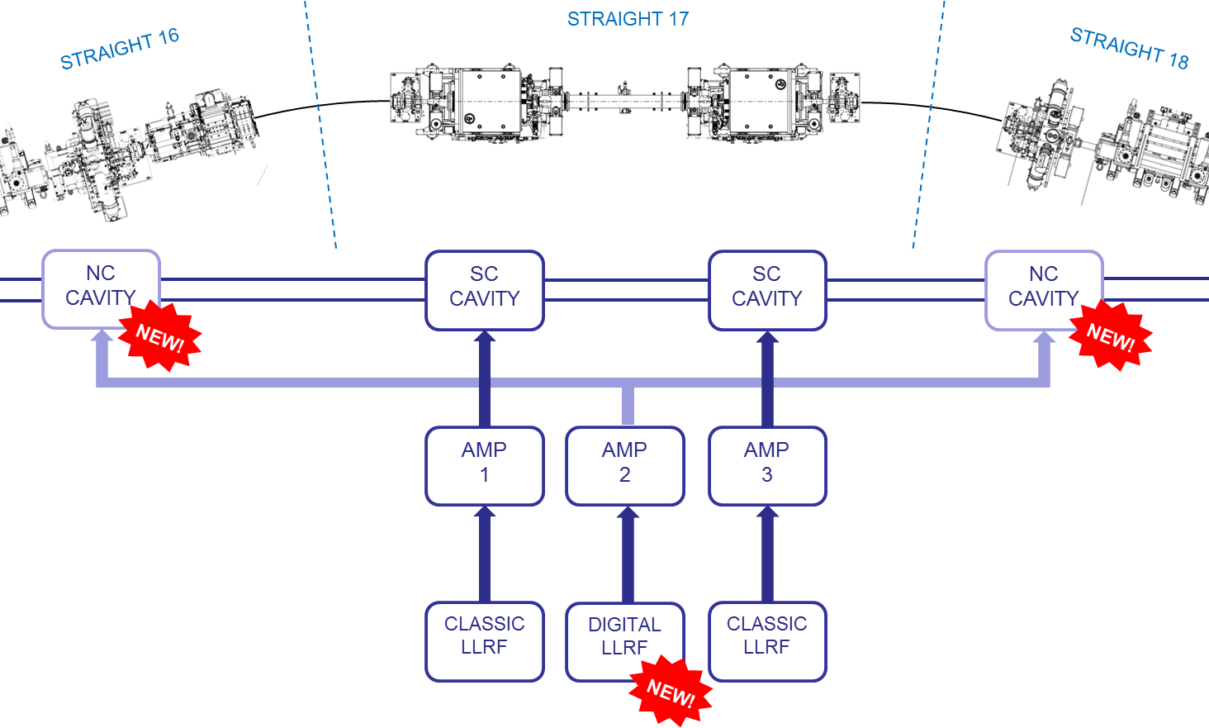
New storage ring RF configuration
Straight 15
3rd NC Cavity
Third HOM Damped cavity is ready to be installed in Straight 15
Has been conditioned
For ease of conditioning / reduce reflected power, β = 1
For operation in the ring, β = 5
Is kept under vacuum

Slide 5
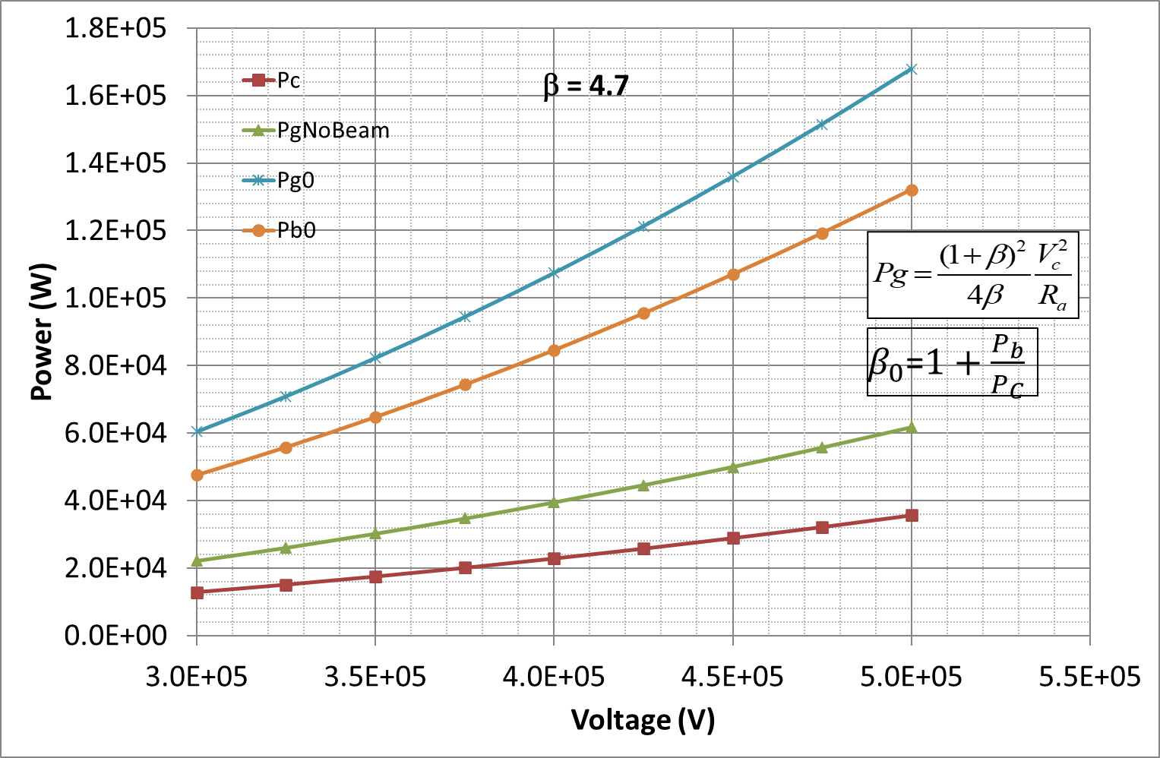
Diamond II upgrade - RF Requirements
Power required for 300mA with all IDs 460kW
Total voltage required 2.7 MV
Number of cavities | 6 | 7 | 8 | 9
Optimal cavity coupling | 3.8 | 4.3 | 4.7 | 5.2
Individual cavity voltage | 450 kV | 386 kV | 338 kV | 300 kV
Generator power per cavity | 104 kW | 85 kW | 73 kW | 63 kW
Power dissipated per cavity | 27 kW | 20 kW | 15 kW | 12 kW
Power dissipated in all cavities | 164 kW | 140 kW | 123 kW | 109 kW
Operation with 8 normal conducting cavities
  Reduces voltage per cavity to conservative level
  Minimises running costs
  Gives acceptable total wall power losses
  Allows redundant operation should one cavity fail
  Enables cavities to fit in storage ring

Slide 6
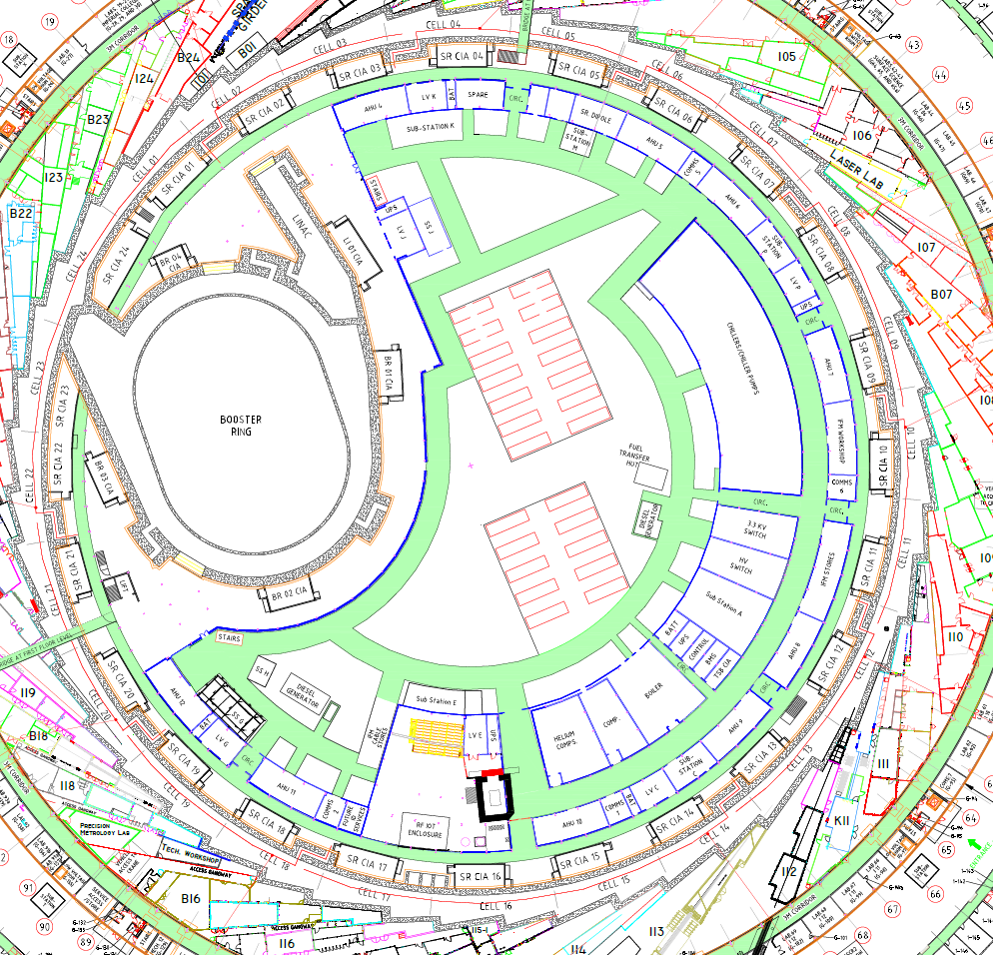
Location of Amplifiers and Cavities
Diamond-I RF is concentrated in one area
  Amplifiers in RF hall
  Cavities in single RF straight
Diamond-II cavities can be distributed in pairs around available mid-section straights
  New beamline can be installed in present RF straight
  Seven mid-section straights are available
  Installation of most new amplifiers is possible with no impact on operating RF
Available mid-section straights

Slide 7
R/Q Data
Requirement from Acc Phys Group for the HOM data for Diamond II Upgrade
Cavity is available for measurements
Unavailability of bead pull setup at Diamond
Measure f, Q and β for the HOMs
Estimate f, R_{SH}, and Q with CST Studio
As R/Q is constant, estimate R_{SH} from measured Q
Observation : Q_{meas} << Q_{CST}
Data for 100MHz band from 450 – 1100 MHz
Data for 200MHz band from 1.1 to 2.5GHz

Slide 8
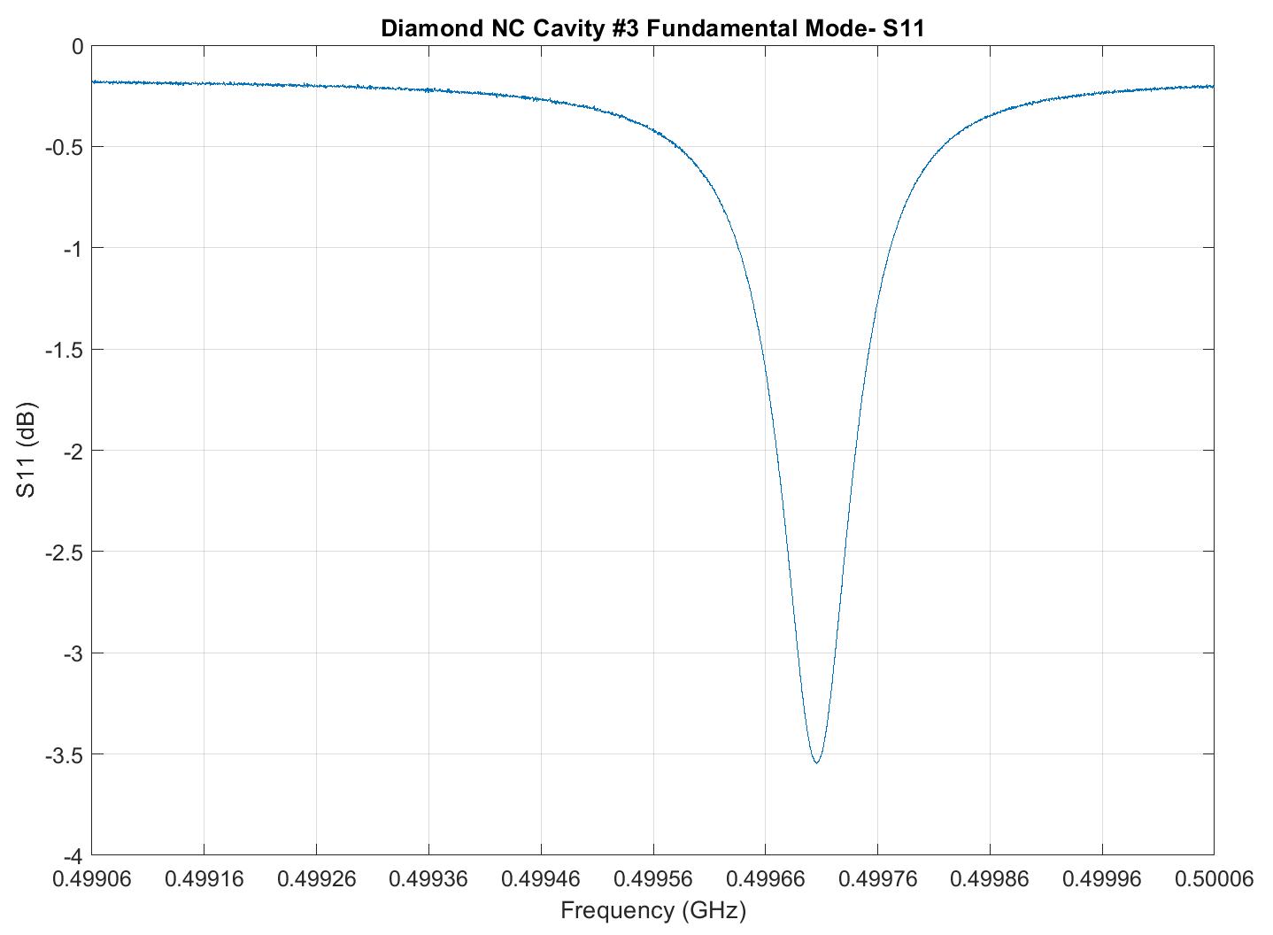
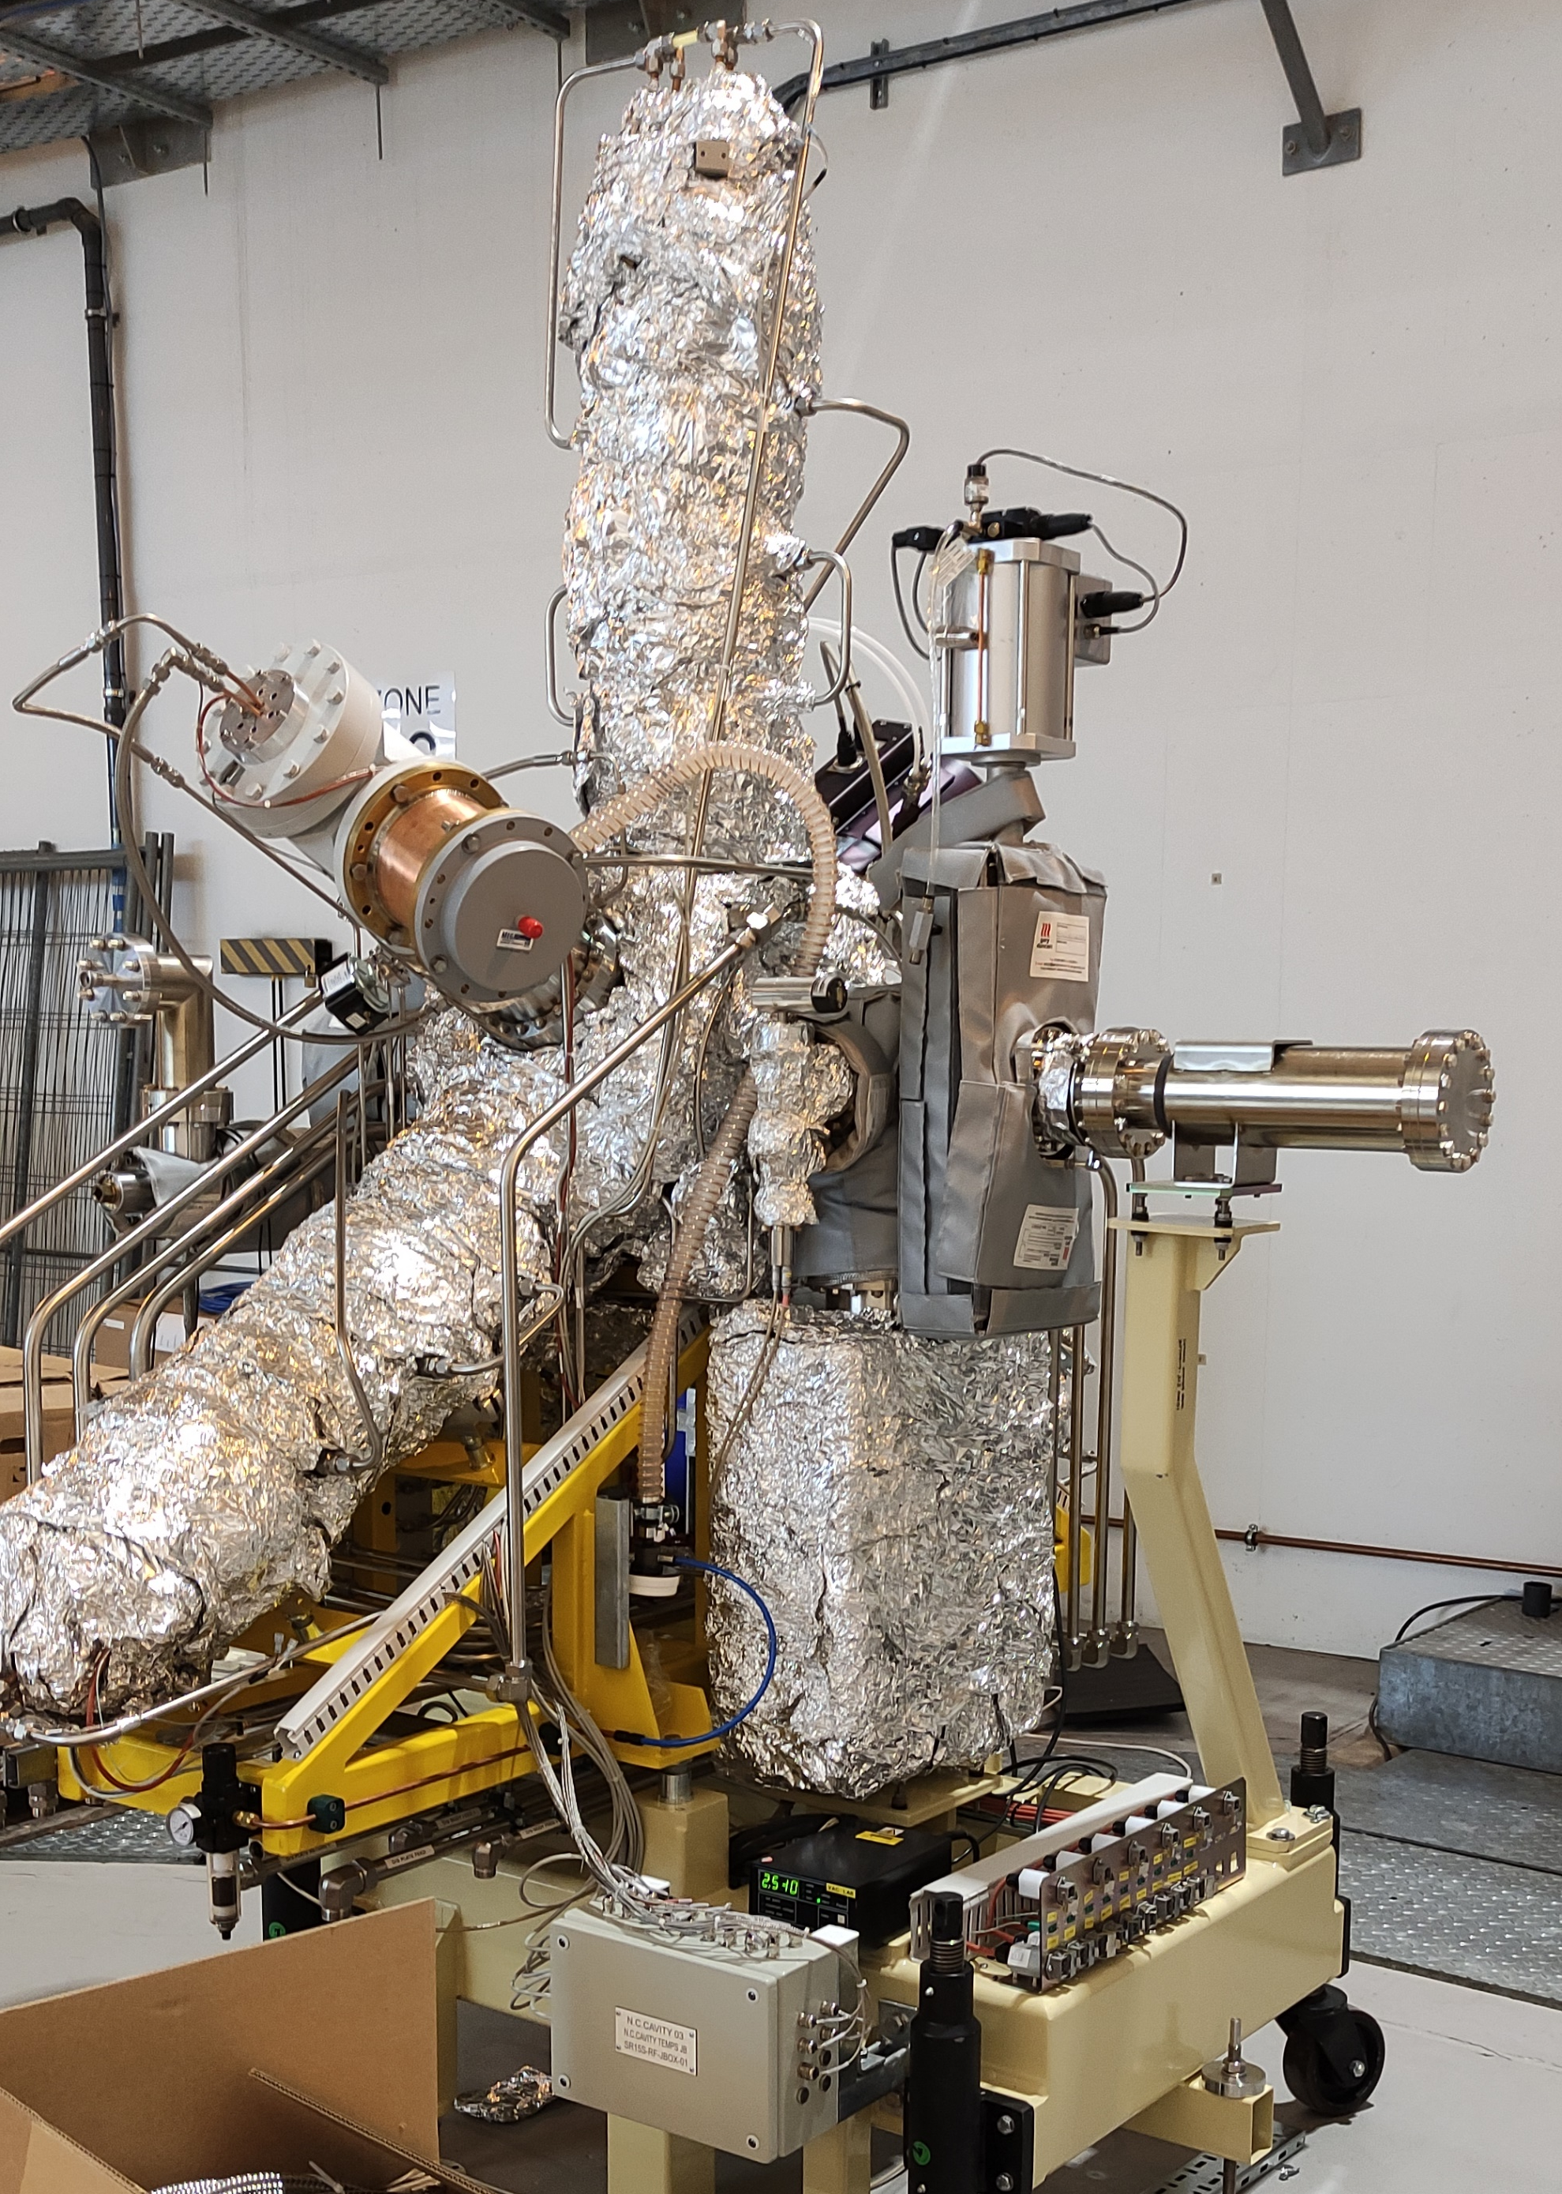
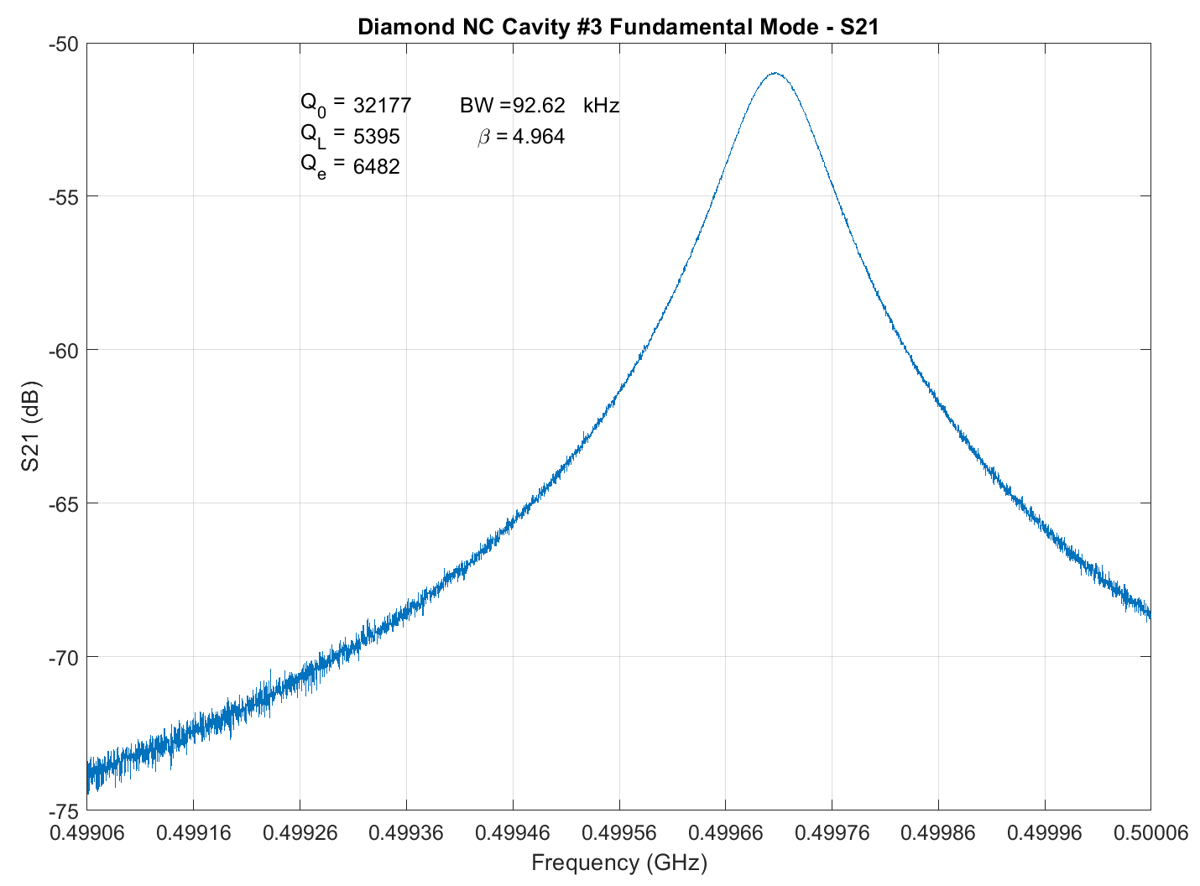
Measurements
Cavity waiting to be installed in the ring
Coupler adjusted to β = 5
S11 fundamental mode
VNA
S21 fundamental mode
Pickup

Slide 9
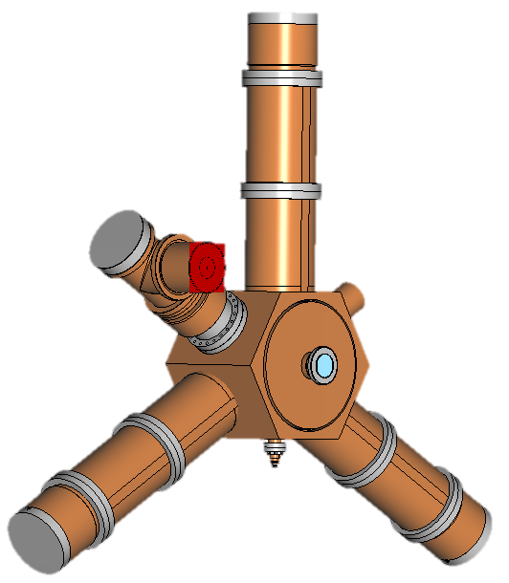
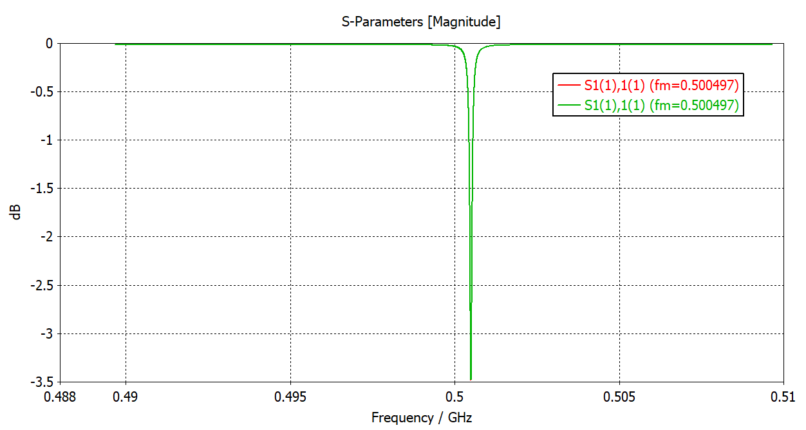
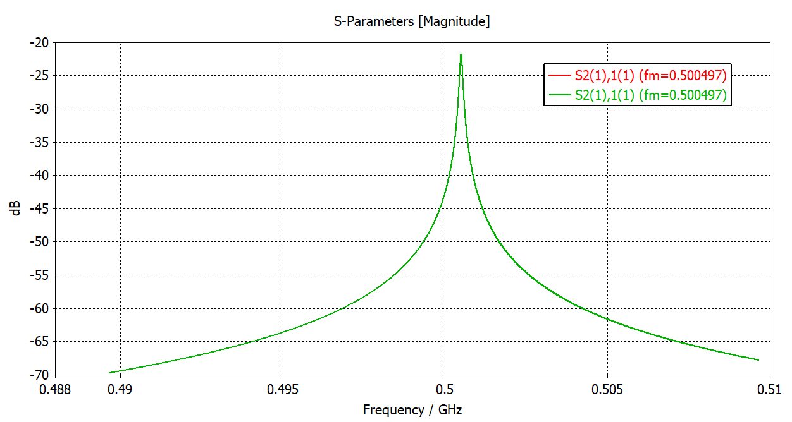
CST Model
Coupling coefficient on the model
β = 5

Slide 10
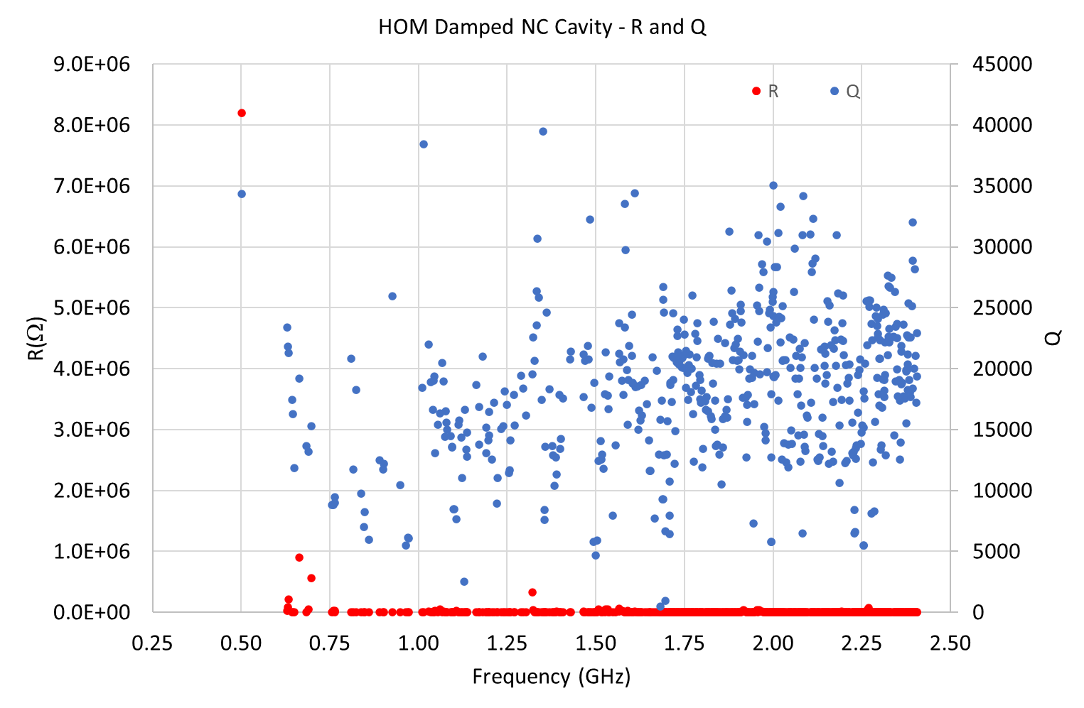
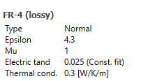
CST Eigen Mode - R and Q Estimated
The Volume losses depend upon ferrite tanδ and so Q

Slide 11
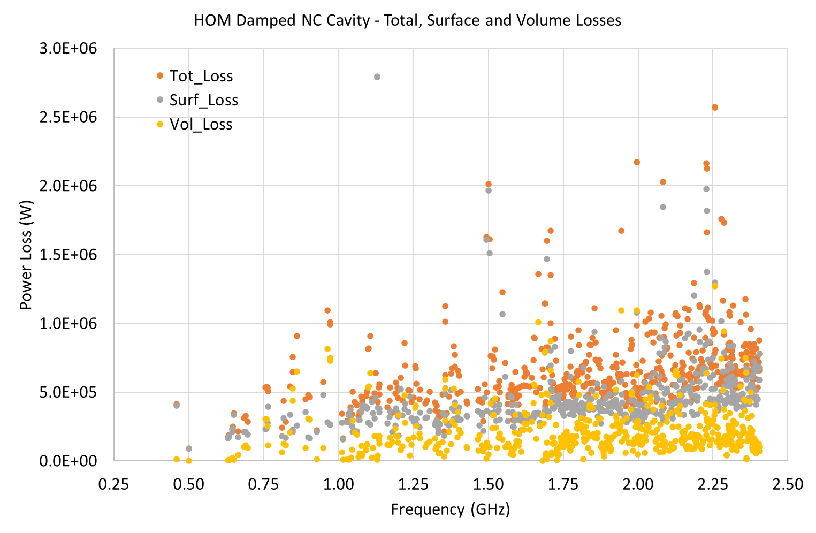
CST – Total, Surface and Volume losses

Slide 12
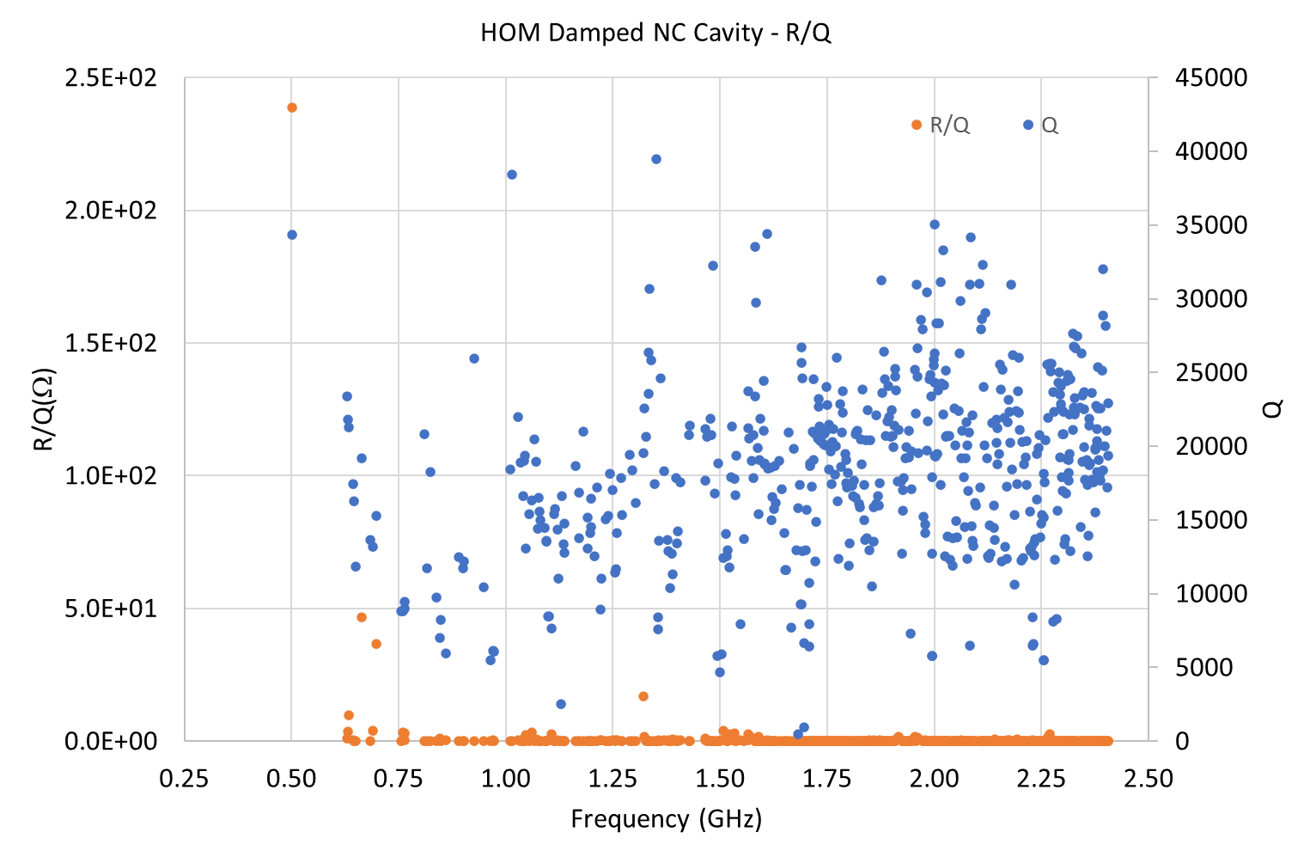
CST Eigne mode - R/Q and Q
Only 3 HOMs with 10Ω < R/Q < 50Ω
And
27 HOMs with R/Q > 1Ω

Slide 13
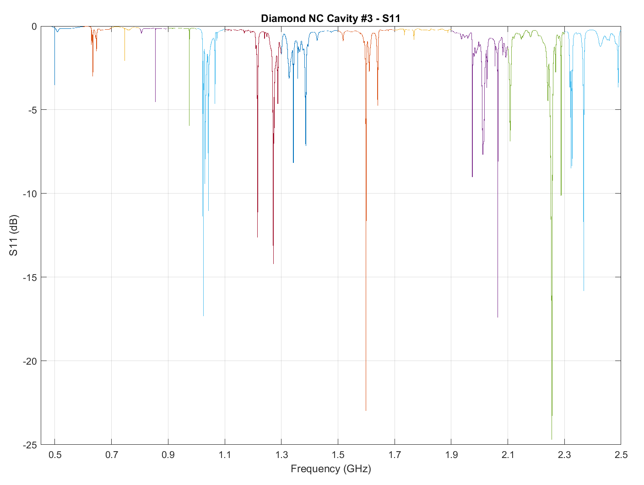
Measurements : S11 (dBMag)

Slide 14
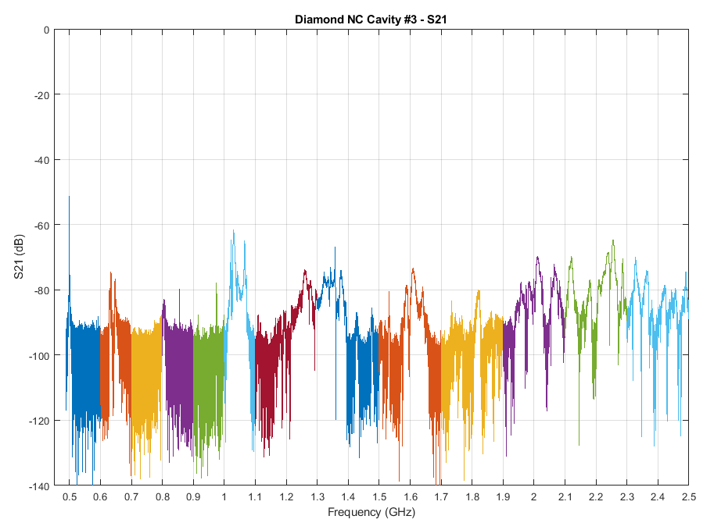
S21 (dBMag)
Each colour represents measurement with 10k points

Slide 15
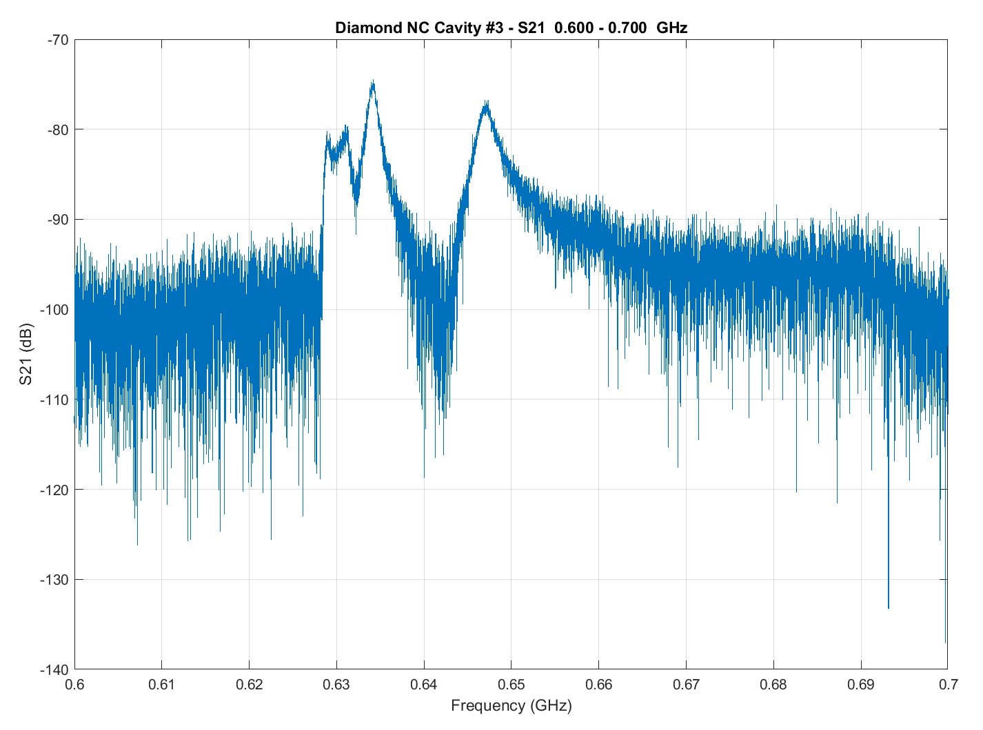
Measured S21 600 – 700MHz
TE111 Modes
TM011 Modes

Slide 16
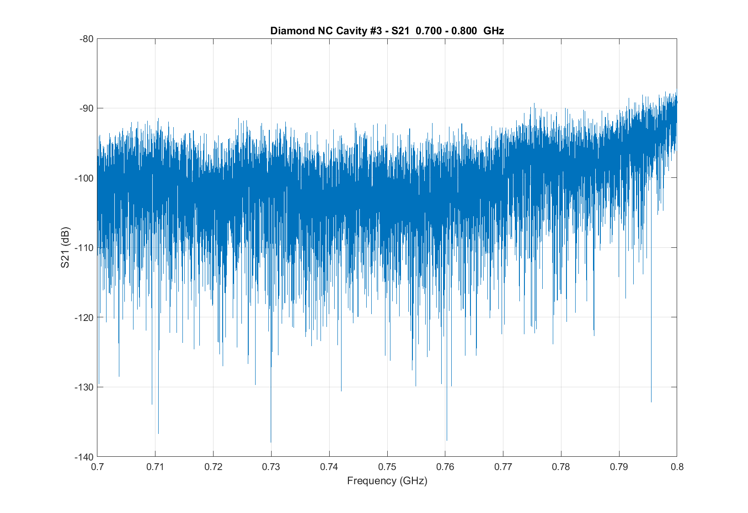
Measured S21 700 – 800MHz

Slide 17
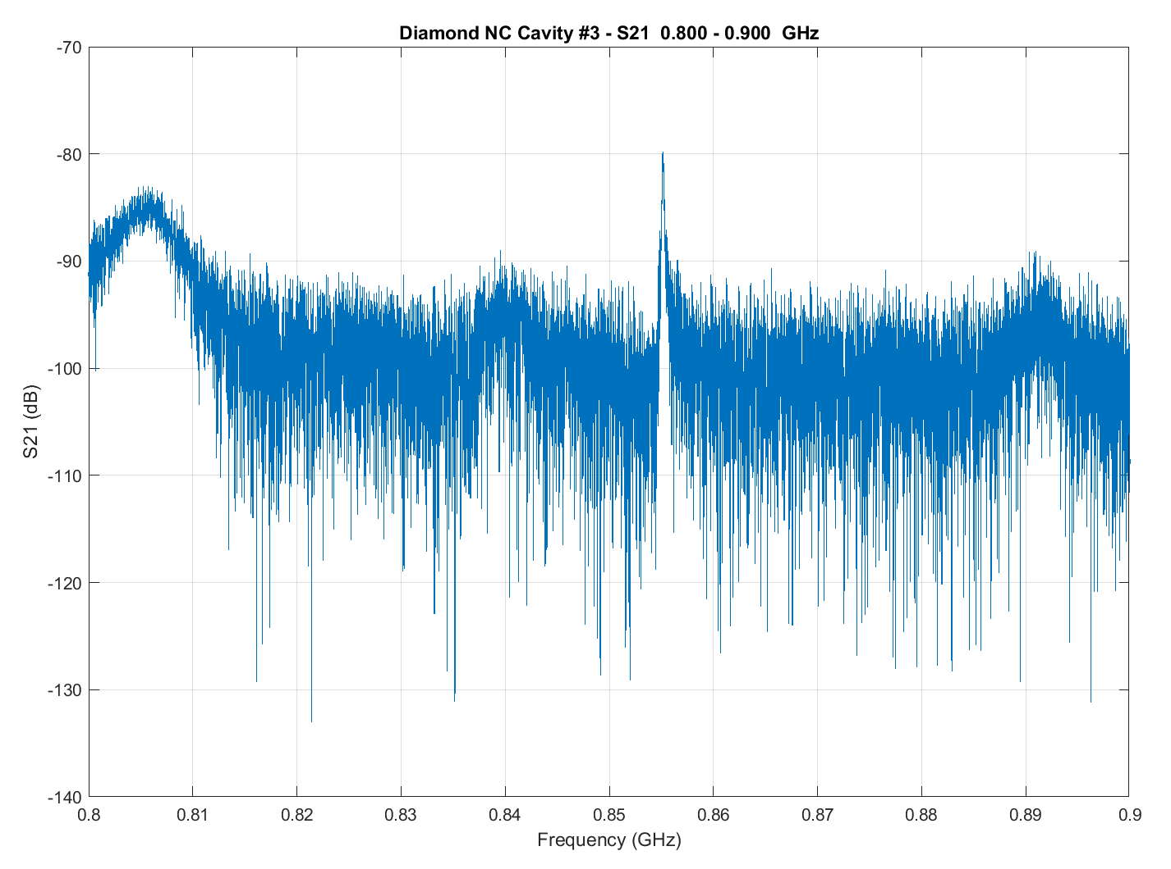
S21 800-900MHz
TE2xx Mode
HOM Waveguide Mode

Slide 18
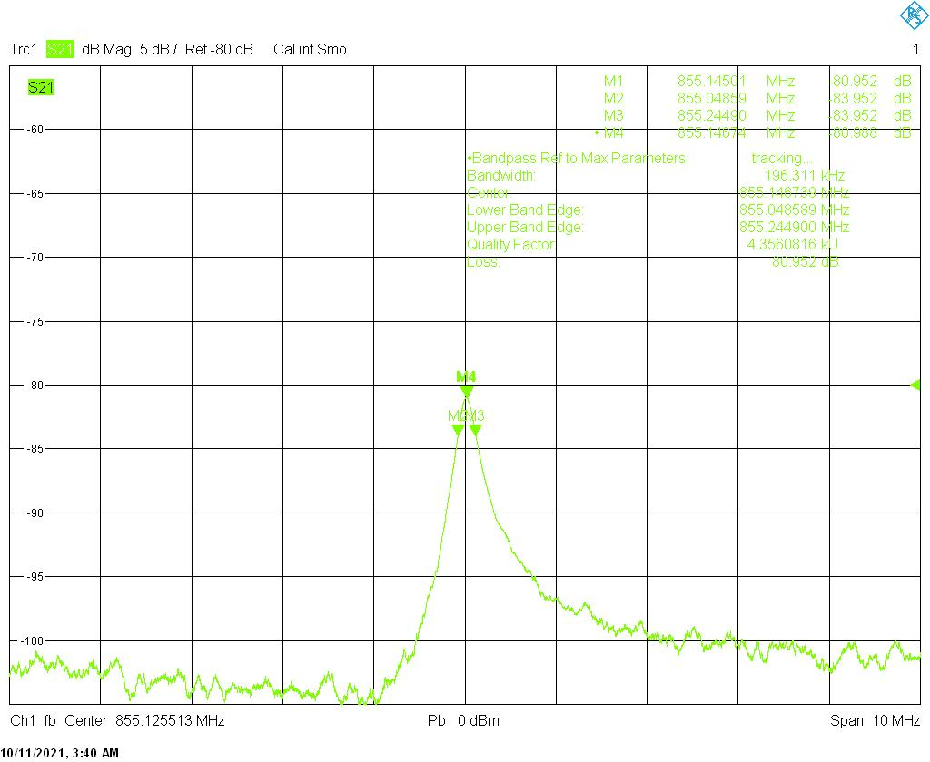
Mode @ 855 MHz
Q = 4356

Slide 19
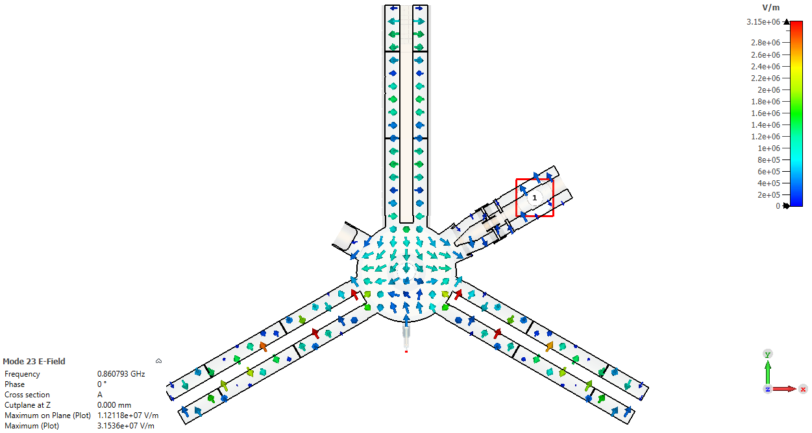
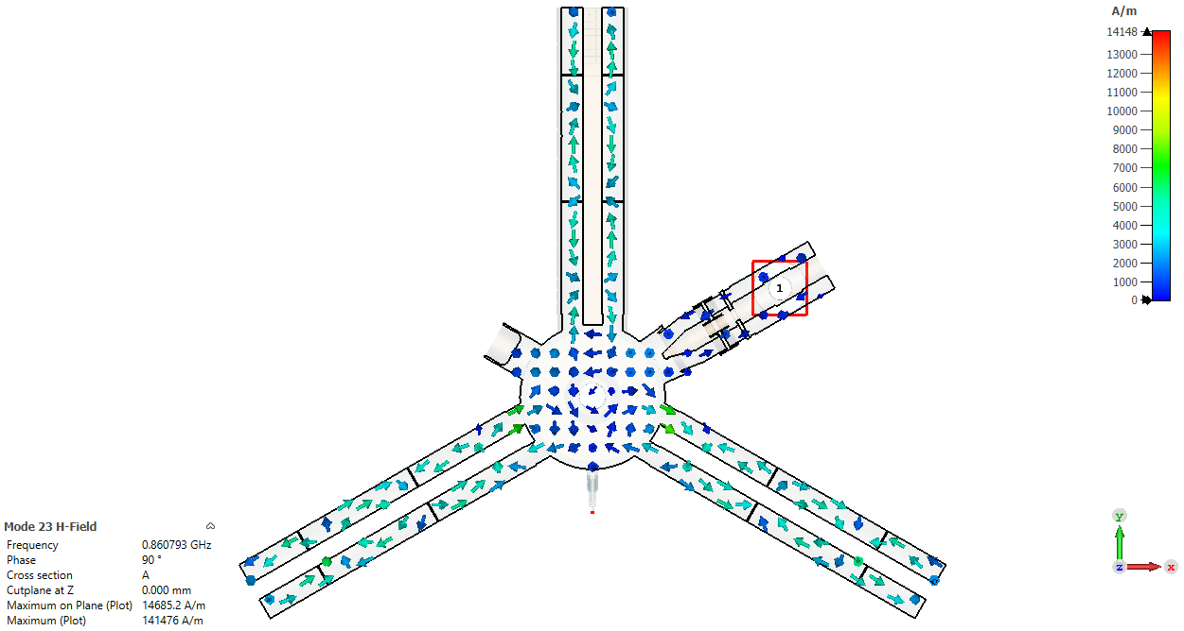
Mode @855 MHz Cut @ Z = 0
HOM Waveguide Mode
Eigen Mode solver
E
Z = 0 mm
H

Slide 20
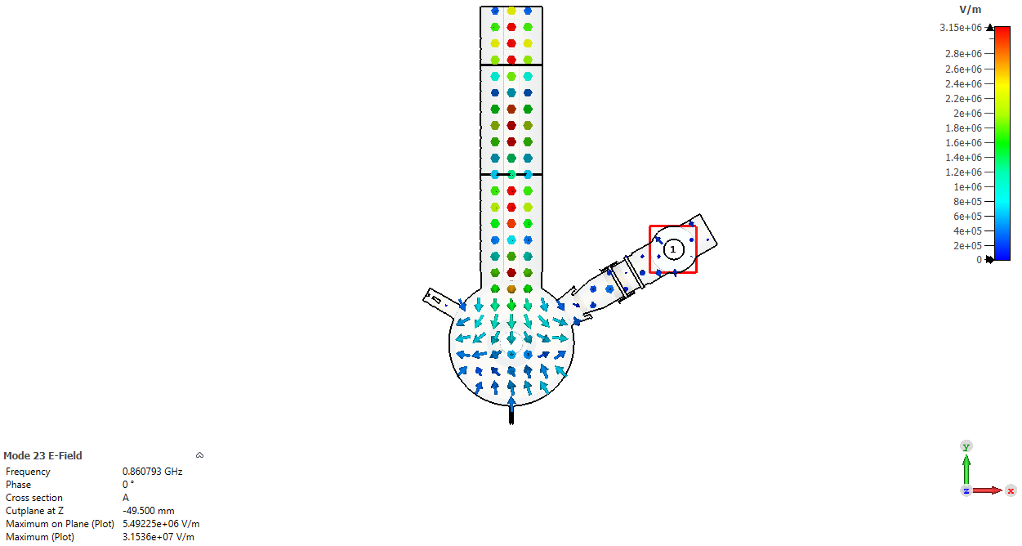
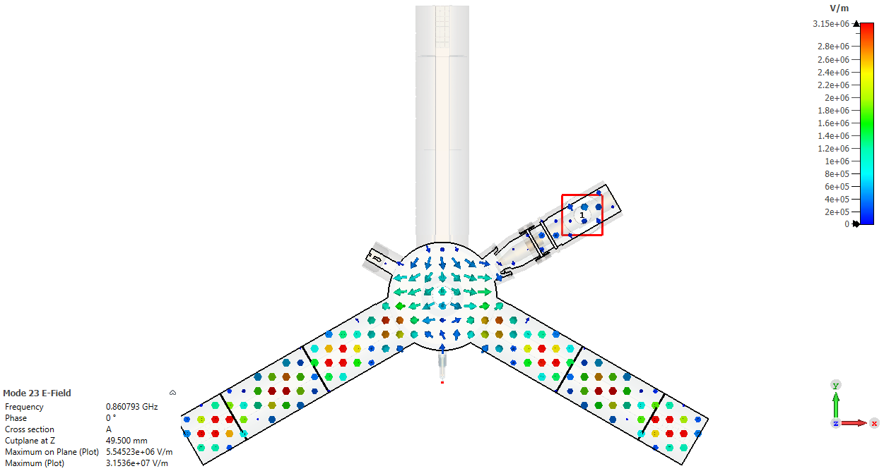
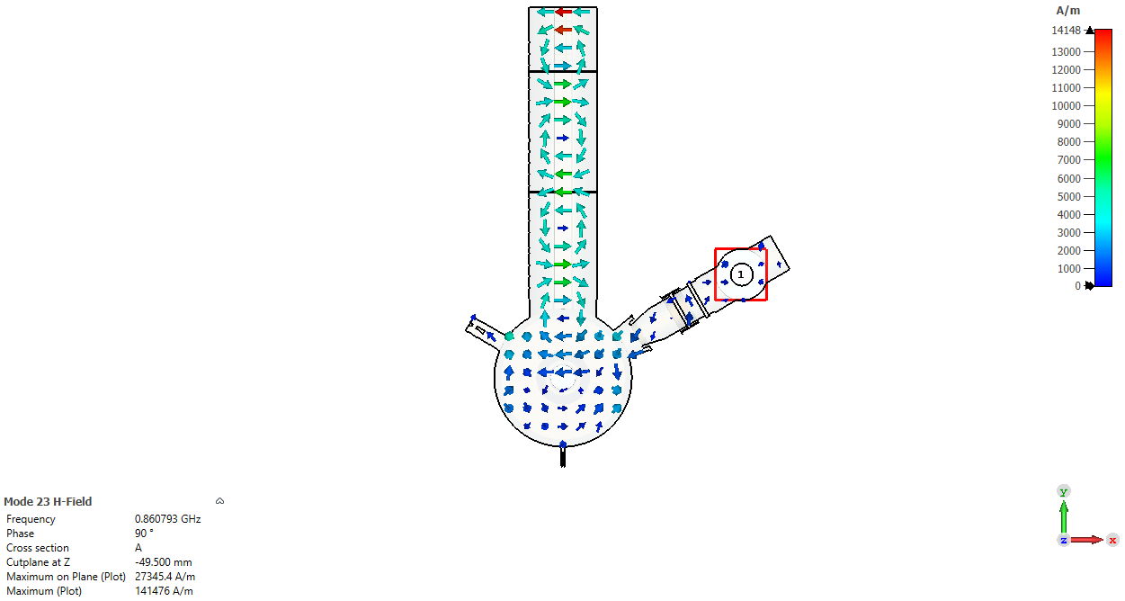
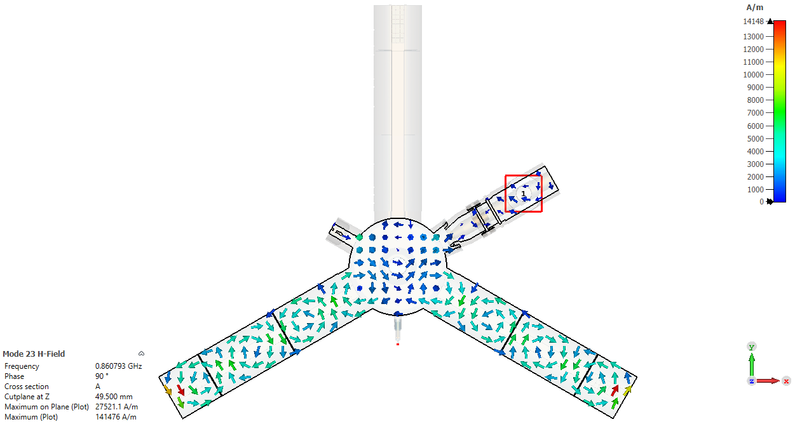
Mode @855 MHz Cut @ Z = ±49.5mm
E
E
HOM Waveguide Mode
f = 860.793 MHz
Z = -49.5 mm
Z = 49.5 mm
H
H

Slide 21
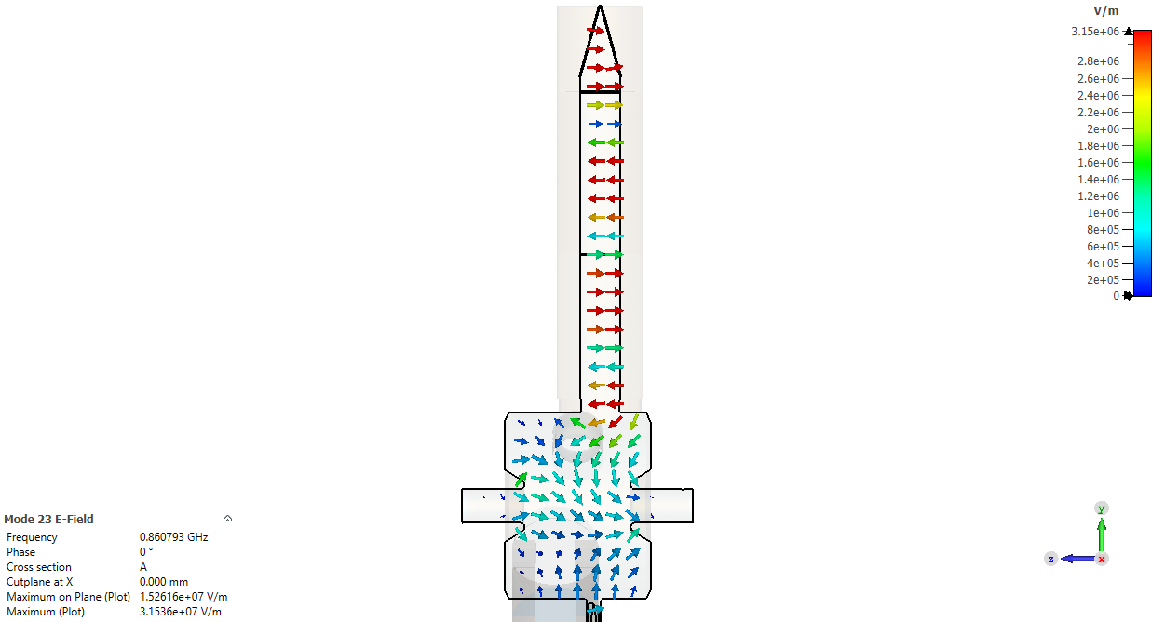
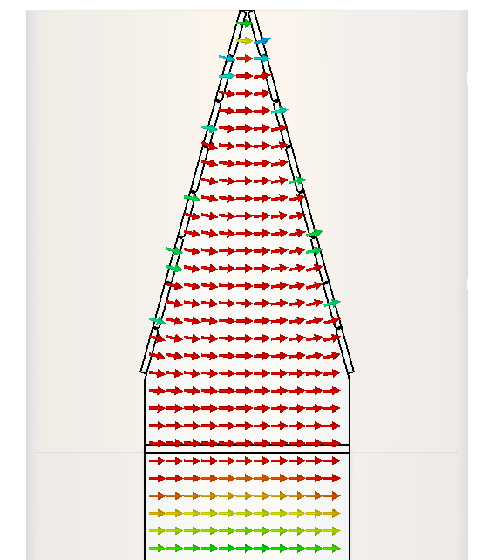
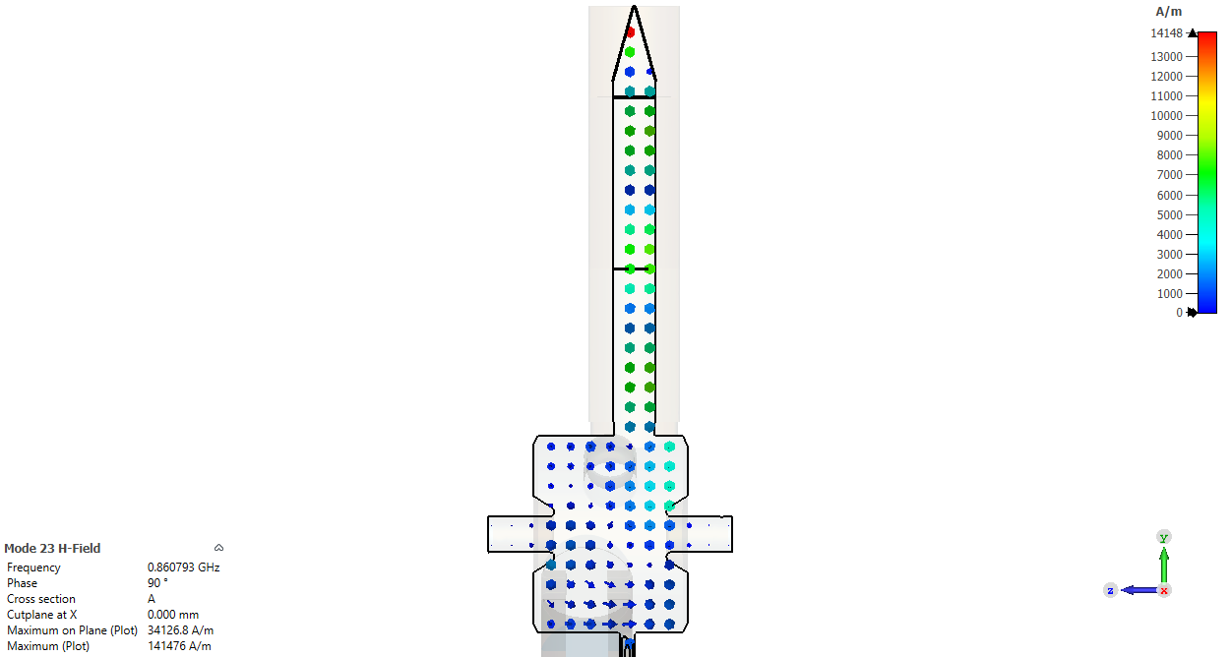
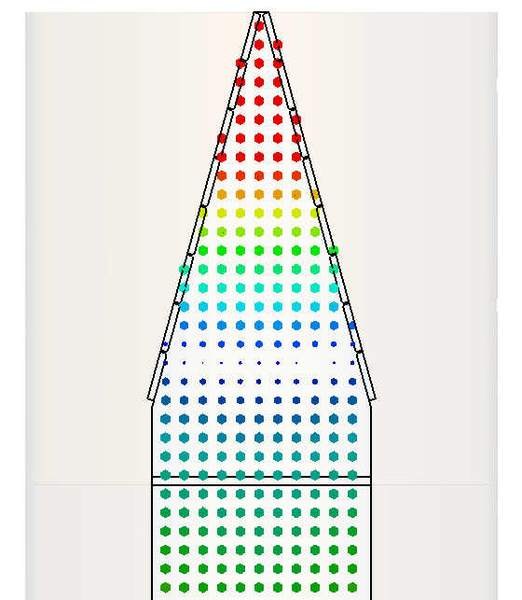
Mode @855 MHz Cut @ X = 0
HOM Waveguide Mode
Eigen Mode Results
E
Field is much stronger in HOM waveguide than the cavity volume
H
X = 0 mm
 | E Mode | Freq Domain | Measured
f (MHz) | 860.793 | 860.783 | 855.14
Q | 5936 | 5971 | 4350
R/Q | 0.35 | 0.39 | Not measured

Slide 22
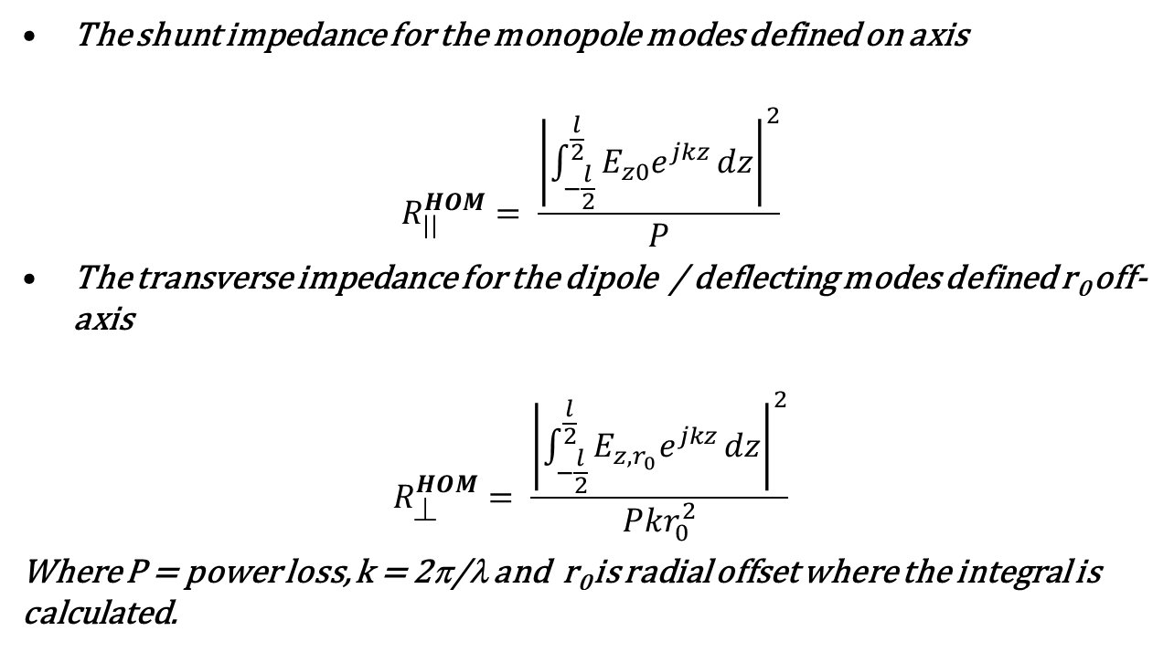
Determination of R|| and R⊥
The shunt impedance for the monopole modes defined on axis
$$R_{||}^{HOM}= \frac{{\left|\int_{−\frac{l}{2}}^{\frac{l}{2}}{E_{z0}e^{jkz}}dz\right|}^{2}}{P}$$
The transverse impedance for the dipole / deflecting modes defined r₀ off-axis
$$R_{⊥}^{HOM}= \frac{{\left|\int_{−\frac{l}{2}}^{\frac{l}{2}}{E_{z,r_{0}}e^{jkz}}dz\right|}^{2}}{Pkr_{0}^{2}}$$
Where P = power loss, k = 2π/λ and r₀ is radial offset where the integral is calculated.

Slide 23
R||/Q for the Monopole Modes
Mode | Freq FD | Freq meas | Q FD | QL meas | R// FD | R///Q FD | Desig’n | β FD | β meas | Q0meas | Qm/QFD | R//eff (Ω)
2 | 0.500497 | 0.49971 | 3.45E+04 | 5.40E+03 | 7.83E+06 | 227.11 | TM010 | 5.061732 | 4.964 | 32175.78 | 9.33E-01 | 5.03E+03
9 | 0.663948 | 0.66165 | 1.93E+04 | NM | 8.78E+05 | 45.58 | TM011L | 0.511616 | 0.01506 | NM | NM | NM
12 | 0.69697 | NM | 1.53E+04 | NM | 7.78E+05 | 50.82 | TM011L | 0.424802 | NM | NM | NM | NM
15 | 0.764009 | 0.7602 | 8.51E+03 | NM | 5.11E+04 | 3.00 | TM011L | 0.211519 | 0.014286 | NM | NM | NM
23 | 0.86078 | 0.85514 | 5.97E+03 | 4350 | 2.36E+03 | 0.40 | HOMWG | 0.125879 | 0.255754 | 5462.53 | 9.15E-01 | 3.98E+03
30 | 0.971305 | 0.9749 | 6.78E+03 | 2010 | 2.84E+03 | 0.42 | HOMWG | 0.015004 | 0.329489 | 2672.273 | 3.94E-01 | 7.92E+02
88 | 1.321991 | 1.32202 | 1.98E+04 | 150 | 5.72E+03 | 0.29 | TM021 | 0.446763 | 0.01 | 151.5 | 7.67E-03 | 1.15E+00
124 | 1.508321 | 1.508 | 1.23E+04 | NM | 5.12E+04 | 4.16 | TM012 | 0.101294 | 0.01 | NM | NM | NM
130 | 1.53231 | 1.53203 | 1.62E+04 | 1600 | 7.51E+04 | 2.64 | TM012 | 0.123449 | 0.005 | 1608 | 9.94E-02 | 1.59E+02
138 | 1.5669 | 1.573 | 1.82E+04 | 400 | 1.79E+04 | 0.99 | TM212 | 0.268038 | 0.01 | 404 | 2.22E-02 | 8.90E+00
139 | 1.577681 | 1.57934 | 2.52E+04 | 1070 | 3.29E+04 | 1.31 | TM212 | 0.051364 | 0.01 | 1080.7 | 4.30E-02 | 4.60E+01
146 | 1.589114 | 1.5882 | 1.57E+04 | 200 | 2.38E+04 | 1.51 | TM212 | 0.10438 | 0.01 | 202 | 1.28E-02 | 2.57E+00
277 | 1.916443 | 1.9214 | 2.04E+04 | 180 | 3.12E+04 | 1.53 | TM221 | 0.258744 | 0.01 | 181.8 | 8.93E-03 | 1.61E+00
290 | 1.953699 | 1.95878 | 2.53E+04 | 300 | 5.32E+04 | 2.10 | TM2X2 | 0.197813 | 0.04 | 312 | 1.23E-02 | 3.69E+00
439 | 2.265918 | 2.25564 | 2.15E+04 | 300 | 5.78E+03 | 0.27 | TMX22 | 0.258732 | 0.9 | 570 | 2.65E-02 | 7.95E+00

Slide 24
R⊥/Q for Dipole modes with r₀ = 3mm
Mode | Freq F Domain | Freq measured | Q F Domain | QL measured | R// 3mm | R⊥(W/m) 3mm | R⊥/Q 03mm | β measured | Q0meas | Designation | Qm/QCST | R⊥/Q eff 03mm | R⊥ eff 03mm
3 | 0.630569 | 0.62895 | 23520 | 100 | 24890.63 | 2.09E+08 | 8896.285 | 0.064309 | 106.4309 | TE111D | 0.004525 | 40.25679 | 9.47E+05
4 | 0.631993 | 0.6311 | 21780 | 200 | 76471.5 | 6.41E+08 | 29450.19 | 0.056433 | 211.2866 | TE111VD | 0.009701 | 285.6947 | 6.22E+06
5 | 0.634288 | 0.63414 | 21440 | 500 | 205932.3 | 1.72E+09 | 80265.79 | 0.171999 | 585.9995 | TE111VD | 0.027332 | 2193.83 | 4.70E+07
6 | 0.645022 | 0.6433 | 20057 | NM | 8491.189 | 69789810 | 3479.574 | 0.038685 | NM | TE111 | NM | NM | NM
8 | 0.647364 | 0.64688 | 23799 | 300 | 219.1689 | 1794853 | 75.41715 | 0.086655 | 325.9965 | TE111 | 0.013698 | 1.033057 | 2.46E+04
14 | 0.759483 | 0.74641 | 8795 | NM | 30356.29 | 2.12E+08 | 24092.57 | 0.118624 | NM | TM111VD | NM | NM | NM
21 | 0.846087 |  | 7055 | 150 | 4092.96 | 25646070 | 3635.42 |  | 150 | TM111VD | 0.021262 | 77.29454 | 5.45E+05
22 | 0.84776 |  | 8246 | 150 | 248.5997 | 1554627 | 188.5219 |  | 150 | TM111HD | 0.018191 | 3.429334 | 2.83E+04
23 | 0.86078 | 0.85514 | 5971.4 | 4350 | 645.8229 | 3977573 | 666.1039 | 0.255754 | 5462.53 | HOMWG | 0.914782 | 609.3399 | 3.64E+06
25 | 0.899576 | 0.891211 | 11764 | 230 | 15.46077 | 91115.34 | 7.745269 | 0.01 | 232.3 | TM110HD | 0.019747 | 0.152943 | 1.80E+03
26 | 0.90327 |  |  | NM | 12.1172 | 71118.59 | 5.828914 |  | NM | TM110VD | NM | NM | NM
34 | 1.02917 | 1.03016 | 22007 | 260 | 6710.924 | 34569450 | 1570.839 | 2.02 | 785.2 | TMXXX Hybrid | 0.03568 | 56.04684 | 1.23E+06
39 | 1.046574 | 1.04214 | 12860 | 350 | 21812.72 | 1.1E+08 | 8591.392 | 0.561798 | 546.6293 | TM112~VD | 0.042506 | 365.1871 | 4.70E+06
41 | 1.060609 | 1.06566 | 16380 | 770 | 41374.59 | 2.07E+08 | 12622.83 | 0.260417 | 970.5211 | TM112 VD | 0.05925 | 747.9074 | 1.23E+07
53 | 1.106478 | 1.10908 | 7711 | 600 | 19932.29 | 95502110 | 12385.18 | 0.01 | 606 | TM112Offcentre | 0.078589 | 973.3393 | 7.51E+06
128 | 1.522945 | 1.5183 | 13630 | 600 | 22490.83 | 78292390 | 5742.858 | 0.01 | 606 | TM112D | 0.044461 | 255.3318 | 3.48E+06

Slide 25
R⊥/Q for Dipole modes with r₀ = 30mm
Mode | Freq F Domain | Freq measured | Q F Domain | QL measured | R// 30mm | R⊥(W/m) 30mm | R⊥/Q 30mmOF | b measured | Q0meas | Designation | Qm/QCST | R⊥/Q eff 30mm | R⊥ eff 30mm
3 | 0.630569 | 0.62895 | 23520 | 100 | 5414.048 | 455184.6 | 19.35062 | 0.064309 | 106.4309 | TE111D | 0.004525 | 0.087564 | 2.06E+03
4 | 0.631993 | 0.6311 | 21780 | 200 | 111144.7 | 9323414 | 428.033 | 0.056433 | 211.2866 | TE111VD | 0.009701 | 4.152325 | 9.04E+04
5 | 0.634288 | 0.63414 | 21440 | 500 | 202367.1 | 16914210 | 788.7619 | 0.171999 | 585.9995 | TE111VD | 0.027332 | 21.55849 | 4.62E+05
6 | 0.645022 | 0.6433 | 20057 | NM | 8422.405 | 692244.7 | 34.51387 | 0.038685 | #VALUE! | TE111 | NM | NM | NM
8 | 0.647364 | 0.64688 | 23799 | 300 | 5382.203 | 440768 | 18.52044 | 0.086655 | 325.9965 | TE111 | 0.013698 | 0.253691 | 6.04E+03
14 | 0.759483 | 0.74641 | 8795 | NM | 31358.56 | 2188953 | 248.8804 | 0.118624 | #VALUE! | TM111VD | NM | NM | NM
21 | 0.846087 |  | 7055 | 150 | 4610.314 | 288877.6 | 40.9494 |  | 150 | TM111VD | 0.021262 | 0.870646 | 6.14E+03
22 | 0.84776 |  | 8246 | 150 | 6397.146 | 400047.8 | 48.51181 |  | 150 | TM111HD | 0.018191 | 0.882461 | 7.28E+03
23 | 0.86078 | 0.85514 | 5971.4 | 4350 | 706.6784 | 43523.77 | 7.288705 | 0.255754 | 5462.53 | HOMWG | 0.914782 | 6.667577 | 3.98E+04
25 | 0.899576 | 0.891211 | 11764 | 230 | 1355.683 | 79894.82 | 6.791468 | 0.01 | 232.3 | TM110HD | 0.019747 | 0.134109 | 1.58E+03
26 | 0.90327 |  |  | NM | 188.0674 | 11038.1 | 0.904688 |  | #VALUE! | TM110VD | NM | NM | NM
34 | 1.02917 | 1.03016 | 22007 | 260 | 8331.794 | 429189.1 | 19.50239 | 2.02 | 785.2 | TMXXX Hybrid | 0.03568 | 0.695837 | 1.53E+04
39 | 1.046574 | 1.04214 | 12860 | 350 | 30234.09 | 1531530 | 119.0833 | 0.561798 | 546.6293 | TM112~VD | 0.042506 | 5.061775 | 6.51E+04
41 | 1.060609 | 1.06566 | 16380 | 770 | 41445.8 | 2071684 | 126.4456 | 0.260417 | 970.5211 | TM112 VD | 0.05925 | 7.491949 | 1.23E+05
53 | 1.106478 | 1.10908 | 7711 | 600 | 18958.6 | 908368.4 | 117.8016 | 0.01 | 606 | TM112Offcentre | 0.078589 | 9.257913 | 7.14E+04
128 | 1.522945 | 1.5183 | 13630 | 600 | 9887.411 | 344188.8 | 25.24674 | 0.01 | 606 | TM112D | 0.044461 | 1.122489 | 1.53E+04

Slide 26
Comparison with BESSY Results
Freq measured | R⊥/Q eff 03mm | R⊥ eff 03mm (Ω/m) | R⊥/Q eff 30mm | R⊥ eff 30mm (Ω/m)
0.62895 | 40.25679 | 9.47E+05 | 0.087564 | 2.06E+03
0.6311 | 285.6947 | 6.22E+06 | 4.152325 | 9.04E+04
0.63414 | 2193.83 | 4.70E+07 | 21.55849 | 4.62E+05
0.6433 | NM | NM | NM | NM
0.64688 | 1.033057 | 2.46E+04 | 0.253691 | 6.04E+03
0.74641 | NM | NM | NM | NM
 | 77.29454 | 5.45E+05 | 0.870646 | 6.14E+03
 | 3.429334 | 2.83E+04 | 0.882461 | 7.28E+03
0.85514 | 609.3399 | 3.64E+06 | 6.667577 | 3.98E+04
0.891211 | 0.152943 | 1.80E+03 | 0.134109 | 1.58E+03
 | NM | NM | NM | NM
1.03016 | 56.04684 | 1.23E+06 | 0.695837 | 1.53E+04
1.04214 | 365.1871 | 4.70E+06 | 5.061775 | 6.51E+04
1.06566 | 747.9074 | 1.23E+07 | 7.491949 | 1.23E+05
1.10908 | 973.3393 | 7.51E+06 | 9.257913 | 7.14E+04
1.5183 | 255.3318 | 3.48E+06 | 1.122489 | 1.53E+04
Frequency(MHz) | Quality | R/Q(Ω) | Impedance(k Ω) | R/Q(Ω)♣ | Impedance(k Ω /m)
 |  | measured on axis |  | measured @ 3 cm off axis
619.68 | 918 | 0.36 | 0.33 | 0.28 | 22.0(H)
620.126 | 1079 | 0.14 | 0.15
625.832 | 770 | 0.5 | 0.38 | 0.69 | 44.8(H)
639.39 | 556 | 0.32 | 0.18
643.925 | 557 | 2.82 | 1.57
654.575 | 168 | 6.02 | 1.01
679.95 | 334 | 32.05 | 10.72
812.508 | 284 | 0.61 | 0.17
1024.224 | 1016 | 0.22 | 0.22 | 0.91 | 48.4(V)
1029.465 | 1085 | 0 | 0 | 0.78 | 43.3(H)
1037.66 | 1213 | 0.002 | 0 | 0.95 | 58.6(V)
1040.318 | 1578 | 0.04 | 0.07
1041.307 | 485 | 0 | 0
1057.539 | 772 | 0.59 | 0.46 | 0.82 | 31.8(V)
1083.7 | 748 | 0.12 | 0.09 | 1.31 | 45.2(H)
1338.864 | 479 | 0.77 | 0.37
1384.696 | 511 | 0.18 | 0.09 | 1.18 | 23.1(H)
1511.12 |  | noisy | noisy | 0.58 | 15.2(V)
1533.813 | 664 | 0.83 | 0.55 | 1.3 | 29.7(V)
1539.625 | 686 | noisy | noisy
1578.385 | 1628 | 0.72 | 1.17
1583.331 | 684 | 0 | 0
1591.087 | 583 | noisy | noisy
2284.448 | 649 | 0.85 | 0.55
2321.303 | #DIV/0! | 0
2596.775 | 817 | 0.02 | 0.02
2662.078 | 551 | 0.69 | 0.38
♣ F. Marhauser, E. Weihreter; Impedance Measurements of the HOM-Damped 500 MHz Metrology Light Source Cavity; Report bessy-034-january-2007

Slide 27
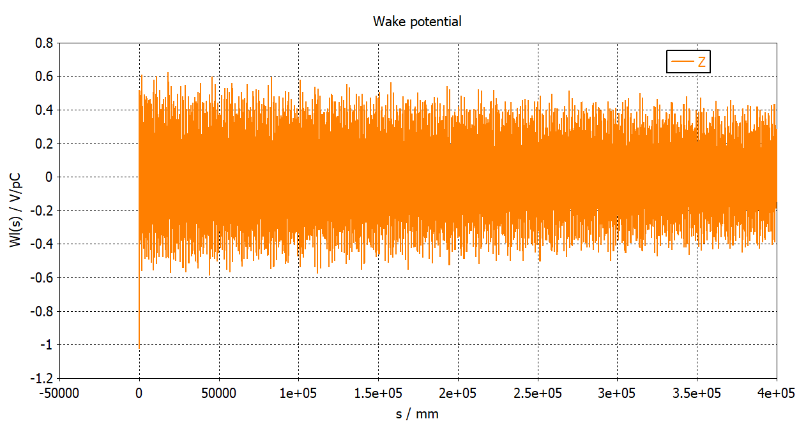
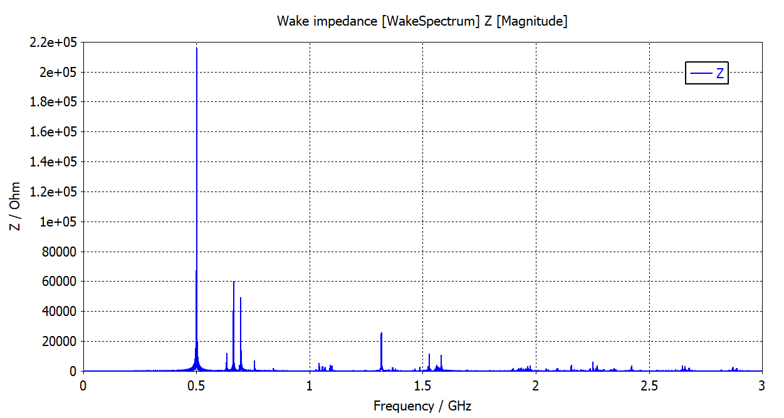
Computation from Wake Potential

Slide 28
Comments?
R⊥ is prone to an error due to choice of the offset?
A factor of 10^2 in R⊥ depending upon choice of radial offset of 3mm and 30mm
Is the defining equation for R⊥ valid in the vicinity of axis or anywhere in the beam tube aperture?
Colleagues at DESY planning for the perturbation measurements
Eagerly wait for the results!

Slide 29
Thanks for your attention

