Slide 1
Single Mode Structures as an Alternative for the PETRA IV High Harmonics RF System
Hülsmann, Peter
DESY, Hamburg, 08.11.2021

Slide 2
Content
1 Motivation for starting a single mode structure study at DESY
2 What is a single mode structure?
Two promising candidates for a closer look:
The choke mode cavity from T. Shintake (1992)
The single mode structure from H. Herminghaus (1978)
4 Conclusion and outlook

Slide 3
Motivation for searching a single mode structure
HH-rf-system needs a frequency of 1.5GHz, the 500MHz BESSY-HOM-damped cavity was downsized by a factor of 3.
simply downsizing is mechanically not an easy task
longitudinal loss factor k_{l} ~ f
transversal loss factor k_{ꓕ} ~ f²
increased HOM damping capabilities for the HH-rf-system would be desireable!
Driven by the arguments we have started to look for other cavity concepts which have to fulfil the following requirements:
The concept has to be mechanically very simple
The HOM-damping capabilities must be more effective compared to the BESSY-cavity

Slide 4
What is a sigle mode structure
The basic idea of a “single mode structure”
Accelerating structures are usually designed in such a way that it is possible to excite a field formation with a rf-source which is suited to accelerate charged particles.
But other field formations with higher frequencies could be excited
This field formations are able to perturb the acceleration process, to deteriorate the beam quality and in the worst case they lead to a beam blow up
The single mode accelerating structure is designed in such a way that all modes, except the wanted mode, will leave the cavity through a coupling hole into the direction of an rf-absorber
If this can be managed one has a “single mode Structure” (the name was created, as far as I know, by M. Tigner [1])

Slide 5
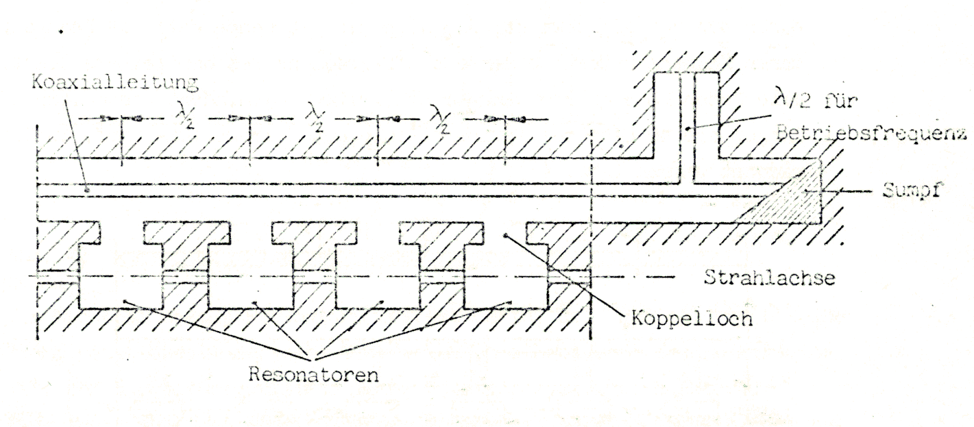
First Proposal of a “single mode structure”
Fig. 1: One of the first proposals of a so called “single mode structure” [1]
Picture: R. Klein: “Messung der Shuntimpedanz und Feldassymmetrie von Beschleunigerresonatoren, Diploma Thesis, Institut für Kernphysik der Johannes Gutenberg Universität Mainz, 1981, KPH 21/81

Slide 6
Two promising candidates for a closer look
The choke mode cavity created by Tsumoru Shintake
Fig. 2: A cut view through the “choke mode cavity”. The cavity is azimuthally symmetric. (Picture: T. Shintake [2])
Fig. 3: TM₀₁₀-Mode is rejected by the choke. Due to the distance of λ/2 from the short of the choke to the annular exit of the cavity, the TM₀₁₀-Mode “sees” a short. (Picture: T. Shintake [2])

Slide 7
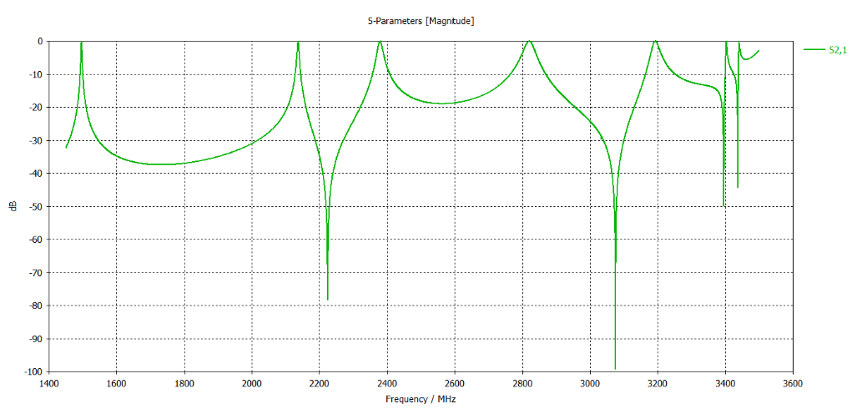
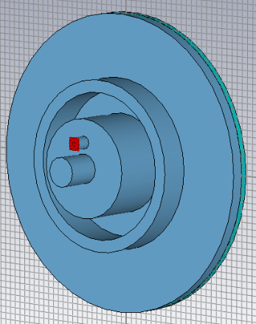
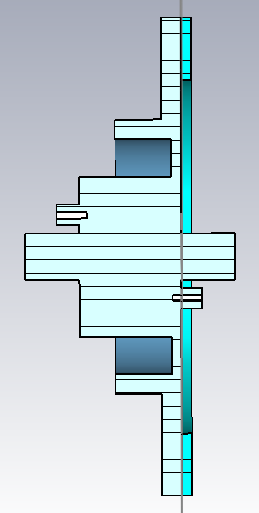
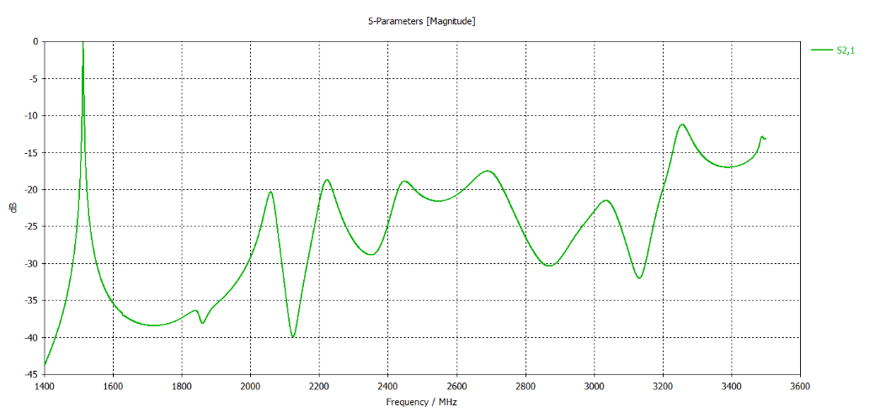
Two promising candidates for a closer look
The choke mode cavity created by Tsumoru Shintake
TM₀₁₀ TM₁₁₀ TM₀₁₁
rf absorber ring
rf choke
Fig. 5: The TM-modes in the equivalent pillbox without the annular slot
TM₀₁₀ TM₁₁₀ TM₀₁₁
rf coupling antennas
Fig. 4: The enlarged (by a factor of 1,9 compared to T. Shintake [2]) model of the choke mode cavity in CST-MWS
Fig. 6: The TM-modes in the choke mode cavity

Slide 8
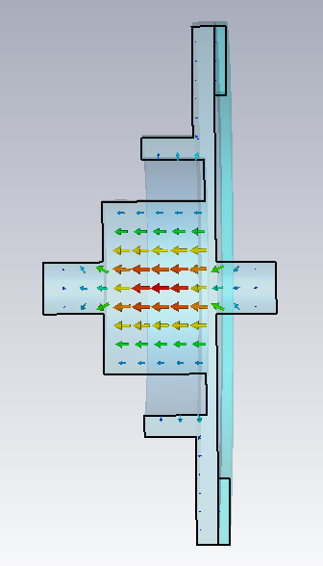
Two promising candidates for a closer look
The choke mode cavity created by Tsumoru Shintake
frequency | f₀ | 1,511GHz
shunt impedance (CST) | R_{S} | 625kΩ
unloaded quality factor | Q₀ | 3090
 | R_{S}/Q₀ | 202Ω
Table 1: The characteristic numbers of the TM₀₁₀-mode in the choke mode cavity
frequency | f₀ | 1,5GHz
shunt impedance (CST) | R_{S} | 1,5MΩ
unloaded quality factor | Q₀ | 17.000
 | R_{S}/Q₀ | 88Ω
Table 2: The characteristic numbers of the TM₀₁₀-mode in the 1,5GHz BESSY-HOM-damped cavity
Fig. 5: The TM010-mode in the choke mode cavity

Slide 9
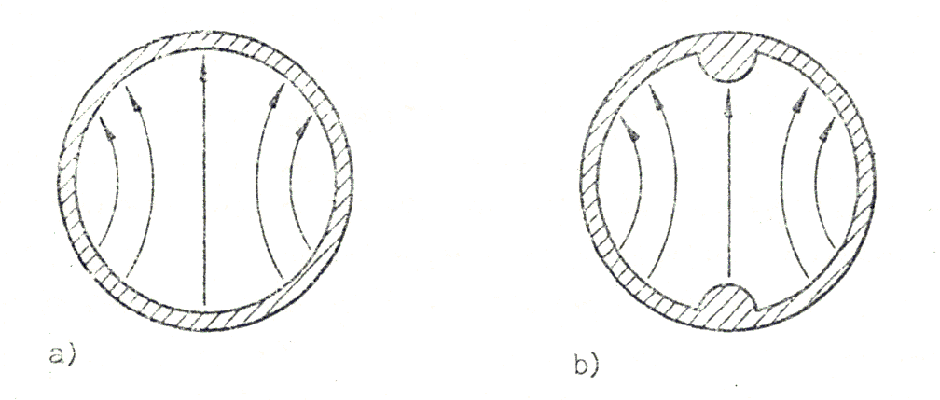
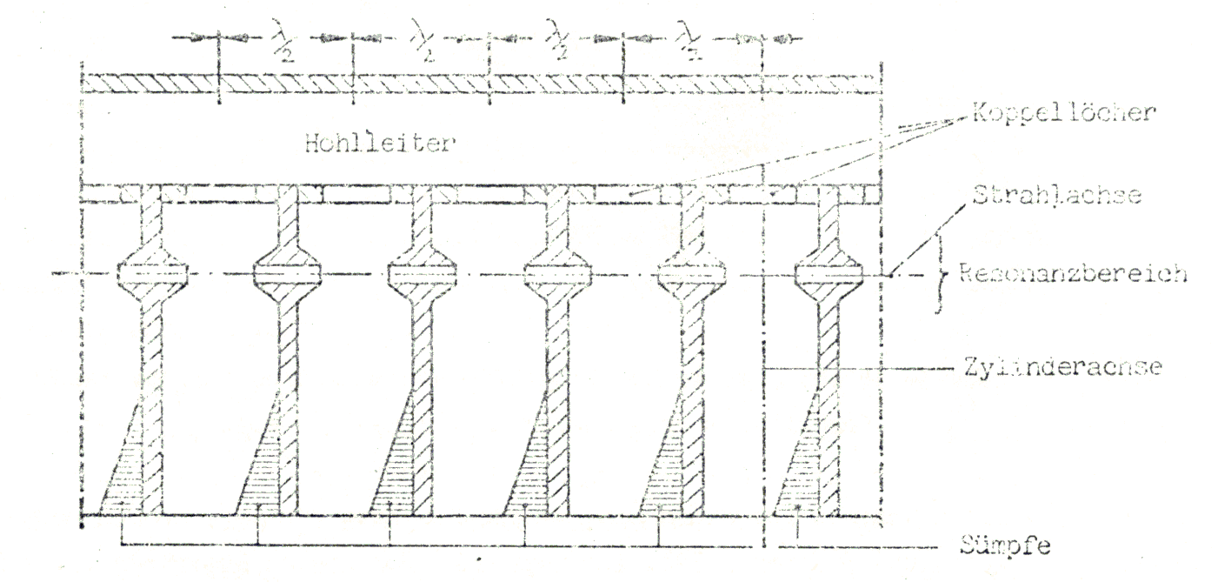
Two promising candidates for a closer look
The TE₁₁-cavity created by Helmut Herminghaus at University of Mainz
The basic idea of H. Herminghaus
Assume a circular waveguide in which a TE₁₁-wave is running
It is possible to form a resonator by denting locally the circular waveguide
The dents form a capacitive load and the cut-off frequency is locally decreased.
By a suitable forming one is able to achieve a situation, where all modes, except the one with the lowest frequency, will be above the cut-off frequency of the tube and therefore they will run in a load at one end of the tube
Fig. 6: TE11-mode in a circular waveguide without and with dents [3]
Fig. 7: TE11-single mode cavities connected to a rf feeder line. The dents are formed by the nose cones [3]

Slide 10
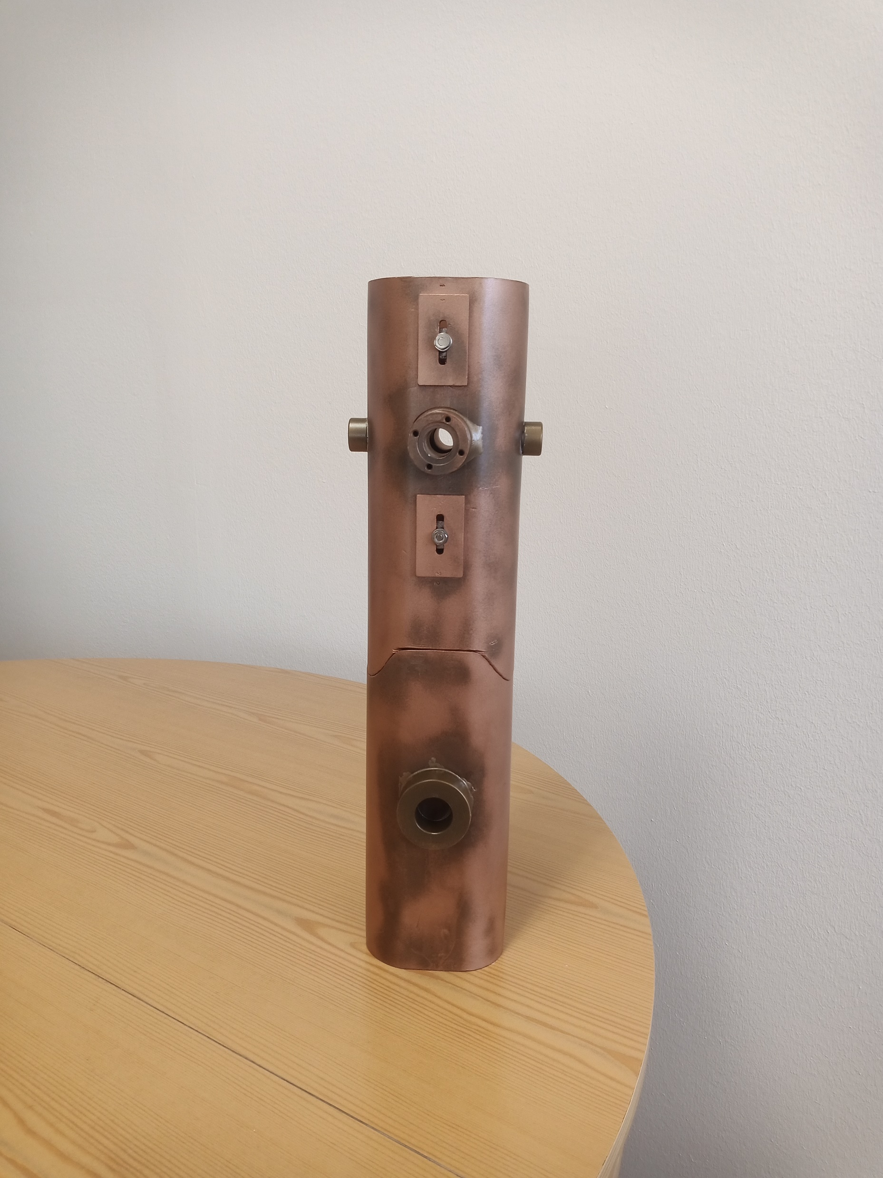
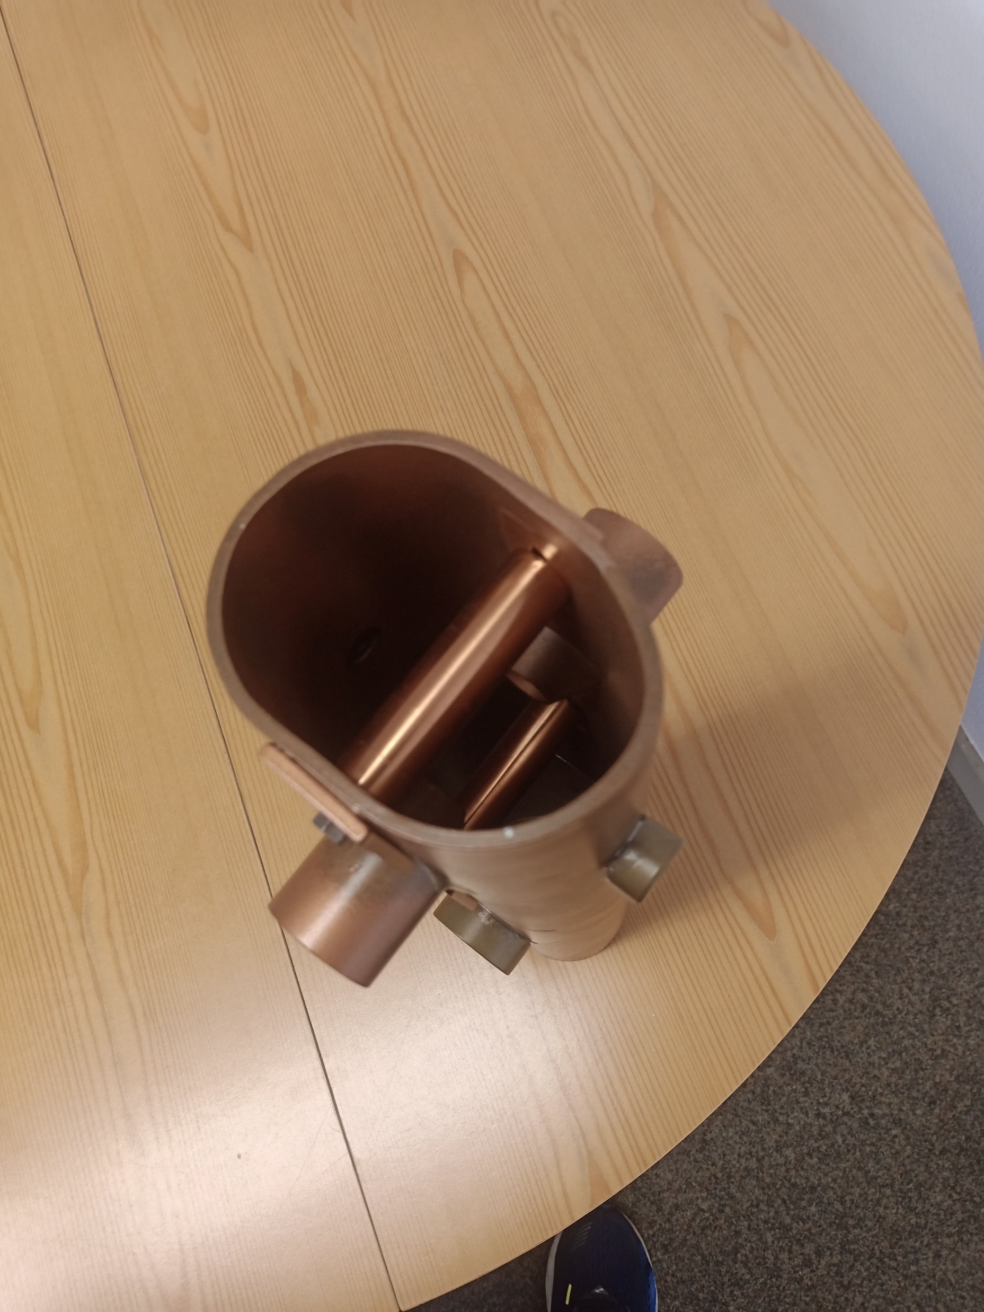
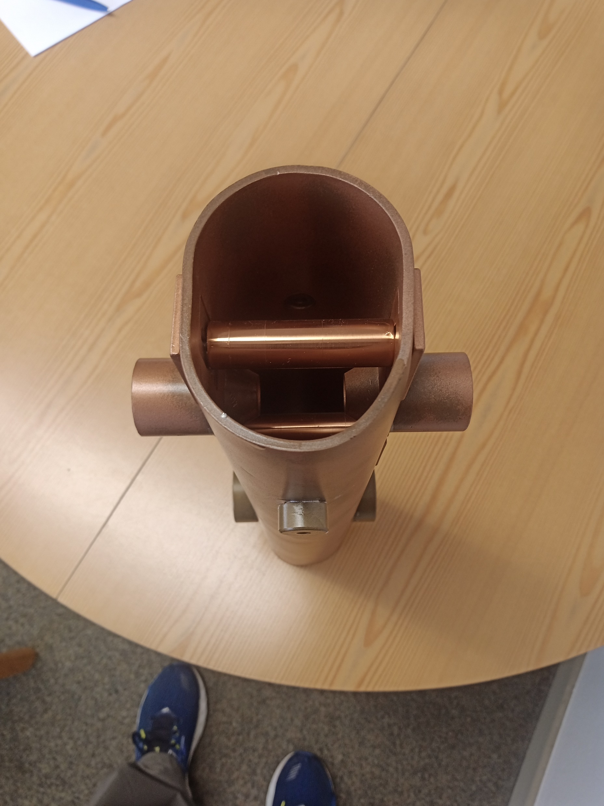
Two promising candidates for a closer look
A copper model of the TE₁₁-cavity created by Helmut Herminghaus at University of Mainz in 1978 for llrf-measurements. The model was provided by the courtesy of Prof. Dr. K. Aulenbacher and Dr. R. Heine (Institut für Kernphysik der Johannes Gutenberg Universität Mainz)
beam hole
inductive stubs
nose cones
adjustment for the stubs
compartment for the rf absorber
Fig. 8, 9 and 10: A model of the TE₁₁-cavity for a frequency of 2451,8MHz. The upper part is the cavity itself, the lower part is for the . The picture in the middle or the right shows adjustable inductive stubs and the nose cones of the acceleration gap.

Slide 11
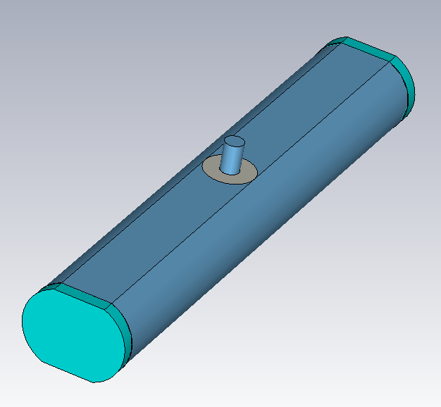
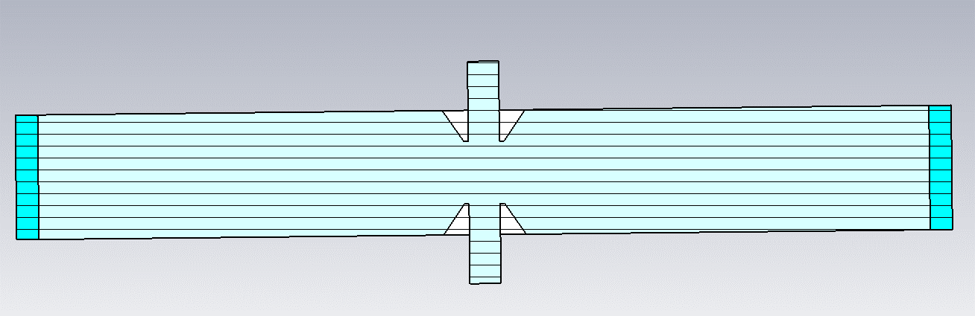
Two promising candidates for a closer look
The TE₁₁-cavity created by H. Herminghaus
rf absorber
Fig. 12: A cut through the TE₁₁-cavity shows the nose cones and the beam pipe
The dimensions were taken from the measurement model
The needed dents were formed nose cones
Frequency was of minor interest
Fig. 11: A simple model of the TE₁₁-cavity. At both ends the waveguide is terminated by lossy material

Slide 12
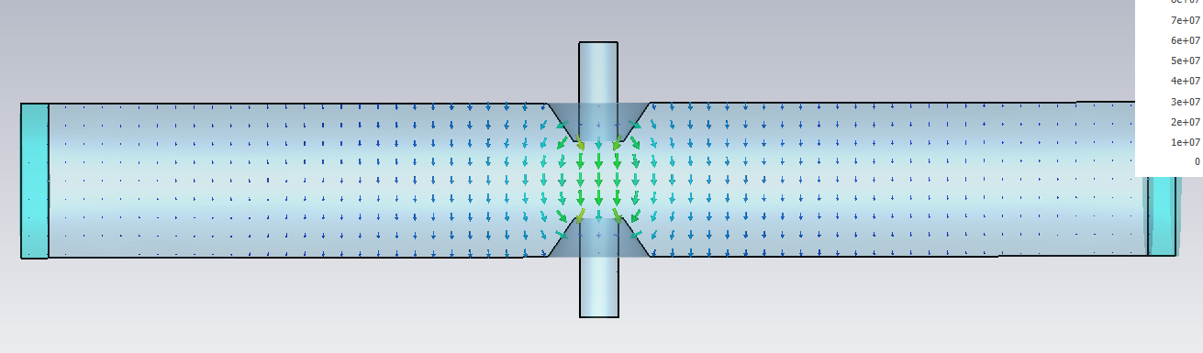
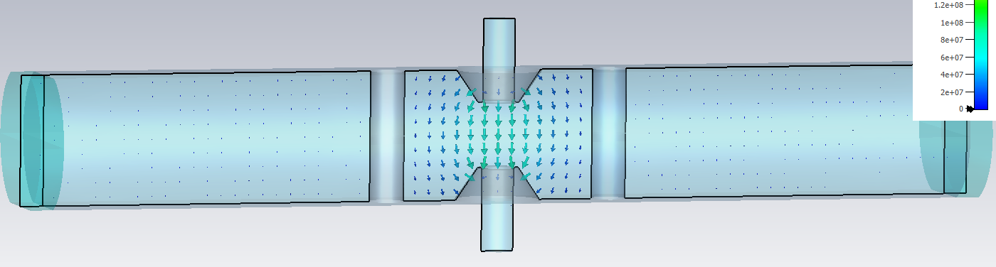
Two promising candidates for a closer look
The TE₁₁-cavity created by Helmut Herminghaus at University of Mainz
frequency | f₀ | 2,104GHz
shunt impedance (CST) | R_{S} | 1.1MΩ
unloaded quality factor | Q₀ | 11.200
 | R_{S}/Q₀ | 183Ω
Table 3: The characteristic numbers of the mode in Fig. 13.
Fig. 13: The trapped TE₁₁-acceleration mode between the nose cones. The mode is below cut-off to both sides of the gap and therefore a strong damping occurs
frequency | f₀ | 2,333GHz
shunt impedance (CST) | R_{S} | 2,6MΩ
unloaded quality factor | Q₀ | 13.800
 | R_{S}/Q₀ | 189Ω
Table 4: The characteristic numbers of of the mode in Fig. 14
Fig. 14: The TE₁₁-cavity is modified by the introduction of two inductive stubs. The stubs keep the field in the gap region and they enhance the characteristics by far.

Slide 13
Conclusion and outlook
Choke mode cavity
Is azimuthally symmetric => easy to manufacture
needs a high power ring coupler with waveguide connector (was already developed by T. Shintake)
was already successfully tested concerning high-power- and vacuum capabilities by T. Shintake
Has a lower shuntimpedance than the equivalent pillbox due to the additional losses by the choke
The TE₁₁₁-like cavity
was not tested concerning the high-power and vacuum capabilities; a model structure exists only
when optimized, the shuntimpedance is a factor of five higher than its pillbox equivalent
easy coupling by a usual coupling loop from the top side seemed to be possible
The field configuration is asymmetric and one has to find out how to arrange the cavities in the beam line to prevent problems from the viewpoint of particle dynamics

Slide 14
Thank you
Literature
[1] R. M. Sundelin, J. L. Kirchgessner, and M. Tigner, “Parallel Coupled Structure,” IEEE Trans. on Nuc. Science, Vol. NS- 24, No.3, June 1977, pp.1686-1688
[2] Tsumoru Shintake: „ The Choke Mode Cavity“, 1992 Jpn. J. Appl. Phys. 31 L1567
[3] R. Klein: “Messung der Shuntimpedanz und Feldassymmetrie von Beschleunigerresonatoren, Diploma Thesis, Institut für Kernphysik der Johannes Gutenberg Universität Mainz, 1981, KPH 21/81

Slide 15
Hülsmann, Peter
MHFe
Peter.huelsmann@desy.de
++49 (0)40 8998 2782

