Slide 1
GBP: Technical Note Status
M. Bruschi (INFN Bologna)

Slide 2
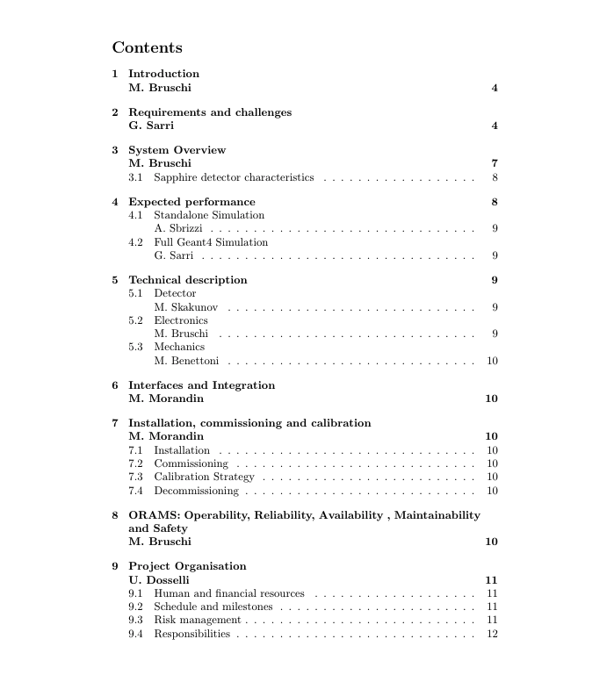

Slide 3
GBP measurement principles
GBP can measure X and Y distributions precisely (SA MC sample: Nγ ~ 10⁷,exp. ~10⁹ )
Amplitude (A): ~1%
Mean (M): ~3 μm
Sigma (σ): ~3 μm
(Still) unknown systematics sources
CCE
Digitization must be implemented in MC
CCE must be studied as a function of the dose
Electronic noise (probably negligible)

Slide 4
Info for LUXE – Stability monitor (relative measurements)
GBP can be a precise shot by shot stability monitor
Provide, for instance, 2D plots containing
A_{Y} vs A_{X}
M_{Y} vs M_{X}
σ_{Y} vs σ_{X}
These type of plots will measure precisely (~1% level) the beam conditions and stability at the IP
Unique measure provided by GBP amongst all the LUXE detectors

Slide 5
Info for LUXE – ξ measurement (absolute measurement)
MC simulation presently available only for ξ>>1 (LCF Approximation)
Thanks to Tom for having provided quickly MC samples usable for the technical note
improvements in modelling ongoing, ready in a couple of months
Ratio σ∥/σ⟂ ~ ξ (proposed in CDR)
it is applicable with lower electron energies
Present MC simulation give other hints
A model-independent method of extracting a₀ has been proposed by Tom and others
VERY DIFFICULT TO REACH dξ/ξ~2.5% with the latter approach (it needs, at least, ξ>>1): must be carefully studied

Slide 6
Info for LUXE – ξ measurement (absolute measurement)
GBP
Amplitude
Mean
Sigma
Laser
ξ (from 3D monitor)
XFEL electrons
Amplitude
Mean
Sigma
Extract ξ_{Nominal} for each BX by using MC simulation and the inputs above mentioned
The simulation of the gamma beam seen by the GBP should be quite straightforward

Slide 7
GBP Detector calibration
Use special runs with tungsten converter foil (~ 10^7 gammas/BC)
Acquire several shots by moving the station position and measure detector response and compare with MC simulation (I assume electron beam initial condition is well measured)

