Slide 1
High-Level Controls for DESY’s Facilities
Team • Goals • Example Projects • Virtual XFEL • Ideas on a Future Sequencer
Lars Fröhlich & Raimund Kammering for the HLC team
2021-11-30

Slide 2
High-Level Controls for DESY’s Facilities
Team • Goals • Example Projects • Virtual XFEL • Ideas on a Future Sequencer
01 Introduction
The HLC team
How to get in contact
02 Scope, Goals & Examples
Overview
Bringing physical parameters into the control system
Automatization
Libraries and toolboxes
Central machine configuration database
03 Virtual XFEL
The idea
Implementation
Lessons learned
What’s next: VFLASH, VPETRA IV
Towards a full simulation
Virtual machines & digital twins elsewhere
04 Outlook: A Scriptable Sequencer
The DESY sequencer
Desirable features for a new sequencer
Possible architecture
05 Summary

Slide 3
Introduction
The HLC Team & How to Get in Touch

Slide 4
High-Level Controls Team
Collaboration across Group Boundaries
Operations ↔ Controls ↔ Physics
Bolko Beutner, Maria-Elena Castro-Carballo, Marie Kristin Czwalinna, Winni Decking, Lars Fröhlich, Daniel Fulla Marsa, Christian Grech, Marc Guetg, Olaf Hensler, Raimund Kammering, Martin Killenberg, Torsten Limberg, Sascha Meykopff, Juliane Rönsch-Schulenburg, Matthias Scholz, Tobias Tempel, Sergey Tomin, Josef Wilgen, Tim Wilksen, and many more
(MCS, MPY, MXL, MFL, MSK, XFEL, …)

Slide 5
For the Record
PETRA IV HLC: https://confluence.desy.de/display/PetraIV/High+Level+Controls
How to Get in Contact
Regular meeting: Every second Thursday at 10:30 on Zoom
Satellite meetings for special topics: Irregular time & place, often on “the other” Thursday
Meeting minutes & team info: https://confluence.desy.de/display/HLC
Mailing list: xfel-hlc@desy.de (subscribe via https://lists.desy.de/sympa/)

Slide 6
Scope, Goals & Examples
What High-Level Controls Are All About

Slide 7
Scope
Communication, Exchange, Development
Physical parameters in the control system
Automatization & procedures
User interfaces & status displays
Current operation problems
Control concepts, strategies
Libraries, toolboxes
Central machine configuration database
Priority of projects
Focus on XFEL, but not exclusively

Slide 8
Goal: Physical Parameters in the Control System
… as Opposed to “in Stand-Alone Applications”
Typical parameters: Beam energy, emittance, magnetic field strength, bunch length
Can be measured/calculated from input data (BPM readings, camera images, power supply currents, spectrometer data)
Stand-alone tools (Python, Matlab) are good at that, but…
they are hard to run 24/7,
they do not produce standard history data,
their results cannot easily be made available to other tools,
this leads to uncontrolled proliferation of calibration data, conversion functions, etc.
they do not compose well and are hard to use in automated workflows.
Raise the level of abstraction by building reliable control system components to make physical quantities directly accessible

Slide 9
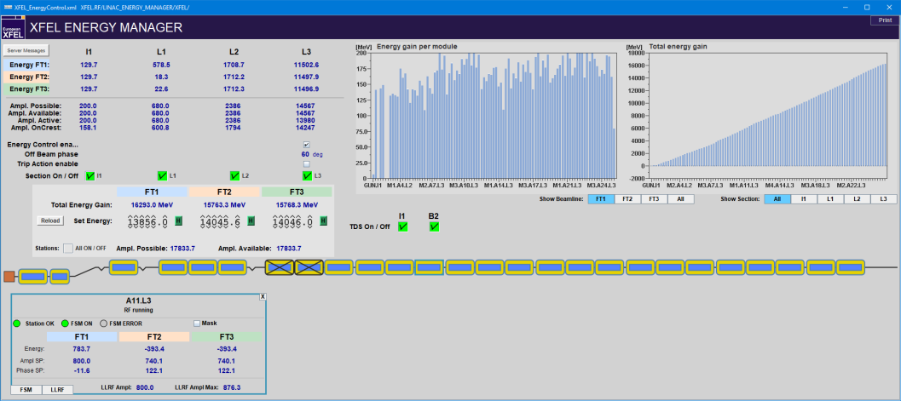
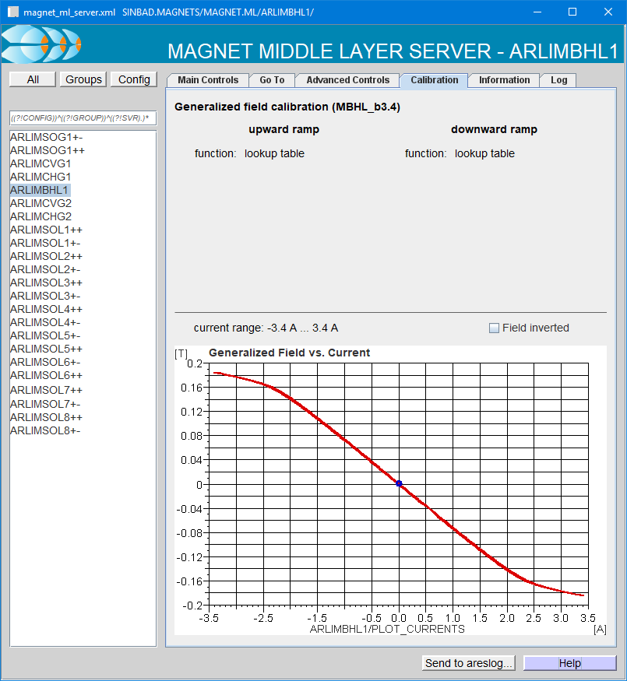
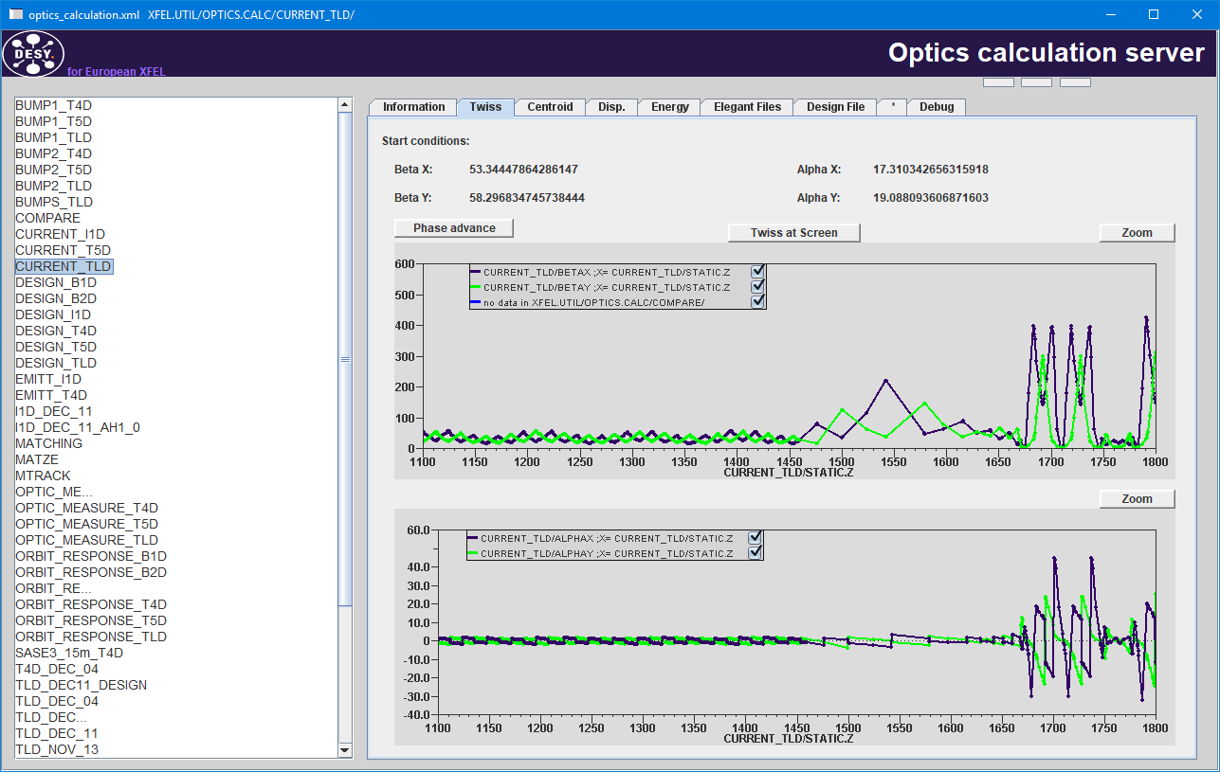
Goal: Physical Parameters in the Control System
Examples
Magnet ML server
Magnet control via field, strength, deflection angle etc., with hysteresis (not just current)
Optics server & design optics server
Optics calculations in the control system
Setting certain groups of magnets to design values via the control system
Beam energy measurement
For arbitrary dispersive lattice segments
Energy manager, LLRF sumvoltage server
Setting RF parameters in terms of beam energy gain, chirp, curvature (not just amplitude & phase)

Slide 10
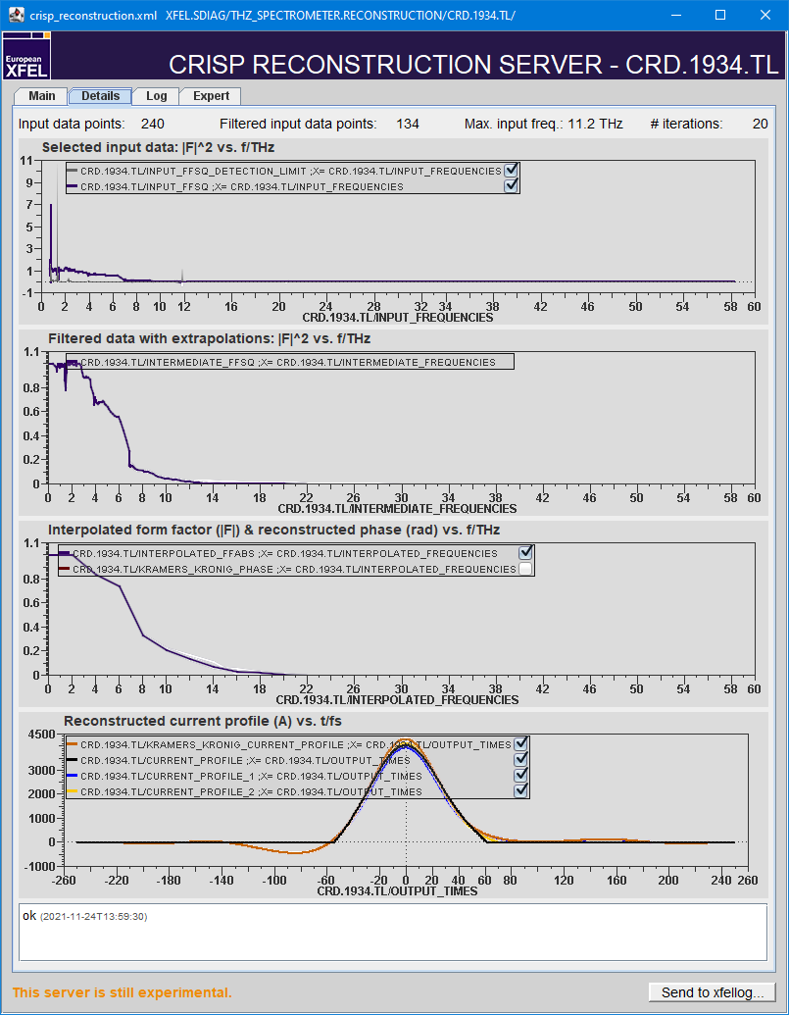
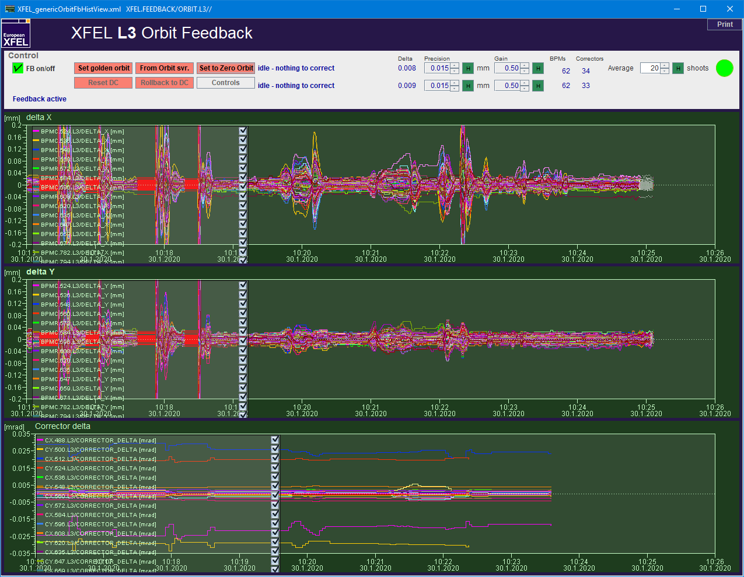
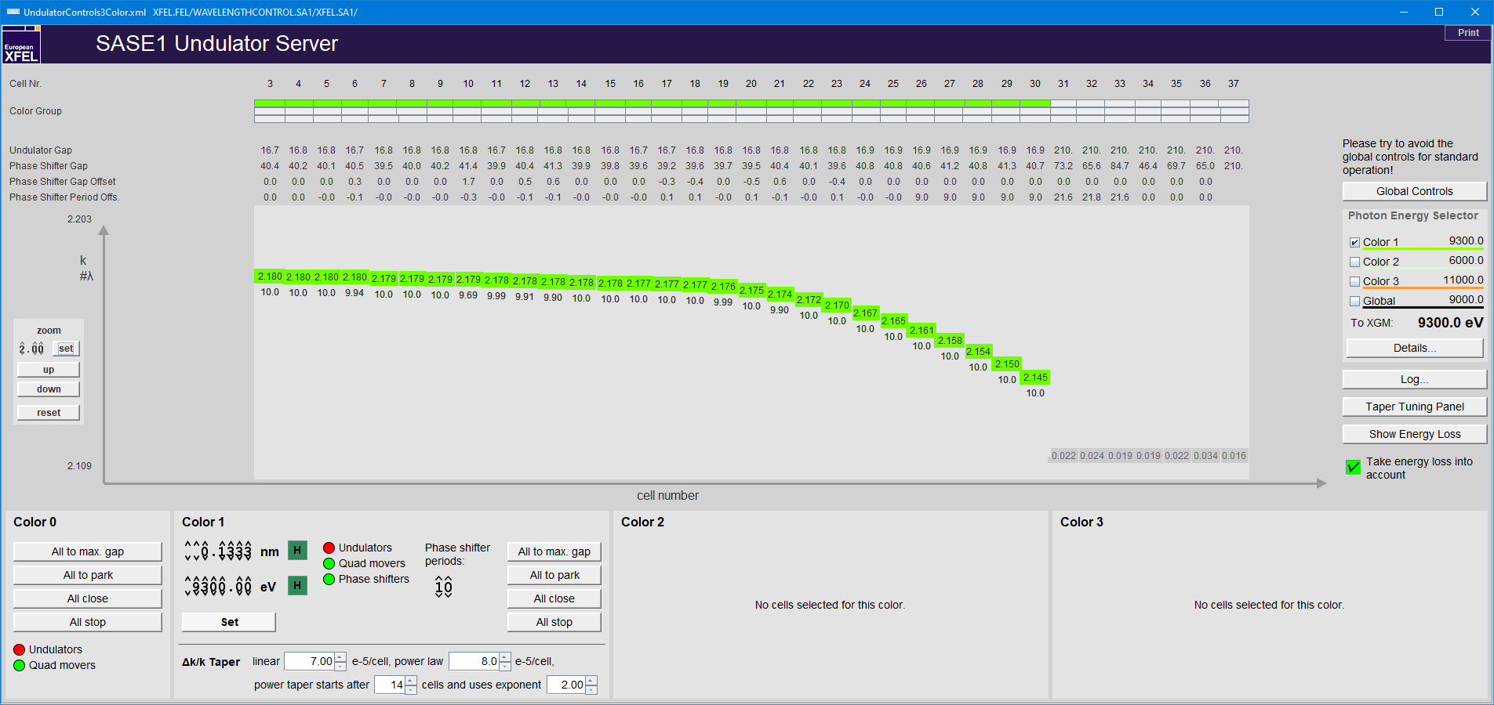
Goal: Physical Parameters in the Control System
Examples
Charge feedback
Specify desired bunch charge (not polarizer angle)
Orbit feedbacks
Orbit control via desired beam position (not corrector strengths)
Wavelength control
Set undulator gaps by photon energy or K parameter, desired taper shape (not gap sizes)
CRISP reconstruction
Reconstruct bunch profile from THz spectrometer data
Still stand-alone: Emittance measurements, matching, orbit correction (Matlab/Python)

Slide 11
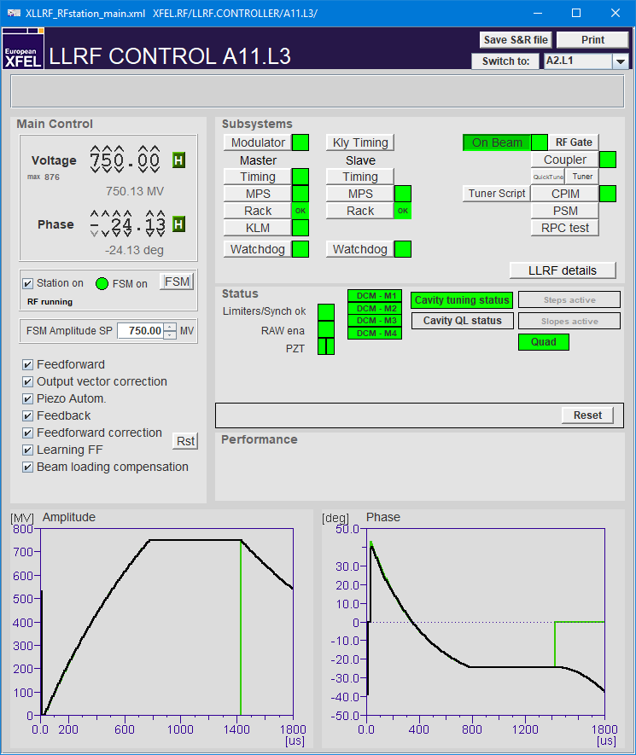
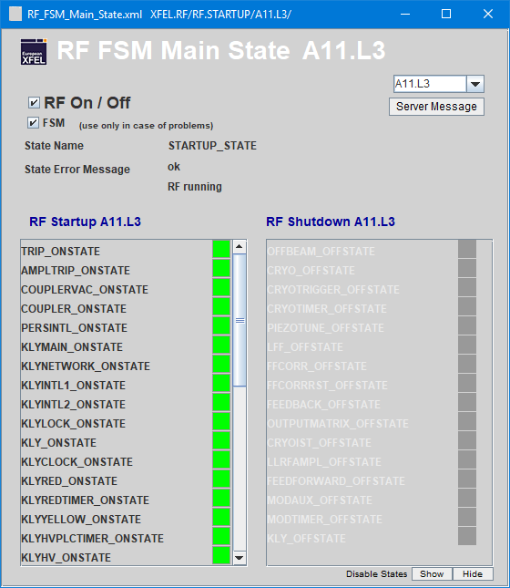
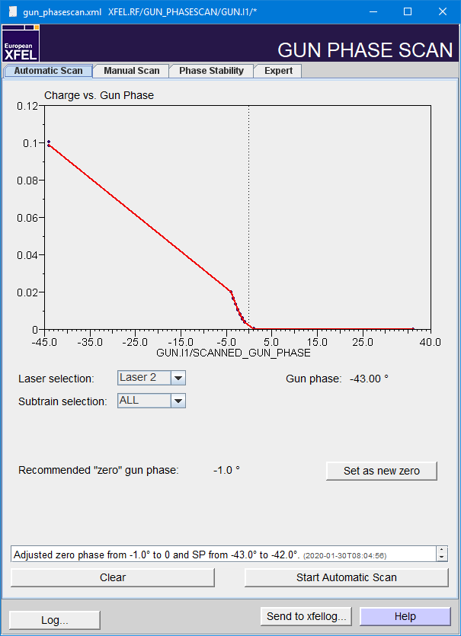
Goal: Automatization
Reducing Operator Clicks per Minute
Finite State Machine (FSM) for RF stations
Automatically ramp up, configure, recover stations
FSM for RF gun startup w/ frequency modulation
Makes startup of gun RF reproducible, safe, and fast
Phase scans
RF gun phase scan
Transparent scan of L3 linac stations under energy feedback
Dump switch
Feedbacks
Sequencer procedures
Lots of remaining pain points: First-time steering through the linac, optics and compression setup, subsystems, …

Slide 12
Libraries and Toolboxes
Simplify the Development of High-Level Software through High-Level Abstractions
C++ libraries
HLC machine lib: Machine-independent device access for XFEL, VXFEL, FLASH, SINBAD
HLC numerics lib: Root finding, interpolation, Gaussian fits, …
HLC SQL lib: General database access and specific classes for machine component lists
HLC tracking lib: Fast particle tracking and handling of optical lattices; trajectory fits
HLC image analysis library: Fast beam profile analysis
…
Matlab and Python toolboxes
Utility functions (block/unblock beam, list components, read optics parameters, send to logbook, …)
Device access classes (magnets, orbit, screens, cameras, …)
GUI helpers
…
Matlab: hlc_*
https://mcs-gitlab.desy.de/doocs/doocs-high-level-support

Slide 13
Central Machine Configuration Database
Providing a Single Source of Information
Software should agree which components exist in the machine and what their name, position and function is.
Tables in Oracle DB
Standardized component lists for XFEL, FLASH, FLASH 2020+, SINBAD-ARES, PETRA III, PETRA IV
Single source of information (e.g. MAD optics file)
Needs maintainer(s) for each machine
Needs a workflow
Calibrations (lookup tables etc.)
Other configuration information
Easy-access libraries/toolboxes for C++ and Matlab

Slide 14
The Virtual XFEL

Slide 15
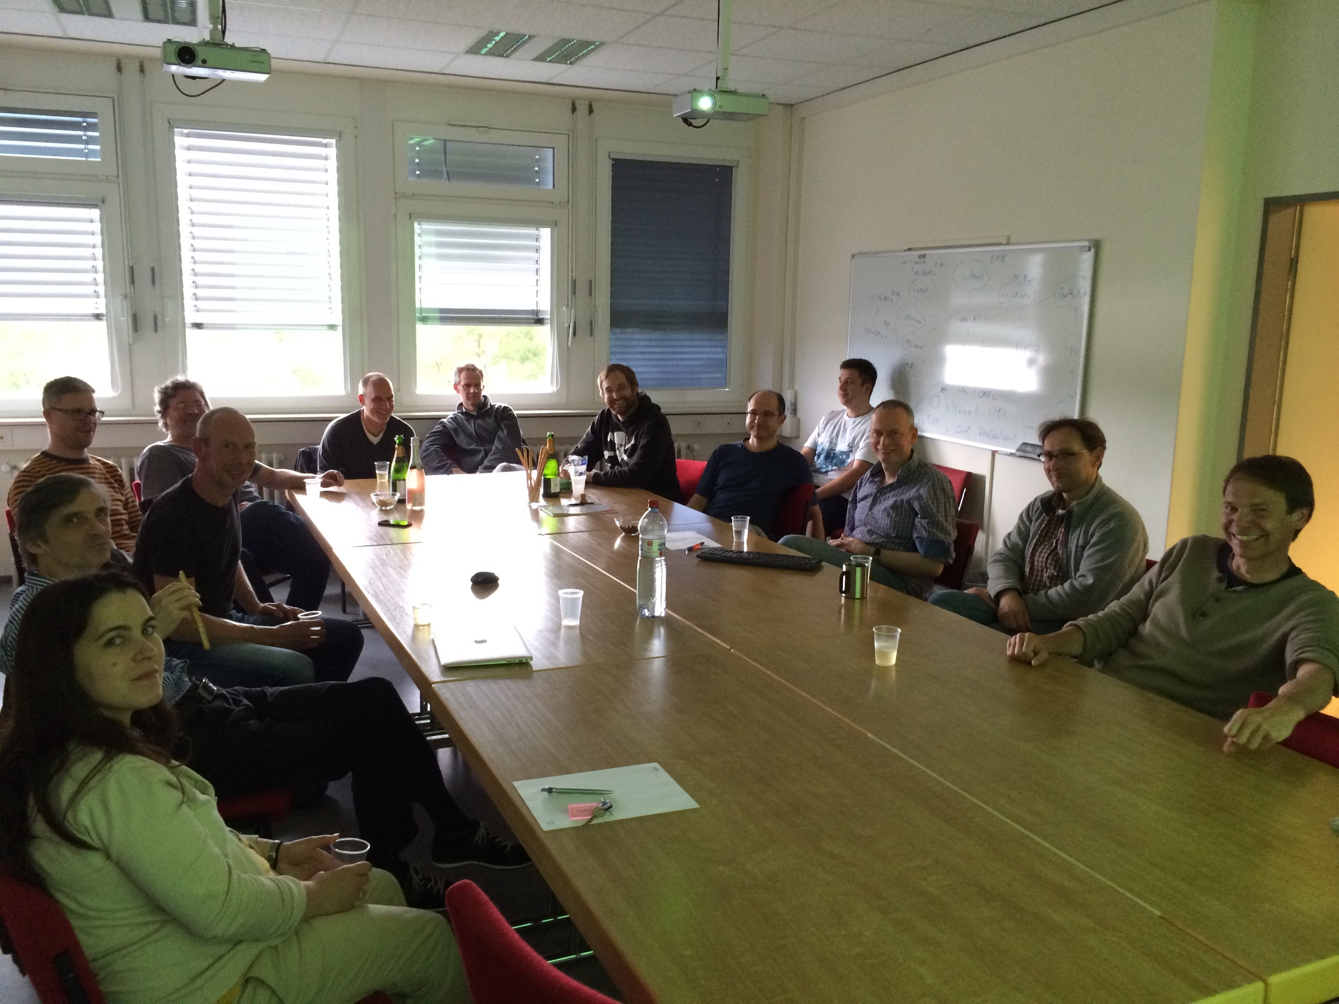
Motivation - the May Test
Needed to prove that the foreseen CS Architecture can cope with the data volume the XFEL will produce
High Level Software must be ready prior to start of injector commissioning!
→ The May Test - later called VXFEL
19. June 2014

Slide 16
The DAQ as the core - Controls Landscape
Client Layer
Orbit displays, sequencer, orbit correction, compression setup, emittance & optics measurement, bunch pattern setup, optimizers, …
Middle
Layer
Energy Manager
Gun Phase Scan
Orbit Feedback
LongitudinalFeedback
Trajectory Storage
Optics
Design Optics
Bunch Pattern
Dump Switch
Wavelength Control
DAQ (shared memory, archiver services)
LLRF Energy Gain
Charge ML
Orbit
Beam Energy Measurem/t
…
Screen ML
Image Analysis
Magnet ML
Quadrupole Mover ML
Undulator ML
Frontend Layer
LLRF
Toroid
BPM
BCM
…
Screen
Camera
Mag. Power Converter
Magnet Mover
Undulator

Slide 17
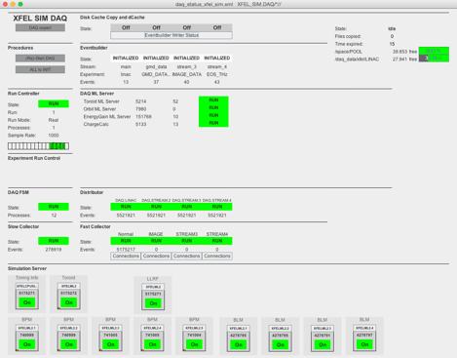
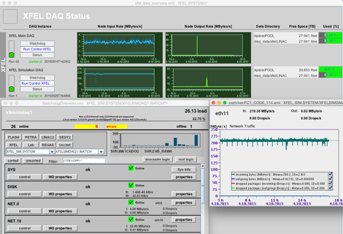
First Implementation - Data throughput

Slide 18
Going further - Trajectory Simulation
Client Layer
Orbit displays, sequencer, orbit correction, compression setup, emittance & optics measurement, bunch pattern setup, optimizers, …
Middle
Layer
Energy Manager
Gun Phase Scan
Orbit Feedback
LongitudinalFeedback
Trajectory Storage
Optics
Design Optics
Bunch Pattern
Dump Switch
Wavelength Control
DAQ (shared memory, archiver services)
LLRF Energy Gain
Charge ML
Orbit
Beam Energy Measurem/t
…
Screen ML
Image Analysis
Magnet ML
Quadrupole Mover ML
Undulator ML
Frontend Layer
LLRF
Toroid
BPM
BCM
…
Screen
Camera
Mag. Power Converter
Magnet Mover
Undulator

Slide 19
Going further - Trajectory Simulation
Client Layer
Middle
Layer
VXFEL Physics (Particle Tracking)
DAQ (shared memory, archiver services)
LLRF Energy Gain
Charge ML
Orbit
Magnet ML
Quadrupole Mover ML
Undulator ML
Frontend Layer
LLRF
Toroid
BPM
Mag. Power Converter
Magnet Mover
Undulator

Slide 20
Testing Tools in the Simulation
Client Layer
Orbit Correction Tool
Middle
Layer
VXFEL Physics (Particle Tracking)
DAQ (shared memory, archiver services)
LLRF Energy Gain
Charge ML
Orbit
Magnet ML
Quadrupole Mover ML
Undulator ML
Frontend Layer
LLRF
Toroid
BPM
Mag. Power Converter
Magnet Mover
Undulator

Slide 21
Virtual XFEL
Environment to test software, procedures, algorithms
… before the real machine is available
… while the real machine is in operation
… when it is too hard to test on the real machine
Hardware
A few computers, including powerful ones (simulation DAQ)
Timing system
Machine protection system board
Software
jddd panels, client applications, middle layer servers: identical to real machine
Simulated frontend servers instead of access to hardware
Physics simulation

Slide 22
Lessons learned
The VXFEL allows us to …
test the network and data throughput.
test the timing system and bunch pattern handling.
test naming conventions and prepare server configurations.
develop and test panels and display concepts.
test software interoperability.
test high level software before deploying it to the accelerator.
Limit: No physics simulation beyond trajectory & simple envelope.
Ideas for upgrades:
Simulate FEL output
Test FEL optimizer tools
Simulate photocathode (for Schottky scan)

Slide 23
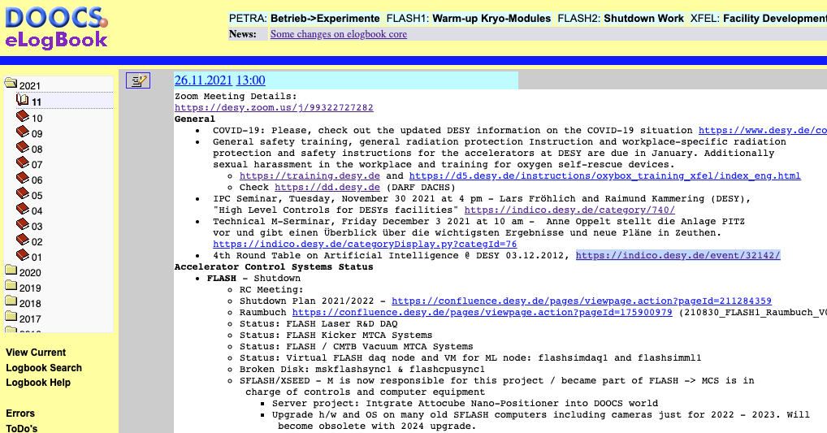
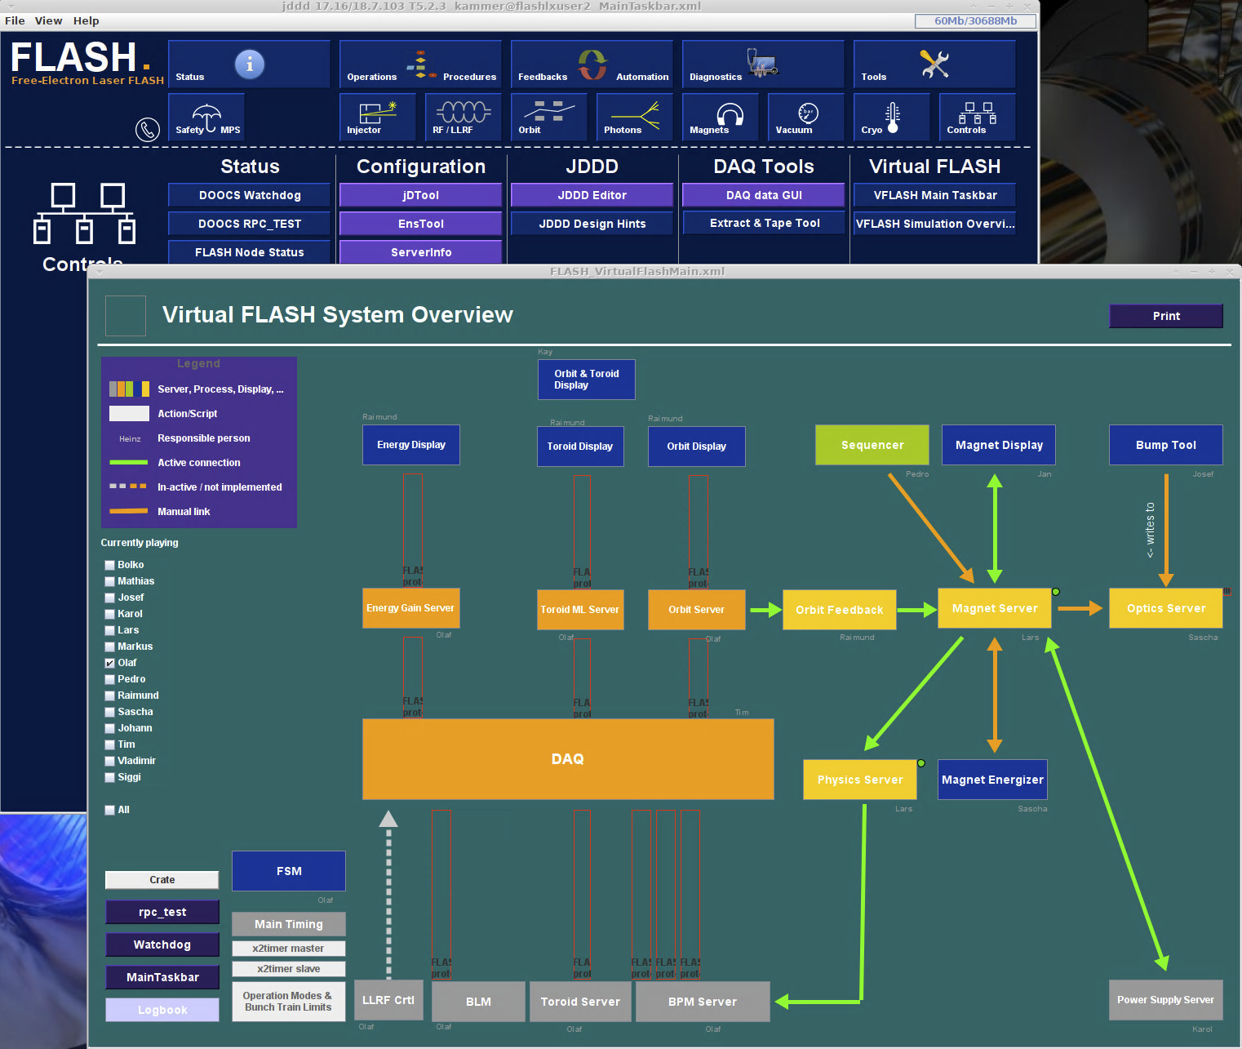
What’s next - VFLASH
VFLASH
due to good experience made with VXFEL the virtual instance for FLASH is on it’s way
XFEL, FLASH, PETRA, …
joining common component DB

Slide 24
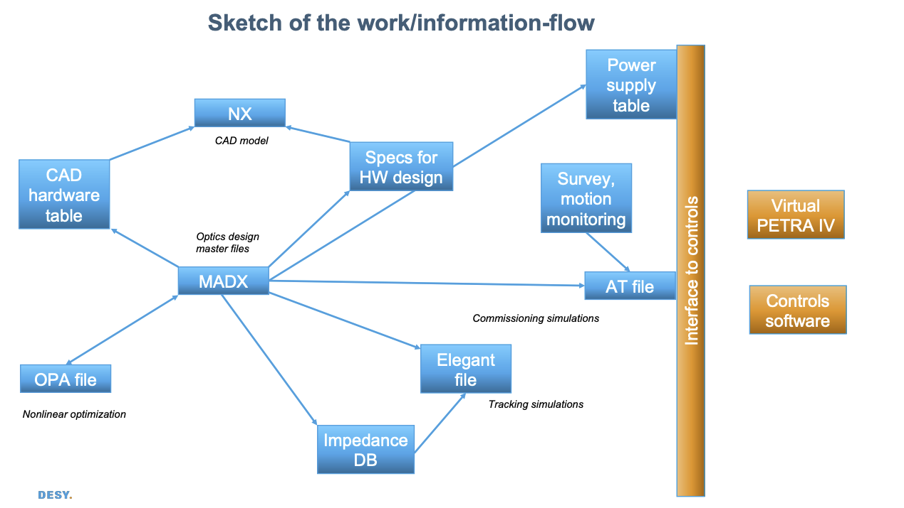
What’s next - VPETRA IV
Virtual PETRA IV
and for sure there will be a VPETRA IV coming soon
here approach more closely coupled to the machine physics (some words about lattices, DBA, …)
Approach from both sides:
similar CS simulation as VXFEL (HLC)
independent developed software stack to enable ML (Helmholtz International Lab HIR³X)

Slide 25
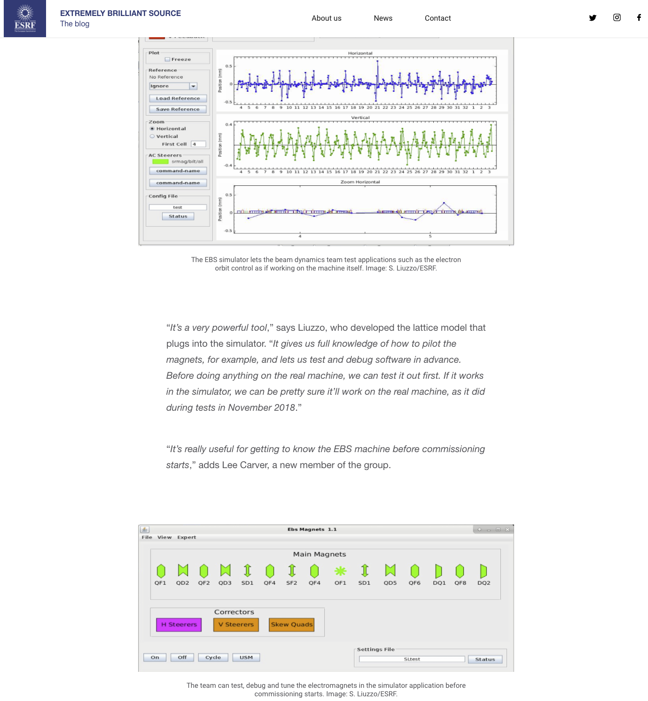
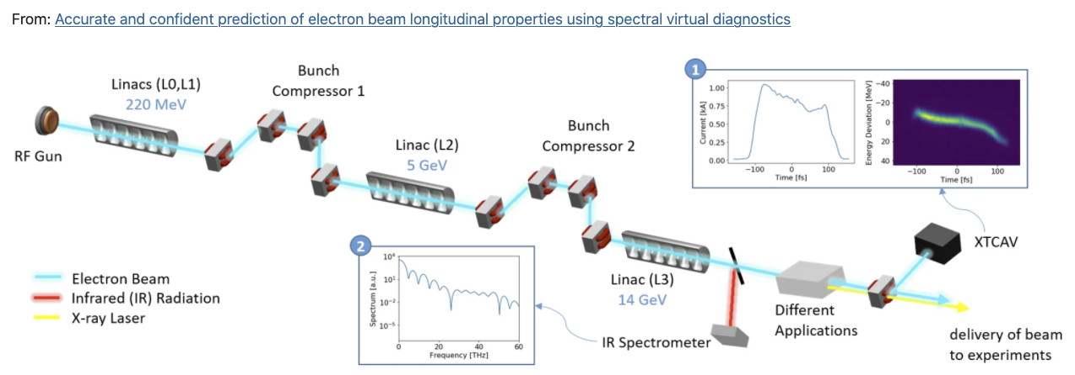
Virtual Machines @ other institutes
EBS simulator @ ESRF
Virtual Diagnostics @ SLAC
see e.g. https://www.nature.com/articles/s41598-021-82473-0
courtesy of A. Hanuka
see e.g. https://www.esrf.fr/home/UsersAndScience/Publications/Highlights/highlights-2016/ET/ET03.html

Slide 26
LIP, DiTARI and such like …
Within the LEAPS
consortium …
to apply for money at EU
HORIZON program
set up LIP:
LEAPS Integrated Platform

Slide 27
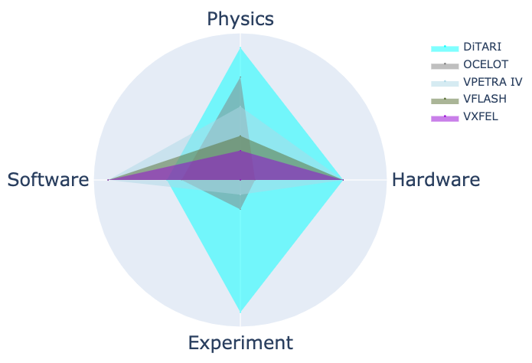
Digital twining

Slide 28
Digital twining
The gap is closing

Slide 29
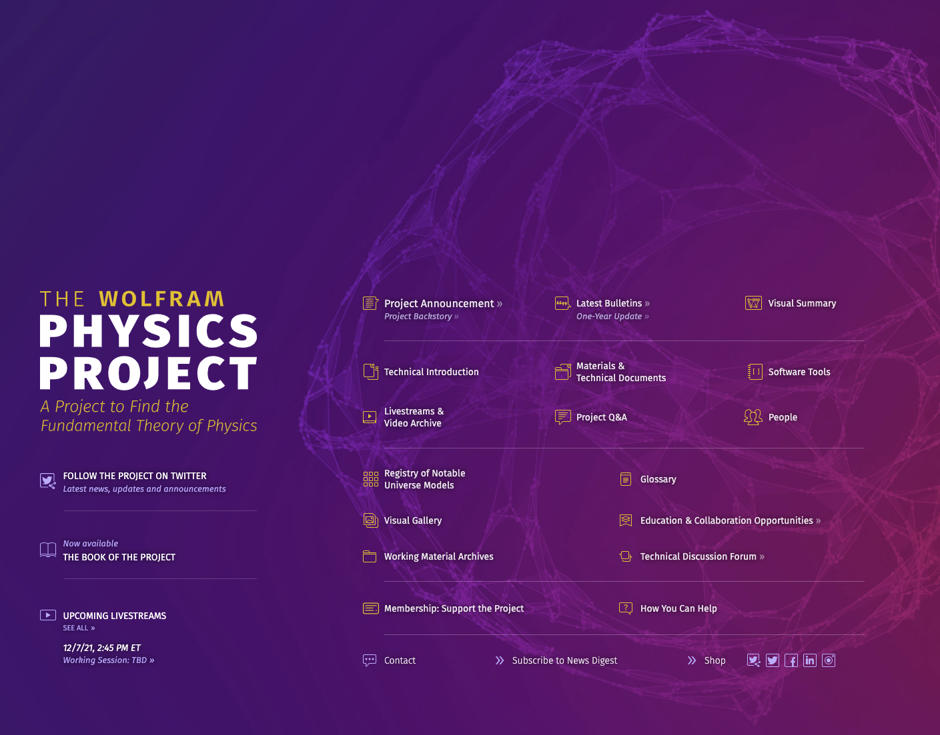
Wrap up
Virtual Machines
allow to simulate machine prior to it’s existence
enable attaching ML, big data
…
simple device/CS simulations like VXFEL already could serve to train e.g. a reinforcement learning agent LOW HANGING FRUIT
efforts in this direction strongly increasing (e.g. HIR^3X, VPETRA IV, from ARES to FLASH -> via VFLASH?)
a lot activity in the field see (e.g. MATLAB https://de.mathworks.com/discovery/digital-twin.html)
What’s the difference between a perfect simulation and the reality

Slide 30
Outlook: A Scriptable Sequencer
…making it easier to automate processes.

Slide 31
The DESY Sequencer
An (almost) stand-alone Java application
Very few active sequence authors
XML syntax
Version control (Subversion)
Limited functionality
Limited control flow, no variables
Not useable from other software
Easily understood & liked by operators
Actively used at almost all DESY accelerators

Slide 32
Desirable Features for a New Sequencer
Initial Requirements
Easy editing & maintenance
Operators, technical & domain experts
More programmability & functionality
Implement loops, exception handling, complex conditions
Integration into the control system
Sequences can be started/stopped/configured via control system set call
Composability
Sequences can be run by other sequences
Scalability
Maintain a library with hundreds of sequences
Run dozens of sequences concurrently
Separation of main logic and control system interface
Sequencer library (control system independent)
Sequencer server/device (embedded in the control system)
Logging
Detailed logs for debugging & analysis
Use a scripting language to define actions, conditions (Matlab, Python, LUA, …)

Slide 33
Mockup: Sequencer with LUA Steps
LUA: BASIC- or Matlab-like syntax

Slide 34
Mockup: Sequencer with LUA Steps
LUA: BASIC- or Matlab-like syntax

Slide 35
Sequencer: Input Welcome
Input welcome
Scope: All DESY facilities, possibly beyond
Initial goal: DOOCS implementation
Exploratory development has started
Full in-house development or external company?
Use cases?
https://confluence.desy.de/display/ HLC/Future+Sequencer
by Emoji One via Wikimedia Commons under Creative Commons Attribution-Share Alike 4.0 International License

Slide 36
Summary

Slide 37
Summary & Outlook
HLC Team
Intersection between operations, controls, physics
Physical parameters in the control system
Automatization & procedures
Libraries, toolboxes, platforms
Central machine configuration database
Virtual XFEL
Test network and data throughput
Test timing system and bunch pattern handling
Test naming conventions and prepare server configurations.
Develop and test panels and display concepts
Test software interoperability
Partially test high-level software before deploying it to the accelerator
Outlook: A Scriptable Sequencer
Attract more sequence authors
More functionality
Scripting language
Embedded in control system
Input & use cases welcome
Contact
https://confluence.desy.de/display/HLC xfel-hlc@desy.de (subscribe via https://lists.desy.de/sympa/)
by Rion via Wikimedia Commons under Creative Commons CC0 1.0 Universal Public Domain Dedication

Slide 38
Spare Slides

Slide 39
ICALEPCS: Sequencers are a Topic
Two contributions on “behavior tree” driven sequencers
Elettra – Sincrotrone Trieste
ITER
…
step9;read($devpsc8$/State) == FAULT ? command($devpsc8$/Reset) && (write(this/Cnt) = read(this/Cnt) + 1) && sleep($sleep_after_reset_cmd) && goto(10) : goto(10);Reset $devpsc8$ fault state;Error resetting $devpsc8$ fault state;-1;tangoerror=goto(10)
step10;read(this/Cnt) > 0 ? sleep($sleep_wait_refresh_state) && (write(this/Cnt) = 0) && goto(11) : goto(11);Waiting after reset ;Error waiting after reset;-1,exit
step11;read($devpsc1$/State) != ON ? command($devpsc1$/On) && (write(this/Cnt) = read(this/Cnt) + 1) && sleep($sleep_after_on_cmd) && goto(12) : goto(12);Turning $devpsc1$ on;Error turning $devpsc1$ on;-1;tangoerror=goto(12)
step12;read($devpsc2$/State) != ON ? command($devpsc2$/On) && (write(this/Cnt) = read(this/Cnt) + 1) && sleep($sleep_after_on_cmd) && goto(13) : goto(13);Turning $devpsc2$ on;Error turning $devpsc2$ on;-1;tangoerror=goto(13)
…
attr;Cnt;long;0

Slide 40
Behavior Trees
Modelling sequences of decisions & actions
by Aliekor via English Wikipedia under CC BY-SA 3.0 license

