Slide 1
Closing Remarks
of our
2nd virtual TTC Meeting
Hans Weise, DESY
January 27th, 2022
Notes:
How to edit the title slide
Upper area: Title of your talk, max. 2 rows of the defined size (55 pt)
Lower area (subtitle): Conference/meeting/workshop, location, date, your name and affiliation, max. 4 rows of the defined size (32 pt)
Change the partner logos or add others in the last row.

Slide 2
We had a great meeting
with many interesting presentations which have shown that our work is continued even in Covid impacted times
We all hope for an in-person meeting which offers more opportunities for
discussion and coffee-break brain storming meetings
laboratory tours
team building
Even if travel can be an effort, it is also an experience
It brings us together and connects laboratories, countries and cultures

Slide 3
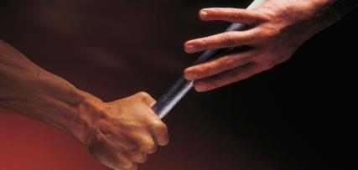
We had a great meeting
with many interesting presentations which have shown that our work is continued even in Covid impacted times
We all hope for an in-person meeting which offers more opportunities for
discussion and coffee-break brain storming meetings
laboratory tours
team building
Even if travel can be an effort, it is also an experience
It brings us together and connects laboratories, countries and cultures
Working with TTC has always been a great pleasure, and it will continue to be!
The ‘baton’ now goes to … a well known member of TTC i.e. the long time Technical Board Chair Eiji Kako

Slide 4
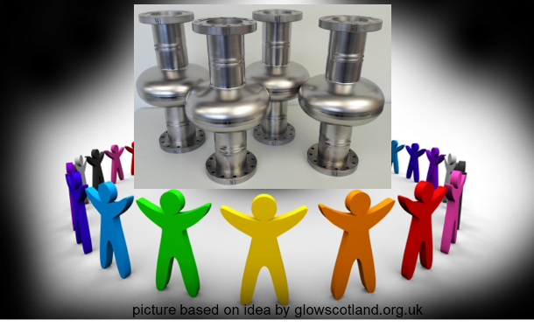
Before closing….
Many thanks to all speakers and participants
Many thanks to all organizers
Many thanks for the efficient ‘background’ communication which helped us to keep the indico site updated
Many thanks to all of you for allowing me to support TTC as Chair; it has been a pleasure!
Many thanks to the TTC Deputy Chair, the Executive Committee, the Technical Board, and all TTC meeting organizers.

