Slide 1
Shipment experience : Example of Canon klystrons for XFEL
TTC Meeting 2022
25-27 Jan 2022
Naoya Munemoto
CANON ELECTRON TUBES ＆ DEVICES CO.,LTD.
25th Jan 2022

Slide 2
Outline
1.Company Overview
2.CETD main lineup of klystron for laboratories
3.Review of L-band MBK
3-1.Advantage of MBK
3-2.The performance and history of MBK for European X-ray FEL E3736H
3-3.General view of E3736H design.
4.Shipping and Packing Transportation of E3736H set
4-1.List of transportation accident factors and countermeasures
4-2. Example of transportation E3736H
5.Toward even higher efficiency
6.Summary

Slide 3
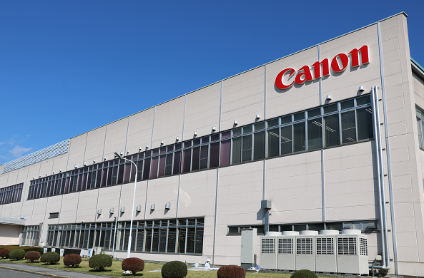
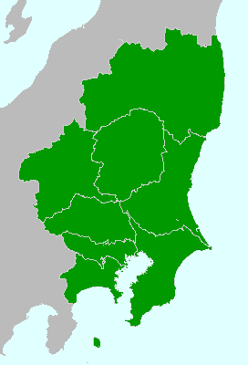
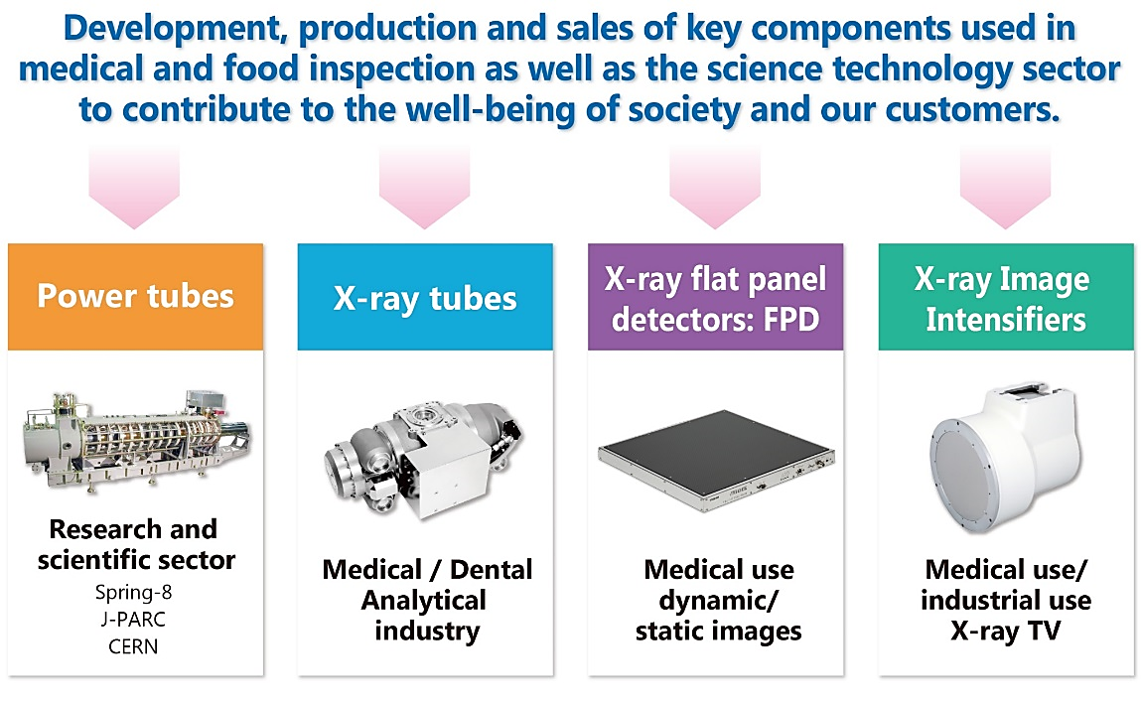
1.Company Overview
Company profile
Company Name | Canon Electron Tubes & Devices Co., Ltd. (CETD)
Founded | 1915 (A part of Toshiba Corp.)
Established | October 1st, 2003 (Renamed: Nov. 1st, 2018)
Headquarters | 1385, Shimoishigami, Otawara-shi, Tochigi 324-8550 , Japan
Business | Development, manufacture and sales of electron tubes and applied products
Main Products | Klystrons, Gyrotrons, Power Grid Tubes, X-ray Tubes, FPDs (Flat Panel Detectors), X-ray Image Intensifiers
Appearance of headquarters
Headquarters
Pictures of main products
~150 km
Tokyo
Mt. Fuji
Metropolitan office

Slide 4
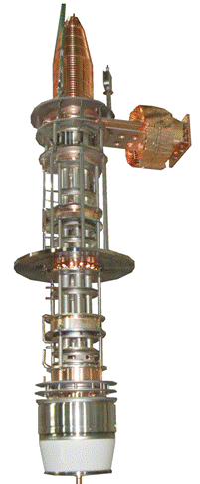
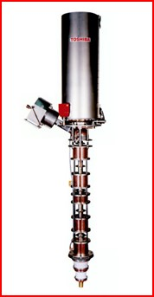
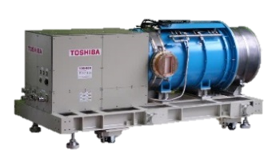
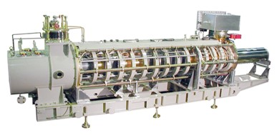
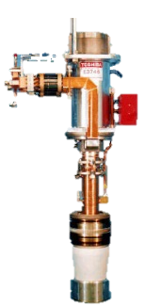
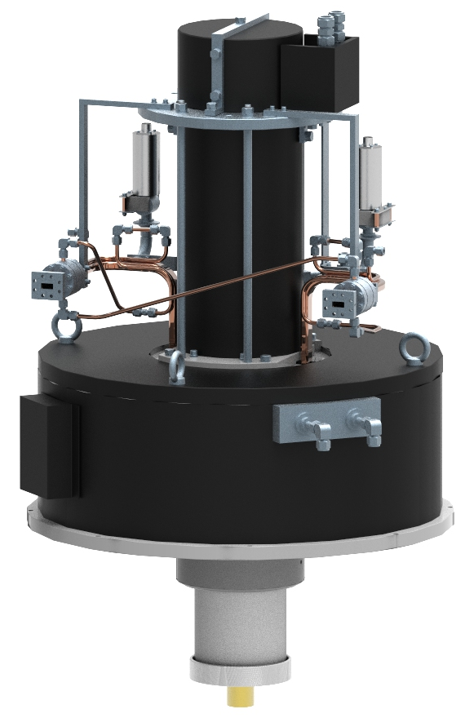
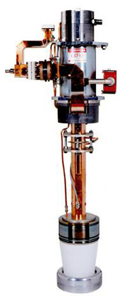
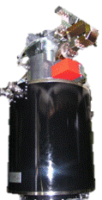
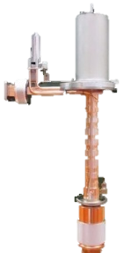
2.CETD main lineup of klystron for laboratories
SP: Short pulse , LP: Long Pulse, CW: Continuous waves
L-band
UHF
E3736H:1300MHz/10MW/LP/MBK
E3766A:972MHz/3MW/LP
E37503:999.5MHz/20MW/LP/MBK
E37504:704MW/1.5MW/CW
E3732:509MHz/1.2MW/CW
E3740A:324MHz/3MW/LP
E3774:500MHz/180kW/CW
C-band
X-band
E37202:5712MHz/50MW/SP
E37212:5712MHz/50MW/SP
E37216,A:5712MHz/55MW/SP
E37123:11994.2MHz/6MW/SP
E37115:11424MHz/6MW/SP
E37116:11424MHz/20MW/SP
S-band
＞~20MW
<~20MW
E3712:2856MHz/100-80MW/SP
E37306:2856MHz/50MW/SP
E3730A:2856MHz/50MW/SP
E37302A:2998MHz/45MW/SP
E3772A:7.5MW/2856MHz/SP
E3779:7.5MW/2998.5MHz/SP
E37325:10MW/2998.5MHz/SP
E37323:10MW/2856MHz/SP

Slide 5

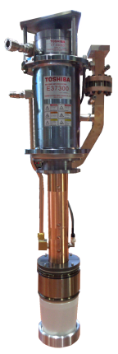
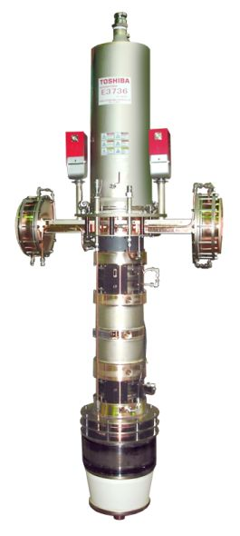
3.Review of L-band MBK
3-1.Advantage of MBK
324MHz/3MW/0.62ms
E3736H perveance
1beamlet:0.56 μP
Total beamlet:3.36 μP
E3712
E3730A
E37503
E3736
Single-beam Klystrons
Multi-beam Klystrons (MBK)
Feng, Jinjun, and Richard G. Carter. "A simple model and MAFIA simulation for studying the beam-wave interaction in the output gap of a klystron." ICMMT 4th International Conference on, Proceedings Microwave and Millimeter Wave Technology, 2004.. IEEE, 2004.
Why we need Multi-Beam Klystron
User desire
・High peak and average power
・Low beam voltage
・High efficiency
・Good reliability
・Compact body etc・・・
→(Single beam kly:SBK)In most cases, you will have to find a compromise among the following
・Peak power
・Beam Voltage
・Efficiency
The perveance is directed to the operational parameter of klystron.
p=I/V^{3/2}
P_{out}=ηIV=ηpV^{5/2}
→P_{out} of the klystron can be estimated by the beam voltage, efficiency and perveance.
(Red line: Approximate curve of experimental values)
→SBK will face the following problems
・Large beam voltage→Large power supply.
・High perveance→Low efficiency, Short lifetime
・Strong focusing magnet→Increase equipment size, power consumption.
・・・etc

Slide 6
3.Review of L-band MBK
3-1.Advantage of MBK
324MHz/3MW/0.62ms
E3736H perveance
1beamlet:0.56 μP
Total beamlet:3.36 μP
E3712
E3730A
E37503
E3736
Single-beam Klystrons
Multi-beam Klystrons (MBK)
Feng, Jinjun, and Richard G. Carter. "A simple model and MAFIA simulation for studying the beam-wave interaction in the output gap of a klystron." ICMMT 4th International Conference on, Proceedings Microwave and Millimeter Wave Technology, 2004.. IEEE, 2004.
E3736H
・1beamlet:0.56 μP→η=67％
・Total beamlet:ｐ＝3.36 μP
P_{out}= 10 MW [at V=115 kV]
Why select MBK
Two different perveance characteristics
・To split a high current beam into multiple beamlet
→①Low perveance beam :Efficient bunching and high efficiency.
→②High total perveance: Achieve a high power.
・Required beam voltage is low.
→Compact power supply
・Low perveance contributes to a design with reduced cathode loading
→Lower cathode loading, Longer cathode (klystron) lifetime
P_{out}=ηpV^{5/2}
→The MBK is the most effective solution for achieving high efficiency
and high peak power
Chin, Y. H. (2008). Design and performance of L-band and S-band multi beam klystrons. Proceedings of LINAC08, Victoria, BC, Canada, 363.

Slide 7
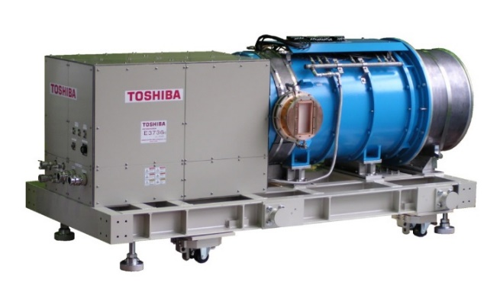
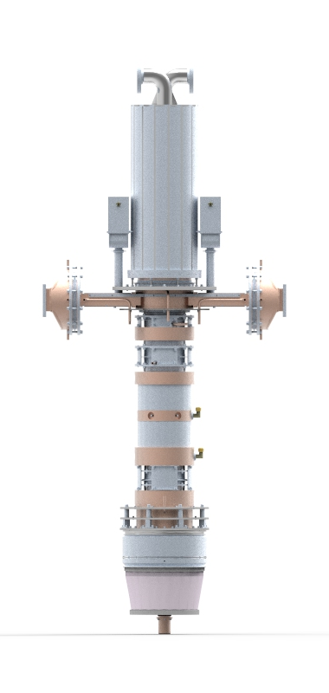
3.Review of L-band MBK
3-2.The performance and history of E3736H
Weight 2.2 t
E3736,H | Typical Operations
Operating Frequency | 1300 MHz
Peak Output Power | 10 MW
Average Output Power | 150 kW
Beam Voltage | 117 kV
Beam Current | 131 A
Efficiency | 67％ (C.D:68.9%)
RF Pulse Duration | 1.5 ms
Repetition Rate | 10 pps
Saturation Gain | 47dB
Number of Beams | 6
Number of Cavity | 6 cavities
Solenoid Power | <4 kW
Weight 340 kg
2.5 m
2.3 m
History of E3736type klystron
2002 Received prototype order from DESY.
Started development in collaboration with KEK / BNIP team.
2004 The first prototype E3736 was completed and delivered to DESY.
2007. Horizontal prototype E3736H was completed and delivered to DESY.
2012 Mass production of 7tubes started→ Complete delivery achieved.
2018 Mass production of 9tubes started→ Complete delivery achieved.
2021 Mass production of 6tubes started→ Under production.
Accelerator Facilities
DESY 1+(Vertical) 18 (Horizontal)
SLAC 1 (Horizontal)
KEK 2(Horizontal)

Slide 8
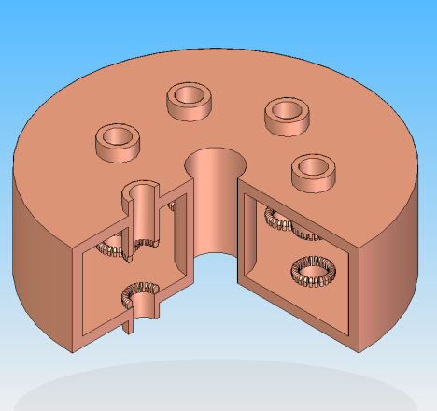
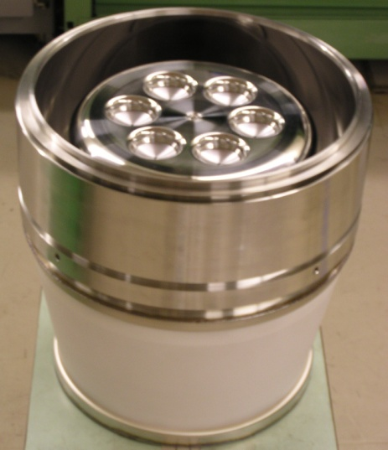
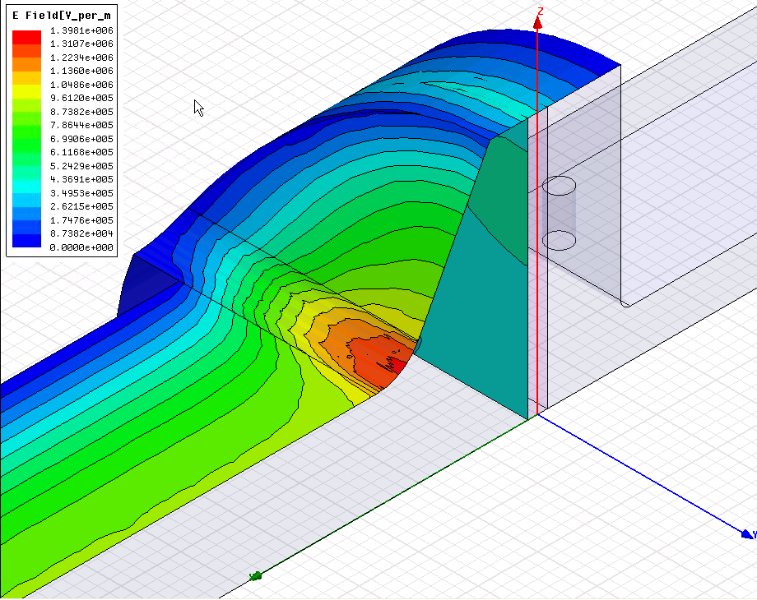
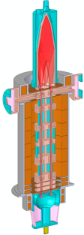
3.Review of L-band MBK
3-3.General view of E3736H design
・Beamlet :6 beams per axis.
・Ring-shaped common cavity is used all cavity.
→Increase the cathode size.
(Reduce cathode loading)
→Operation mode of all cavity:TM010.
・Second harmonic cavity is employed to 3rd cavity.
①Bunching with less drift length.
→Downsizing of klystrons.
②Reduce the effect of beam voltage fluctuation on RF phase.
→Facilitation of microwave low-level control.
Collector
Output window
RF Interaction Part
(6 Cavity)
Electric field strength of output window at 5 MW operation by using 2 port output structure.
Vacuum
side
Ceramic surface
Window flange of air side
Low max electric field
2nd Harmonic Cavity
Air
side
From 2011
No discharge can be used with pressurized air. SF6 free design.
・M-type cathode is used.
・Adequate Cathode loading
→ Adequate CD Lifetime :145,000 h is expected.
・Low Max surface electric field
→The risk of discharge at electron gun is low.
Electron Gun
(6 Cathodes)

Slide 9
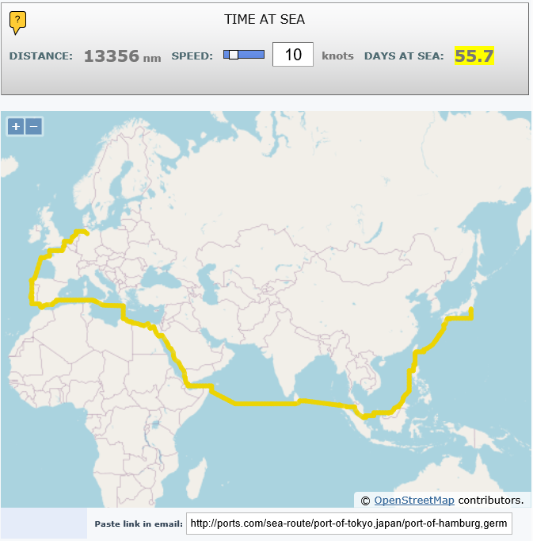
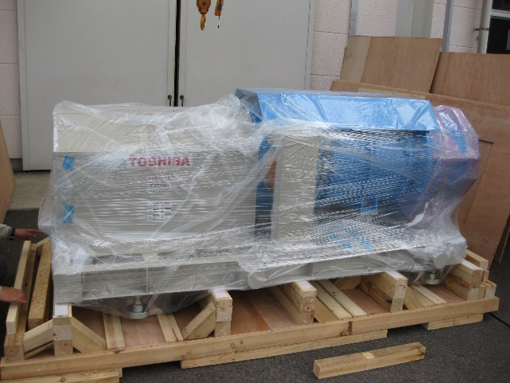

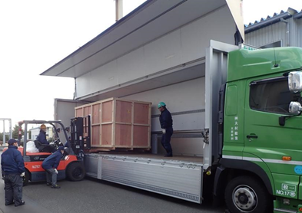
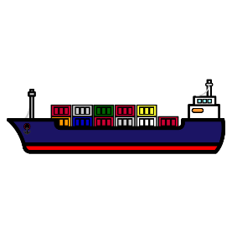
4.Shipping and Packing Transportation of E3736H set

Slide 10
4.Shipping and Packing Transportation of E3736H set
4-1.List of transportation accident factors and countermeasures
Problem Factor | Examples of Problems (klystron) | Countermeasures to the problem factor
・Condensation ・Moisture adhesion | ・Discharge in waveguide and electron gun during operation ・Cracking of ceramic during operation. ・Rusting ・Corrosion of cooling pipe | ・Desiccant inclusion ・Pack in a polyethylene bag to shield the outside air. ・Dehydration by dry air before packing ・Covered water circuit inlet/outlet.
・Internal water freezing | ・Deformation of internal structure due to water freezing. | ・Dehydration by dry air before packing
・G-force ・Vibration ・Tilt | ・Disconnection or short circuit in the electron gun heater. ・Deformation of a klystron. (Over tilt, Strong G-force) ・Loose screw fixture (Vibration) | ・Fully fix the klystron to the inner box. ・Protect the inner box with cushioning material (Materials that absorb or compensate for vibration, shock, and tilt) ・Observation by tilt and shock sensor ・Transport by air suspension truck ・Specify the position of the center of gravity
Handling (human factors) | Damage caused by rough handling of cargo | ・Caution labeling ・Placing shock watches, etc. in a visible position

Slide 11
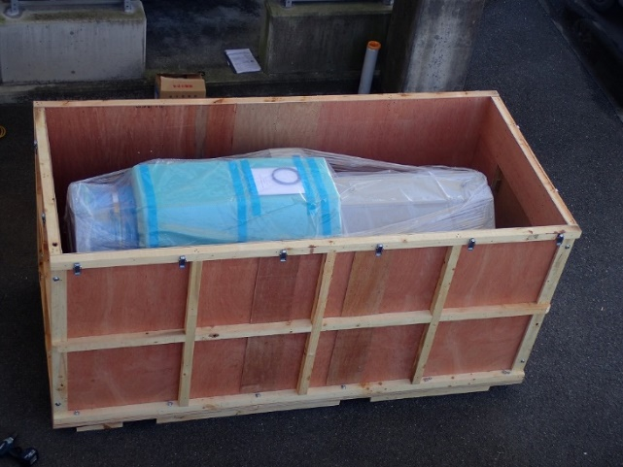
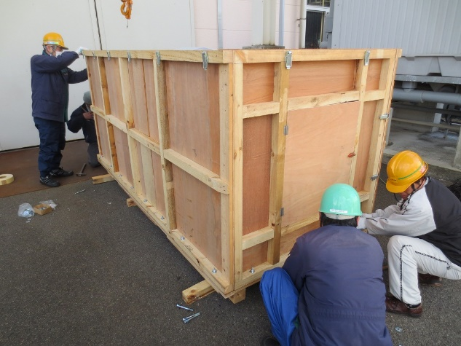
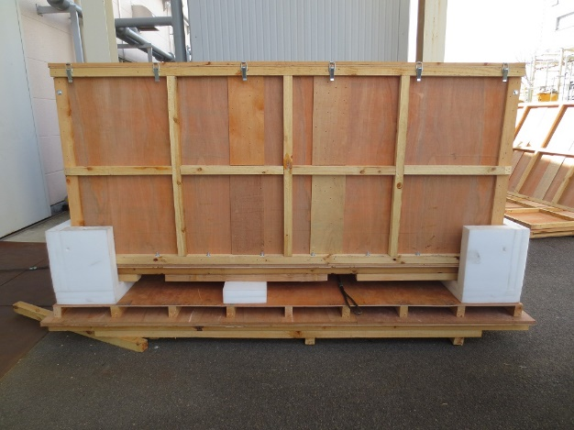
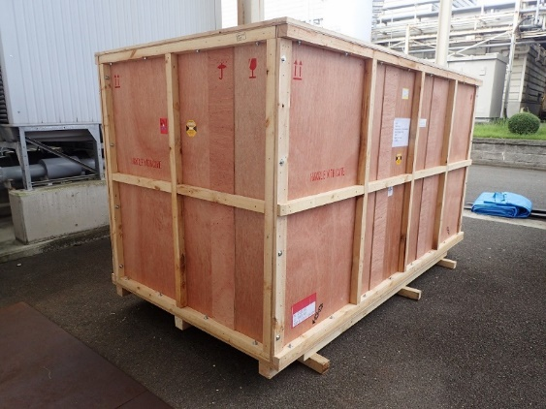
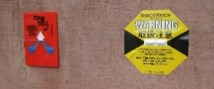
4.Shipping and Packing Transportation of E3736H set
4-2. Example of transportation E3736H
①
②
③
④
・E3736H set weight: 2.2 t
Day of Arrival (Japan→Germany)
・Shipping service
Via:East China Sea, Indian Ocean, Suez Canal, Mediterranean Sea, North Sea
→2 months
・Flight service
→about 1-2 day
⑤
⑥

Slide 12
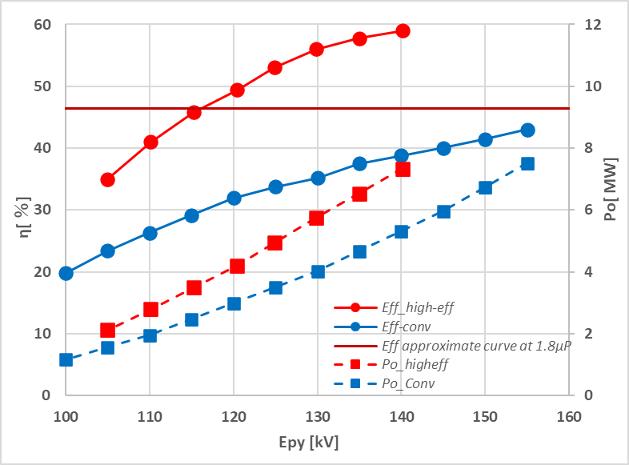
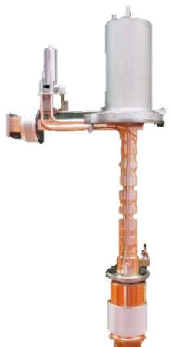
5.Toward even higher efficiency
・ Development and demonstration of a high-efficiency design using a multi-cavity scheme began in 2017.
・High efficiency design applied to S-band tube [perv.1.8 μP,7.5 ＭＷ,(at 155 kV), Short pulse SBK]
Results
・Conventional design klystron
Typical：43％
・High-efficiency design klystron
Measured results：59.2％
→Succeeded in increasing efficiency by 15%.
Case study of high-efficiency design L-band MBK design
Condition:
Same beam voltage 115 kV
Same total perveance:3.36 μP
→・Different number of beams 6, 10, 12
・High efficiency design applied
 | 1beamlet perv | Efficiency [SIM results]
unit | μP | ％
E3736H | 0.56 | 72.9
6beam high eff | 0.56 | 77.1
10 beam high eff | 0.34 | 81.7
12beam high eff | 0.28 | 82.8
15％
Results
・The efficiency increases by 5％ under the same number of beamlet.
・The efficiency is expected to reach 80％ under number of beamlet is increased.
15 kV
E3736H
・1beamlet:0.56 μP→η=67％
・Total beamlet:ｐ＝3.36 μP
P_{out}= 10 MW [at V=115 kV]
E3736type_10higheff・1beamlet:0.34 μP→η=81.7％
・Total beamlet:ｐ＝3.36 μP
P_{out}= 12 MW [at V=115 kV]

Slide 13
6.Summary
・ MBK is a known solution to achieve high efficiency and high power.
・CETD has produced a total of 21 unit of E3736 type MBK.
・MBK is transported in the same normal packaging as other klystron. No problem.
・80％ efficiency is expected to be achieved, in the case of the high efficiency design is applied to MBK.
Please contact CETD if you are interested
・More energy in the accelerators
・Energy saving in facilities
Thank you for your attention!

