Slide 1
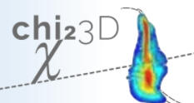
FLASH2020+ seeding laser SLASH - Start-to-End simulation using chi3D
www.chi23d.com
Tino Lang

Slide 2
Outlook
01 Introduction
FLASH2020+ seed laser SLASH
02 Laser system and UV conversion concept
OPCPA and cascaded chirped pulse sum frequency generation (ccSFG)
03 chi3D – Start to End simulation via chi3D
Model
Results
04 Hand-over to G5

Slide 3
Requirements for seed laser system (SLASH)
Seeding laser specification for wavelength tunable UV x-ray seeding
Parameter | Specifications
Tunable wavelength | 297 – 317 nm
Pulse duration | 50 fs (FWHM)
Bandwidth | Fourier limit
Pulse energy | 0.3 – 16 µJ
Burst duration/ rep. rate | 600 µs / 1 MHz
burst-burst | pulse-pulse instabilities | < 4% | < 2% (RMS)
Wavelength stability | 0.06 nm @ 300 nm
- beam transport - in-coupling losses
- safety margin
50 µJ / 50 W, 50 fs, 1 MHz
tunable UV pulses - 24/7
T
UV Seed Laser

Slide 4
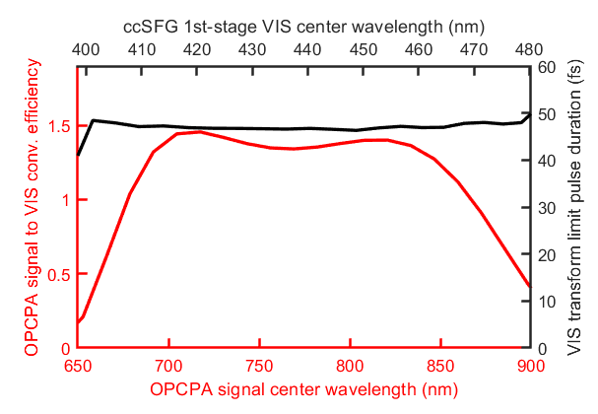
Laser concept
Broadly tunable green pumped OPCPA based on high power Ytterbium chirped pulse laser amplifiers (CPA)
+ efficient broadband UV conversion
Power budget
P
T
In-burst power
600 µs
3500 W
1750 W
100 W
50 W
293 298 303 308 313 318 323 - corresponding UV wavelength -
> 50 % conversion efficiency
100 ms
t
CPA
OPCPA
ccSFG
Compressor
Seeder
FE
300 fs 4 µJ
SHG
680 - 950 nm
100 µJ
297 - 317 nm
50 µJ
Fused Silica
3 µJ
1 µJ
nJ
WLG
NOPA
ϕ
NOPA
NOPA
SFG
SFG
50 fs
800fs
400W
5kW
1 MHz, 3.5 mJ, 600 µs (10 Hz bursts)
SHG
→
1 mJ
417 - 480 nm
Laser system
Optically synchronized low noice oscillator + 5kW Yb-based laser amplifier system (NKT+Amphos)
High-power tunable optically parametric amplifier (OPCPA)
UV conversion + beam transport:
Two subsequent tunable and high efficient SFG stages
Relay imaged beam transport with simple bulk pulse compression

Slide 5
Simulation model
Start-to-End (excluding Laser amplifier)
Modeled part of seed laser system (SLASH)
Chi3D simulations building blocks
CPA
OPCPA
ccSFG
Compressor
Seeder
FE
300 fs 4 µJ
SHG
680 - 950 nm
100 µJ
297 - 317 nm
50 µJ
Measured power, pointing and pulse duration & fluctuations
3 µJ
Fused Silica
Measured spectrum
nJ
NOPA
ϕ
NOPA
NOPA
SFG
SFG
50 fs
800fs
400W
5kW
1 MHz, 3.5 mJ, 600 µs (10 Hz bursts)
SHG
→
1 mJ
417 - 480 nm

Slide 6
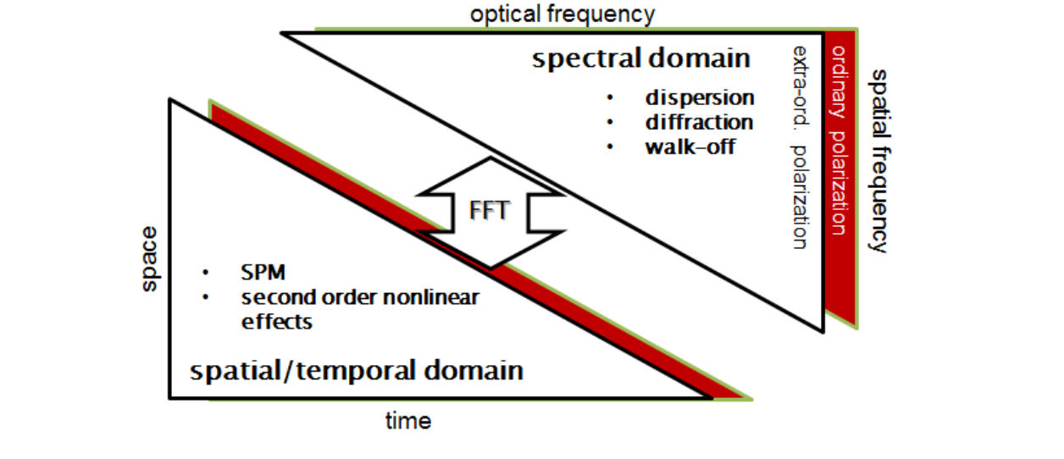
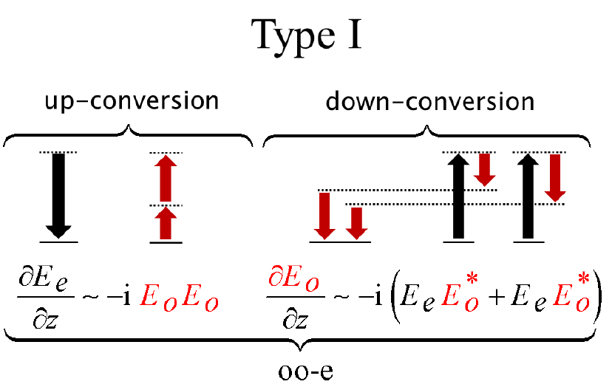
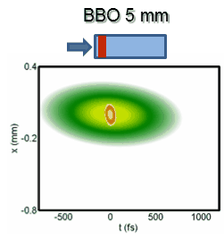
Simulation model
3+1 dimensional simulation tool for noncollinear interaction and propagating broadband and ultra-short laser pulses – chi3D
Methods
Type I second order nonlinearity
Laser pulses in nonlinear crystal
www.chi23d.com

Slide 7
Start-to-end simulation
Fluctuation transfer study
Simulation results vs. pump laser stabilities
Input parameter variation |  | SHG (no.) | NOPA (no.) |  |  |  | SFG (no.) |  | Required UV stability
CPA short-pulse pulse energy | 1 % | (1) | (1) | (2) |  | (3) | (1) | (2) | 2 %
 |  | 1.14 % | 1.75 % | 0.8 % |  | 0.6 % | 0.5 % | 0.6 %
CPA 4kW pulse energy | 1 % | (2) | (2) |  | (3) |  | (1) | (2)
 |  | 1.24 % | 3.44 % |  | 3.48 % |  | 3.58 % | 2.66 %
CPA 4kW output pulse duration | 1 % | (2) | (2) |  | (3) |  | (1) | (2)
 |  | 0.25 % | 2.52 % |  | 2.54 % |  | 2.08 % | 0.38 %
OPCPA pump – seed timing | 10 fs |  | (2) |  | (3) |  | (1) | (2)
 |  |  | 0.03 % |  | 0.03 % |  | 0.01 % | 0.01 %
 |  |  | 0.46 nm |  | 0.46 nm |  | 0.15 nm | 0.08 nm | 0.06 nm (2e-4)

Slide 8
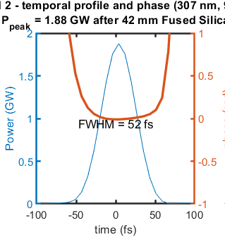
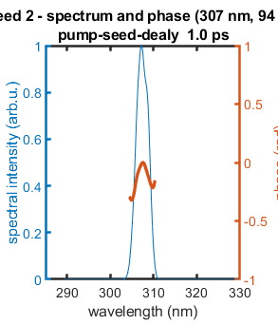
Start-to-end simulation
Example output UV seeding pulse
3+1 dimensional simulation building blocks (chi3D)
3D pulse intensity distribution in space and time
Seed peak power and phase
Phase (rad)

Slide 9
Start-to-end simulation
Providing electrical field for GENESIS
3+1 dimensional simulation building blocks (chi3D)
3D pulse intensity distribution in space and time
chi3D to hdf5 conversion tool
chi3D output is a 3D complex electrical field in spectral domain E(f,kx,ky)
???Faktor??? 826177384779

Slide 10
Tino Lang
Department: FS-LA
tino.lang@desy.de
+49 40 8998-6096
We acknowledge DESY (Hamburg, Germany), a member of the Helmholtz Association HGF, for the provision of experimental facilities. Parts of this research were carried out at FLASH.

Slide 11
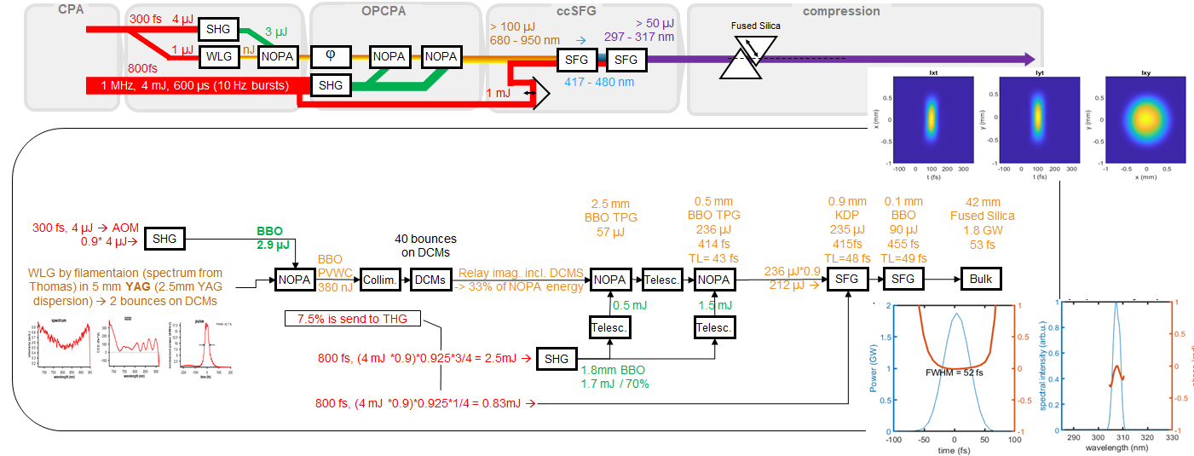
Start-to-end simulation
FLASH2020 FLASH1 seeding laser – including all second-order nonlinear conversion stages
3+1 dimensional simulation building blocks (chi3D)

