Slide 1
T20
Stuart Walker
MXL
DESY
12/11/2021

Slide 2
Overview
SASE2
Beamline has been frozen.
The beam parameters at the IP
Spot size
Beam energy
Beam emittance
Beam length
Short mention of instrumentation
dogleg
KL
BZ
SASE1

Slide 3
Beam parameters at the IP

Slide 4
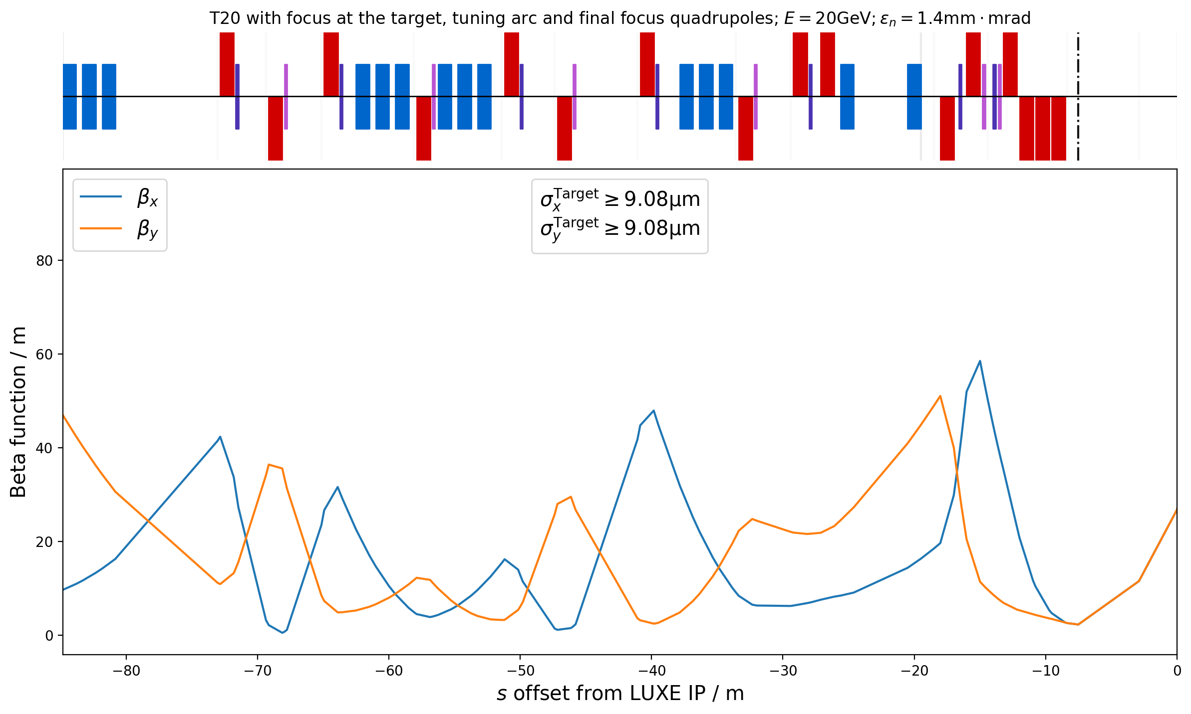
Optics (Spot size)
CDR Value: 5µm!!!
Assuming an emittance of at least 1.4mm•mrad at the IP:
Beam size is at least 9µm in size at the target/IP with these optics
Final focus system: 6 XQH quads, 4 making up the inner triplet.

Slide 5
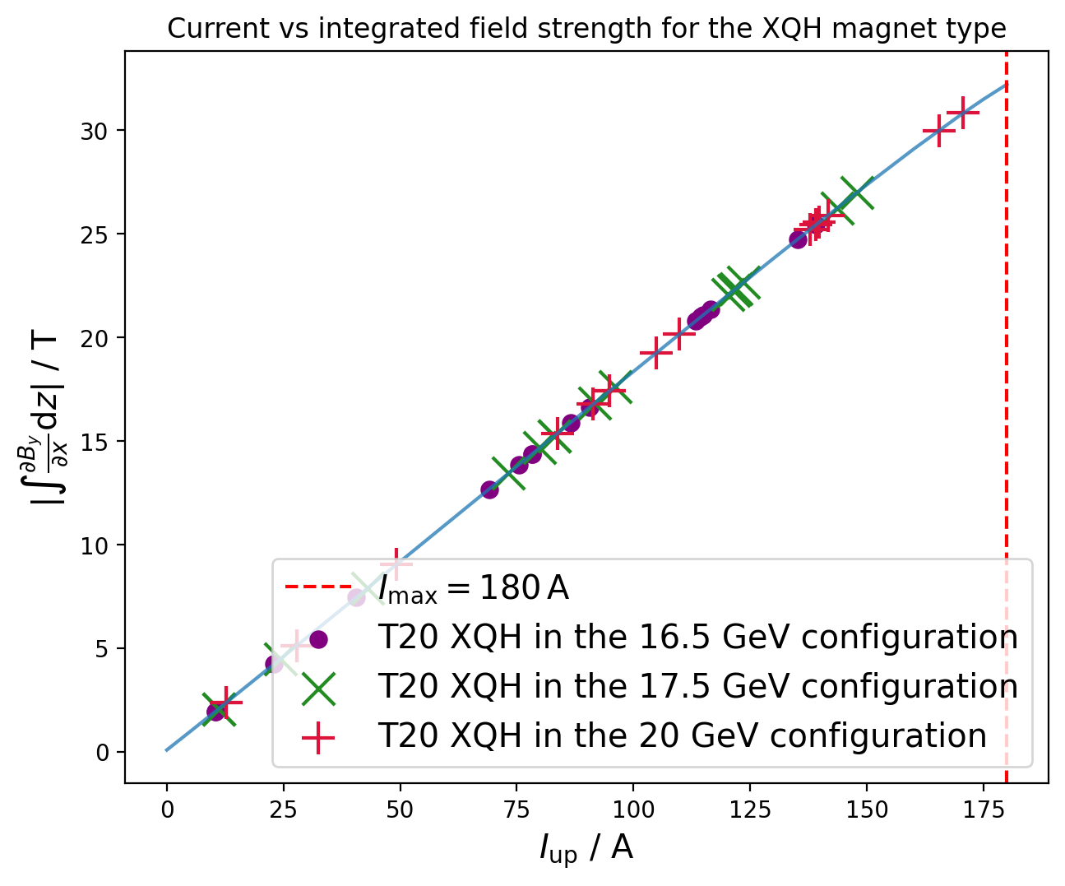
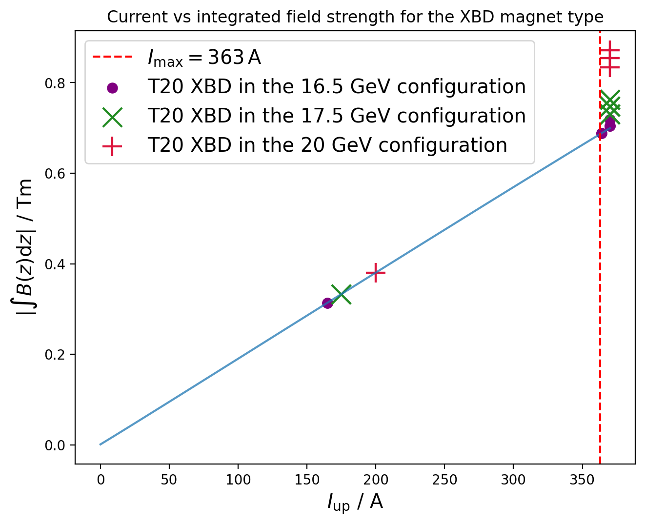
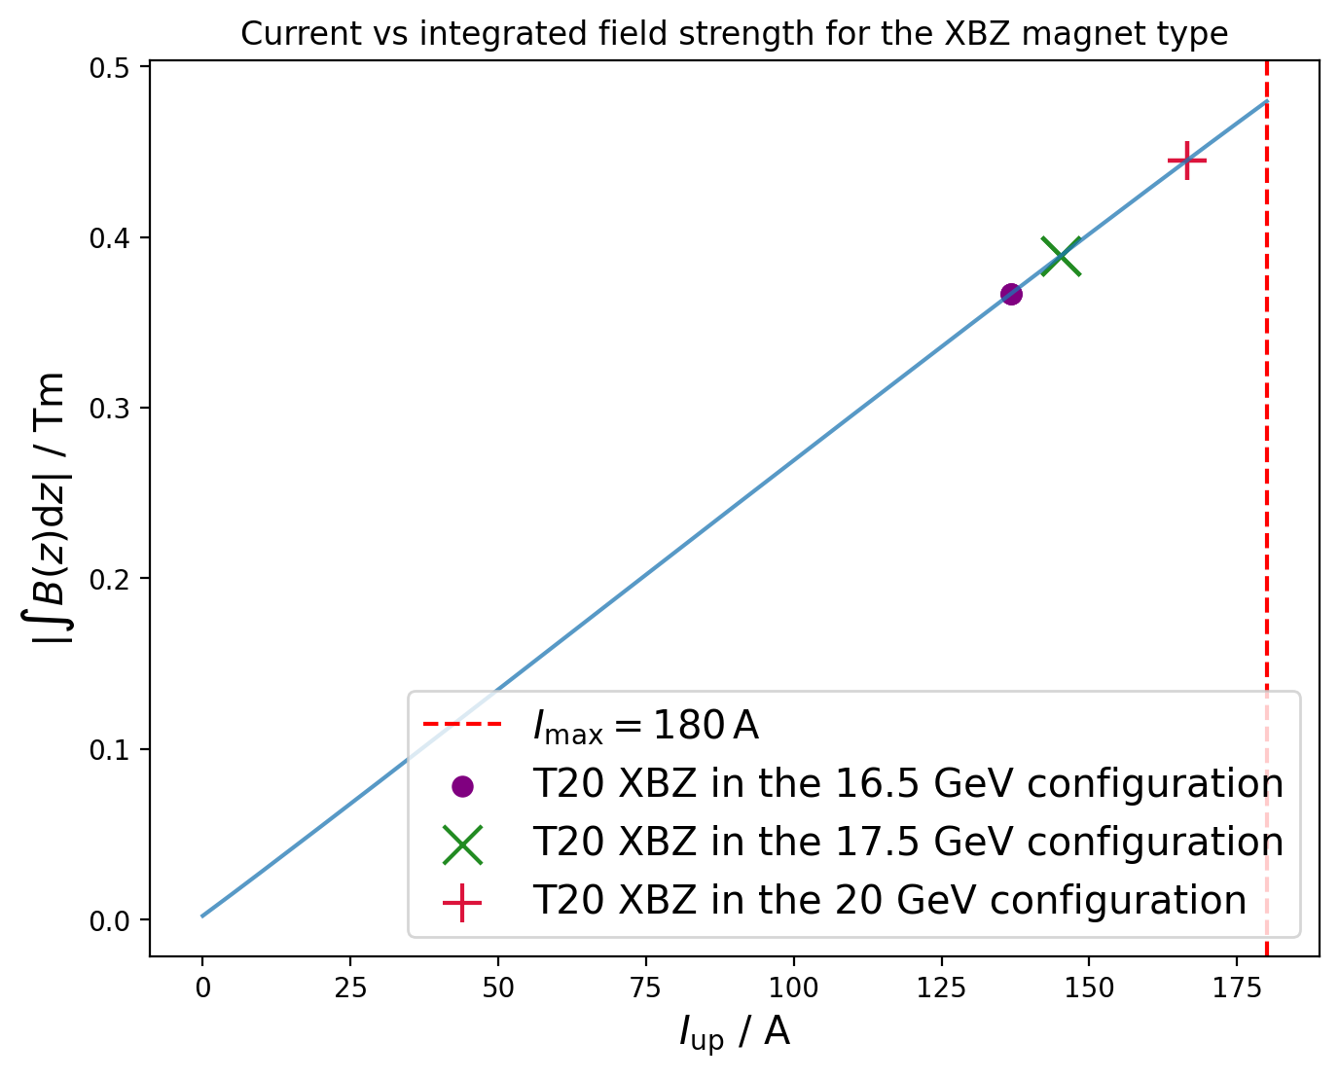
Beam energy
For the bending and focusing magnets employed in the lattice:
Going to 20GeV is no problem
Except in XBD → slightly beyond the design current

Slide 6
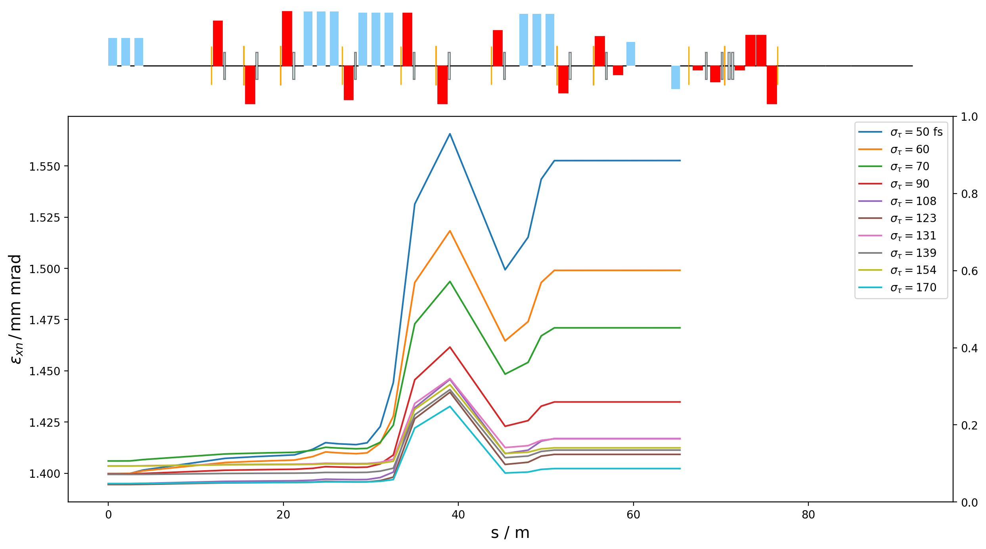
Beam emittance
30µm
The question: what sort of emittance is transferred to the target/IP?
TDR assumes bunch lengths of 30-50µm, and emittance of 1.4mm•mrad.
Shorter bunch lengths will have worse emittances at the IP.
50µm
Even assuming 1.4mm•mrad in the switchyard (very pessimistic), the worst case scenario:
Emittance goes to 1.55mm•mrad -> Increase in the spotsize by 3%.
In reality the emittance in the switchyard will tend to be <1mm•mrad

Slide 7
The beam length and the beam for the undulators
Compressed beam for undulators in the switchyard (just before LUXE).
Very non-Gaussian
But, notably :
projected emittances << 1.4mm•mrad.
Beam size << (30-50)µm
For this reason: beam in IP should be quite achievable, even if we have assumed 10µm.
Needed: less compression for LUXE.

Slide 8
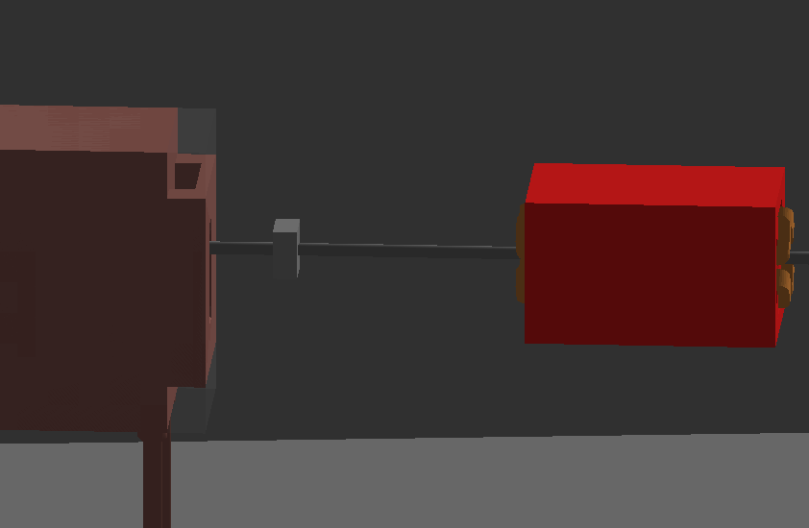
The gap between the last quadrupole and the beamline
(Target) not yet designed!!
And will take up
some of this space.
Should shrink?
Should be room for wirescanner
(~1µm resolution for long bunch trains)
and a
Beam position monitor ((2-3)µm resolution)
1m
Last quad ends 8.5m upstream of the IP

Slide 9
Summary / Conclusion
Except for the spotsize, the beam parameters at the IP are all achieved with the current design.
However a spotsize of 10µm has been agreed upon as fine for LUXE.
Essentially relaxed to make more room for the experiment / instrumentation.
However possibly 5µm still achievable as an emittance fo 1.4mm•mrad at the IP is probably pessimistic.
Todo: start (gun) to end (LUXE) simulations to confirm the expected emittance, spot size and beam distributions at the IP.
Still needs discussion about where the post-beamline instrumentation is located.
Propose using some of the space before the target for this purpose.
Beamline fitting (maybe see next talk…)

