Slide 1
ANGELOTTI/TOSCA STATUS UPDATE
TP 1: Energieeffiziente Nb₃Sn-Kavität auf Kupferbasis

Slide 2
Roadmap: ANGELOTTI
Nr. | Deadline (Quarter/year) | Description Milestone
1 | 04/2021 | Preconditioning of carrier material
2 | 02/2022 | Process optimization for copper
3 | 04/2022 | Coating of antenna and QPR cups
4 | 02/2023 | Construction of cavity sputtering system finished
5 | 03/2023 | Preconditioning of copper cavity
6 | 04/2023 | Coating of copper cavity
7 | 01/2024 | Evaluation of Nb₃Sn copper cavity
8 | 02/2024 | Documentation and publication of results

Slide 3
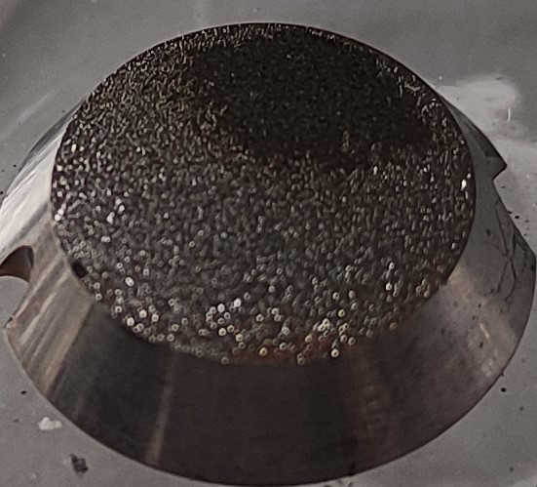
Preconditioning of carrier material
Electropolishing
Cu

Slide 4
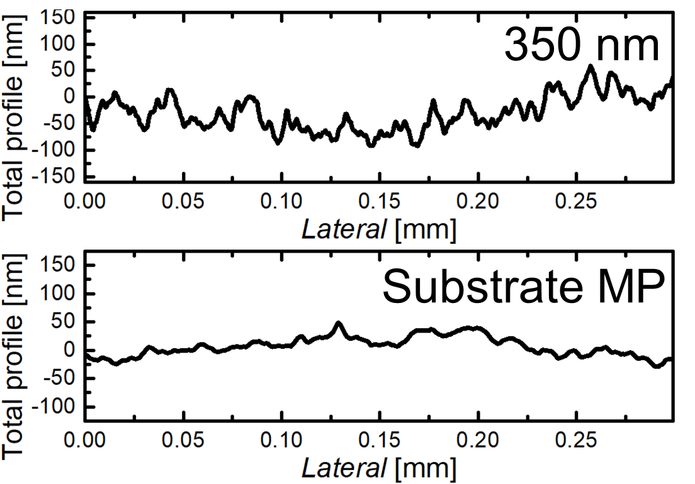
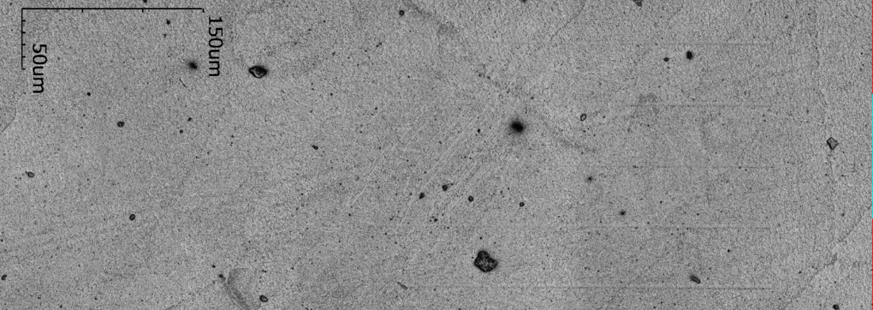
Preconditioning of carrier material

Slide 5
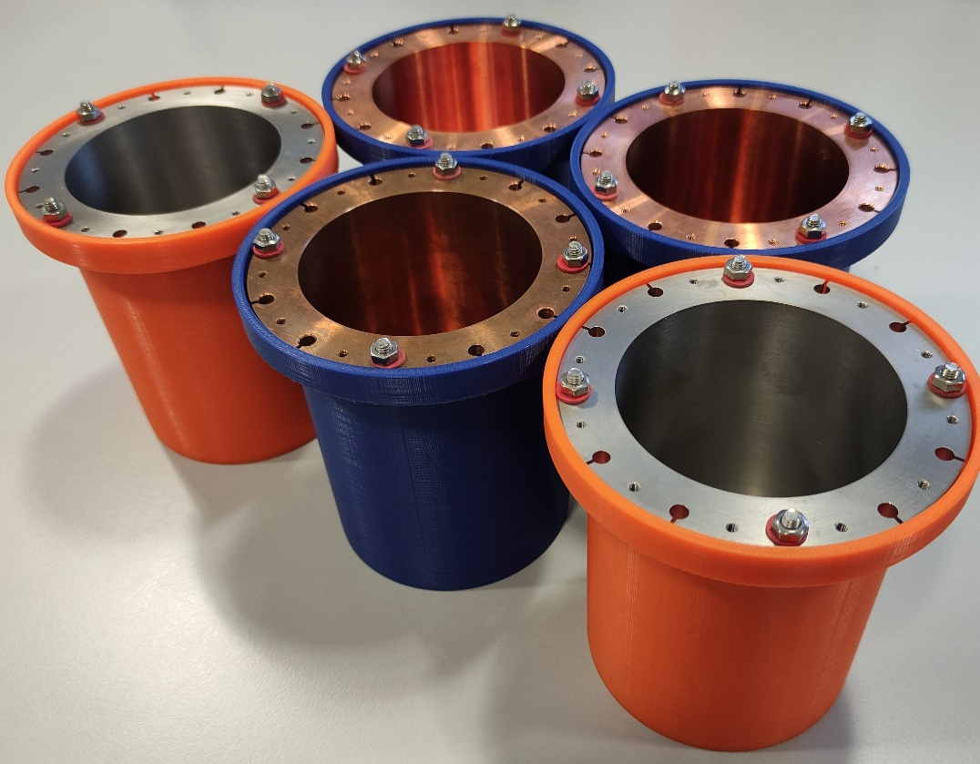
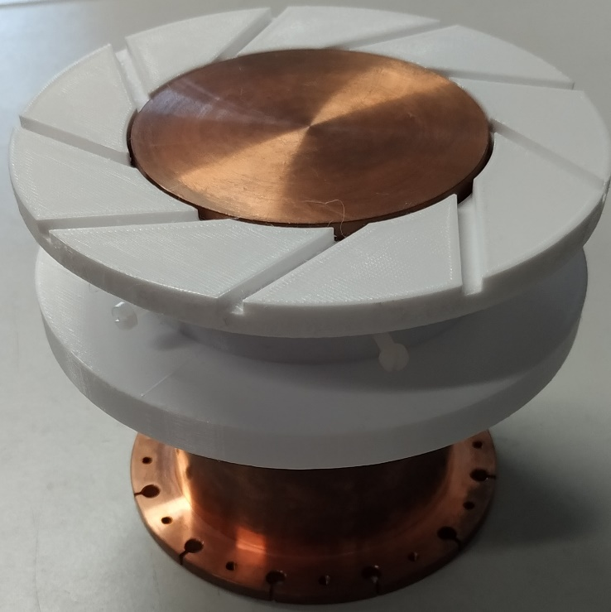
Coating of antenna and QPR cups

Slide 6
Construction of cavity sputtering system
Vacuum pump
+ -
~
Water
reservoir
Ar

Slide 7
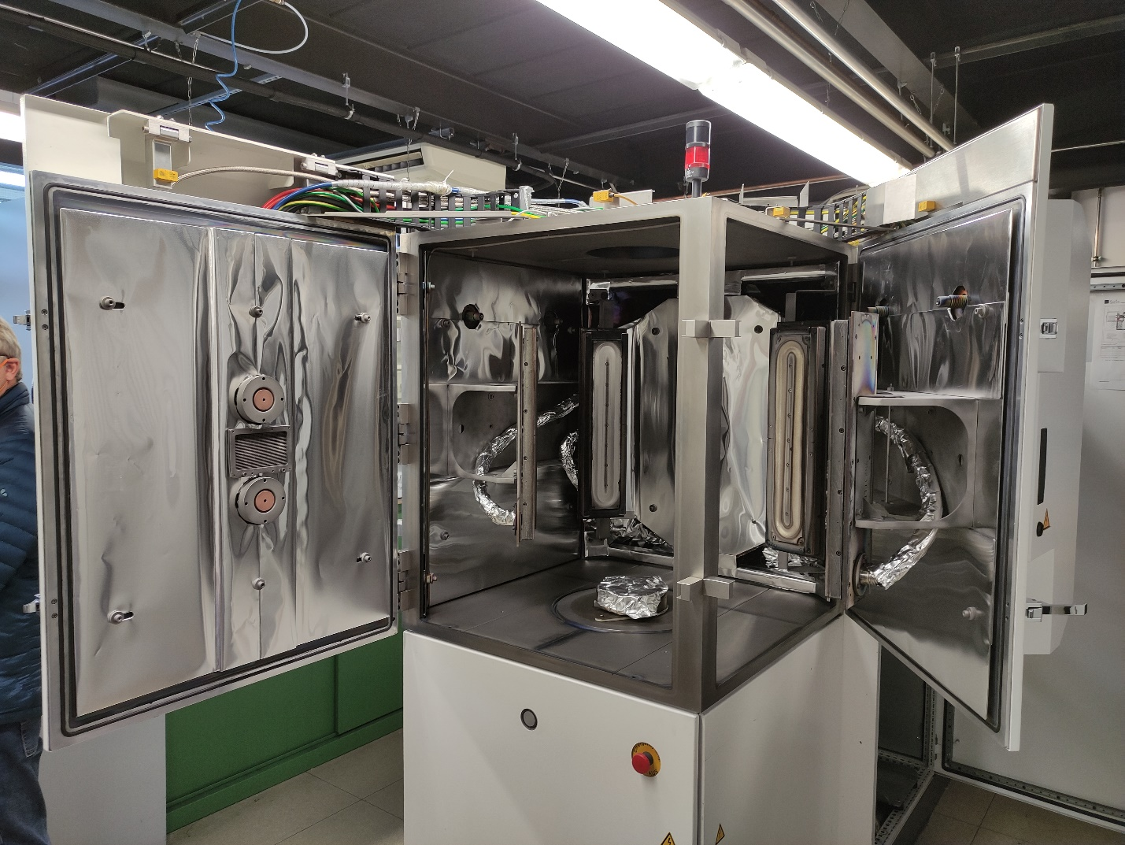
Construction of cavity sputtering system

Slide 8
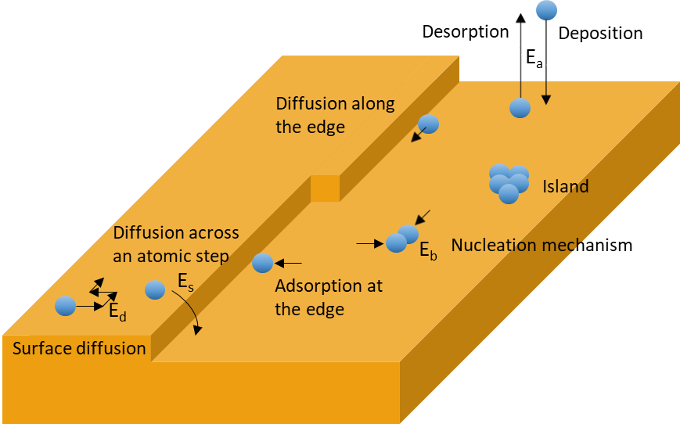
Construction of cavity sputtering system
Parameters
Dimensions
Pressure
El. field
Glow discharge Plasma
DC-MC
PIC-MC
Thin film growth modelling
Plasma distribution
Particle movement
Thin morphology

