Slide 1

SIS sample studies
I. Gonzales, G. Deyu, M. Wenskat, R. Zierold, W. Hillert
14.1.2022
6th SMART Collaboration Meeting

Slide 2
Our current best results for SIS
Si-samples coated with 15 / 25 nm of AlN / NbTiN
New post-processing recipe achieves a T_{c} of 15.4K
[I. Gonzales, et al. “ALD-Based NbTiN Studies for SIS R&D“, SRF21]

Slide 3
SIS sample studies (last ~6 months)
On behalf of I. Gonzales – she does all the work
Why does the RTA, and even more so the “slow-annealing”, improve T_{c}?
Method | What do we obtain | Samples | Status
PALS | Density and type of vacancies & their chemical loading – depth profile | Coated Nb | Done – analysis ongoing
SIMS | Concentrations – depth profile | Coated Si | Done – analysis ongoing
XRR | Amount of layers & their thickness, electron density (aka what material) | Coated Si | Done – analysis ongoing
XRD | Lattice properties, e.g. constants, and interstititals | Coated Si | Done – analysis ongoing
SEM/EDX/EBSD | Surface topography, „near-surface“ elemental composition, check of crystallinity | Coated Si & Nb | Currently done „again“
XPS | Elemental composition & chemical state | Coated Nb | Next

Slide 4
Reminder Trapped Flux
Pinning sites
$y$
[M. Checchin, et al. “Trapped-flux Surface Resistance at High Gradients“, LCWS2019]
$x$
$T_{c}$
Trapped vortices
Thermal gradient,
$R_{flux}=S∙η∙B_{ext}=S∙\left(1−ε\right)∙B_{ext}$
Pinning sites are material imperfections or defects e.g.:
Inclusion (normal-conducting, dielectric)
Grain boundaries
Dislocations / vacancies
Local disorder
η is the flux trapping efficiency
ε is the flux expulsion efficiency
S is the flux sensitiviy [nΩ/mG]
B_{ext} is the applied magnetic field

Slide 5
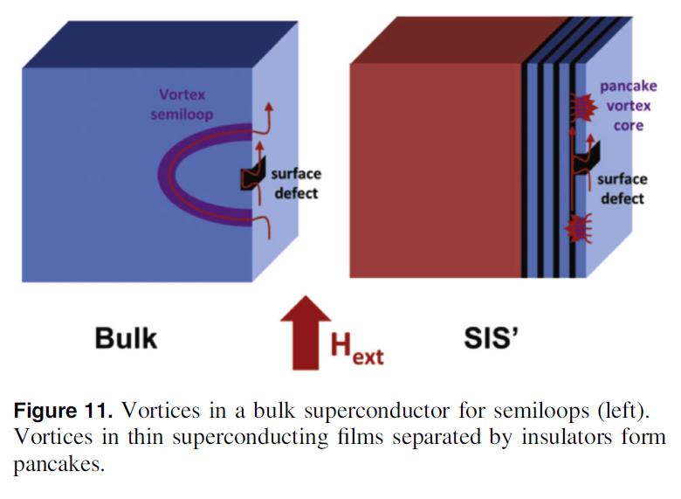
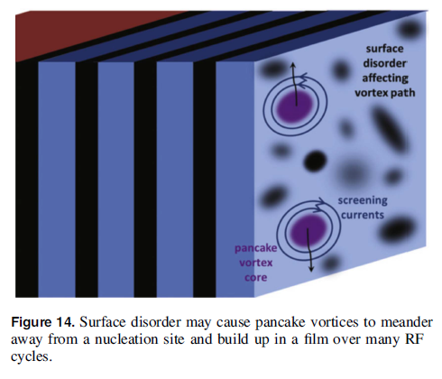
Why should SIS be more prone for trapped flux?
[D. Liarte, et al. "Theoretical estimates of maximum fields in superconducting resonant radio frequency cavities: stability theory, disorder, and laminates." Superconductor science and technology 30.3 (2017): 033002.]

Slide 6
Temperature behaviour of: ARIES 1st sis
 | SIS films tested | Structure | Base test? | Produced by
ARIES 1st SIS | NbN – AlN – Nb(film)/Cu | 197nm – 35 nm – 3 µm Nb | Yes | Siegen
Interesting results are obtained after 2nd Cooldown of same sample:
Measurement results for Q1 ~ 415 MHz
Pre-conditions
Warmup after 1st test Sample was stored in the cavity under nitrogen/air Test break: 4 month
[D. Tikhonov et al. "INVESTIGATION OF SIS MULTILAYER FILMS AT HZB." 9th International Workshop on Thin Films and New Ideas for Pushing the Limits of RF Superconductivity]
Peak has shifted
After a shift observed, a VTS thermocycle (>25K) was done to check is peaks are due to trapped flux
Disclaimer: lines added for visual effect, and not a fit; errorbars coming from the thermal behavior of He system/cavity/heater, and come from statistical average
<number>

Slide 7
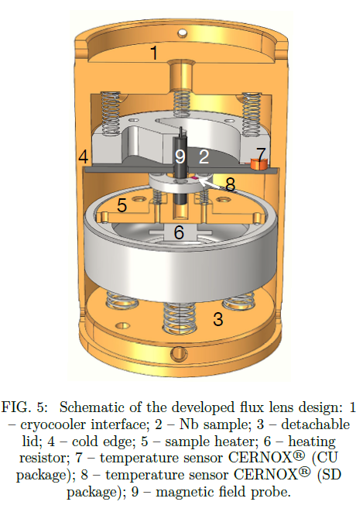
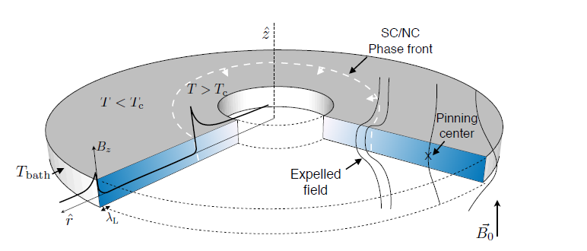
Magnetic Flux Lens @ CERN
90 mm diameter disc
Center hole >6mm for Fluxgate
Thermal contact from bottom – indium gasket is pressed against sample
Relative measurement
[A. Ivanov, et al. "Partial Meissner effect measurement by a superconducting magnetic flux lens." arXiv preprint arXiv:2103.06697 (2021).

Slide 8
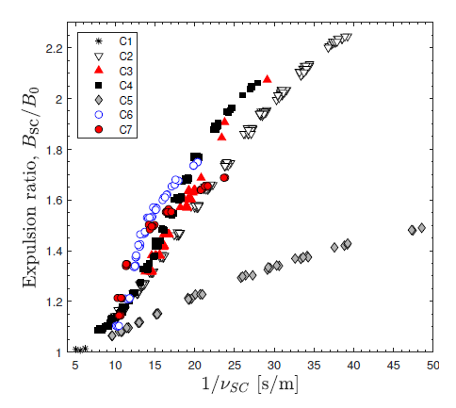
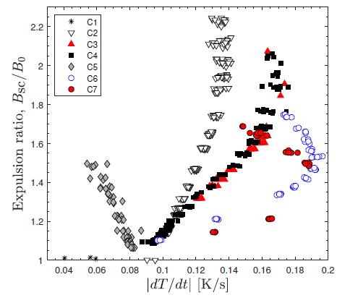
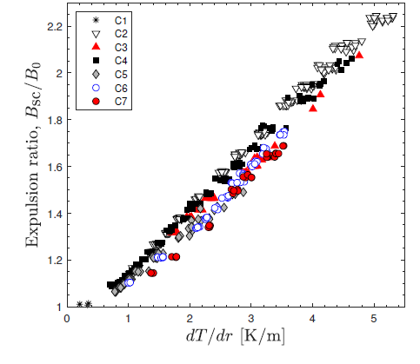
Exemplary results: Expulsion ratio measurement
as a function of the inverse speed of the SC front
as a function of the cooling rate.
as a function of the spatial temperature gradient.
[A. Ivanov, et al. "Partial Meissner effect measurement by a superconducting magnetic flux lens." arXiv preprint arXiv:2103.06697 (2021).

Slide 9
Suggested samples
Material: Nb, fine grain Tokyo Denkai RRR308
Geometry: d=90mm,h=2.8mm
Campaign 1: Jan. ‘22
1.1 BCP+800°C anneal+BCP
2.1 BCP+800°C anneal+BCP + NbTiN (as deposited)
3.1 BCP+800°C anneal+BCP + AlN/NbTiN (as deposited)
4.1 BCP+800°C anneal+BCP + AlN/NbN (as deposited)
1.2 BCP+800°C anneal+BCP + AlN/NbTiN + Annealing
2.2 BCP+800°C anneal+BCP + NbTiN + Annealing
3.2 BCP+800°C anneal+BCP + AlN/NbTiN + Annealing
4.2 BCP+800°C anneal+BCP + AlN/NbN + Annealing
Send back to Hamburg
Campaign 2: Q2/3 ’22

Slide 10
Questions under consideration
Expulsion efficiency
  of FG BCP sample (S1.1)
  modification by +1 NbTiN layer (S2.1 v S1.1)
  modification by +1 insulating layer (S3.1 v S2.1)
  comparison NbN / NbTiN (S3.1 v S4.1)
Does annealling alter expulsion? (SX.2 v SX.1)
Direct comparison before/after coating (S1.1 v S1.2)
Comparability within the samples (S1.2 v 3.2)

