Slide 1
Kyle’s beam results

Slide 2
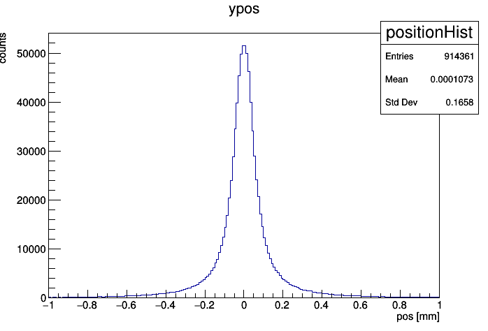
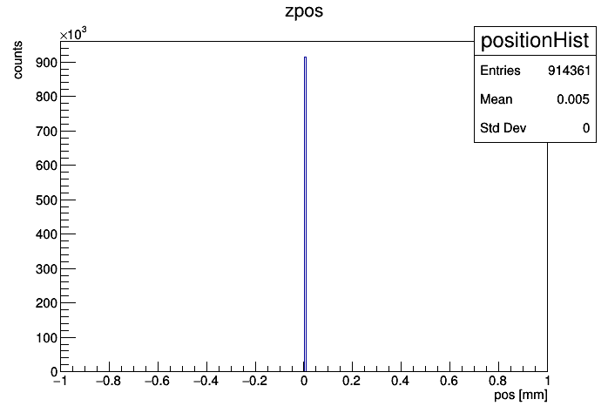
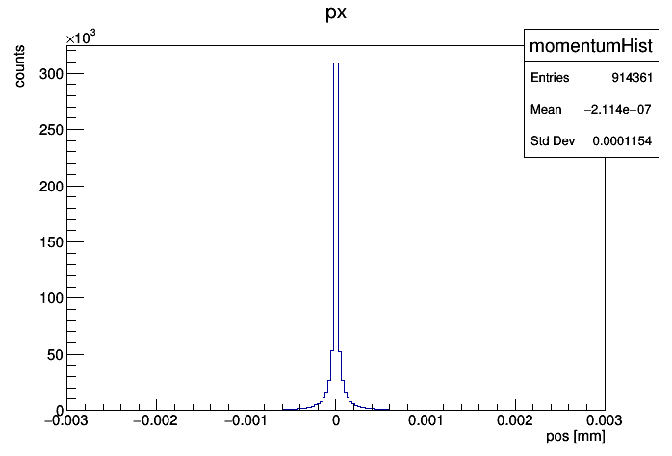
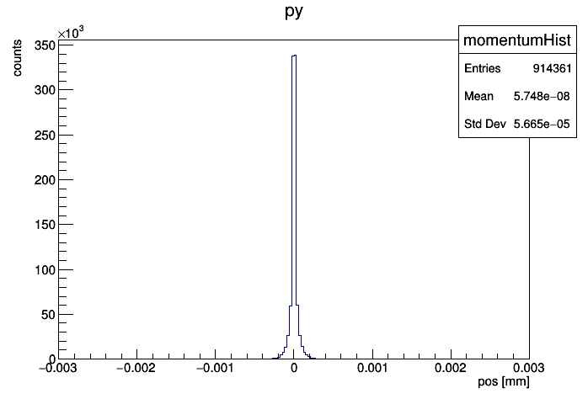
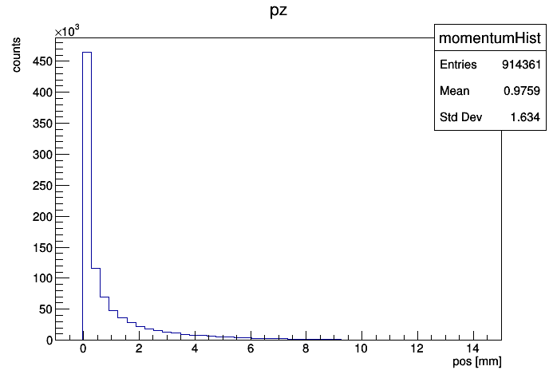
Kyle’s beam properties ptarmigan_5.0_0_tracks

Slide 3
Units
The units of the ptarmigan file are those reported in the analysis macro file (see the right panel):
distance in cm
energy in GeV
The default units from the geant4 simulation are different:
distance in mm
energy in MeV
The units of the monitor histogram are
distance in mm
momentum in GeV/c
energy in GeV (to be eliminated)
/**********************************************************************
* ****************************************************************** *
* ROOT macro to analyse the distribution on the gamma profiler for *
* different values of xi. Results come from FLUKA simulations using *
* the linearly polarised Ptarmigan MC data. *
* *
* All distances are in cm, energies in GeV and angles in radians. *
* ****************************************************************** *
**********************************************************************

Slide 4
Tree data ptarmigan_5.0_0_tracks
Position [mm?]
xpos_min: -0.999884 xpos_max: 1
ypos_min: -0.99991 ypos_max: 0.999934
zpos_min: 0 zpos_max: 0
Momentum [arbitrary units]
px_min: -0.0191829 px_max: 0.00957282
py_min: -0.00872869 py_max: 0.00913132
pz_min: -0.000675423 pz_max: 14.5973
Energy [GeV]
energy_min: 0 energy_max: 14.5973
The z position distribution is monochromatic with mean value at 0.
The gun position is set as the sum of a custom center position and these distributions. This way one can set the center distribution to hit a specific strip, or not.
The momentum distribution along z has some has some negative component, meaning that part of these particles are going in the opposite direction with respect to the GBP
Particle distribution in the tree is as follows:
What particles?
How many in the central part of the distribution?
What is their energy?

Slide 5
Generating random numbers with arbitrary distributions
It is possible that x,y,z-components of the position vector are correlated with the x,y,z-components of the momentum vector. Also, one has to capture energy correlations as well.
It is better to cut out some of the features of the pos/momentum distributions. This because the resolution of the simulated beam distribution depends over bin size of the input histograms. In particular this procedure applies to the tails of the distributions. The cut is performed by removing no more than 5% of the particles, excluding about x % of the total energy deposited by killing particles with this energy spectrum:
Graph here
Energy and momentum are related by mass-shell. The PDG code gives me the particle type

Slide 6
Generating random numbers with arbitrary distributions
Ptarmigan \xi = 5 w0= 0
In fact, position and momentum are correlated as one may appreciate by looking at the 3d scatter plot posX vs posY vs energy
Simulated beam without correlations
-> 4*10^12 bytes
-> 4*10^6 bytes

Slide 7
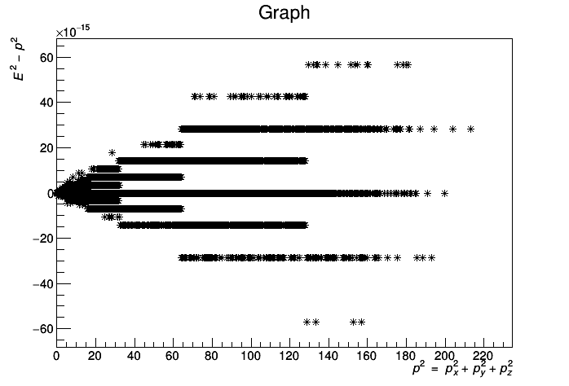
Mass-shell
It appears that momentum components satisfy the mass-shell up to \sim 1e-15. This is perfectly fine since double precision is up to 15 digits…
Photons

Slide 8
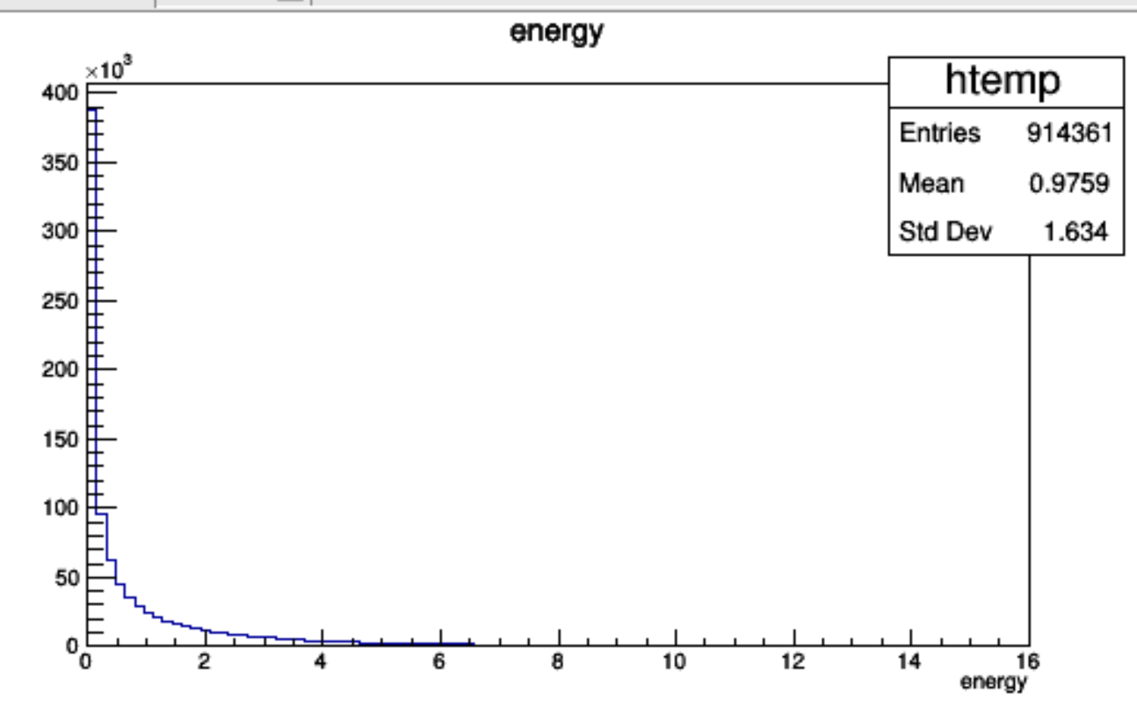
energy
The energy values are in GeV

Slide 9
Is this true?
For what laser polarisation is this holding? Linear.
First let us verify the energy spectrum, partition the beam into a low energy and high energy part using the mean and rms. Then select high energy events and inspect for the “central” component – after understanding what does ‘central’ means. I’ve verified. It is satisfied with RMS.
Also it is necessary to verify also that \sigma_y does not change.

Slide 10
What is the detector accuracy in measuring \xi, intensity?
Input distributions
Ptarmigan distribution at the Kapton window is contained in a Ttree.
Some distribution, e.g. let us say xpos, is given to Geant4 as an input with an histogram.
How to bin the input distributions?
Text here

Slide 11
MC weights
The MC weight is the same for every particle (1500). It has no sense to weight the points in the xpos, …, pz distributions with 1500 because I am interested in the shape of the distr. which is unaffected by the scaling by any factor.

Slide 12
Uncorrelated distr. results

Slide 13
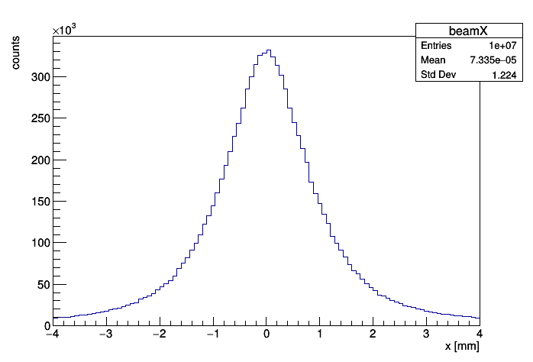
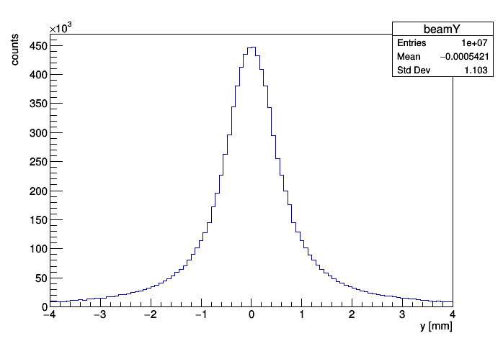
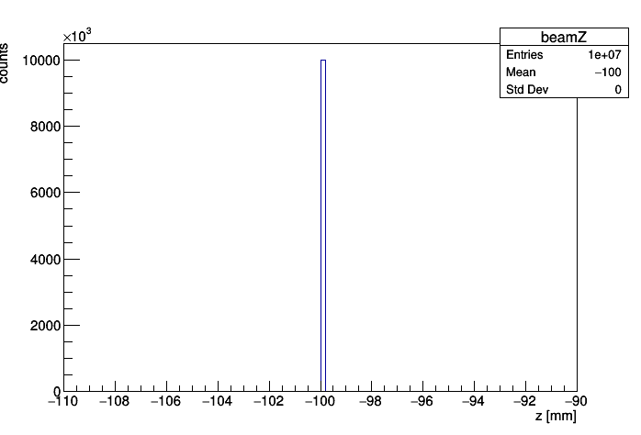
Primaries
Beam monitor
Issues

Slide 14
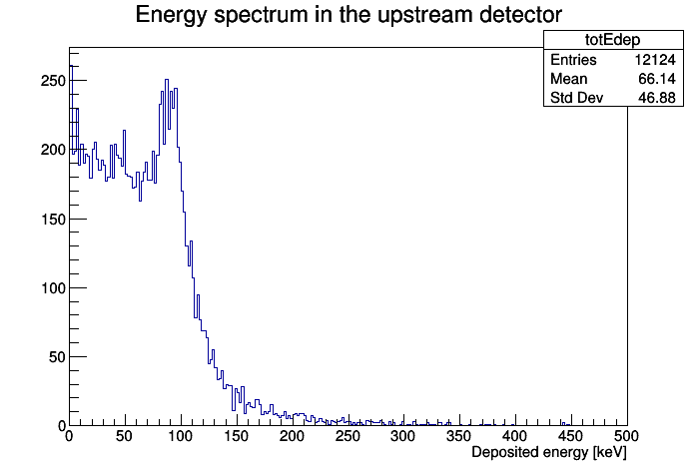
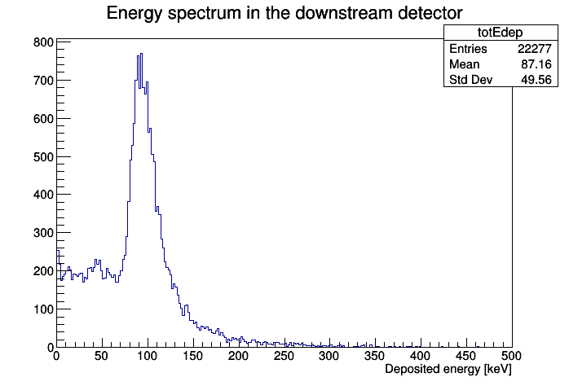
Energy deposited at comparison - \xi = 5
Detector: upstream
Total energy deposit is: 0.802283 GeV
Total absorbed dose is: 0.000122155 Gy (2.64695e+08 um3)
Peak dose is: 0.000111157 Gy (2758.08 KeV in 1e+06 um3)
----------------BX--------------------
Total energy deposit/BX is: 80.2283 GeV
Total absorbed dose/BX is: 0.0122155 Gy (2.64695e+08 um3)
Peak dose/BX is: 0.0111157 Gy (275808 KeV in 1e+06 um3)
peak position (mesh center): 0.25, -0.15 mm
Detector: downstream
Total energy deposit is: 1.94666 GeV
Total absorbed dose is: 0.000296397 Gy (2.64695e+08 um3)
Peak dose is: 0.000224217 Gy (5563.39 KeV in 1e+06 um3)
----------------BX--------------------
Total energy deposit/BX is: 194.666 GeV
Total absorbed dose/BX is: 0.0296397 Gy (2.64695e+08 um3)
Peak dose/BX is: 0.0224217 Gy (556339 KeV in 1e+06 um3)
peak position (mesh center): 0.15, 0.05 mm

Slide 15
Performances - \xi = 5

