Slide 1
Gamma Group Meeting
News
Status talk Tobias Kleiner (PhD VERITAS / CTA)
‘Social’ check-out in breakout rooms

Slide 2
News
Gamma group get-together tomorrow
https://confluence.desy.de/display/DESYAstroparticle/Gamma+Group+Get-together+December+2021
16:00 to 18:00 at the lake, access via Villa Seminar Room please
Mulled wine, fresh ginger-lemon tea, sweets
If snowing then we use the wooden hut for the drinks / sweets
Goodbye to Johannes and Ralf
Volunteers
Team Fire: Dan, Stefan, Shashank; barrel in the boat hut, ”Spiritus” too, need lighter, I’m still checking the wood; meet at 15:00?
Team Drinks: meet me at 15:00 at Canteen, need 2-3 helpers, please write down your names on conflu page
APC 6 report

Slide 3
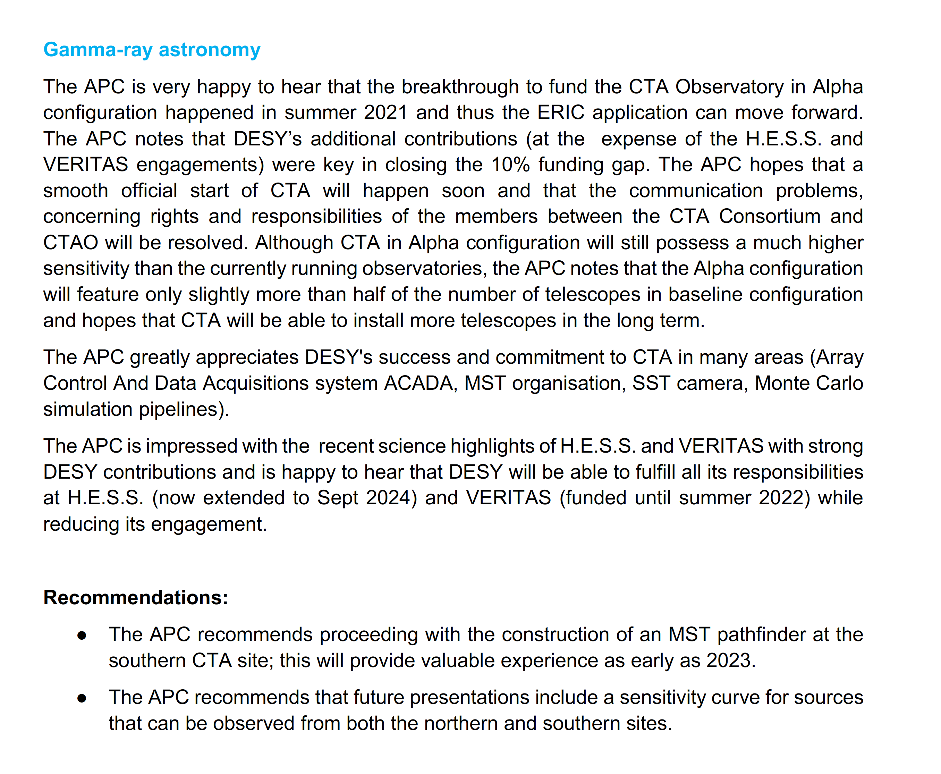

Slide 4
