Slide 1
Fundamental Science in Germany
01 April 2022, R-ECFA visit to Germany Dr. Volkmar Dietz, Large Facilities and Basic Research, BMBF

Slide 2
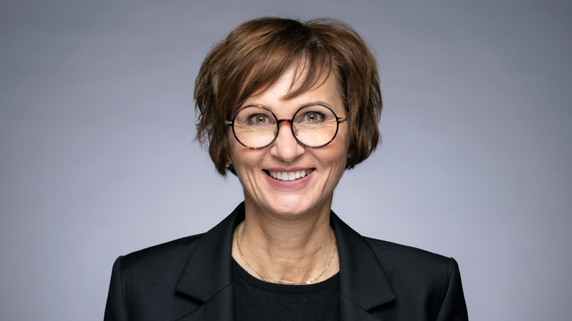
Federal Ministry of Education and Research
Federal Minister
Bettina Stark-Watzinger
7
Provision for the Future – Basic Research
and Research for Sustainable Development
Z
Central Services
1
Policy Issues and Strate-gies
2
Euro-pean and Inter-national Coope-ration
3
General Education and Vocational Training
4
Higher Edu-cation and Research System
5
Research for Techno-logical Sovereignty and Inno-vation
6
Life Sciences
71
Large Facilities and Basic Research
72
Sustainability; Provision for the Future

Slide 3
Fundamental Research in Germany
Gaining knowledge as a cultural value in itself. How does the universe develop? Where do we come from?
Key innovations always start in fundamental science! We don't want to run out of ideas for innovations in the medium term.
Germany wants to be a key player in the top league of fundamental research worldwide!
Fundamental science as a unique opportunity for training and education of young people.

Slide 4
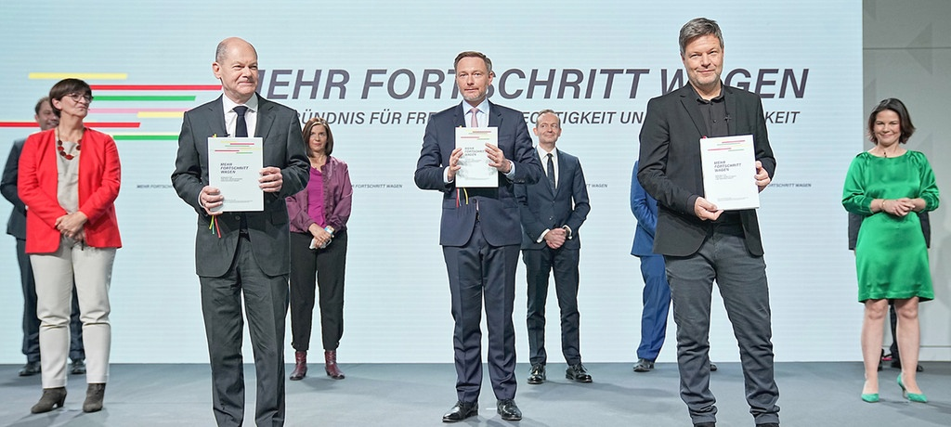
20th Legislation Period
The coalition agreement comprises a clear commitment to support:
Strong research policy
Free, curiosity-driven fundamental research
Future-oriented large infrastructures
Bold research project ideas
Emphasis placed on innovation and transfer

Slide 5
Supporting Research and Development
Goal: 3.5 % of GDP investment for research and development by 2025
2019 Germany invested 3.19 % of GDP for R&D (3rd time in a row more than 3 % of GDP)
Federal spending on research and development increased from 9.0 billion € in 2005 to 18.7 billion € in 2019
Tax incentives for research started in 2020 to support SMEs
Innovation agency “SPRIND” and “DATI” (in the future)

Slide 6
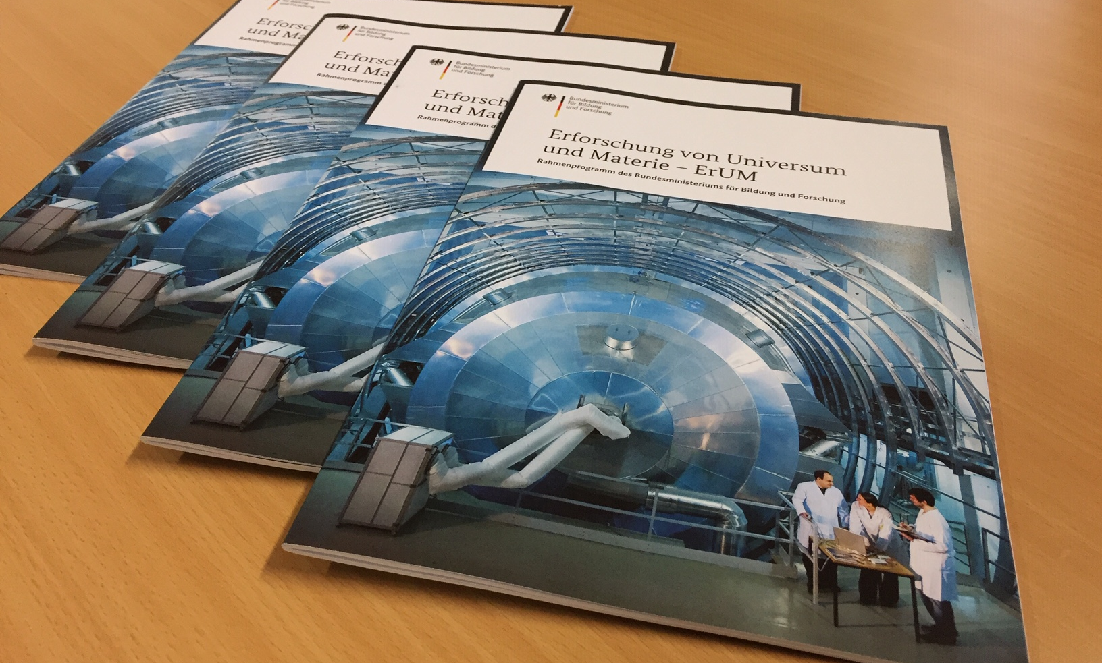
ErUM: Exploration of the Universe and Matter
Strategic and thematic framework
of the Federal Ministry of Education and Research
for basic research at large-scale facilities
Timeframe
2017 bis 2027
Budget
in total about 1.5 billion € funding per year including ca. 350 Mio. € per year project funding

Slide 7
ErUM Topics
Particles
Matter
Universe
Wide range of research fields
Call for proposals for each of the three fields every three years

Slide 8
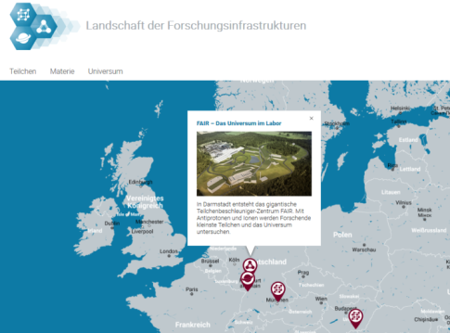
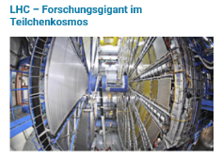
Research Infrastructures (RIs)
ErUM focuses on fundamental research in the natural sciences with large-scale facilities
Germany is home to several RIs of global significance and involved in more than two dozen unique large-scale devices worldwide
RIs are implemented by science organizations (mainly by research centers of the Helmholtz association)
BMBF funding according to scientific needs and research policy in order to shape the landscape of RIs
www.fis-landschaft.de

Slide 9
Instruments for Funding
Institutional funding: jointly by federal and state governments for non-university research centers as well as the DFG and contributions to international research infrastructures
Contributing to planning and construction of national and international research infrastructures
Project funding ErUM-Pro (“collaborative research”)
Shaping the landscape of large scale research facilities
Institutional funding / contributions
Planning and construction of large scale facilities
Project funding ErUM-Pro

Slide 10
Action Plans
Action plans
ErUM-Pro
Published in 2018
ErUM-Data
Published in 2020
ErUM-Transfer
In preparation
Fields of action
Key objectives

Slide 11
Action Plan: ErUM-Pro
Goals
Enable excellent research
Address future needs
Keep RIs at the leading edge
Ensure Germany´s position in science and economy
Unique project funding
Connecting universities and RIs and involving universities in the development of new methods and instruments for use at RIs

Slide 12
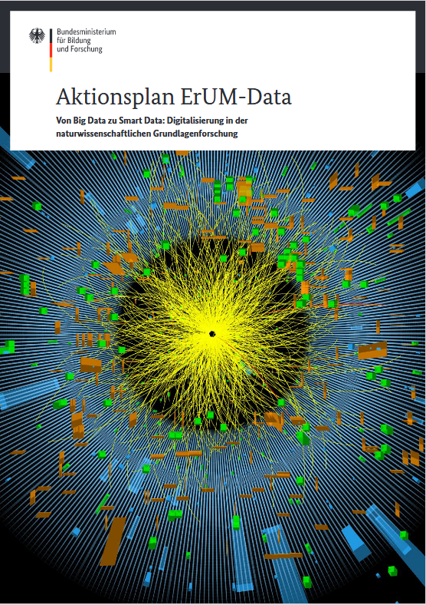
Action Plan: ErUM-Data
Key factors for digital transformation:
Efficient data management
→ Building a network between relevant actors and structures regarding digitalization
Data processing
→ Enhancing digital competencies in science
Open and easy data access
→ Strengthening transfer and communication - in ErUM and beyond ErUM

Slide 13
Action Plan: ErUM-Transfer
Contribution of fundamental research to great challenges. Making better use of the potential of fundamental science for economy / society
“Great challenges” put pressure on fundamental research in competition for funding resources
To secure the budgets:
Increase the visibility of fundamental research at large-scale facilities
Communicate the need for fundamental research at large-scale facilities
Support transfer activities
→ Creation of a new action plan
Concept
Preserve the character of fundamental research
Promote transfer in society and the economy through specific measures: Address needs and close existing "gaps"
Current status
Involvement of relevant stakeholders from science, economy, politics

Slide 14
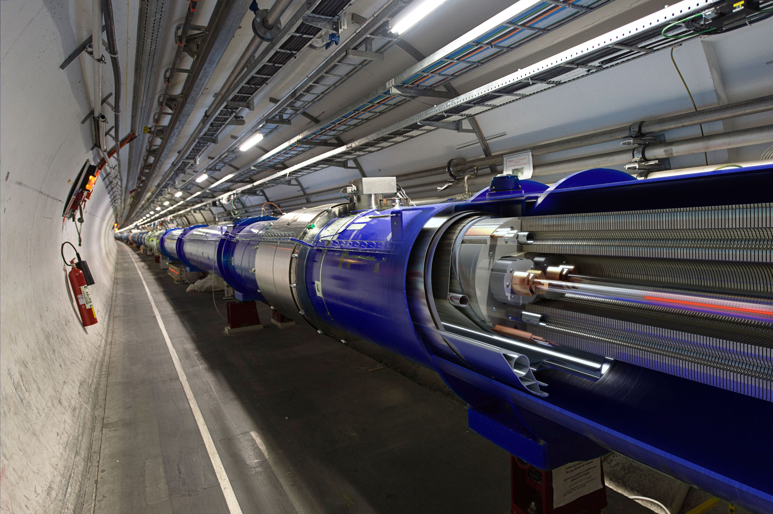
ErUM-Topic “Particles”
Includes
Elementary particle physics
Hadron physics
Nuclear physics
© CERN

Slide 15
Field “Particles” – Funding tools
Institutional funding: DESY, GSI, KIT, MPG
Membership fees: CERN
Construction of the FAIR accelerator complex
Phase-II-Upgrades of ATLAS and CMS
Project funding ErUM-Pro, focus on:
Service and upgrade of the LHC-Experiments
Construction of the FAIR pillars
Cross-cutting activities
Institutional funding
Shaping the landscape of large-scale research facilities
Planning and construction of large-scale RI
Project funding ErUM-Pro

Slide 16
Field “Particles” – Main focus
Funding period
2021-2024
status January 2022

Slide 17
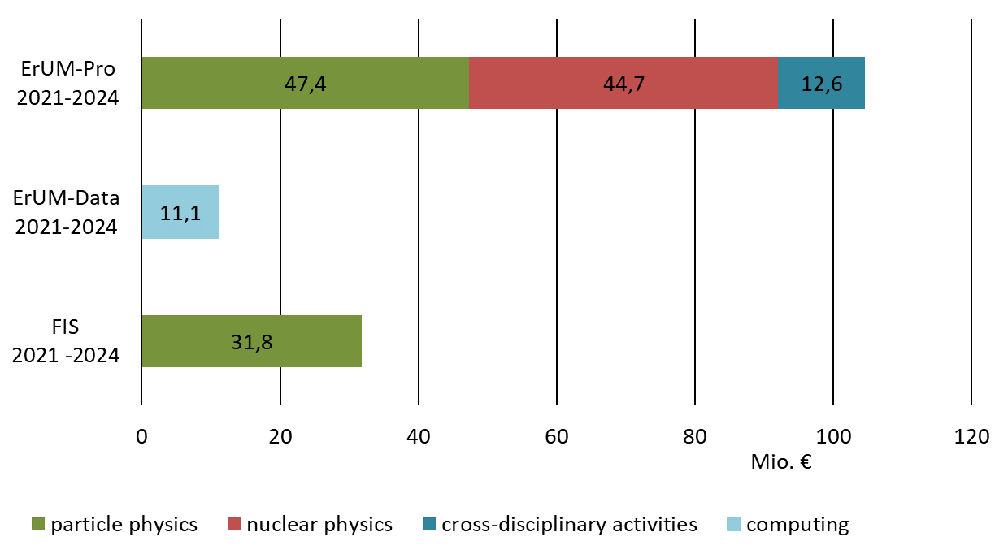
Priorities in the ErUM field “Particles”
Project funding ErUM-Pro
116 Mio. €
Project funding ErUM-Data
Planning and construction of large-scale RI
32 Mio. €
(Phase-II-Upgrade)
total:
148 Mio. €
status March 2022

Slide 18
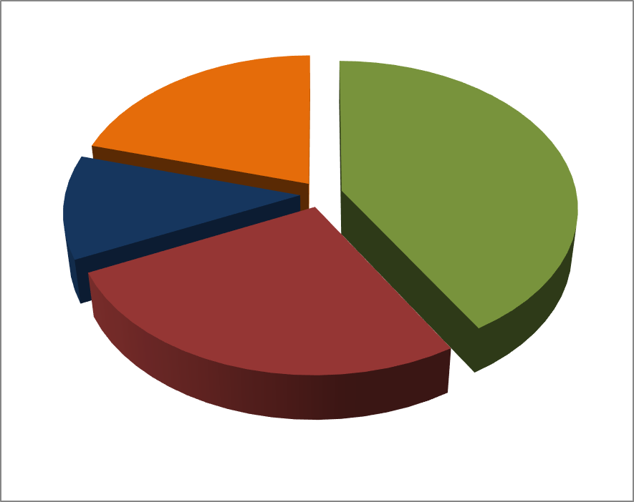
Current Priorities ErUM Field “Particles” 2021-2024
Project funding ErUM-Pro
Project funding ErUM-Data
cross-disciplinary activities 20%
total:
116 Mio. €
other experiments 11%
LHC experiments 42%
FAIR experiments 27%
status March 2022

Slide 19
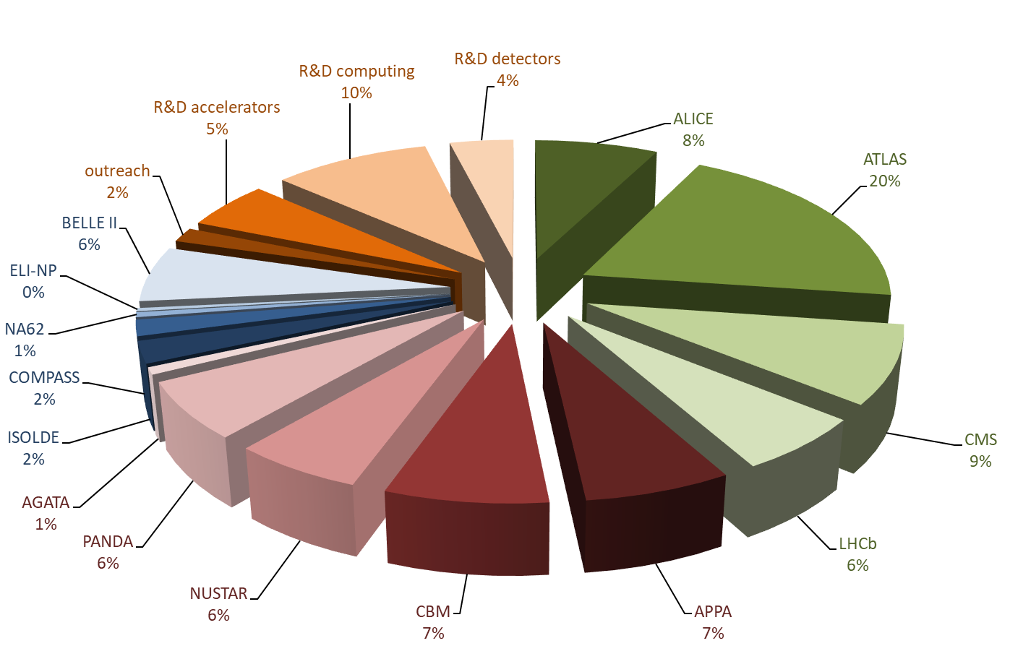
Current Priorities ErUM Field „Particles“ 2021-2024
Project funding ErUM-Pro
Project funding ErUM-Data
total:
116 Mio. €
status March 2022
Notes:
this is a snapshot of the current priorities in the ErUM field “particles” for 2021-2024
priorities can be adjusted and reevaluated every three years with a new funding period
detailed distribution of project funding ErUM-Pro and ErUM-Data
Priorities are:
LHC – green
FAIR – red
other experiments at CERN or elsewhere (complements portfolio) – blue
Cross-disciplinary activities – orange
The extra funds for the phase II upgrade of ATLAS and CMS are not included here because of the different time scale. General funding is approved until 2027.

Slide 20
RIs in fundamental research under construction with German participation
FAIR
HL-LHC: Contribution to Atlas and CMS
CTA
SKA
ELT
ESS
Wendelstein 7X (construction finished in January 2022)

Slide 21
Brief look into the future of the next RIs
The BMBF will use a wide variety of strategic documents, national and international, as basis for future decisions.
Possible future RIs need to be on the national Roadmap to get funded
- competition to other research fields (health, environment etc.) - Including German contribution to future CERN machine?
The decision will be guided by science-case:
What fundamental questions do we want to answer?
What RIs do we need to be able to answer these questions?

Slide 22
RIs and Sustainability
Re-usage of materials → sustainability!
Usage of climate-friendly technologies and materials throughout the whole life-time of a facility
Climate-neutrality needs to be a goal in the development of future RIs
There is a need of concepts for practicable solutions!

Slide 23
Germany is aware of national and international ideas for large facilities in fundamental research:
Photon Strategy: BESSY III, PETRA IV, DALI, upgrade XFEL?
Neutron Strategy: High Brilliant Sources?
Astronomy: Einstein-Telescope, Ice-Cube Gen II ?
CERN future machine?
Competition also to other fields: Research vessels for climate research, satellites for earth observation, health facilities, High performance computing, social science, and others

Slide 24
BMBF Summary
The BMBF commits to funding of fundamental research, in particular at large research infrastructures as well as other related fields.
The BMBF uses a variety of different funding tools.
Cross-disciplinary topics such as R&D work, digitalization, transfer activities are prioritized as well.
With this we contribute to shape the future of the physics landscape!

Slide 25
Personal Outlook
Let us shape the future of CERN as the world-wide leading facility in particle physics. Is there a “plan B” to the fcc?
Integrate science more into society, enhance the communication and interaction.
Enhance the ability for technology transfer and sustainability
Focus on the most urgent science-cases, not on replacing machines by new ones!

Slide 26
Thank you very much

Slide 27
Backup

Slide 28
Action Plan: ErUM-Transfer
Currently: Preparation of an action plan
Objectives of the action plan
Improve the visibility of the significance of fundamental research for the innovation chain
Increase the scope of successful approaches of transfer initiatives
Use the innovation potential of cutting-edge research in Germany
Promote the transfer of fundamental research to business and society through targeted measures
Intensify the exchange and cooperation between science and industry

Slide 29
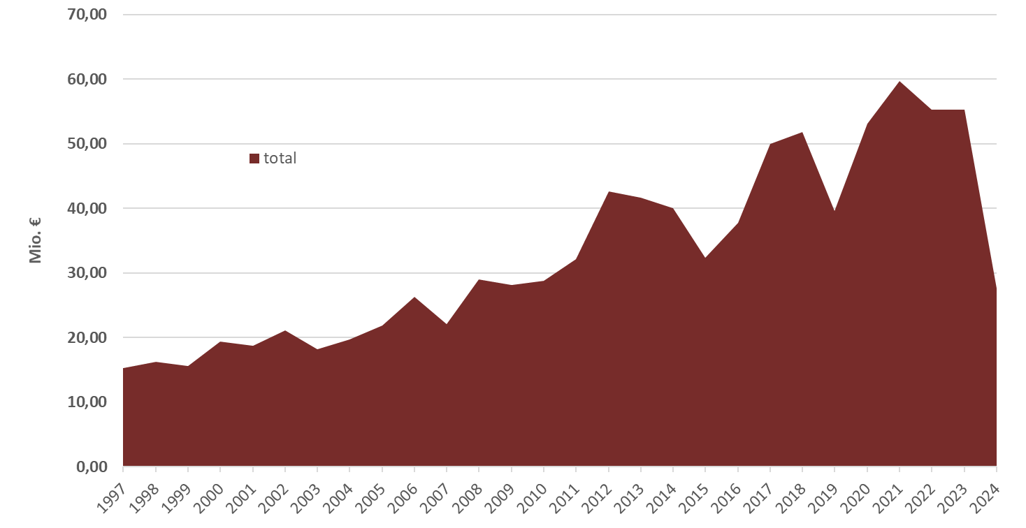
ErUM Field “Particles” since 1997
919 Mio. €
since 1997
3 year funding cycle
status March 2022

Slide 30
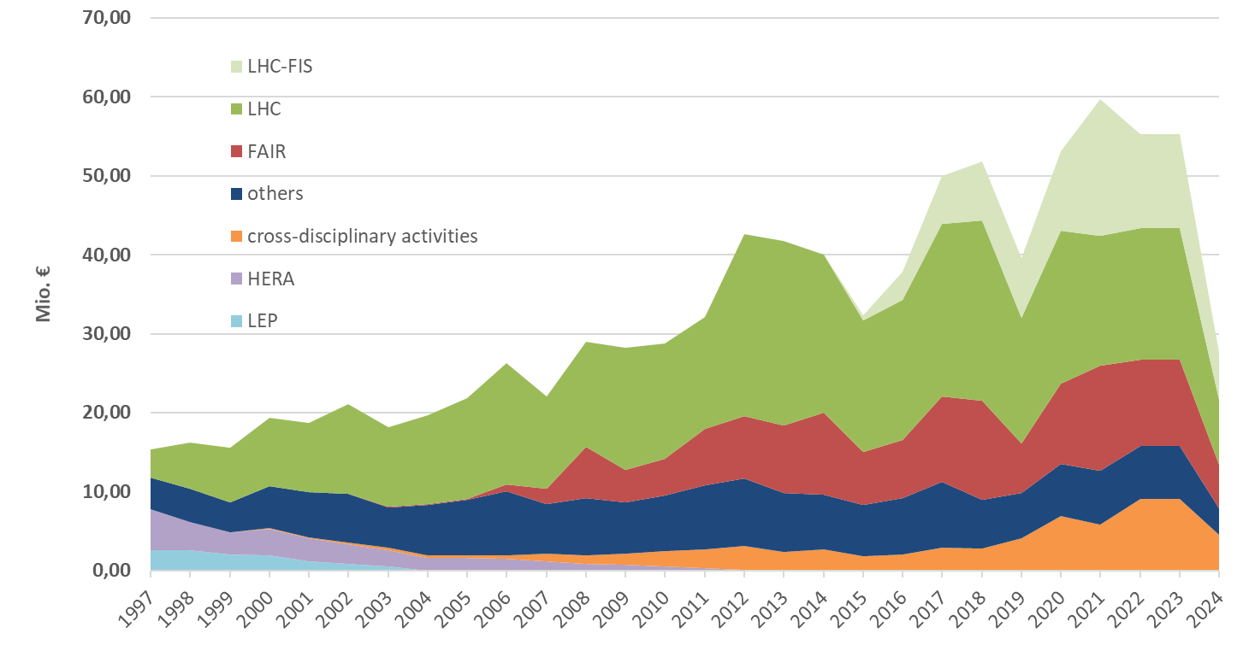
ErUM Field “Particles” since 1997
919 Mio. €
since 1997
status March 2022

